Slide 1
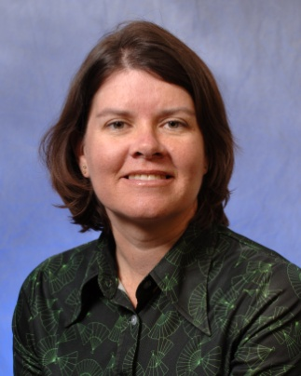
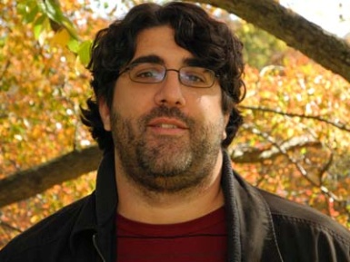
Achieving Thresholds for Discovery
5 December 2013
OCLC TAI-CHI webinar series
#oclcr
Addressing Issues with EAD to Increase Discovery and Access
Dan Santamaria
Assistant University Archivist for Technical Services
Seeley G. Mudd Manuscript Library
Princeton University
Merrilee Proffitt
Senior Program Officer
OCLC Research

Slide 2
Achieving Thresholds for Discovery
Issues with EAD
Merrilee Proffitt
Senior Program Officer, OCLC Research
5 December 2013
OCLC TAI-CHI webinar series
#oclcr

Slide 3
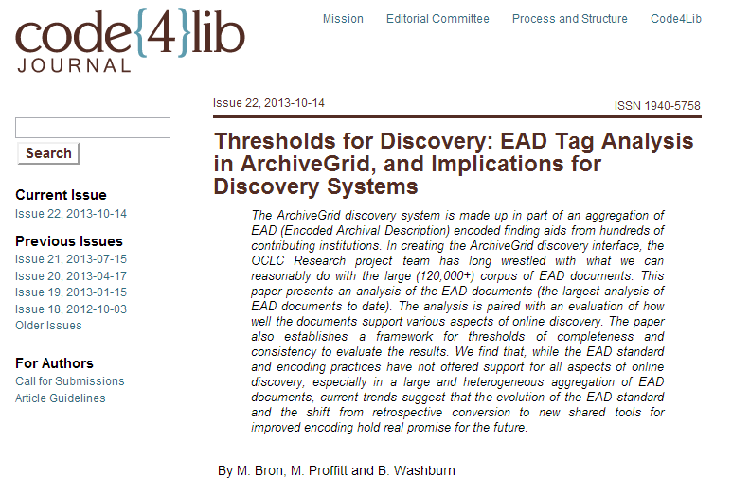
http://journal.code4lib.org/articles/8956

Slide 4
EAD analysis
Based on an April 2013 harvest of EAD encoded finding aids for ArchiveGrid
Analysis of elements that would support five dimensions of a discovery system:
  Search
  Browse
  Display
  Sort
  Limit

Slide 5
EAD analysis
Focus on support for discovery not standards or best practices (although not mutually exclusive).

Slide 6
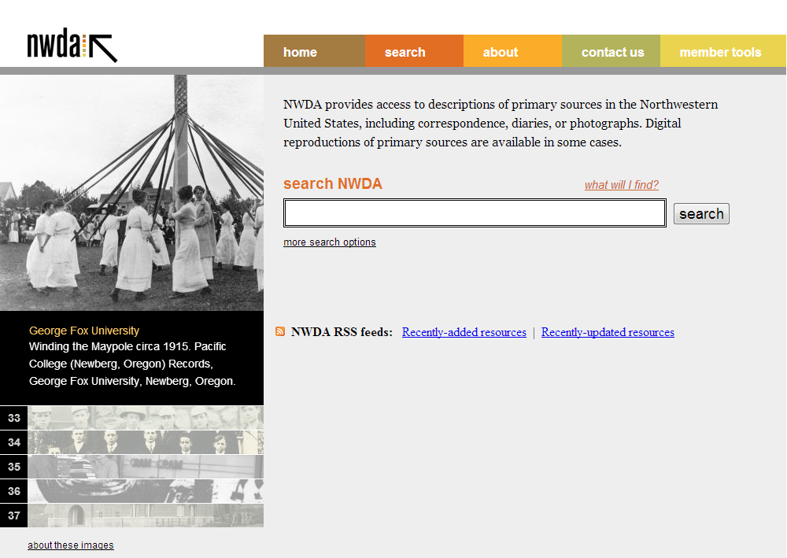
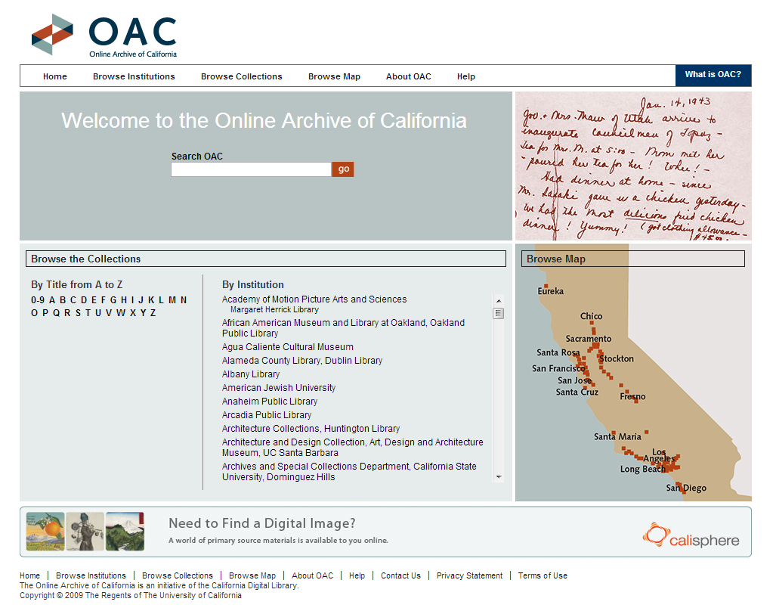
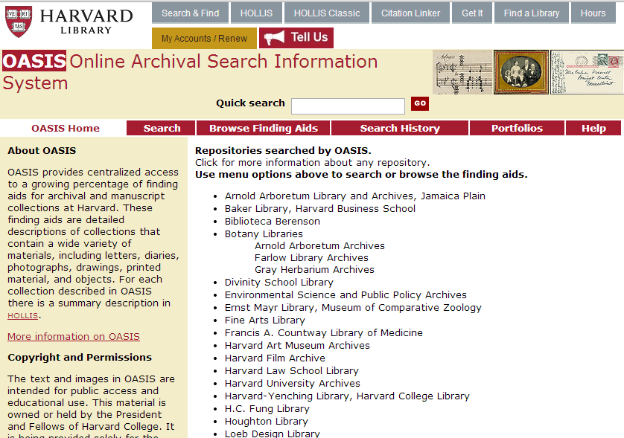
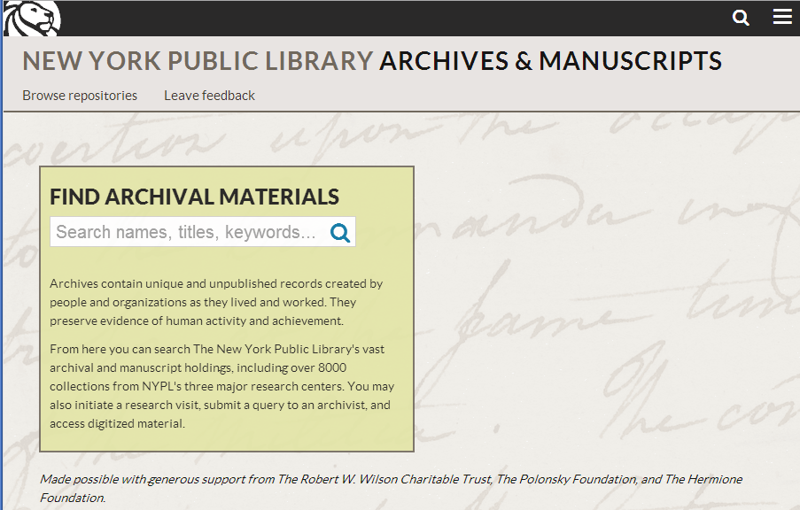
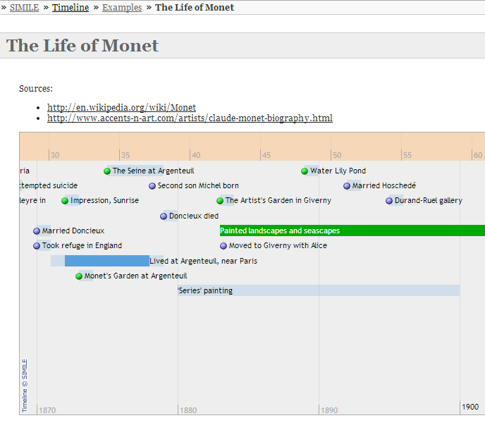
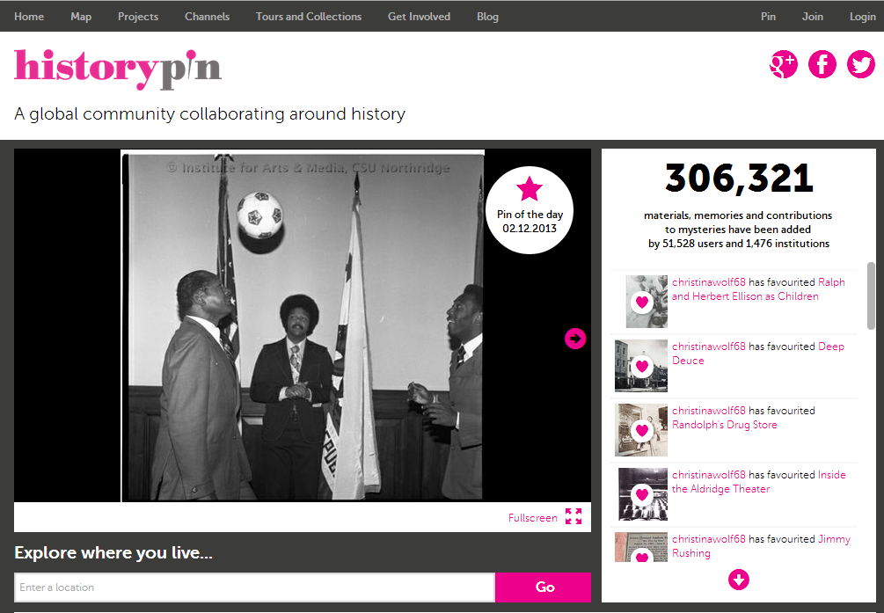
A Review of Discovery Options

Slide 7

Methodology
Recreated analysis* done by Wisser and Dean – Xpath queries across the data set
Considered which elements would (or could) be used to “power” various aspects of discovery
*not all tables reproduced

Slide 8
Methodology
The distribution of element usage was roughly divided into 4 groups:
Low -- between 0% - 50%
Medium -- between 51% - 80%
High -- between 81% - 95%
Complete -- between 96% - 100%

Slide 9
Findings
Lots of “medium,” few “high” or “complete”
Even when an element is accounted for, the content may make it difficult to use (unitdate and extent are two examples)
Most “complete” elements are administrative in nature, or are required by the DTD/schema
In short, EAD encoding may not (now) give a lot of bang for the discovery buck.

Slide 10
Is hope on the horizon?
Finding aids in ArchiveGrid may represent legacy encoding
New focus on shared authoring tools may help
EAD3 may help
Tools and techniques for improving finding aids (with an emphasis on discovery) may help

Slide 11
Over to Dan..

Slide 12
Finding Aids and Thresholds for Discovery at Princeton
OCLC Research Webinar
Dan Santamaria
Seeley G. Mudd Manuscript Library

Slide 13
Discovery: Profession-Wide Challenges
The reluctance to embrace archival standards
EAD and document-centric description
Most of all, the persistence of backlogs

Slide 14
Challenges: Backlogs
  AN INTERNET ACCESSIBLE FINDING AID EXISTS FOR 44% OF ARCHIVAL COLLECTIONS
        OCLC “Taking Our Pulse Survey”

Slide 15
Discovery:
Institution-Specific Challenges
Backlogs
  Princeton University Archives had no finding aids as late as 1990.
  2005: 2/3 of University Archives lacked descriptive records of any kind.
Little structured data for “Finding Aids” from any division.
Most arrangement and description work done by staff on short-term and soft money positions.

Slide 16
Thresholds for Discovery: Phase 1
Efficient backlog reduction
DACS compliance
Collection-level and series-level focus
Make sure all of our collections were represented online

Slide 17
Phase 1: Our Approach
Punting on idiosyncratic legacy description
  TMs, pp. numbered 1-62, (pp. numbered 1-23 are photocopies of the original), ANs and holograph corrections 215 pages (pages 19 and 20 are missing). Dates and locations, 1975 March 26-1976 June 29; Princeton, N.J. (1-26, 31-34) Madison, Wis. (26-30) . Hanover, N.H. (34-38) . Sitges, Spain (39-215). Notebook on Casa de campo. Preoccupation with plot details, characterization, chapter transitions. After a long period away from home and from the novel (1-52), the author resumes work on it by re-evaluating each chapter. By the end of the notebook he has completed a second draft of the novel's first part (chs. 1-7) and the first chapter of the second part. The notebook contains a variety of personal comments about the author and those around him.

Slide 18
Phase 1: Our Approach
Stated goals
  Provide minimum level of online access to collections (collection-level records).
  Gain acceptable level of intellectual control over collections.
  Provide a centralized entry point for researchers and staff.

Slide 19
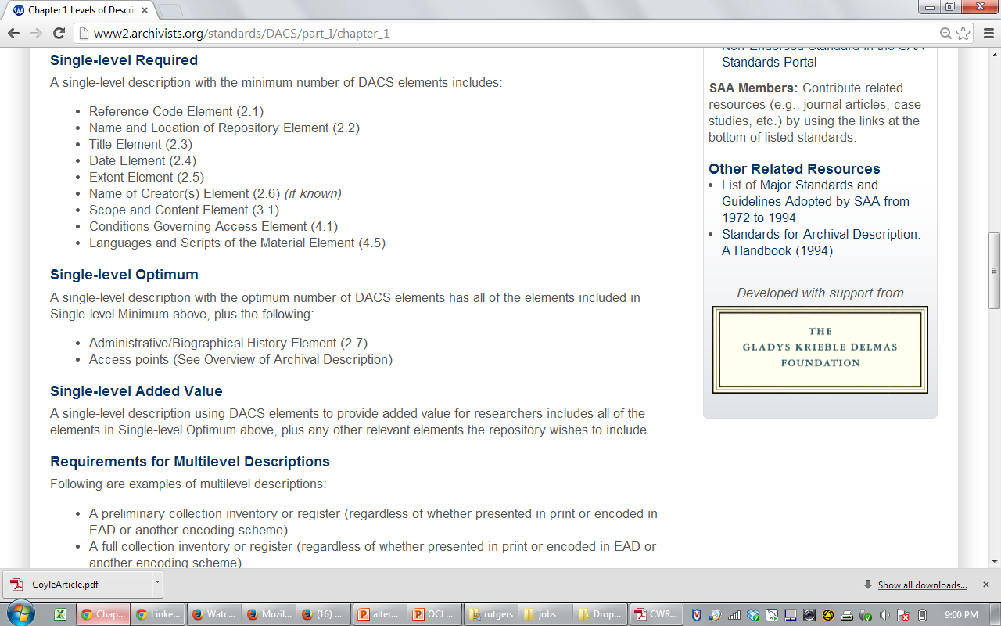
Phase 1: Our Approach
Survey entire holdings and record holdings/location information and very basic descriptive data
Create collection-level records for all collections
  MARC
  DACS single-level optimum

Slide 20
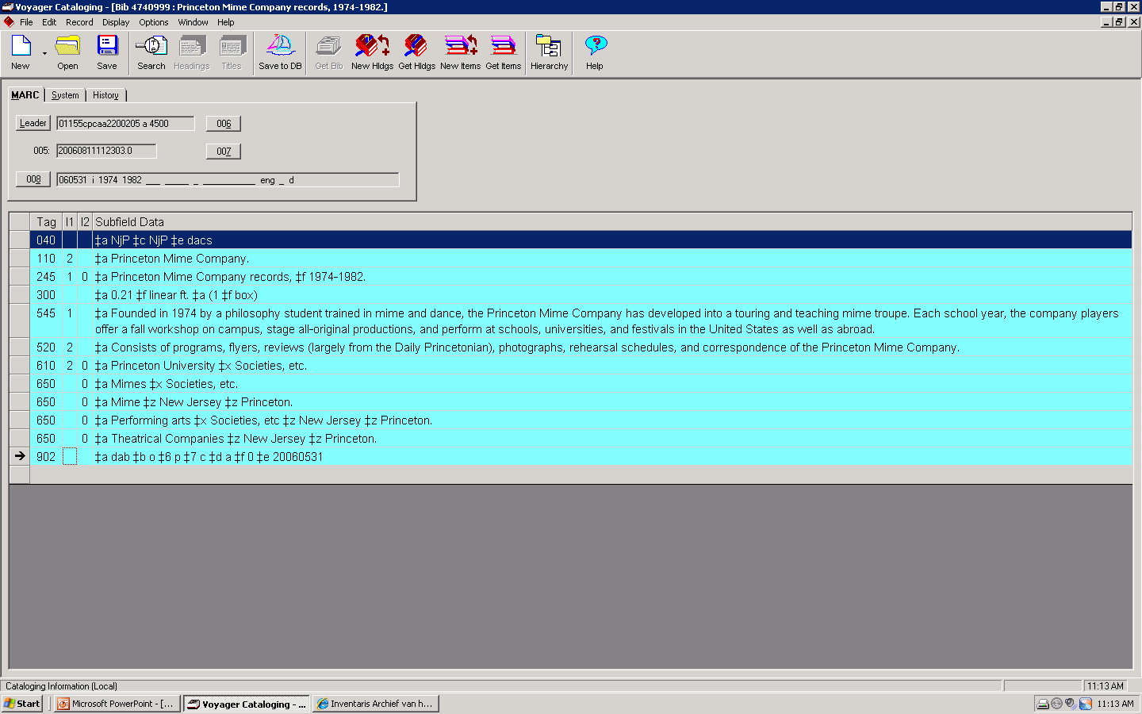
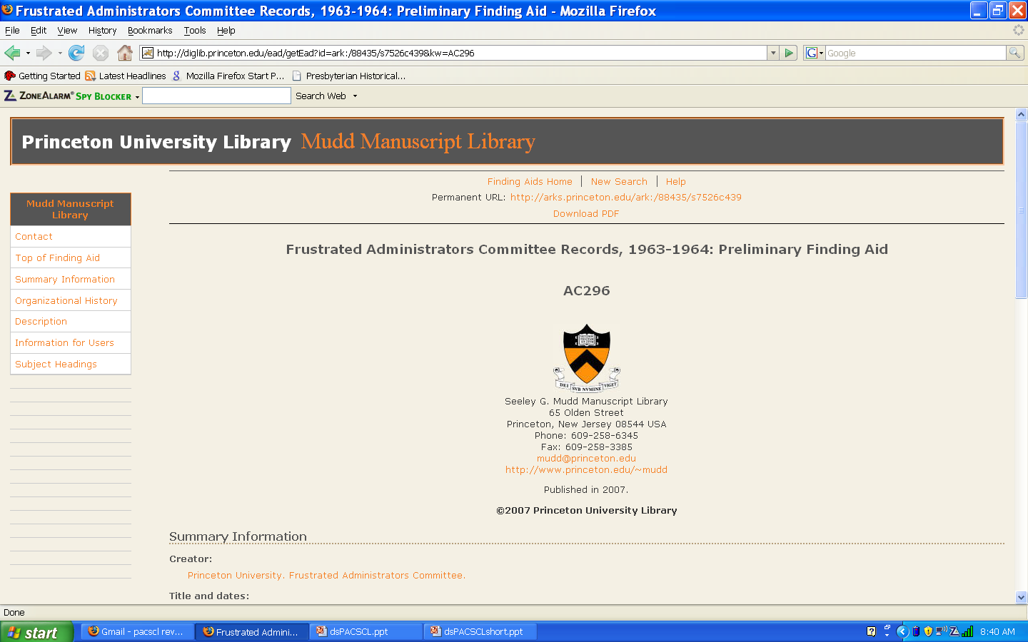
Collection-Level EAD

Slide 21
Phase 1: Results
All collections encoded in EAD and MARC by end of 2007
    DACS single-level and multi-level optimum
Processing and retro-conversion happening concurrently
  More than 800 finding aids encoded, 2006-2007
  More than 2500 linear feet processed/described in 2006-2007

Slide 22
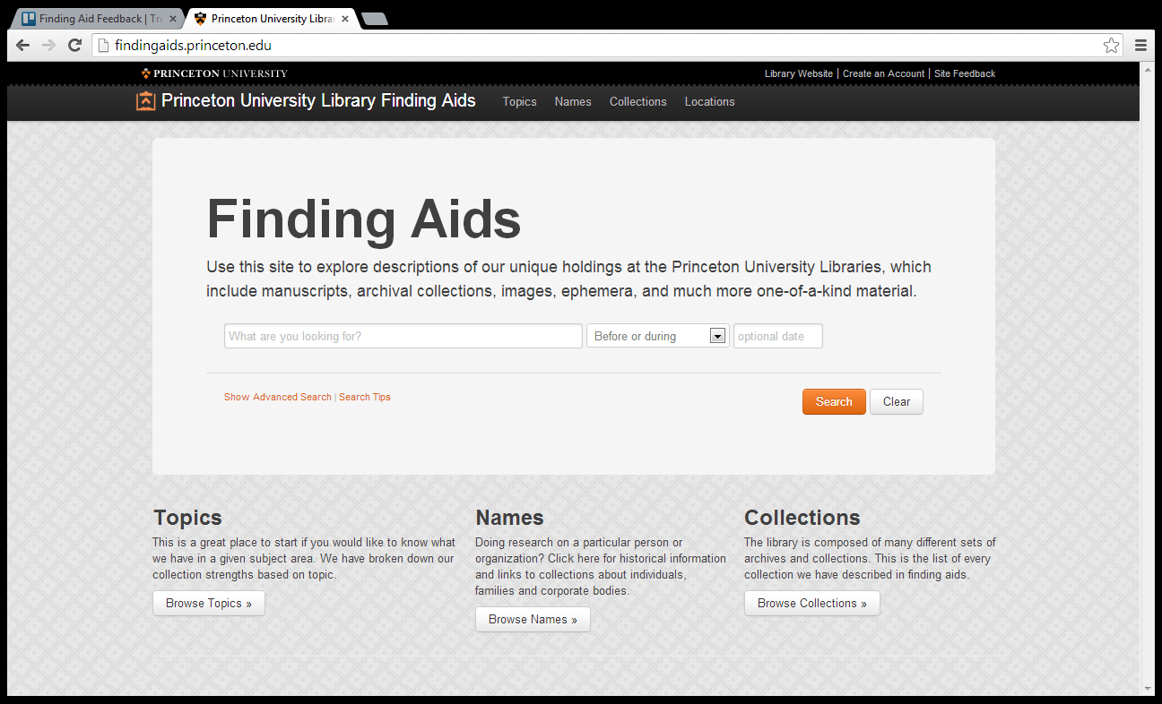
Thresholds for Discovery: Phase 2

Slide 23
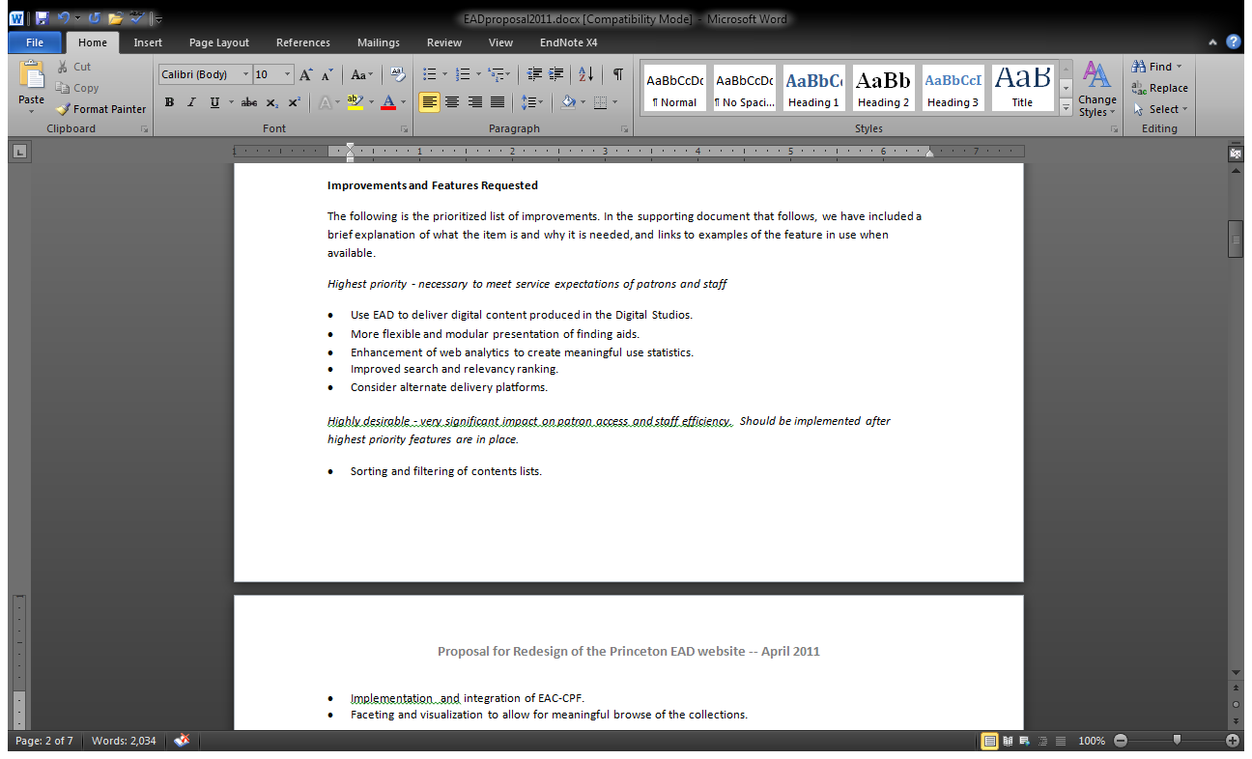
Phase 2: Requirements and Goals

Slide 24
Principles
User focus
  Find
  Identify
  Select
  Obtain
Data not documents

Slide 25
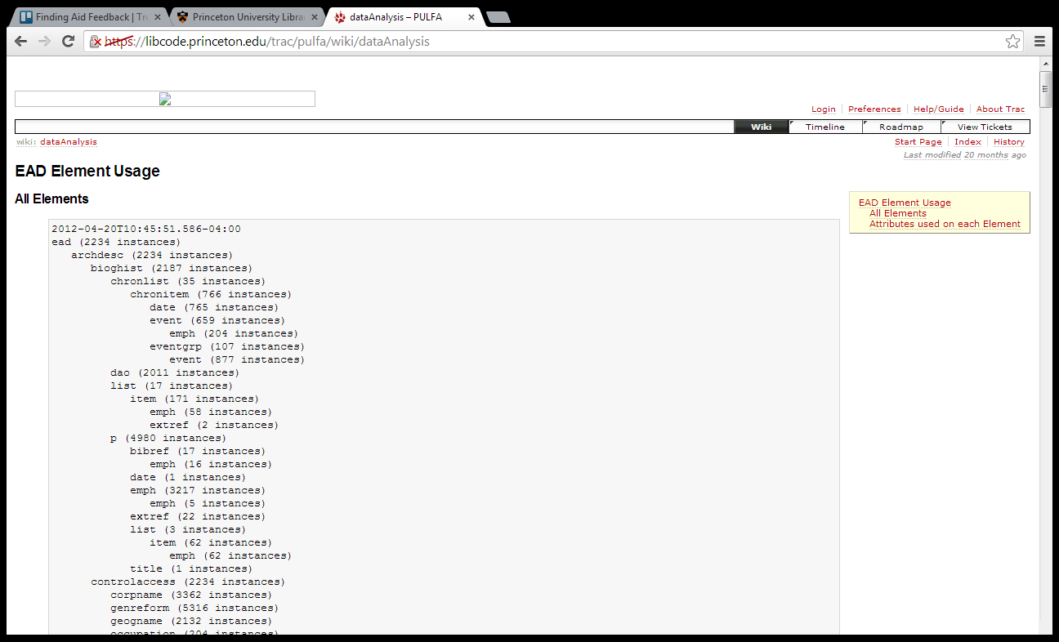
Data Analysis

Slide 26
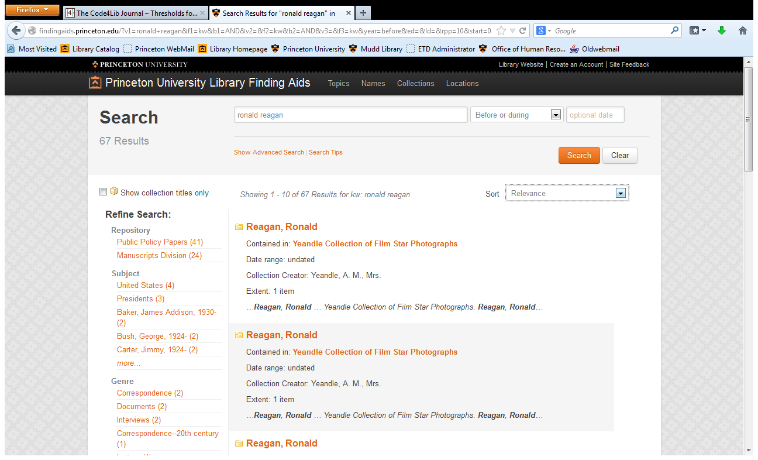
Search/Browse/Sort/Display/Limit

Slide 27
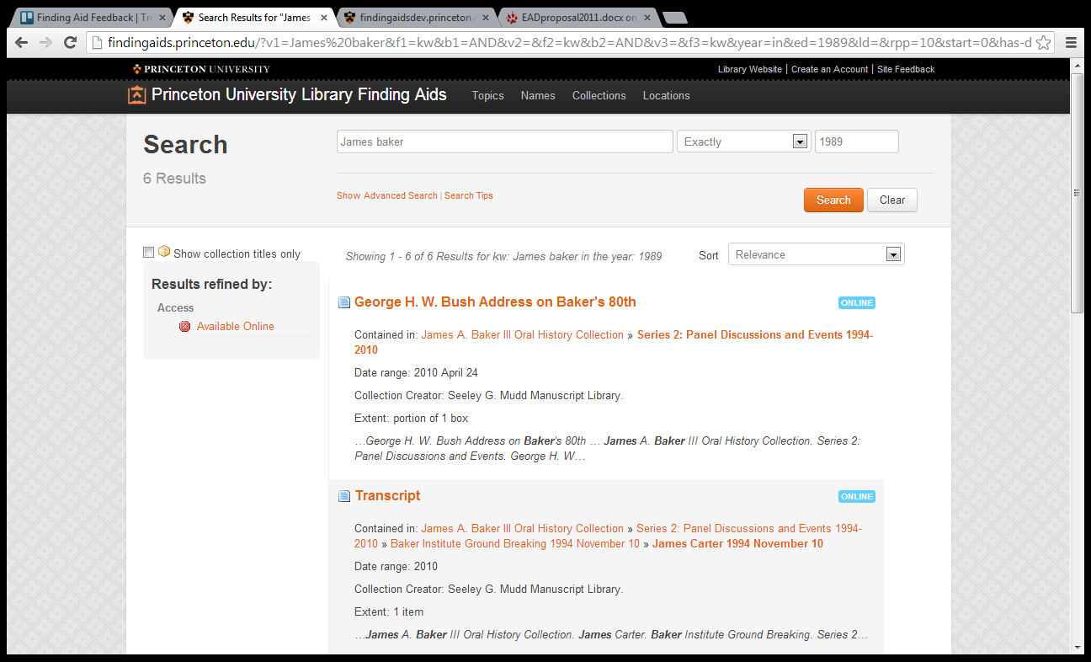
Search/Browse/Sort/Display/Limit

Slide 28
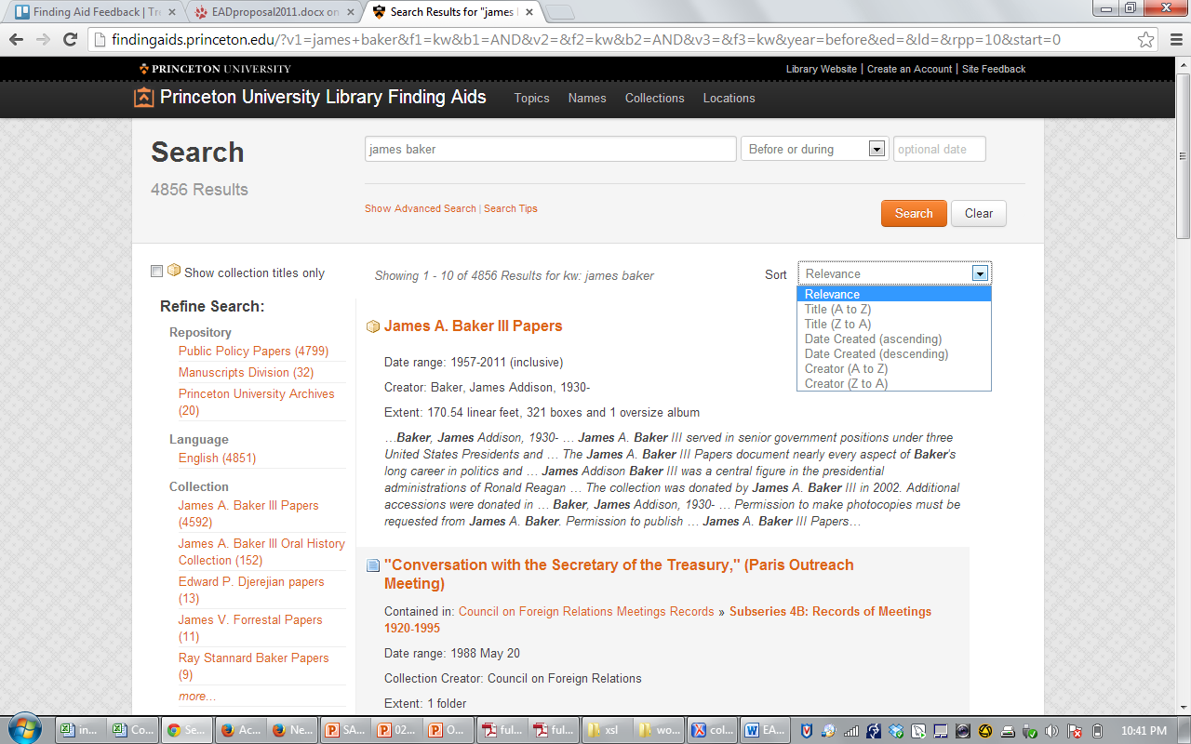
Search/Browse/Sort/Display/Limit

Slide 29
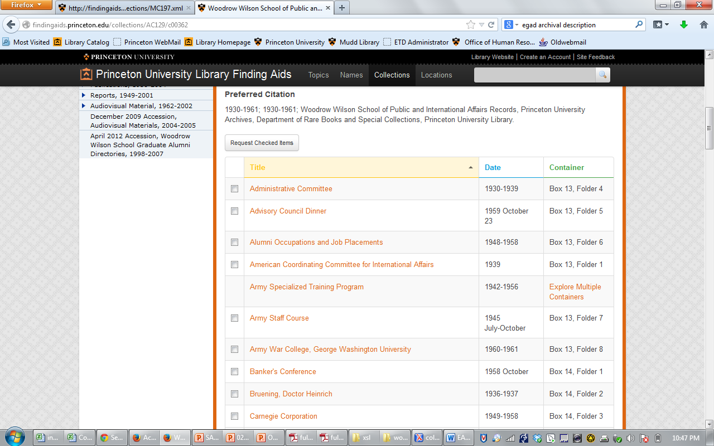
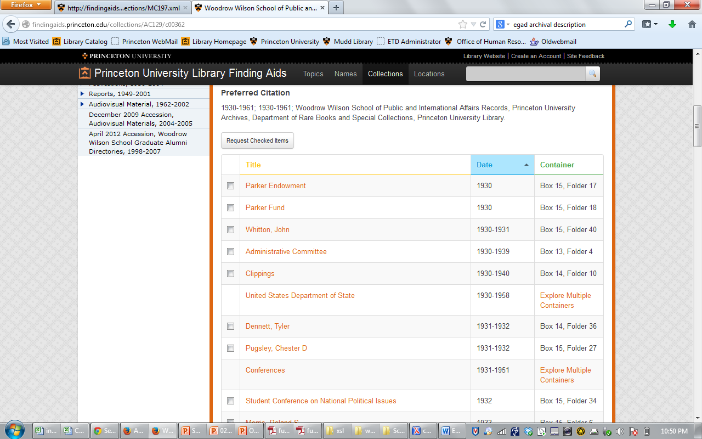
Beyond Collection-Level
Sort by title
Sort by date

Slide 30
Data Enhancement
Specific Elements
  Dates
  Extent
  Titles
  Creators
  “Access Points”
  Digital Content
ALL EADs
  Minimize mixed content
  Unnumber <c0X>
  Denested <unititle> and <unidate>
  Remove <head> and @label

Slide 31
Dates
Collection-Level
Component-Level
Virtually all present
Virtually all normalized
Little work required
WORK REQUIRED!
2 months

Slide 32
Extent
Collection-level
Component-level
Virtually all present
Little structure
Effective for display
Ineffective for sorting; reporting; analysis
Consistently present at series/subseries level
Infrequently present at lower component levels
Little structure

Slide 33
Coming Soon: <physdescstructured>
Attributes:
  @coverage = whole or part
  @physdescstructuredtype = carrier, materialtype, or spaceoccupied
Required Elements
  <quantity>
  <unittype>

Slide 34
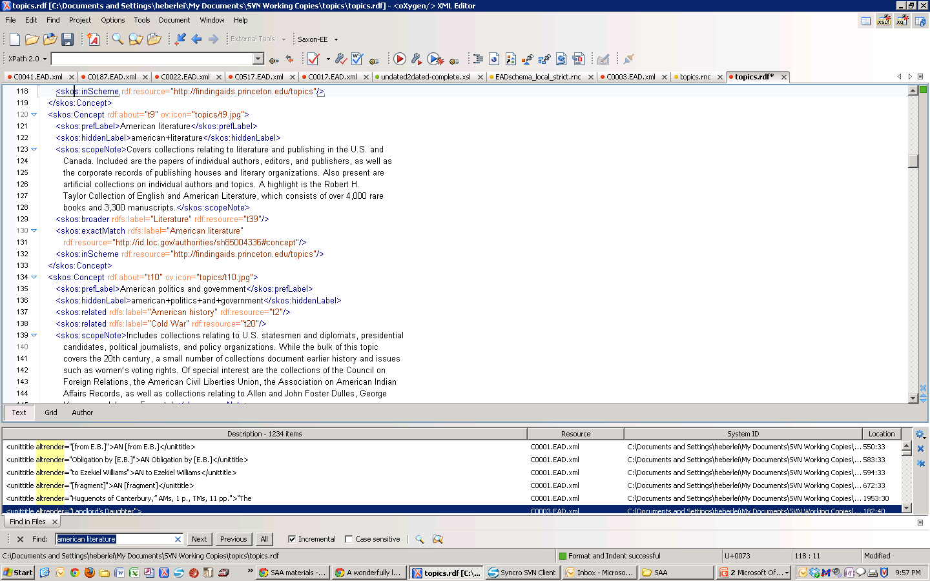
Access Points: Subjects and “Topics”
EAD
SKOS
<subject
rules="local"
source="local" encodinganalog="690" authfilenumber="t9">
American literature
</subject>

Slide 35
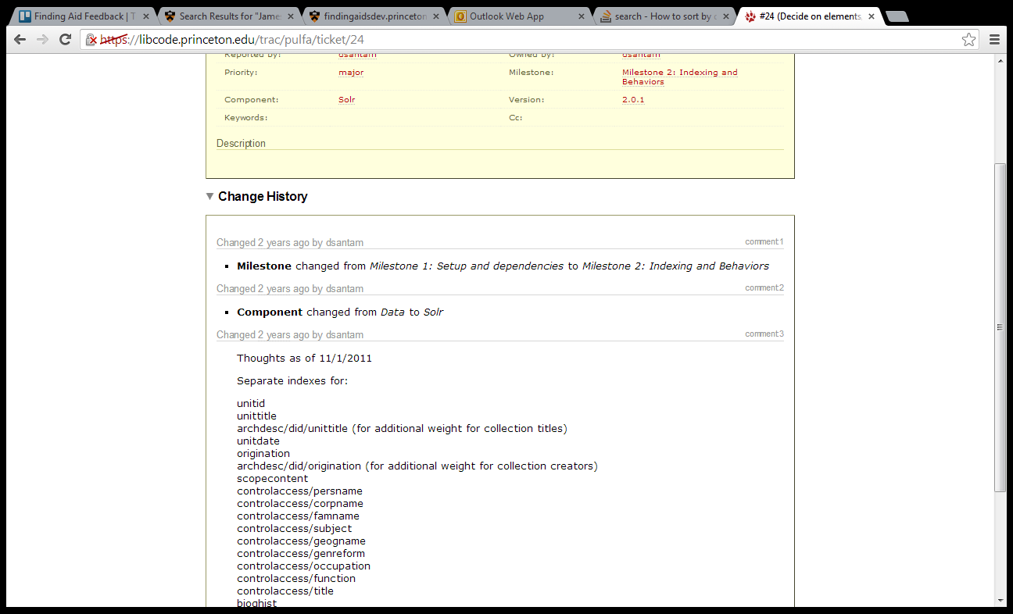
Indexing

Slide 36
Component Identifiers
<c id="C0041_c0070" level="series">
<did>
<unittitle>
Series 3: Correspondence
</unittitle>
<unitdate normal="1951-08-21/1978-12-31" type="inclusive">
1951 August 21-1978
</unitdate>
<physdesc>
<extent type="computed">1 folder</extent>
</physdesc>
</did>

Slide 37
Data Management
RelaxNG schema
  Loose
  Strict
Normalization tool

Slide 38
Lessons Learned
Iterative Description Works

Slide 39
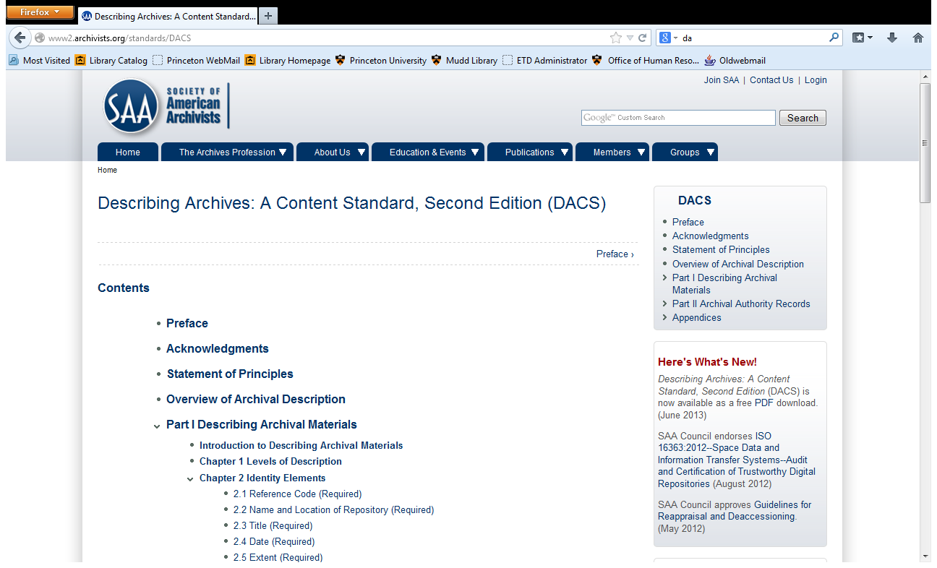
Lessons Learned: Content Standards

Slide 40
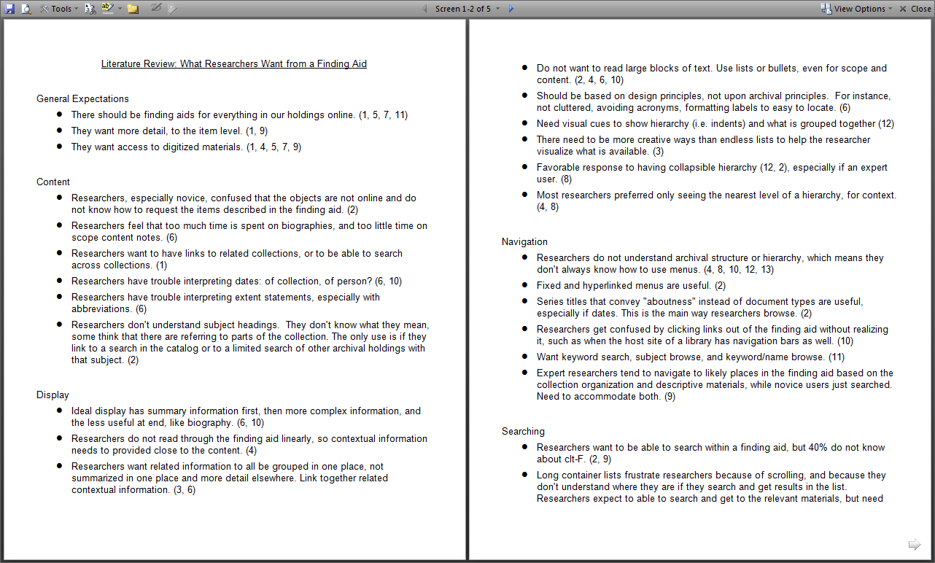
Lessons Learned
Usability

Slide 41
Lessons Learned:
Discovery Happens Elsewhere

Slide 42

Lessons Learned
Think beyond EAD: Monitor developments with conceptual models and linked data.
http://www.ica.org/13799/the-experts-group-on-archival-description/

Slide 43
Where to Start
1. DACS
2. Structure
3. Iterate
Tools that support all three

Slide 44
Credits
Archival Description Working Group
(2011-2013)
Maureen Callahan
John Delaney
Shaun Ellis
Regine Heberlein
Dan Santamaria
Jon Stroop
Don Thornbury

Slide 45
findingaids.princeton.edu
Questions: dsantam@princeton.edu

Slide 46
Merrilee Proffitt
proffitm@oclc.org
Dan Santamaria
dsantam@princeton.edu

