Slide 1
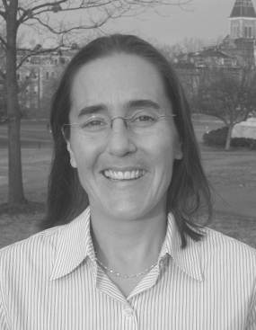
Managing Research Data—from Goals to Reality
OCLC Research Library Partnership Webinar
14 May 2013
#orlp
Featuring Karen Smith-Yoshimura, OCLC Research
Sally Rumsey, Bodleian Libraries, University of Oxford
Wendy Kozlowski, Cornell University
OCLC Research
Exploration, innovation and community for libraries and archives.

Slide 2
Managing Research Data — from Goals to Reality
14 May 2013
#orlp
Karen Smith-Yoshimura, OCLC Research
smithyok@oclc.org
Sally Rumsey, Bodleian Libraries, University of Oxford
sally.rumsey@bodleian.ox.ac.uk
Wendy Kozlowski, Cornell University
wak57@cornell.edu

Slide 3
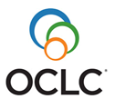
What?
Research data: The raw output of research
Investigations — not the resulting reports.
Examples: instrument measurements, survey results, statistical datasets…

Slide 4
OCLC Research’s exploration of dataset curation
Economics of data integrity paper (Erway, Lavoie)
Dissemination Information Packages for Information Reuse project (Faniel)
Focus groups on motivations, disincentives for librarian support of research data management (Faniel)
What is the “Changing Scholarly Record”? (Malpas, Lavoie)
Notes:
Ricky Erway and Brian Lavoie wrote an article on the Economics of Data Integrity.
Ixchel Faniel is co-PI on the Dissemination Information Packages for Information Reuse project, which is investigating researchers in three disciplines to identify their needs for contextual metadata in order to effectively reuse the data.
Ixchel is also conducting librarian interviews and focus groups to identify the motivations and disincentives for librarian support of research data management.
Constance Malpas and Brian Lavoie are beginning an investigation of the Changing Scholarly Record

Slide 5
OCLC Research Information Management Interest Group
Look at institutional benefits of data management plans and promote their use in all research
Address selection, retention, and de-selection of campus-managed datasets
Notes:
The benefits of data management plans also includes making sure data curation is in grant proposal budgets.

Slide 6
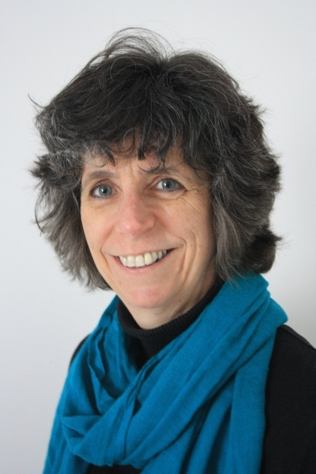
Two OCLC RLP perspectives…
Wendy Kozlowski
Cornell University
Sally Rumsey
Bodleian Libraries,
University of Oxford
… Yours?
Notes:
This will be a dialog presenting perspectives from two OCLC Research Library Partner staff:
Sally Rumsey is Digital Research Librarian at the Bodleian Libraries, University of Oxford, where she manages the institutional publications repository, ORA. She is working with colleagues across the University to develop and implement a range of services to support research data management. Sally is Senior Programme Manager for the University’s Open Access Oxford programme.
Wendy Kozlowski is the Science Data and Metadata Librarian and coordinator of the Research Data Management Service Group at Cornell University. Wendy’s work focuses on issues related to the data curation lifecycle, metadata for science data, outreach and consultation on information management and other needs related to research data.
We hope during this session to also hear your perspective. Feel free to use the chat room & chime in – we will unmute you during the discussion period.

Slide 7
Structure of the dialog
Context and goals
Activities and plans (including demonstrations)
The reality—chime in on your experiences with these issues
Metadata requirements
Encouraging researchers to contribute
Cost models
Notes:
Sally will be demonstrating Oxford’s Database under development and Wendy will show Cornell’s Datastar for registering metadata with liniks to the repository where it’s stored

Slide 8
University of Oxford: research data infrastructure
Drivers for handling research data at Oxford
Overview of Oxford’s handling of research data
Role of the Bodleian Libraries
Objectives for Damaro (Data Management Roll-out for Oxford) – JISC funded project
DataFinder and Databank – two key systems
Fit into bigger picture: research outputs including publications
Disciplinary/item specific context – registered and safe: not necessarily open
Notes:
CONTEXT
drivers for handling research data; Funders esp EPSRC (significant funder for Ox research); journals; lack of systems and services in most areas; realisation at end of projects – what to do with data now
Overview of U. Oxford’s handling of research data; very patchy picture – some depts/groups well sorted internally, some served externally (eg ESRD, NERC),personal computers, others don’t realise they even have data
role of library; In this case Bodleian LIBRARIES, Traditional archival role; being contacted anyway; not just bit storage; network of subject librarians; metadata expertise
Multi-agency problem requiring multi-agency solution; external funding; Damaro aiming to address whole infrastructure; Libraries role in Damaro – technically developing two central systems
DataFinder and Databank – two key systems – why? What for?
Fit into bigger picture: research outputs including publications - OA
Disciplinary/item specific context – registered and safe: not necessarily open

Slide 9
Damaro project
Data management rollout for Oxford
DataFinder as the key service for RDM at Oxford

Slide 10
Cornell University – Context and Goals for Managing Research Data
Current Funders’ Mandates
Office of Science and Technology Policy Memorandum
Research Data Management Service Group
Cornell University Library Institutional Repository
Datastar Dataset Registry
Cornell University Library Archival Repository
Notes:
Set background by brief discussion of Funder’s Mandates in the US, mainly NIH and NSF.
Topic is in a state of growth and flux – recent OSTP memo will likely lead to more changes and requirements, which we knew were likely coming, but now have a timeline (6 months from 22 Feb 13).
With announcement of requirement for DMP with NSF proposals, Cornell University’s Office of the Vice Provost for Research and the University Librarian joined to support the formation of the Research Data Management Service group, a cross-institutional group that offers support for data management needs across campus… more on this group in a moment
With respect to the role that the Cornell University Libraries play in research Data Curation, that play is still, to some extent, being scripted. Talk about DataExec…

Slide 11
Collaborative, campus-wide organization
Links faculty, staff and students with data management services to meet research needs
Broad range of science, policy, data and information technology experts…
Provide assistance for creation and implementation of data management plans…
At any stage of the research process, including initial exploration, data gathering, analysis and description, long term preservation and access
Notes:
RDMSG – support and education for broad data management needs of CU researchers, staff and students
As I said, we were formed in 2011 in response to the NSF mandate for data management plans (DMP) with submission of proposals, but our mission is much broader than just DMP support -

Slide 12
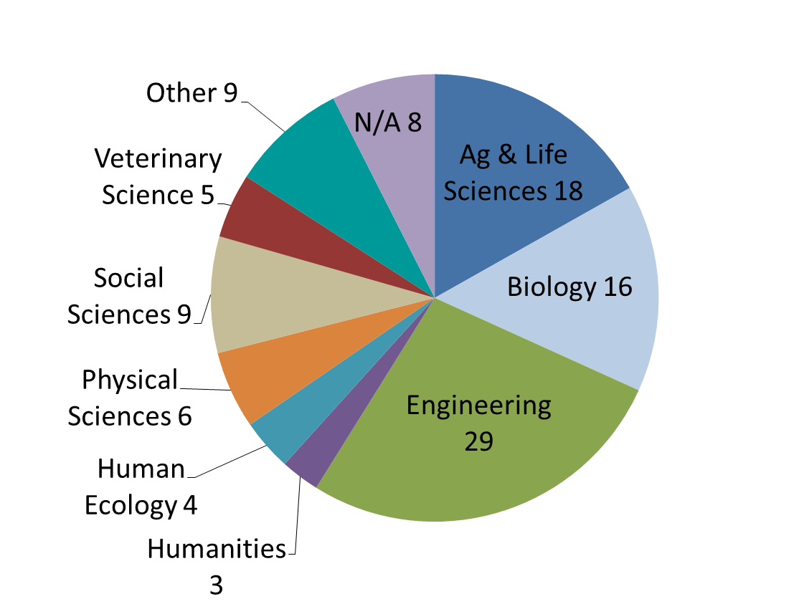
Cornell University – Current Provisions for Managing Research Data (RDMSG)
RDMSG Help Requests
Jan 2011 – Apr 2013
Notes:
I mentioned before that we know that there is a need for data services and management help across campus -- this shows the distribution of help requests that have come in to the RDMSG since January of 2011. As you can see, we’re not just helping one domain here. And we’ve learned that the needs of each of each domain are not necessarily the same – someone in Engineering or Genetics may be looking for storage and access to large volumes of data, a social scientist may need help with a metadata standard that’s difficult to understand, and a researcher in natural resources might want help finding the best tools to organize information within her lab group. To be able to provide the best help possible across all these needs, Cornell has made research data management support a priority across our entire campus, libraries included.
One problem with any such service or group is finding a way to get the word out (so it’s heard) that you exist. For us, this effort has included direct outreach to faculty and students, as well as fostering relationships with service providers, both those involved directly with RDMSG, as well as key stakeholders such as the Office of Sponsored Programs.

Slide 13
University of Oxford provision for research data
Theory and set-up
Integration (soft and hard systems)
Policies
Technical
Metadata
Aesthetic: user interface
Legal
Information and training
Cost model & sustainability
DataFinder and Databank – see the story so far
Timescale
Notes:
ACTIVITIES & PLANS What U. Oxford has done thus far and will do – where we are and where we’re heading
Theory and set-up
Integration (soft and hard systems)
University policy, Bodleian policy and service policies inc DOI assignment)
Technical (systems architecture, statuses)
Metadata (fields, mandatory (see next slide), DataCite min, controlled vocabularies)
Aesthetic (user journeys, user interfaces, non-daunting, type ahead, default settings)
Legal (deposit licence, Ts & Cs, take down (risk), data ownership)
Information and training
DataFinder and Databank – see the story so far
Timescale – end of project does not equal end of problem. No formal trumpeted launch this year. Ongoing dev

Slide 14
Minimum mandatory metadata (manual)

Slide 15
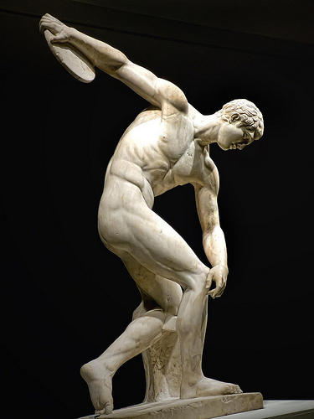
Absolute perfection?
By mharrsch http://www.flickr.com/photos/mharrsch/8331229082/
Notes:
Pragmatic compromises and pay-offs

Slide 16
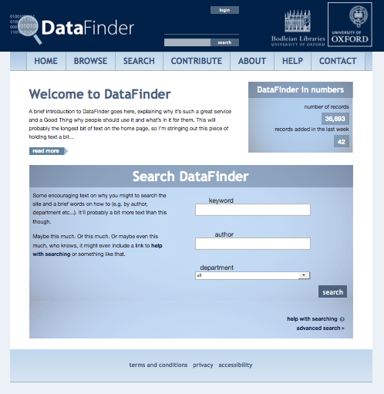

Slide 17
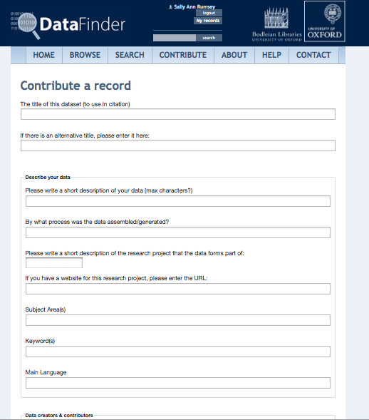

Slide 18
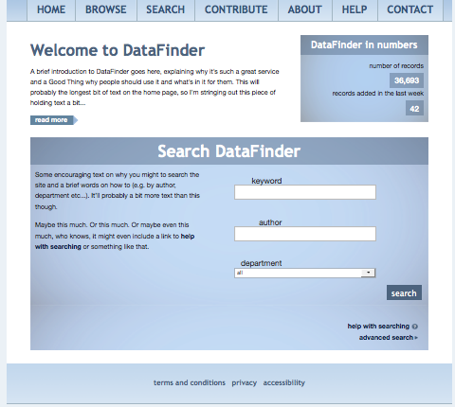

Slide 19
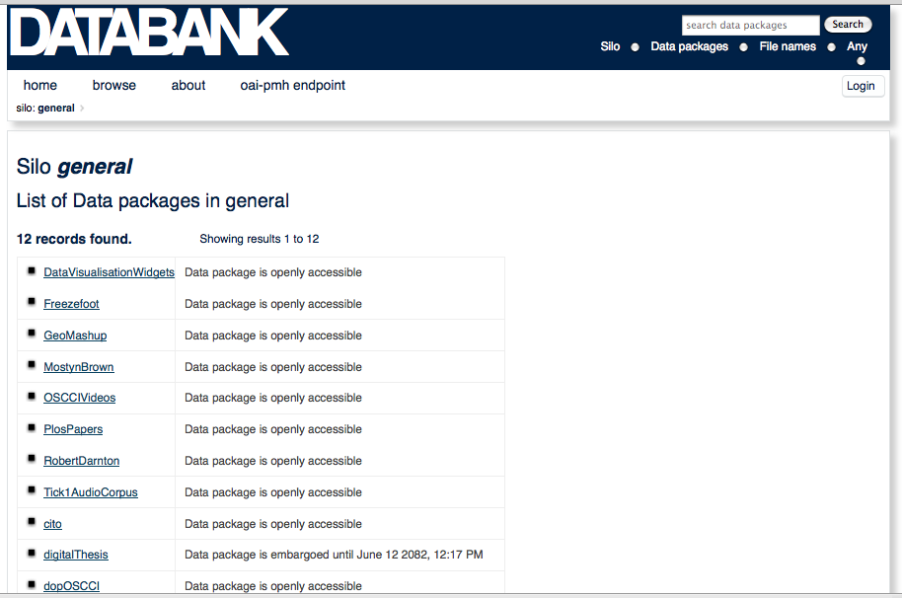

Slide 20
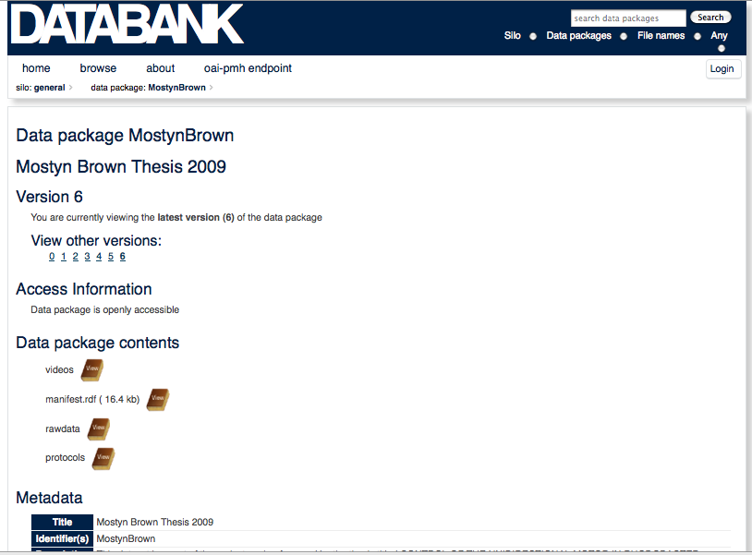

Slide 21
Cornell University – Current Provisions for Managing Research Data
Research Data : CUL’s Institutional Repository
DSpace
Deposit Policy
Embargo Option
Size Limitations
Considerations
Persistent Identifiers
Versioning
Citation Information
Metadata

Slide 22
Cornell University – Current Provisions for Managing Research Data
eCommons Metadata - Dublin Core Elements (qualifiers)
Contributor (8)
Coverage (2*)
Date (3)
Description (8)
Format (3)
Identifier (9)
Language (2)
Publisher
Relation (12)
Rights (2)
Subject (6)
Title (1)
DataCite.org
?
Notes:
One concern we have with datasets in eCommons has to do with metadata. Are we collecting adequate metadata for re-use? Do we need to? What is the purpose of the metadata for our IR? Is it to facilitate finding or reuse or both?
Listed here are the DublinCore elements currently used (with additional qualifiers for some shown in parentheses) Some datasets currently in eCommons have metadata files already associated with them to allow actual re-use. While building a set of metadata elements for datasets that’s somewhat closer to the (full) DataCite list, that alone would not allow re-use, so the discussion continues…
DataCite List (first 5 required)
Identifier
Creator
Title
Publisher
Publication Year
Subject
Contributor
Date
Language
Resource Type
Alternate Identifier
Related Identifier
Size
Format
Version
Rights
Description

Slide 23
Cornell University – Plans for Managing Research Data
Dataset registry to support data documentation, discovery and re-use
Cornell University Mann Library
Washington University in St. Louis
http://www.datastarproject.org
Standalone application or VIVO companion
Notes:
Brief introduction to the Datastar project :
Phase II : redesign of what began as a “data staging repository” to a dataset registry
Collaborative effort between CUL and WUSL
Used information gathered from Data Curation profiles of CU and WUSL researchers and online profiles from other institutions to guide development.
URL for project website shown here, and the underlying ontology building the relationships is shared on Sourceforge, if anyone is interested.
Datastar is being developed to be used either as an independent application, or – ultimately – to be used in conjunction with VIVO to provide information about researcher datasets along with publications, collaborators etc.
Currently still in development but I can show you around a bit on the test site…
BEGIN DESKTOP SHARING

Slide 24
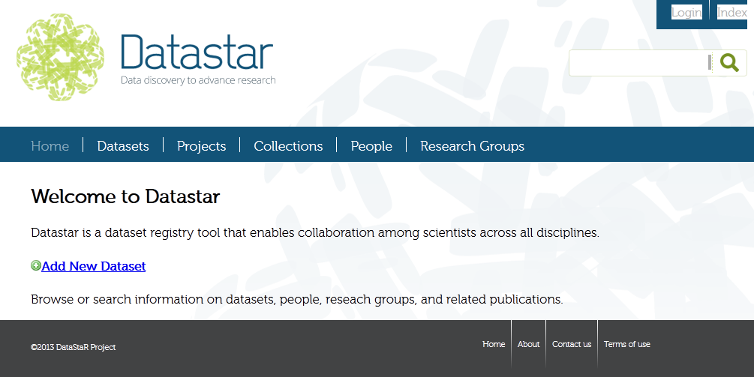
Cornell University – Plans for Managing Research Data
Notes:
This is a still shot of the “welcome” page when you arrive at Datstar… use only if screen sharing fails?
Jump here to a desktop sharing of Test site of Datastar… walk through main points, highlighting:
Information about the dataset
Related publication(s) information
If dataset is derived from another
Data and metadata links
Note that, like eCommons, Datastar allows for upload of formalized metadata – in whatever standard was chosen – to be related to the dataset. The underlying ontology for Datastar itself has many elements… [get required elements list from Huda], which, if fully completed, will provide at least enough information to allow users to decide if they dataset is a proper fit for re-use, if not actually allow appropriate re-use without additional information. Still, the submission of a dataset to this registry is optional and user-driven, so has obvious weaknesses.
Citation information – not shown in current test site, but will be added

Slide 25
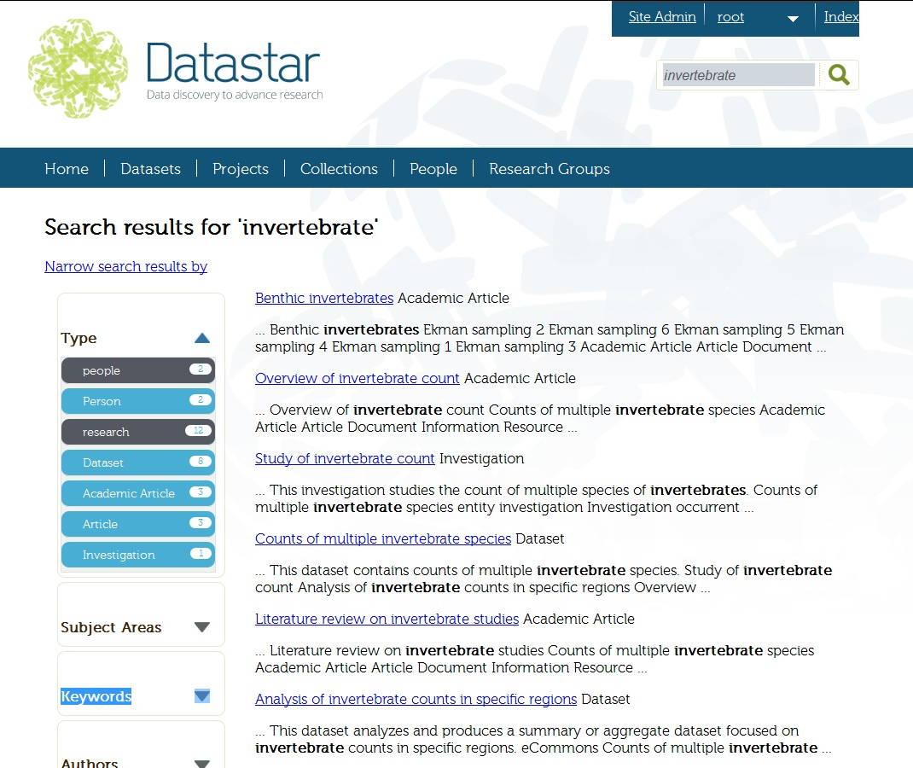
Notes:
[Back to powerpoint here because this is now the latest development site]
Screen shots of Datastar’s latest dev site – facets now added along the left side of screen for things like subject / keyword / author searching…

Slide 26
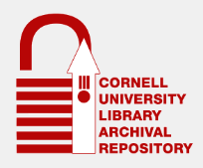
Cornell University – Possibilities for Managing Research Data
Preservation of digital collections at the bit-level, over the long term
Strengths: Preservation
Storage Elasticity
Constraints: No Delivery Platform
Dark Archive
· Inefficient Access
· No Discovery Layer
Notes:
Finally, looking probably pretty far into the future (for reasons we’ll get to here in a moment), Cornell also has in development an archival repository that might possibly serve as an option for data - particularly for large data, particularly for “storage and preservation”. It’s a Fedora-based system that is meant to preserve digital collection over the long term…
I’d like really to focus here on the word Preservation – when it comes down to it, preservation drives both CULAR’s strengths and weaknesses…
Still under development – currently only accepting Library materials, and we’re still working on development of the cost / business model, but if the decision is made (at some point down the road) that there is a need for something other than our current IR structure for research data, CULAR holds promise.

Slide 27
Key issues:
Metadata requirements
Encouraging researchers to contribute
Cost models
Notes:
Sally will be demonstrating Oxford’s Database under development and Wendy will show Cornell’s Datastar for registering metadata with links to the repository where it’s stored

Slide 28
Resources
Erway, Ricky and Brian Lavoie. 2012. "The Economics of Data Integrity." Chapter preprint: http://www.oclc.org/content/dam/research/ publications/library/2012/erway-dataintegrity.pdf
Dissemination Information Packages for Information Reuse project (Ixchel Faniel) http://dipir.org/
Role of Libraries in Data Curation http://www.oclc.org/research/activities/ datacuration.html
Notes:
Ricky Erway and Brian Lavoie wrote an article on the Economics of Data Integrity.
Ixchel Faniel is co-PI on the Dissemination Information Packages for Information Reuse project, which is investigating researchers in three disciplines to identify their needs for contextual metadata in order to effectively reuse the data.
Ixchel is also conducting librarian interviews and focus groups to identify the motivations and disincentives for librarian support of research data management.
Constance Malpas and Brian Lavoie are beginning an investigation of the Changing Scholarly Record

Slide 29
Managing Research Data—from Goals to Reality
OCLC Research Library Partnership Webinar
14 May 2013
#orlp
Karen Smith-Yoshimura, smithyok@oclc.org
Sally Rumsey, sally.rumsey@bodleian.ox.ac.uk
Wendy Kozlowski, wak57@cornell.edu
OCLC Research
www.oclc.org/research.html
Our Webinars
www.oclc.org/research/events/webinars.html
OCLC Research
Exploration, innovation and community for libraries and archives.

