Slide 1


Shifts in Scholarly Attention Among World Regions
OCLC Research Briefing at UNC Chapel Hill
7 June 2013
#oclcr #insightseries
Dr. Charles Kurzman
Professor of Sociology
UNC Chapel Hill

Slide 2

OCLC Research Briefing at UNC Chapel Hill
Eric Childress
Consulting Project Manager
OCLC Research
Dr. Charles Kurzman
Professor of Sociology
University of North Carolina at Chapel Hill

Slide 3
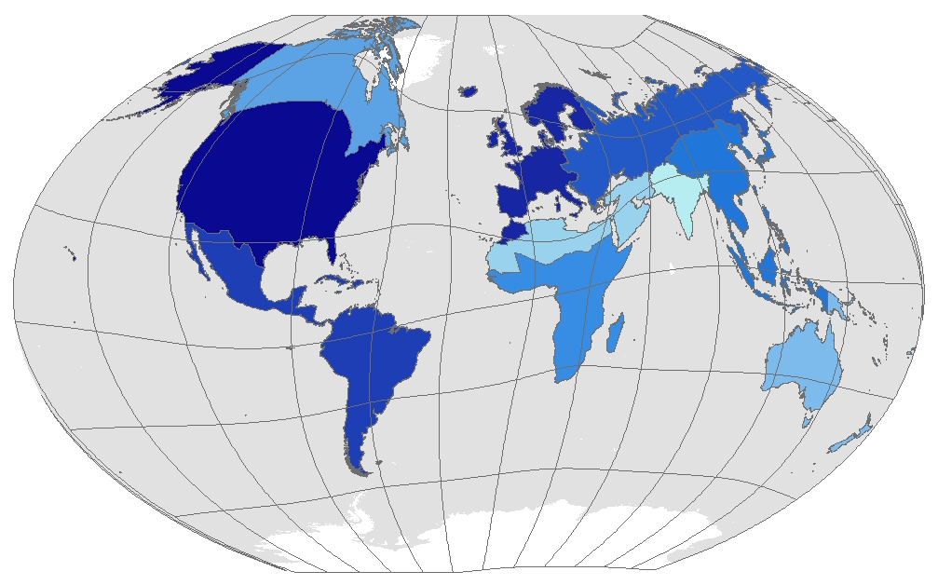
Shifts in Scholarly Attention Among World Regions
Charles Kurzman
http://kurzman.unc.edu
OCLC Research Briefing
University of North Carolina at Chapel Hill
June 7, 2013

Slide 4
The challenge of globalizing U.S. higher education…

Slide 5
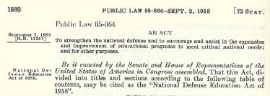
National Defense Education Act of 1958:
“The present emergency demands that additional and more adequate educational opportunities be made available … [to] correct as rapidly as possible the existing imbalances in our educational programs which have led to an insufficient proportion of our population educated in science, mathematics, and modern foreign languages and trained in technology.”

Slide 6
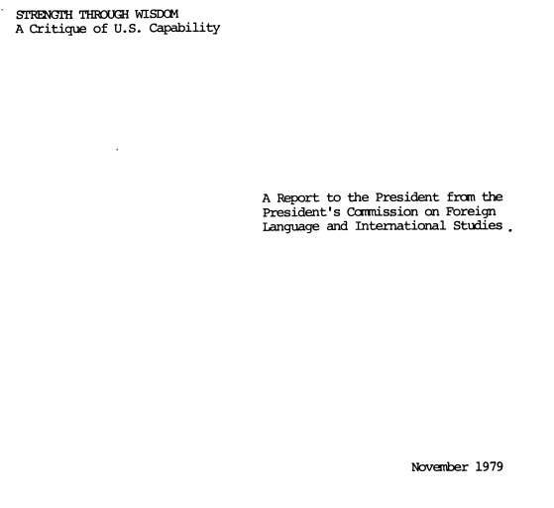
President’s Commission, 1979: “We are profoundly alarmed by what we have found: a serious deterioration in this country’s language and research capacity, at a time when an increasingly hazardous international military, political and economic environment is making unprecedented demands on America’s resources, intellectual capacity and public sensitivity.”

Slide 7

National Research Council, 2007: “A pervasive lack of knowledge about foreign cultures and foreign languages threatens the security of the United States as well as its ability to compete in the global marketplace and produce an informed citizenry.”

Slide 8
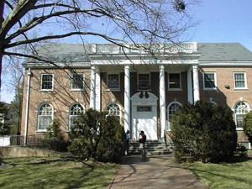

U.S. university investments in global education
Old and new global education centers at the
University of North Carolina at Chapel Hill

Slide 9
Globalizing library collections

Slide 10

Data source:
29 million WorldCat records of books published between 1958 and 2010 and held at more than 1,000 U.S. academic libraries as of December 2011.
Includes the number (but not the names) of libraries holding each book.
Includes year of publication (but not year of acquisition or cataloging).

Slide 13
Globalizing the social sciences
1. Books

Slide 14
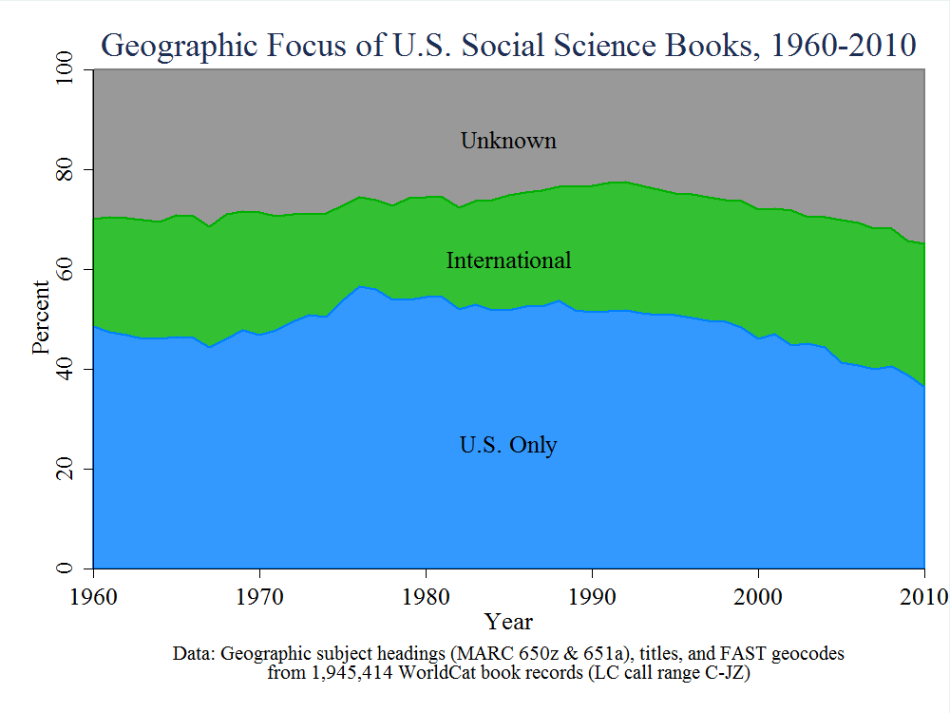

Slide 15
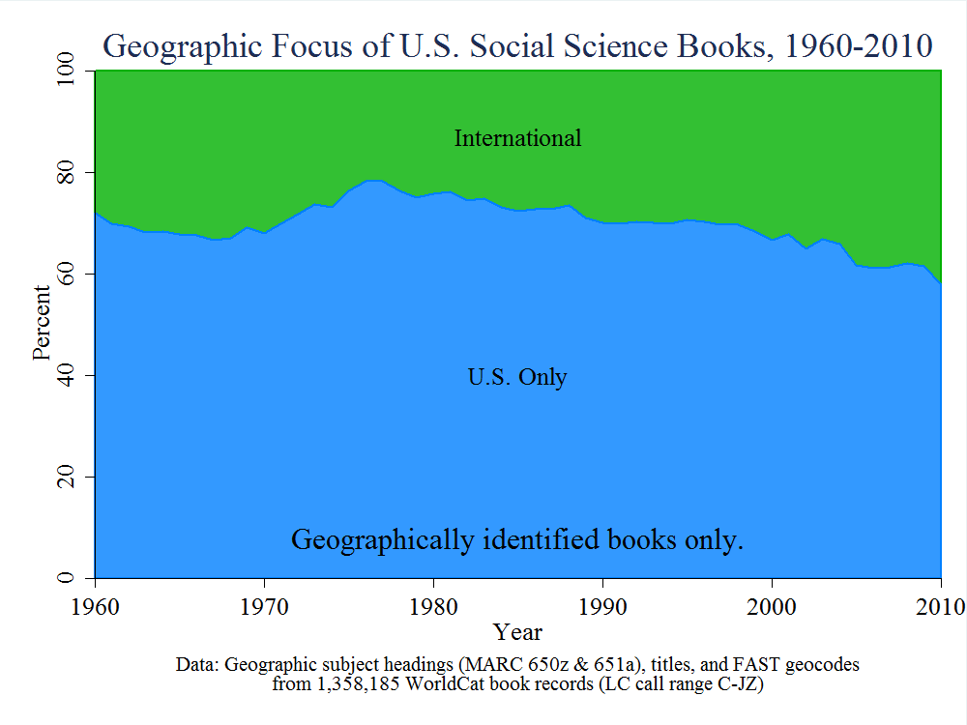

Slide 16
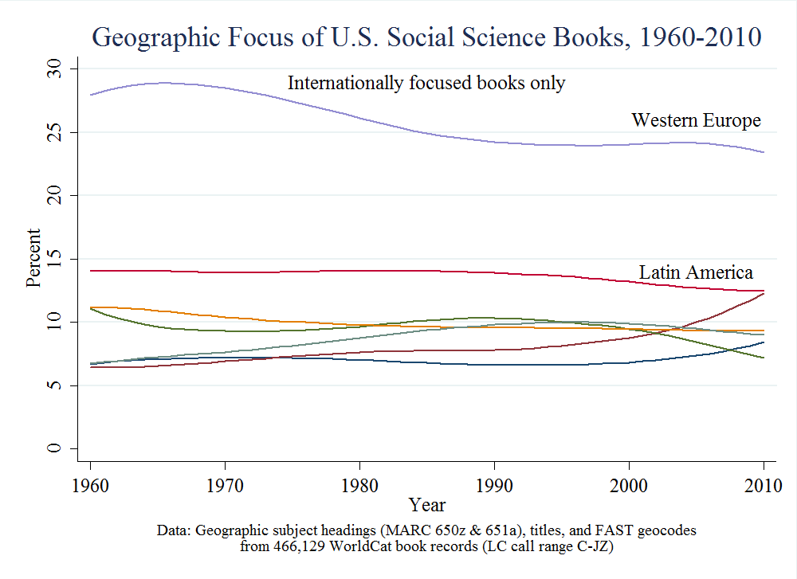

Slide 17
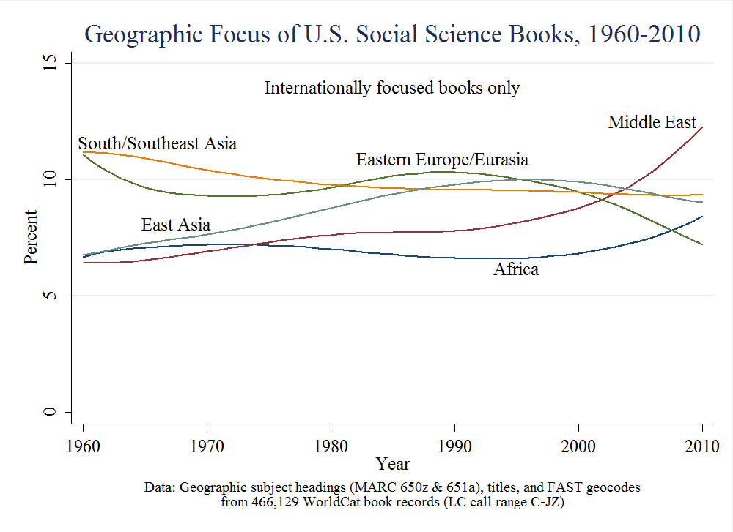

Slide 18
Globalizing the social sciences
2. Journal articles

Slide 19

Data source: Top 10 U.S. journals in each discipline in the social sciences.
Challenges include: rankings are for recent years only; rankings are based on journal citations; rankings include non-U.S. journals and citations; rankings overrate science-related journals and underrate humanities-oriented journals, since more science journals and their citations are included in the database.

Slide 20
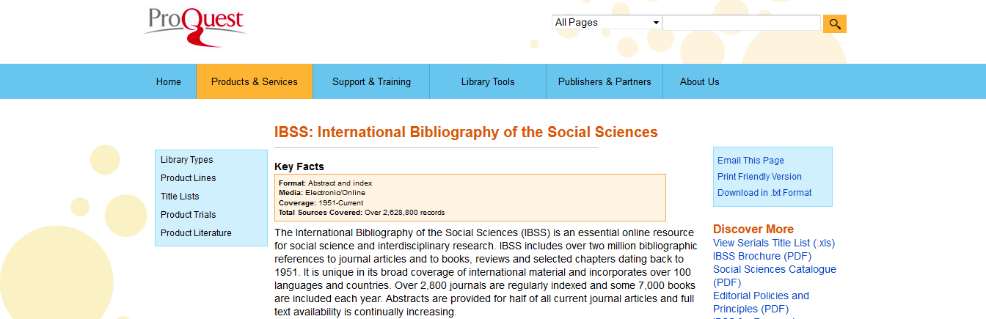
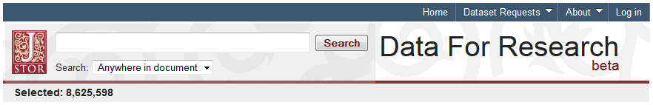
Data source: Top 10 U.S. journals in each discipline in the social sciences.
Article titles and abstracts downloaded from ProQuest’s IBSS,
JSTOR’s Data For Research, and other sources.

Slide 21
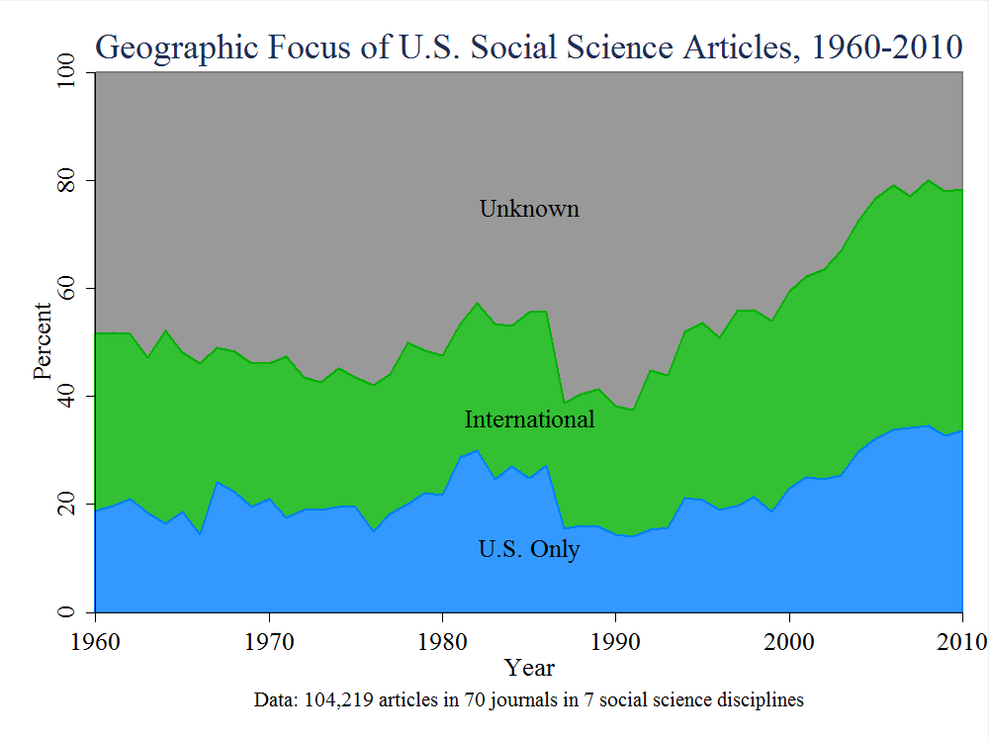

Slide 22
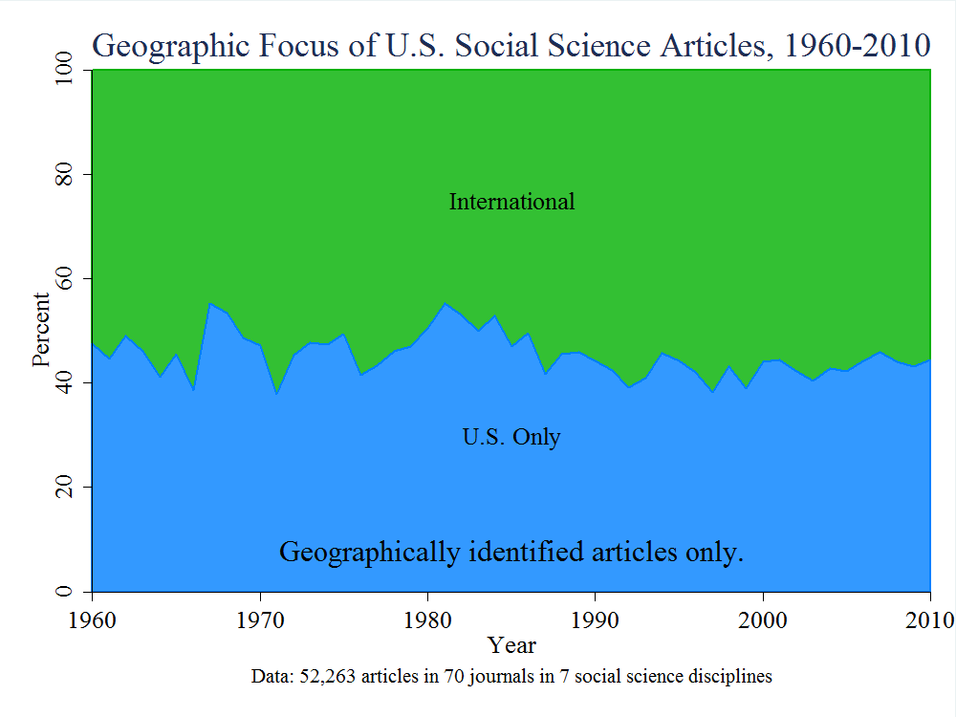

Slide 23
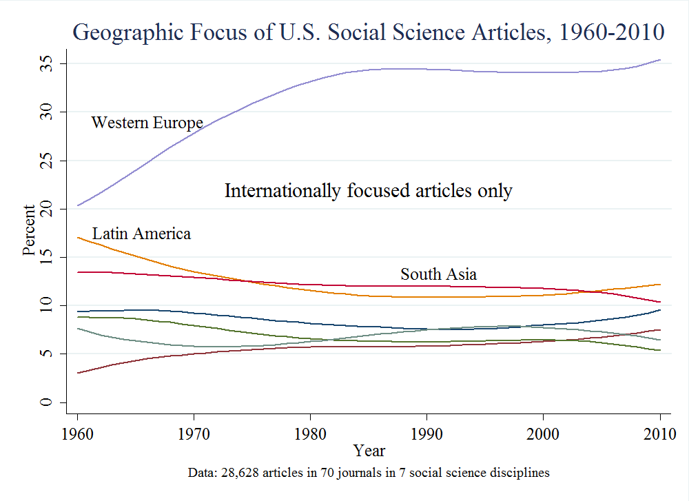

Slide 24
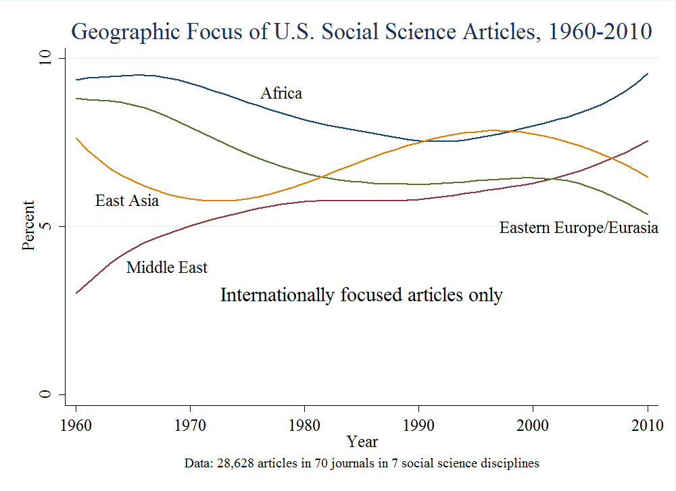

Slide 25



The Global Dimensions of Scholarship and Research Libraries
Finding Synergies, Creating Convergence
April 2013
http://bit.ly/17rDFB1
A task force working to improve cooperation between scholars, librarians, and other colleagues to help internationalize U.S. higher education.
Please get in touch if you are interested in this effort!
Task force leaders include:

Slide 26
Shifts in Scholarly Attention Among World Regions
OCLC Research Briefing at UNC Chapel Hill
7 June 2013
#oclcr #insightseries
Dr. Charles Kurzman
http://kurzman.unc.edu
OCLC Research
www.oclc.org/research.html
OCLC Collective Insight Series
www.oclc.org/go/us/CollectiveInsight.en.html

