Slide 1
No One Cooks the Bacon Alone: Models for Success in Building out a Digitally-Integrated Special Collections Program Erin O’Meara OCLC Past Forward! Meeting Stakeholder Needs in 21st Century Special Collections June 4, 2013
This work is licensed under a Creative Commons Attribution 3.0 Unported License. http://creativecommons.org/licenses/by/3.0/

Slide 2
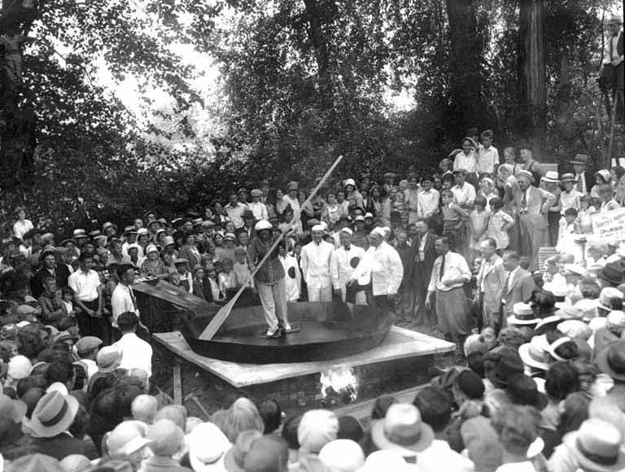
Inspiration
UW Special Collections
http://www.flickr.com/photos/uw_digital_images/4497387707/

Slide 3
Background
Gates Archive
New independent organization (formed Spring, 2011)
Collecting areas
Bill & Melinda Gates Foundation
Gates family personal papers
Related philanthropic and personal collections
Staff:
Director, Assistant Director, 4 Archivists, Strategic Program Lead, Oral History Team
Notes:
Separate from the foundation

Slide 4
Gates Archive Focus
Establish modern era archive focused on process and technology
Majority of collections will be born-digital
Design without constraints of legacy systems or processes
Focused approach to innovate
Learn from colleagues and leading thinkers in the field
Current activities:
Begin acquisition activities with core donor group
Refine and enhance digital acquisitions workflows
Developing integrated processing manual (digital and physical collections)

Slide 5
Modern Collecting
Proactive approaches
In the moment collecting
Integrating ethnographic methods
Enhanced acquisition strategies
Interviews with donors to discuss activities that led to the creation of the documents
Photography of workspace
What does work look like collecting hybrid collections:
Asking new questions
Focus on provenance, instead of original order
Understanding complex landscape and context of creation of the donor (paper, local digital, hosted digital, shared digital, artifacts, etc.)
Notes:
Shift away from solely reactive collecting of inactive records
Others are working on ethnographic or enhanced acquisitions (BL, Emory, etc.)

Slide 6
Sustainable Models for Change
Leadership is invested and engaged and ALL staff know it
Shared professional development activities
Not just one person’s job to do “all the born-digital things”
Leveraging the digital archivist hire into the digital re-imagination of the archives
Accountability in shifting roles and responsibilities
Digital archivist is not the sole change agent
Blockers to change should be directly addressed in a change management approach
Creativity in staff’s skillsets
Cultivate existing relevant interests (e.g. media preservation, knowledge of computing peripherals or file formats, interest in project management, etc.)
Library of Congress
http://www.flickr.com/photos/library_of_congress/2179920874/
Notes:
We can move towards technological approaches for processing born-digital content. The main need for change is behavioral and organizational.
Digital archives hire is the seed for a funded project that grows into a program that is conducted across the special collections

Slide 7
Process Re-alignment
Assumed - strong command of traditional archival concepts (theory and practice)
Design the “work” of the archives, regardless of format:
Strategies define intent: Acquisitions Strategy
Process steps define process: Transfer, Accession, Inventory, Shelve
Detailed workflows define the work:
Network transfer workflow, Portable hard drive transfer workflow
Modularize process to allow for diversity of content and approach
OSU Special Collections
http://www.flickr.com/photos/osucommons/5857872317/
Notes:
Emphasize change in approach to born-digital collections. This isn’t a slight readjust to paper acquisitions and processing.
Document your processes – this isn’t done beyond processing enough.
Modularize: choose your own adventure/archival workflow

Slide 8
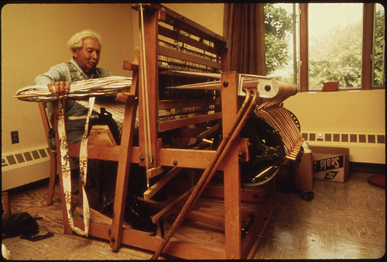
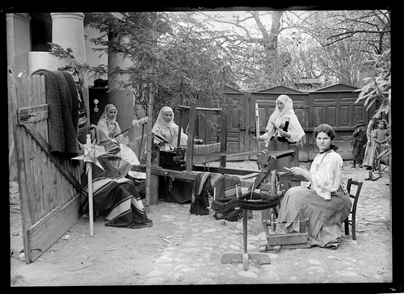
Shift: lone artisan to team of experts
NARA
http://www.flickr.com/photos/usnationalarchives/4727564718/
Library of Congress
http://www.flickr.com/photos/library_of_congress/2179920874/
Notes:
One person shouldn’t hold all the knowledge for an end-to-end workflow.
Use weaving as an example.

Slide 9
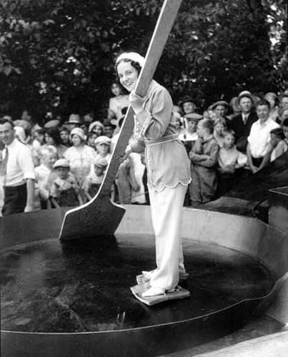
Thank you!
erino@gatesarchive.com
UW Special Collections
http://www.flickr.com/photos/uw_digital_images/4498023042

