Slide 1
Born Difficult?
Michelle Light
Director, UNLV Libraries Special Collections
(formerly Head of Special Collections, Archives, and Digital Scholarship at UC Irvine)
This work is licensed under a Creative Commons Attribution 3.0 Unported License. http://creativecommons.org/licenses/by/3.0/

Slide 2
Outline
ARL Spec Kit 329 on Managing Born Digital Special Collections and Archival Material
A tale of two projects
Access and delivery challenges
Processing challenges
Staffing lessons

Slide 3
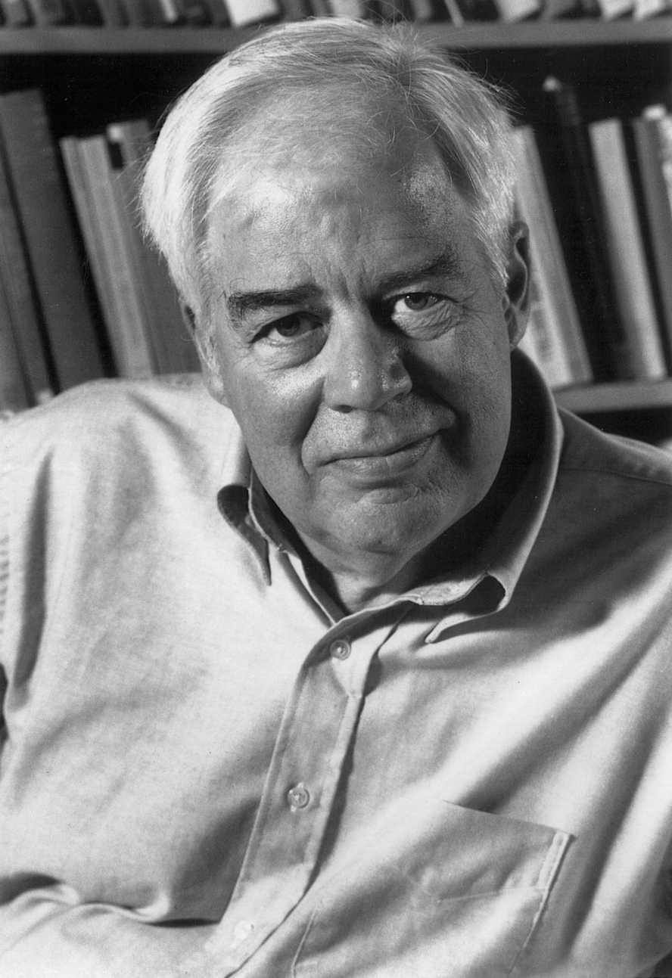
 | Richard Rorty Papers
Collection | 78 floppy disks; ~1,100 unique files
 | All word processing files
 | All files authored by Rorty
Gift agreement | Copyright retained by widow
Staffing | Archivist assisted by IT staff member
Appraisal | Automated deduplication, item-level review
Arrangement | Files sorted individually into series
Description | Item-level description
Preservation | PDF/A migration; Merritt repository
Access | Virtual reading room in Dspace (i.e., remote access for registered users)
 | All files searchable in Dspace
 | Description harvested by Worldcat

Slide 4
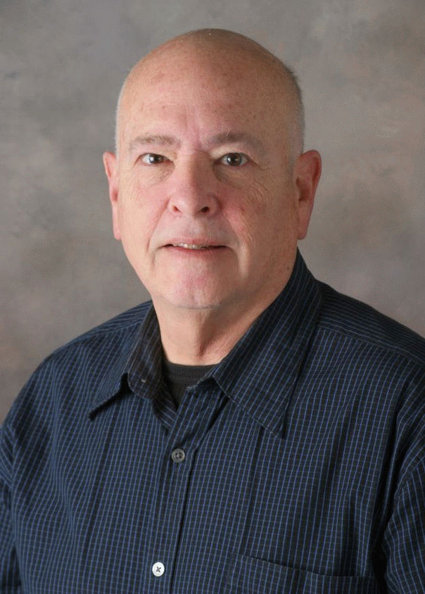
 | Mark Poster papers
Collection | 1 hard drive; 221 directories; ~3,500 files
 | Word processing files, databases, spreadsheets, html pages, emails, images, videos, published articles
 | Mix of authors and publishers
Gift agreement | Creative Commons License
Staffing | Archivist, IT staff, cataloger, subject librarian
Appraisal | Retained most noncorrupt files
Arrangement | Original structure retained
Description | Item and sub-series level description
Preservation | PDF/A migration; some files left as-is; Merritt repository
Access | Open access & virtual reading room in Dspace
 | Partially searchable in Dspace
 | Description harvested by Worldcat

Slide 5
Access and delivery challenges
ARL SPEC Kit 329: Managing Born-Digital Special Collections and Archival Materials (August 2012) noted that:
50% identified sensitivity of materials as the biggest access and delivery challenge
44% identified the lack of IT infrastructure to provide access

Slide 6
UCI’s Virtual Reading Room
Concerns: copyright, privacy, FERPA, access, risk reduction
Richard Rorty’s gift agreement:
Widow retained copyrights, including exclusive publishing rights
“Material may be made available for research without restriction according to the established procedures of the UCI Libraries.”
Nature of Rorty born-digital files:
All files authored by Rorty
Many, many letters of recommendation

Slide 7
UCI’s Virtual Reading Room
“Access to Rorty's born digital files is provided through UCIspace @ the Libraries. Researchers must submit an application to use the collection and agree to follow the Rules of Use for the Virtual Reading Room. Access may be granted in less than 5 business days.”

Slide 8
UCI’s Virtual Reading Room

Slide 9
UCI’s Virtual Reading Room

Slide 10
UCI’s Virtual Reading Room

Slide 11
UCI’s Virtual Reading Room
Concerns: copyright, privacy, FERPA, access, risk reduction
Richard Rorty’s gift agreement:
Widow retained copyrights, including exclusive publishing rights
“Material may be made available for research without restriction according to the established procedures of the UCI Libraries.”
Nature of Rorty born-digital files:
All files authored by Rorty
Many, many letters of recommendation

Slide 12
UCI’s Virtual Reading Room
Mark Poster’s gift agreement:
Included a Creative Commons License
Mark Poster’s files:
Email with multiple authors
Research files collected from multiple authors and publishers
Book chapters authored by Poster
Word processed documents, web pages, pdfs, database files, spreadsheets, emails, audio and video files

Slide 13
Copyright
Section 108
Published works
(a) ….it is not an infringement of copyright for a library or archives…to reproduce no more than one copy or phonorecord of a work…if—
(1) the reproduction or distribution is made without any purpose of direct or indirect commercial advantage;
(2) the collections of the library or archives are (i) open to the public, or …; and
(3) the reproduction or distribution of the work includes a notice of copyright …or includes a legend stating that the work may be protected by copyright ...
Unpublished works
(b) The rights of reproduction and distribution … apply to three copies or phonorecords of an unpublished work duplicated solely for purposes of preservation and security or for deposit for research use in another library or archives … if—
(1) the copy or phonorecord reproduced is currently in the collections of the library or archives; and
(2) any such copy or phonorecord that is reproduced in digital format is not otherwise distributed in that format and is not made available to the public in that format outside the premises of the library or archives.

Slide 14
copyright
Code of Best Practices in Fair Use for Academic and Research Libraries (Association of Research Libraries, 2012)
“It is fair use to create digital versions of a library’s special collections and archives and to make these versions electronically accessible in appropriate contexts.”
“Presenting these unique collections as a digital aggregate, especially with commentary, criticism, and other curation, can be highly transformative.”
“Providing access to published works that are available in unused copies on the commercial market at reasonable prices should be undertaken only with careful consideration, if at all.”
“Libraries should consider taking technological steps… to prevent downloading of digital files by users, or else to limit the quality of files...”
“…a special collection should be digitized in its entirety, and presented as a cohesive collection whenever possible.”

Slide 15
Processing
“Many respondents stated a need to further develop policies, processes, and tools for arranging and describing born digital materials in ways that make them the most accessible.”
ARL SPEC Kit 329: Managing Born-Digital Special Collections and Archival Materials (2012)
“…good processing is done with a shovel, not with tweezers.”
Mark A. Greene and Dennis Meissner, “More Product, Less Process: Revamping Traditional Archival Processing.” American Archivist (2005)

Slide 16
Appraisal, Arrangement &description
Richard Rorty papers
Automated inventory of files’ properties
Automated deduplication
Item-level description (i.e., providing titles) by archivist
Item-level sorting into series
Item-level restriction review
Indexed and fully searchable within repository
Mark Poster papers
Automated inventory of files’ properties
Failed attempt at automating titles
Item-level description started, then abandoned for sub-series level
Item-level appraisal started, then abandoned
Arrangement reflects original order
Partially searchable within repository, partially searchable after download

Slide 17
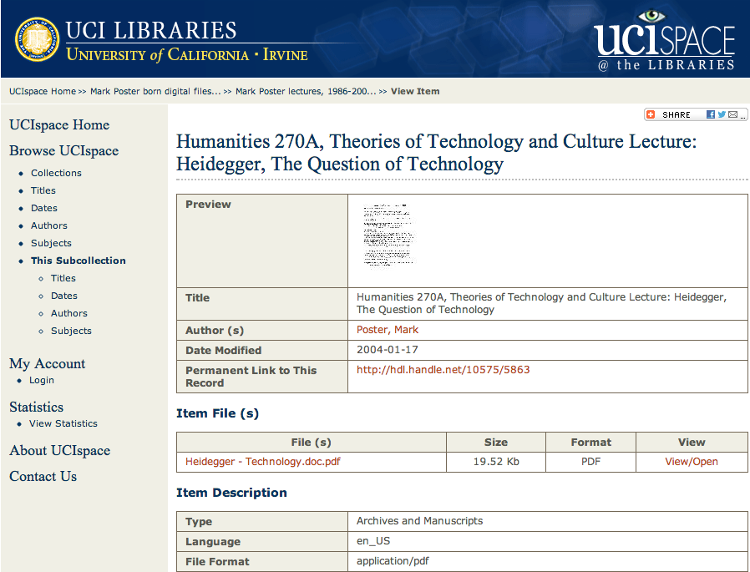
Item-level description

Slide 18
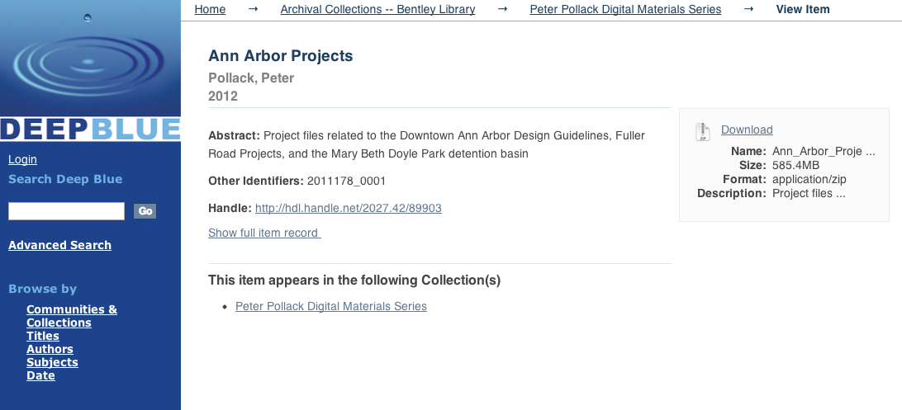
Series level description

Slide 19
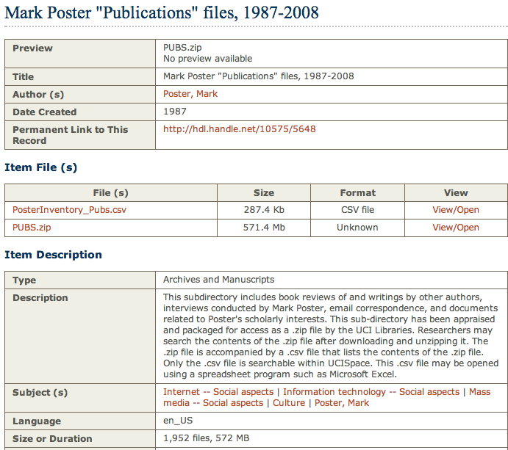
Series-level description

Slide 20
Processing & Access
How do we process collections to maximize access and minimize staffing costs?
How do we move away from item-level work? At what cost and risk?
What theories, practices, or tools need to be developed?
What does effective access to born-digital archival collections look like? What kinds of architecture, interfaces, and searching capabilities would best serve archival collections?

Slide 21
Staffing & collaborations
ARL SPEC Kit 329: Managing Born-Digital Special Collections and Archival Materials
“libraries continue to experiment with organizational models to find those that will be most effective to manage born-digital, primary-source materials”
“frequently staff from special collections, library IT, digital repositories, digital curation, and other areas work together to ingest, appraise, describe, preserve, and provide access to this content”

Slide 22
Staffing & collaborations
Richard Rorty papers (2009-2010 – a 6 month project):
Planning: Dept. Head (an archivist)
Processing: Archivist assisted by Library IT staff
Preservation & delivery: Library IT, Library Web Services, Campus IT, California Digital Library
Mark Poster papers (2010-2013 – a 2.5 year project):
Planning: Dept. Head (an archivist), Library IT staff (a new digital archivist)
Processing: Subject librarian, metadata librarian, Library IT staff, archivist (at end)
Preservation & delivery: Library IT, Library Web Services, Campus IT, California Digital Library

