Slide 1
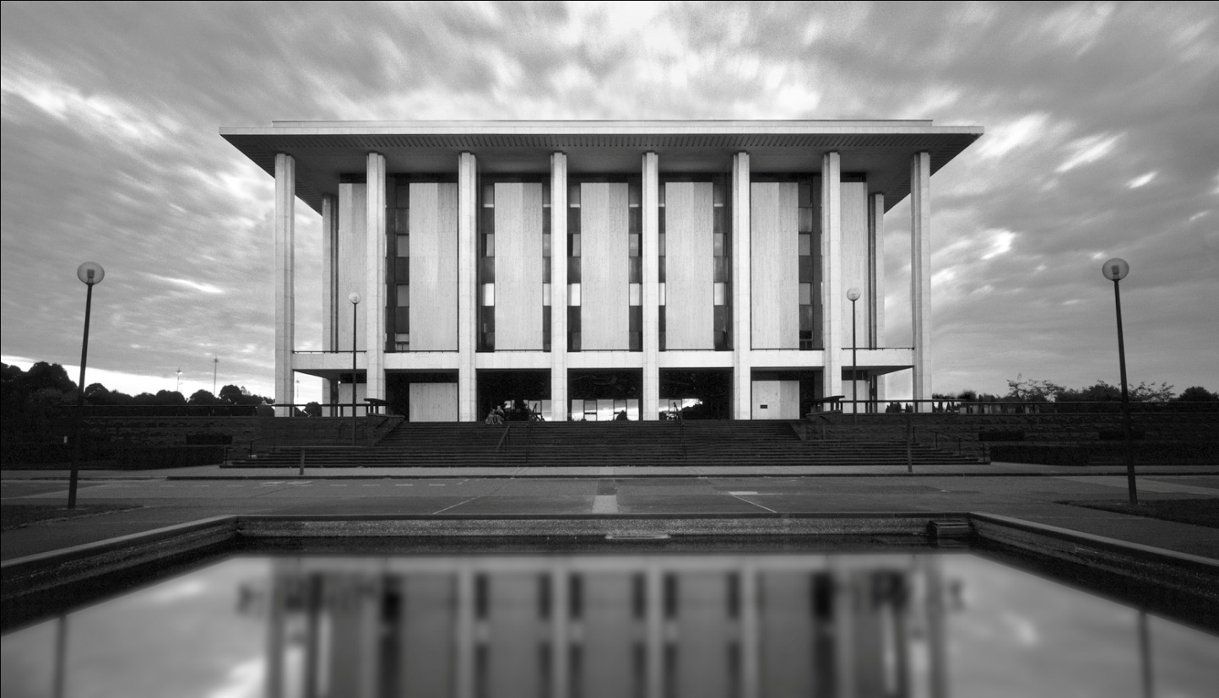
One Library: Re-valuing the Special
OCLC Past Forward: Repositioning Special Collections
ROBYN HOLMES
Senior Curator
National Library of Australia
This work is licensed under a Creative Commons Attribution 3.0 Unported License. http://creativecommons.org/licenses/by/3.0/

Slide 2
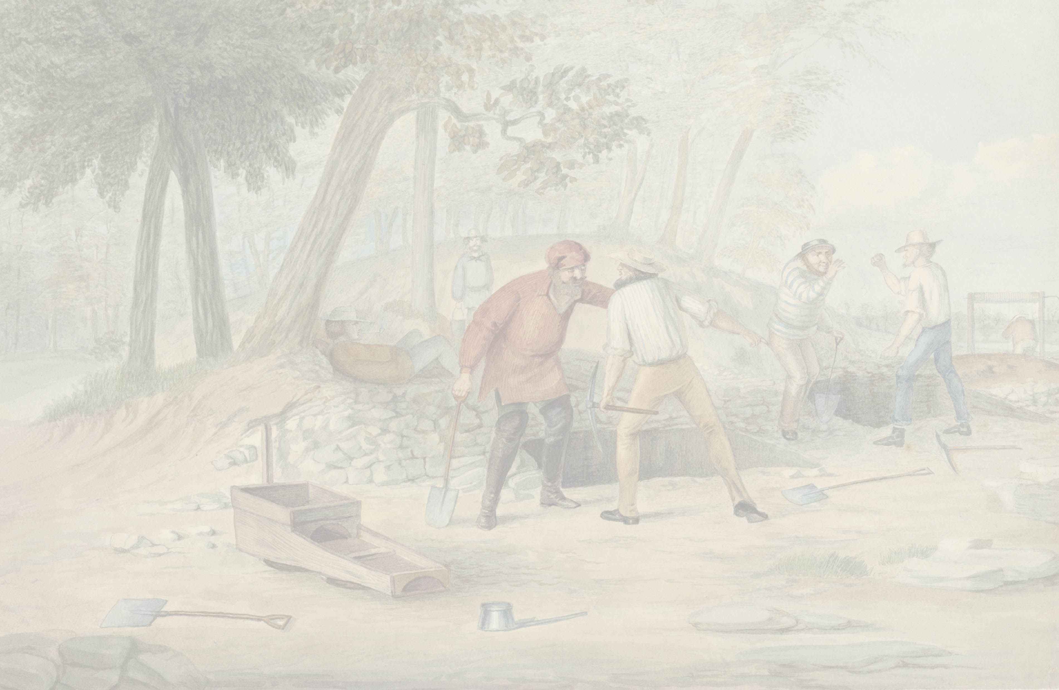
Provocations!
‘Specialness’ is not ‘preciousness’
Revalue and empower specialist expertise
(i.e. value your people as much as your collections)
Integrate the common, triage the special, and risk manage the rest
It’s all about the user, online as well as onsite

Slide 3
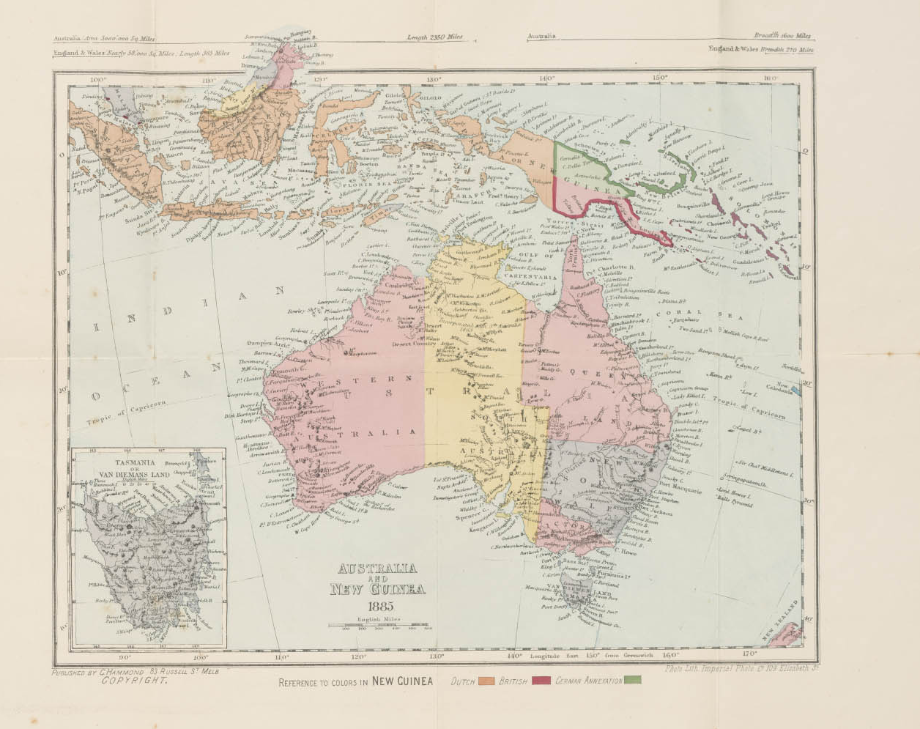

Slide 4
NSLA reimagining libraries

Slide 5
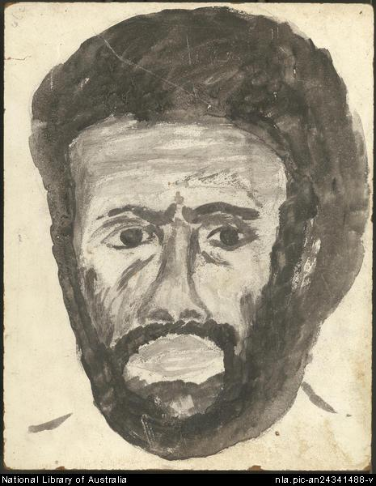
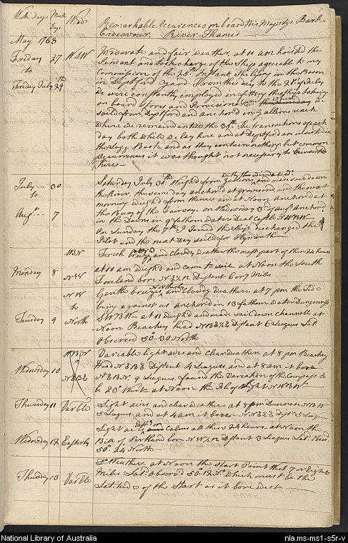
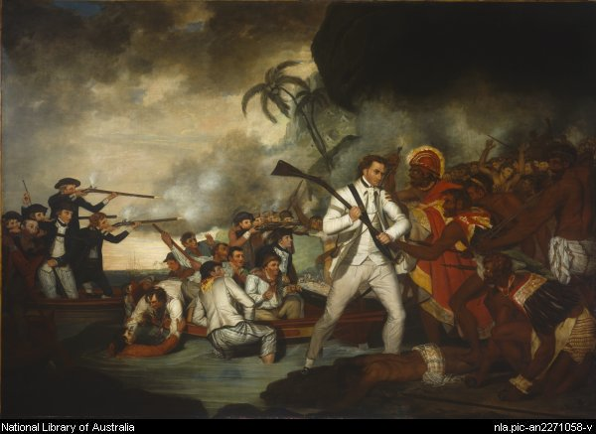
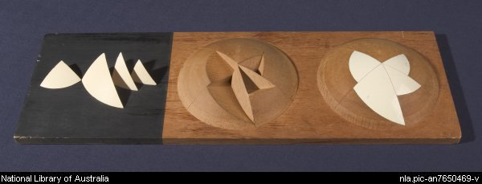
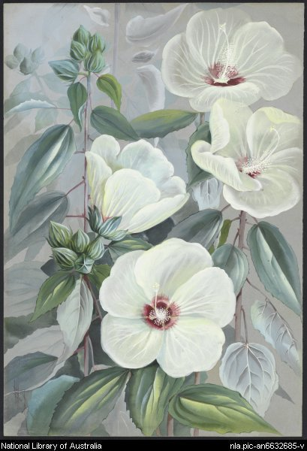
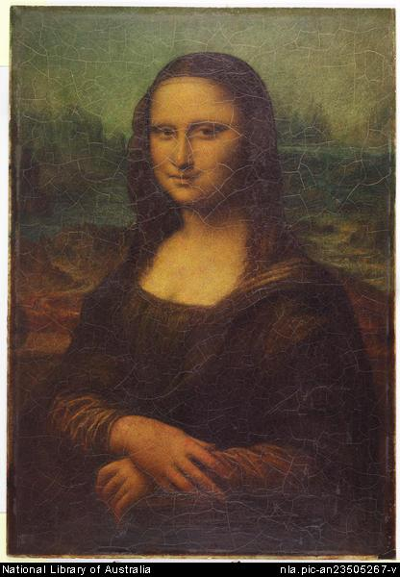
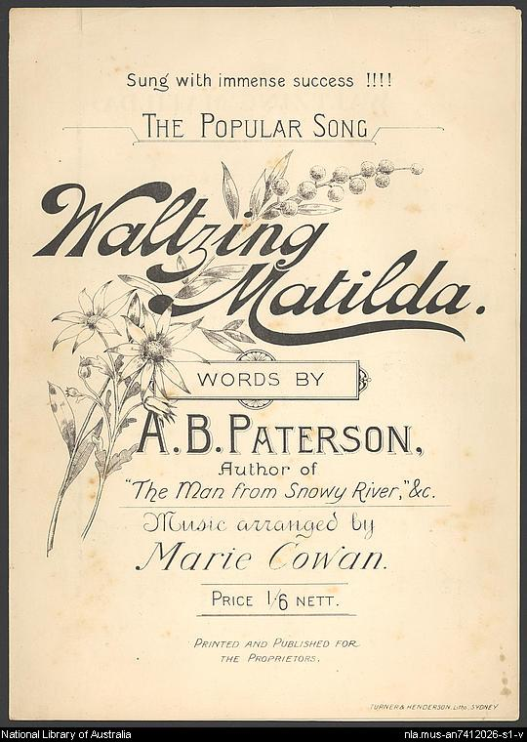
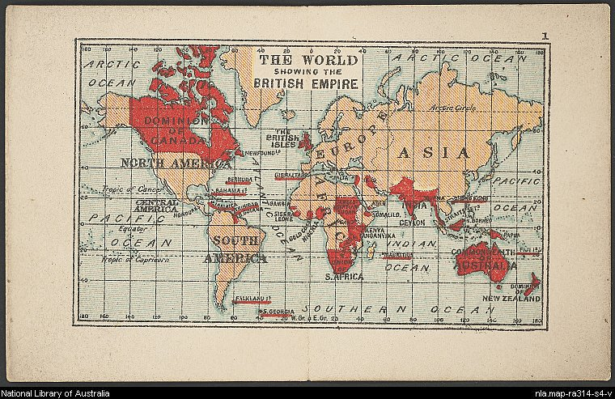

Slide 6
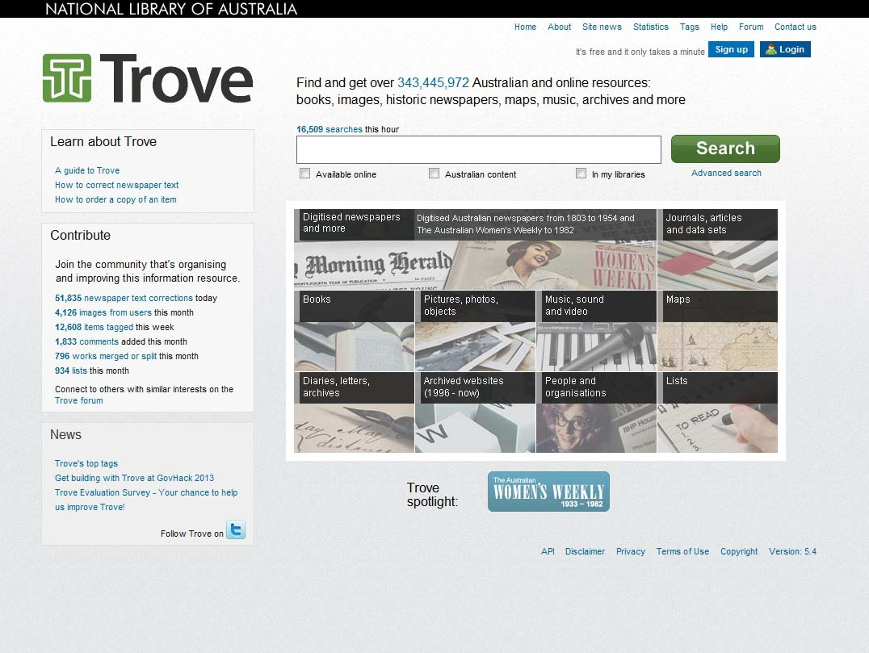
Trove home page

Slide 7
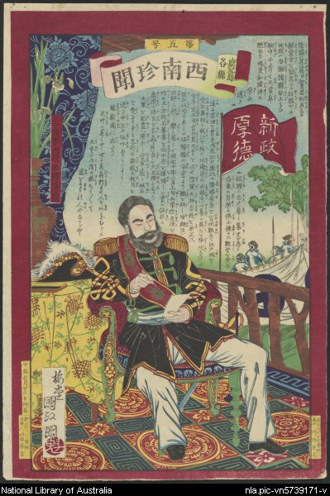
Japanese woodblock print collection ca. 1800 – ca. 1900

Slide 9
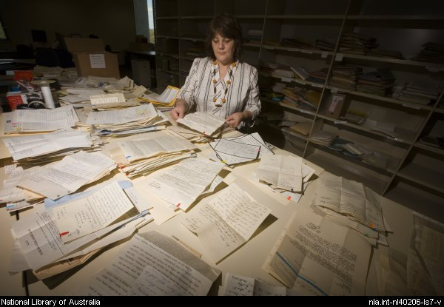
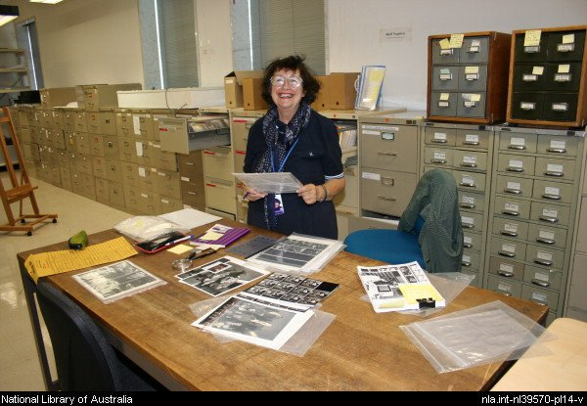
Pictures and Manuscripts Reading Room
Integration
= One National Library

Slide 10
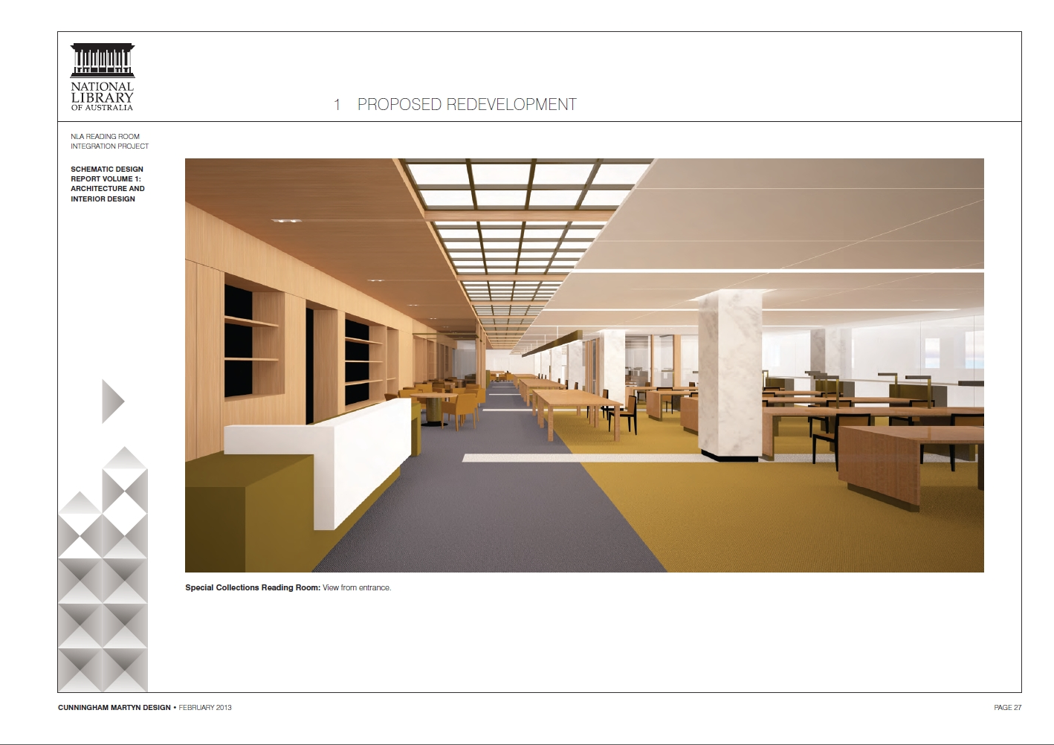

Slide 11
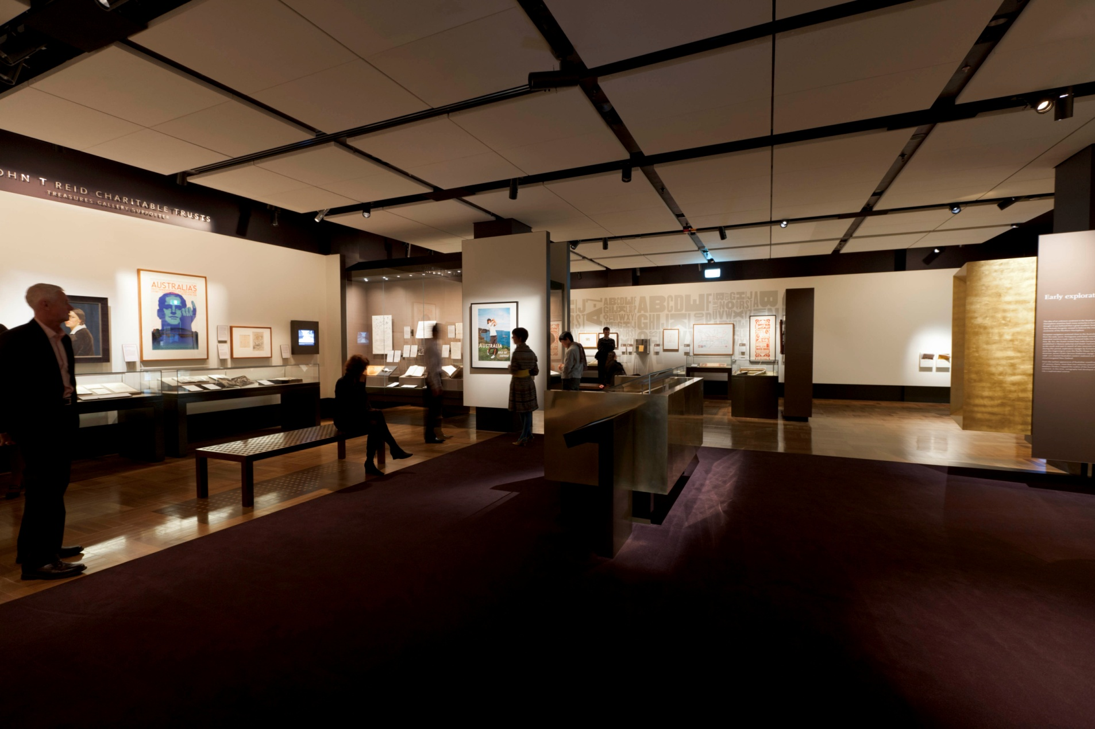

Slide 12
Forte NLA sheet music for iPad

Slide 14
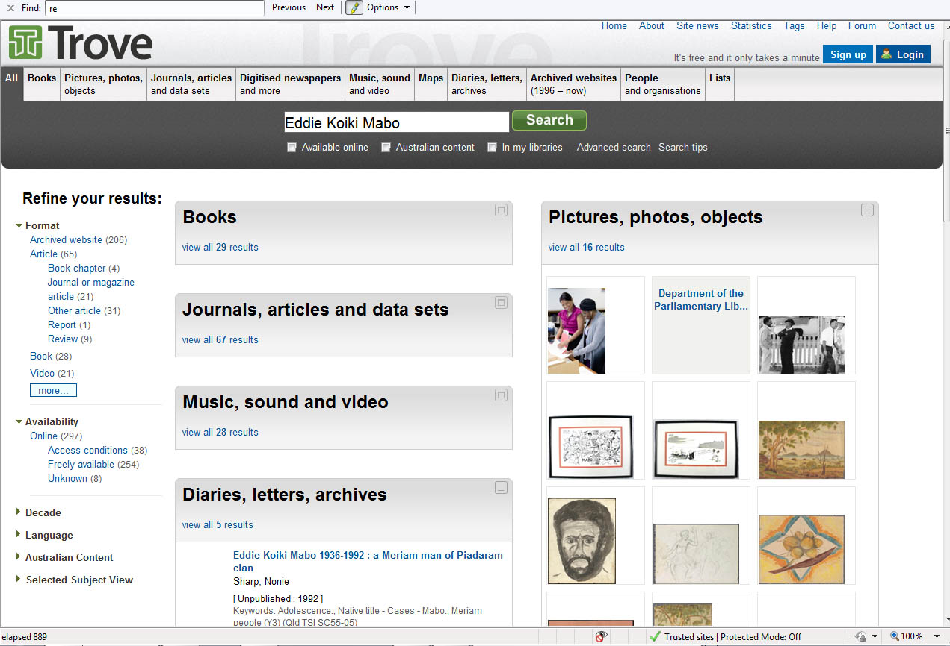

Slide 15
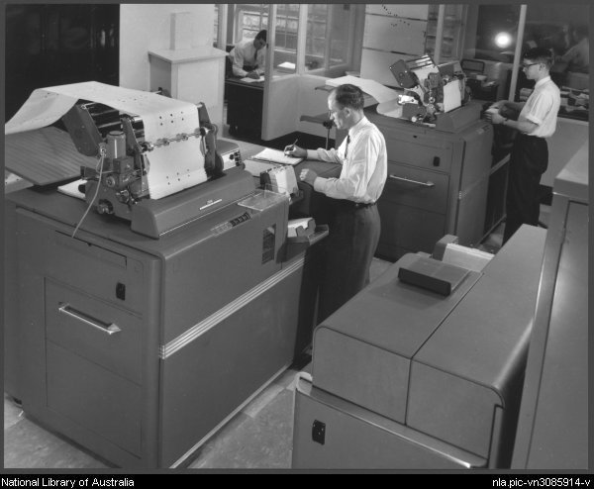
Re-imagining the Special
Enhance capacity to collect and provide access
Engage donors, researchers, audiences
Improve infrastructure for processing and discoverability
Explore new modes of digital creation, innovative spaces and uses

Slide 16
Key principles
Systems not unique: uses and formats are
Generic solutions fit for purpose
Focus special expertise on real needs
Focus on tasks that only we can do
Create common processes and workflows, except for complex, high end, difficult and innovative

Slide 17
r
e
c
o
m
m
e
n
d
a
t
i
o
n
s
analysis
brainstorm
ideas
THE
T
EAM
What must we do?
What are better ways?
What does it cost ?
What do we do now?
What are the best ways?
Value Impact and tasks Statement
Functional
analysis
Costing
analysis
Multiple
perspectives
Shared
understanding
Evaluation
Implementation
Plan
convergence

Slide 18
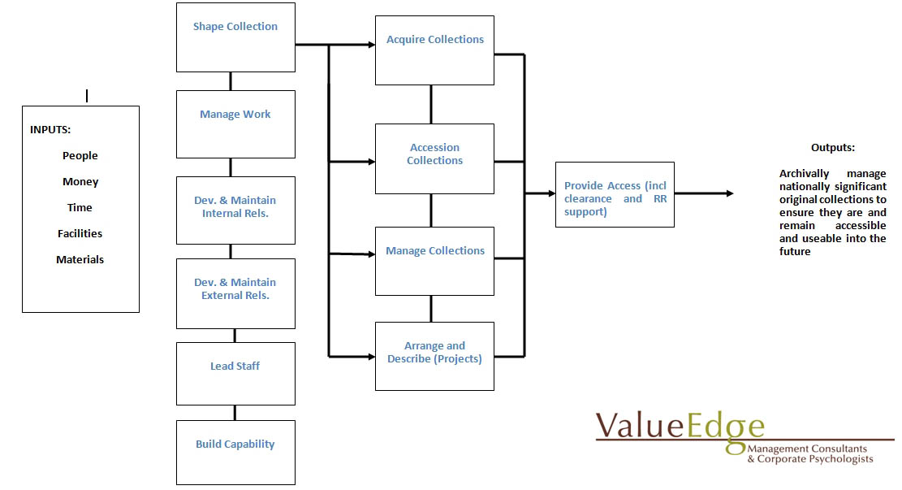
Work Functions diagram

Slide 19
STAFF TIME BY FUNCTION | Annual hours | Percentage
Lead Staff | 105 | 1%
Develop & maintain Ext. relationships | 118 | 1%
Build Capability | 209 | 2%
Manage Collections | 857 | 7%
Develop & maintain int. relationships | 1,014 | 9%
Manage Work | 1,029 | 9%
Provide access to collections | 1,103 | 10%
Acquire Collections | 1,113 | 10%
Arrange and Describe Projects | 1,647 | 14%
Shape Collection | 1,808 | 16%
Accession Collection | 2,574 | 22%
Total | 11,576 | 100%

Slide 20
What we found
Amount of operational work to do is twice the staff time available!
Complex functions and demands increasing
Strategic initiatives not factored into workload
User expectations of remote access and staff digital expertise
‘Operational endlessness’

Slide 21
Align with Strategic Directions
Shape collections proactively
Balance operational and strategic work
Engage with ‘digital deluge’ despite ‘analogue avalanche’
Interconnect the separate components of business infrastructure
Animate the collections with curatorial knowledge
Share knowledge and build staff capability

Slide 22
What’s different?
Focus on ‘what only we can do’ as specialists
Invest specialist expertise to support generic business systems
Integrate shared, common or ‘like’ functions
Improve flexibility, rotation and staff training
Re-define roles and responsibilities, trust staff down the line
Adopt project /matrix approach to break ‘operational endlessness’
Special not precious: generic, not case-by-case, workflows
Risk-manage more decisions
Triage: acquisitions, collection control, reference, access…

Slide 23
MSS Business Improvement Project
7 phases; 80+ deliverables; 18 months:
Shape the collection
Acquire collections
Control collections for use
Integrate functions
Improve business systems and interoperability
Attack operational endlessness
Animate the collections and build capability

Slide 24
Project Strategies
Think the user, every time!
Streamline everything possible
Ensure systems/processes interconnect
Embed improvements in operational work (brainstorm, trial, measure and evaluate)
Empower and energise all staff in the change process
Engage own professional expertise to generate solutions

Slide 25
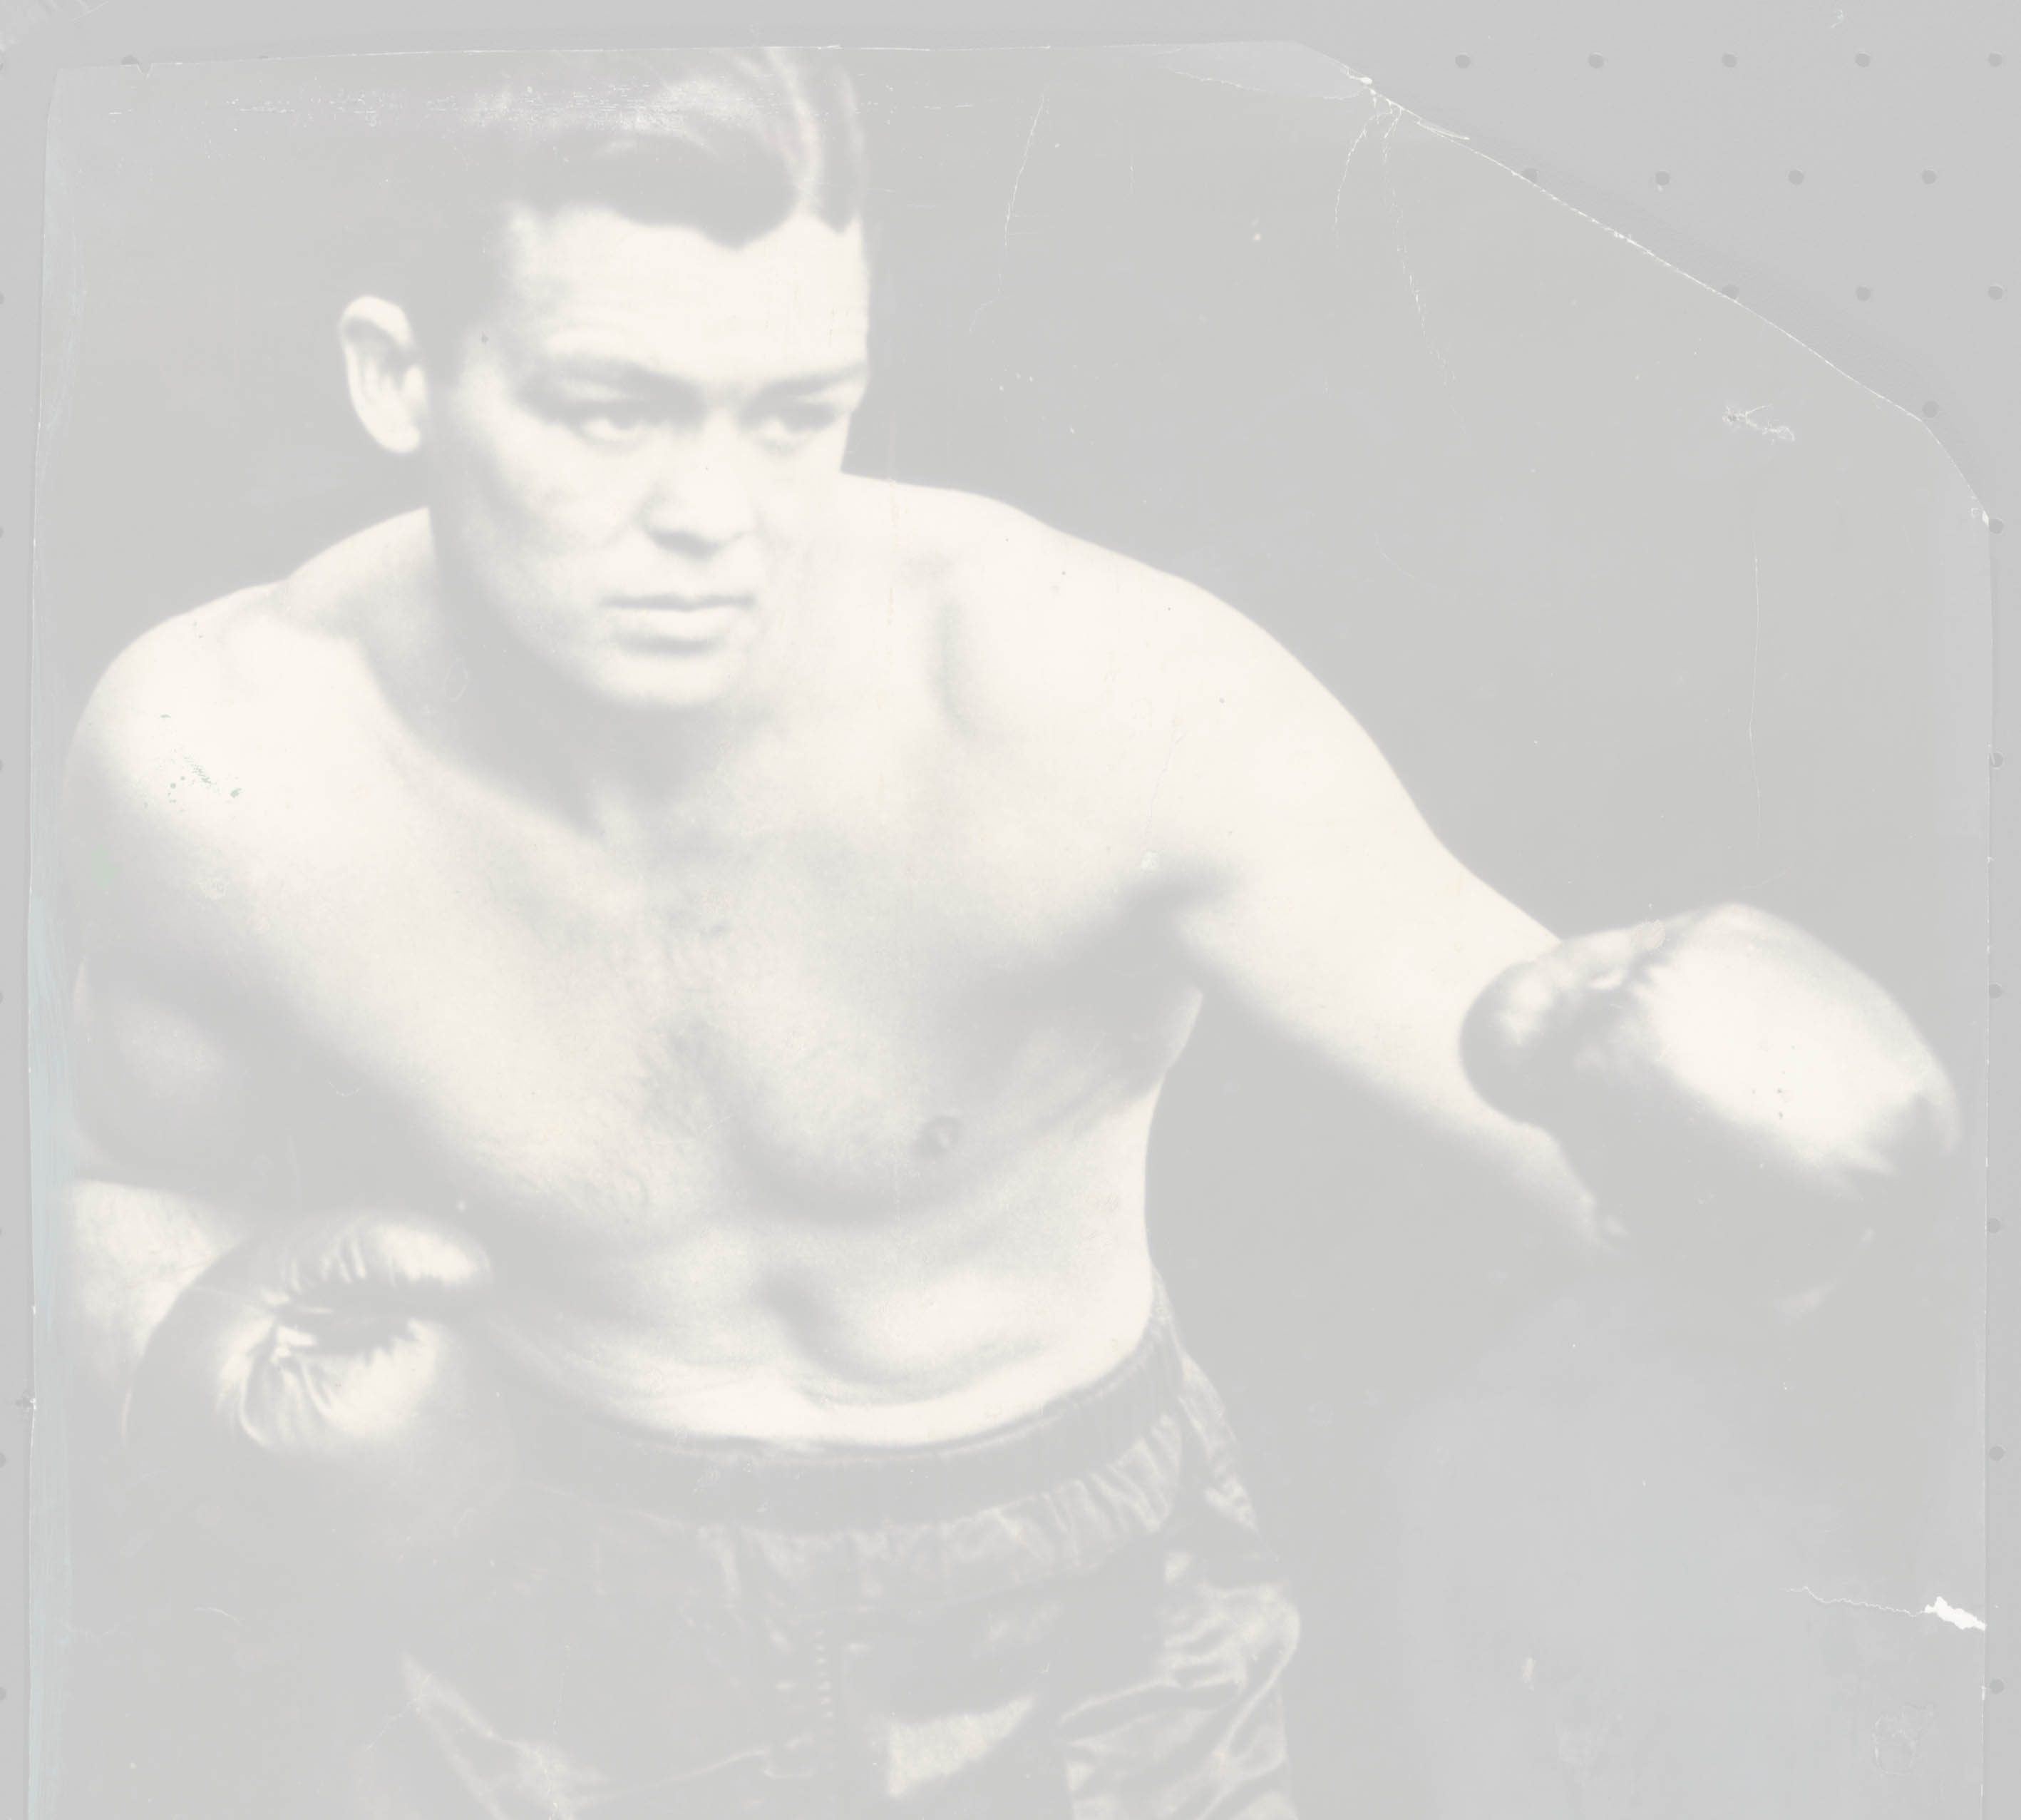
Building and connecting workflows and systems
Donor offer and rights capture
Communication and negotiation
Registration, accession, control
Web form
Acquisitions management system
Collection management system (AT)
XML

Slide 26
Repositioning Special Collections
Align
Embed
Empower
Re-value
Re-imagine

