Slide 1
Teaching with Special Collections: Thinking Inside and Outside of the (archival) Box
OCLC Research Workshop – Yale University – June 3, 2013

Slide 2
Outreach and Learning Services Librarian for Olin/Uris Libraries and the Division of Rare and Manuscript Collections
This work is licensed under a Creative Commons Attribution 3.0 Unported License. http://creativecommons.org/licenses/by/3.0/

Slide 3
What are students learning?
Disciplinary Knowledge
Critical Thinking
Communication Skills
Scientific and Quantitative Reasoning
Self-Directed Learning
Information Literacy
Engagement in the Process of Discovery or Creation
Multicultural Competence
Moral and Ethical Awareness
Self-Management
Community Engagement

Slide 4
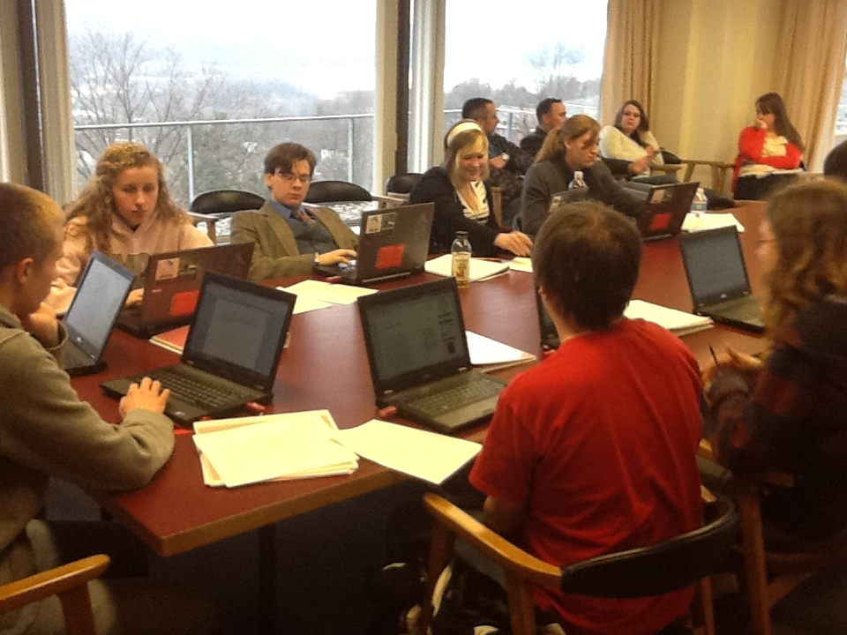
First-Year Writing
Seminars

Slide 5
Ye Olde Dogge and Powney Shewe

Slide 6
Dog and Pony Show 2.0

Slide 7
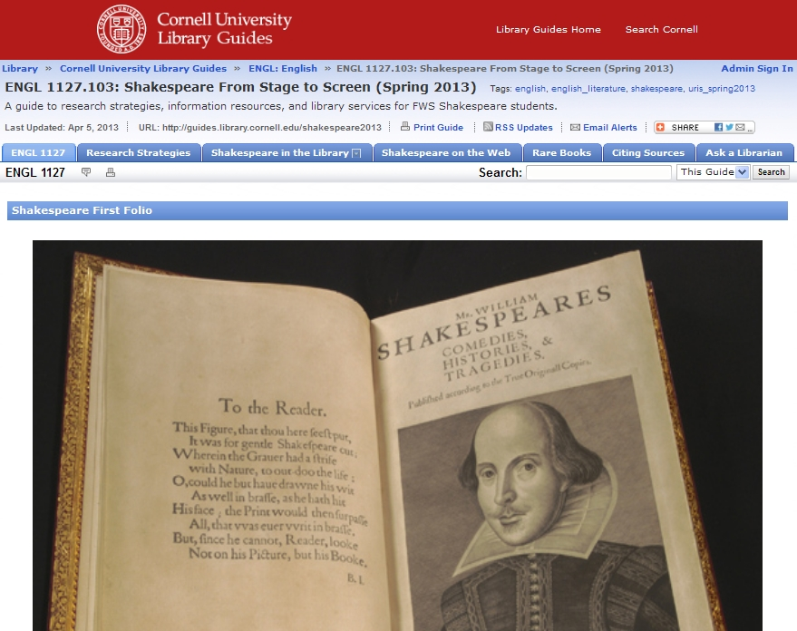

Slide 8
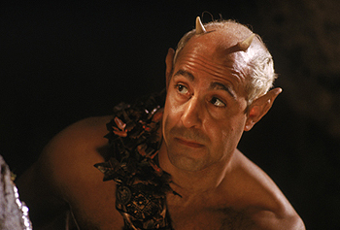
Integrating Special Collections and General Library Instruction
Pros
Cons
Coordination
Collaboration
Flexibility
Cross-training
Communication
2 X Everything
Scalability
Learning Curve
Competition
“Up and down, up and down
I will lead them up and down….”

Slide 9
What does LEARNING look like?

Slide 10
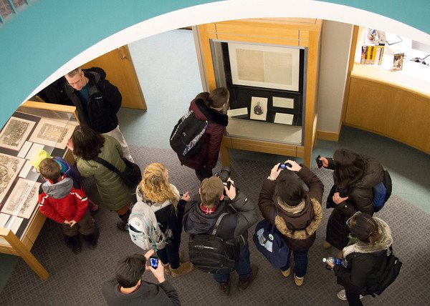

Slide 12
LOL

Slide 13
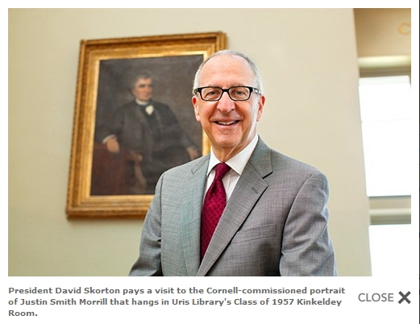

Slide 14
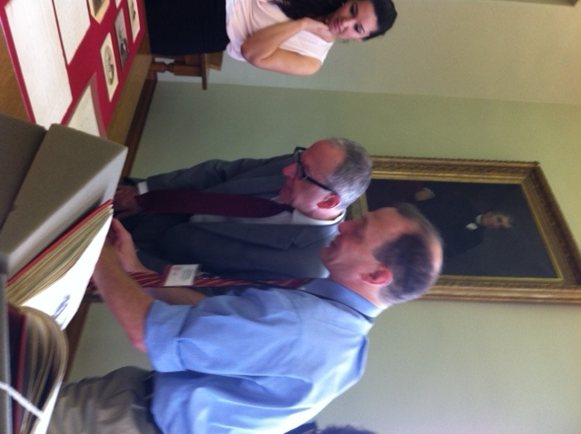

Slide 15
Questions?
Lance J. Heidig
Outreach and Learning Services Librarian
ljh5@cornell.edu

