Slide 1
Holding the stakeholders together: The Women’s Library moves to LSE
Liz Chapman
Director of Library Services
London School of Economics and Political Science
This work is licensed under a Creative Commons Attribution 3.0 Unported License. http://creativecommons.org/licenses/by/3.0/

Slide 2
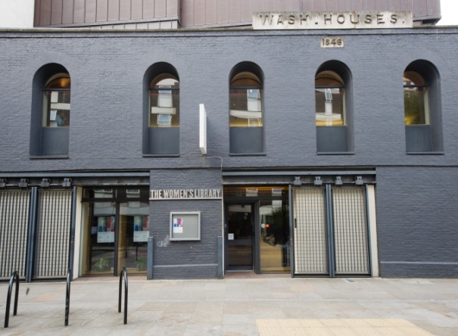
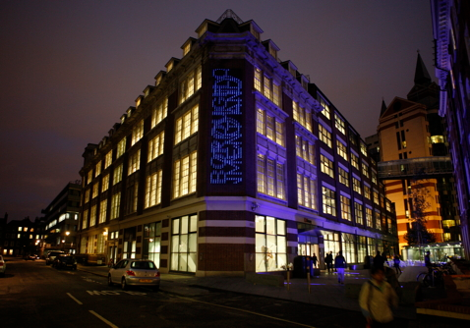
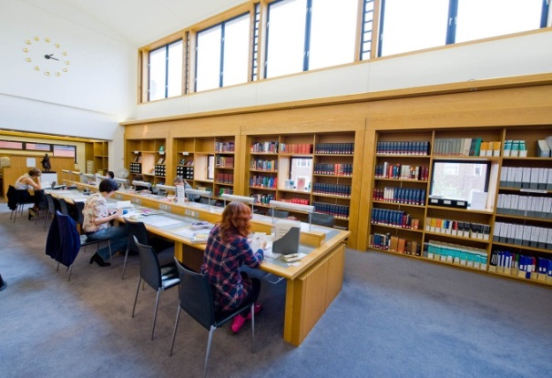
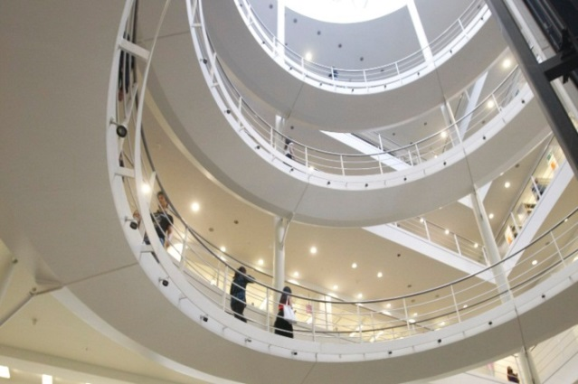
Bringing collections together: from Wash House to Workhouse

Slide 3
Building the case: inside
Internal politics: seeking support
Library staff
Academic staff
Students
Estates / Finance / Human Resources
LSE Director(s) and Management Team
LSE Committees
LSE Council

Slide 4
Building the case: inside out
Writing the Bid
Library bid writers
LSE Fundraisers
LSE Estates / Finance / H.R.
The Friends of the Women’s Library
The staff of the Women’s Library
Prominent depositors
The Bid adjudicators
Personal contacts

Slide 5
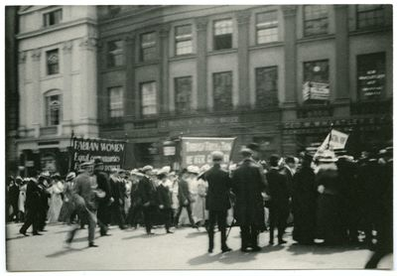
Eyes on the prize
George Bernard Shaw photographs a Suffragette rally, 1909
http://www2.lse.ac.uk/library/archive/shaw/exhibition.aspx

Slide 6
Building the case: outside
Public politics : moving into a different league
Professional organizations
Public funders
Heritage Lottery Fund (existing relationship)
Arts Council
The National Archives
Higher Education Council for England (HEFCE)
Competition
Colleagues and competitors

Slide 7
Defending the case: outside
Public protest: Kidnap or rescue?
Media campaign
Women’s Groups
Local Councillors
Members of Parliament
Depositors
Researchers
Protestors
Friends

Slide 8
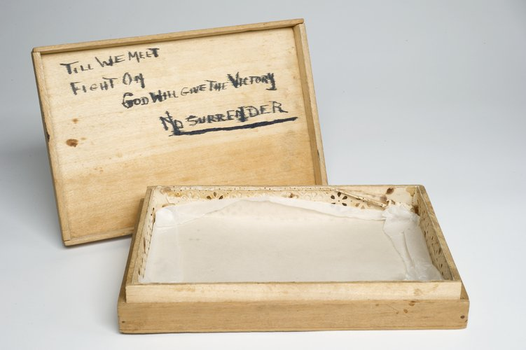
Keeping going: patience is a virtue but so is persistence with passion

Slide 9
Politics: internal and external
Internal politics
Space issues in the Library
Building snags
Leverage for space
Holding back the academics
External politics
Communications
Messages
Publishers are circling
Restraining the researchers

Slide 10
What have we learned?
Pre-existing profile
TWL Collection high profile
LSE Collection low profile
Close links previously undiscovered
Over-sensitivity to protest
Alumni engaged
Professional Colleagues supportive
Effect on fundraising
We are not lawyers
But we are professionals
Talk, email, write, meet, tour, talk, email, meet, tour, talk

Slide 11
Staff as Stakeholders
Engaging staff in the project
Project Board, Team, Manager and more
Bringing TWL staff to LSE
Keeping staff onside
Innovation to support the project
Project to support innovation
Reviewing and renewing practice

Slide 12
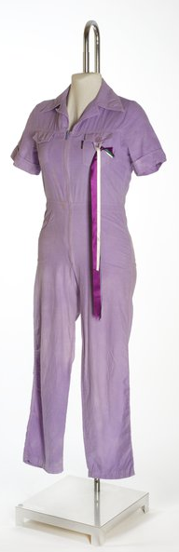
Look for the Golden Thread

Slide 13
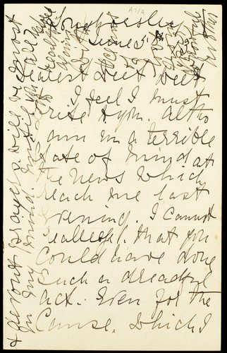
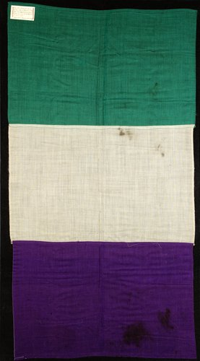
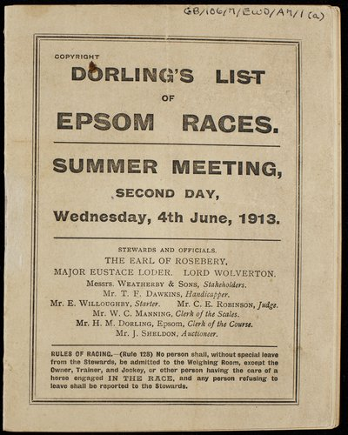
Link the past and present
Emily Wilding Davison Online Exhibition
http://digital.library.lse.ac.uk/exhibitions/emily-wilding-davison-centenary

Slide 14
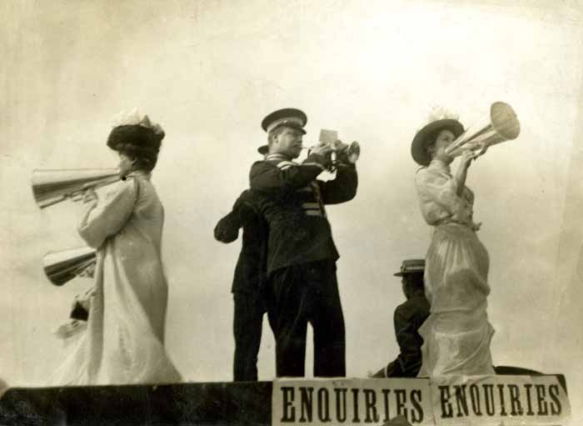
Looking to the future: we’re not finished yet but well underway

