Slide 1




Connecting to Mission
Lisa R. Carter
carter.1088@osu.edu
Past Forward! Meeting Stakeholder Needs in 21st Century Special Collections
June 3, 2013
This work is licensed under a Creative Commons Attribution 3.0 Unported License. http://creativecommons.org/licenses/by/3.0/

Slide 2
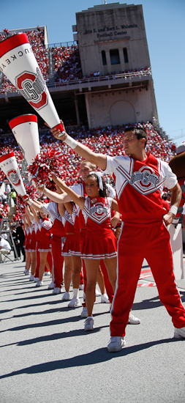
Context for Advocacy
Being “special” is not enough
Reduced resources
Increased, changing demands
Data driven decision making
Focus on outcomes, results
Targeted, strategic investment

Slide 3
Library Directors on Special Collections
“. . . it is their accumulated special collections that increasingly define the uniqueness and character of individual research libraries.”
-- Special Collections in ARL Libraries, March 2009
ARL Working Group on Special Collections
“stewardship of unique assets associated with an institution is an increasing priority”
-- 21st-Century Collections: Calibration of Investment and Collaborative Action, March 10, 2012
ARL Task Force on 21st-Century Research Library Collections
Notes:
In an environment where mass digitization of books and periodicals for Web access is accelerating, and electronic journals and aggregated databases are part of the shared landscape of scholarly communication, it is their accumulated special collections that increasingly define the uniqueness and character of individual research libraries. The time is now to meet the challenges and responsibilities that these materials present.
In its 2012 issue brief on calibrating investment and taking collaborative action, the Steering Committee on Transforming Research Libraries, noted that “stewardship of unique assets associated with an institution/library is an increasing priority,” but clearly indicated that this prioritization will take place within a more holistic view of research library collections as “components of the academy’s knowledge resources.”

Slide 4
Library Directors on Special Collections
“Expecting an appreciation of the intrinsic goodness of special collections won’t carry the day even in well-off, prestigious institutions, because—well, because at the top level “it’s all about them.”
-- Sarah Pritchard
Afterword: Special Collections and Assessing the Value of Academic Libraries
RBM, Fall 2012
Notes:
The key challenge in special collections—in fact, in any part of the academic library—is getting the broader institution to care. How does one ensure that the university and its stakeholders will be willing to underwrite the support of special collections, arguably the most expensive component of a library as far as acquisitions, skilled professional staff, customized space, preservation, and security? Expecting an appreciation of the intrinsic goodness of special collections won’t carry the day even in well-off, prestigious institutions, because—well, because at the top level “it’s all about them.” Our assessment program has to demonstrate the value of special collections to advancing the mission of the entire library, and in turn the value of the library in contributing to the accomplishment of the university’s goals.

Slide 5
Library Directors on Special Collections
Special collections may have “a role as an integral leader in shaping the evolving 21st-century collection—but it will be as a component activity contributing to broad institutional goals.”
-- Tom Hickerson
Rebalancing the Investment in Collections
Research Library Issues, no. 277, December 2011
Notes:
In “Rebalancing the Investment in Collections,” Tom Hickerson noted that “special collections can become an increasingly central element of our libraries—but special collections must first become a central element of our libraries. A new alignment is necessary, incorporating special collections, staffing, and expertise into the common asset base of the library.” He went on to cite the importance of “mission alignment both with the broader library and with the university mandate,” and the need for “new organizational structures [to bring] librarians and archivists together to pursue common outcomes.” Finally, he noted that special collections may have “a role as an integral leader in shaping the evolving 21st-century collection—but it will be as a component activity contributing to broad institutional goals.”
Hickerson, H. Thomas. 2011. “Rebalancing the Investment in Collections.” Research Library Issues: A Bimonthly Report from ARL, CNI, and SPARC, no. 277, p. 5.

Slide 6
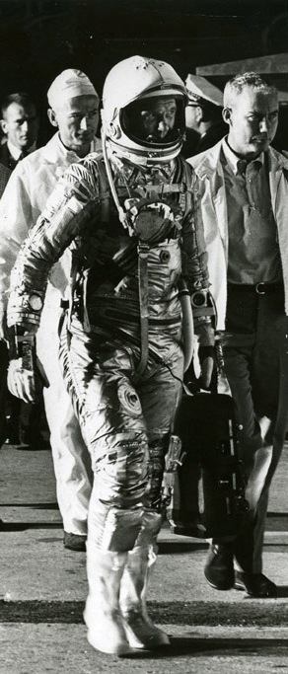
Mission Alignment
Know and understand the mission of your parent organization
Read your context critically
Be part of the dialog of innovation
Take a broad view
Write concisely and with purpose

Slide 7

Example: OSU
Vision
The Ohio State University will be the world’s preeminent public comprehensive university, solving problems of world-wide significance.
Mission
We exist to advance the well-being of the people of Ohio and the global community through the creation and dissemination of knowledge.
Values
Commitment to Excellence
Collaboration as One University
Diversity in People and Ideas
Change and Innovation

Slide 8
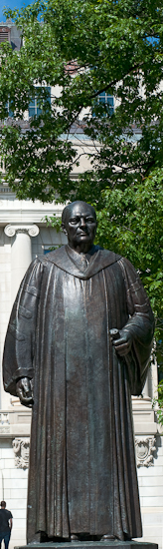
OSU: Core Goals
Teaching and Learning: student-centered learning led by engaged faculty
Research and Innovation: distinctive contribution to knowledge and scholarship
Outreach and Engagement: mutual partnerships with our communities.
Resource Stewardship: an affordable public university, operational efficiency and effectiveness.

Slide 9

OSU Libraries
Vision
Advance student and faculty success.
(echoes “student centered, engaged faculty”)
Deliver distinctive content.
(“distinctive contribution to scholarship”)
Foster intellectual connections.
(“partnerships with communities”)

Slide 10

OSU Libraries: Mission
A dynamic partner and campus leader in advancing discovery and learning for OSU, for the state of Ohio, and for an ever expanding community of world scholars.
We create, acquire, organize, disseminate, and preserve scholarship in traditional and digital forms; we foster an environment conducive to academic inquiry, scholarly communication, creative achievement, and lifelong learning; we help students become information literate and globally aware; and we contribute to the University’s drive to eminence in teaching, research, and service.

Slide 11

OSU Libraries: Strategic Themes
Services: user-centered
Collections: reflect the changing technologies and practices
Library as Intellectual Crossroads
Innovative Leadership: national
Infrastructure: diverse, innovative, effective

Slide 12


OSU Special Collections
Increase alignment of library sponsored programs and exhibitions with University level teaching and research initiatives.
Robust exhibition program
Campus Arts initiative
Data management
Humanities Institutes’ Working Groups
Billy Ireland Cartoon Library & Museum
Byrd Polar Research Center Archival Program

Slide 13

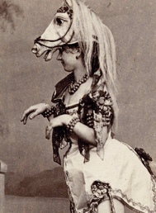
OSU Special Collections
Intensive research assistance
Support graduate student success as advisors and in practicums
Increasingly supply raw data for digital scholarship
Offer enhanced and innovative research services to faculty and graduate students.
Hilandar Research Library
Lawrence and Lee Theatre Research Institute

Slide 14
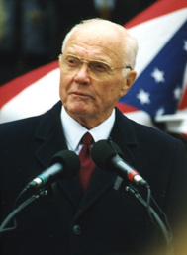
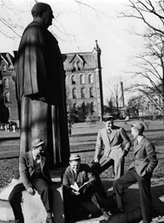
OSU Special Collections
Increase the scale and scope of distinctive and digital collections and enhance access to and usage of these materials to support research and anytime, anywhere learning.
Digitizing like crazy
Buckeye Stroll
Blogs, Flickr, Facebook
Ohio Congressional Archives
Ohio State University Archives

Slide 15


OSU Special Collections
Highly engaged with faculty and service units across campus to integrate library services and resources to enhance teaching and learning.
Redesigning curriculum
Research methods courses
Hands-on, intensive use
Records management program
Rare Books and Manuscripts Library
Charvat Collection of American Fiction

Slide 16
Special Collections | Library Strategy
Engaged in the classroom, embedded expertise | Services
Distinctive collections built on research strengths | Collections
Dynamic exhibits, programs, learning opportunities | Intellectual Crossroads
World-class collections with global reach | Innovative Leadership
Innovation, professional development, efficiency | Resource Stewardship

Slide 17
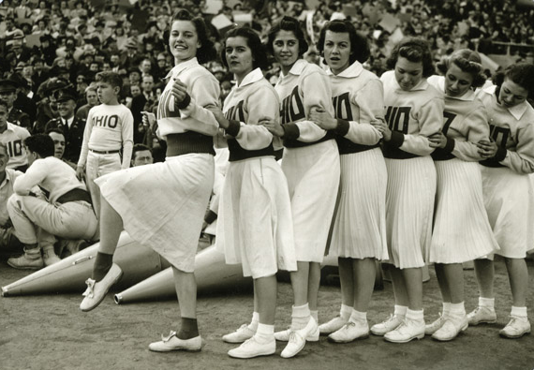
How will you align?

