Slide 1
Recording Options
Do-it-Yourself…In a Studio….On Location

Slide 2
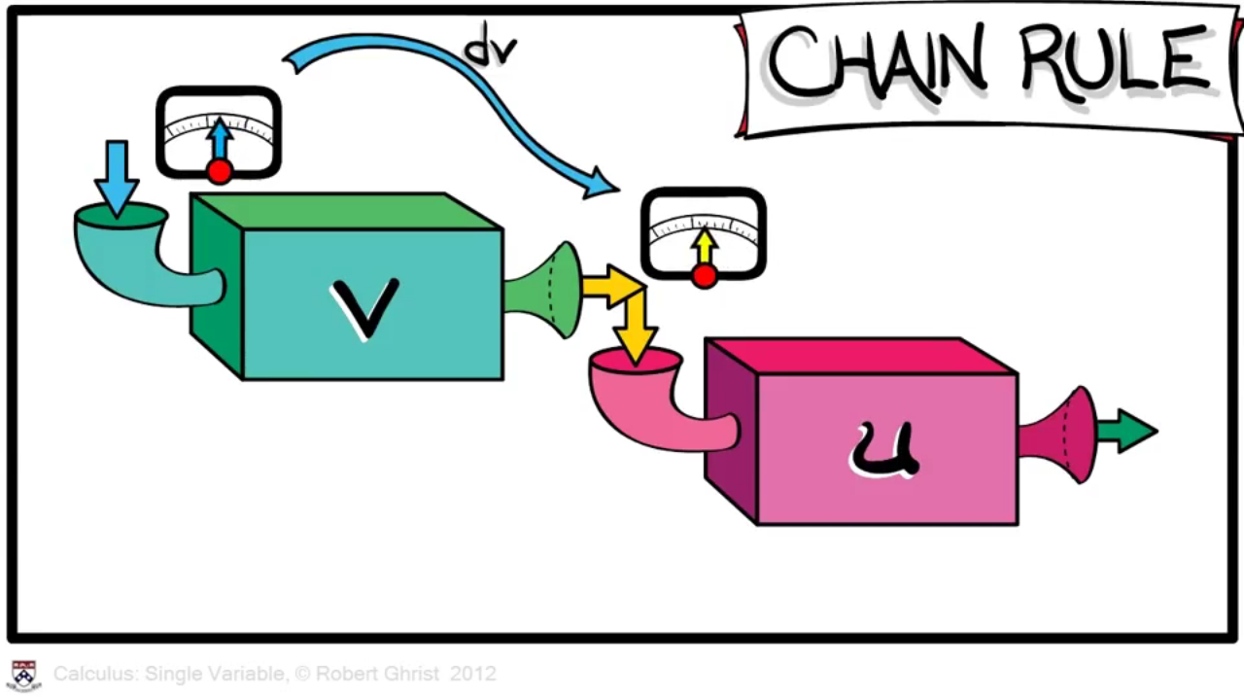
create graphics and animations

Slide 3
self-service at library media lab

Slide 4
DIY
“white board”

Slide 5
computer webcam
mini camera
in your own setting

Slide 6
Recording Options
Do-it-Yourself…In a Studio….On Location

Slide 7
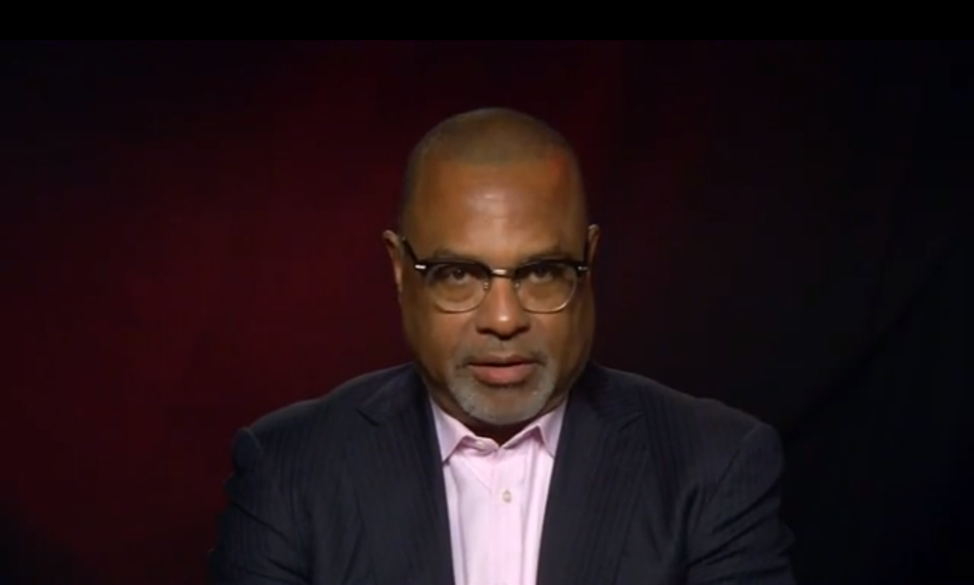
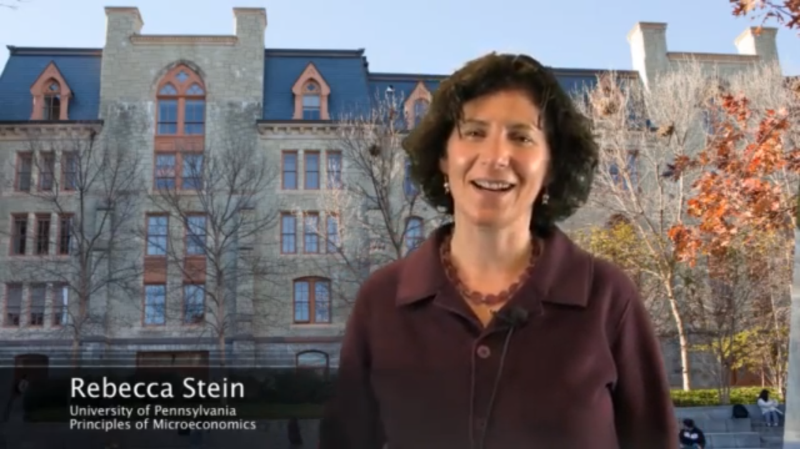
in-studio
with green screen
in-studio
plain backdrop

Slide 8
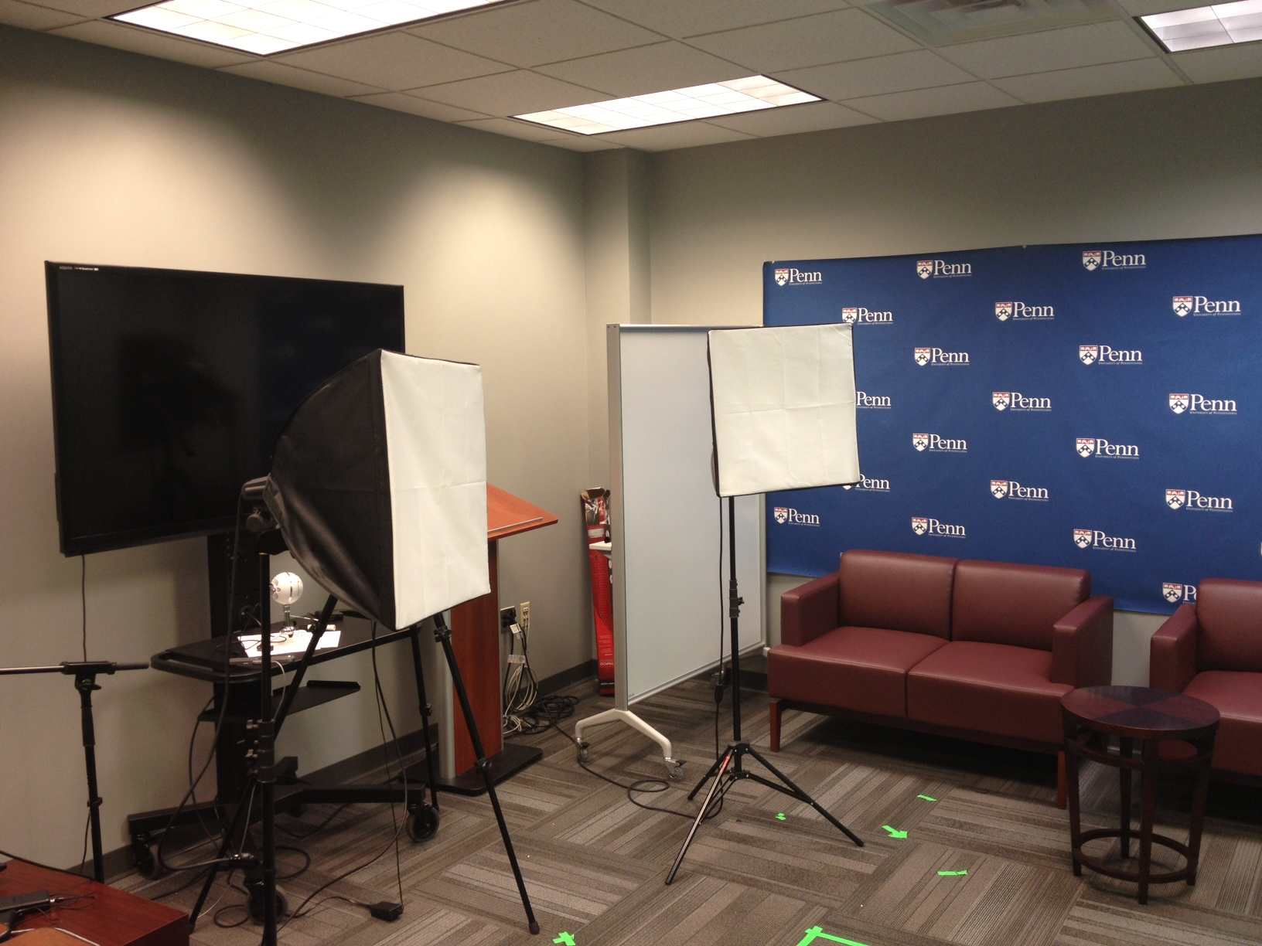
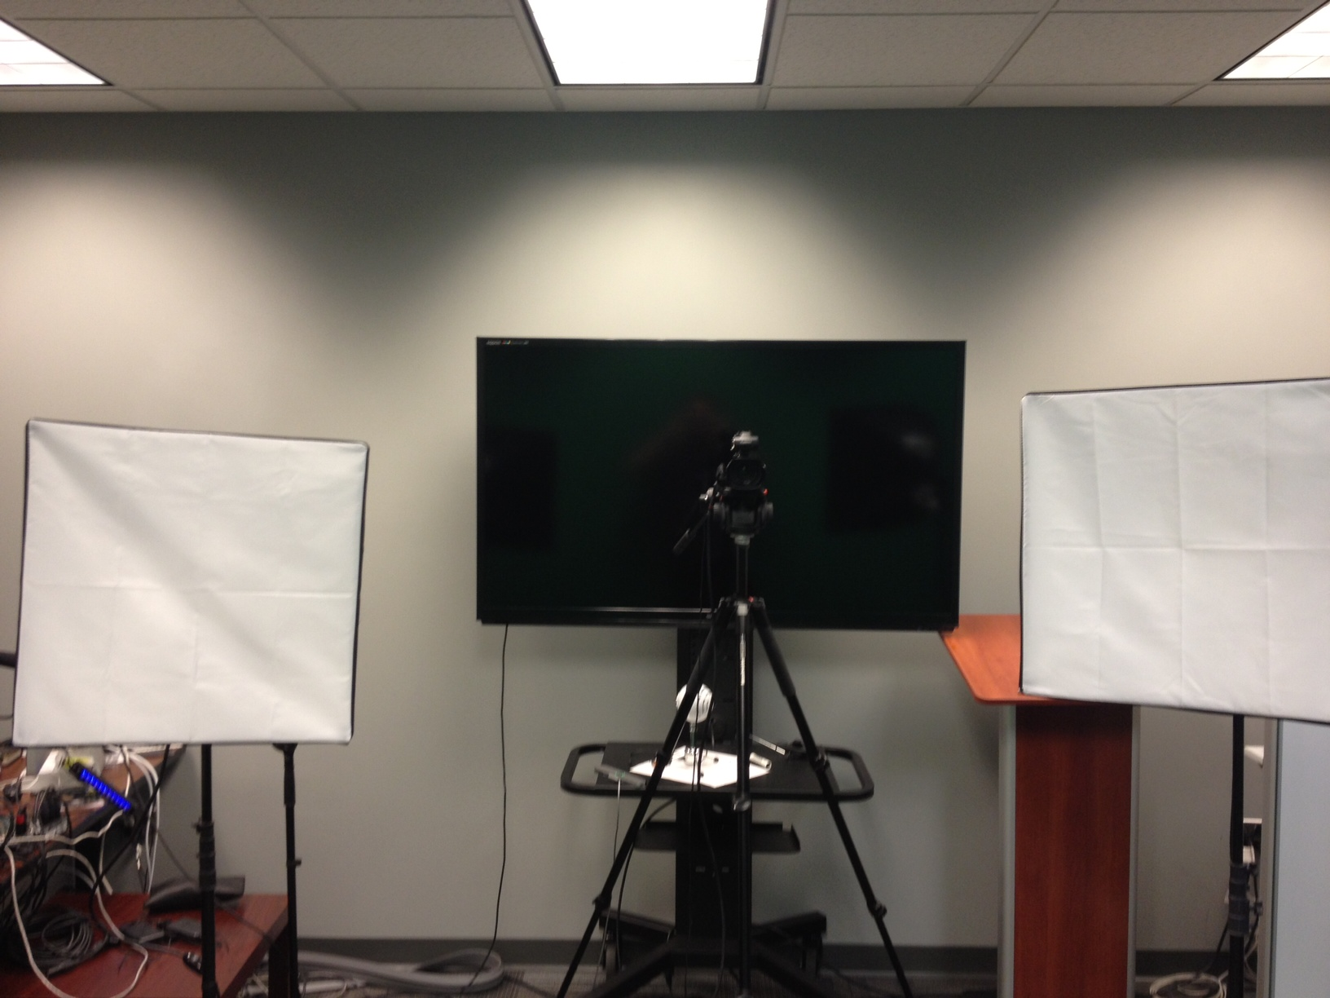
in studio with professional lighting and backdrops

Slide 9
real-time markup
on-screen

Slide 10
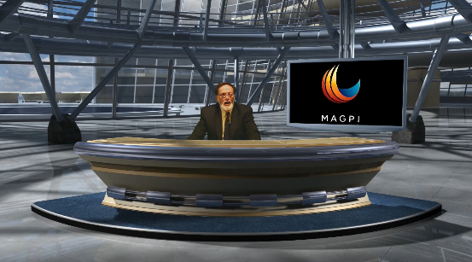
digitally
created
setting

Slide 11
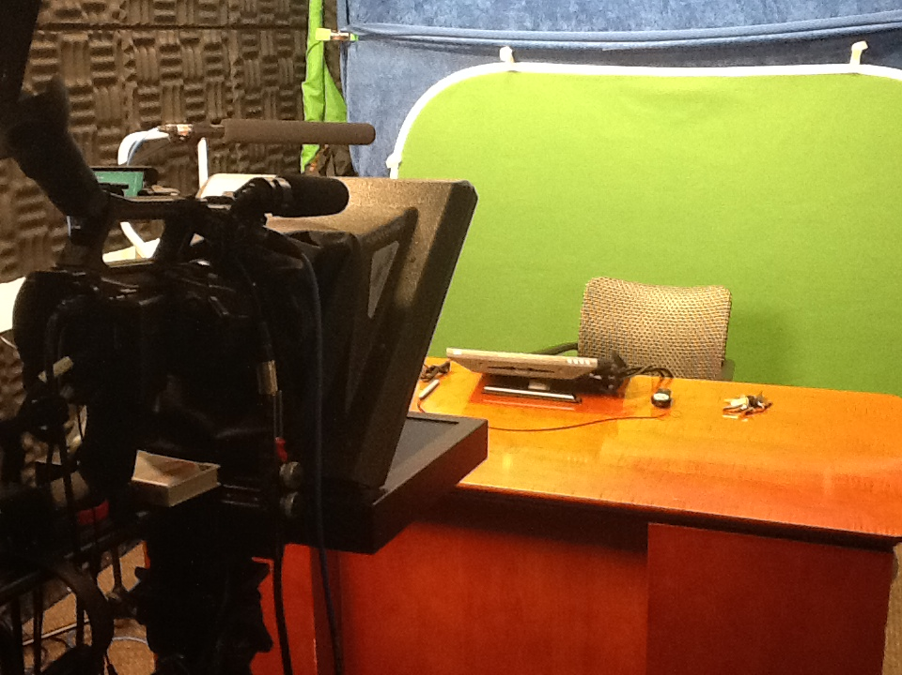
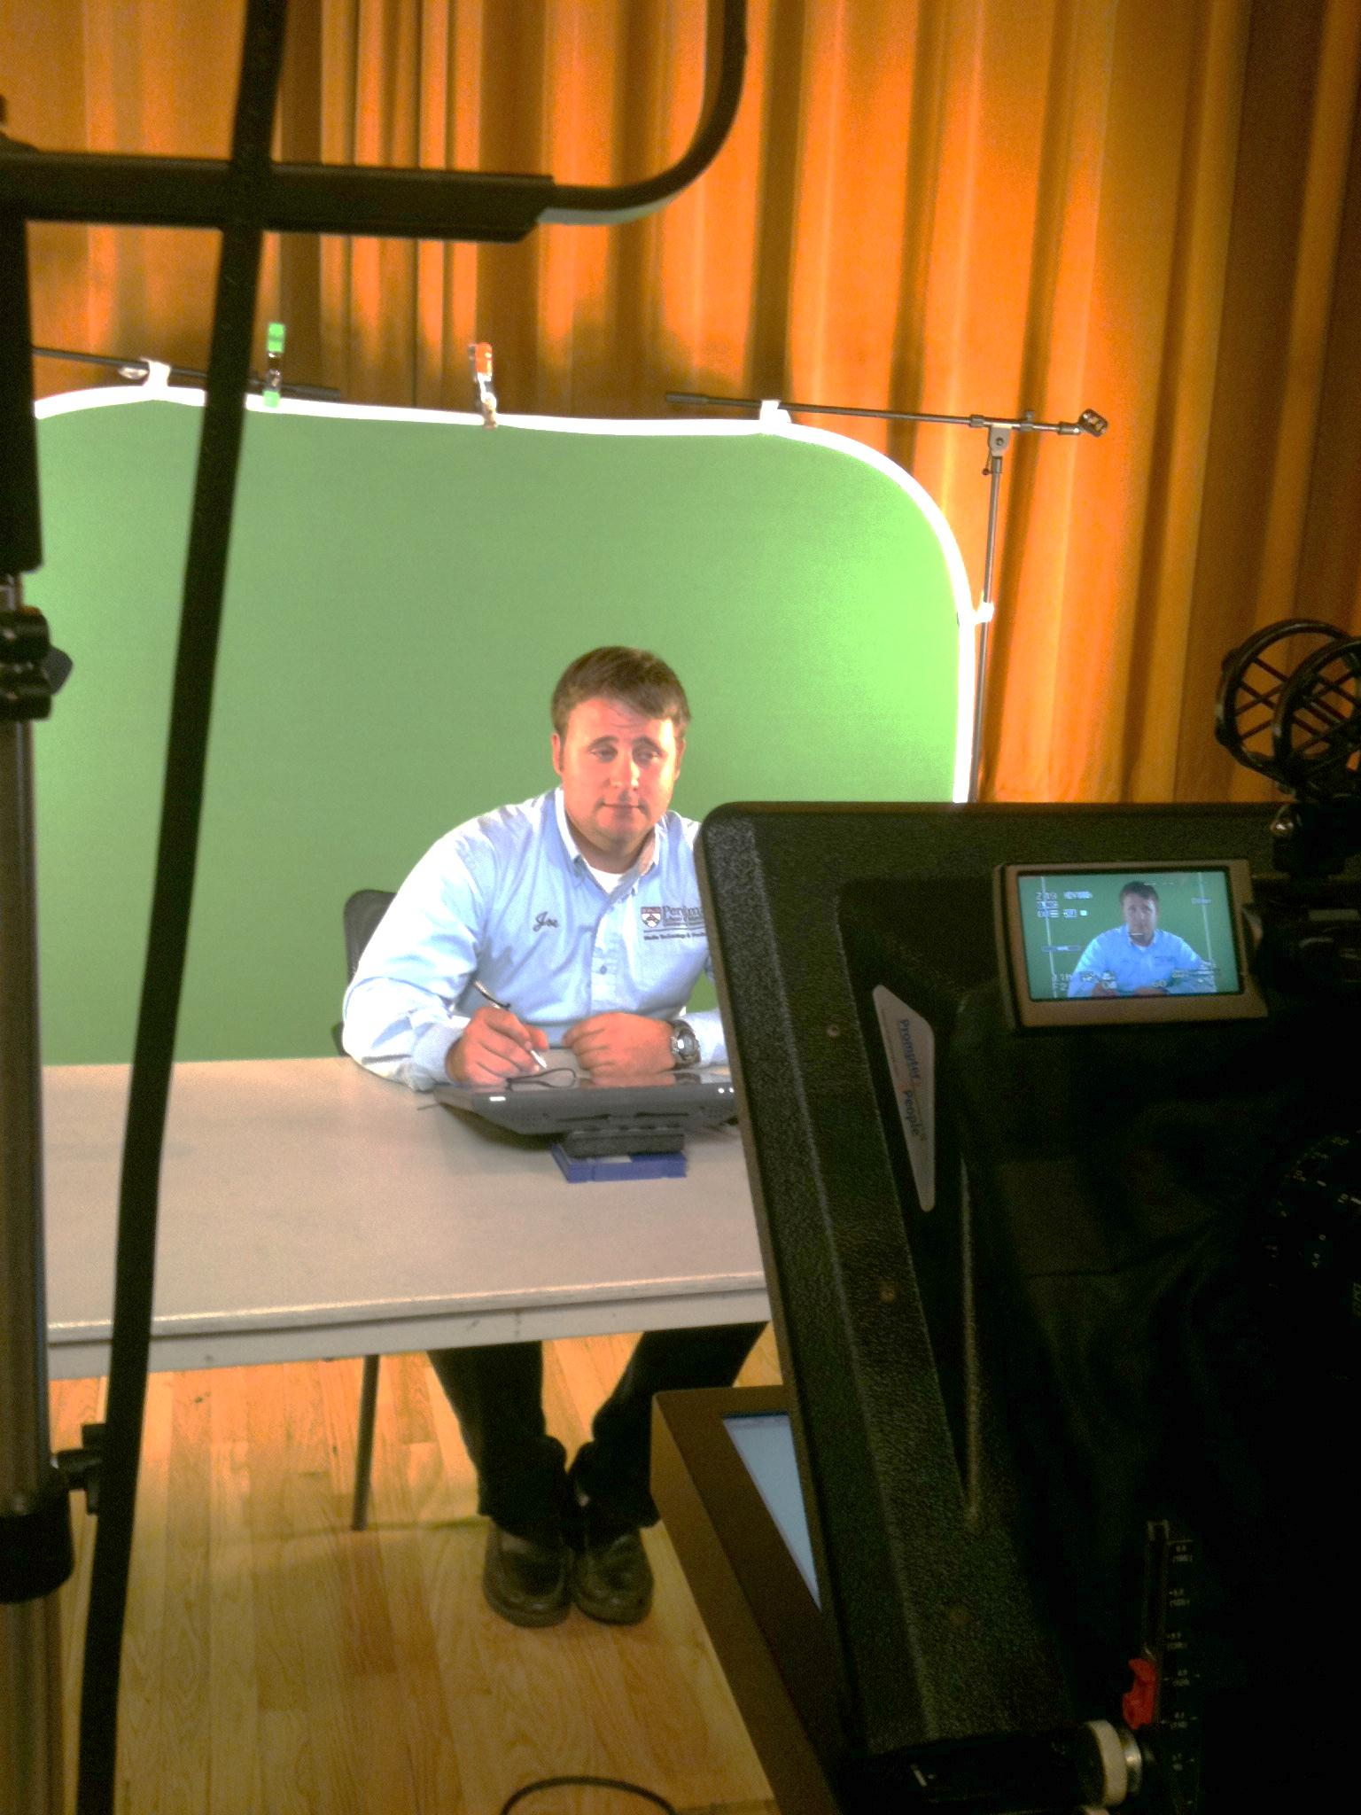
in studio with green
screen and teleprompter

Slide 12
Recording Options
Do-it-Yourself…In a Studio….On Location

Slide 13
taped, double hi-tech
camera
roundtable discussion

Slide 14
outdoors, fixed
setting
single camera on tripod fixed setting

Slide 15
Editing
Do-it-Yourself…Bring in the Experts

Slide 16
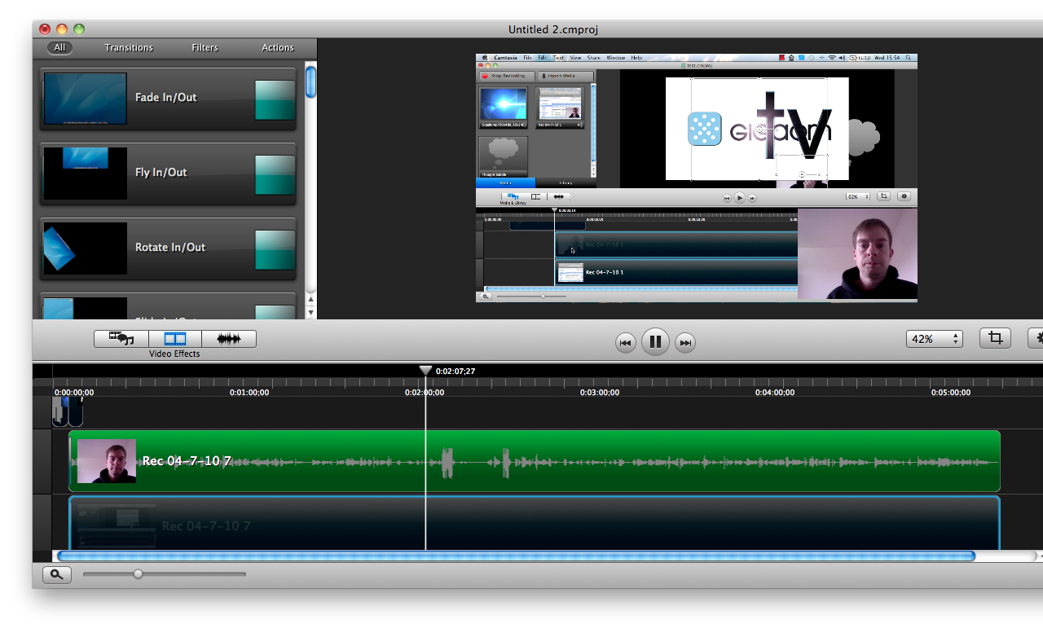
simple but robust editing program on your computer

Slide 17
self-service video and audio editing at library media lab

Slide 18
Editing
Do-it-Yourself…Bring in the Experts

Slide 19
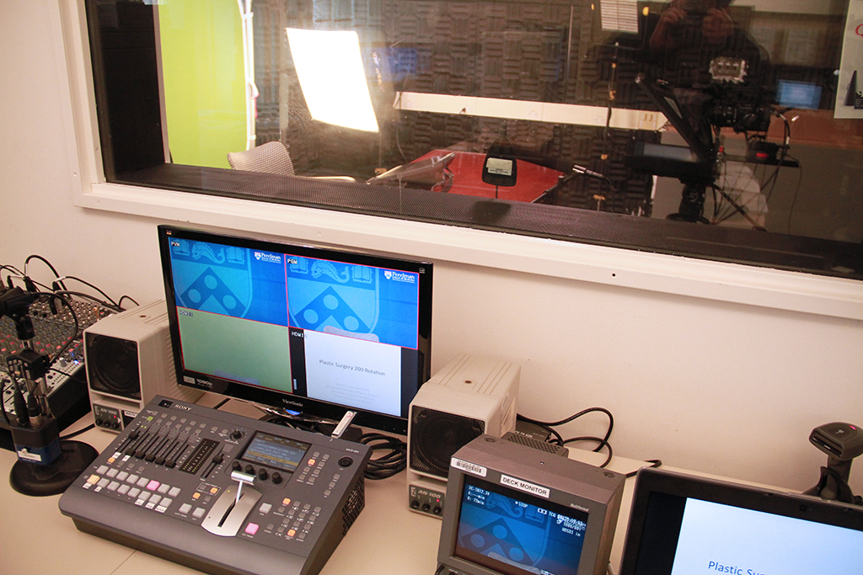
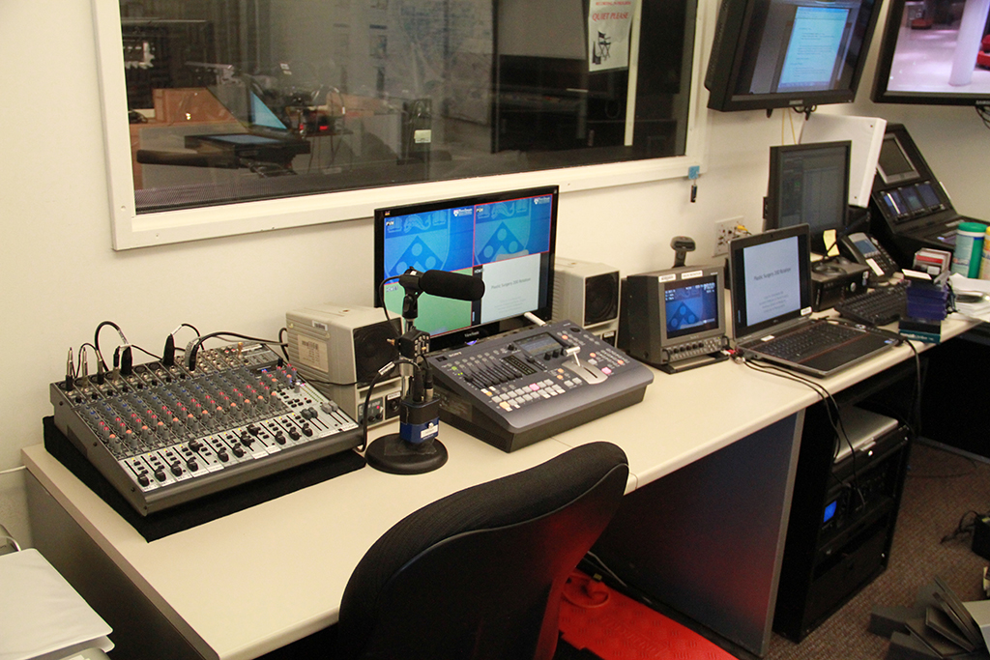
experts at your school’s production studio

Slide 20
anything you can imagine

