Slide 1
New Opportunities for Librarians Marjorie Hassen Lynne O'Brien Sarah Bordac Jennifer Dorner
MOOCs
& Libraries
Massive Opportunity or Overwhelming Challenge?

Slide 4
MOOCs and the Duke Libraries
Lynne O’Brien
Director, Academic Technology & Instructional Services
Duke University Libraries
OCLC 3/19/13

Slide 5
Why should libraries care about MOOCS?
Disruptive to teaching & library models
Externally driven
Rapid uptake
Seem contradictory to what we know
Fast changing
Happening in an environment of rising costs and questions about educational quality

Slide 6
MOOCs at Duke
11 courses developed and taught in 2012-13 (2 re-launched so far)
13 Duke faculty (and 1 UNC) from 13 departments and 5 schools
623K (non-unique) registrations across all Duke courses
Significant positive feedback
Rapidly changing technology and educational models
Notes:
Goals:
1. Drive teaching innovation at Duke because we are very free to experiment in this environment;
2. share knowledge in service to society;
3. reach a global audience, consistent with Duke’s goal of being a global educational institution and
4. showcase Duke’s excellent faculty and programs.
Fast moving: Signature Track, ACE credit recommendation, Gates Foundation funding all in last six months. Duke courses first to try Signature Track and in first cohort of courses for ACE.

Slide 7
Duke Coursera MOOCs 2012-13
https://www.coursera.org/duke
Notes:
Courses in humanities, social sciences, science, health sciences, engineering
Largest enrollment = 180K in Philosophy course
We have 20 proposals for the coming year, and they also reflect a variety of subject areas and schools not in first group

Slide 8
Duke Coursera Students’ Locations
Europe – 31%
Northern America – 37%
Asia - 16%
Latin America and the Caribbean – 10%
Africa – 2%
Oceania – 3%
Notes:
Sidenotes:
--Student demographic summary data across these courses based on ~53,000 pre-course survey responses.
--China: the number of survey responses from China is 487, approximately 1 percent (0.93 percent) of all survey responses.
______________________________
Notes:
--Using UN standard geographical regions and sub-regions, we see the distribution of survey responses from among registrants for our first 5 Duke Coursera courses to have the following distribution [CLICK]
CHINA likely to increase because of technical improvements on network bandwidth
AFRICA constrained by tech infrastructure; materials are not as well adapted to mobile phones as they need to be

Slide 9
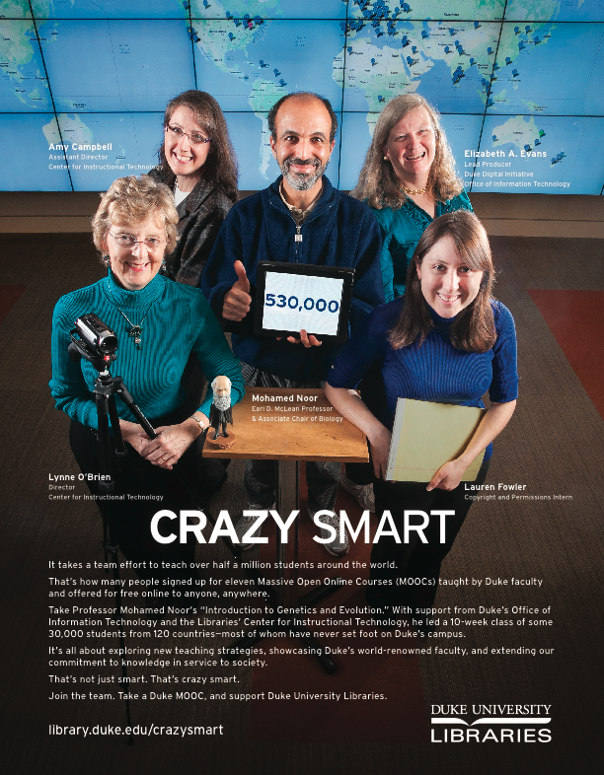
Library:
Center for Instructional Technology consultants & tech support
Librarians
Scholarly Communications intern
Assessment specialist
Liaison to OIT, Provost’s Office, other groups
Notes:
Librarians have offered:
Locating sources of open educational resources (OERs) and other appropriate resources to include in Coursera course materials,
Creating tutorials (screencasts or webpages/LibGuides with screenshots) to help Coursera students locate OERs,
Creating LibGuide(s) with links to freely available websites/tools (e.g., Zotero, Mendeley, Citing Sources), OERs and tutorials,
Showing how to link LibGuides to the Coursera class,
Providing step-by-step instructions for posting materials to Duke’s Institutional Repository so these resources may be included in your Coursera course materials .

Slide 10
Student feedback
Dearest, dearest Prof Barr, thank you for the wonderful exploration stage you set for us all! It has so much color and texture and warmth it is hard to imagine it all took place in a virtual world ! As far as I'm concerned, it is a life changing experience. Thank you ! – Bioelectricity student
Prof. Noor … has demonstrated to us that Duke is home of the most excellent academics and also the most caring and kind. Duke University Biology Department will forever be (in my mind) as the best in the world.
– Genetics & Evolution student
The best part of the course for me is that I have also been able to enjoy watching the videos with my children. When we look up at the stars at night I can tell that they have been listening and learning along side me. For that I want to again express my heartfelt thanks to Dr. Plesser. – Astronomy student
Notes:
Deep appreciation for the instructor and the opportunity
Admiration for Duke
Prospective students (and parents of prospective students) are checking out Duke
Extending Duke’s global reputation and connections

Slide 11
Faculty feedback
“Amazing fun. It’s addictive.”
“Took more time than I thought”
“Needed a lot of help”
“Feedback from students and from faculty in the course gave new insights on teaching”
“Surprised at high level of student interaction”
“Definitely want to do it again”
Read Dr. Mohamed Noor’s description of his experience: http://science-and-food.blogspot.com/2012/12/teaching-massive-online-class.html

Slide 12
Looking ahead
Experimenting with for-credit courses that have some of the same library challenges as MOOCs
Additional 15 – 20 MOOCS next year
Shifting to more experimental models
Promoting open access publishing and use of open access materials
No boundaries between course, textbooks, library resources, learning activities
Notes:
Life long - What if universities really treated learning as a life long endeavor [mention Duke senior going to med school, grandfather, and current doctor all taking courses – implications for curriculum? Mention students exposed to all kinds of backgrounds and age groups as regular part of education
Global – mention backgrounds of students in Tokyo
Social - show meet up groups
Iterative and data driven - teaching of course improves, course materials improve, students taking courses more than once as a routine activity
Embedded – textbooks, library resources, scholarly publishing, video lectures as embedded in the teaching experience, with no clear boundaries between them
Open – teaching more visible, faster push for creation and use of open access materials, push for open access to syllabi, course evaluations
Experimental – We don’t expect everything we are doing now to be a success or to last. There is still a lot that we don’t know, so one prediction is that we can’t predict what all the outcomes will be.

Slide 13
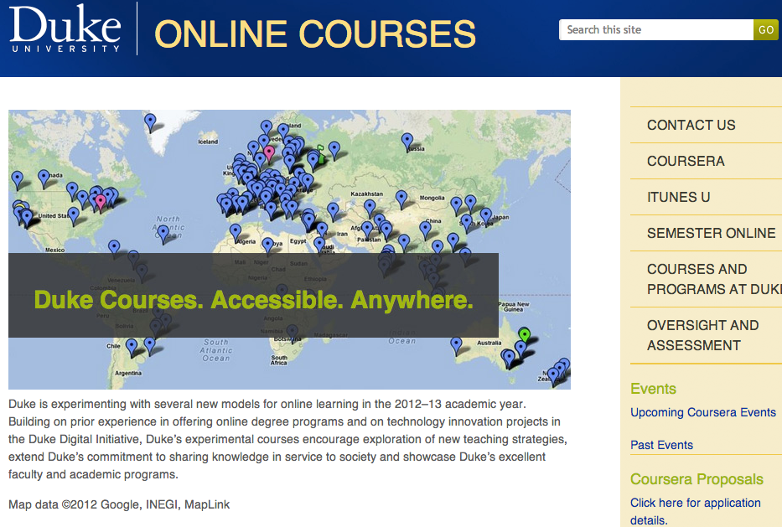
onlinecourses.duke.edu

Slide 14
Coursera
3 Courses
Flipped Classroom
Microeconomics
Canvas Network (MOOC)
Engineering
Pre-College Online Courses
Online
Credit-Bearing
Non-Fiction Creative Writing
Blended
Executive Masters in Healthcare Leadership

Slide 16
Coursera: Cross Campus Team
Center for Teaching and Learning
Continuing Education
Media Production Services (CIS)
University Library
Multidisciplinary collaboration
Dialogue informs strategic vision for online learning

Slide 17
Library Roles
Negotiation with Publishers
Fair Use Consultant
Public Domain Image Recommendations
Digital Production Services
Teaching Spaces
…all hands on deck

Slide 18
Online education at
Berkeley
UC Berkeley Extension
UC Online Education (UCOE)
Summer Sessions
Professional Schools
BerkeleyX

Slide 19
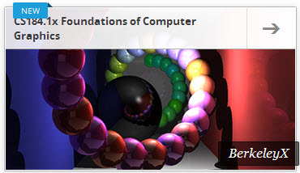
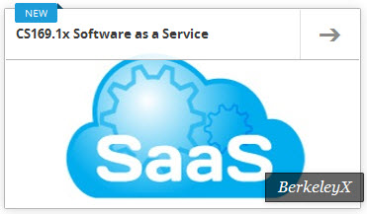
BerkeleyX courses
CS169.1x: Software as a Service (EECS)
CS169.2x: Software as a Service 2 (EECS)
CS188.1x: Artificial Intelligence (EECS)
CS 184.1x: Foundations of Computer Graphics (EECS)
STAT2.1x: Introduction to Statistics: Descriptive Statistics (Statistics)
CS191x: Quantum Mechanics and Quantum Computation (EECS)

Slide 21
Research Skills Working Group
Mary Frances Angelini, Harvard
Jennifer Dorner, UC Berkeley
Cody Hennesy, UC Berkeley
Sandra Hussey, Georgetown
Ramona Islam, Harvard
Deb Morley, MIT
Michele Ostrow, UT Austin
Mark Szarko, MIT
William Wheeler, Georgetown

