Slide 1
Social Metadata for Libraries, Archives & Museums (LAMs)
#sm4LAMs
Karen Smith-Yoshimura
OCLC Research
smithyok@oclc.org
Marja Musson, IISH (Amsterdam)
Ken Varnum, U. Michigan
Cyndi Shein, Getty Research Institute
Cheryl Gowing, U. Miami
Elizabeth Yakel, U. Michigan School of Information
9 March 2012

Slide 2
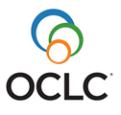
What?
User-generated content that helps us
understand and evaluate the resources
described by libraries, archives and museums.
Includes:
annotations, audio, comments, images, links, lists, ratings, recommendations, reviews, tagging, text editing, video

Slide 3
Why?
The OCLC Research Library Partnership eager:
to take advantage of users’ expertise to enrich their descriptive metadata.
to expand their reach into user communities.

Slide 4
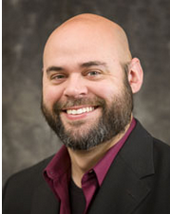
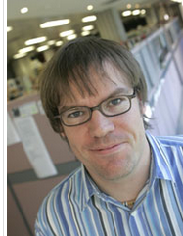
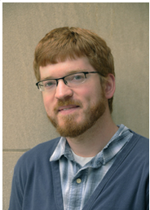
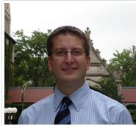
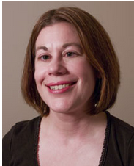
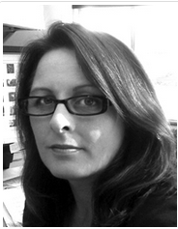
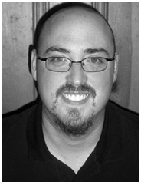
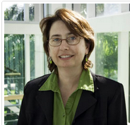
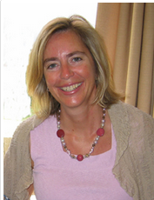
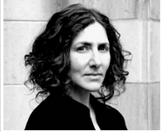
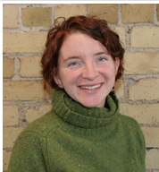
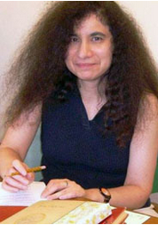
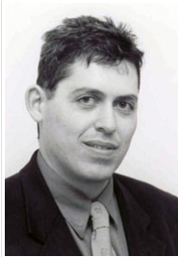
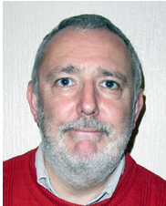
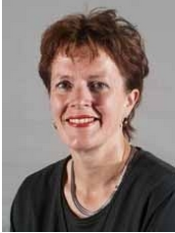
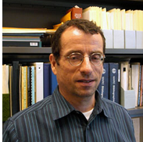
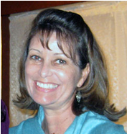
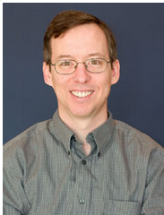
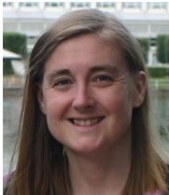
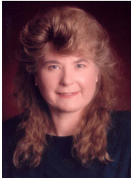
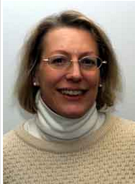
Who? Social Metadata WG
http://www.oclc.org/research/activities/aggregating/group.htm
Notes:
The Social Metadata Working Group comprised 21 OCLC Research Library Partner staff in five countries and 21 time zones. You can see their brief biographies at the URL shown here.

Slide 5
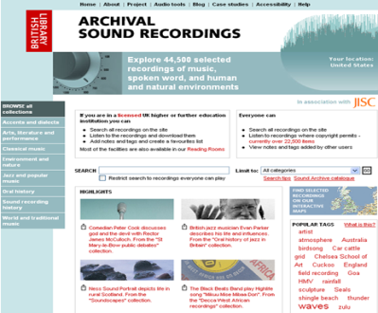
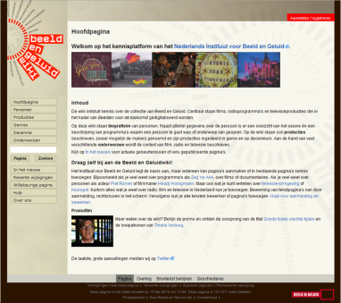
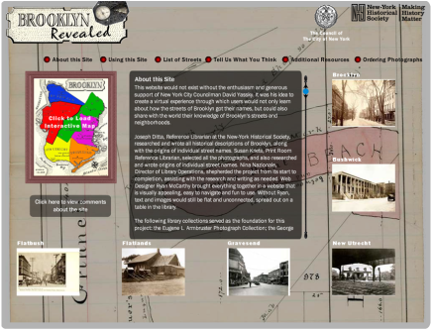
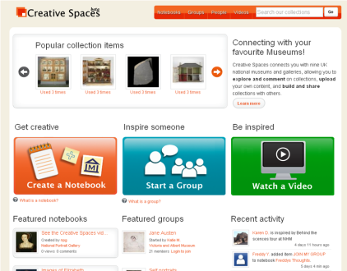
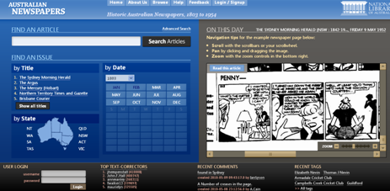
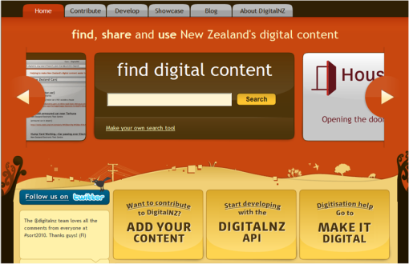
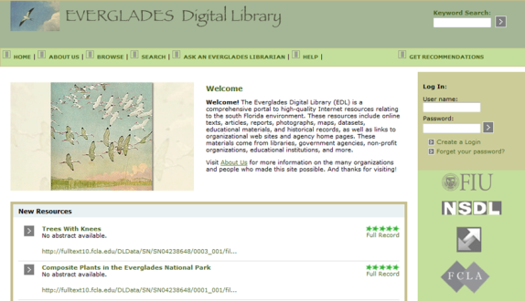
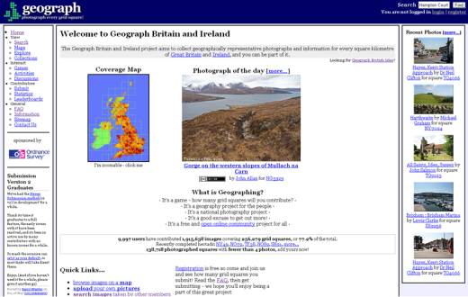
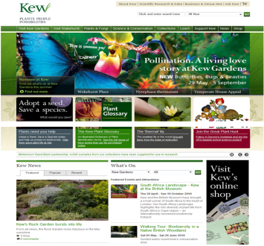
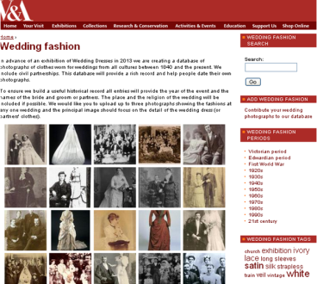
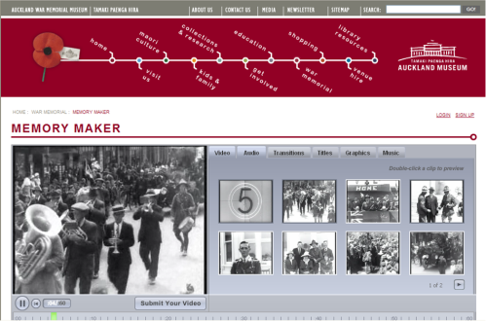
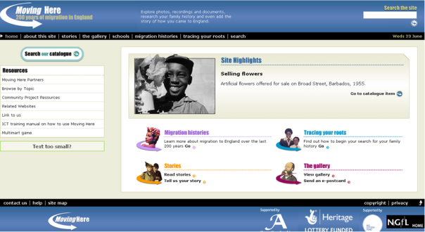
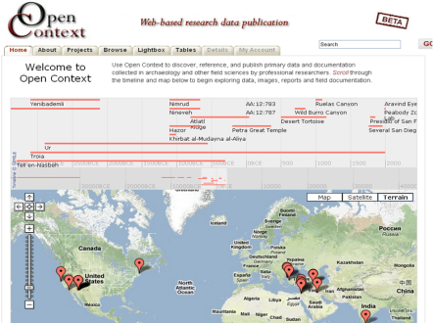
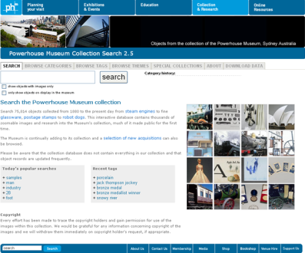
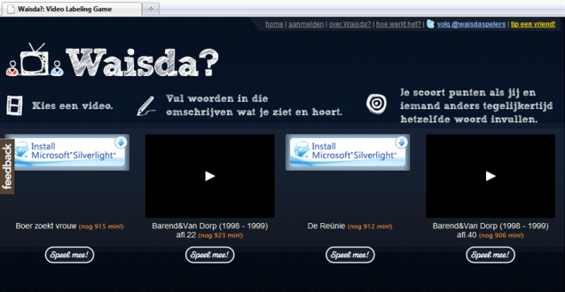
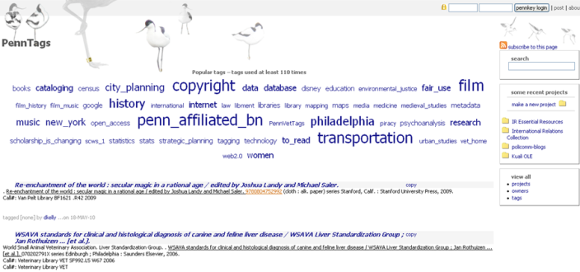
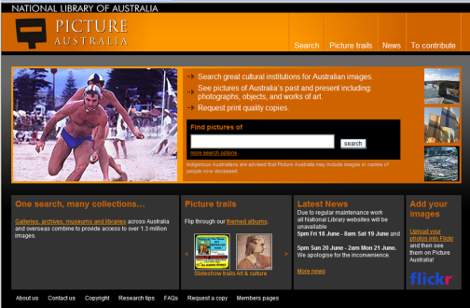
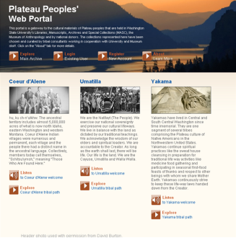
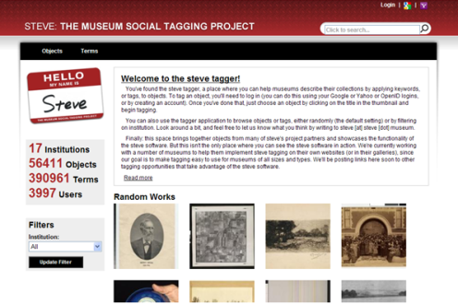
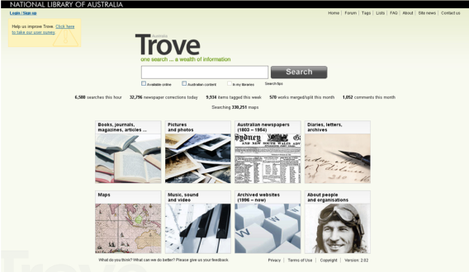
How? (1) Site reviews
Notes:
The working group reviewed 76 sites relevant to libraries, archives and museums that supported social media features. 20 of them are pictured here, from our first report.

Slide 6
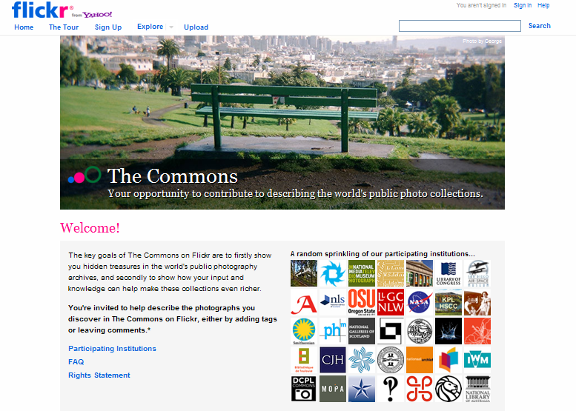
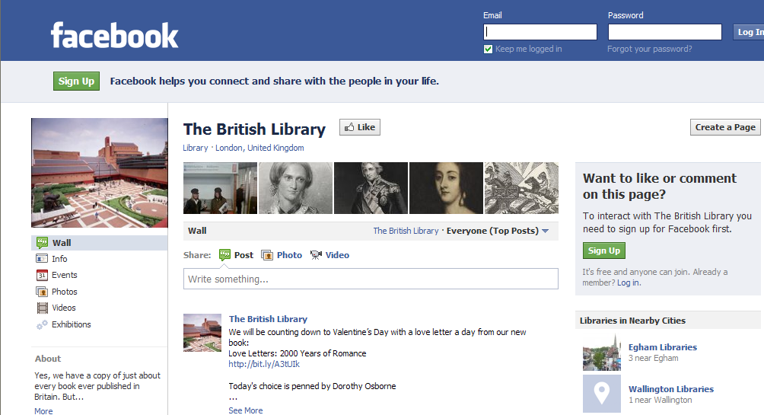
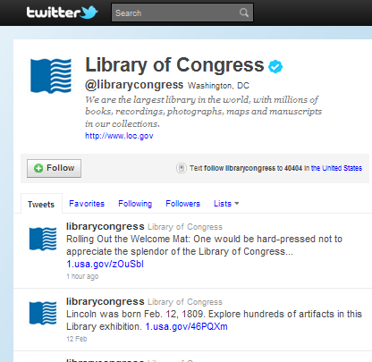
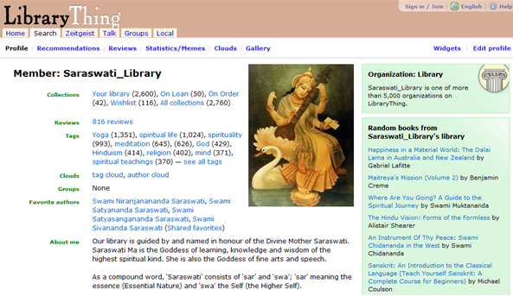
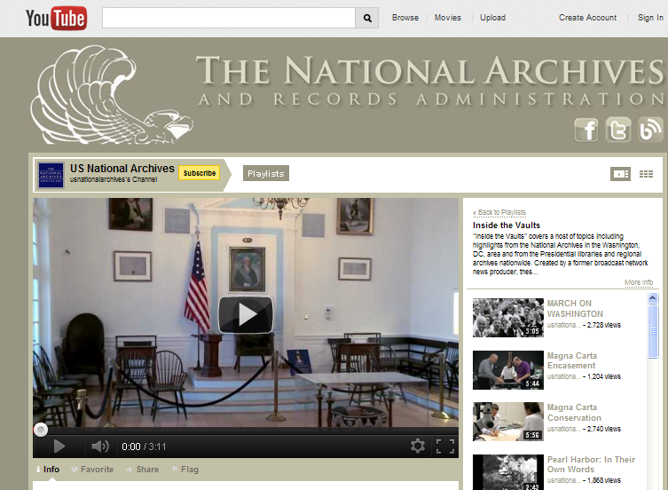
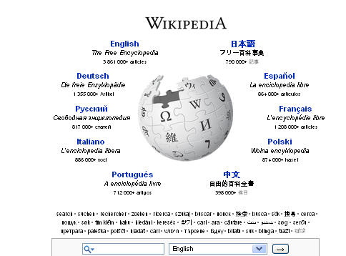
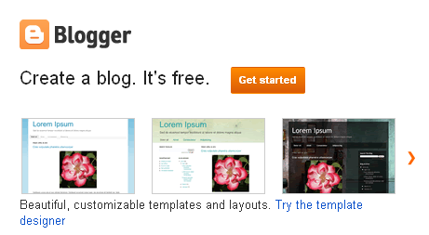
How? Look at 3rd party sites

Slide 7
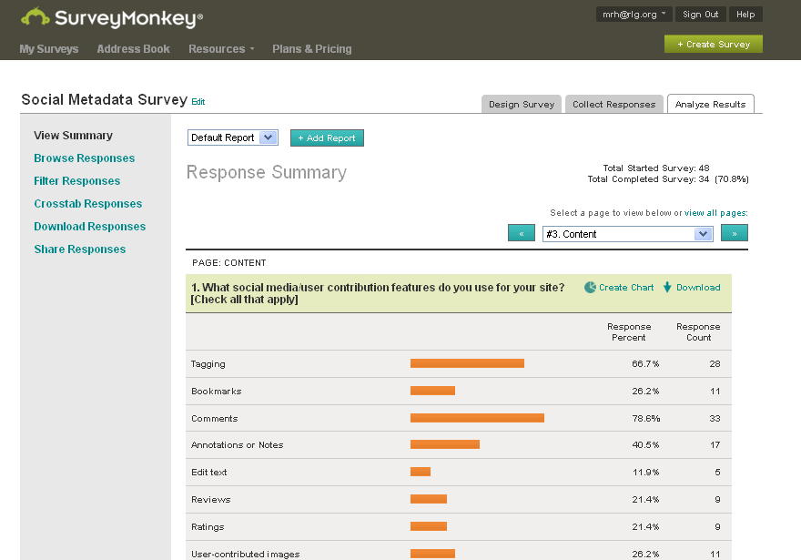
How? (2) Conduct survey

Slide 8






How? (3) Read and watch
Notes:
We read articles, reports, and blog postings and watched videos or presentations. The annotated reading list in our third report has almost 200 items.

Slide 9
Results
Three reports and executive summary
18 recommendations
See: Sharing and aggregating social metadata
www.oclc.org/research/activities/aggregating
“We believe it is riskier to do nothing and become irrelevant to your user communities than to start using social media features.”

Slide 10





Presenters
Marja Musson
International Institute of
Social History
Ken Varnum
U. Michigan
Cyndi Shein
Getty Research Inst.
Elizabeth Yakel
U. Michigan
School of
Information
Cheryl Gowing
U. Miami

Slide 11

Observations on our research
Marja Musson
International Institute of
Social History (Amsterdam)
Social Metadata Working Group

Slide 12

Example: Waisda?

Slide 13
WAISDA
Waisda?
Started: 2008-2010
Partners (Free University of Amsterdam a.o.)
Goal: Improve access to audiovisual material
How: Add tags to videos while watching, listening and playing (with other players)

Slide 14

Successor: Woordtikkertje

Slide 15
Motivate users and leverage their enthusiasm
Design

Slide 16

Motivate users and leverage their enthusiasm
2. Clear goals
Motivate users and leverage their enthusiasm
On the website: “Play Woordentikkertje and improve the searchability of the archive of Man bijt Hond ”
On the weblog: Video explaining the research goals of the university

Slide 17
3. Easy and fun
Motivate users and leverage their enthusiasm
Motivate users and leverage their enthusiasm
Popular television programs
“Playing Wordfeud or Woordtikkertje”
More players at the same time = more fun
Rewards
Clear explanation of rules
Screenshots how to start and play your first game

Slide 18
Motivate users and leverage their enthusiasm
4. Reliable
Rules for players
Log in account
Profile of players visible

Slide 19

5. Intuitive, interesting
Motivate users and leverage their enthusiasm
Trigger the interest of user
What’s there to discover?

Slide 20
6. Topical
Motivate users and leverage their enthusiasm
Clear for potential user/community
Clear for LAM: where to find potenial user/community

Slide 21
7. Acknowledgement, reward
Motivate users and leverage their enthusiasm
Ranking
Prizes to win (every week, month)
Meeting first players at the Institute of Sound and Vision
Possibility for user to give feedback and add ideas for improvements

Slide 22



8. Community building I
Motivate users and leverage their enthusiasm
Facebook
RSS Feed
Weblog
Twitter
Newsletter

Slide 23
8. Community building II
Motivate users and leverage their enthusiasm
Messages: “Already 430,387 tags added and 240,617 matches made”
Number of players online
Ranking, own score and statistics during game
Possiblity to give feedback (and see what others already mentioned)
Make your website known on relevant websites (where potenial users can be found)

Slide 24

Personal observations
Bush

Slide 25


Be aware of the speed of developments!
prepare yourself
and prepare your staff!
THANK YOU

Slide 26



Tagging, crowd-sourcing, and other uses of social metadata
Ken Varnum
University of Michigan
@varnum
facebook.com/varnum

Slide 27
My Interest in Social Metadata
Grew out of our experiment in social bookmarking
  Modeled after Delicious
  Added to catalog items, library web pages, images in digital collections
  Used by faculty, staff, students, librarians
  Hoped to learn user-focused ways to categorize library stuff
Outcomes
  Didn’t get a lot of use. In 4 years:
    88,000 items
    9,300 tags
    8,300 users
  BUT 80% of items (72,000), and 75% of users (7,000) came at it through our catalog’s ‘favorites’ tool

Slide 28
Favorites gathering more use
Launched a new favorites tool in October 2011
More than 3000 items saved for later (excluding catalog)
More than 700 different users
An average of 30 items added by 15 users per day

Slide 29
Didn’t use social metadata to enhance discovery
User tags were placed on the page, but not part of the page. Why?
Analysis of tags showed that users generally applied tags that already were on the page.
  Some catalog items tagged with course names/numbers
  Intended use was a minority theme (to read, for class, no good)
Tagging was very sparse so would not have provided consistent additional metadata
Lack of controlled vocabulary (no suggested terms) off-putting to some librarians
61% of surveyed sites included user content in indices

Slide 30
Lessons learned
Our model based on idea that people would “tag selfishly, think globally”.
Our academic users did neither
Our tool was built to share tags, not let scholars organize their research
“Tagging” is an altruistic act
“Favoriting” is a personal act
New model for same function is based on saving library resources for later use and (maybe) enable sharing of resource lists later on

Slide 31

Islamic Manuscripts Project
CLIR-sponsored, Mellon-funded crowdsourcing effort
Improve cataloging of these important resources
Built on “CommentPress” – a WordPress derivative
Viewed as successful model
Notes:
Take poorly-cataloged manuscripts from 13th-18th century Islamic world and ask Islamic scholars to tell us what they are
Process
Manuscripts are digitized
Catalogers create bare-bones records
Catalog information and digital image are presented on a page
Experts (self-identified) from around the world look at manuscript and can comment on any of the available MARC fields
Catalogers reviewed comments and updated the catalog records
Sometimes went through a second round

Slide 32
Lessons learned
Crowdsourcing cataloging can work
Clearly identifiable “crowd” helps
Local review of contributions made library staff confident in quality

Slide 33











LAMs’ use of third-party sites
Cyndi Shein
Getty Research Institute
Notes:
Thank you, Ken.
When the Social Metada Working Group was forming in late 2008, I had just begun exploring the many uses of Web 2.0 and was inspired by the University of Michigan’s Polar Bear Expedition Digital Collections Experiment, the Beinecke's Room 26 Cabinet of Curiosities blog, and Steve, the collaborative museum social tagging project.
I joined this working group to learn more about different ways LAMs might effectively engage their communities via the web and which of these efforts provide a good return on investment.

Slide 34
Social metadata social media
How did our research on social metadata expand to include the study of social media and other third-party sites?
Most of the institutionally-based sites were only attracting moderate user participation.
Popular sites were attracting a great deal of participation.
Notes:
As Karen mentioned, we began our research by reviewing sites with social media features that were created and administered by LAMs.
While there were some real stand-outs in the sites we reviewed, many of the sites were very young and had not yet gained momentum or developed a strong user-base.
How did our research of social metadata expand to include the study of social media and third-party sites?
Fairly early in our research we began to notice that regardless of how fascinating their content was or how many bells and whistles they had, most of the institutionally-based sites we looked at were only attracting moderate user participation. Sadly, the notion "If you build it they will come” did not prove true.

Slide 35
Social metadata on popular sites
While projects such as PennTags and Mtagger were struggling to attract participants, users of sites like LibraryThing and Good Reads were tagging books by the millions.
What can we learn from third-party sites?
How are LAMs leveraging the popularity of blogs, LibraryThing, Flickr, YouTube, Facebook, Twitter, and Wikipedia?
Notes:
Ken has mentioned Mtagger’s challenges; the working group found these challenges were not unique. We found that while projects such as PennTags and Mtagger were struggling to attract participants, users of sites like LibraryThing and Good Reads were literally tagging books by the millions.
That prompted us to ask ourselves what we could learn from third-party sites and to look at how LAMs were leveraging the popularity of blogs and various social media sites.

Slide 36

Lessons learned
Notes:
Through our research we learned that LAMs are using several different third-party sites and social media platforms for various purposes. In Report 1 we provide examples of typical as well as very innovative uses of these platforms. We also discuss some of the reasons an institution might select one tool over another.
While we learned a lot collectively as a working group, I also gained a great deal of personal insight through our research.
Image:
Teacher, Lorraine Lapthorne conducts her class in the Grade Two room at the Drouin State School, Drouin, Victoria
Fitzpatrick, Jim, 1916-
Part of the collection: Drouin town and rural life during World War II.; Inscriptions:"U429/19" --In pencil on verso.; "U429/19. 212 children are taught at Drouin State School by six teachers - five of them women. School, a modern building, is the third building to house students since 1900. conveniences such as sewing machine, radiators, decorations, piano were provided by a committee of parents. ..."--Printed on label; Also available in an electronic version via the Internet at: nla.gov.au/nla.pic-an24229822. Teacher is Lorraine Lapthorne, front row 3rd from left: David Pollard, John Boyd. 2nd row: 1st from left; Robyn Butterworth, 6th from left: Chris Parsons, 3rd row: 2nd from left, Frank Murray, Back row: 2nd from left; Joan Black.
Persistent URL nla.gov.au/nla.pic-an24229822

Slide 37
Lessons learned
Don’t reinvent the wheel
Look before you leap
Keep your finger on the pulse
Notes:
In thinking back on our site reviews, survey, and conversations with different institutions, the lessons I learned personally can be summed up by three American idioms:
Don’t reinvent the wheel
Look before you leap
Keep your finger on the pulse

Slide 38

Don’t reinvent the wheel
Notes:
The first lesson I learned is that you don’t have to reinvent the wheel. If you're considering creating a blog or using a third-party social media site, survey the current profiles of various organizations to see how others are using these tools.
Image: http://www.flickr.com/photos/powerhouse_museum/2821106432/
Workman posed with Noakes patent composite wheel,
Format: Glass plate negative.
Rights Info: No known restrictions on publication.
Repository: Clyde Engineering Photographic Collection, Powerhouse Museum www.powerhousemuseum.com/collection/database/collection=Clyde_Engineer ing_Photograph
Part Of: Powerhouse Museum Collection
Persistent URL: http://www.powerhousemuseum.com/collection/database/?irn=367803
Acquisition credit line: Gift of Clyde Engineering Pty Ltd, 1988

Slide 39
Survey the landscape to see how others are using blogs and social media sites to:
Build user communities
Share collection content and promote special events
Harvest user-contributed images and metadata for incorporation into their own websites
Create interactive walking tours/maps featuring historic collection images
Bring historic news, diaries, and correspondence to life by delivering info chronologically as a serial
Display user-generated metadata in OPACs alongside LC headings
Notes:
Build upon the experiences of others.
As you explore the web, you will discover institutions using social media sites to accomplish goals such as those listed here.
Find a site that reflects some or all of your objectives then be creative! Customize the platform to suit your specific needs.

Slide 40

Look before you leap
Before you jump headlong into the social media arena
Identify a clear goal
Survey available resources
Create a plan
Notes:
The second lesson I learned is to look before you leap, that is not to let your enthusiasm for the “latest thing” rush you into a project that doesn’t serve a real purpose at your institution.
If you're thinking about engaging your user community through social media, you shouldn't do it just because that's what all the cool kids are doing…you've got to have a specific reason for using these tools. Your objective and your available resources will, in large part, determine which tool (or combination of tools) you use. The next step is to create a viable and sustainable plan.
Image: http://www.flickr.com/photos/nationaalarchief/3586139080/in/set-72157619017241107/
Nationaal Archief of the Netherlands
Zweefduik / Swallow dive
Spaarnestad Photo, SFA002002452
Collectie SPAARNESTAD PHOTO/Het Leven
Seaside life. Man standing ready to catch a woman coming down with a swallow dive. Photograph from the Dutch illustrated magazine 'Het Leven' (bathing issue), 1937.
Voor meer informatie en voor meer foto’s uit de collectie van Spaarnestad Photo, bezoek onze Beeldbank: www.spaarnestadphoto.nl/

Slide 41
Plan must consider...
Who is your audience?
What type of content will you deliver?
What type of user contribution do you seek?
What will you do with the user contribution?
What is your exit strategy?
How will you define and measure success?
Notes:
In Report 3 we recommend you ask yourself some important questions during the planning phase, some of which are listed here. One of the most challenging questions to answer is:
How will you define and measure success?
Before you begin a project you should decide how you will gather and evaluate both quantitative and qualitative data related to your efforts. This evaluation will help you determine if the endeavor is worth continuing.

Slide 42



Measuring success
Portrait of Ruth Nomura
Notes:
To address the complexity of measuring success, Oregon State University (OSU) Special Collections and Archives provided the working group with examples of user contributions to OSU images on Flickr.
A user named "VintagePix" commented on this OSU image of Ruth Nomura, whose name was originally misspelled on their Flickr site and in the archival record. VintagePix corrected the misspelling of Nomura’s surname and provided biographical information from the 1928 census and Social Security Death Index.
OSU staff used this user-generated contribution to correct their records. The corrected spelling of Nomura’s name led the OSU Archives to identify Nomura in their own 1930 yearbook and to discover that she was a local figure of some importance. This connection led them to additional resources that were helpful to their researchers.
User contributions that are this rich in content are rare. How much weight do they carry when you are measuring success? Beth Yakel will also touch upon this issue later in our presentation.

Slide 43

Keep your finger on the pulse
Notes:
The third lesson I learned is to keep your finger on the pulse of what's going on in your own profession, in your user community, and in the world of social media. New sites, platforms, and tools are popping up all the time. It’s important to stay informed.
Image:
TITLE: Washington, D.C. A Red Cross nurse's aide taking a patient's pulse. Women between 18 and 50, who volunteered like this one for the 80-hour training course and 150-hour yearly service in hospitals, help to relieve the nurse shortage
CALL NUMBER: LC-USW33- 042510 [P&P]
CREATED/PUBLISHED: 1942 Mar.
NOTES: Image source: U.S. Navy. Transfer; United States. Office of War Information. Overseas Picture Division. Washington Division; 1944.
PART OF: Farm Security Administration - Office of War Information Photograph Collection (Library of Congress)
REPOSITORY: Library of Congress Prints and Photographs Division Washington, D.C. 20540

Slide 44



Interesting developments
Notes:
As far as new social media sites are concerned, I’d like to point out that several interesting developments have come to our attention since the working group concluded its research in the spring of 2010. Among them are Google+, Pinterest, and Historypin.

Slide 45


Notes:
Google+ is a social networking site that was launched in June of 2011.

Slide 46


Notes:
Many LAMs have created Google+ profiles, but Google+ has yet to reach critical mass as far as social networking sites are concerned.

Slide 47



Slide 48

Notes:
Pinterst is a relatively new site designed for sharing and collecting images and ideas. Pinterest users copy images from all over the web to create groups of images on “pinboards,” which are displayed as virtual bulletin boards.
Individual images can (and should) be linked to their site of origin, directing users to the institution’s website.
The Indianapolis Museum of Art is one of a few LAMs currently experimenting with Pinterest. The museum has created thematic pinboards, featuring items from its collections.

Slide 49

Notes:
The Darien Library in Connecticut has created a Pinterest profile, including various boards with book-related themes.

Slide 50

Notes:
The Darien has also has added the “Pin it” button to the social media features in its library catalog.

Slide 51
Notes:
This enables a Pinterest user to directly pin images of audio, video, and books from the Darien OPAC to their own boards.

Slide 52


Notes:
Booklovers with profiles on Pinterest can pin images directly from Darien Library’s catalog to their own boards and can also re-pin images from the library’s Pinterest boards to their own boards.

Slide 53

Notes:
The final site I’d like to share is Historypin, a site for sharing historic visual material within its geographic context. This tool asks users to "pin" their own digital audiovisual and photographic materials to a world map. Participants are encouraged to add descriptive information and personal recollections associated with the materials they contribute.

Slide 54

Managed by:
“We are what we do”
Notes:
Historypin is managed by the British nonprofit project “We Are What We Do” in partnership with Google. The site is designed to be an online, user-generated archives. Naturally, LAMs are among the community of users who are creating tours and collections and contributing historic materials.

Slide 55


Notes:
This is a screenshot of a “Tour” on Historypin. This particular tour displays various Chinatowns in North America. Users can create thematic tours and collections and open them to public contributions of images and personal narrative.
This screenshot is an example of how user-contributed photos of yesteryear are superimposed upon a current Google map, placing historic photos in context geographically and allowing visual comparison between then and now. The historic image will remain in place, while the background image is interactive and users can scroll in any direction to view the surrounding areas.

Slide 56
Growing possibilities
Notes:
These newer sites have overlapping functionalities with the more familiar sites we reviewed in Report 1; what makes them seem “New” is that they have selected, combined, and presented existing social media features in new ways.
As the number of electronic communication platforms grows, so do our possibilities for connecting with our user communities. As we engage in different forms of communication through our own sites or third-party-hosted sites, it is important to continually re-evaluate our own institutional goals and growth.
The working group conducted a survey that asked managers of websites to do just that; we surveyed LAMs that were using Web 2.0 features, asking them to tell us about where they’d started, what they’d accomplished, and how they envisioned using these tools in the future
Cheryl Gowing is now going to share her observations about the survey and our analysis of it.
Thank you.

Slide 57



Key Points from our Survey
http://thirdfloorwithwaterview.blogspot.com/2010/12/paging-dr-jung.html
Cheryl Gowing
University of Miami
cgowing@miami.edu

Slide 58
What We Originally Wanted to Know..
Objectives & Measures
Administration & Technical prerequisites
Privacy Protections
Folksonomies and/or Taxonomies

Slide 59

What I Wanted to Know…
Moderation
Frequency of Abuse
Best Practices for Policies
Notes:
Library Next-Gen Catalogs – starting to use tagging, rating, [letting the user layer their own meaning]
digital Collections starting to experiment w/ allowing user comments, tags
Flickr Commons [letting user add/improve our understanding of our content]

Slide 60

Sample Sites At-a-Glance
Notes:
Site Reviews revealed widening scope of social metadata
Need to define/categorize types of social metadata
Users Tagging, Comments, Review/Ratings widely used
Some experimentation with user contributed content – uploading images, videos, stories
- Difficult to find policies & administrative information

Slide 61


Slide 62


Slide 63

Normalizing Survey Responses

Slide 64
Key Survey Findings
73% of respondents managed their own site, rather than use hosted services
  Majority using open-source software and/or tools developed internally
  Flexible – but often not shareable
Usability studies done after the fact, rather than as part of development
Use of controlled vocabularies common

Slide 65
Moderation
75% “moderate” user contributions
  Only 10% of maintenance activity devoted to moderation
53% require login/registration before contributing
Spam/abuse not as prevalent as feared

Slide 66
Where Are We Now?
Usability testing incorporated in development and on-going assessment
LAMs increasing interest in hosted/cloud services
Increasing interest in linked data
Notes:
More Libraries integrating services and resources with social media

Slide 67



Slide 68


Shareable Social Metadata on the Horizon

Slide 69

Measuring success
Elizabeth Yakel
University of Michigan
School of Information

Slide 70

My interest in Archives 2.0
Polar Bear Expedition Digital Collections Experiment (http://polarbears.si.umich.edu)
  Comments
  User profiles
  Recommender system

Slide 71

Polar Bear Expedition experience
Success is contingent on larger site goals
Quality versus quantity

Slide 72
Issues of peer production in archives
  “Balancing Archival Authority with Encouraging Authentic Voices to Engage with Records,” in A Different Kind of Web: New Connections between Archives and Our Users with Web 2.0, Kate Theimer, ed. (2011)
  “Who Represents the Past? Enabling Reuse and Re-creation of Digital Objects in Cyberspace,” in Controlling the Past: Documenting Society and Institutions (Essays in Honor of Helen Willa Samuels), Terry Cook, ed. (2011)

Slide 73
Success criteria

Slide 74
Measurement techniques

Slide 75
Type of Activity | Number of Responses | Percentage
Number of comments | 25 | 76%
Number of unique visitors | 22 | 67%
Number of visits | 21 | 64%
Number of user accounts | 19 | 58%
Most frequently accessed content | 19 | 58%
Geography of users | 15 | 46%
Number of tags | 14 | 42%
Domain IP | 8 | 24%
Number of uploads | 7 | 21%
Other | 6 | 18%
Number of downloads | 4 | 12%
User names | 1 | 3%
Number of groups formed | 0 | 0%

Slide 76
Friction
Audiences and community not metadata
Measures capture quantity of engagement
Libraries, archives and museums want to measure quality of engagement

Slide 77
New Measures
Presence of community users who provide feedback to community members
Community participation and driving of content, policy, etc.
Shared responsibility

Slide 78
We can’t measure success only in terms of the institution
We have to measure success in terms of the community

Slide 79
We’ve gotta let go!
The era of control is over: You can either stay in the bunker, or you can try to participate. And to not participate is criminal. (Ed Dilworth, Wired, December 2006.)

Slide 80
Questions? Comments?
Marja Musson: mmu@iisg.nl
Ken Varnum: varnum@umich.edu
Cyndi Shein: cshein@getty.edu
Cheryl Gowing: cgowing@miami.edu
Elizabeth Yakel: yakel@umich.edu
Karen Smith-Yoshimura: smithyok@oclc.org
Social Metadata for LAMs is on Facebook! “Like” it!

