Slide 1
The RLUK/OCLC Survey of Special Collections and Archives in the UK & Ireland Outcomes and Perspectives
Jackie Dooley
OCLC Research
RLUK, Newcastle
16 November 2012
Notes:
Modeled on US/Canada survey published a year ago.
Delighted to be invited to work with RLUK.
Will focus on RLUK data rather than entire UK/Ireland survey population.
Will note comparison with US/Canada results where noteworthy.

Slide 2
Overview
“Big-picture” outcomes
“Major challenges” cited by respondents
Recommendations & commentary

Slide 3
The overarching challenge?
“Demonstrating the value of SC to the University in tough times, and the need for improved engagement with research and learning …”
“Keep pace with and even drive research and academic agenda within the University but also the wider world of scholarship.”
--Survey respondents

Slide 4
Big-picture outcomes
Alignment of special collections with institutional missions and priorities is an ongoing challenge.
The special collections sector is undergoing a major culture shift that mandates significant retraining and careful examination of priorities.
Philanthropic support is limited, as are special collections librarians’ fundraising skills.
Use of all types of material has increased across the board.

Slide 5
Big-picture outcomes, cont.
Management of born-digital archival materials remains in its infancy; upper management must actively support this important work to ensure progress.
Users expect everything in libraries and archives to be digitized; national strategies for digitisation of rare and unique materials are therefore needed.
One-third of archival collections are not discoverable in online catalogues.
Many cataloging backlogs have decreased, while some continue to grow.

Slide 6
“Most challenging issues” *
Outreach (writ large)
Space & facilities
Born-digital materials
Collection care
Cataloging & archival processing
* Based on respondents’ answers to final survey question.
Notes:
Space: lack of for collections, quality of facilities in various ways. Also top challenge in US.
Outreach: seeking broader audience, challenges of being visible, providing excellent service to users.
Preservation: physical. Much higher attention to this than in US other than the challenges of AV and born-digital.
Born-digital: #2 in US.
Digitization: #3 in US.

Slide 7
Project recommendations
Please note that these …
… were initially formulated by the authors and then significantly revised following discussion at the UDC symposium in Aberdeen, March 2012.
… do not entirely reconcile the significantly different perspectives of RLUK directors and special collections practitioners.
… are in rough order of perceived important 1) by section/topic and 2) within each section.
… are not a set of actions officially endorsed by RLUK or intended for RLUK action. (The UDC report forthcoming in March 2013 will fulfill that need.)

Slide 8
Recommendations: Staffing
Analyse the array of duties performed by special collections staff and identify the new skills and expertise needed to move the profession forward in alignment with institutional missions.
Develop a plan to provide educational and development opportunities in areas, both traditional and emergent, in which skills need enhancement across the sector.

Slide 9
Staffing
“Training and acceptance of the changing landscape of special collections.”
“Culture change—shifting focus and priorities of curators, from “back of the house” to “front of house.”
“Keeping up with the ever-increasing and diversifying demands on the service.”
--Survey respondents
Notes:
SCs are labour intensive, e.g. we lack capacity for self service, unique material requires unique description, digitisation leads to alternatives and additions rather than substitutes). This is a key challenge – how can we identify resources for new activities, when we still do the more established ones?
Special collections staff are working in new ways, carrying out new activities. Some of this requires new skills and it certainly needs new attitudes. Survey respondents report the challenge of juggling and balancing the competing demands on their time . The comments about “outreach/promotion [vs] curatorial work”, and “balancing *core* professional demands (such as cataloguing and conservation) and with [outreach] activities” suggest that further culture change is required – to what extent is outreach seen (or not?) as a “core” professional duty by SC staff? And none is this is going to stop – the SC landscape will continue to evolve and we must be agile in responding to further change.

Slide 10
RLUK number of staff
 | Permanent FTE | Temporary FTE | Total FTE
Professional | 11.4 | 3.4 | 14.8
Support | 7.9 | 2.4 | 10.3
Total | 19.3 | 5.8 | 25.1
Mean
 | Permanent FTE | Temporary FTE | Total FTE
Professional | 6 | 1.9 | 7.9
Support | 4 | 1 | 5
Total | 10 | 2.9 | 12.9
Median

Slide 11
RLUK change in number of staff

Slide 12
RLUK change in allocation of staff time

Slide 13
RLUK education and training needs

Slide 14
Recommendation: External funding
Develop a set of arguments to assist institutions with development of external sources of funding in support of special collections.

Slide 15
External funding
“Obtaining funding for core activities, eg cataloguing, as opposed to capital funding for short term projects, is a major challenge.”
“Getting to grips with digitisation priorities is dependent on external funding.”
“Currently in sub-standard temporary accommodation, pending fundraising for new premises.”
“Cataloguing has specifically increased due to project funding.”
--Survey respondents

Slide 16
Recommendations: Outreach & user services
Develop an outreach toolkit, including case studies illustrating best practices, to build skills for presentation, promotion, and engagement with special collections.
Develop pricing models, templates, and shared policies for user-initiated digital scanning to encourage consistency across the sector.

Slide 17
Outreach & user services
“Outreach: promoting the interest and potential of our collections for study and research”
“Lack of awareness of what [special collections] can offer both within the parent organisation and the wider community”
“Keeping abreast with discovery and access technology”
--Survey respondents
Notes:
There is an imperative to exploit SCs. The good news is that use of all types of material in the reading room is increasing (more than half of respondents stated that the use of SC by all types of user has increased over the past decade), but this isn’t enough. We can’t afford to be passive and need to reach out to existing and new audiences. Outreach was the most frequently mentioned challenge. We need to raise awareness of the potential of SCs and to improve access and discoverability.

Slide 18
RLUK presentations
 | n | Number of Presentations | Percent of Total | Mean | Median
College/University courses | 29 | 849 | 37% | 29 | 22
Others affiliated with responding institution | 29 | 288 | 12% | 10 | 6
Local schools | 28 | 219 | 9% | 8 | 2
Local community | 28 | 427 | 18% | 15 | 6
Other visitors | 29 | 529 | 23% | 18 | 10
Total |  | 2,312 | 100% | 81 | 46

Slide 19
RLUK use of social media
Note: Numbers of respondents.

Slide 20
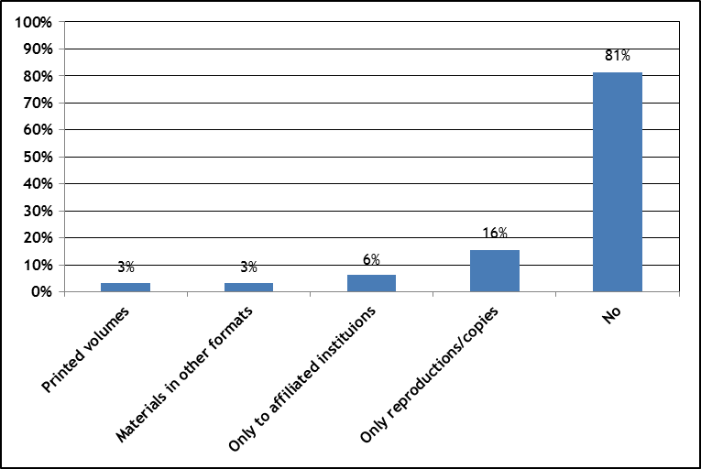
Interlibrary loan
Notes:
Is this at all a priority for RLUK library directors? Huge emphasis on increasing spcoll resource sharing in US.

Slide 21
RLUK average charge for a digital scan

Slide 22
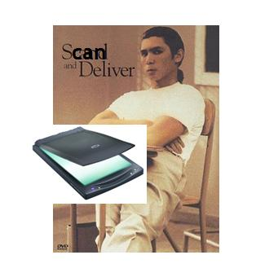
Managing User-Initiated Digitization in Special Collections and Archives
Notes:
"Scan and Deliver“, released last month, ⁹investigates policy issues related to patron-initiated digitization of materials.
Steps in user-initiated digitization – review, decide, scan, and deliver – have a spectrum of tracks for workflow.

Slide 23
Recommendations: Born-digital materials
Define the basic steps involved in initiating a program for managing born-digital archival materials to assist libraries that have not yet begun this work.
Investigate the feasibility of extending broadly across the sector the adoption of successful technical environments for managing born-digital materials that have been developed by a small number of UK institutions.

Slide 24
Born digital
Summary analysis for the U.S./Canada survey:
Undercollected
Undercounted
Undermanaged
Unpreserved
Inaccessible
In the U.K./Ireland: alas, the same.

Slide 25
Born digital
“Until [active collecting] happens, the ability to develop the capacity to manage such resources will not be addressed.”
“Lack of support from senior management who are put off from even discussing the matter due to potential cost implications.”
--Survey respondents
Notes:
Hence our current project on baby steps: need to help libraries get started.

Slide 26
RLUK born digital strategy development

Slide 27
RLUK impediments to born digital management

Slide 28
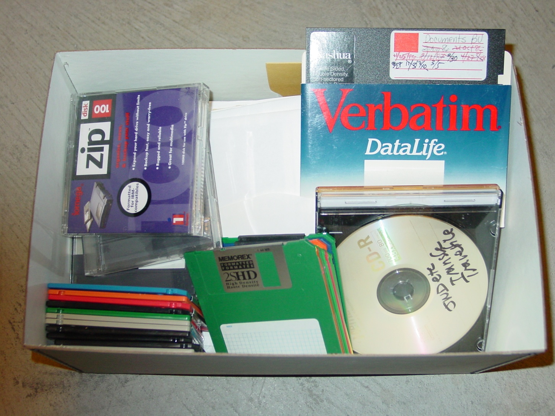
Demystifying born digital
Audio
Databases
Email
Institutional records
Manuscripts
Moving images
Photographs
Publications
Social media
Static data sets
Textual documents
Video games
Websites
Works of art
… and more
American Heritage Center
Notes:
To start out, we recognized that different people may have entirely different things in mind when they use the term born-digital. So we identified nine different types of born-digital material (you could no doubt, add more). There’s a document, but those of you with short attention spans (or who’d like to see OCLC Research staff make fools of ourselves) may want to view the video on our YouTube channel.

Slide 29
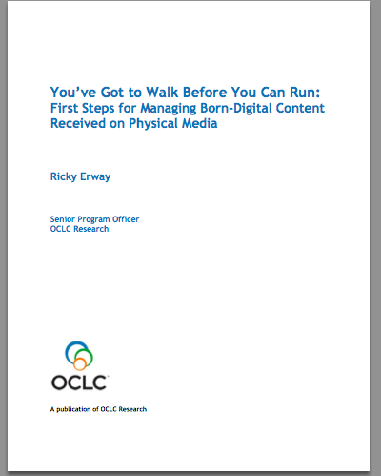

Slide 30
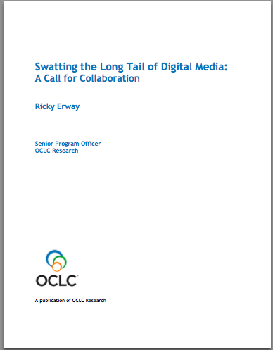

Slide 31
Recommendations: Digitisation
Develop both a national strategy for continued digitisation of special collections and a national gateway for discovery of digitized content. As part of the strategy, identify sustainable funding strategies and international partners with which to collaborate.
Develop cost-effective models for large-scale digitisation of special collections that take into account the special needs of these materials while also achieving high productivity.

Slide 32
Digitisation
“Special collections are in danger of being left behind with….increasing expectation that everything will be available online.”
--Survey respondent
Notes:
User expectation of access to digital content is very high. The survey report states that “there is a near universal sense that comprehensive digitisation of special collections is not only desirable, but an obligation. The drive to digitise comes as much from outside SCs as within”. We are currently, however, a long way from satisfying this need. Digitisation ranked 6th in the challenges.

Slide 33
RLUK large-scale digitisation
Definition: Systematic reproduction of entire collections using streamlined production methods to enable production at scale while accounting for special handling needs.
Notes:
In US 38% said they had done large-scale, but follow-up indicated that few had actually achieved results at scale or impressive rates of production.

Slide 34
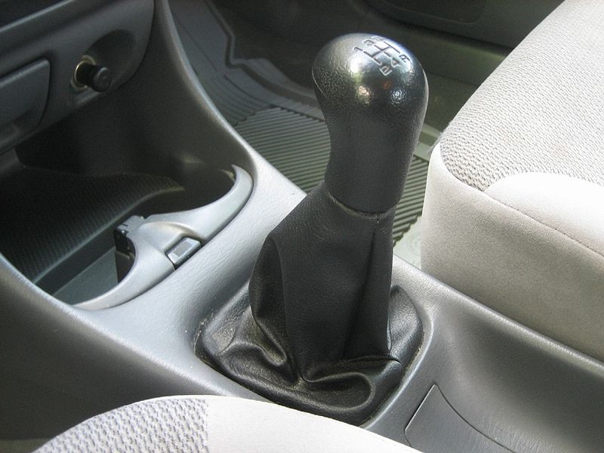
Digitization for Access
Notes:
“Shifting Gears” argues for scaling up the digitization of special collections, with a particular focus on adopting a “just do it” attitude towards digitization.
Its recommendations are intended to help special collections keep pace with mass digitization of books. As we increasingly share a collective collection of books, it will be our special collections that distinguish cultural repositories. We can hide those treasures in our backlogs or behind custom portals -- or we can push them out into the light of day.
Some of the advice sounds quaint now, but it was important to say – and important for RLG to say, since we had been advocates of the “you only get one chance so scan at the highest quality possible” approach
http://commons.wikimedia.org/wiki/File:Shift_stick.jpg
Gear shift stick of my Mazda Protege SE 1999. Public domain
http://commons.wikimedia.org/wiki/File:MUTCD_W4-3.svg
MUTCD W4-3 merging traffic sign From: Manual on Uniform Traffic Control Devices for Streets and Highways - 2003 Edition. Public domain

Slide 35
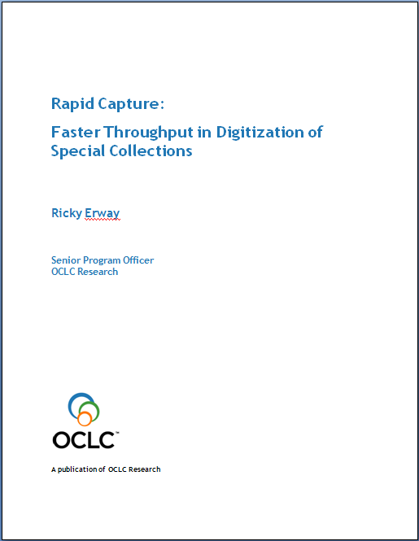
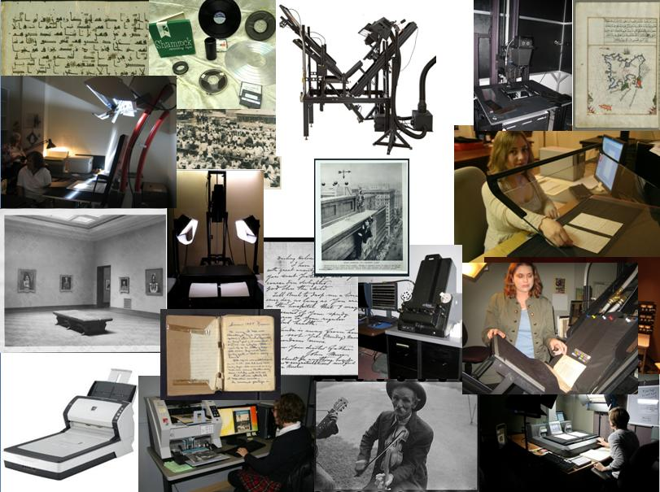
Seeking digitisation production at scale
Notes:
Some parts of the process need to be routinized in ways that speed the throughput and allow the overall project to succeed
As institutions begin programmatically digitizing collections, they will want to incorporate innovative approaches. "Rapid Capture” looks at the moment of actual digitization of a variety of formats and highlights approaches that capture at scale.
We identified some innovative ways to accelerate throughput.
There are 9 vignettes + 2 bonus stories. They describe quite succinctly: What they did, how they did it, and the result.
Report came out earlier this month, here are some highlights.
Montage compiled by Ricky Erway from images used with permission.
forthcoming

Slide 36
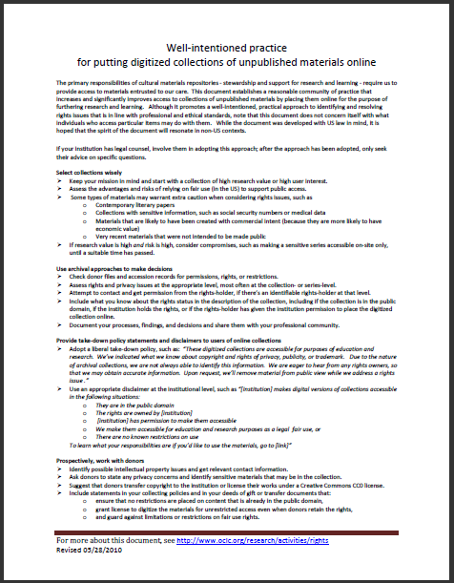
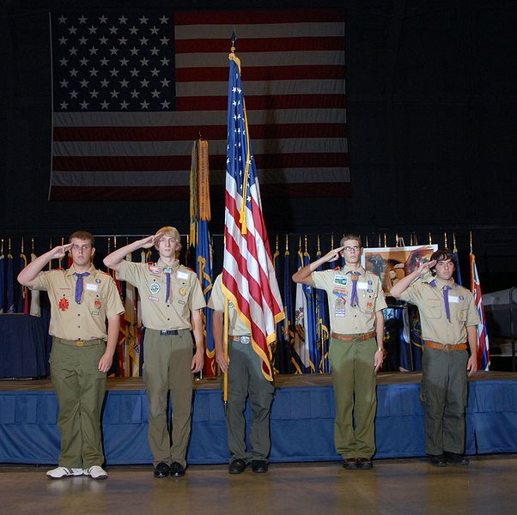
Well-intentioned practice for putting digitized collections of unpublished materials online
United States Air Force. "DAYTON, Ohio (10/27/2009) -- Members of Boy Scout Troop...at the National Museum of the U.S. Air Force“ Public domain
Notes:
Digitization of special collections can be inhibited by concerns about IP or privacy rights. The 2010 “Well-Intentioned Practices” document establishes a community of practice for digitization of unpublished materials based in risk analysis and adoption of fair use.
The primary responsibilities of cultural materials repositories - stewardship and support for research and learning - require us to provide access to materials entrusted to our care. This document establishes a reasonable community of practice that increases and significantly improves access to collections of unpublished materials by placing them online for the purpose of furthering research and learning. Although it promotes a well-intentioned, practical approach to identifying and resolving rights issues that is in line with professional and ethical standards, note that this document does not concern itself with what individuals who access particular items may do with them. While the document was developed with US law in mind, it is hoped that the spirit of the document will resonate in non-US contexts.
If your institution has legal counsel, involve them in adopting this approach; after the approach has been adopted, only seek their advice on specific questions
http://commons.wikimedia.org/wiki/File:Charles_Metcalf_DESA_ceremony.jpg
United States Air Force. "DAYTON, Ohio (10/27/2009) -- Members of Boy Scout Troop 236, Christ United Methodist Church, Kettering, Ohio, post the Colors during the Distinguished Eagle Scout Award presentation at the National Museum of the U.S. Air Force. (U.S. Air Force photo)“ Public domain

Slide 37
Recommendations: Archival collections
Convert print archival catalogues using affordable methodologies to enable Internet access. Develop approaches to modifying existing descriptions that strike a balance between incurring overheads and being effective for discovery. Develop tools to facilitate conversion from local databases.
Develop a shared understanding of the goals, characteristics, and benefits of “simplified archival processing.”
Establish a methodology to assess unprocessed archival collections and develop a plan to make the national collection more fully accessible.

Slide 38
RLUK Internet access to finding aids
Note: Percentages of respondents.

Slide 39
RLUK archival finding aids
Internet | Non-Internet | None
64% | 24% | 14%

Slide 40
RLUK use of simplified archival processing

Slide 41
Recommendations: Metrics
Determine the potential value and uses of metrics for reporting core statistics (e.g., collection size, users, outreach efforts, catalogue records) across the sector. If warranted, define categories and methodologies and encourage their use across the sector.

Slide 42
Metrics
Metrics could improve our ability to realiably measure and compare things such as …
Who uses special collections (faculty, students …)?
How much material do they use?
Which types of material do they use?
Size of collections in various formats
How much material have you digitised?

Slide 43
Recommendations: Collections
Define key characteristics and desired outcomes of meaningful collaborative collection development, and encourage collaborations in areas of national significance
Scrutinise local collecting policies to determine how well they reflect the institutional mission and can feasibly be implemented.

Slide 44
RLUK use of secondary storage

Slide 45
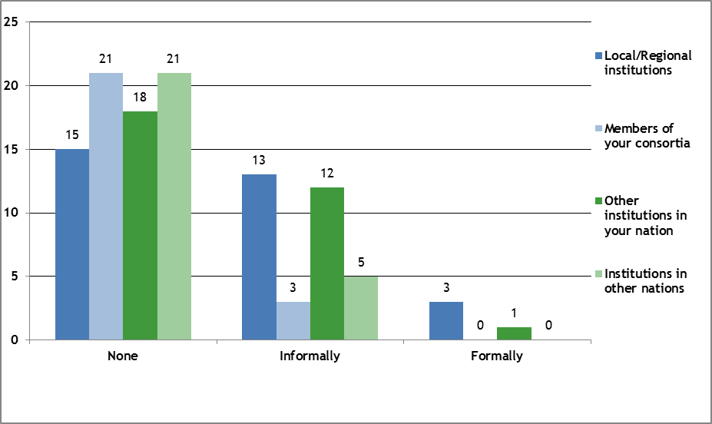
RLUK collaborative collection development

Slide 46
Recommendations: Cataloguing & metadata
Collaborate to share expertise and create metadata for cartographic materials to enable improved discovery of the national collection.
Build on the findings of RLUK’s “hidden collections” survey of print materials to identify national cataloguing priorities.

Slide 47
Online catalog records
Printed volumes: 84%
Archives/MSS (collections): 72%
Manuscripts (items): 61%
Cartographic: 43% <<<<<<<<<<<<<<<
Visual: 49% + more in collections
Audiovisual: 47% + more in collections
Born-digital: 27% + more in collections
Note: percentages of online records, not of respondents.
Notes:
Higher than US/Canada for every format other than born-digital, which is roughly the same.

Slide 48
RLUK change in size of backlogs

Slide 49
Recommendations: Collection care
Further inflect the COPAC collection management tool to meet the requirements of special collections. Investigate its potential for determining priorities for preservation and other management activities across the national print collection.
Take collective action to share resources for cost-effective preservation of at-risk audiovisual and born-digital archival materials.

Slide 50
RLUK collections care needs

Slide 51
Recommendations: Building community
Identify beneficial ways in which to build productive relationships across the diverse community of special collections libraries that participated in this survey.

Slide 52
The non-RLUK survey population
14 universities
9 independent research libraries
5 public libraries and archives
5 royal colleges
4 museums
4 learned societies
4 church institutions
2 colleges
2 conservatoires
1 national botanic garden (Kew)

Slide 53
Thank you!
Jackie Dooley
dooleyj@oclc.org
@minniedw

