Slide 1
Lessons learned from rebuilding ArchiveGrid
San Diego, Calif., June 21, 2012 #RBMS12
The Discovery Channel
Ellen Ast
Research Assistant OCLC Research
@AstMeansBranch

Slide 2
What we’ll cover today …
ArchiveGrid’s Mission & History
Previous User Studies
Our Survey and Highlighted Findings

Slide 3
ArchiveGrid’s Mission & History

Slide 4
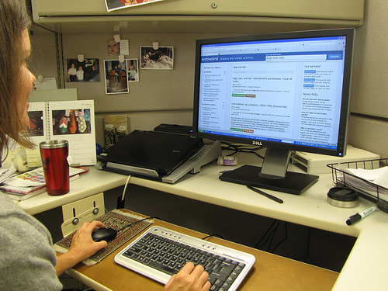
Connect researchers …
Notes:
“Passe-partout” is copyright (c) 2011 Wies van Erp and made available under a Attribution-noDerivs 2.0 license:
http://creativecommons.org/licenses/by-nd/2.0/deed.en

Slide 5
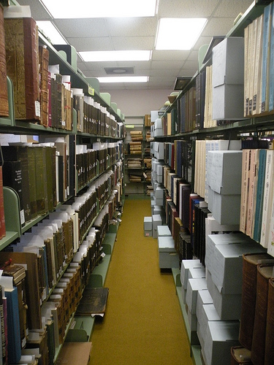
…to primary source materials
Notes:
“Current Archives” is copyright (c) 2011 Carmichael Library and made available under a Attribution 2.0 license: http://creativecommons.org/licenses/by/2.0/deed.en

Slide 6
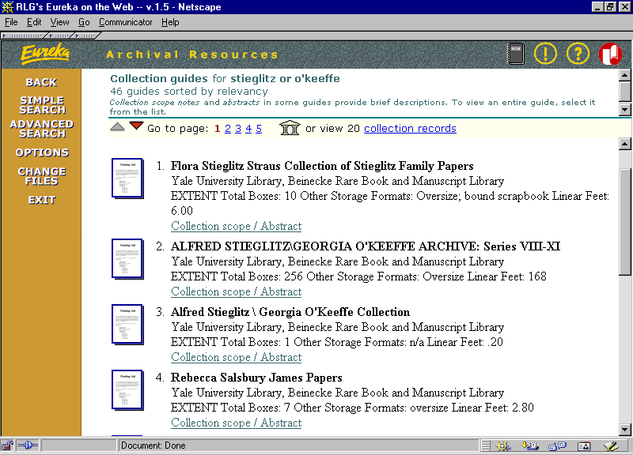
1999: RLG’s Archival Resources

Slide 7
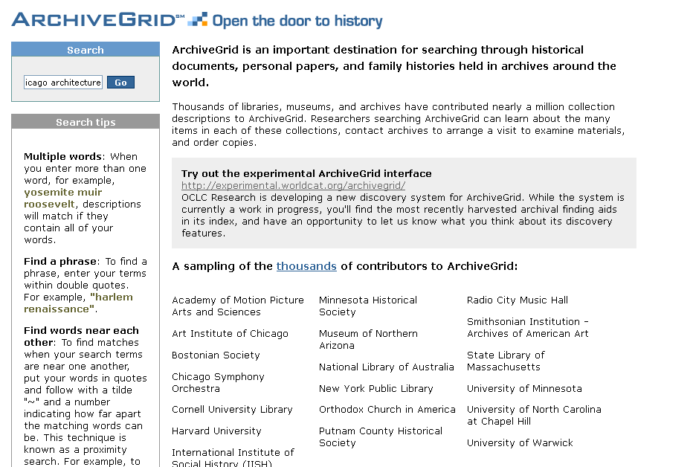
2006: ArchiveGrid.org subscription service

Slide 8
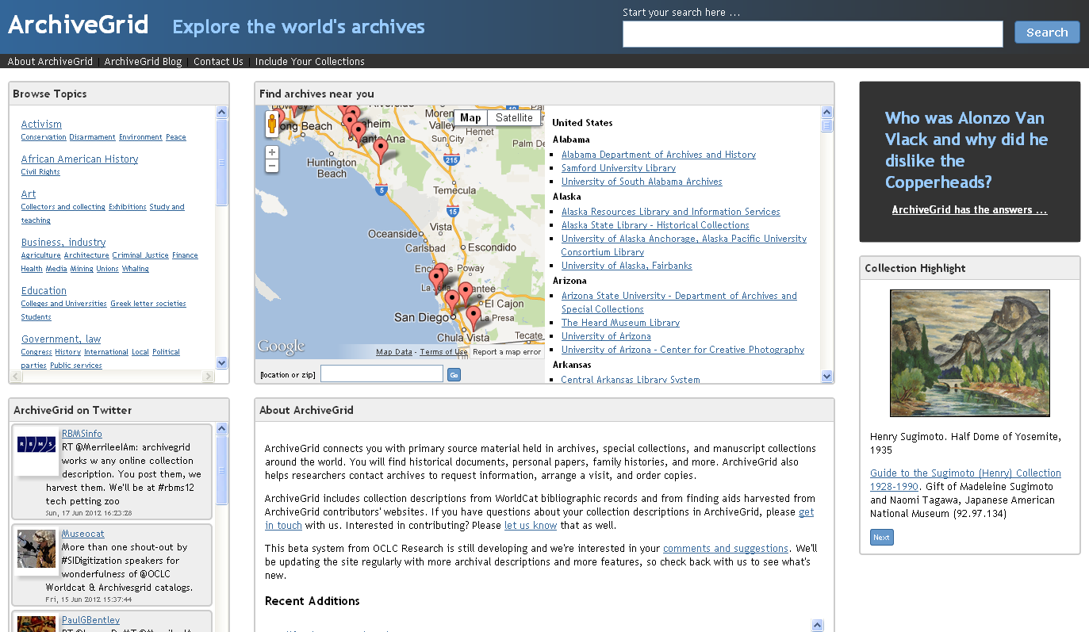
2011: Freely available ArchiveGrid from OCLC Research

Slide 9
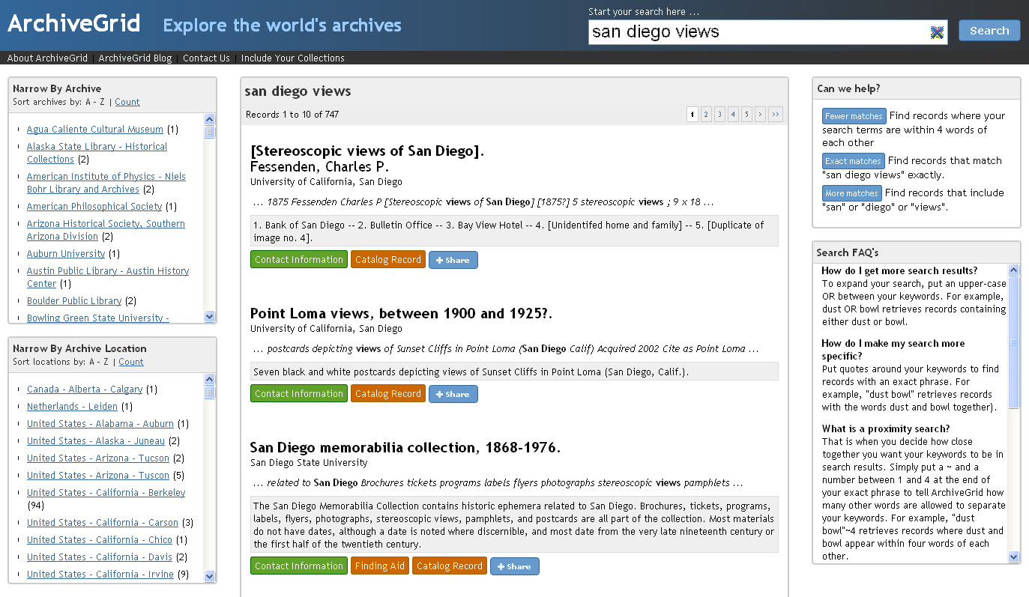
2011: Freely available ArchiveGrid from OCLC Research

Slide 10
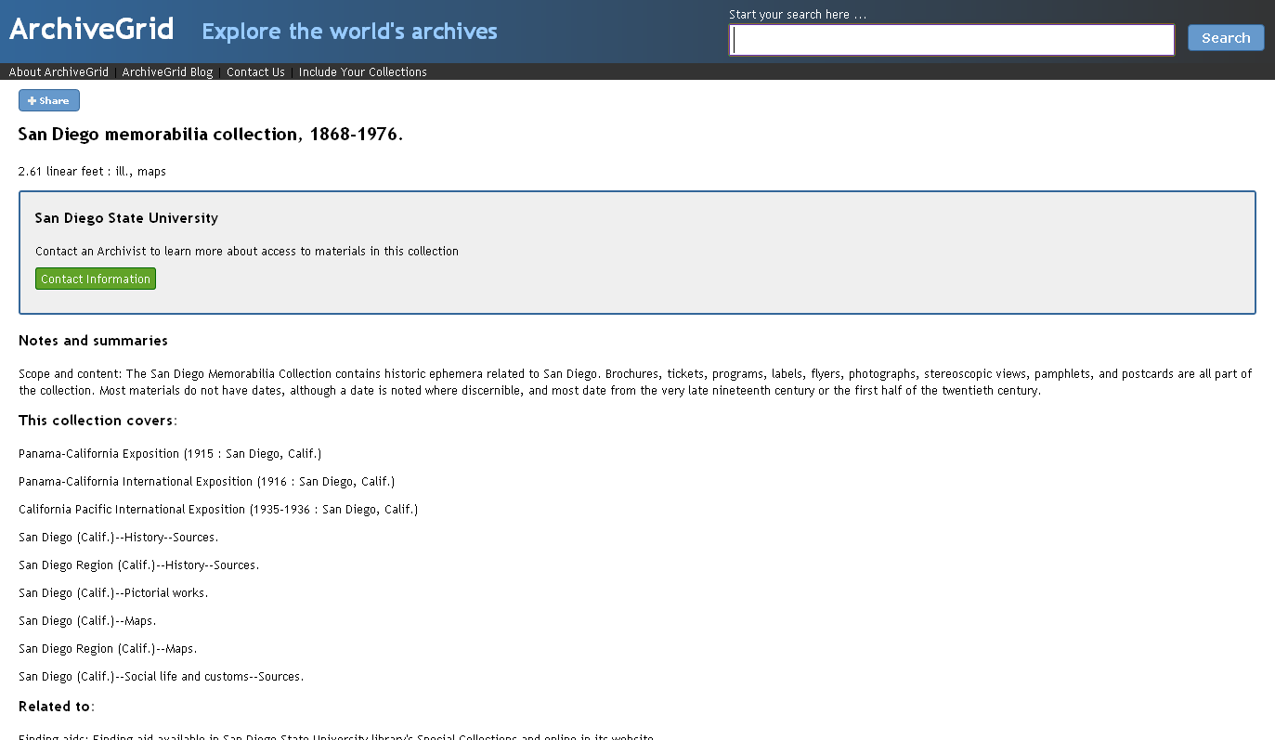
2011: Freely available ArchiveGrid from OCLC Research

Slide 11
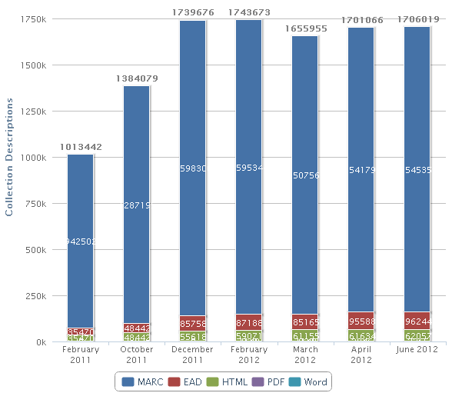
ArchiveGrid index growth

Slide 12
User Studies

Slide 13
User Studies: Key questions
Who are the researchers and what are they like?
What resources do researchers use and how do they find them?
How do researchers search online?
What do researchers want to know from their search?

Slide 14
Original three user groups are going strong…
Genealogists
Connected the most online
Most independent seekers of new research resources
Faculty
Connected the most to librarians and archivists
Intend to publish research findings
Grad students
Connected the most to others who can teach them about new places to go for research.

Slide 15
Survey and Highlighted Findings

Slide 16
Methodology
15 new questions based on prior questions
Survey Monkey
April 27-May 25
$50 Amazon gift card!
Multiple choice and open-ended questions
ArchiveGrid blog: http://beta.worldcat.org/archivegrid/blog/

Slide 17
Q. 10
How do you discover new websites and other research resources?

Slide 18
Q. 12
When you want to share information about a new website or other research resources what are your preferred ways to communicate?

Slide 19
Q. 13
Which of these website features are valuable for your research?

Slide 20
Q. 14
Comments, tags, reviews and recommendations can come from a variety of sources. Is there a particular type of user whose comments, recommendations, etc. you find most valuable?

Slide 21
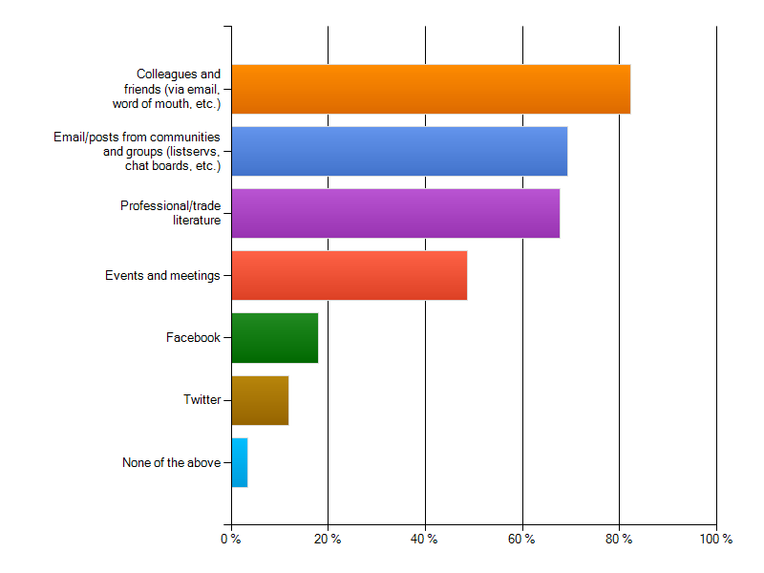
How do you discover new websites and other research resources?

Slide 22
How do you discover new websites and other research resources?
Finding Aids
Footnotes
Bibliographies
Genealogy Section
at the Library
Newspapers and magazines on my topic

Slide 23
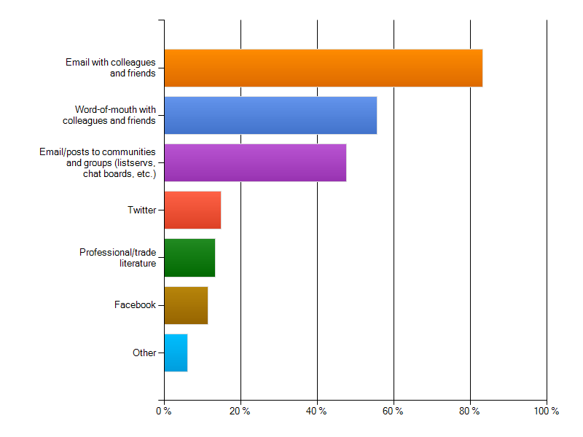
How do you share new websites and other research resources?

Slide 24
How do you discover new websites and other research resources?
“I also find it useful to speak with my colleagues and advisor about resources that may be relevant or provide a good jumping off point.”
graduate student
“I'm on Facebook, and use it, but do not generally find new research related sources there. Twitter though is a constant stream of new information.”
– museum curator

Slide 25
Who is the unaffiliated scholar?
Artist
Journalist
Exhibit designer
Archives, library, museum, historical society employee
Model ship builder
Church member
Tutor
Teacher
Writer
Metal detecting explorer
Living history performer
Forensic engineer
Consultant
Presenter
Blogger
Event planner
Curious person
Volunteer
Filmmaker
Documentary maker
Retiree
Working professional
Historic homes tour guide
Family member

Slide 26
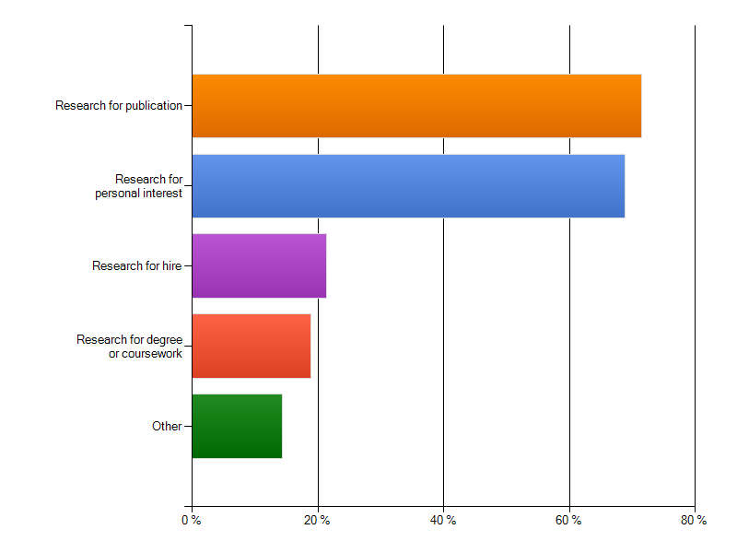
Unaffiliated scholars: what is the intended purpose of your research?

Slide 27
Unaffiliated scholars: what is the intended purpose of your research?
“I frequently use photos and negatives of the city of Bellingham and Whatcom County in collaboration with my colleagues in order to catalog and refer to them for future use for museum exhibits, business reference, or for printing.”
– undergraduate/unaffiliated scholar

Slide 28
Unaffiliated scholars: what is the intended purpose of your research?
“I am finishing a book on the history of photography in Alabama, 1839-1941, and use special collections for their unique resources of photographs, and for the original documents about the persons and places that restore context to the images.”
– photograph historian

Slide 29
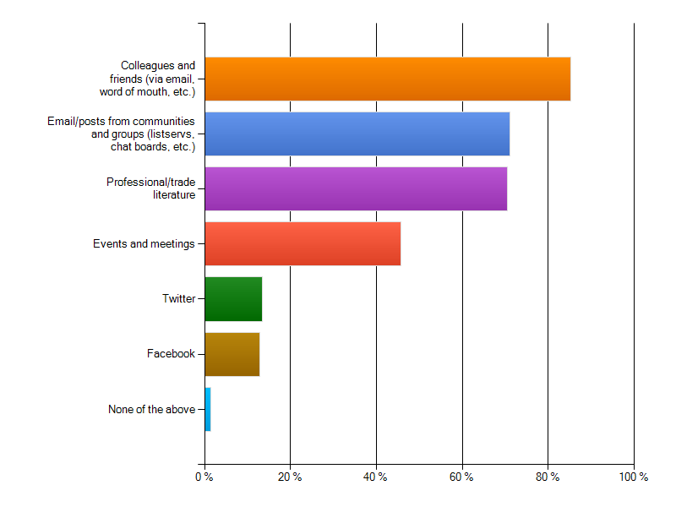
Unaffiliated scholars: How do you discover new websites and other research resources?

Slide 30
Unaffiliated scholar? How do you discover and share new resources?
“I check every six months or so for new sources using an ordinary search engine.”
– unaffiliated scholar
“When I want to share a research resource with friends, I email them a link.”
- unaffiliated scholar

Slide 31
Unaffiliated scholars: how do you share information about resource discoveries?

Slide 32
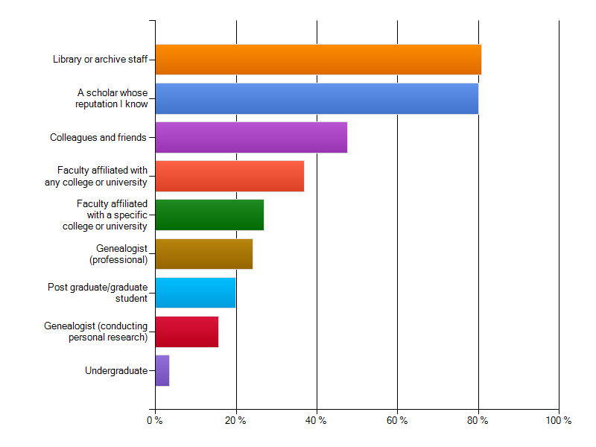
Whose comments, recommendations, etc. do you find most valuable?

Slide 33
Whose comments, recommendations, etc. do you find most valuable?
“I also have my students using a variety of documents in Special Collections for research projects. The staff at my university’s department of special collections are SUPERB!”
– college/university faculty

Slide 34
Fin
Ellen Ast aste@oclc.org
Notes:
34
34
34

