Slide 1
Scarcity and Abundance: the cooperative imperative in special collections
RBMS “Futures!”, 21 November 2012 #RBMS2012
Constance Malpas
Program Officer OCLC Research
@ConstanceM

Slide 2
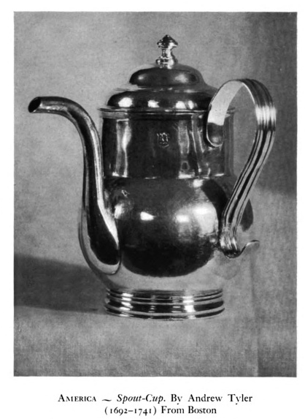
Old forms, evolving functions
This is an early American spout cup. . .
a pouring vessel somewhere between
a pap boat and a tea pot.
My aim today:
dispense more bitter stimulant
than soothing pabulum
Pickman, D. Leavitt. (1938). Pouring vessel vagaries. Cambridge, Mass.: The Mythology Company.
Notes:
http://babel.hathitrust.org/cgi/pt?id=uc1.b139230;seq=188
Page 168
OCLC no: 758408
It’s customary in presentations like this to start with a few words about who I am and where I’m coming from – especially as I’m an outsider in the RBMS community.
Instead, I present you with this odd item. At first glance it looks like a teapot, but on closer examination you can see that unlike the ‘short and stout’ form, this pot has its handle positioned 90 degrees from its spout.
It’s actually a early American spout cup – a pouring vessel located about mid way on the continuum between a pap-boat (which resemble today’s sauce boats and were used to feet infants and invalids) and a teapot.
I introduce this perplexing object here because it is emblematic of the interplay of social, cultural and technological changes that are continually reshaping the world around us. Special collections have traditionally had an important role in preserving artifacts and cultural iconography so that scholars, antiquarians (like Dudley Pickman, author of Pouring Vessel Vagaries) and others may have the opportunity to interpret them in rich, historical context.
In contrast to the spout cup (a bona fide museum item), Leavitt’s book may not appear to be particularly ‘special’ – it’s held by 75 libraries, it was published in the 1930s, it’s freely available online – and yet in the digital environment it is if anything more valuable and useful than ever before, because it is now woven into a larger information context. This claim – that abundance creates value – runs contrary to received wisdom in the special collections community. We like to say that what is rare, distinctive and especially what is ‘unique’ is what makes special collections special. I’m going to argue against this notion and say that what will make special collections special and valuable in the future is not their scarcity but their ‘embeddedness’ in an economy of abundance.

Slide 3
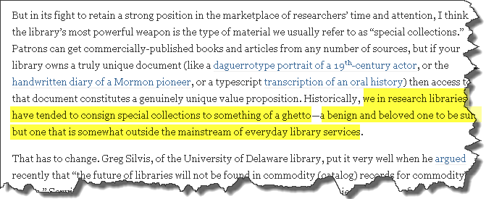
A view of the future
Rick Anderson. The Portal Problem, Part 2: The Plight of the Library Collection Scholarly Kitchen Blog (April 16, 2012)
Notes:
It’s common these days for library observers to gesture toward the growing homogeneity of academic print collections and increased reliance on disintermediated discovery on the web, and make pronouncements about the decline of library relevance.
Often this accompanied by a hasty reassurance that library can still deliver distinctive value by increasing the visibility and use of local special collections.
In this recent blog post, Rick Anderson, acting dean of the Marriott library at the University of Utah, offers up a similarly hopeful picture – saying that special collections are the library’s ‘most powerful weapon’ and differentiator. But, as Anderson acknowledges, it’s not as simple as declaring that rare books and MSS will naturally move from the wings (or ‘benign and beloved ghettos’) to center stage as commodity collections and the local operations that support them are deprecated. Special collections – by their very nature – have a comparatively limited constituency. By Anderson’s own reckoning, it’s not clear that libraries have a good strategy for identifying, growing or capitalizing on demand for special collections. But he’s still bullish on their intrinsic value.
http://scholarlykitchen.sspnet.org/2012/04/16/the-portal-problem-part-2-the-plight-of-the-library-collection/

Slide 4
Or maybe it’s something else.
ARL–CNI Forum, October 2011
Louisiana State University President, John Lombardi
When solicited for university funding, his first question is: “What will that project do to make the university more competitive?”
“If you can’t persuade me that the work you’re doing is going to make us more famous, we’re not going to be interested in investing in you,” he said.
“Is that wise and profound and good? No. It’s stupid. But that’s the way it is.”
http://www.youtube.com/watch?v=n49VJKPVw_0
Notes:
A somewhat different view of library futures was offered up by John Lombardi, past president of LSU, at an ARL-CNI forum last October. Lombardi took a purely utilitarian stance on the value of the library. He said: it’s no different from any other department or school on campus – if it isn’t adding luster to the reputation of the university, it’s marginal. It won’t be put out of business any time soon, but it won’t attract institutional investment either.
He did carve out an modest exception for special collections. To the extent that your archival collections are absolutely unique, he said, if you can get a donor to help you digitize them, I will be eternally grateful. But unless that digital product is deemed indispensable by the larger community, attracts new faculty members to the university, etc., it’s still not worth much. Overall, he was much more concerned with what the university can do to keep its top performing research faculty operating at full bore – and the library didn’t seem to have too much to offer on that score.
(He later published a softer pitch, affirming his deep appreciation for all that libraries do.)
I want to offer a view of how these two perspectives on library ‘futures’ – the ineluctable rise of special collections, or the ultimate subordination of the library within campus technology centers and offices of sponsored research – might be reconciled.

Slide 5
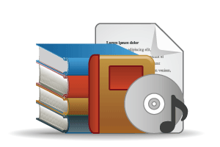
Purchased materials
Licensed E-Resources
In many collections
Open Web Resources
Commodity Goods & Services
Exotic Instruments
Licensed
Purchased
High Stewardship
Low Stewardship
Hereditary Duchy of RBMS
New Republic of Institutional Impact
Special Collections
Local Digitization
Research & Learning Materials
In few collections
OCLC Collections Grid. Credit: Dempsey, Childress (OCLC Research. 2003)
Notes:
This is a model we have used to frame some discussions about library collections and operations in the past. The horizontal axis is a measure of the stewardship or curatorial efforts that have traditionally been needed to manage these materials in libraries. The vertical axis is a measure of how widely held the materials are in the library system: at the top are resources that are abundant in the library community, at the bottom are materials that relatively scarce.
In the upper left quadrant are the materials that libraries traditionally purchased and increasingly are leasing. Below that are special collections, rare books and manuscripts. The bottom right includes research outputs and teaching materials. The upper right includes a wide variety of resources found on the Open Web – twitter streams, blogs etc.
Libraries may be interested in all of these areas, but not equally.
Traditionally, local library operations have focused on the upper left quadrant. This is where the majority of library spending is concentrated. But increasingly, cooperative approaches to managing ‘commodity collections’ are reducing that spend and enabling libraries to redirect resources toward other areas – including special collections.

Slide 6
Redirection of library resource
In Many Collections
Licensed
Purchased
High Stewardship
today
+5 yrs
Low Stewardship
Emerging shared services
New skill sets
Renovated value proposition
In Few Collections
OCLC Research, 2010.
Notes:
This is a projection of how we expect academic library to change over the next while.
The shape-shifting varies by library type, but it’s most pronounced for academic libraries, where we anticipate fairly dramatic shifts toward licensed collections and toward increased support for managing research outputs and learning objects. At the time we did this projection, we did not see much evidence of a deliberate redirection of investment in special collections.
However, we did anticipate some redefinition of the boundaries between the bottom two quadrants, and potentially some interesting opportunities for intra and inter-institutional cooperation.

Slide 7
So, what’s the problem?
Cooperative infrastructure developed to support efficient management of ‘commodity’ collections…
widely-held print publications ➔ cooperative cataloging
shared print collections
approval plans
on-demand purchasing
licensed electronic resources ➔ group licensing knowledge base maintenance
shared digital preservation
not necessarily extensible to special collections
Notes:
Rather than seeing special collections as a ‘green pasture’ for new investment, the university is likely to look for ways to make it run more efficiently. But it’s not at all clear that the cooperative infrastructure that we have developed to support efficient management of commodity collections is obviously, necessarily or naturally extensible to special collections.

Slide 8
Moreover . . .
Limited institutional incentives to share in prestige of ownership
Cooperative agreements for ‘joint custody’, shared stewardship, coordinated acquisitions, etc. are rarely and/or imperfectly memorialized
Special Collections mostly focused on managing scarcity; the network economy is governed by the principle of plenitude. Abundance = opportunity, not threat.

Slide 9
‘Collaboration is a success strategy’
Lombardi Rules:
It suggests that shared efficiencies will result, reducing the cost of local operations.
It raises confidence that some other smart people are involved, limiting institutional exposure to risk.
It builds market share for success

Slide 10
What makes us special is changing
In many academic research libraries, 30 to 50% of collections, including special collections, are off-site.
For ARLs, 30% or more print collection has already been digitized – even if the library hasn’t scanned a single book.
For Oberlins, the rate is even higher (>40% median).
Among IRLA, rates are variable but can exceed 50%.
A substantial portion of the digitized titles in each library are also relatively abundant in the library system (30%-90%).
Notes:
I’ve said that the cooperative imperative in managing commodity collections doesn’t necessarily lend itself to application in the special collections environment. But – just as the rise of hot caffeinated beverages transformed the form and function drinking vessels – the changing nature of general collections is also having an effect on the shape of special collections.

Slide 11
Pre-1850 imprints in HathiTrust
>175K unique (discrete) titles
Cf. Dooley et al. (2010) report avg. special collections print volume count ~80K
Median holding libraries per title = 7
‘scarce’ supply in native print format
99% designated as (US) public domain [B©]
now embedded in an economy of abundance
OCLC Research analysis of HathiTrust snapshot data, May 2012.
Notes:
What does this mean for special collections?

Slide 12
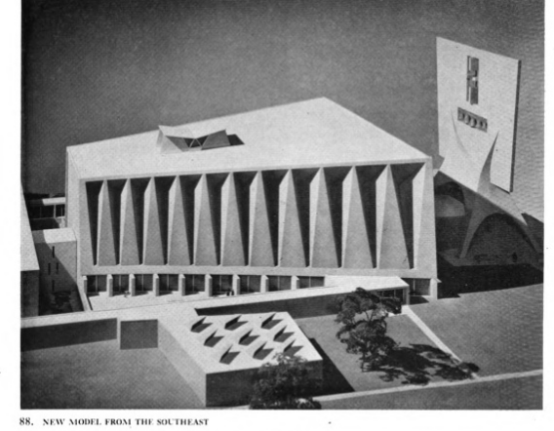
A ‘monumental’ opportunity
Marcel Breuer’s design for St John’s Abbey, Collegeville MN, ca 1958.
Preserving and providing access to the monumental dimension of digitized material is a vital task for libraries.
Roger Chartier, June 2012
Stoddard, W. S. (1958). Adventure in architecture: building the new Saint John's. [1st ed.] New York: Longmans, Green.
Notes:
http://hdl.handle.net/2027/mdp.39015006743473?urlappend=%3Bseq=130
Roger Chartier, « Portrait Roger Chartier : Traces, pratiques de l’écrit, pratiques de l’histoire », in Circé. Histoires,
Cultures & Sociétés, Numéro 1, 2012. [http://www.revue-circe.uvsq.fr/spip.php?article10]
Chartier,a celebrated historian of the book, does not argue against digitization – on the contrary, he acknowledges that it has enriched and multiplied opportunities for research. But he does argue very eloquently for the special role of libraries in preserving and even expanding access to historical materials. By ‘monumental’ he means something more than ‘physically impressive’ – instead, he is interested in preserving and extending the historical record of cultural production, dissemination, reception and re-use.
The illustration I’ve used here is a maquette produced by Marcel Breuer during the time he was designing St John’s abbey. Breur is famous for his ‘monumentalist’ architecture – but I chose this image because it represents the process of dialogue between Breuer and the Church that actually shaped the structure. Scholars rightfully expect the Web to deliver a rich and inter-connected view of published and primary source materials -- and special collections libraries are well situated to provide it. But doing so will require new forms of collaboration: within and across institutions.

Slide 13
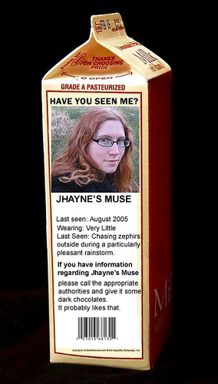
New service frameworks are needed
A further stage in the evolution of pouring vessels:
the milk carton as a tool for massively coordinated discovery
Enabling the creative re-use of content in special collections is a tremendous technical – and cultural – challenge. We must embrace it.
Lucile AKA ‘Lavinia’
http://www.flickr.com/photos/foxtongue/119445060 “My muse as a milk carton kid” by Foxtongue – remixed with illustration from a public domain version of Lucile, sourced from HathiTrust.
Notes:
http://www.flickr.com/photos/foxtongue/119445060/lightbox/ “My muse as a milk carton kid” by Foxtongue
The missing children milk carton campaign of the 1980s – a leitmotif of moving discovery into the flow. It became a model for how institutions could collaborate on national search and recovery.
This picture is a mash-up of content from two sources. I was inspired by a remark Jackie made about Owen Meredith’s “Lucile” being the poster child of a special collections title that isn’t very distinctive. Reportedly 2000 editions were produced in the US alone.
Flickr and HathiTrust both provide tools to assist with citation and re-use of material, but for digitized library content in general the toolkit is woefully inadequate.
This represents an opportunity for special collections – an area for the kind of cross-boundary work I alluded to in the context of the collections grid.

Slide 14
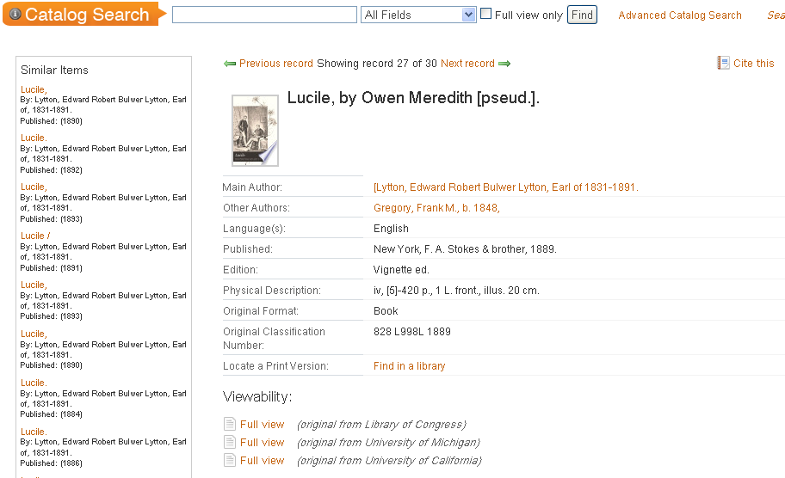
Citation, scholarly work, scale
The historian cites sources “so that the past may be made present.”
R. Chartier (2012)
}
What should be cited? The manifestation or the original item?
Notes:
Citation critical part of scholarship and something that libraries have traditionally supported with authoritative cataloging. Yet, in the mass-digitized environment it can be almost impossible to identify and accurately cite sources. Here too there are opportunities

Slide 15
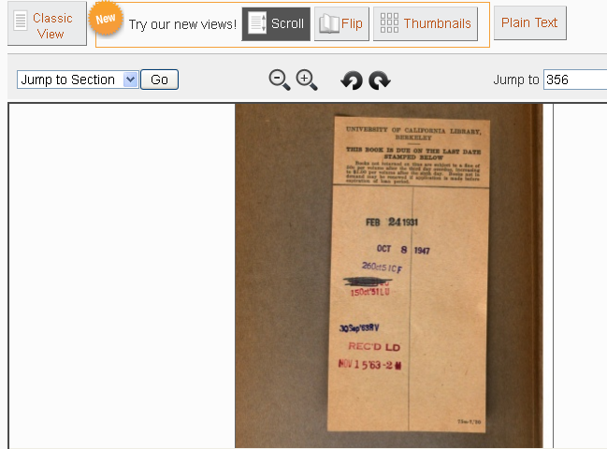
Content vs. container: our vessels weep
Redefining citation practices will not be the work of librarians alone – it will require collaboration with the communities that create and use our collections
Notes:
It’s not hard to imagine use cases in which citation of the specific item – even for a widely-held work in which the intellectual content of the text is unchanged – would be necessary. For example, one of the digitized copies might have annotations of interest. Or the history of a single copy’s use might be of interest. These are some of the ‘monumental’ characteristics that a scholar like Chartier might worry about.

Slide 16
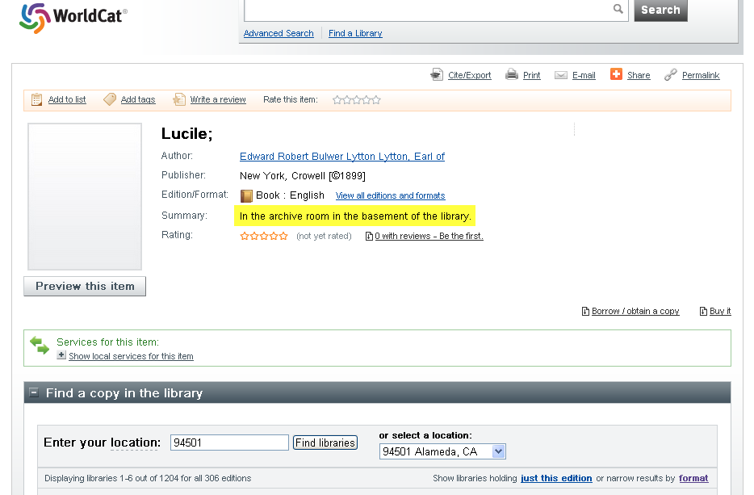
Library, lead-pipe, Lucile.
Oh my.
All 55 holdings?
This won’t end well.
Notes:
Current cooperative infrastructure – including bibliographic infrastructure – is a ‘blunt object’ when it comes special collections.
This image demonstrates how a simple, well-meaning effort by a special collections cataloger – adding a local note to the bibliographic record to alert staff to the location of the physical item – has been propagated through the library system. More than 50 libraries have set holdings on this WorldCat record, with the tragi-comic effect that it is now impossible to tell which of the 50 copies is actually “in the archive room in the basement of the library.”
This story doesn’t end well for Lucile.

Slide 17
In closing
Maximizing the scholarly value and institutional relevance of special collections will require new forms of collaboration:
Within and across institutions, to establish common service frameworks for managing content creation, dissemination and re-use
Among repositories and donors to broaden the collective collection and more effectively reveal its underlying ‘connective tissue’
In partnership with scholars who are defining use cases not supported by traditional library infrastructure, service portfolios or personnel

Slide 18
Thanks for your attention. Questions, comments?
Constance Malpas malpasc@oclc.org
Notes:
18
18
18

