Slide 1
Archival Collections Assessment
RBMS 2012 Preconference, San Diego, 20 June #RBMS12
The state of the state
Merrilee Proffitt
Senior Program Officer OCLC Research
@MerrileeIAm

Slide 2
What is collections assessment?
Systematic, purposeful gathering of information about archival collections
“Census” of collections
Can consist of both qualitative and quantitative data
Designed to help institution act strategically
Notes:
"archival collections assessment" is used to refer to the systematic, purposeful gathering of information about archival collections. It includes collection surveys of all kinds, including those undertaken for purposes of appraisal, setting processing and other priorities, conservation decision-making, and collection management.
An accurate census of its archival collections enables the institution to act strategically in meeting user needs, allocating available resources, and securing additional funding.

Slide 3
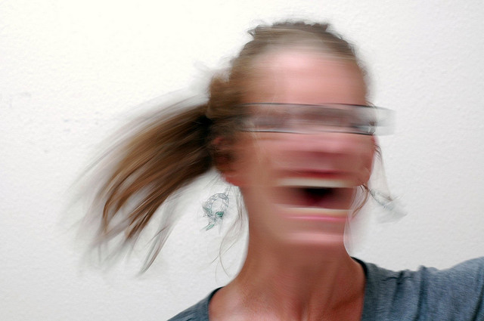
Why collections assessment?
Notes:
Why collections assessment? Because there’s just too much to do, too many possible directions, and you need a tool that will help to sort it out.
photo credit: http://www.flickr.com/photos/evilerin/3796279865/ Evil Erin
http://creativecommons.org/licenses/by/2.0/

Slide 4
Why collections assessment?
Too much to do, too many possible directions!
Cataloging & Processing (backlogs)
Digitization
Preservation
Collection management
However, what to tackle highly dependant on local context
Priorities shaped by resources and opportunities
Notes:
Era of assessment

Slide 5
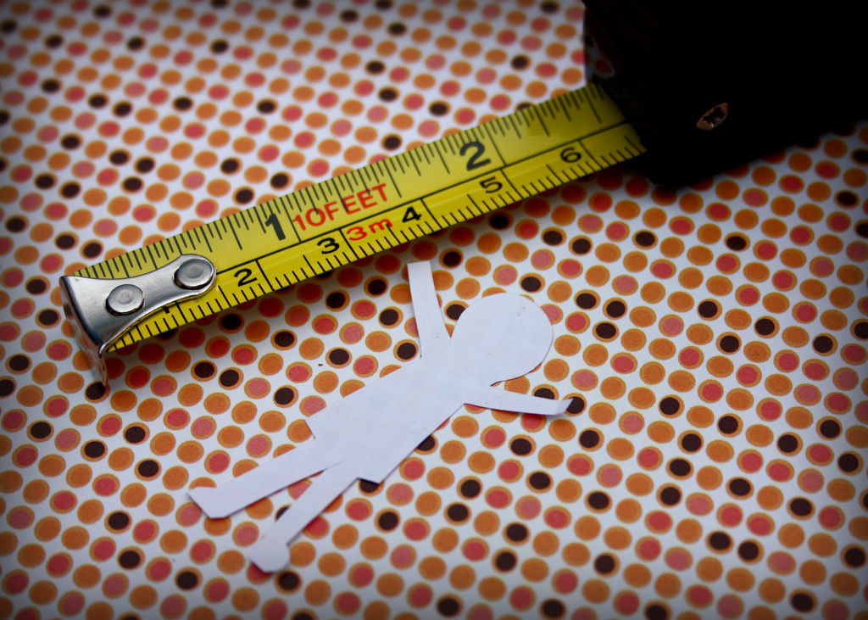
Why collections assessment?
Notes:
It’s worth remembering that we are in an era of assessment…
Not enough to rely on good instincts any more. Assertions should be backed up with data.
photo credit: http://www.flickr.com/photos/venosdale/4376443940 Krissy.Venosdale
http://creativecommons.org/licenses/by-nc-sa/2.0/

Slide 6
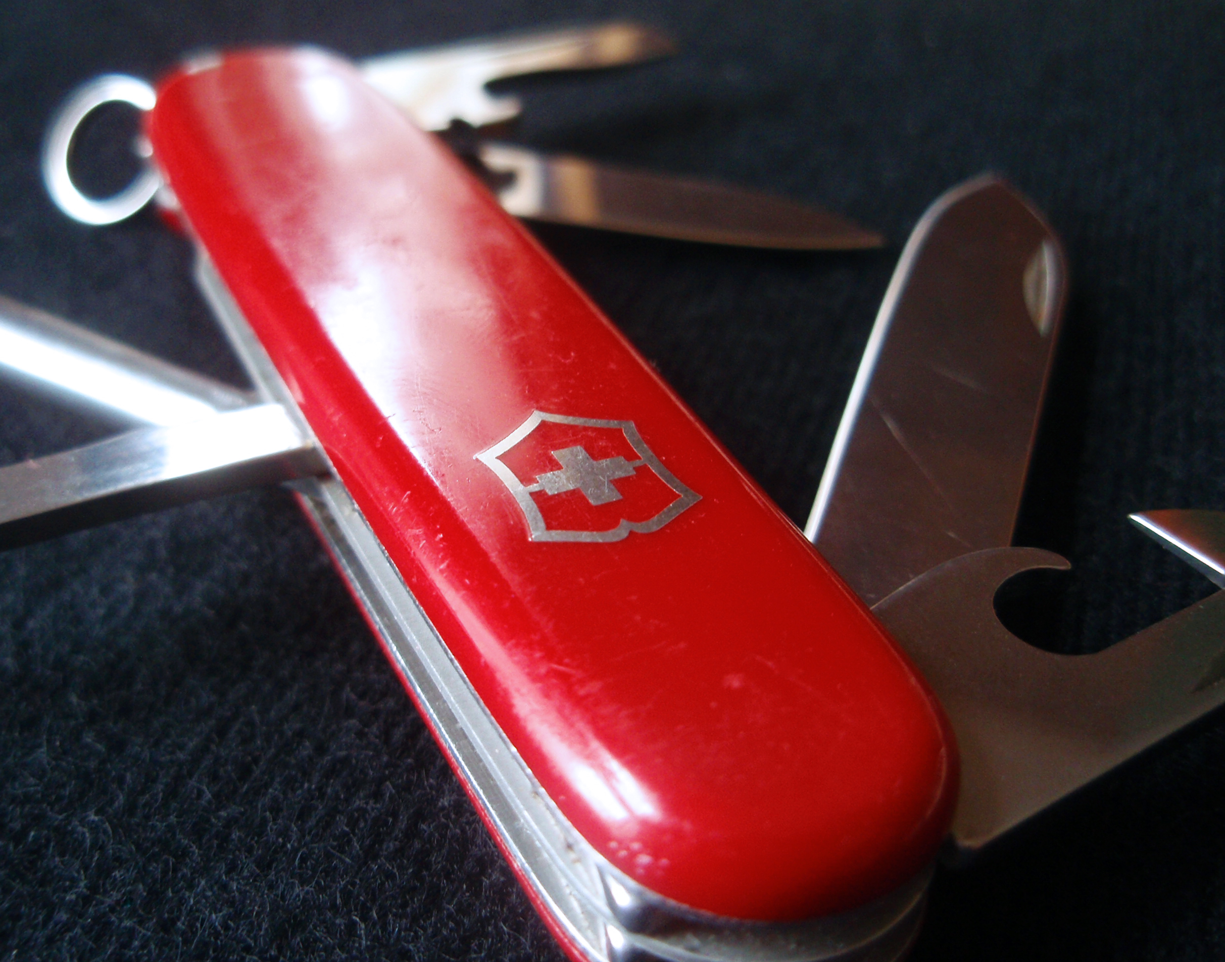
Why collections assessment?
Notes:
What you need is a Swiss Army Knife. And what we are proposing is the collections assessment is the Swiss Army Knife that you can turn to in your moments of professional need.
photo credit: http://www.flickr.com/photos/myklroventine/3474391066/ Mykl Roventine
http://creativecommons.org/licenses/by-nc-sa/2.0/

Slide 7
What we know about collections assessment
bit.ly/rbms_assess
(pro tip! Google “taking stock and making hay”)
Notes:
For starters you could read our paper which is only 28 pages. (Go ahead, we’ll wait)

Slide 8
What we know about collections assessment
You can do this!
There are models, techniques and tools for you to use
A growing community of institutions and practitioners
Doesn’t require special skills

Slide 9
What we know about collections assessment
A range of institutions have used collections assessment for
Dealing with the backlog (processing, cataloging)
Prioritizing for preservation
Collection management
Making a case for funding
Notes:
Including deassessioning
Grant funding but also could be pitching to those who hold the purse strings at your institution – can also help you find opportunities once you know where needs are.

Slide 10
What we know about collections assessment
Opportunities spaces?
Digitization and risk analysis
Assessing “born digital” needs
Collaborative uses
Notes:
PACSCL has been successful working collaboratively, as has the Black Metropolis Research Consortium.

Slide 11
What we know about collections assessment
Foundations program: “…grants of up to $40,000 will support planning, assessment, and pilot activities that incorporate expertise from a mix of professional domains.”

Slide 12
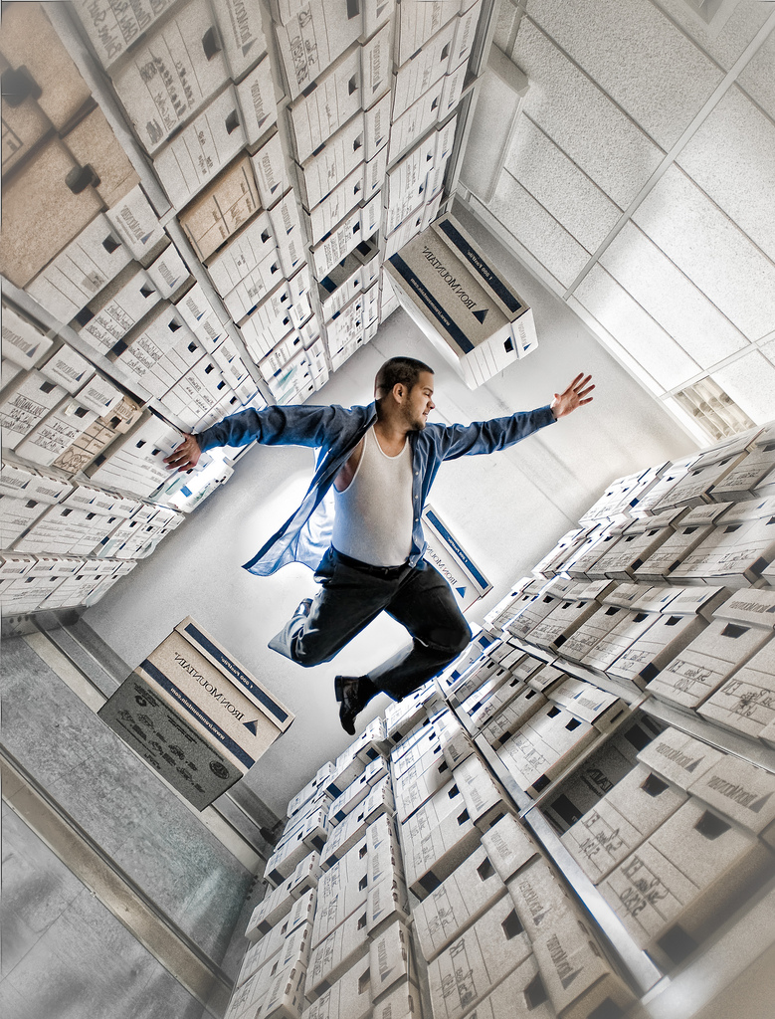
Collections Assessment in Action!
Notes:
You too can have the power!
photo credit: http://www.flickr.com/photos/jr8henry/4797675041/ GoboNdc
http://creativecommons.org/licenses/by-nc-sa/2.0

