Slide 1
Positioning Space as a
Distinctive Asset
Click here to add text
Libraries Rebound: Embracing Mission, Maximizing Impact
OCLC Research Library Partners,
Philadelphia, 5-6 June 2012
Click here to add text. Click here to add text.
Click here to add text. Click here to add text.
Click here to add text. Click here to add text.
Sarah M. Pritchard, Northwestern University

Slide 2
Space as a Dynamic
Overcome stereotypes of “the library”
No longer one size fits all
Space as a service and an interface
Customize for strategic goals
Northwestern University Library

Slide 3
Targeting Niche Services
Subject disciplines
Levels (lower or upper undergrad, MA, PhD, faculty, etc.)
Types of tasks (research, quick info, media creation)
Develop space depending on which users need what services
Northwestern University Library

Slide 4
Link Space to Campus Goals
Strategic and academic planning
Teaching, Research, Community
Reinterpret the same space for new goals
Respond to external opportunities
Northwestern University Library

Slide 5
Library Space Planning
Benefits and contents of long-range plans
Tiers or categories of space
Incremental and non-linear progress
Opportunities and negotiations
Northwestern University Library

Slide 6
Partnerships
May arise unexpectedly; need to be nimble
More chances for funding; but know where your “boundaries” are
Advantage of new audiences
Document uses and obligations
Northwestern University Library

Slide 7
Leverage Funding Sources
Rare to get full cost or perfect campaign
Use combinations of sources:
Philanthropy (major and minor)
Annual Budgets
Savings and one-time extras
Special facilities expense categories
Public vs. private institutional policies
Northwestern University Library

Slide 8
Leadership Role
Major stakes financially and reputationally
Build internal and external relationships
Negotiations and multi-year commitments
Maintain consistent vision over time while awaiting right combination of factors
Northwestern University Library

Slide 9
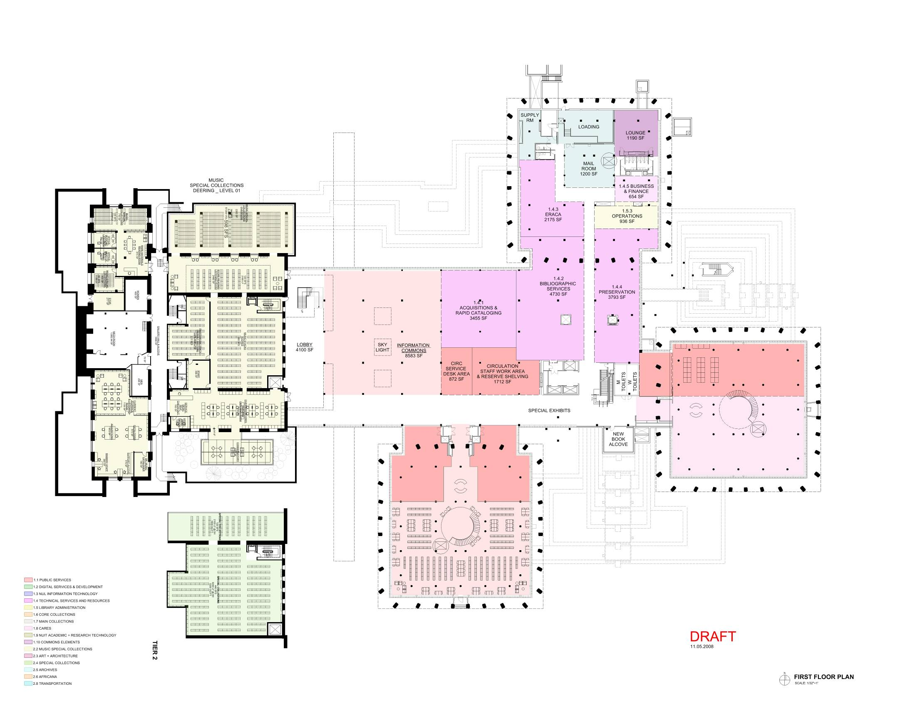
USE YOUR SPACE AS A DISTINCTIVE ASSET!

