Slide 1
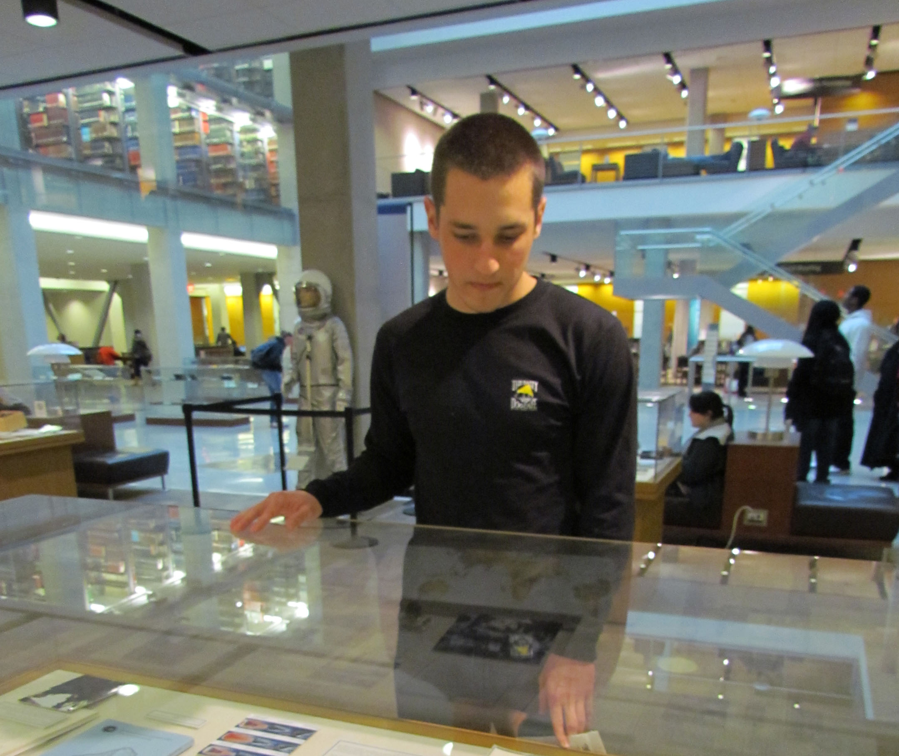
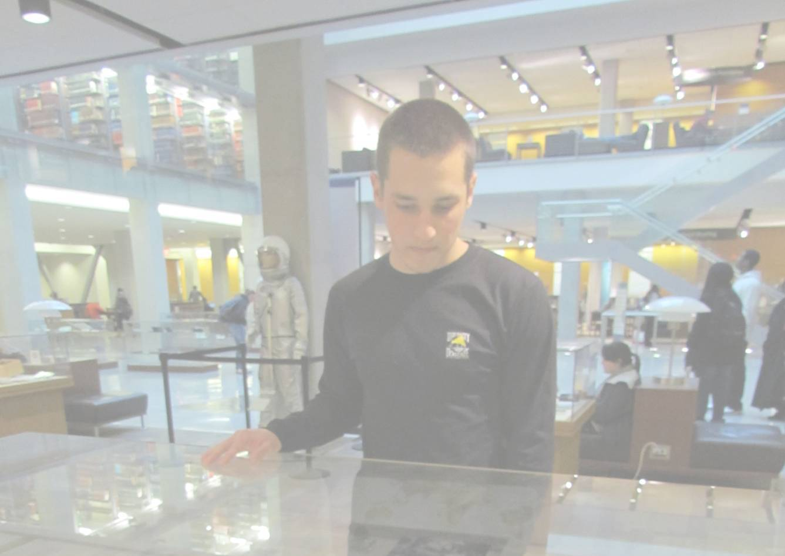
Special Collections:
Distinction with Impact
Lisa R. Carter
OCLC Research Library Partners
Libraries Rebound
June 5, 2012

Slide 2
Distinctive Signifiers of Excellence
“. . . the libraries’ expectations of special collections have changed . . . they are now regarded as distinctive signifiers, almost trademarks.”
--Nicolas Barker
in Cronenwett, P. N., Osborn, K., & Streit, S. A. (Eds.). (2007). Celebrating research: Rare and special collections from the membership of the Association of Research Libraries. Washington, DC: Association of Research Libraries. http://www.celebratingresearch.org/

Slide 3
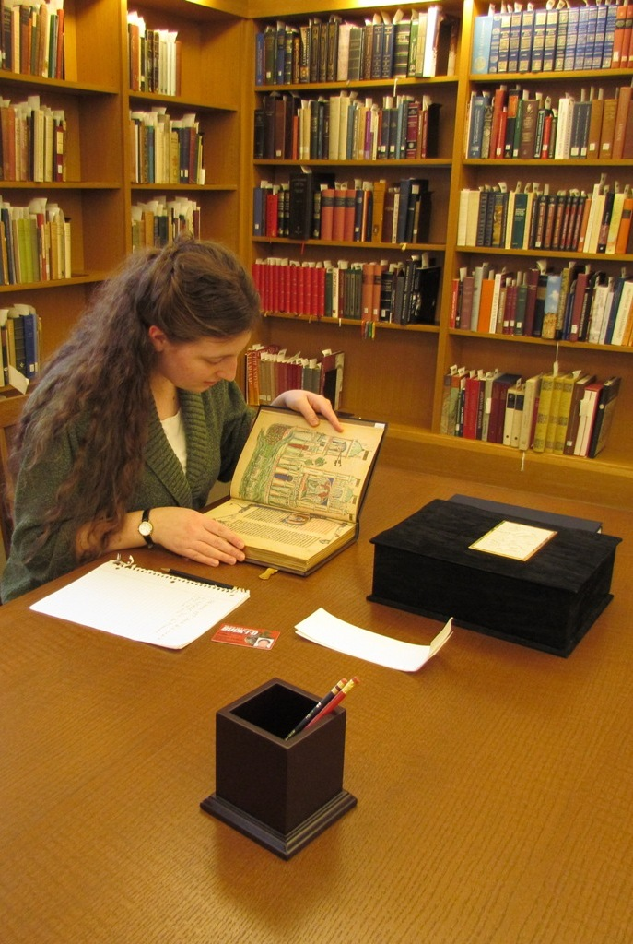
Redefining the Terms: Primacy of Use
More Product, Less Process
Exposing Hidden Collections
CLIR Hidden Collections Grants
An Age of Discovery: Distinctive Collections in the Digital Age
Transforming Special Collections in the Digital Age Working Group
Shifting Gears: Gearing Up to Get Into the Flow
Beyond the Silos of the LAMs: Collaboration Among Libraries, Archives and Museums
Scan and Deliver: Managing User-initiated Digitization in Special Collections and Archives
Rapid Capture: Faster Throughput in Digitization of Special Collections
The Metadata is the Interface: Better Description for Better Discovery of Archives and Special Collections, Synthesized from User Studies
Past or Portal? Enhancing Undergraduate Learning through Special Collections and Archives

Slide 4
Assessment
In the context of the broader institution’s mission,
how do we measure the impact of our activities
so that we can decide what to stop doing and where to direct resources
and articulate contribution and success?

Slide 5
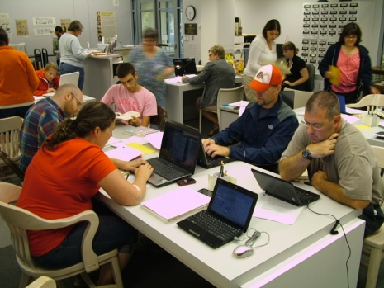
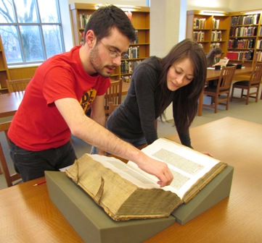
Articulating the Value Proposition
Existing Discussions | Emergent Elements
Intrinsic Value / Distinctive Collections | Alignment
Access, Use, Engagement, Outreach | Impact
Processing Hidden Collections | Data Driven Allocation of Resources

Slide 6
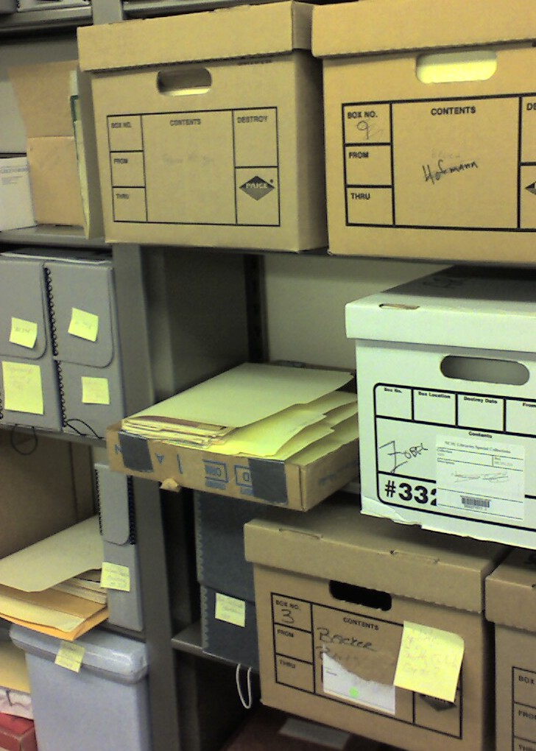
Collection Assessment
Hidden Collections
Taking Stock and Making Hay: Archival Collections Assessment
PACSCL Consortial Survey Initiative
Refining collections at the American Heritage Center

Slide 7
Alignment of Collections
University
Arts and Humanities
Dance
OSU Libraries: Theatre Research Institute
Research and Innovation
Cyber-Enabled Discovery
Center for Performance Documentation
Dance Notation Bureau Collections

Slide 8
Distinctive Services
“It is not simply that it is unique, but that there are aspects of what the collection provides to the campus that bring a synergy that is also unique. Not just the content but what the content allows the campus to pursue.”
-- Walter, Scott. (2011) The “Service Turn” and the Future of the Academic Library. OCLC. http://www.oclc.org/research/dss/pdf/dss_walter.pdf
“We connect people with scholarship. This is the core mission of the research library in the 21st century.”
-- Dewey, B.I. (2009) Through any means available: connecting people with scholarship. Journal of Library Administration, 49 (5), 533-544
“The way they are doing it is consciously connected with a core idea that’s woven throughout that institution’s fiber about what it means to go to school [there].”
-- Walter, Scott. (2011) The “Service Turn” and the Future of the Academic Library. OCLC. http://www.oclc.org/research/dss/pdf/dss_walter.pdf

Slide 9
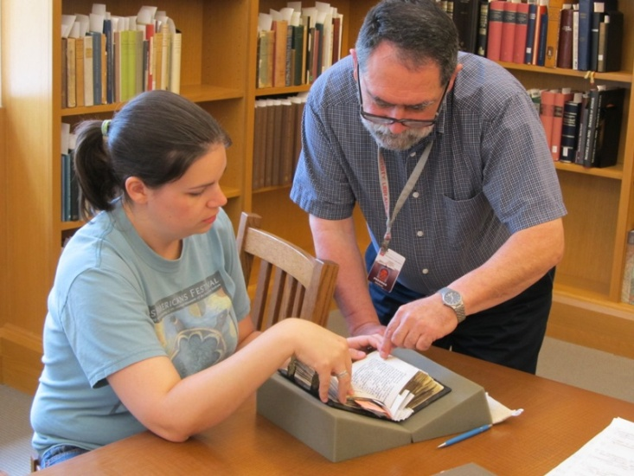
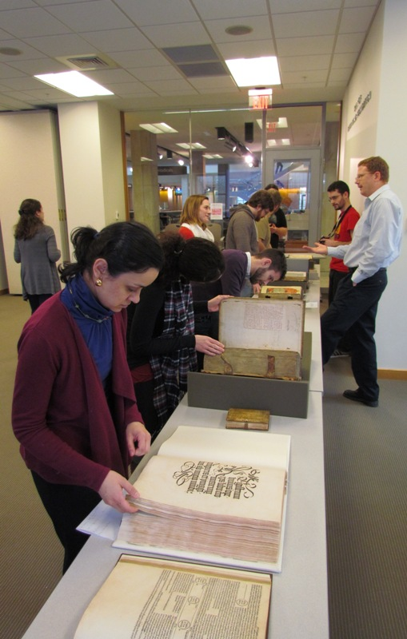
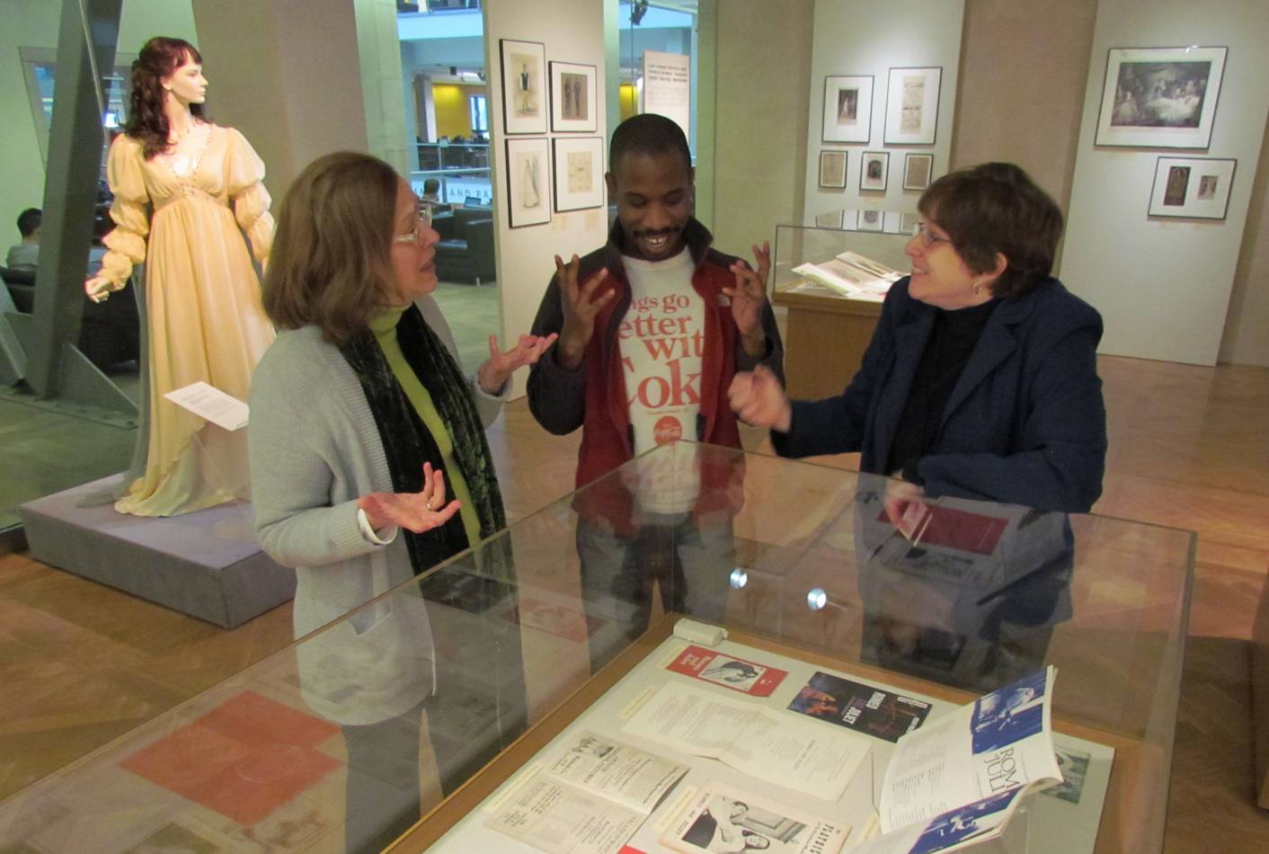
In the flow of research, teaching and learning
Embedded in the Classroom
Expert Research Consultation
Engaged in Academic Discourse

Slide 10
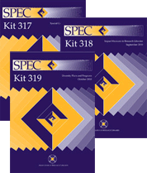
Assessing Impact
“Institutions feel they are not able to quantify the success of their efforts, and this in turn limits the ability to compare activities within the institution or across institutions, to plan further outreach effectively, or to communicate the results of those outreach activities to the larger special collections community.”
--Berenbak, A., Putirskis, C., O'Gara, G., Ruswick, C., Cullinan, D., Dodson, J.A., Walters, E., Brown, K. (2010) SPEC Kit 317: Special Collections Engagement. ARL, 16-17. http://publications.arl.org/19vd2r.pdf

Slide 11
Special Collections Use Assessment
Recent Activity
ARL SPEC Kit on Outreach
Archival Metrics
RBMS 2011 plenary
RBMS Metrics and Assessment Task Force
Fall 2012 RBM special issue
Alignment in Assessing Impact:
ARL Stats
Local tools
ACRL’s Value of Academic Libraries

Slide 12
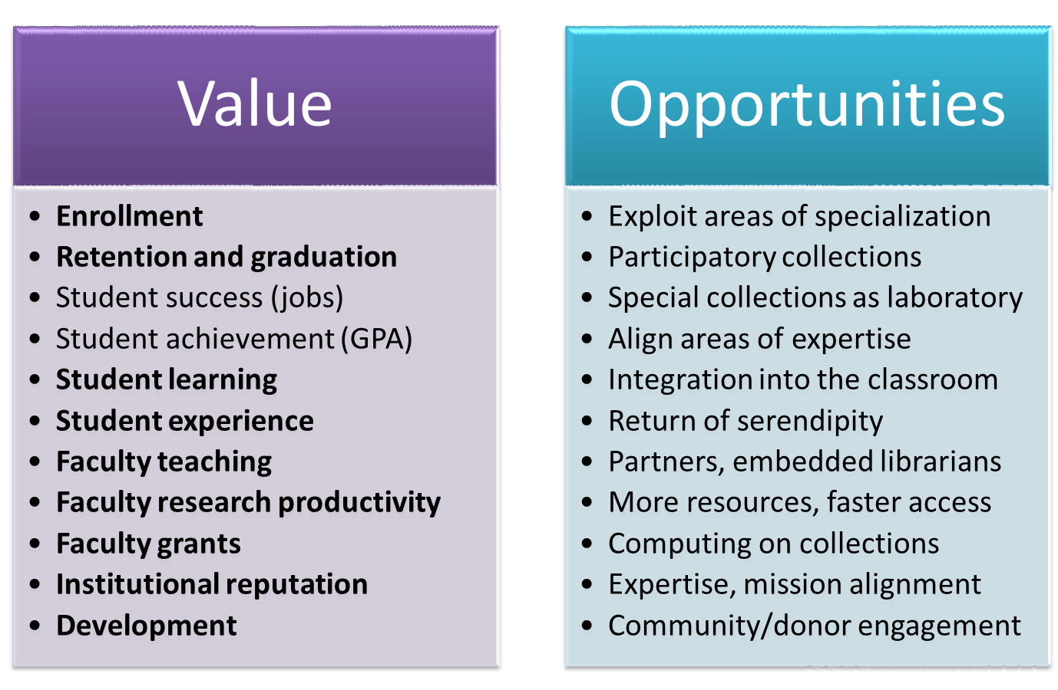
Aligning the Value of Research Libraries
Special Collections Use Assessment
ARL Spec Kit on Outreach
Archival Metrics
RBMS 2011 plenary and Task Force
Fall 2012 RBM issue
Alignment in Assessing Impact:
ARL Stats
Local Tools
ACRL’s Value of Academic Libraries

Slide 13
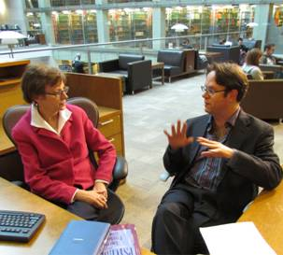
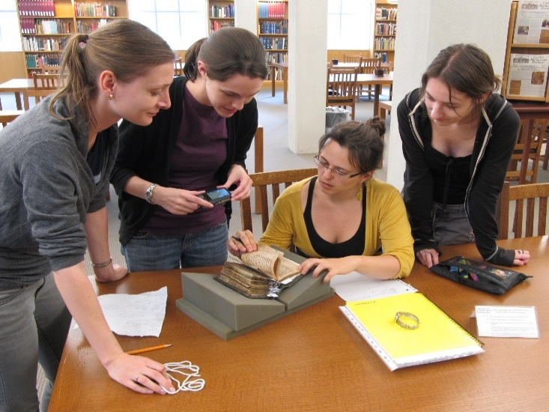
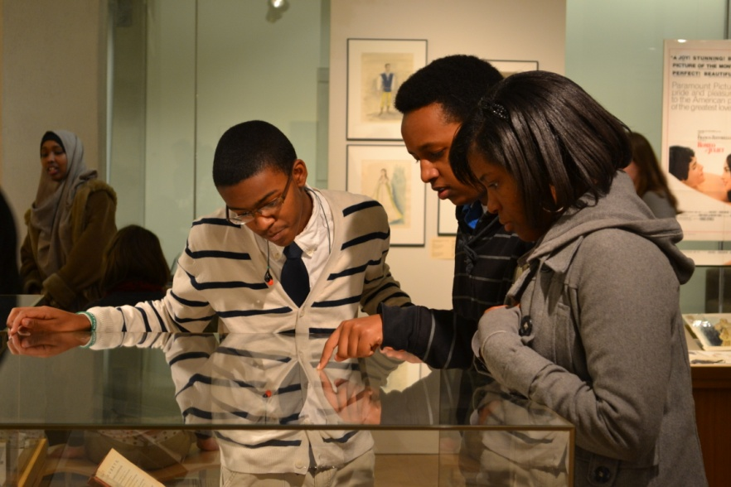
Impact: Teaching, Learning, Research

