Slide 1
Managing Globally for Acting Locally
Organizational Support for Liaison Librarians
Tracy Gabridge, tag@mit.edu
MIT Libraries

Slide 2
Success differentiators
Marketing and Promotion
Service evaluation
Services provided
Management support
David Shumaker and Mary Talley, Models of Embedded Librarianship. Final Report. Alexandria, VA: Special Libraries Association, 2009.
Notes:
Management support in report: authorization for special services not required, facilitation of service provider into group, customer group provides input on perf. Rev., written agreements with customers, continuing education required.

Slide 3
Success differentiators
Marketing and Promotion
Service evaluation
Services provided
Management support
David Shumaker and Mary Talley, Models of Embedded Librarianship. Final Report. Alexandria, VA: Special Libraries Association, 2009.
Notes:
Management support in report: authorization for special services not required, facilitation of service provider into group, customer group provides input on perf. Rev., written agreements with customers, continuing education required.
What does it take to enable librarians to work directly with researchers on the life cycle of their work?

Slide 4
About MIT
The community
11K students, 60% graduate, 40% undergraduate
1K faculty
9K staff/researchers
~70% of students in science and engineering (problem set focus)
Highly decentralized departments
Strong, common value system
Libraries:
~185 Staff
~14 FTE liaison librarians – about 27 people with liaison roles.
Librarians are not on a tenure track
~$20M budget
Notes:
Mit values: innovation, meritocracy, curiosity, team based/collaborative, (intense!), etc.

Slide 5
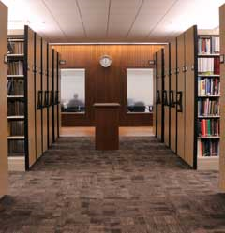
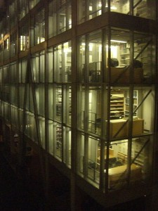
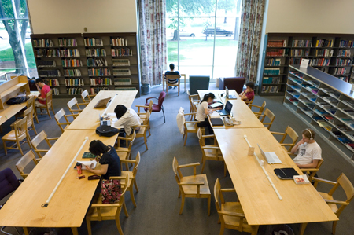
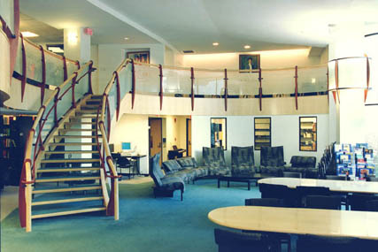
The old way
Engineering and Science
Libraries
Dewey Library
Humanities and Music
Libraries
Rotch Library
Notes:
Silos

Slide 6
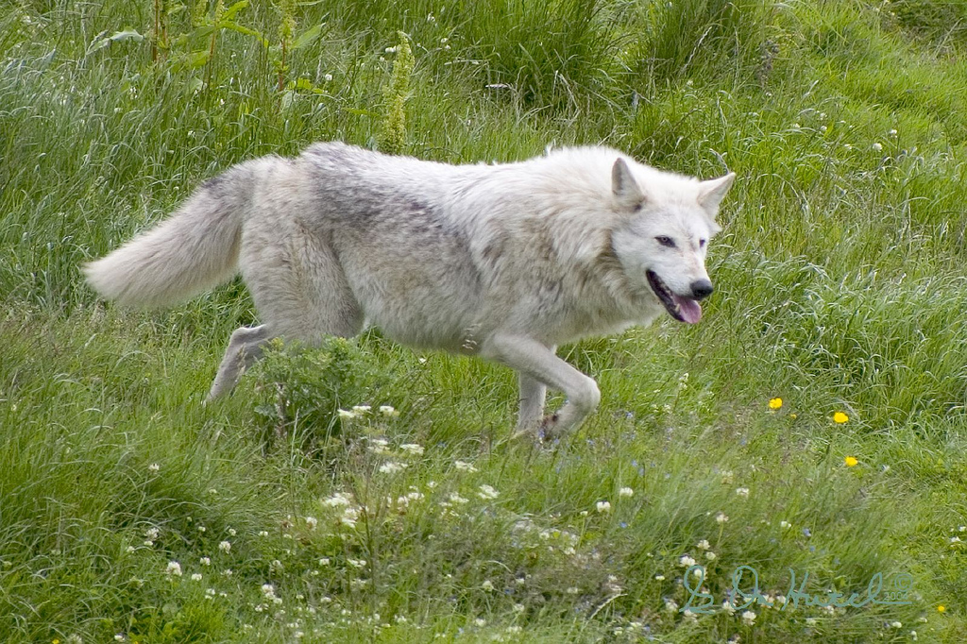
http://www.flickr.com/photos/wildphotons/
Notes:
Liaison paradigm: lone wolf. Give some basic training and set them off on their way. Great for customized service to a community, but not so good for the amount of variability (lack of consistency) and lack of learning across the silos

Slide 7
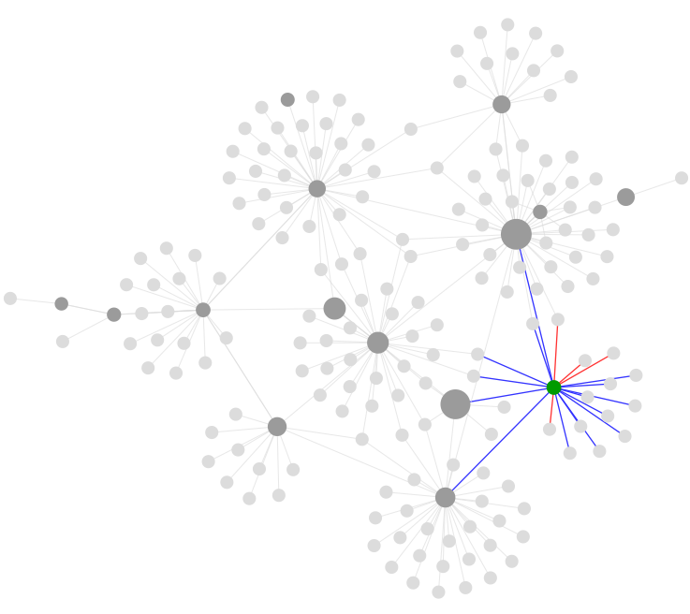
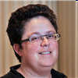
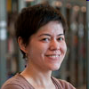
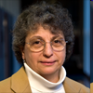
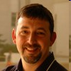
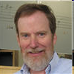
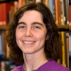
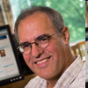
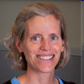
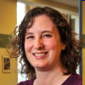
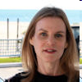
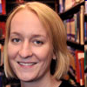
http://www.flickr.com/photos/thefangmonster/352439602/#/
Notes:
Networked liaisons, interdependent, supporting each other, enabling deeper engagement and addressing higher level information needs.
We are working with a majority of liaisons who were trained under the old system. – Change does not happen overnight and it’s important to work with people where they are.

Slide 8
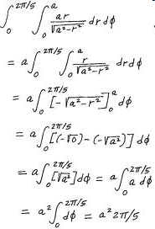
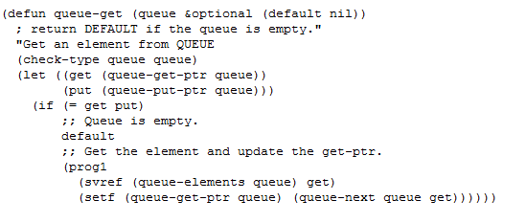
Notes:
Math v computer science
Go back in history v large data sets to try out algorithms
Require libraries more traditionally v willing to partner on research
Cs – interested in legal ramifications

Slide 9
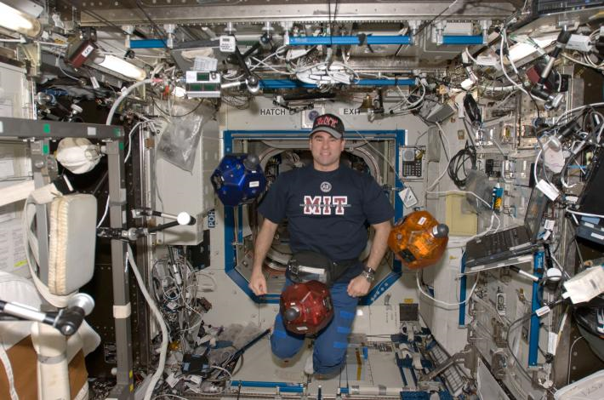
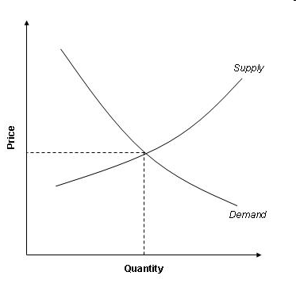
http://aeroastro.mit.edu/videos-photos/image-gallery
Notes:
aero v econ
Technical reports, system level technical info v econ data
Team based v not
Integrative v deep
Seek collaboration v one-on-one
No domain knowledge necessary to support their information needs so far - just

Slide 10
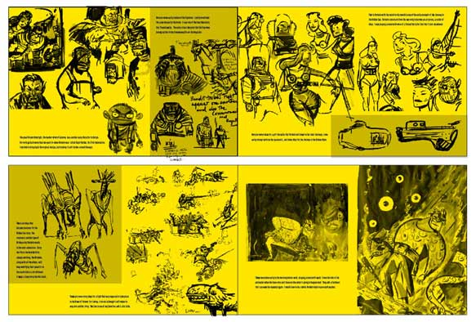
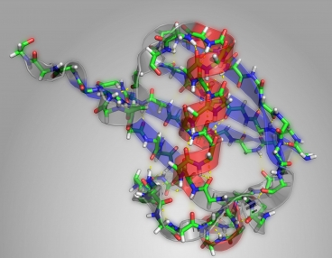
Notes:
Comparative Media Studies v Chemistry
Both require involved librarians
Collaborative v requests
Involved in research v supportive on the side
Pushing the envelope on information use and reuse, pushing the envelope on immediacy needs

Slide 11
Commonality

Slide 12
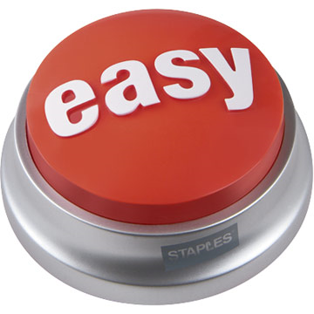
Notes:
Need Easily accessible information

Slide 13
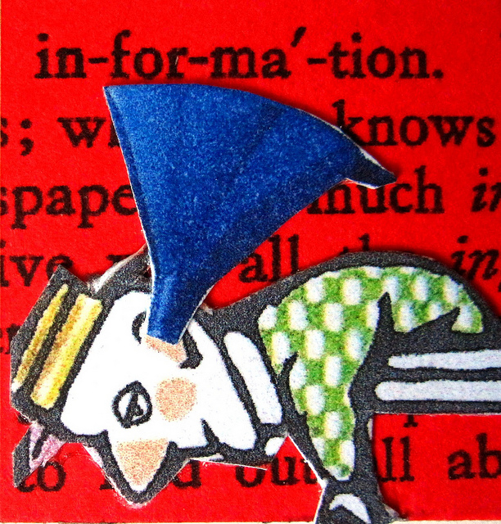
http://www.flickr.com/photos/49333775@N00/5366688138/
Notes:
Information overload

Slide 14
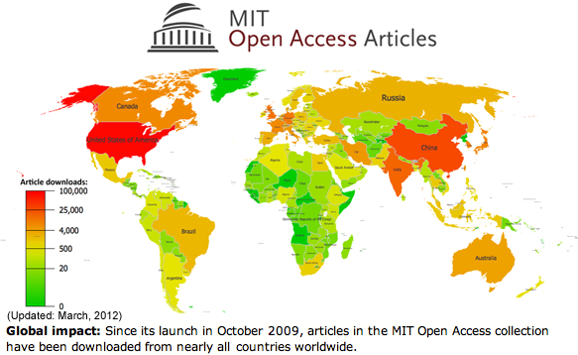
Notes:
Common (mostly!) values of openness, sharing with the world
All a part of MIT – common Open Access Policy, common institutional priorities

Slide 15
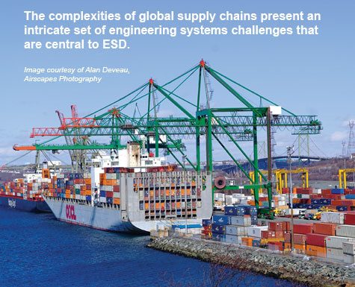
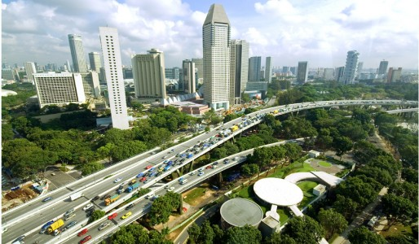
Notes:
Multidisciplinary approaches

Slide 16
Universal structures
Notes:
Universal needs mean universal support structures will be helpful

Slide 17
Characteristics of a successful liaison program, examples
Liaisons understand the research and teaching directions for their assigned communities, both emerging and waning interests, and how we can support those needs.
All new members of the department receive proactive communication from the liaison introducing them to relevant library services.
Liaisons cultivate relationships with publishers and vendors of information products in their fields in order to advocate for their community’s needs
Notes:
Common set of practices and expectations

Slide 18
Department goals and common practices
Increase community’s awareness of their librarian.
Liaisons complete a self-review of their own liaison program and develop at least one learning goal from their findings.
New faculty contact practices
Notes:
Departmental goals drive a common purpose
Tie liaisons into the library mission and strategy (which is tied to the institutional strategy)
Ideally the goals are universal in intention, but can be made specific to a liaison and their communities

Slide 19
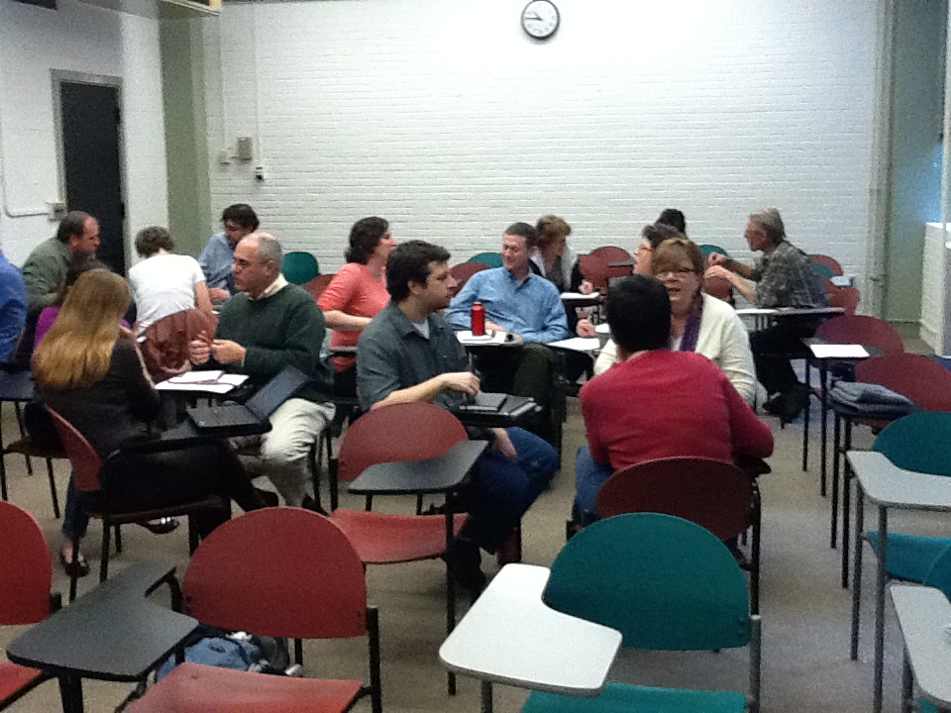
Notes:
Forum to share and learn from colleagues

Slide 20
http://www.flickr.com/photos/dborman2/3290560161/in/photostream/
Notes:
$$ to support activities

Slide 21
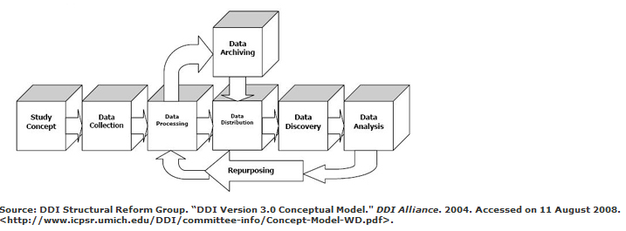
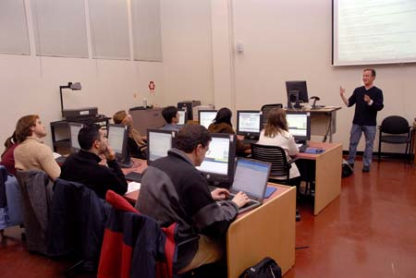
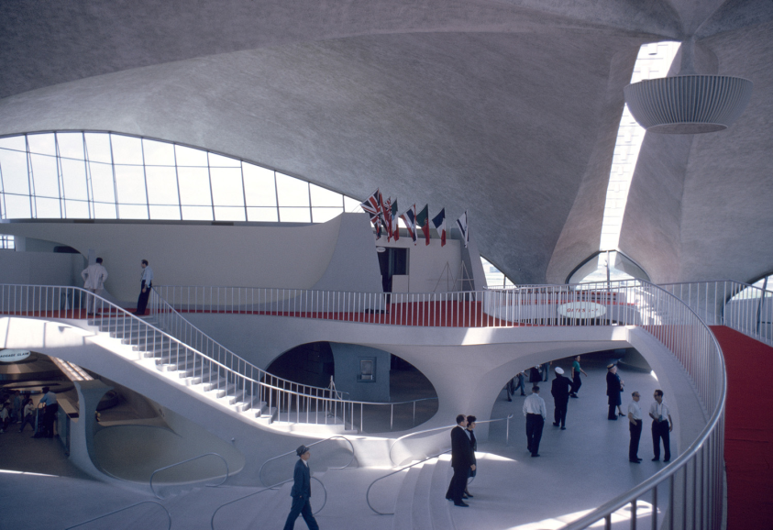
Notes:
Expertise on staff, GIS, Scholarly publishing and licensing, research data management, Images, Video, Instruction, Collections

Slide 22
Understanding User Needs
User experience group
Assessment team
Multidisciplinary groups
Notes:
User experience group – study user needs/ethnographic research to spur deeper understanding of the community
Assessment team – survey results
Multidisciplinary groups – deliberately study cross-departmental initiatives, patterns, and needs

Slide 23
http://www.flickr.com/photos/28551156@N06/2695918301/#/
Notes:
A path for advocacy

Slide 24
What about domain knowledge?
“Embedded Librarians acquire domain knowledge through continuous learning, but not always through formal degrees in a related subject.”
Shumaker and Talley, Models of Embedded librarianship, June 16th, 2009, presentation Washington DC

Slide 25
What else does it take?
The right mix of services
The ability to evolve services
Explicitly changed roles
Notes:
The right mix of services (provided well!)
The ability to evolve services
Explicitly changed roles (e.g. open access support)

Slide 26
Challenges
Library reputation among faculty and students
Difficult for liaisons to know everything in order to respond to the opportunity of the moment.
Ability of the library organization to grow and change in response to user needs
Time!

Slide 27
Examples of engagement
Assessing for Impact:
Co-authoring books
Providing competitive intelligence for a research program
Teaching TAs to evaluate student assignments for information skills
Bringing together documentary filmmakers across the university to collaborate
Sitting in on journal discussion groups with a goal of creating a new class
Helping a faculty member conceive of how to structure a database to hold the data for their project
Notes:
Assessing for impact: Informally liaisons tell me they feel supported better than ever, but what other evidence do we have that they are building close relationships with their communities? Here are some the types of things they are working on.

Slide 28
More…
Assessing for Impact:
Working with lab administrators to demonstrate the value of co-locating researchers in a single building through publishing patterns
Doing original research and writing with faculty in areas of overlapping interest
Finding sources of large data sets to be repurposed in research
Doing a technical analysis of RSS feeds to enable faculty to manipulate incoming publishing data for their research
Working with faculty to create meaningful conference programs, identifying speakers of relevance, etc.

Slide 29
Assessing for Impact:
Notes:
How do (will) we know we’ve made an impact?
Survey – impact of instruction

Slide 30
Assessing for Impact:
Notes:
How do (will) we know we’ve made an impact?
Knowledge and participation in open access

Slide 31
3.091 Learning Outcomes
Assessing for Impact:
Pre-post comparisons: students reported statistically significant gains in 15 of 18 library skills.
http://www.flickr.com/photos/prolithic/6616679503/
Notes:
How do (will) we know we’ve made an impact?
Learning outcomes in classes.

Slide 32
New faculty contact practices
Assessing for Impact:
100% of new faculty contacted
48% result in a face-to-face meeting
61% of new faculty have contacted their liaison librarian in their first year.
92% of new faculty are aware of their liaison librarian, compared to 72% of faculty overall.
Notes:
How do (will) we know we’ve made an impact?

Slide 33
Thank you!
Tracy Gabridge
tag@mit.edu
617-253-8971

