Slide 1
Directly Supporting Researchers
Session 1

Slide 2
Changing roles in research support
Traditional academic librarian
Is a generalist
Serves all users
Is in library
Is a service provider
Provides materials
Standardizes
Responds
Answers individual inquiries
Subject liaison
Is a subject specialist
Focuses on a group
Is in users’ workspace
Is a team member
Provides analysis/data support
Customizes
Anticipates
Creates an ongoing relationship

Slide 3
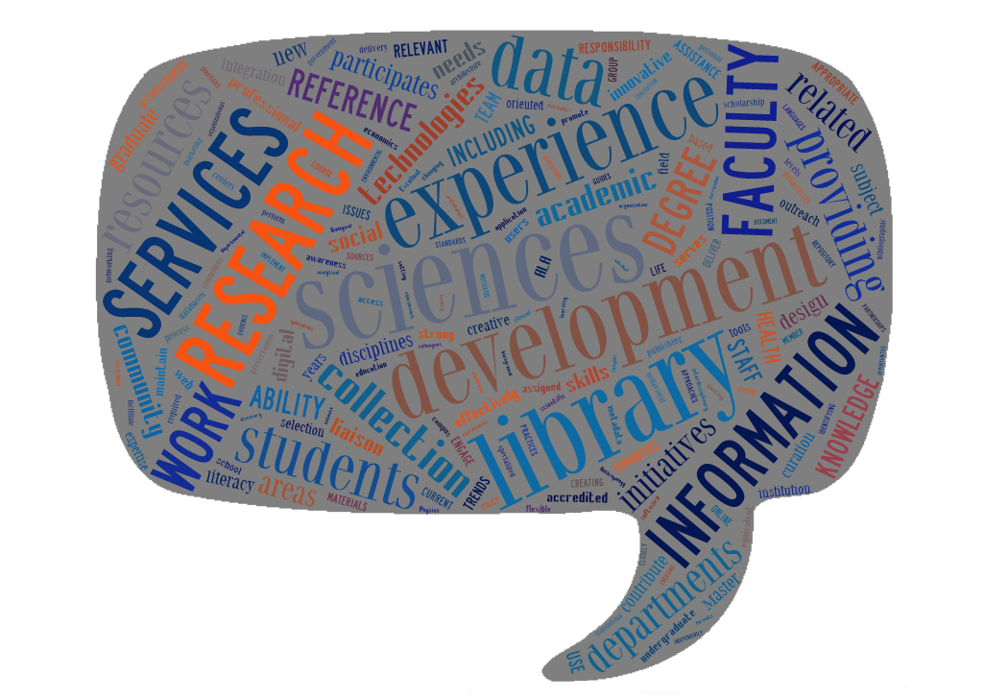

Slide 4
Session 1
Speakers
Kurt de Belder, Leiden University
Tracy Gabridge, Massachusetts Institute of Technology
David Shumaker, Catholic University of America
Reactors
Liz Chapman, London School of Economics
Chris Bourg, Stanford University
Dana Rooks, University of Houston

