Slide 1
Making the Service Turn: Identifying, Supporting, and Sustaining Distinctive Services for the 21st-Century Research Library
Scott Walter
DePaul University
Presented at the OCLC Research
“Libraries Rebound” Conference, Philadelphia, PA
June 5, 2012

Slide 2
Table of Contents
Stories Are Important
The Big Questions
Planning for Services
Celebrating Service
Friedman, V. (2008, July 7). Table of contents: Creative examples. Smashing Magazine. Retrieved from http://www.smashingmagazine.com/2008/07/07/table-of-contents-creative-and-beautiful-examples/

Slide 4
Stories Are Important
“How and what we choose to count and the manner in which we array and display our accounts is a form of narrative – legitimately, necessarily, and inevitably.”
Source: Shulman, L. S. (2007). Counting and recounting: Assessment and the quest for accountability. Change, 39 (1). Retrieved from http://www.changemag.org/Archives/Back%20Issues/January-February%202007/full-counting-recounting.html

Slide 5
The Library Story
The University of Illinois at Urbana-Champaign Library, by the numbers:
12,000,000+ volumes
120,000+ current serials
400,000+ e-books
9,000,000+ microforms
23,000,000+ total items
Source: University of Illinois at Urbana-Champaign Library. (2011). About the University Library. Retrieved from http://www.library.illinois.edu/geninfo/history.html

Slide 6
The Library Story
“Among the Library's most notable collections are its holdings in Slavic and Eastern European history, literature, and science; music, especially Renaissance music; 17th- and 18th-century American and British literature; American, British and Irish history, including a distinguished collection of Lincolniana; French, German, and Italian literature, including world-famous Proust, Rilke, Dante, and Tasso collections; Latin American history and literature; historic and modern maps; linguistics; entomology, ornithology, botany, chemistry and mathematics; and serials across all disciplines.”
Source: University of Illinois at Urbana-Champaign Library. (2011). About the University Library. Retrieved from http://www.library.illinois.edu/geninfo/history.html

Slide 7
The Library Story
“ARL libraries want to be known for their distinctive collections, not by some characteristic shared with every other library.”
Source: Cronenwett, P. N., Osborn, K., & Streit, S. A. (Eds.). (2007). Celebrating research: Rare and special collections from the membership of the Association of Research Libraries. Washington, DC: Association of Research Libraries. Retrieved from http://www.celebratingresearch.org/

Slide 8
The Story Changes
“At the University of Illinois at Urbana-Champaign, we believe that . . . . Fundamental changes in the information and academic environments . . . demand new approaches to defining, designing, and delivering library services. An approach to library service designed for the twentieth century retains limited value if it cannot adapt to the demands of a new era in teaching, learning, and scholarship. To meet the challenge of designing a library for the next generation, we must embrace changes to our organization and to traditional ways of conducting our work.”
Source: University of Illinois at Urbana-Champaign. (2008). Challenge, change, and the service imperative: The University Library in the twenty-first century. Retrieved from http://www.library.illinois.edu/nsm/

Slide 9
The Story Changes
“ARL libraries are increasingly exploring and adopting a range of new roles in serving research institutions, researchers, scholars, and students, making the time ripe for ARL to organize a new report cluster focusing on key new roles. The series will identify and delineate emerging roles and present research on early experiences among member libraries in developing the roles and delivering services.”
Source: Association of Research Libraries. (2009). Transforming research libraries. Retrieved from http://www.arl.org/rtl/

Slide 10
The Story Changes
“We have to live with the enormity of our prior success . . . . We were extremely good at getting computers and hardware to anybody who needed it on the globe. That became who we were. If Kleenex started doing milk, it would be a hard thing for them to brand themselves differently.”
Source: Rosenthal, P. (2012, May 30). Dell focuses outside the box, but it can be hard to break free of old branding. Chicago Tribune. Retrieved from http://www.chicagotribune.com/business/columnists/ct-biz-0530-phil-20120530,0,4671369.column

Slide 11
The Service Turn
“[In] an era when everything we know about how content is created, acquired, accessed, evaluated, disseminated, employed, and preserved for the future is in flux, the research library must be distinguished by the scope and quality of its service programs in the same way it has long been by the breadth and depth of its locally-held collections.”
Source: Walter, S. (2011). "Distinctive signifiers of excellence": Library services and the future of the academic library [Editorial]. College & Research Libraries, 72 (1), 6-8. Retrieved from http://crl.acrl.org/content/72/1/6.full.pdf+html

Slide 12
Why Make a Service Turn?
“Today’s academic libraries face unprecedented challenges. The relentless pace of change combined with increasing levels of complexity and ambiguity are creating chaotic and turbulent work environments. Even the largest and wealthiest of libraries are straining to meet escalating demands for new technologies, new skills, and new services in the midst of static or declining budgets.”
Source: Ray, K. A. (2001). The postmodern library in an age of assessment. In H. A. Thompson (Ed.), Crossing the divide: Proceedings of the 10th national conference of the Association of College and Research Libraries March 15-18, 2001, Denver, Colorado. Chicago: Association of College & Research Libraries. Retrieved from http://www.ala.org/ala//mgrps/divs/acrl/events/pdf/kray.pdf

Slide 13
Why Make a Service Turn?
“The brand has changed out of necessity, the result of an ongoing reinvention to position Dell for a competitive landscape in which PCs are a low-margin business and buyers recognize the need for more ongoing support.”
Source: Rosenthal, P. (2012, May 30). Dell focuses outside the box, but it can be hard to break free of old branding. Chicago Tribune. Retrieved from http://www.chicagotribune.com/business/columnists/ct-biz-0530-phil-20120530,0,4671369.column

Slide 14
Why Make a Service Turn?
Evolving user perceptions of place of libraries in the academic enterprise
Reconsider library “value statement” in light of changes in access to scholarly content
Pursue collaborative initiatives based on shared service goals
Re-envision what “excellence” in academic librarianship means
Promote greater interaction and collaboration across library types
Facilitate strategic planning and resource allocations

Slide 15
The Big Questions
What are the “core services” for a research library in the 21st century?
What makes a library service “distinctive”?
What do discussions of the “collective collection” mean for discussions of “shared service”?
What can a focus on identifying “distinctive services” mean for planning, budgeting, staffing, etc., during a period of constrained resources?

Slide 16
A Taxonomy of Library Services
Traditional
Access
Collection Development and Management
Information and Assistance
Contemporary
Teaching and Learning
Outreach and Engagement
Emergent
Student services
Scholar services
McMaster University Library Mills Learning Commons http://library.mcmaster.ca/category/library-news/mills-learning-commons

Slide 17
A Spectrum of Library Services
Universal
Access Services
More Common
Information Services
Instructional Services
Less Common
Digital Publishing
Copyright Consulting
Distinctive
Harvard University Library Harvard Library Lab http://osc.hul.harvard.edu/liblab

Slide 18
How Broad is Your Service Spectrum?
“The event will offer an interactive forum for library patrons to ask questions, tour the building and see demonstrations about services provided, including electronic resources, personal librarians and free digital images. Information also will be provided on the many items available for checkout . . . . The fair will feature breakout workshops on EndNote Web . . . and on Mining Uncle Sam’s Data, featuring Geographic Information Systems, maps and patents.”
Source: Toland, J. (2010, August 26). Library Fair to feature smoothies, swag, and demos. Retrieved from http://today.ttu.edu/2010/08/library-fair-to-feature-smoothies-swag-and-demos-2/

Slide 19
How Broad is Your Service Spectrum?
“Welcome to the Center for Digital Scholarship. This exciting new concept is brought to you by KU Libraries, whose mission is to serve “as dynamic partners and campus leaders in advancing inquiry and learning for KU, for the state of Kansas, and for an ever-expanding community of world scholars.”
Source: University of Kansas Libraries. (n.d.). Center for Digital Scholarship – About. Retrieved from http://cds.lib.ku.edu/about/

Slide 20
How Broad is Your Service Spectrum?
“We connect people with scholarship. This is the core mission of the research library in the 21st century. It is an inherently active mission and strikingly different than in previous decades . . . . It is simply not possible to connect people with scholarship without collaboration, partnerships, and dynamic interaction.”
Source: Dewey, B. I. (2009). Through any means available: Connecting people with scholarship. Journal of Library Administration, 49 (5), 533-544.
Notes:
20

Slide 21
Learning from Collections
Bowling Green State University Libraries Browne Popular Culture Collection http://www.bgsu.edu/colleges/library/pcl/
Notes:
21

Slide 22
What Makes a Service “Distinctive”?
Does it represent a new approach to, or a new area of, library service that has served as a “lighthouse,” i.e., an innovation that has been broadly taken up by other libraries?
Does it represent a unique or unusual library service closely tied to a distinctive area of strength in the library’s collections or the campus academic program?
Does it represent a unique or unusual library service closely tied to a distinctive aspect of the campus mission, identity, or history?
University of Michigan Library MPublishing http://www.publishing.umich.edu/

Slide 23
What Makes a Service “Distinctive”?
Does it represent a new approach to, or a new area of, library service that has served as a “lighthouse,” i.e., an innovation that has been broadly taken up by other libraries?
University of Southern California Leavey Library Information Commons http://www.usc.edu/libraries/locations/leavey/ic/

Slide 24
What Makes a Service “Distinctive”?
Does it represent a unique or unusual library service closely tied to a distinctive area of strength in the library’s collections or the campus academic program?
University of Illinois at Urbana-Champaign International and Area Studies Library http://www.library.illinois.edu/ias/

Slide 25
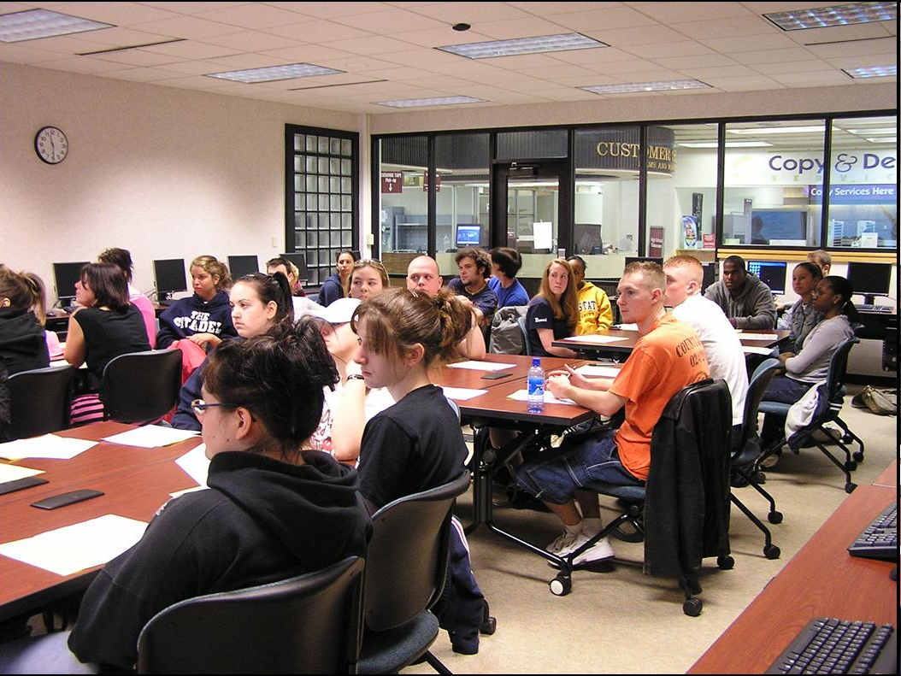
What Makes a Service “Distinctive”?
Does it represent a unique or unusual library service closely tied to a distinctive aspect of the campus mission, identity, or history?
Kent State University Libraries High School Outreach Program http://www.library.kent.edu/page/10973

Slide 26
Shared Distinction
University of Illinois at Urbana-Champaign Center for Academic Resources in Engineering https://wiki.engr.illinois.edu/display/care/Center+for+Academic+Resources+in+Engineering+%28CARE%29
University of Illinois at Urbana-Champaign http://www.eui.illinois.edu/
University of Kansas http://kuinfo.ku.edu/

Slide 27
Authorial Intrusion 1 (also known as “active learning”)
Think about your own institution: can you quickly identify one or more of its “destination collections”?
Can you identify one or more of its “distinctive services”?
Of the “distinctive services” you just thought of, what makes them distinctive in the manner we’ve discussed?
If you cannot think of any that are currently distinctive in this way, can you think of one or more that might be (with additional attention)?

Slide 28
Service Programs
Clear mission
Compelling vision
User-centered goals
Identified constituents and partners
Flexibility in application to promote broad relevance
Commitment to staffing, facilities, resources
Research base
Her Majesty’s Government (HMG). (2011). ITIL Service Design. http://www.best-management-practice.com/serviceDesign2011_demo/

Slide 29
Service Expertise
“As we look back on a decade of extraordinary change in academic libraries . . . [we find] nothing so important to the future of the library and its continued place at the heart of the academic enterprise than its people and the expertise they bring to the design, development, and delivery of library services.”
Source: Walter, S., & Williams, K. (Eds.). (2011). The expert library: Staffing, sustaining, and advancing the academic library in the 21st century. Chicago: Association of College & Research Libraries.

Slide 30
Service Clusters
“[Services are] designed or modified as they are delivered; they are co-created with customers; and service providers must often respond in real time to customer desires and preferences. Services are contextual – where, when and how they are delivered can make a big difference. They may require specialized knowledge or skills. The value of a service comes through the interactions . . .”
Source: Gray, D. (2011, November 21). Everything is a service. Retrieved from http://www.dachisgroup.com/2011/11/everything-is-a-service/

Slide 31
Service Clusters in the Library
“Research is a primary mission of the University, and therefore Harvard’s library collections must be funded and supported accordingly. Harvard’s libraries have an obligation to scholarship that transcends any particular time or contingent circumstances. The collection is paramount to the research university’s library in a way that it is not in the library of a liberal arts college where teaching and curriculum are the overriding concerns.”
Source: Harvard University. (2009). Report of the Task Force on University Libraries. Retrieved from http://isites.harvard.edu/fs/docs/icb.topic869018.files//Library_Task_Force_Report.pdf

Slide 32
Service Clusters in the Library: A Liberal Arts College Model
Undergraduate Research http://thesis.haverford.edu/
Teaching and Learning http://library.wartburg.edu/infolit/
Peer Leadership http://www.grinnell.edu/library
Community Engagement https://www.amherst.edu/academiclife/cce

Slide 33
Service Clusters on Campus
Orientation Leader
Chicago Quarter Mentor
Transition Leader
Milewalker Cast Member
STARS Peer Mentor
Office of Multicultural Student Success Interns
Writing Center Tutors
College of Computing and Digital Media Tutors
Language Tutors
Source: Connelly, A. (2012, May 3rd). University summit focuses on student-tutor relationships. DePaulia. Retrieved from www.depauliaonline.com/news/university-summit-focuses-on-student-tutor-relationships

Slide 34
Shared Services
“Large-scale electronic publishing and the retrospective digitization of millions of print books and journals have produced new centers of gravity around which users congregate with little attention to institutional provenance or ownership. In this environment, the once distinctive value of locally held print collections has rapidly diminished . . .”
Source: Michalko, J., & Malpas, C. (2009). Managing the collective collection. NextSpace, no. 12. Retrieved from http://www.oclc.org/nextspace/012/research.htm

Slide 35
Shared Services
“The intention of this program is to leverage the expertise resident at one or another of the CIC libraries to provide support for staff, faculty and students on other campuses . . . . In the long run, it enhances communication and coordination across our campuses, such that a greater breadth of resources can be proximate to scholars in the Midwest.”
Source: CIC libraries co-invest in Japanese Studies expert. (2011). Center for Library Initiatives News. Retrieved from http://info.cic.net/eNews/CLI/Article.aspx?List=e2b6f931-966b-48a1-a375-36f2c6a5860d&ID=48
35

Slide 36
Planning for Services
Strategic Planning at Illinois http://strategicplan.illinois.edu/planning_cycle.html

Slide 37
Planning for Services:
Values

Slide 38
Planning for Services: Distinctions
“We are in the midst of strategic planning – less than an hour ago we were talking about the concept of ‘excellence’ and could easily point to our collections and several metrics related to them. A little murkier when focusing on services, so this is provocative and timely and definitely strikes a chord.”
Colleges of Distinction http://www.collegesofdistinction.com/home.html

Slide 39
Planning for Services: Choices
“Librarians are always proposing and adding new services, but not always critically examining existing realities in light of our missions, and letting go of obsolete or less useful programs. Given the current economic climate, libraries can no longer afford to maintain the status quo.”
Source: Evangeliste, M., & Furlong, K. (2011). When interdependence becomes codependence: Knowing when and how to let go of legacy services. In D. M. Mueller (ed.), Declaration of interdependence: Proceedings of the ACRL 2011 Conference, March 30 – April 2, 2011, Philadelphia, PA (pp. 490-496). Chicago: Association of College & Research Libraries. Retrieved from http://www.ala.org/acrl/sites/ala.org.acrl/files/content/conferences/confsandpreconfs/national/2011/papers/when_interdependence.pdf
Martinez, R. H. (2011). A Pasadena Latina http://pasadenalatina.blogspot.com/2011_05_01_archive.html

Slide 40
Planning for Services: The Service Bundle
“As the network shifts the pattern of transaction costs, the composition of the internalized “library service bundle” will change. Some services that the academic library has traditionally undertaken will be externalized to others. But it is important to emphasize that the shifting boundaries of the library are not the result of a one-way downsizing process. Even as some activities are shed, new ones will be taken on.”
Source: Lavoie, B., & Dempsey, L. (2010). Rethinking the boundaries of the academic library. NextSpace, no. 17, retrieved from http://www.oclc.org/nextspace/017/research.htm

Slide 41
Planning for Services
Build on strength
Consider campus connections
Acknowledge role in library landscape
Identify collaborative projects and programs
Allocate resources to high-priority services
Planned abandonment of low-priority services
Consider shared services
University of Washington Libraries Libraries budget meeting. http://www.lib.washington.edu/dean/budget.html

Slide 42
Distinctive Services and Strategic Planning
The University Library is committed to:
Improving access to library content and collections;
Preserving and curating physical and digital collections entrusted to its care;
Promoting subject, functional, and technical expertise among its faculty and staff in order to inform the design of Library services and the development of library collections;
Fostering a supportive, inclusive, and diverse environment among its faculty, staff, and users;
Stimulating innovation in library practices, services, and technologies;
Advocating global perspectives on library issues and issues relevant to the broader enterprise of scholarship and scholarly communication; and
Mentoring the next generation of librarians and information professionals.
Source: University Library Strategic Planning Task Force. University of Illinois at Urbana-Champaign. (2012). Strategic initiatives, FY12 – FY14. Retrieved from http://www.library.illinois.edu/committee/exec/documents/2011-2012/Library_Strategic_Initiatives_Final.pdf

Slide 43
Distinctive Services and Strategic Planning
“The university derives its title and fundamental mission from St. Vincent de Paul . . . . As an urban university, DePaul is deeply involved in the life of a community which is rapidly becoming global, and is interconnected with it. DePaul both draws from the cultural and professional riches of this community and responds to its needs through educational and public service programs, by providing leadership in various professions, the performing arts, and civic endeavors and in assisting the community in finding solutions to its problems.”
Source: DePaul University. (1991). History and mission. Retrieved from http://www.depaul.edu/about/Pages/history-and-mission.aspx

Slide 44
Distinctive Services and Strategic Planning
Enhance Academic Quality and Support Educational Innovation
Deepen the University’s Distinctive Connection with the Global City of Chicago
Strengthen Our Catholic and Vincentian Identity
Foster Diversity and Inclusion
Assure a Business Model that Builds the University’s Continued Strength and Educational Excellence
Source: DePaul University. (2012, May 4th). Strategy comes into focus for Vision 2018. Retrieved from http://newsline.depaul.edu/Pages/StrategycomesintofocusforVision2018.aspx

Slide 45
Authorial Intrusion 2 (also known as “active learning”)
Consider the “distinctive services” in your library that you identified earlier
How are they connected to the strategic concerns or historic commitments of your library and/or university?
What resources do you need to sustain and enhance those services?
How might resources be allocated to those services?
How is a commitment to sustaining and enhancing those services built into your strategic plan?

Slide 47
Stories Are More Important
“Are libraries - hallowed, dusty halls lined with shelves and shelves of books in popular imagination - going extinct soon?”
Source: Redefining the library in the age of Google and Wikipedia. (2010, November 2). Retrieved from http://www.ibtimes.com/articles/78072/20101102/library-google-wikipedia.htm

Slide 48
Stories Are More Important
“We have the Internet. We don’t need a library at all. I don’t know anyone who’s been to a library since 1997.”
Source: How the world sees us. (2011). American Libraries, 42 (11/12), 28.

Slide 49
Stories Are More Important
“The introduction of digital technologies built upon the Internet have and will continue to transform scholarly research . . . . This transformational shift is an opportunity for academic libraries. We can reallocate our resources and services from basic information assistance to collaborative and in-depth research assistance.”
Source: University of Rochester. (2009). 5-year River Campus Libraries strategic plan.

Slide 50
Epilogue: Leadership Matters
“Among the messages we hope to convey . . . [are that] leadership matters, no trends are immutable, and that timely and well-informed intervention can decrease the likelihood and severity of negative developments and increase the likelihood of positive ones.”
Source: National Intelligence Council . (2008). Global trends 2025: A transformed world. Retrieved from http://www.dni.gov/nic/PDF_2025/2025_Global_Trends_Final_Report.pdf
Notes:
50

Slide 51
Questions

Slide 52
Contact
Scott Walter, M.L.S., Ph.D.
University Librarian
DePaul University
swalte11@depaul.edu

