Slide 1
Rapid Capture in Special
Collections and Archives Webinar
27 October 2011
Laura Clark Brown, University of North Carolina at Chapel Hill
Ben Goldman, University of Wyoming
Mary Elings, University of California, Berkeley
Erik Moore, University of Minnesota
Brian Wilson, The Henry Ford
Ricky Erway, OCLC Research
Notes:
Introduction:
Welcome to our webinar, Scan and Deliver: Creative User-initiated Digitization in Special Collections and Archives
This seminar presents innovative experiments scanning and delivering digital copies of special collections materials at the request of users. Our speakers have established different, yet equally creative, streamlined workflows to fulfill their users’ requests..
We will hear about common-sense practices: self-serve scanning in the reading room, collaborating with interlibrary loan (ILL) colleagues, and using requests to scan whole collections and populate a digital library. Our speakers will discuss workflows-in-progress, lessons learned, and how they learned to stop worrying and love digital copy requests.
Modern reproductions workflows need not be paralyzing when managed in flexible and economical ways. Embrace the opportunity to leverage digital technology to deliver special collections and archives to users efficiently.
[use the chat feature and be sure to scroll to chat with everybody]

Slide 2
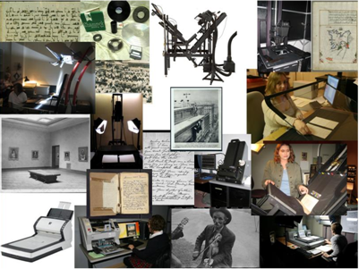
Rapid Capture
Faster Throughput in Digitization of Special Collections
OCLC Research 2011
http://www.oclc.org/research/publications/library/2011/2011-04r.htm

Slide 3

Meeting Demands
For More and More Content
A programmatic approach to large-scale digitization of manuscript collections
The Southern Historical Collection
at the Louis Round Wilson Special Collections Library
Laura Clark Brown
Coordinator of the Digital Southern Historical Collection

Slide 4
The Southern Historical Collection
at the Louis Round Wilson Special Collections Library
The Digital Southern Historical Collection
is a large-scale manuscripts digitization program that employs a set of nimble workflows and technologies to scan and present online multiple streams of content demanded from multiple sources.

Slide 5
The Southern Historical Collection
at the Louis Round Wilson Special Collections Library
Multiple Streams for Multiple Demands
Archivists’ Choice
Special Projects
Donors
Researchers
Preservation

Slide 6
The Southern Historical Collection
at the Louis Round Wilson Special Collections Library
Multiple Streams, Same Nimble Workflows
Pre-Production
Curatorial Decisions
Material Preparation
Production
Scanning
Metadata
Post Production
Online Presentation
Quality Control
Finding Aid Preparation
Quality Control
File Management

Slide 7
The Southern Historical Collection
at the Louis Round Wilson Special Collections Library
Multiple Streams, Same Technological Solutions
HTML finding aids and ingest packages built from XSL transforms of base xml file
Both contain unique identifiers
API created to query CONTENTdm collections and return results
JavaScript added to every HTML finding aid
AJAX query for content and create links if appropriate
Client loads HTML and JavaScript
Javascript makes API call
API searches CONTENTdm collections and returns array (may be empty)
JavaScript builds links if appropriate
Client displays links to pre-coordinated search of CONTENTdm collections

Slide 8
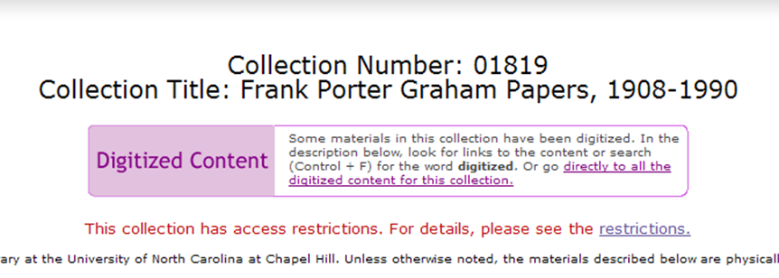
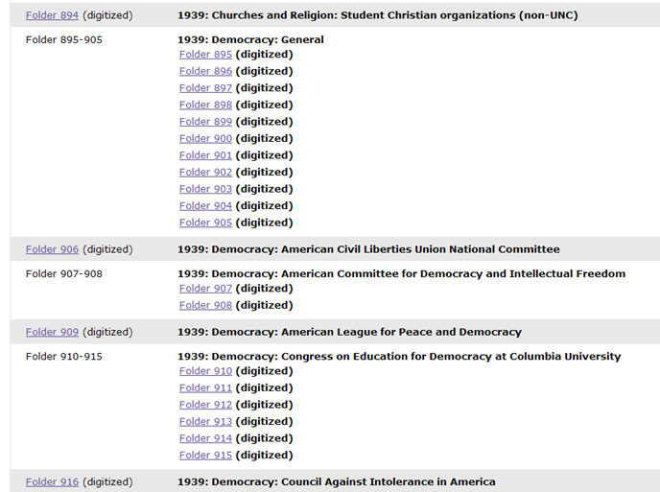
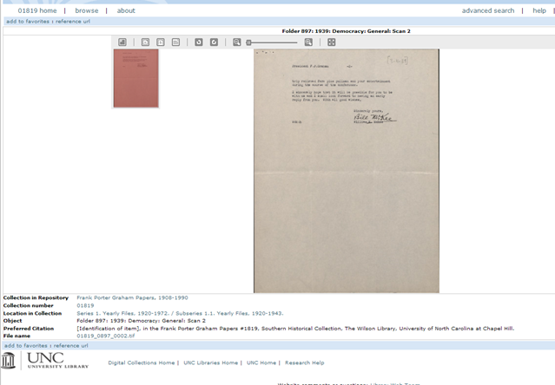
The Southern Historical Collection
at the Louis Round Wilson Special Collections Library

Slide 9
The Southern Historical Collection
at the Louis Round Wilson Special Collections Library
Can we meet the demands for more and more digitized content from more and more people?
of course not . . . but we can start to . . .

Slide 10
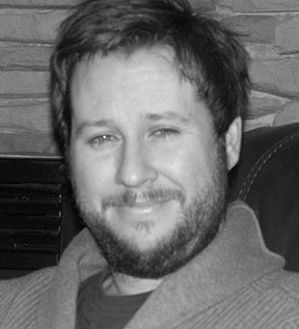
Re-Using Archival Description
Ben Goldman
Digital Programs Archivist
American Heritage Center
University of Wyoming

Slide 11
Mass Digitization at the AHC
Metadata is the most time-consuming task in a digitization project
We already have a team of (6) processing archivists describing collections
RE-USE METADATA
Focus on processed collections with finding aids
Describe digitized material to whatever level the physical materials are described

Slide 12
Details and Results
Use LUNA digital asset management system
  Metadata uploaded via Excel spreadsheets
Dublin Core
  Lots of copy and paste, most fields map to collection-level values
75,000 new items from 60+ collections the last two years, with minimal digitization resources (two part-time students on hourly wage)

Slide 13
Descriptions That Don’t Work
“Accomplishments to Jackson Hole, 1927-1948: Box 1”
“Correspondence, Chronological, 1930-1939: Boxes 65-80”
“Miscellaneous Negatives, undated: Boxes 19-23”

Slide 14
Procedural Opportunities
Describing for the web:
  Manageable chunks described
  Focus on “About-ness”
  Accuracy
  Maintain and improve a “minimal” methodology

Slide 15
Administrative Opportunities
Begin to treat digitization as an integrated part of the archival administration workflow
Collection flow freely between Digitization and Processing staff
Archival staff with dual responsibilities?
Embrace practical levels of reprocessing to support digitization

Slide 16
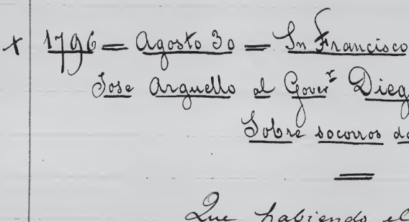
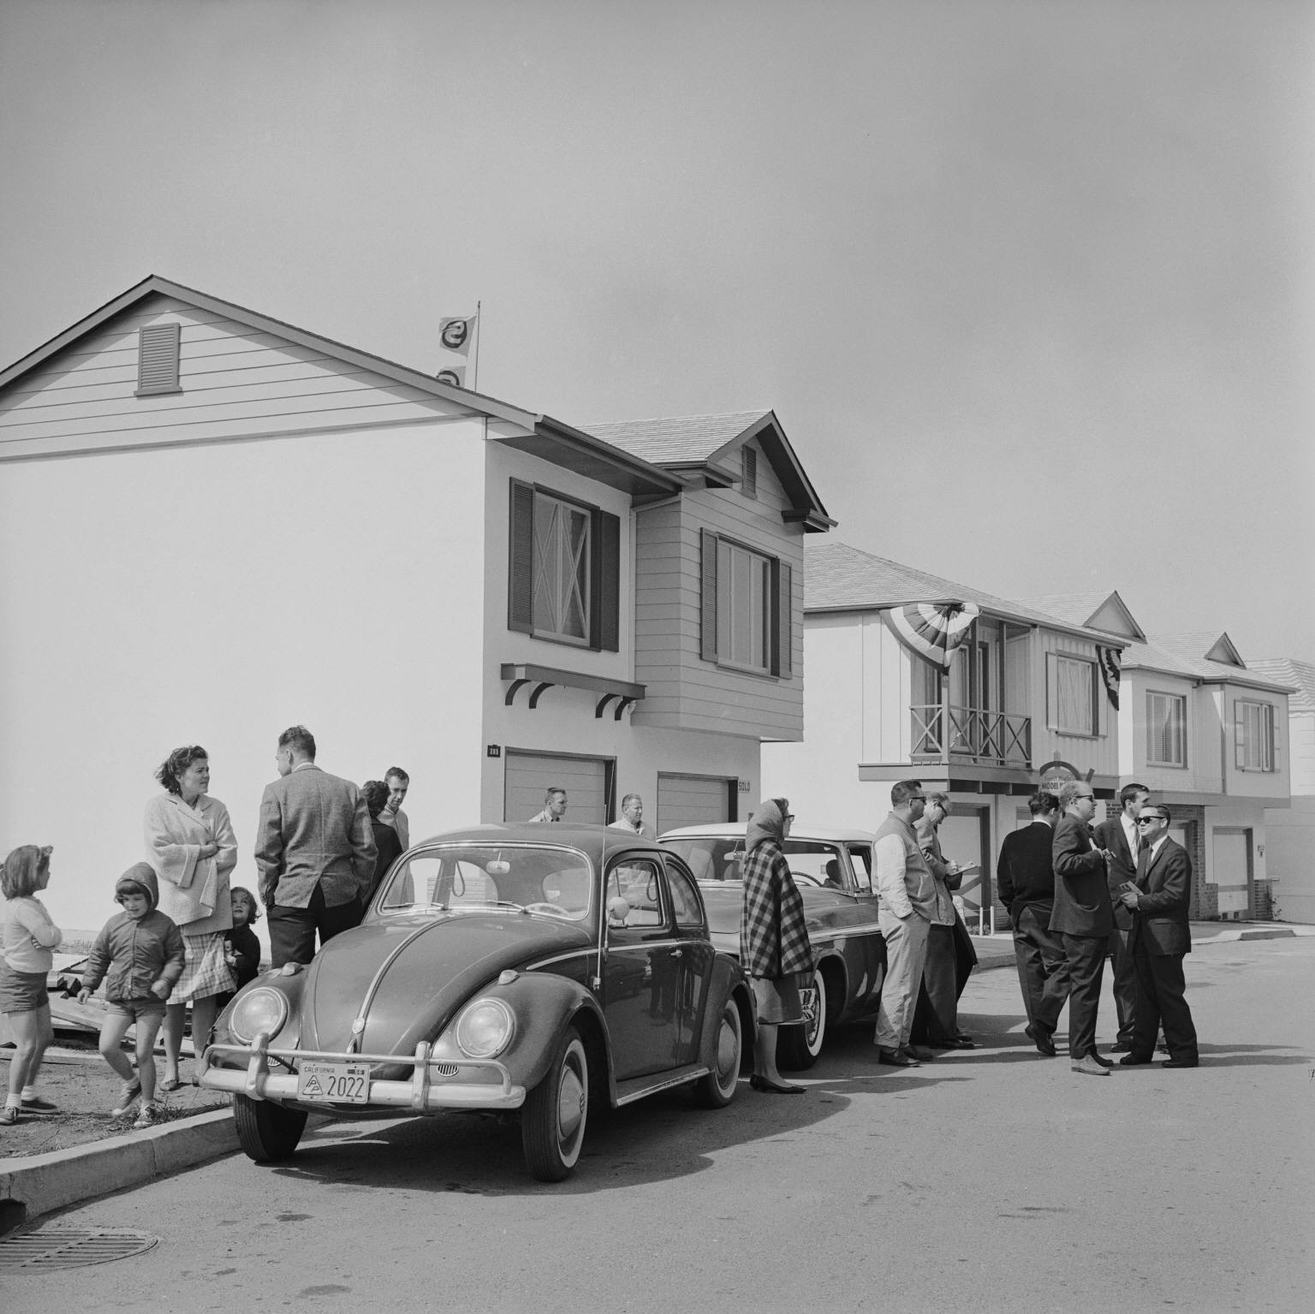
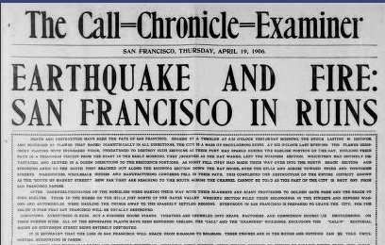
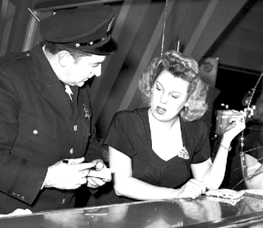
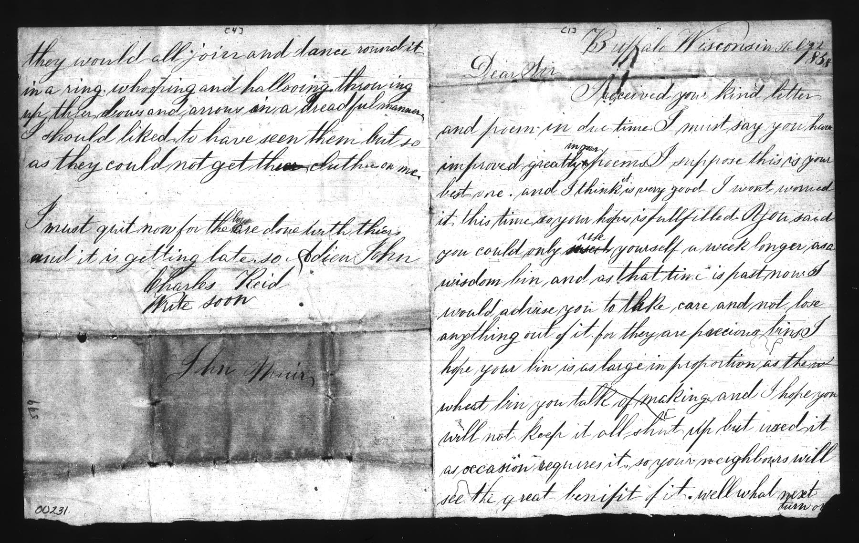
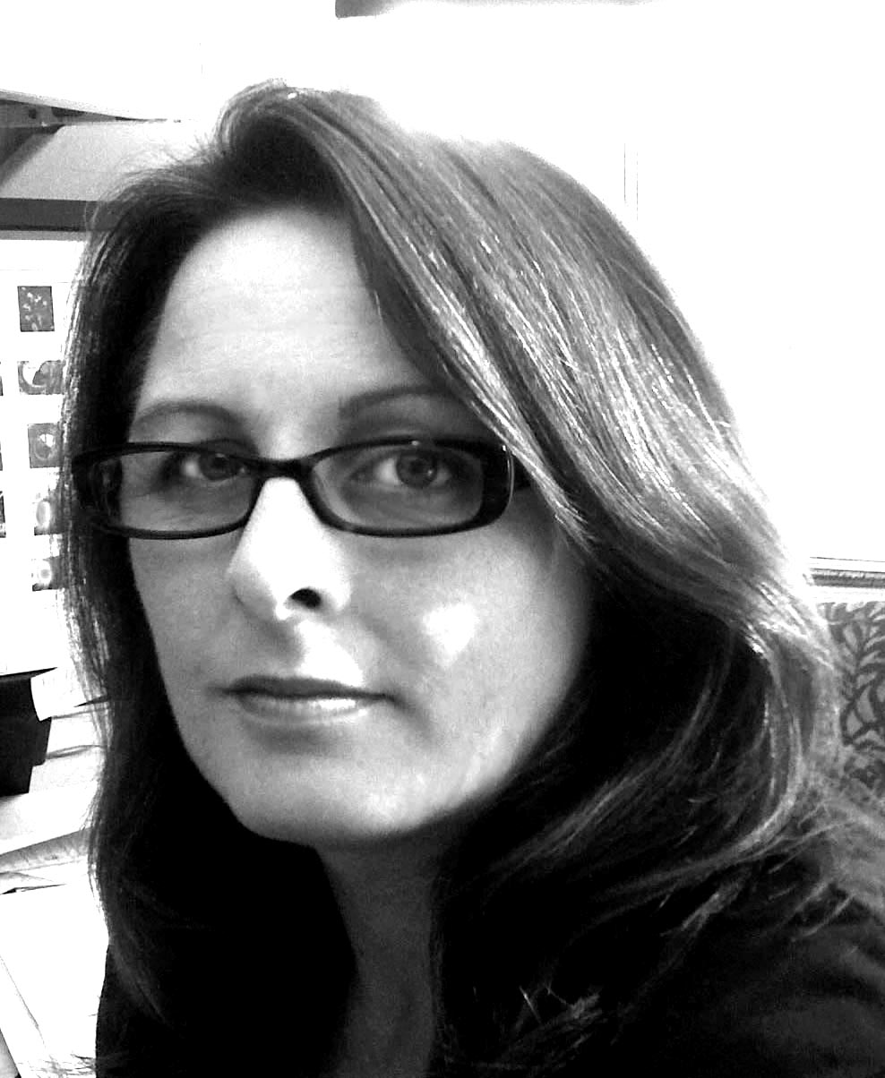
Outsourcing Rapid Capture of
Special Collections
The Quick and the Good:
Mary W. Elings
Archivist for Digital Collections
The Bancroft Library
University of California
This work is licensed under the Creative Commons Attribution-Noncommercial-No Derivative Works 3.0 United States License.
To view a copy of this license, visit http://creativecommons.org/licenses/by-nc-nd/3.0/us/

Slide 17
Outsourced Rapid Capture Projects
Microfilm of Manuscript/Print Collections
2003-2004: Hearst Papers pilot (4,000 pages)
2004-2005: Bancroft Dictations (16,000 pages)
2005-2010: Historic CA Newspapers-NDNP (300,000 pages)
2008-2010: John Muir Correspondence (24,800 pages)
Negatives from Pictorial Collections
2004-2005: SF Call Bulletin negatives (500 images)
2009-2011: SF Examiner negatives (31,000 images so far…)
Mary W. Elings
OCLC Webinar: Rapid Capture in Special Collections and Archives Webinar
27 October 2011

Slide 18
Rapid Capture Stats
~350,000 images from Manuscript Collections
~35,000 images from Pictorial Collections
Mary W. Elings
OCLC Webinar: Rapid Capture in Special Collections and Archives Webinar
27 October 2011
Notes:
18

Slide 19
Rapid Capture Costs
Rapid Capture Costs
Anytime scanner throughput can be increased, costs are reduced.
Doing work in quantity, grouping materials by size, and minimizing handling and equipment adjustments reduces the overall cost of capture.
The Bancroft Library has successfully reduced costs and increased throughput using this methodology.
Traditional Capture
  Paintings, Drawings, Prints
    2,700 images in two years
    $20 per image
Rapid Capture
  Microfilm
    80,000 images in two years
    $0.30 - $0.60 per image
  Historic Negatives
    23,000 images in two years
    $2.50 per image
Mary W. Elings
OCLC Webinar: Rapid Capture in Special Collections and Archives Webinar
27 October 2011
Notes:
19

Slide 20
Outsourcing: Pros and Cons
Outsourcing: Pros and Cons
Pros
  Vendors usually have the expertise and staffing in place
  Vendors can purchase, use, and maintain equipment
  Venders have more work, can make more investment in equipment, and develop more efficient workflows based on volume
  Investment is leveraged across multiple projects
  Cost are fixed and can be budgeted
Cons
  Loss of control over process and materials
  Difficult to send out original materials
  Need to budget for shipping (time and cost) and insurance
  Specifications must be set at outset/contract
  Do not gain staff expertise and equipment
Mary W. Elings
OCLC Webinar: Rapid Capture in Special Collections and Archives Webinar
27 October 2011
Notes:
20

Slide 21

Outsourcing and Partnerships
Outsourcing and Partnerships
  Contracts
  Standards
  Access
  Preservation
  Sustainability
  Quality…
Mary W. Elings
OCLC Webinar: Rapid Capture in Special Collections and Archives Webinar
27 October 2011
Notes:
21

Slide 22
QA vs. QC
QA vs. QC
Quality Assurance ensures the process will meet quality parameters defined for a given project (proactive).
  “How will we create products that meet our specifications?”
Quality Control makes sure the product meets the specifications defined in the process (reactive).
  “Are we creating products that meet our specifications?”
Mary W. Elings
OCLC Webinar: Rapid Capture in Special Collections and Archives Webinar
27 October 2011
Notes:
22

Slide 23
The Quick and the Good
The Quick and the Good
Capture rates can be increased and costs reduced by
  grouping by size and type of material
  minimizing handling
  scanning in volume
  minimizing individual image adjustments
Quality can be ensured by establishing QA at the outset and QC throughout production
Mary W. Elings
OCLC Webinar: Rapid Capture in Special Collections and Archives Webinar
27 October 2011
Notes:
23

Slide 24
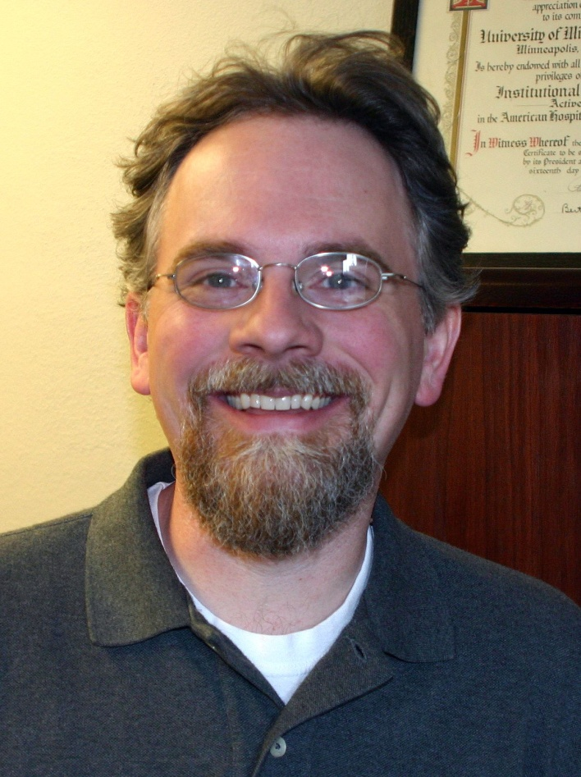
Rapid Capture at the
University of Minnesota Archives
Erik Moore
Assistant University Archivist &
Lead Archivist for Health Sciences
University of Minnesota Archives
moore144@umn.edu
Twitter @moore144

Slide 25
Sustainable Scanning
What we’re scanning:
20th century, mass produced pubs & records Institutional records, informational value No online catalog access to hardcopy
How we are doing it:
DIY digitization, 2 sheet-fed scanners PDFs via institutional repository Viewed as programmatic, not project

Slide 26
Rapid Capture Update
Report | Current
219,074 scans in a single year 500 per hour 0.4% of holdings | 650,000+ scans since 2009 600-700 per hour 1.5% of holdings

Slide 27
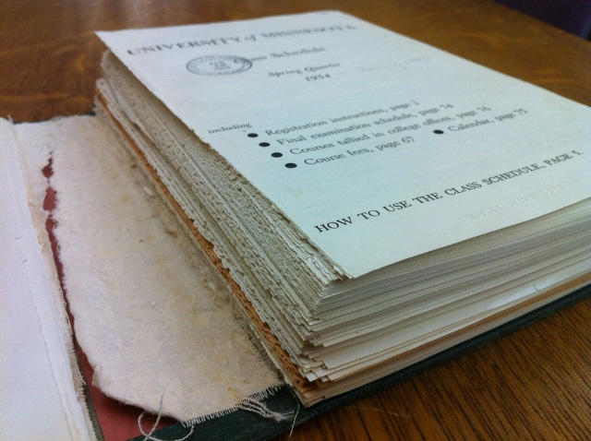
Destructive Scanning
99% of scanning is sheet-fed
Bound items are cut & shaved
Post scanning workflow
  Tied & reshelved
  Foldered & boxed
  Recycled

Slide 28
Digital not Paper
If informational in value & accessible as digital, why preserve the “original”?
  Important ≠ Unique
When reformatted, preservation commitment follows the information
  Preservation ≠ Permanent
Improved upon with full-text searching & portability

Slide 29
Repository not Box
Digitally reformatted materials join born-digital counterparts in IR
Complete run accessible in single location
Preserved as single format
Curtail problem of “little archives everywhere”
Discovery happens elsewhere
Delivery now happens at point of discovery

Slide 30
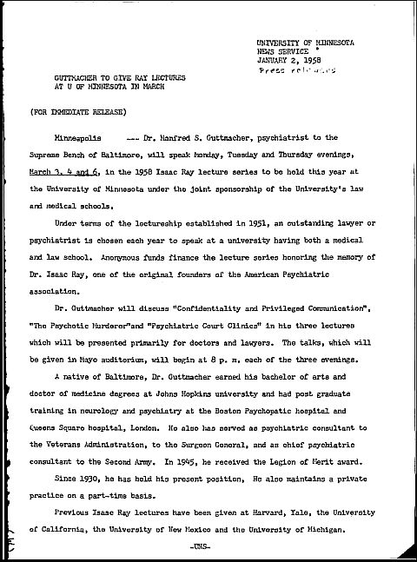
Discovery & Delivery
Is it working?
1958 bound volume of press releases No index; card catalog access to title only Zero recorded prior use Downloaded 771 times since June 2009

Slide 31

Rapid Capture. Rapid Access.
Brian Wilson
Benson Ford Research Center
The Henry Ford

Slide 32
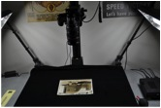
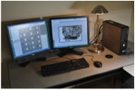
Rapid Capture
Basics
    In place since January 2011
  Camera / copy stand approach
  Based on Yale Beinecke Library RIP
  Using Canon EOS 5D Mark II DSLR
  $8700 total for hardware and software
Stats
  Over 6500 images produced since Feb 2011
  Imaging average: 45 images/hr (8.5 objects/hr)
  Imaging peak: 114 images/hr (57 objects/hr)
  Post-processing average: 50 images/hr

Slide 33

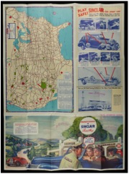
Learning Points
Many Positives
  Can reach published imaging rates
  Documentation publically available
  Plays well with various material formats
  Speed has different meanings
  Process is a “black box”
But
  “Box” is part of larger workflow
  Workflow can involve many stakeholders

Slide 34
Standard Workflow
Imaging
Object Description
File Description
Management
Selection
Ingest
Delivery
FB
RC
Selection
Delivery
RC Imaging
Rapid Access Workflow

Slide 35
Rapid Access
Single PDF per folder
  Entire folder content in single PDF
  1-2 images per page
  Created directly from Adobe Bridge
  Images receive sequential file name only
  Page displays collection name, id, folder number
Accessed through description
  At folder level for EAD; collection level for non-EAD
Presented in website context
  Flexpaper embedded viewer application
  Display of collection information
  Navigation between folders

Slide 36
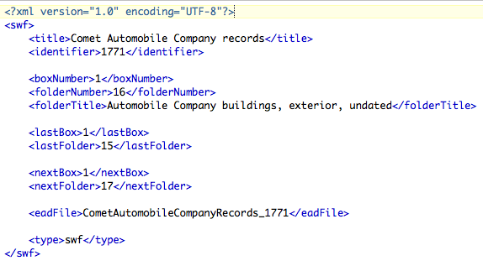
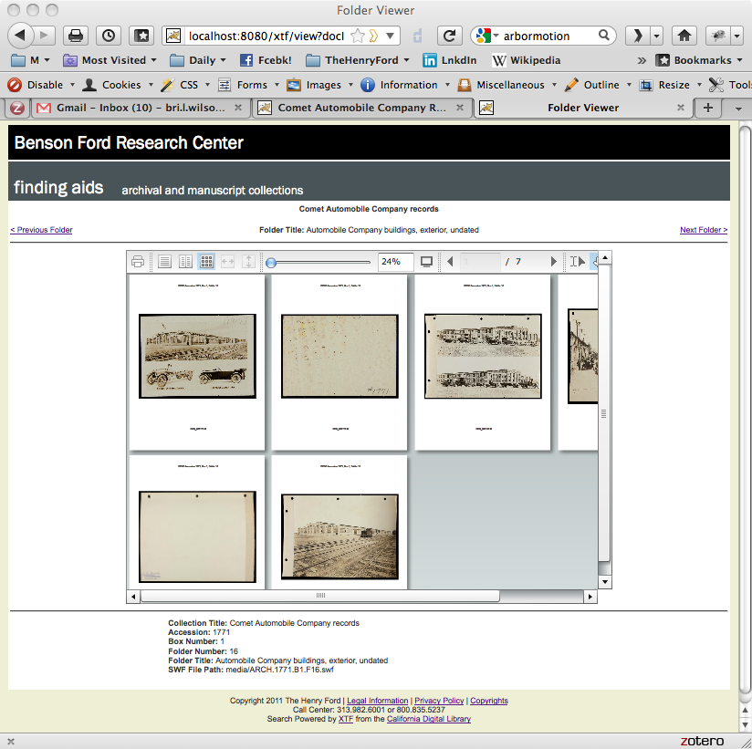
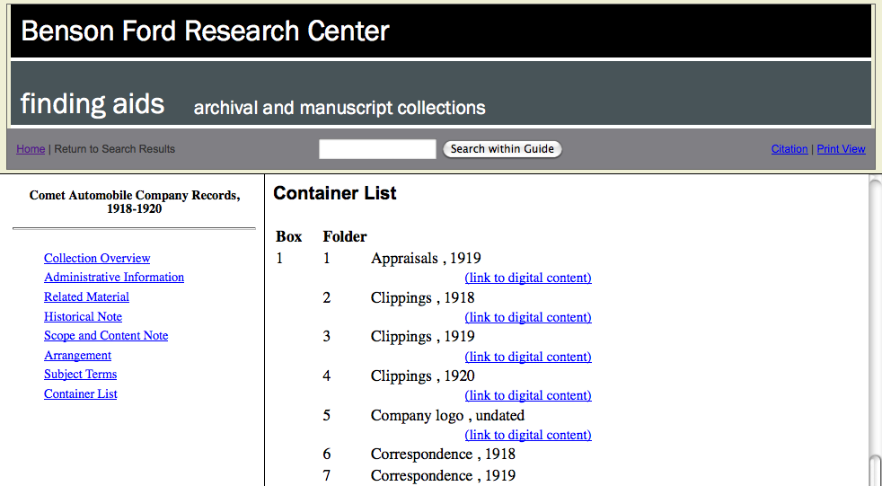
System Components
PDF
EAD
PDF
MS Word
SWF
XML
XTF

Slide 37
Folder Viewer

Slide 38
Development Status
Imaging to Access
    6 hours for 200 photo prints across 20 folders
    Image post-processing = 25%
    PDF creation, linking, etc = 25%
Three collections processed fully to date
Using Flash version of Flexpaper
  An HTML5 version is available
Running on internal network only
Positive staff feedback

Slide 39
Questions?
Laura Clark Brown
University of North Carolina
at Chapel Hill
ljcb@email.unc.edu
Ben Goldman
University of Wyoming
bgoldma3@uwyo.edu
Mary Elings
University of California, Berkeley
melings@library.berkeley.edu
Erik Moore
University of Minnesota
moore144@umn.edu
Brian Wilson
The Henry Ford
BrianW@thehenryford.org
Ricky Erway
OCLC Research
erwayr@oclc.org

Slide 40
References
Adobe Bridge CS5
http://www.adobe.com/products/bridge.html
California Digital Library, XTF
http://xtf.cdlib.org/
Canon U.S.A., EOS 5D Mark II Camera
http://www.usa.canon.com/cusa/consumer/products/cameras/slr_cameras/
eos_5d_mark_ii
Content, Context, and Capacity: A Collaborative Large-Scale Digitization Project on the Long Civil Rights Movement in North Carolina
http://www.trln.org/ccc/index.htm
Devaldi Ltd., Flexpaper
http://flexpaper.devaldi.com/
Dietz, Brian and Jason Ronallo. 2011. Automating a Digital Special Collections Workflow Through Iterative Development. Philadelphia, PA: ACRL.
http://www.ala.org/ala/mgrps/divs/acrl/events/national/2011/papers/
automating_digital_s.pdf

Slide 41
References, Continued
Dunnam, Jennifer, Vicki Field, et al.2006. University Information Assets: Re-Defining the University Archives in a Digital Age. University of Minnesota: President's Emerging Leaders Program. http://purl.umn.edu/5513.
Erway, Ricky, and Jennifer Schaffner. 2007. Shifting Gears: Gearing Up to Get Into the Flow. Dublin, Ohio: OCLC Programs and Research. http://www.oclc.org/research/publications/library/2007/2007-02.pdf.
National Archives and Records Administration. 2007. Plan for Digitizing Archival Materials for Public Access 2007-2016.
http://www.archives.gov/comment/nara-digitizing-plan.pdf.
Schaffner, Jennifer. 2009. The Metadata is the Interface: Better Description for Better Discovery of Archives and Special Collections, Synthesized from User Studies. Dublin, Ohio: OCLC Research.
http://www.oclc.org/programs/publications/reports/2009-06.pdf
Yale Beinecke Library, Digital Imaging Studio
http://beinecke.library.yale.edu/brbltda/dis/dishome.asp

Slide 42
Thank you!

