Slide 1
Collaboratively Building Web-Scale with Libraries
The Web-Scale Platform
OCLC Research
Libraries
Partners
10 June 2011
Robin Murray
Vice President, Global Product Management
OCLC
Notes:
Good morning...
I am...
Front page of OCLC’s business plan for the last few years has had “Building Web-Scale for Libraries”.
This is a long term mission and I think it will be there for many years to come...
This is all very well of course, but it does raise the question “what is web-scale”.
Interesting, because since we started using this term a few years ago, we have noticed others pick it up. Which is nice of course, but you worry that the initial meaning gets lost...
SO....

Slide 2
Collaboratively Building Web-Scale with Libraries
What is Web-Scale?
  Is it the same as “The Cloud”?
  Examples of Web-Scale
Data, Community, Infrastructure
OCLC and Web-Scale
  Data, Community, Infrastructure
  OCLC Product Strategy : The Web-Scale Platform
Collaboratively building Web-Scale with Libraries:
  Where we are today...
Notes:
In terms of what I am going to talk about today:
- Give what I think of as various “definitions” of Web-Scale.
Is it the same as “the cloud” – the answer is no...
Give some obvious examples of web-scale services and see how libraries stack up against those.
What we see as the 3 core pillars of “web-scale” are massive aggregations of data, aggregations of “community”, and aggregations of infrastructure.
You could call community “crowd”, and infrastructure “cloud” – if anyone could come up with an “oud” word for data...
I then want to look at how OCLC stacks up in helping libraries build web-scale
Lastly look our view of how we can incrementally get to web-scale and see where we are today...
So. Web-Scale. If we look at the web today it looks something like this...

Slide 3
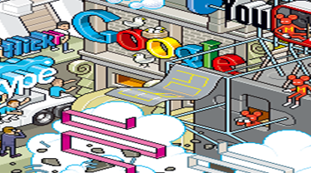
Notes:
3
3
3
3
This is a picture of the web – Google.
No actually, this is the real picture…
CLICK TO FULL PICTURE

Slide 4
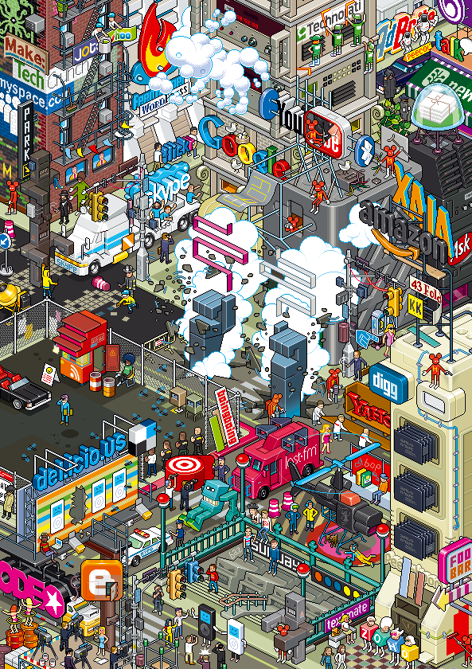
Notes:
4
4
4
4
Depicts the web as a City centre
Been using this for many years now – apologize
It’s a little out of date now (no facebook), but the metaphor still holds
Big question is:
Where is the sign to the library?
There isn’t one…
This is my easiest definition of web-scale – How do you get into the city center on the web?
If you say don’t be daft – that is not possible… if you were to consider a reasonable proportion of the world’s libraries connected – it is a bigger organization than any of these…
TO be a little more sophisticated…

Slide 5

Web-Scale
“'Web-scale' refers to how major web presences architect systems and services to scale as use grows. But it also seems evocative in a broader way of the general attributes of the large gravitational hubs which are such a feature of the current web (eBay, Amazon, Google, WikiPedia, ...).”
Lorcan Dempsey
Notes:
So, that was my definition. In a slightly more eloquent way, here is Lorcan’s definition…
READ
I like the use of the word GRAVITY – mass attracts mass
But it is not just OCLC or Lorcan.
Here is Chris Anderson…
CLICK TO CHRIS ANDERSON…

Slide 6

Web-Scale
The Web is all about scale, finding ways to attract the most users for centralized resources, spreading those costs over larger and larger audiences as the technology gets more and more capable.
Chris Anderson
Notes:
And it’s not just us talking about this…
Here is Chris Anderson
READ
OH, and if it isn’t obvious … SCALE MATTERS

Slide 7
And Scale Matters…
  In a web-economy the rich get richer and…
  =>
  Web Scale is critical for libraries
Notes:
Oh, and it isn’t obvious…
It is clear in the web economy…
Whatever your definition of ‘rich’ – traffic / usage/ money
It is our contention that Web-Scale is absolutely critical to the future of libraries…
Fantastic US headline: “Big sucks at the expense of small”
So how does this notion of “Web-scale” related to the current hot topic of ‘Cloud Computing’
CLICK TO CLOUD

Slide 8

Web-Scale and Cloud Computing
A style of computing in which scalable and elastic IT-enabled capabilities are delivered as a service to external customers using Internet technologies.
-Gartner Group
Simple: Web-based applications delivered remotely.
Cloud = Infrastructure
Web-Scale is more than just Infrastructure
Notes:
A complex definition of Cloud…
A simple definition of cloud…
Bottom line : Cloud is an infrastructure which is required for Web-Scale, but Web-Scale is much more than just infrastructure…
CLICK TO SOME GENUINE WEB-SCALE PROVIDERS

Slide 9




Web-Scale : examples
Infrastructure
Data
Community
Notes:
Who might we think of being web-scale – it’s the guys in the city center
Some genuine web-scale providers
Seem to have these things in common
They have all generated a massive aggregation of data.
Around that data they have generated a massive aggregation of community
And to support that they have delivered a massively aggregated community – and yes it happens to be a cloud infrastructure of course...
So it seems to me that the core pillars of web-scale are...
Massive aggregations of Data, Community and Infrastructure...
So, how do libraries stack up against Web-Scale requirements?

Slide 10
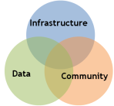

Libraries and Web-Scale?
Infrastructure
Data
Community
Notes:
So, how do libraries stack up...
Well, Libraries have data, infrastructure and community. So they should be well-placed for leveraging web-scale.
The only problem is it looks like this... CLICK (only worse).
Libraries actively disaggregate infrastructure, community and data. This is what keeps libraries in the backstreets...
We estimate some 1.2 Million libraries each with a small sign.
This is what puts libraries in the backstreets
Actively disaggregated – not through any fault, it is just through history.

Slide 11
OCLC: Collaboratively Building Web-Scale with Libraries
Infrastructure
Data
Community
Notes:
So, I finally come back to the title of this talk.
Helping Libraries build web-scale for libraries.
We believe OCLC is uniquely positioned to do this.
I am going to talk a little about data and community and then move on to the main point of this talk which is ‘infrastructure’ – the core platform strategy for OCLC.
So: DATA

Slide 12

Data: WorldCat Growth since 1998
Millions of records
Notes:
12
If you have been to any OCLC presentation ever, you will probably have seen this chart. It depicts the growth of WorldCat
It is fantastically impressive. The statistic I like is that it took
-- 31 years, from 1971 to 2002, to add the first 50 million records
--six years (2002–2008) to add the next 50 million
--and just 1.5 years to add the most recent 50 million.
BUT, THIS IS THE TRADITIONAL VIEW OF WORLDCAT.
What you might not have noticed is this…

Slide 13



Data: WorldCat across Print, License and Digital Data
1.9 billion items and growing!
Physical holdings
in WorldCat
Licensed digital content in library collections
Local library content being digitized
170 million bib records
3.6 million digital items
1.5 billion holdings
325 million electronic database records
NEW!
JSTOR Metadata:
4.5 million records
30 million items
(Google, HathiTrust, OAIster)
Notes:
However the larger part of WorldCat, and the area that is growing most rapidly is this:
On top of the physical holdings ~ ½ Billion license holdings and millions of digital items
Library digitized and mass dig programs
Nearer 2.5Bn today
And when we talk about WorldCat.org, WorldCat Local and Web-Scale Management Services – it is this that they are built on…
So that is Data. WHAT ABOUT COMMUNITY?

Slide 14
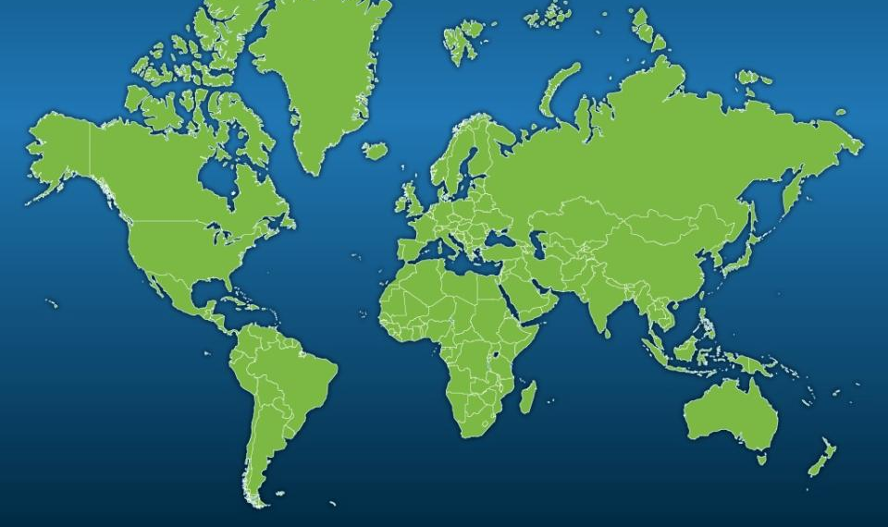
Community: The OCLC Cooperative
72,035 libraries in 171 countries
1,418
5,715
55,820
4,058
1,752
1,091
1,800
381
Notes:
14
14
14
14
14
Well OCLC represents around 70k libraries in 171 countries
Of course this is a proxy for the real community – the users.
But I would claim it is the best starting point that exists…

Slide 15
OCLC Enterprise Strategy:
Collaboratively Building Web-Scale with Libraries
Web-Scale is critical for libraries
  In a web-economy the rich get richer and…
OCLC is uniquely positioned collaboratively build web scale with libraries
  Data, Community, Infrastructure
  Opportunity and Obligation
Notes:
So just to complete the circle – this is why for the last few years…
Web-Scale is critical for libraries…
OCLC is uniquely positioned
Opportunity & Obligation
This is why it is the front page of the business plan…
SO - INFRASTUCTURE

Slide 16
Infrastructure: OCLC Web-Scale Product Strategy
Design for Library Web-Scale
  Design for Scale
  Design for Community
    An Open Platform for “Collective Innovation”
  Design for Capability
    D2D; License Management; Circulation & Acquisitions; Analytics; 3rd Party Apps...
  Design for Economy
    Reduce costs
Notes:
OK – So back to the 3rd leg of the stool... Infrastructure.
I am going to talk briefly about the infrastructure we have been putting in place for the last few years.
How do you design for Web-Scale?
The cataloging and Resource Sharing infrastructure are well-known.
And I could say that they are ‘Web-Scale’ – to some degree they are...
But how big is ‘Web-Scale’ for total library operations?
When we started down this path 3 years ago we did some quick fag-packet calculations...
Just how big is library web-scale

Slide 17

“Library Web scale”
Worldwide libraries and worldwide library transactions
Libraries worldwide 1,212,383
Books: physical processing 15,517,196,010
Back-office transactions 61,879,349
OPAC searches 105,607,800,600
Database searches 36,555,852,000
Circulation / ILL 4,983,393,968
+ Adds/deletes; patron record maintenance, etc.
____________________________________________________________________
Annual transactions 166,041,975,140
Possible with a small farm of commodity servers in the cloud
With appropriately architected software
=> Massive infrastructure cost reductions possible for libraries.
18,954,563 transactions / day
5,265 transactions / second
Notes:
CLICK1
ANALYSIS – INDIVIDUAL TANSACTIONS
CLICK2
TOTAL
CLICK3
RATE
CLICK4
Servers
18,954,563 transactions per day
5,265 per second
Very doable -
BUILD FROM THE GROUND UP TO SUPPORT THIS….
So, we started about 3 years ago with the view that we had to have an infrastructure that was capable of scaling to this level – not that we would necessarily get there, but you don’t want to get to a point where the system just stops…
SO WHAT DOES THAT MEAN?

Slide 18
Design for Web-Scale
Goals
Architecture Features
Responsive
Service Oriented Architecture
Partition by data and domain
Judicious Caching
Embrace Open Standards
Massively Scalable
Network savvy APIs
“Shared Nothing” Architecture
Optimistic Locking
Stateless Services
Highly Fault Tolerant
Asynch. Transactions
Highly Layered
Versioned APIs
Discoverable Services
Data Redundancy
Suitable for Public Consumption
Replication & Failover
Temporary data inconsistency
Avoid Distributed Transactions
Notes:
Well we stated some clear architectural goals
Responsive CIRC HAS TO BE FAST
Massively scalable DIFFERENT
Fault tolerant GOOGLE FAILURE
- Who believes they don’t have any bugs or they have magic hardware that never fails? – NO...
Suitable for public consumption Didn’t understand this
Then we looked at how other had done this:
Amazon; eBay, Facebook – it turns out they have all had to do massive system rebuilds as they scaled because they got it wrong first time.
There are key facets of system design that are required if you want to support this scale, that are just hard and you don’t do if you don’t have to.
So we established key architecture features... CLICK
Not going to go through these one-by-one,
Just pull out “Shared Nothing” / Asynch transactions maybe.
SOA

Slide 19
Design for Web-Scale
Goals
Architecture Features
Responsive
Service Oriented Architecture
Partition by data and domain
Judicious Caching
Embrace Open Standards
Massively Scalable
Network savvy APIs
“Shared Nothing” Architecture
Optimistic Locking
Stateless Services
Highly Fault Tolerant
Asynch. Transactions
Highly Layered
Versioned APIs
Discoverable Services
Data Redundancy
Suitable for Public Consumption
Replication & Failover
Temporary data inconsistency
Avoid Distributed Transactions
Notes:
Now, I have to say that the first time this was all presented to me. I didn’t really understand it.
Then 2 things happened pretty much at the same time.
The first was I was getting a demonstration of what “Discoverable Services” meant – basically every one of the underlying service components (check a book in, check a book out, find a license term etc) is exposed to the network for other programs to find.
At roughly the same time I got one of these, and is one App that changed my life...
CLICK

Slide 20
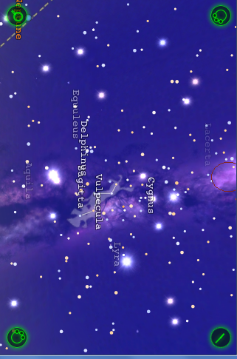
Design for Community : Collective Innovation
Notes:
I got myself one of these...
And I downloaded a few apps – we all know what apps are these days.
And this one literally changed my life
Demo...
Didn’t change my life because I am that interested in astronomy...
The first thing you do is “how on earth does that work”
Then you work it out...
That’s not the bit the changed my life. The real point was “who would have thought of that”.
And that’s the key – If you expose services – GPS, compass etc – suitable for public consumption to the community – GREAT INNOVATION WILL HAPPEN.
Isn’t that just what OCLC should be doing – exposing a rich set of services, suitable for public consumption. The library equivalent of the GPS, Compass, clock etc.
Design to allow collective innovation – a PLATFORM that is extensible and open...
This is what change my life...
SO... How we describe the OCLC technical staretgy is

Slide 21
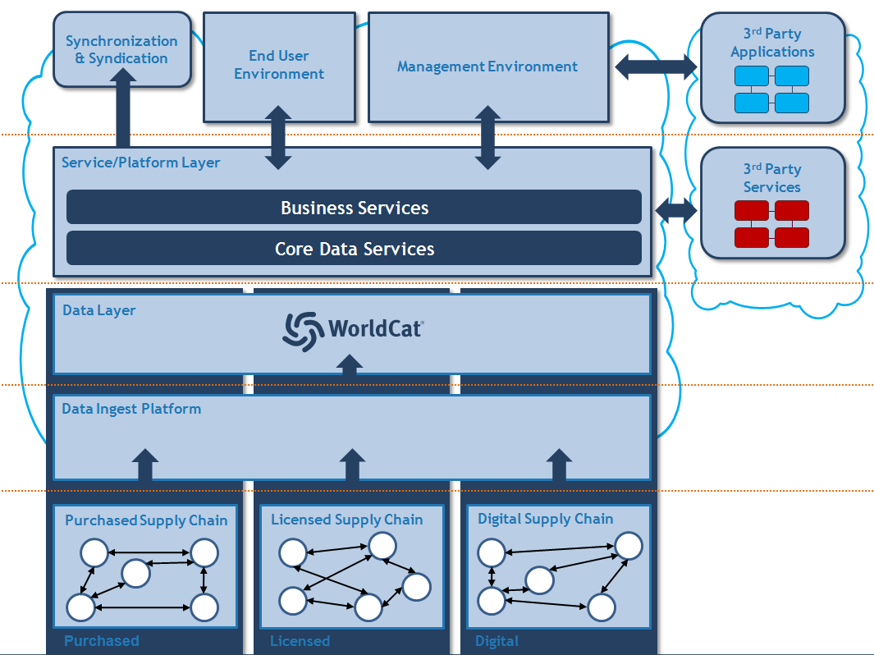
Infrastructure: OCLC Product Strategy
Open and Extensible Platform built on an extended view of WorldCat.
“Open” – 3rd-party systems can make use of core services in a supplier-neutral manner – supporting the widest possible reach of the co-operative and use of the platform.
Extensible” – users, third-party suppliers and the library development community can add services and applications – fostering collective innovation.
“Extended View of WorldCat” – the collection of databases that represent data for purchased, licensed and digital content, exposed through a rich range of network-level data services.
Notes:
Open, Extensible Platform, built on an extended view of WorldCat...
This underpins all the services you will see later...
If we look in a little depth at the platform we see:

Slide 22
The Platform
What is it?
  Innovate, Publish, Share...
Some early examples
  Plugging additional features into an OCLC application...
  Surfacing OCLC services in a 3rd party environment...
  A 3rd party surfacing library services in their app...
Notes:
So I want to go through what the exposure of these services looks like and what it supports...
Explain the use cases:
And then give some early app examples...

Slide 23
The Platform
Business Logic Services
Core Data Services
Registry
KBWC
WorldCat
Identifiers
X-ID
…
Data Layer

Slide 24

The Platform
I want to
Innovate and
Integrate
I want to
Innovate and
Integrate
I want to
Expose and
share
innovations
I want to
Benefit from
others’
innovations
Business Logic Services
Core Data Services
Registry
KBWC
WorldCat
Identifiers
X-ID
…
Data Layer

Slide 25
The Platform
I want to
Innovate and
Integrate
I want to
Innovate and
Integrate
I want to
Expose and
share
innovations
I want to
Benefit from
others’
innovations
Ability to create apps.
(service catalog, service directory)
Ability to publish apps.
Ability to find & install apps.
(App Store)
Business Logic Services
Core Data Services
Ability to share
(Community Site)
Registry
KBWC
WorldCat
Identifiers
X-ID
…
Data Layer

Slide 26
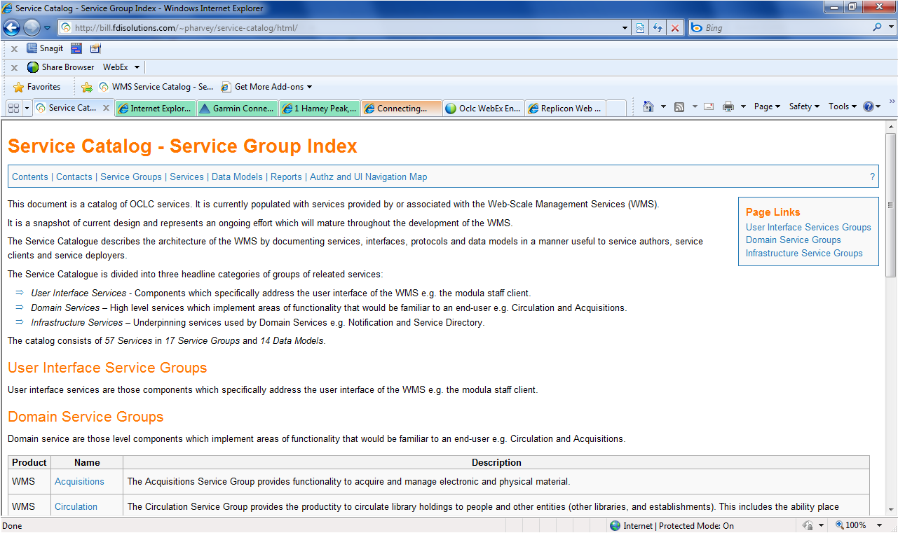
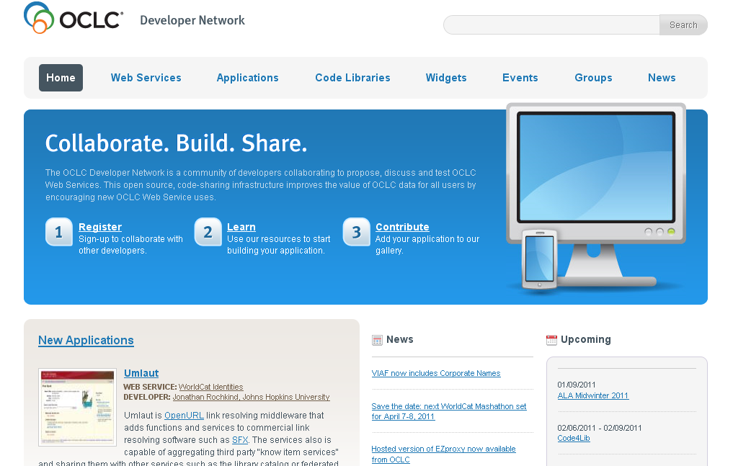
Building Apps
Service Catalog – provides full documentation to the platform
Community Site – provides help and collaboration facilities
Developer Network
‘Hackathons’

Slide 27
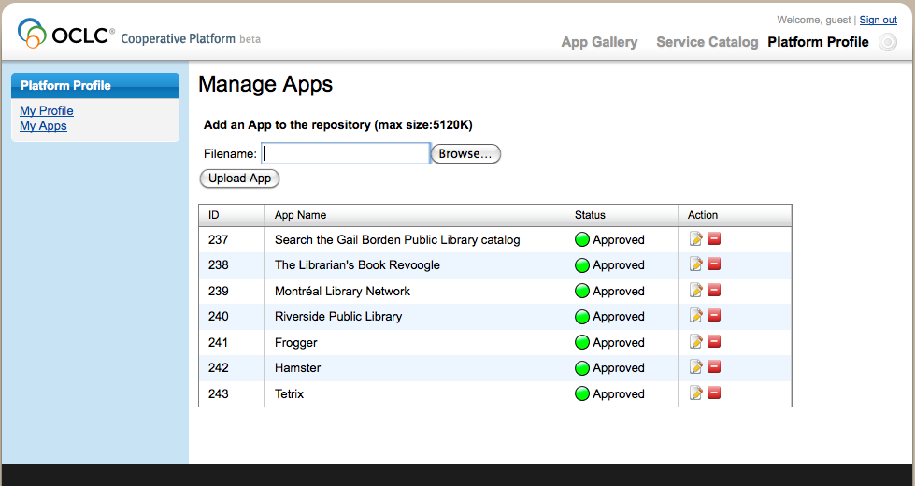
Publishing & Exposing Apps on the Platform
Notes:
So, now that we’ve seen the App Gallery, let’s talk about how those apps get there – which involves the developer role.
Each developer has a Platform Profile, which is essentially his or her Platform workspace. The Profile provides access to the developer’s “personal” information, as well as any of his or her apps.
This screen shows the Profile for a user, including all of the apps that he’s uploaded to the Platform – with status, options to edit, and to delete.
From here, a developer can upload an app to the platform. We’re currently using the Open Social model to integrate apps, so after building the app in the language of his or her choice, the developer describes that app in an XML file and uploads that into the Platform. (The next several slides show this in detail.)

Slide 28
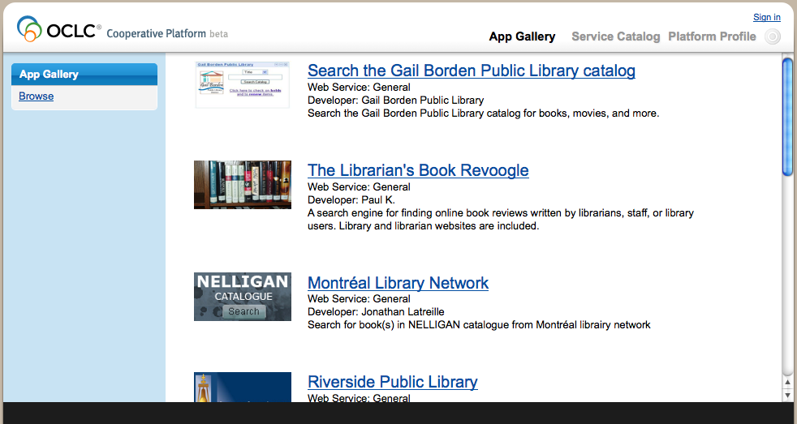
Finding & Installing Apps : The App Gallery
Bestseller.xml
Notes:
The platform supports two primary users: developers who are working with OCLC’s services to build apps and “consumers” – library staff that want to find and install apps created by the development community. We’ll look at both of these roles, starting with the consumer.
The app consumer works in the App Gallery, which provides easy access to all of the apps created locally and contributed by the community. In the example shown here, you see a number of apps that have been developed and shared. The consumer can browse for apps of interest – say, for all Acquisitions apps – or search by specific criteria – for example, I want to see all of the apps that use the budget service contributed by the University of Maine.
The App Gallery provides brief details about each of the apps, with the option to drill down for more details. All you need to do to learn more is click on the hyperlink for the app of interest…

Slide 29
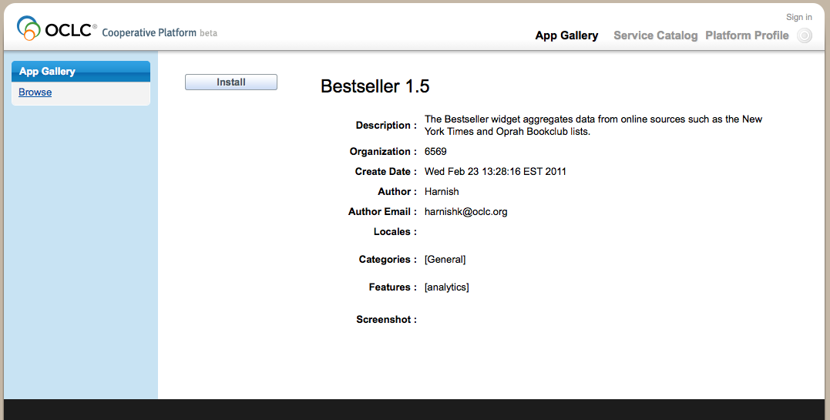

Finding & Installing Apps : The App Gallery
Notes:
And you’ll move to the App Details view, which provides a bit more information about its function, as well was an option to install. In this case, we see information about a “bestseller” app, which is designed to give acquisitions staff more information about activity within the library and trends outside of the library. With this information right at hand, acquisitions staff members can make better decisions about what to purchase.
If you click on the Install button, one of two things will happen:
1. If the app gets installed in the Modular Staff Interface, the user interface through which OCLC delivers its management applications, a single click sets everything up for you. This is how the Bestseller app is configured, so all you need to do is navigate to the appropriate spot in the module in which the app was installed…

Slide 30
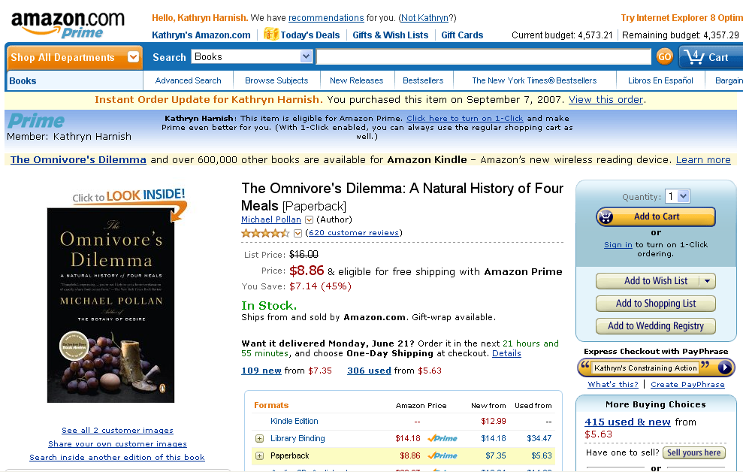
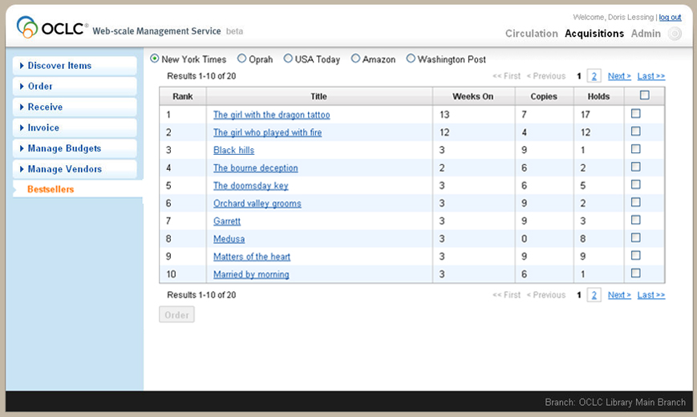
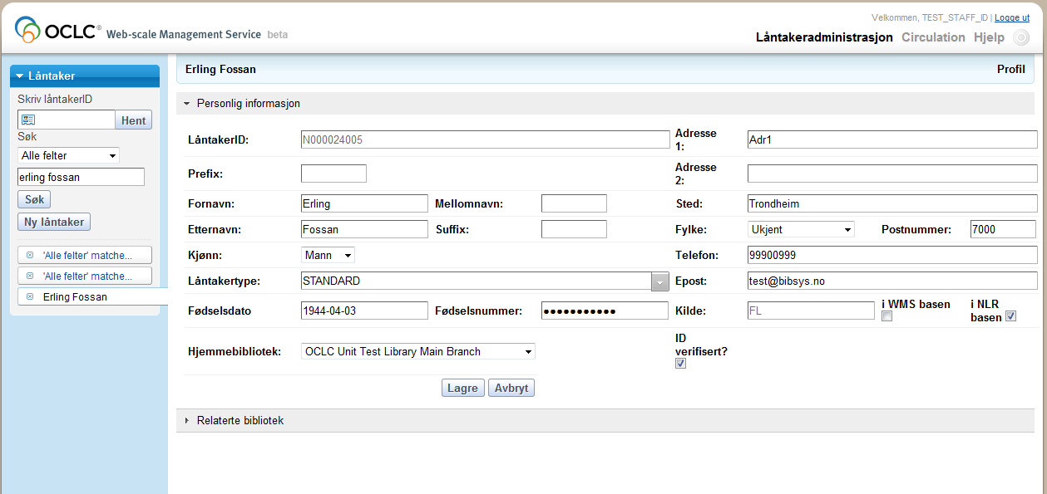

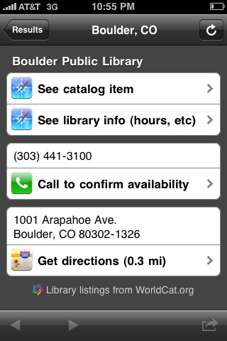

Early App Examples
Current Budget: 4,573.21
Remaining Budget: 4,348.43
http://redlaser.com

Slide 31
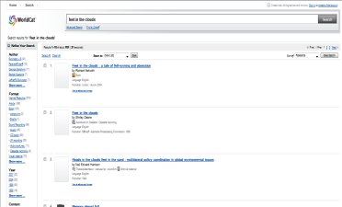
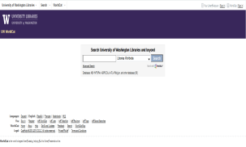
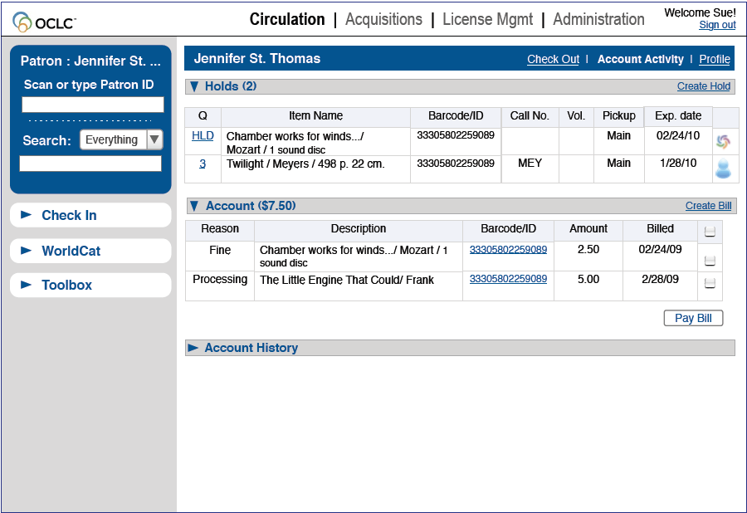
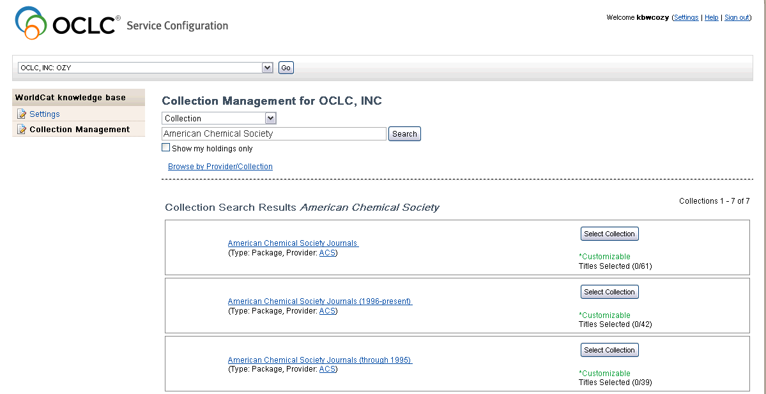
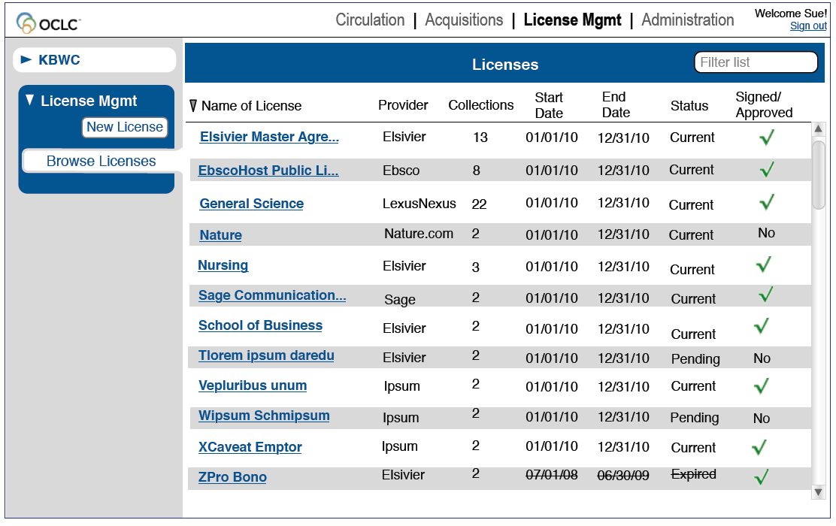
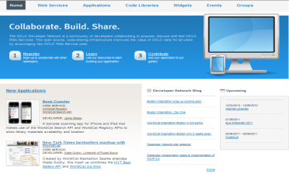
Current Status...
Global Library Exposure : WorldCat.org
  Search-engine syndication; Google books; affiliate sites...
  >1M referrals to libraries/month
Discovery to Delivery : WorldCat Local
  ~1200 libraries live with WorldCat Local
Circulation & Acquisitions
      First sites live now.
Knowledge Base Management
      Available Now. Free as part of cataloguing
License Management
    Pilot Jan 2011. General Availability mid-2011
Open Platform
  DevNet now; Pilot March; Full Platform mid-2011
Notes:
So where are we in terms of rolling out a web-scale infrastructure...

Slide 32
Collaboratively Building Web-Scale with Libraries: Summary
Web-Scale is Critical for Libraries
Web-Scale : Data, Community, Infrastructure
OCLC has unique position in helping libraries achieve Web-Scale
Web-Scale Platform – designed for collective innovation
Notes:
So that is what we are doing...
In summary...

Slide 33
Collaboratively Building Web-Scale with Libraries
The Web-Scale Platform
OCLC Research
Libraries
Partners
10 June 2011
Robin Murray
Vice President, Global Product Management
OCLC
Notes:
Good morning...
I am...
Front page of OCLC’s business plan for the last few years has had “Building Web-Scale for Libraries”.
This is a long term mission and I think it will be there for many years to come...
This is all very well of course, but it does raise the question “what is web-scale”.
Interesting, because since we started using this term a few years ago, we have noticed others pick it up. Which is nice of course, but you worry that the initial meaning gets lost...
SO....

