Slide 1

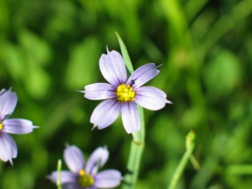
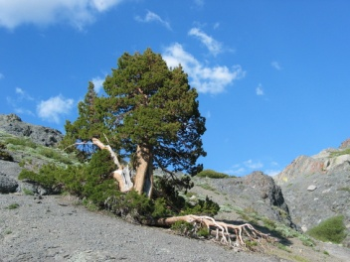
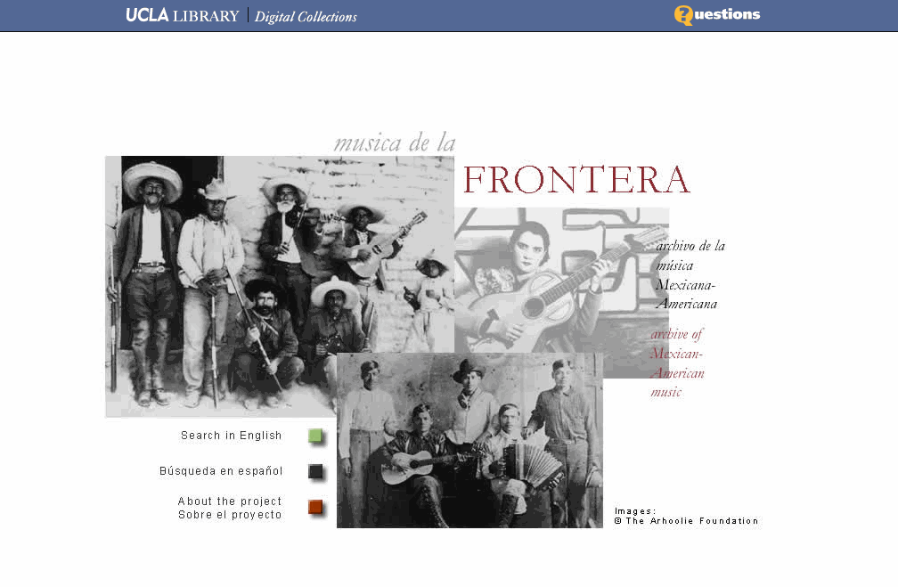
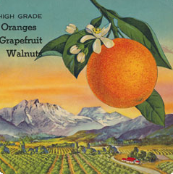

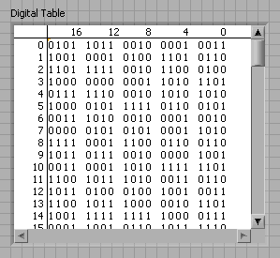
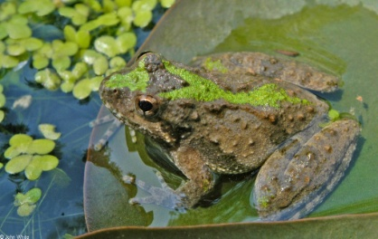
Merritt: A Micro-Services-Based Curation Repository
University of California Curation Center
California Digital Library
November 18, 2010

Slide 2
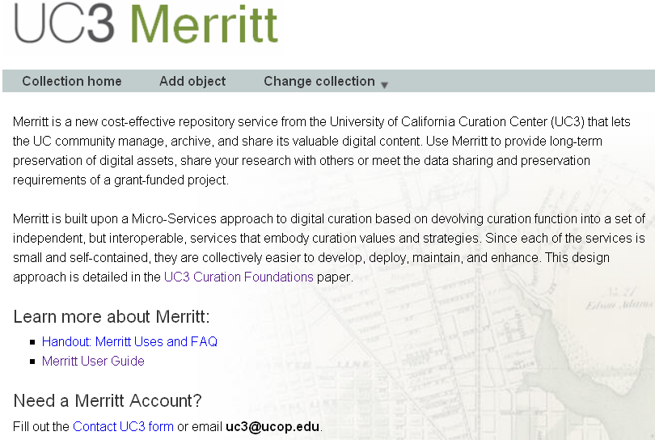
Introducing Merritt
UC Curation Center (UC3)
Curation micro-services
Merritt repository
Demonstration
Next steps
Summary
Discussion

Slide 3


UC Curation Center
Creative partnership between the CDL, the 10 UC campuses, and other peer institutions
A community of shared concern and practice
A channel to pool and distribute diverse experience, expertise, and resources
Robust, innovative, and cost-effective solutions to counteract inevitable disruptive change
Ken Spraque, The Parable of the Fishes

Slide 4
Diversity of stakeholders…
UC Curation Center
Private sector
National / international libraries
Faculty / researchers
Libraries
Museums
IT / data centers
Non-profit
Academic institutions
Organized research units
UC community
External to the University

Slide 5










Diversity of content…
CDL eScholarship Open access publishing
Open Context Archaeological
Minnesota Historical Society Legislative history
Media Hub Program Museum collections
California Digital Newspaper Collection News media
Water Resource Center Archive Environmental
UCTV Multi-media
DataONE member node Scientific
UC3 Web Archiving Service Everything
UC3 legacy DPR collections Anything
… and lots more!

Slide 6
Goals
Empowerment
Features
Provide curators with control of their content
Content sharing
Meet the data sustainability requirements for grant-funded research
Long-term preservation and access
Centrally hosted, or locally deployed
Easy to use interfaces and APIs
Low barriers to submission
Stable URLs for reference
Semantic interoperability
Tools for long-term curation
Permanent storage
Easy configuration

Slide 7
Assumptions
Curated content gains
  Safety through redundancy
  Meaning through context
  Utility through service
  Value through use
Curation is an outcome, not a place
  Focus on content, not the systems in which that content is managed
Curation stewardship is a relay
“Lots of copies keeps stuff safe”
“Lots of description keeps stuff meaningful”
“Lots of services keeps stuff useful”
“Lots of uses keeps stuff valuable”

Slide 8
Moving forward by looking back
The “Unix philosophy” provides a very useful set of design principles
  “Make each program do one thing well”
  “To do a new job, build afresh rather than complicate
  old programs by adding new features”
  “Expect the output of every program to become the
  input of another, as yet unknown, program”
  “Design and build software … to be tried early”
  “Don't hesitate to throw away the clumsy parts and
  rebuild them”
  McIlroy et al., “Unix time-sharing system forward,” Bell System Technical Journal 57:6.2 (1978): 1902

Slide 9
Curation micro-services
Devolve curation function into a granular set of independent, but interoperable micro-services
  Since each is small and self-contained, they are collectively easier to develop, maintain, and deploy
  Since the level of investment in any given service is small, they are easier to replace when they have outlived their usefulness
  The scope of each service is limited, but complex behavior can emerge from the strategic composition of individual atomistic services
  All service interactions through public interfaces

Slide 10
Curation micro-services
Value |  | Annotation | of content by consumers
 |  | Notification | of new content availability
 |  | Access | for retrieval
 |  | Transformation | to create derivatives
Service |  | Search | of content and metadata
 |  | Index | to enable fast search
Curation |  | Ingest | of content for curation
Preservation | Context | Characterization | to extract content properties
 |  | Inventory | of curated content
 |  | Replication | for safety
State |  | Fixity | to verify bit-level integrity
 |  | Storage | for long-term retention
 |  | Identity | for long-term reference

Slide 11
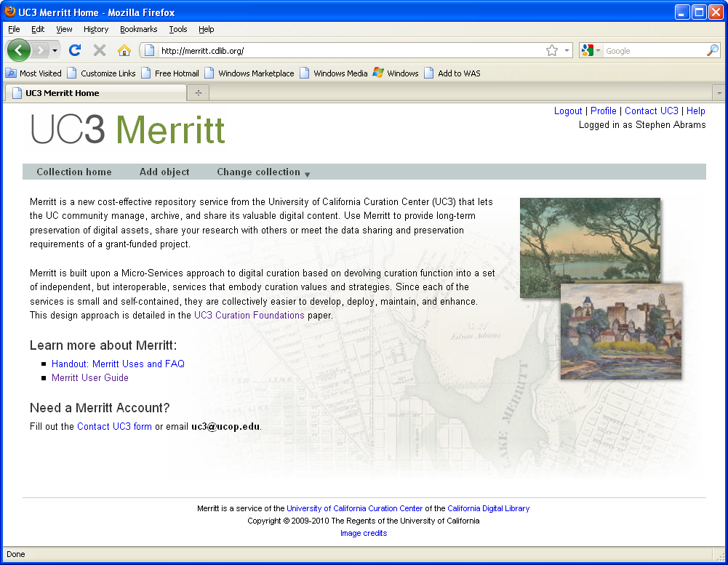
Merritt repository
http://merritt.cdlib.org/

Slide 12
Merritt features
Merritt is content-agnostic
  Contributors can submit any content in any form
  Content can be accompanied by any (or no) metadata
While all forms of content are acceptable, certain forms are preferable
  UC3 offers guidance and best practice recommendations for content creation that is inherently amenable to long-term curation
Merritt supports simplified submission workflows
  Flickr-like interface for people
  RESTful API for machines

Slide 13
Merritt features
Simple, but inclusive data model
Simple, but inclusive data model
Collection
Object
Version
File
Flexible deployment model
  UC3 operates Merritt as a centrally-hosted service
  The underlying micro-services technology can be easily deployed for local use on campuses

Slide 14
Using Merritt
Dark archive for important digital assets
  UCTV
Bright archive with direct discovery and access
  Part of grant-funded research data sustainability plan
Preservation back-end for existing or new discovery and content management systems
  eScholarship, Media Hub, Open Context
Integration with distributed data grids
  Chronopolis, DataONE member node
Local deployments for special-purpose campus repositories

Slide 15
Demonstration
http://merritt.cdlib.org/

Slide 16
Ingest choreography
Create identifier
Identity
Identifier
Submitting user agent
Submit
Ingest
Add version
Node
Notification
Version metadata
Get version metadata
Add version
Notification
Storage
Node
Version metadata
Get version metadata
Inventory
Version metadata
Node

Slide 17
Next steps
UC3 is working with campus partners to determine ongoing development and collection priorities
Annotation
Notification
Transformation
Characterization
Fixity / Linked data
Replication
IDm/Authn/Authz
Ingest, Access Inventory, Queuing
Storage and Identity
Technology watch
Metadata standards
Policy and business model
Data management guidelines
Object and collection modeling
New content
acquisition

Slide 18
Summary
Merritt is a repository for the 21st century
  “Emerging technologies promise … to create transparent access to and delivery of information across formats and collections and to improve the ability of libraries to … build the most effective collections”
UC Collection Development Committee, The University of California Library Collection:
Content for the 21st Century and Beyond, August 2009
An innovative, cost-effective, and sustainable repository solution
Content agnostic, simple interfaces and workflows

Slide 19
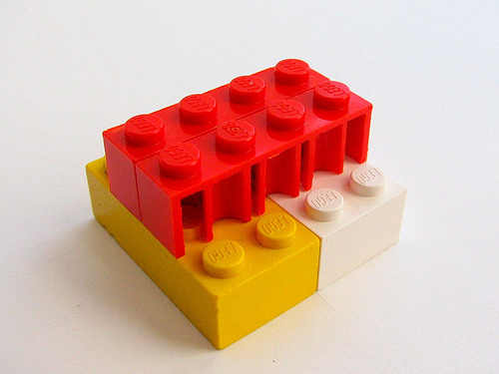

Summary
Implementation of the micro-services concept
Metaphors | Assumptions | Principles | Preferences | Practices
Pipeline | Safety through redundancy | Modularity | The small and simple over the large and complex | Focus on outcomes, not means
Lego bricks | Meaning through context | Granularity | The minimally sufficient over the feature laden | Complexity through composition, not addition
 | Utility through service | Orthogonality | The configurable over the prescribed | Policy neutral, platform and protocol independent
 | Value through use (and reuse) | Emergence | The proven over the (merely) novel | Approach sufficiency through incrementally necessary steps
 | Stewardship is a relay | Evolution |  | Early prototyping, frequent refactoring
 |  | Parsimony |  | Code to interfaces

Slide 20
Summary
Comprehensive support for submission, update, management, discovery, access, and preservation
Mode | Focus | Value | Service |  | Valence | Visibility
Curation | Value | Accretion | Annotation | UI / Access control / Message queue | Interoperation | User-facing
 |  | Visibility | Notification
 | Utility | Accessibility | Access |  | Application
 |  | Derivation | Transformation
 |  | Selectivity | Search
 |  | Actionable | Index
 |  | Stewardship | Ingest
Preservation | Context | Epistemology | Characterization |  | Interpretation | Provider-facing
 |  | Ontology | Inventory
 | State | Reliability | Replication |  | Protection
 |  | Fixity | Fixity
 |  | Stability | Storage
 |  | Identity | identity

Slide 21
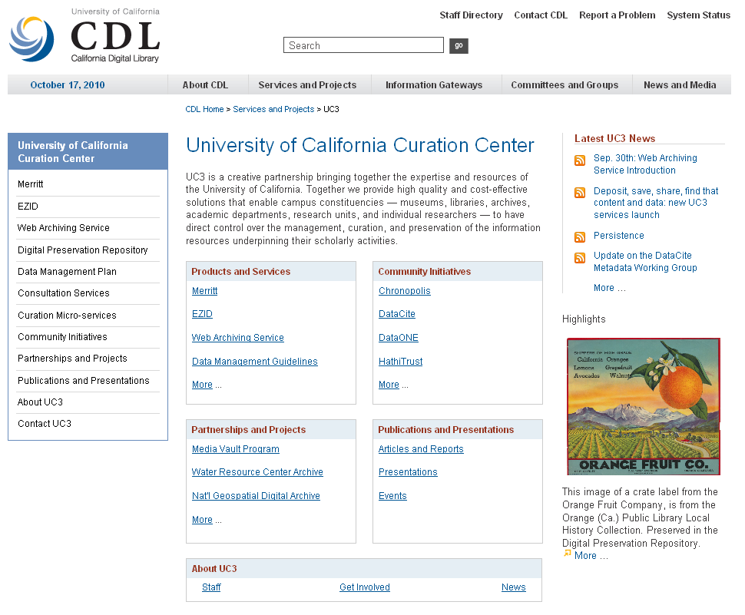
For more information
UC Curation Center
http://www.cdlib.org/uc3
uc3@ucop.edu
Merritt repository
http://merritt.cdlib.org/
Micro-services
http://www.cdlib.org/uc3/cuation
http://groups.google.com/group/digital-curation
UC3/CDL
Stephen Abrams David Loy
Patricia Cruse Isaac Rabinovitch
Scott Fisher Mark Reyes
Erik Hetzner Tracy Seneca
Greg Janée Joan Starr
John Kunze Marisa Strong
Margaret Low Perry Willett

