Slide 1
Taking Our Pulse The OCLC Research Survey of Special Collections and Archives
Jackie Dooley
Program Officer
RLG Partnership webinar
28 October 2010

Slide 2
Overview
Survey population
Project objectives
Data & action items
Organizational profiles
What’s next?
Discussion

Slide 3
What’s wrong with this [big] picture?
Overall collections size is growing
Use is increasing
Too many materials remain “hidden”
Backlogs continue to grow
Staffing is stable
75% of library budgets have been cut

Slide 4
Project objectives
Obtain current data to determine changes across the ARL libraries since 1998
Expand ARL’s survey population
Enable institutions to place themselves in the context of norms
Provide data to support decision-making
Recommend actions based on survey results

Slide 5
Survey population
Libraries surveyed: 275
Rate of response: 61% (169)
Five membership organizations
Association of Research Libraries
Canadian Association of Research Libraries
Independent Research Libraries Association
Oberlin Group
RLG Partnership

Slide 6
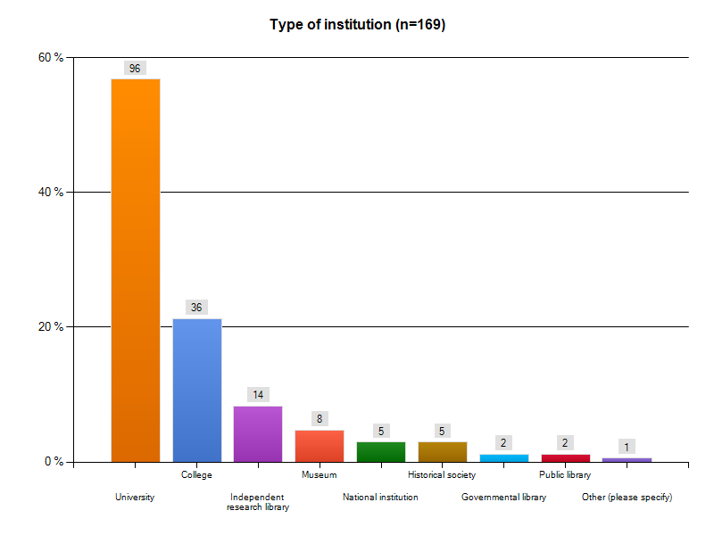
Notes:
6

Slide 7
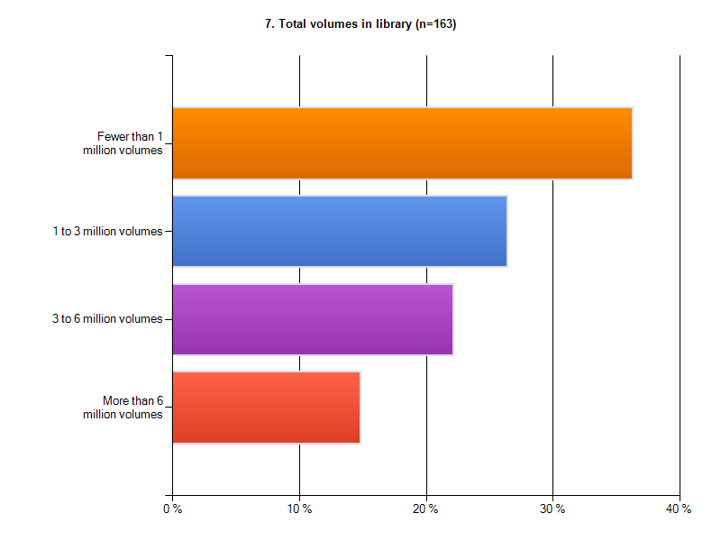

Slide 8
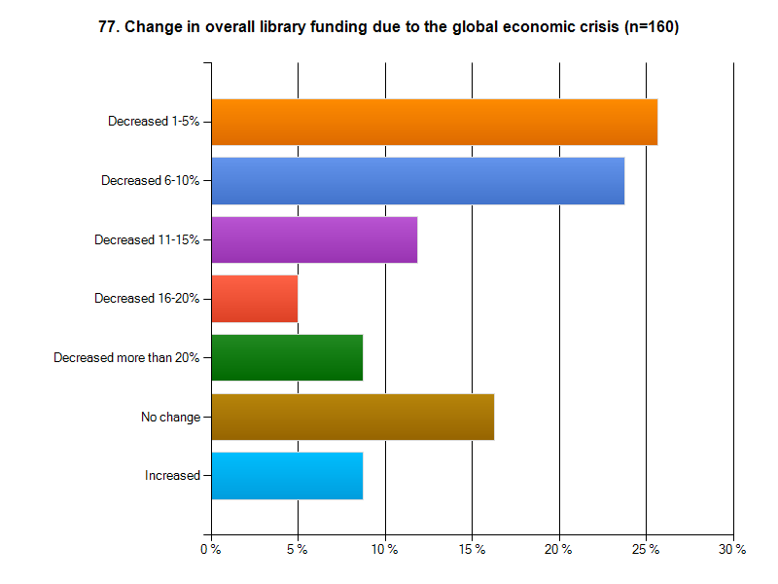
Notes:
8

Slide 9
“Your three most challenging issues” **
Space (by a very long mile)
Born-digital materials
Digitization
** Funding and staffing were disallowed.

Slide 10
Be asking yourself about the action items …
Which are the most important?
Are some not worth doing?
What’s missing?
Who should do what?

Slide 11
Assessment: Action item
Develop and promulgate metrics that enable standardized measurement of key elements of special collections use and management.

Slide 12
Key to percentages:
Red = % of respondents
Black = numerical data

Slide 13
Collections: Growth
Mean ARL collections growth since 1998
Books: 50%
Archives/manuscripts: 50%
Audio: 240%
Visual and moving image: 300%
Microforms: decreased 80%
Special collections in remote storage: 67%

Slide 14
Collections: Acquisitions
Purchase vs. gift
57% of books are purchased
50/50 institutional and special funds
18% of other formats are purchased
Source of funding
Institutional: 38%
Special: 62%

Slide 15
Collections: Acquisitions Funding
ARL
Mean: $488,000
Median:$200,000
CARL
Mean: $293,000
Median: $103,000
IRLA
Mean: $821,000
Median: $167,000
Oberlin
Mean: $53,000
Median:$18,000
RLG
Mean: $724,000
Median: $268,000

Slide 16
Collections: Acquisitions
Hundreds of new collecting directions
#1: gift
#2: new institutional direction
#3: faculty suggestion
Cooperative collection development
Mostly informal/regional
Very few formal arrangements (5%)

Slide 17
Collections
Materials deaccessioned
Reported by 33 respondents (20%)
Most frequent reasons
Transferred to more appropriate institution (13)
Returned to donor (5)
Transferred to general stacks (4)
Preservation
Audiovisual materials are at “code blue”
Visual materials: problematic, but less so

Slide 18
Collections: Sample questions
Is dramatic growth of collections sustainable? If not, what should change?
Why are formal collaborative collection development partnerships still so rare?

Slide 19
Collections: Action items
Identify barriers that limit collaborative collection development. Define key characteristics and desired outcomes of effective collaboration.
Take collective action to share resources for cost-effective preservation of at-risk audiovisual materials.

Slide 20
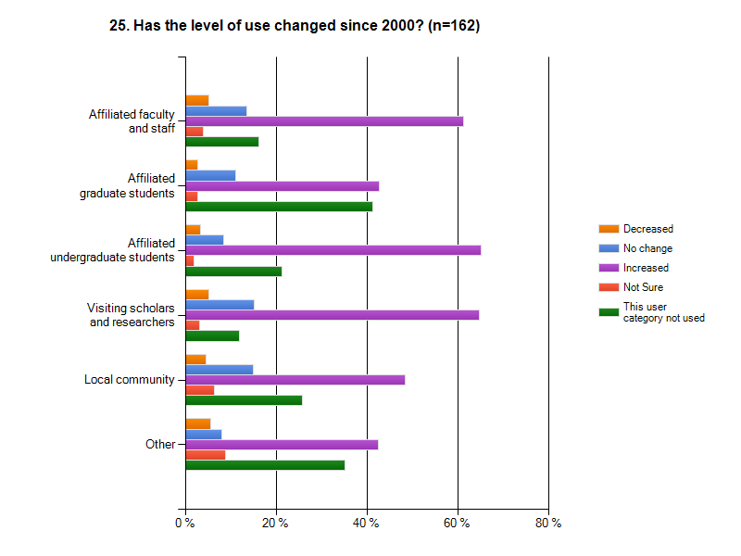
User services
Notes:
20

Slide 21
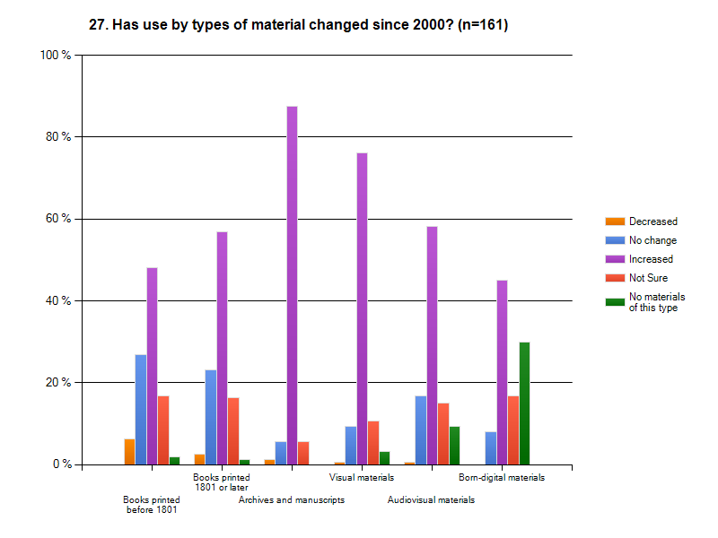
User services
Notes:
21

Slide 22
User services
Percent of each type of user
Faculty/staff: 9%
Graduate students: 5%
Undergraduates: 12%
Visiting scholars/researchers: 24%
Local community: 7%
“Other”: 43%

Slide 23
User Services: Onsite visits
ARL
Mean: 6,200
Median: 3,100
CARL
Mean: 4,900
Median: 2,300
IRLA
Mean: 8,300
Median: 4,400
Oberlin
Mean: 788
Median: 731
RLG
Mean: 7,500
Median: 4,500

Slide 24
User services
Digital cameras permitted: 87%
Access to materials in backlogs: 90%
Interlibrary loan
Loan of original rare books: 38%
Loan of reproductions of originals: 44%
Web 2.0 technologies
Most common: blogs (49%)
Runners up: Wikipedia links, Facebook, Flickr

Slide 25
User Services: Presentations
ARL
Mean: 157
Median: 87
CARL
Mean: 45
Median: 35
IRLA
Mean: 164
Median: 78
Oberlin
Mean: 34
Median: 27
RLG
Mean: 194
Median: 101

Slide 26
User services: Sample question
Does the level of use of special collections justify the resources being expended?

Slide 27
User services: Action items
Develop and liberally implement exemplary policies to facilitate rather than inhibit access to and interlibrary loan of rare and unique materials.

Slide 28
Cataloging and metadata
Online catalog records
Books: 85%
Maps: 42%
Archival formats: 50% or less
ARLs show minimal improvement in “exposing hidden collections”
Backlogs
Decreased: 59% (books), 44% (other)
Increased: 25% (books), 41% (other)

Slide 29
Cataloging & metadata: Sample Questions
Why are so many backlogs continuing to increase?
Why hasn’t the emphasis on sustainable metadata methodologies had more payoff?

Slide 30
Cataloging and metadata: Action items
Compile, disseminate, and adopt a slate of replicable, sustainable methodologies for cataloging and processing to facilitate exposure of materials that remain hidden and stop the growth of backlogs.
Develop shared capacities to create metadata for published materials such as maps and printed graphics for which cataloging resources appear to be scarce.

Slide 31
Archival management
Archival finding aids
Online: 44%
Print-only or in local silos: 30%
Simplified processing techniques
Always: 18%
Sometimes: 57%

Slide 32
Archival management
Finding aids tools are not standardized
Most commonly used: word processing, databases
Archivists Toolkit: 34%
Archon: 11%
Institutional archives
Reports to library: 87%
Responsible for records management: 70%

Slide 33
Archival management: Action item
Convert legacy finding aids using affordable methodologies to enable Internet access.
Resist the urge to upgrade or expand the data.
Develop tools to facilitate conversion from local databases.

Slide 34
Digitization
Projects completed and/or active program: 97%
Special collections contributions
Collections content
Cataloging/metadata
Digital image production
Large-scale project completed: 38% (??)
Content licensed to commercial firms: 26%

Slide 35
Digitization: Sample questions
What constitutes an effective large-scale digitization project?
Can we collaborate to complete the corpus of digitized rare books?

Slide 36
Digitization: Action items
Develop models for large-scale digitization of special collections, including methodologies for selection of appropriate collections, security, safe handling, sustainable metadata creation, and ambitious productivity levels.
Determine the scope of the existing corpus of digitized rare books, differentiating those available as open access from those that are licensed. Identify the most important gaps and implement collaborative projects to complete the corpus.

Slide 37
Born-digital archival materials
In a nutshell …
Undercollected
Undercounted
Undermanaged
Unpreserved
Inaccessible

Slide 38
Born-digital materials
Holdings reported by: 35%
Percent held by top two libraries: 51%
Percent held by top 13 libraries: 93%
Digital materials currently held by: 79%
Assignment of responsibility for born-digital management made by: 55%
Education/training needed by: 83%

Slide 39
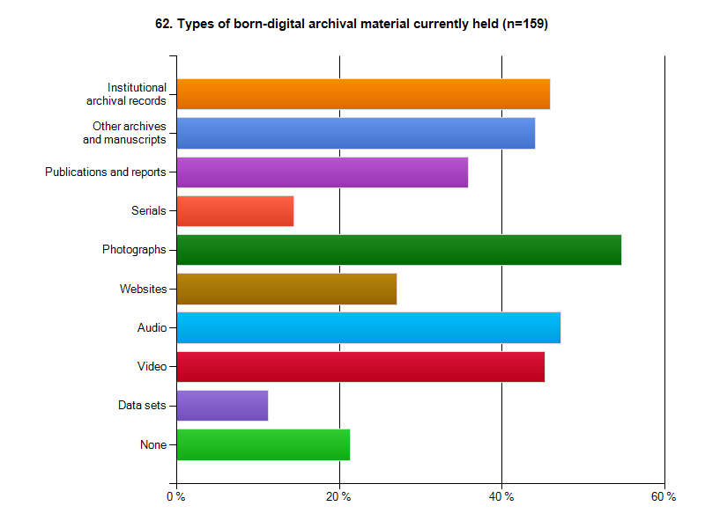
Born-digital materials
Notes:
39

Slide 40
Born-digital materials: Sample questions
What would best help us jump-start progress on managing born-digital archival materials?

Slide 41
Born-digital materials: Action items
Define the characteristics of born-digital materials that warrant management as “special collections.”
Define a reasonable set of basic steps for initiating an institutional program for responsibly managing born-digital archival materials.
Develop use cases and cost models for selection, management, and preservation of born-digital archival materials.

Slide 42
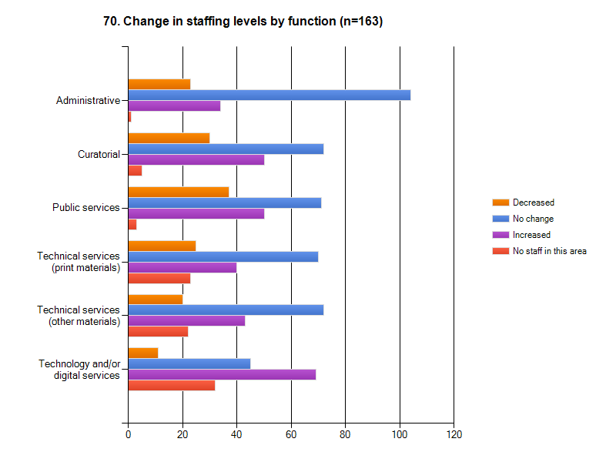
Staff
Notes:
42

Slide 43
Staff
Retirements likely within five years: 9%
Top four educational needs
Born-digital materials
Information technology
Intellectual property
Cataloging and metadata
Multiple special collections units/depts: 25%

Slide 44
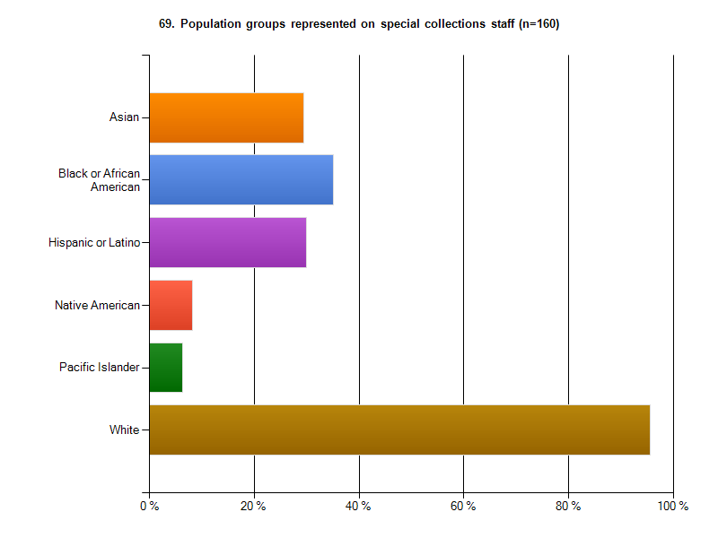
Staff
Note: Percentages are for institutions, not individuals.
Notes:
44

Slide 45
Staff: Action items
Confirm high-priority areas in which education and training opportunities are not adequate for particular segments of the professional community. Exert pressure on appropriate organizations to fill the gaps.

Slide 46
Profile: Association of Research Libraries
124 large university and other research libraries
Lots of comparisons with 1998 data in Chapter 2
Enormous increases in collection size, acquisitions funding, onsite users, presentations
Minimal increase in “exposing hidden collections”
High percent of the overall holdings across the population
97% of audiovisual
84% of archives/manuscripts
85% of printed volumes
80% have special collections in secondary storage
Nearly half reported all users as “other”

Slide 47
Profile: Canadian Association of Research Libraries
31 Canadian research libraries
More than half are also ARL members
Significantly lower than overall means
Special collections size
Acquisitions budget
Onsite users and presentations
Staff
Far fewer permit use of uncataloged/unprocessed materials
Few use EAD or simplified archival processing
Little use of Web 2.0 technologies

Slide 48
Profile: Independent Research Libraries Association
20 independent research libraries
Highest special collections acquisitions budgets
Highest mean number of users
Most active use of Web 2.0 technologies
Most have researcher fellowship programs
Largest mean number of staff
All have decreased budgets

Slide 49
Profile: Oberlin Group
80 elite liberal arts colleges
Most have fewer than one million volumes overall
Smallest in terms of special collections size, acquisitions budgets, users, staff, &c.
Undergraduates are about half of users
Many make digital scans at no charge

Slide 50
Profile: RLG Partnership
Heterogeneous membership: universities, independent research libraries, museums …
Mean numbers (collection size, acquisitions funding, onsite visits, staff size, etc.) all high due to inclusion of large ARLs and most IRLAs
Higher percentages of catalog records and finding aids online than the overall means
Half contribute finding aids to ArchiveGrid
More have collected born-digital materials than the overall means
40% have decreased public services staffing

Slide 51
What’s Next?

Slide 52
Consider the survey outcomes vis-à-vis …
Your institution
How do you compare to various norms?
Your membership organizations
How can members collaborate to move forward?
Your professional societies
Conference sessions? Best practices?
Your professional future
Issues that suggest research projects?

Slide 53
Special thanks to …
Katherine Luce
Research intern
Merrilee Proffitt
Indispensable adviser
Reviewers
Colleagues across the five organizations
OCLC Research colleagues in San Mateo
ARL
Transformative 1998 survey

Slide 54
Taking our Pulse
The OCLC Research Survey of
Special Collections and Archives
http://www.oclc.org/research/publications/library/2010/2010-11.pdf

Slide 55
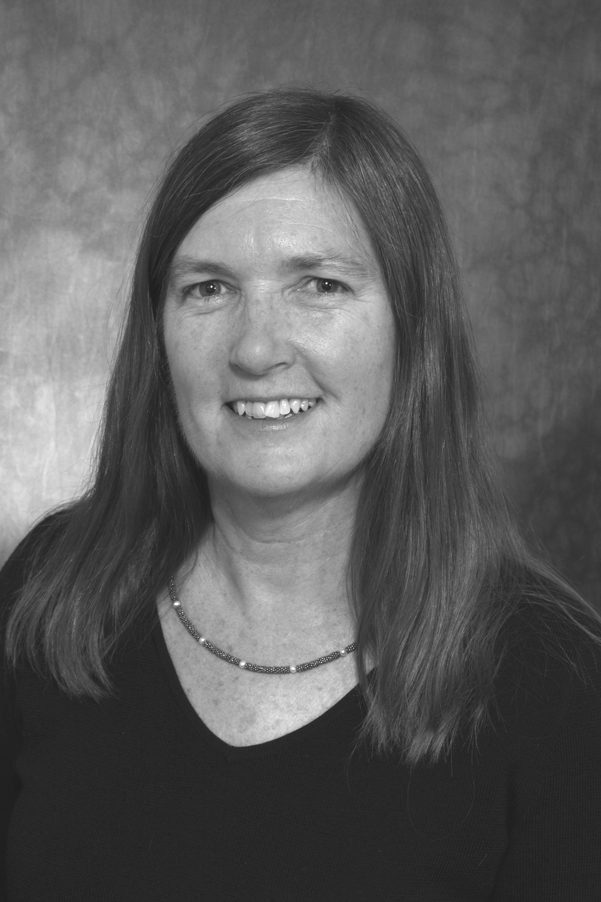
Thank you!
Jackie Dooley
dooleyj@oclc.org

