Slide 1
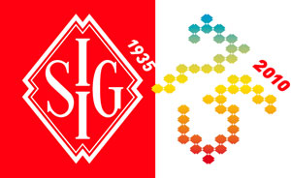
Building collections at the IISH
Moving the past into the future
Special collections in a digital age
Titia van der Werf
Notes:
This is an extended version of the presentation given at the RLG Partnership European Meeting in Oxford, on the 12th of October 2010. The session of the presentation was entitled: “Management of Collections: Working with Donors, Building Collections Now and for the Future”.

Slide 2
CONTENT
Collection characteristics
Characteristics of the collection building process
The organisation of collection building
How to continue?
Framing collection building in the research process
Moving the past into the future
Notes:
Today, I will give you an overview of the IISH collections and of the collection building process and organisation. In view of trends such as internationalisation and digitisation, the Institute is at a turning point now, and we need to re-assess our core tasks: collection building and research. As I will explain, internationalisation and digitisation are opportunities for the Institute to reshape its collection building activity into future-proof molds.

Slide 3
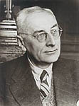
Collection characteristics
The International Institute of
Social History was founded in 1935
by Posthumus
Notes:
Posthumus was a pioneer of modern economic history in the Netherlands and a collector of business archives. Since he was a researcher and collector with a broad vision, he became increasingly interested in collecting the papers of the labour movement and the legacy of 19th century social democracy, that advocated the establishment of a socialist economy through class struggle. With the mounting threat of fascist regimes in Europe, Posthumus felt the urgency of rescuing these endangered papers, and founded the International Institute of Social History: an independent, politically neutral, scholarly institution. The Institute was supported financially by Nehemia de Lieme, director of the Centrale (a worker’s insurance company), who donated a part of its profits to cultural aims of the labour movement. This year, the Institute celebrates its 75th anniversary. See: http://www.iisg.nl

Slide 4
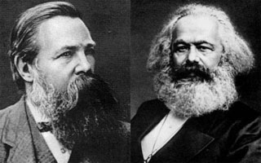
Marx-Engels papers
Notes:
As a result, the papers of Marx and Engels found shelter at the IISH…

Slide 5
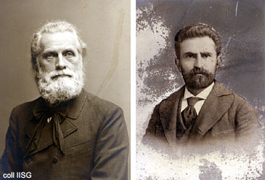
Anarchism
Notes:
important collections of anarchists, including Bakunin’s manuscripts, were smuggled from Eastern Europe

Slide 6
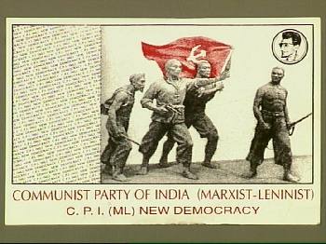
Trade unions and leftist parties
Notes:
The Institute is the home of archives of international trade unions and leftists parties, including the communist parties from former colonies, who played a role in the fight for independence…

Slide 7
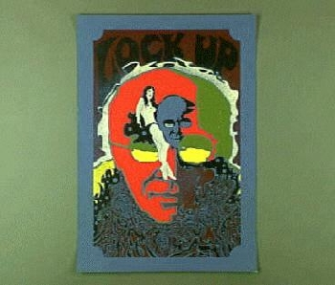
Emancipatory Movements
Notes:
Additions to the collections include all sorts of social movements, that fight against oppression, whether political, economical or social, and that stand for the values rooted in 18th century enligthenment

Slide 8
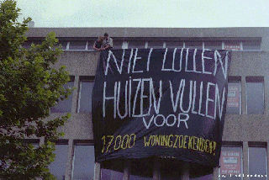
Activists’ movements
Notes:
The Institute also collects so-called “new social movements”, mainly activist and solidarity movements, such as squatter groups, and human rights or environmental groups such as Amnesty Internalional and Greenpeace International…

Slide 9
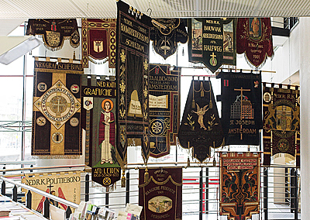
Banners
Notes:
The collections contain all material types: printed matter such as books, newspapers and brochures; handwritten sources such as manuscripts and personal papers, image and sound such as photographs, posters, audio and film recordings and even 3-dimentional objects such as paintings and banners…

Slide 10
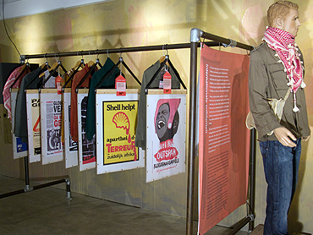
Posters
Notes:
The Institute holds one of the biggest poster collections in Europe

Slide 11
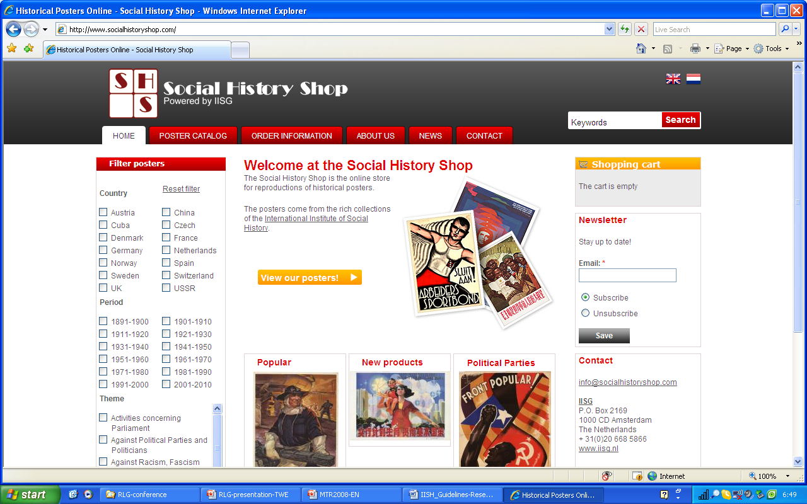
Notes:
And it has recently launched its social history webshop, where one can order original size posters from the collections, printed on high-quality paper…

Slide 12
Collection Statistics
Total: 50 km
>3000 archives
>1 mln books
>1 mln visual items
>15.000 hours audio
>1.100 hours film
>6.500 hours video
>20 TB digitised collections + born-digital photographs
Notes:
A former cocoa warehouse in Amsterdam’s Eastern Docks stores the collections of the IISH, with over 50 kms of materials, and the digital stacks are growing at a fast rate, with both digitised and born-digital collections – mostly image and sound.

Slide 13
Characteristics of the collection building process
1935-1940: saving material from all over Europe
1940-1955: war and recovery
1960-now: rescue mission still leading principle
material from Latin America
Turkish communist party, Kurdish movement
Rights movements, the Karen Human Rights in Burma
Papers of the Iranian diaspora, after the Islamic Revolution
In the Netherlands:
IISH is the de-facto memory institution for the Dutch Left (trade unions and political parties)
Notes:
The collection building process is driven by the Institute’s rescue mission and shows a strong international orientation. In the past 75 years, the Institute has also collected the Dutch Left and is considered as one of the main heritage institutions of the Netherlands.

Slide 14
Characteristics of the collection building process
Integrating collections
Press museum: Dutch newspaper heritage
AdvertisingArsenal: Dutch advertising heritage
NEHA: Dutch economic and corporate heritage
Library of the Dutch Academy of Sciences: History of science
NIZA: Anti-apartheid movement
Notes:
In addition, the IISH has attracted and integrated the collections of other Dutch collecting organisations … thereby extending its holding both in terms of volume and variety.

Slide 15
Characteristics of the collection building process
Traditionally:
Collecting private papers of individuals
(leading thinkers, political leaders and academics)
Collecting private archives of organisations and movements
Building trust relations with donors
Collecting collections
Keeping all collections in Amsterdam
Notes:
Collecting the personal papers of individuals and the archives of private organisations requires a considerate and patient approach towards donors and depositors. As a principle, the institute does not buy archives, but receives them as a donation or in loan deposit. The approach is based on trust building and on developing extensive networks, which is very time consuming but also rewarding. An effective approach is also to collect complete private collections of leading thinkers and academics, thereby harnessing the intellectual power of individual collectors.

Slide 16
Characteristics of the collection building process
Shift and new trends:
From 1989 onwards, with the crumbling of the Communist regimes in Central and Eastern Europe: providing on-the spot-assistance to local memory institutions.
In the Global South: recording protest movements and producing oral histories
Global Hubs for global history: research data collection and building analytical databases for comparative research
Notes:
From the 1990’s onwards, the focus of collection development has slowly shifted away from Europe, towards the East and the Global South, with offices and correspondents in Turkey, Iran, India, Thailand and soon also in Brazil and Ethiopia. As a result, the Institute undertakes documentation and oral history projects, in regions where written sources are scarce. Another more recent development, is the building of so-called data-hubs: analytical databases with historical data on social conditions across the world for comparative research. The Historical Sample of the Netherlands, is one of the first large-scale data-sets created at the IISH with data from birth, death and marriage registers dating from 1812 to 1922.

Slide 17
The organisation of collection building
From the early days, collectors have been scientific researchers at the IISH with 2 main occupations:
Collecting materials from specific acquisition fields
Anarchism, Spain, Portugal and Latin America
France, Italy and Israel
Netherlands, Belgium and Luxemburg
Eastern Europe,
Central Europe,
Great Britain and North America, etc.
Carrying out individual scientific research
publishing sources from the IISH collections
research projects based on the IISH collections
Notes:
The evolution of the collection building process can be explained by the way in which collection building was organised within the Institute. In the first 50 years, collection building and carrying out research on the basis of the collections went hand in hand.

Slide 18
The organisation of collection building
In 1979 the IISH became an institute of the Royal Netherlands Academy of Sciences (KNAW).
From that moment on, the KNAW pushed the IISH:
to develop its research activity
to curtail its number of acquisition fields
As a result the collection-driven research activities slowly disappeared in favour of a separate research programme. Research and collection building became separate activities.
Notes:
From the 1980’s onwards these activities became separated as a result of the development of a separate research department with a distinctive research programme… but this process took at least twenty years and was very gradual.

Slide 19
The organisation of collection building
In the 1990’s the IISH Research programme took shape:
More analytical research:
Labour history and labour relations in the ‘Western world’, ‘Third world’ and ‘Eastern Europe’
Research on Socialism and Communism
based on source publications from the IISH collections
The first strand has taken a flight (now called: ‘Global Labour History’), whilst the second slowly became a secondary activity.
Yet, at the same time, the rescue function followed the research activity, e.g. the collection of Turkisch materials with the appointment of Dr. E.J. Zürcher in 1992 as researcher.
Notes:
As the more traditional research activities, centrered around Socialism and Communism, faded away, the research programme on international comparative labour history took shape and reached out to new geographical fields of interest. The rescue mission followed in the wake of the researcher’s interest and as a result, the collection activity expanded to these new fields.

Slide 20
How to continue?
From 2005 onwards, the recurring KNAW questions impose themselves again:
Need for a fundamental discussion to re-define focus of the collection policy
Review and clarify relationship between research and collections
Notes:
It is clear from the previous slides that the IISH has accumulated extensive collections of papers and data. In view of many restricting conditions, such as available funds and space, there is an urgent need for the institute to reconsider its collection policy, its position as an heritage institute and academic research institute. In how far can both core activities be continued, and if so – how to continue? These are also the questions asked by the Royal Dutch Academy of Sciences, which is the umbrella organisation of the IISH.

Slide 21
Framing collection building in the research process
Back to the purpose of the IISH
To advance the scientific knowledge and practice of social history, by:
Collecting
Researching
Publishing
Collection-building is part of the historical research process
Notes:
For carrying out fundamental discussions about the tasks of an organisation, one always needs to go back to the purpose of the organisation. The IISH’s mission is clearly framed in the scientific research domain.
Collecting material and data is part of the historical research process… and it is not an activity left over to others, it is considered as an integral part of an historian’s work. It is very important for historians that memory institutions collect materials and even more importantly, that they keep their collections for future use – but it is equally clear that historians play an important role in this collection building effort.

Slide 22
Framing collection building in the research process
Seemingly conflicting interests
Research and collections have different dynamics and short-term/long-term interests – should collection building therefore:
Not be research-driven ?
Not necessarily have immediate value for research ?
Does research-driven collection building lead to:
orphan collections ?
unpredictable collection profiles ?
Notes:
Are there inherent conflicting dynamics between collection-building and historical research? Collection building as a long-term and sustained effort versus short-term research projects?

Slide 23
Framing collection building in the research process
BUT: collection-building by researchers is not a short-term enterprise!
Historians tend to collect livelong and to entrust their collections to successors or memory institutions
The trust alliance between historians and memory institutions is a way to extend the individual historian’s capability of collection-building
Historical research is an ongoing iterative process that needs facilities to safe keep the artefacts and evidence on which historical knowledge is based
Collections are the labs of historical research and they are built and nurtured by historians...
Notes:
The history of the IISH demonstrates that collection-building for historical research and carrying-out historical research go hand-in-hand and that this is a natural symbiosis…

Slide 24
Framing collection building in the research process
Policy-direction of the IISH from 2008 onwards
Bring collection-building and research back together in one job description
Establish regional desks in the research&collection area’s, with local staff to maintain the networks and to describe the new acquisitions:
Russia
Middle East and Central Asia (MECA)
South/South-East Asia
Latin-America
Africa
Notes:
The new policy of the IISH from 2008 onwards is first of all to bring research and collection-building together again and to consolidate the natural symbiosis between both activities into an institutional organistional structure.

Slide 25
Moving the past into the future
Globalisation
Regional desks for processing local acquisitions
Supporting regional safe havens
Digitisation
Digital duplication of local acquisitions is also a form of source publication
Developing knowledge and skills in Amsterdam and the regional desks to build digital collections
Creating digital labs for historical research
Notes:
By creating new and consolidating existing regional desks across the Institute’s research&collection fields, the collection processing tasks can be decentralised and can make better use of local knowledge and language skills. In this way it is no longer necessary to keep increasing the processing capacity and skills at the central Amsterdam site. Thanks to digitisation technologies, it is furthermore increasingly possible and preferable to keep the materials in safe havens in the region and to make digital duplicates for online access across the Internet. In this way it will also be possible to spare the ever growing need for physical storage capacity in Amsterdam. Also, it will be possible to develop skills to create digital collections that will serve the needs of historical research in the future. Digitisation becomes a new method of publishing sources, enabling new kinds of source editing possibilities. Internationalisation and digitisation are thus opportunities for the Institute to reshape its collection building activity into new practices geared towards the future, yet solidly based on the same proven principles of historical research dating from the past.

