Slide 1
Collaboration Trials and Triumphs: EDAN
Common Administration
"We work together because we have the same employer.“
Ann T. Speyer
Chief Information Officer
Smithsonian Institution
Notes:
Good afternoon. The project I’m going to discuss with you today is EDAN – the Enterprise Digital Asset Network. I could have picked one of any number of projects to discuss with you today because by nature of IT--the discipline I represent— we have to collaborate and are often viewed as an honest broker. We don’t build systems for ourselves!
This was an initiative that I help begin early on in my position as Chief Information Officer of the Smithsonian back in 2007.
----------------------------
20 minute presentation
15 min Q&A
Co –Panel Members
Meg Bellinger, Director, Office of Digital Assets and Infrastructure, Yale Digital Commons
Tom Hickerson, Vice-Provost, Libraries and Cultural Resources, University of Calgary

Slide 2
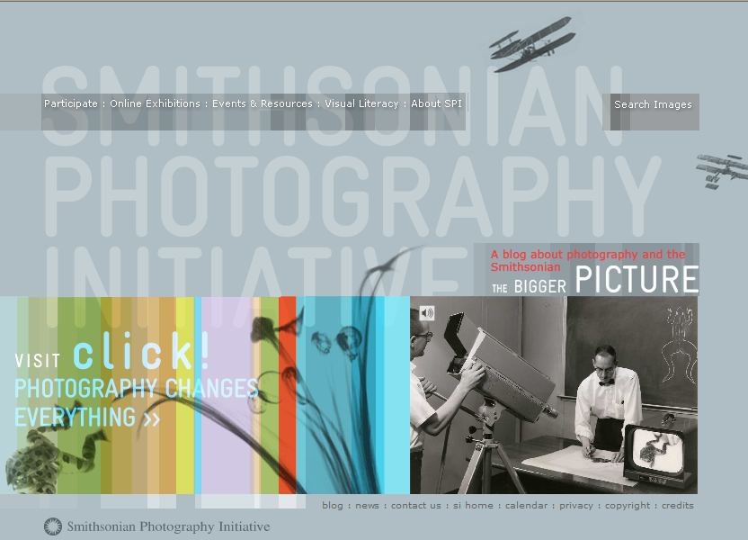
Smithsonian Photography Initiative
More than 13M images in some 700 collections throughout our museums and research centers
– of which some are digitized
Notes:
Initially this project began as a collaboration between The Smithsonian Photography Initiative and the Office of the Chief Information Officer.
The Smithsonian Photography Initiative was a unit without its own collection. It was formed to virtually bring together the dispersed photography collections across the Smithsonian and to present them through online experiences – in particular click! Photography Changes Everything, an online exhibit.
When there are more than 13M images in some 700 collections throughout our 11 museums, 20 libraries, and 14 archives – the challenge becomes for SPI to find what exists and then how to get permission to use it? And when they do, how does SPI use these images that reside in multiple databases across 25 major Institutional collection systems. SPI was not alone at the Smithsonian with this challenge.
Up to this point, the only option was to create yet another database. This consumed already limited storage and backup solutions—a deep concern of mine—compounded by the fact that this approach separated the image from its system of record. The impact being that if a curator updated the information about the image, SPI would not know about the update and would be using outdated and possibly incorrect data. When you are the size of the Smithsonian, manual coordination is not a scalable and sustainable option for projects of this magnitude.

Slide 3




Conceptual Diagram
Virtual Exhibits
& Museums
Image Delivery Service (IDS)
Smithsonian Photography Initiative
Interactive Kiosks
Derivative Image Storage
Education
NMAAHC
Latino Center
Asian Pacific
Search Engines
(e.g. Google)
Scholarly Research
Open Source Applications
Enterprise Digital Asset Net
(EDAN)
Derivative Generator
SAN, Centera, & Tivoli
T
NPM CIS
NMAI CIS
NMAH CIS
DAM
ArtCIS
Preservation Quality Image Storage
NASM CIS
ACM CIS
NMNH RCIS
SIRIS
Enterprise Storage Infrastructure (ESI)
Notes:
My staff developed a concept of developing a technology middle-layer which could enable web, mobile application, and kiosk access to data on objects and associated digital assets within the Institution’s collections. A key factor in our design was to accept what we could not change. Which was, that we had to assume a constraint that we would not force any of our units to change their collection information systems. EDAN would therefore provide a centrally managed metadata and service layer infrastructure that would be shareable for numerous SI applications.
At the same time, we wanted to develop the solution as an open source solution and harness the power the Digital Asset Management System which matured with the proper resources into a full-fledge production system. SPI liked the approach and now what we needed was funding.
And part of what we all liked, was that the solution that had emerged could be used by multiple virtual presentations across the Smithsonian. What this architecture provided is the ability to search for everything that Smithsonian had for instance on butterflies. Results would include butterfly specimens in Natural History, living butterflies at the zoo, butterflies on silk screens in Freer Sackler, paintings with butterflies at American Art, and a Bonanza plane at Air & Space with a butterfly tail design.

Slide 4
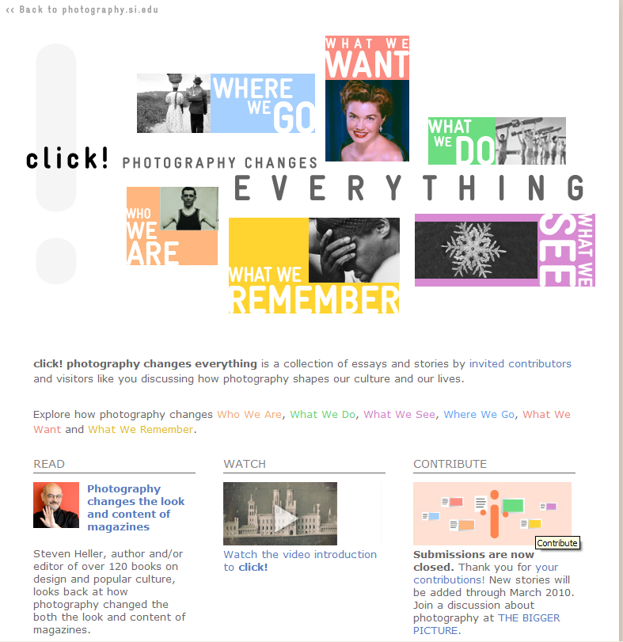


Collaboration to get funding
http://photography.si.edu.
Notes:
Working together, the Smithsonian Photography Initiative and OCIO pursued and received a grant from the Getty Foundation for developing EDAN in late 2007 . While the Getty Foundation was very interested in our approach to build a system that could access siloed CISs across our LAMs. A key consideration in obtaining the Getty grant was that it would also produce a content-driven online exhibit– click! Having both an innovative technical approach and a real world virtual exhibit where essential.
The Getty funded the initial EDAN development including integrating it with the DAMS– for images only. This initial effort was further limited in scope to only include one of our collection information systems (SIRIS). SIRIS actually represented a microcosm of the bigger problem we were trying to solve with its 8 independent databases.

Slide 5





The World Wide Web
SI EDAN
Status
(September 2010)
Over 5.4 Million Records
Over 460,000 digital objects
and growing
Web Applications
Museum
Websites
collections.si.edu
photography.si.edu
. . .
Mobile Applications
Flickr
Commons
iPhone proof of concept
Search
Engines
Kiosks
?
Metadata Delivery Service
Tag Service
List Service
Image Delivery Service (IDS)
Index / Repository of SI Collections Metadata
EMu 11
Mimsy 1
Artesia
TMS 10
Horizon 8
Other ∞
Digital Asset Management System
Anthropology
NMAI
NMAH
Botany
Entomology
HMSG
NASM
Invertebrate
SIL
AAA
NMAfA
NPM
Mineral
Archives
SIL DSpace
Implemented
Under development
Future
FSGA
ACM
Paleobilogy
SAAM - ARI
STRI
NMAAHC
Birds
SAAM - Juley
SIG
NPG
Fishes
SAAM - AECI
Misc datasets
SAAM
Herpetology
Bibliographies
Note: All LAMS owners are being contacted and each collection system is being systematically mapped and added to the EDAN index.
CHNDM
Mammals
History of SI
Airplanes
Library, Archive and Museum Systems (LAMS)
Notes:
Today, EDAN is implemented and we have expanded beyond the initial implementation functionality to include images from most of our collection information systems. The EDAN index repository currently ingests data from 25 major Institutional collection systems / databases, providing a single point of access to over 5.4 million SI collection records and over 460,000 digital objects. The project is actively working with all SI museums to ingest additional data from at least 6 more systems.
[FYI –Additonal Info for Ann]
Access to EDAN is facilitated by a set of web services, in particular a Metadata Delivery Service, Tag Service, List Service, and Image Delivery Service. The first three services are used for search, retrieval, enhancement, and custom display of data. The image delivery service includes on-the fly image resizing, slide-show and image viewing (zoom in/out, drag focus point) functionality.

Slide 6
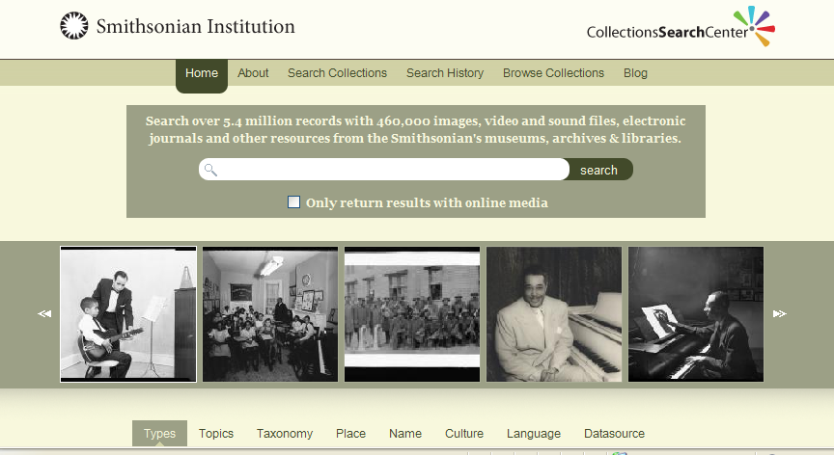
Developing EDAN
Shared Objectives
  common access to digital assets
  links to system of record
  don’t force change to existing systems
Notes:
Now between the funding slide and where we are today, a lot of collaboration took place. Each of those databases that are being ingested by EDAN have their own stakeholders and in many cases their own standards. One of the smart things we did, was during the creation of the EDAN pilot, the technical team worked with the CIS owners to gather their requirements to ensure that the metadata index would work for them as well as SIRIS.
While everyone who worked on this project works for the Smithsonian, no one was being told that they must cooperate on the EDAN project. The units worked with OCIO to build and expand EDAN because we had shared objectives to provide common access to digital assets to overcome a shared problem that people were struggling to find our online collections.
Let me note, that here’s another example on the screen of EDAN being used to provide one Web portal to search across our collections, collections.si.edu. This website is also mobile device friendly and works on the iPhone and Droid.

Slide 7
Total Collaboration Continuum
Evaluation
Performance Measurement
Strategy
Governance
Access & Use Policy
System Development
Open Source Tools
Common Access
Metadata Standards
We Share
EDAN
DAMS
Surveys
Notes:
In developing collaborative systems, we must work with multiple stakeholders throughout the Total Collaboration Continuum to:
Align the need/solution with the organizational mission and objectives [STRATEGY];
Formalize a framework in which decisions can be made regarding policy and standards [GOVERNANCE];
Establish well-defined team roles and responsibilities, select technologies [SYSTEM DEVELOPMENT]; and
Implement effective performance measurement [EVALUATION]

Slide 8
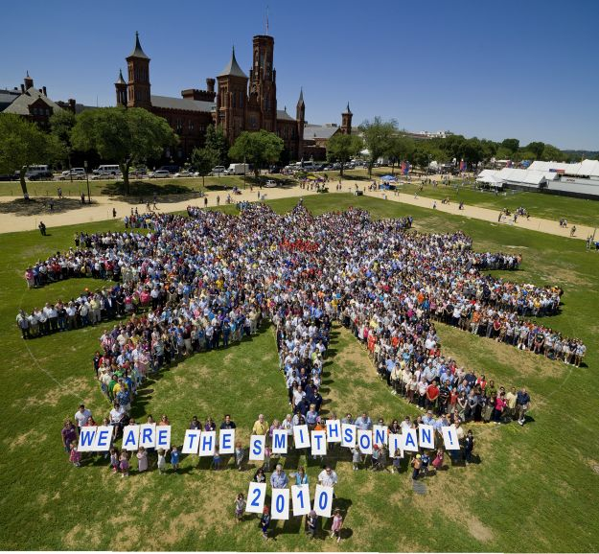
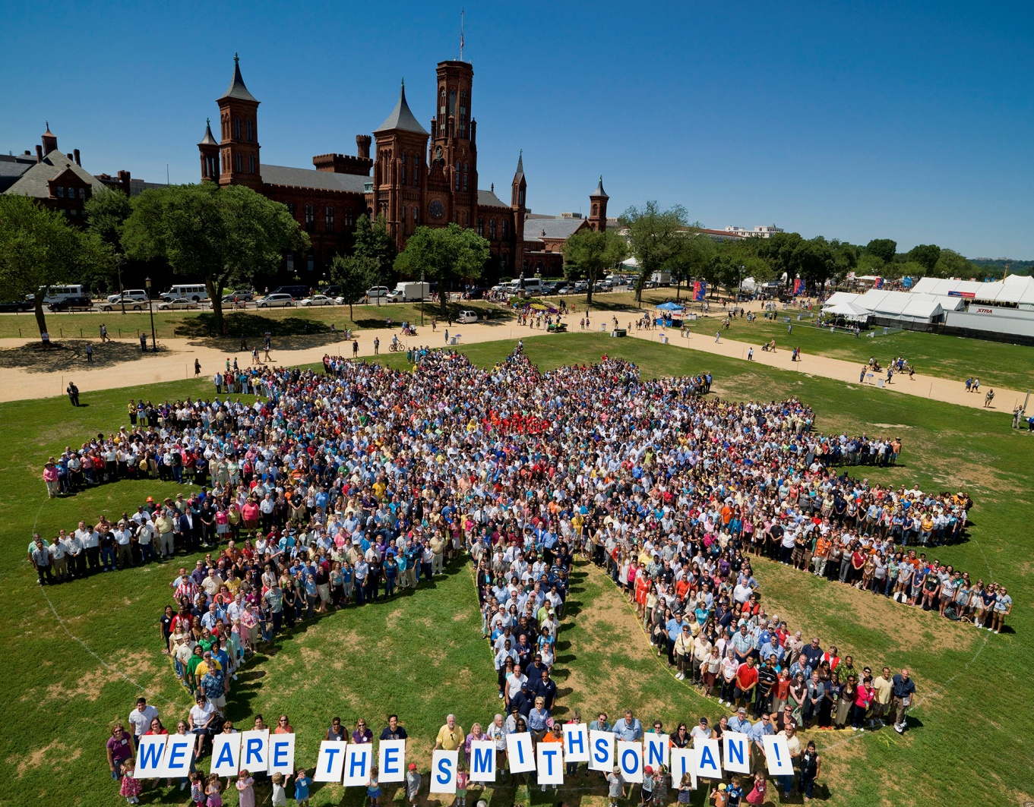
Involve the Right Mix of People
Notes:
The challenges for any collaboration team is that everyone always thinks that they are different, when in reality there is often a very large common core around which collaborations and solutions can be developed. It is important that you involve the right mix of people from the start of any collaboration. It is very normal for a variety of reasons to start with a small group of trusted individuals to develop the initial concept, but if you want your collaboration to succeed and grow you need to quickly open it up for more inclusiveness.
The more people that you bring into the project early on, the more likely you are to discover what is common.

Slide 9
Key Collaborators
Why? How?
Technical Experts
Deep understanding of technology , risks, objective, and strategy
Deep understanding of best practices and tactics
Deep understanding of content and individual unit missions
Allowed a small group to power through technical decisions, with limited input once requirements were defined
When it came to standards and models empowered a larger group to maximize their subject matter expertise
No need to change current system or documentation level for initial phase; future changes in hands of content owners
Standards-setting Groups
Content Owners
Notes:
In building any system the biggest challenge is not the technology but the people. The players you need to invite include:
Your technical experts have a deep understanding of the technology and can with limited input make the technical decisions AFTER the requirements are gathered and agreed to by everyone. You want this team to be free to move quickly in order to stick with budget and schedule.
Your standards-setting group leverages their understanding of best practices and tactics, and subject matter expertise to recommend standards needed by the technology to work seamlessly and to address policies. In practice this group also includes both technical experts and content owners.
The content owners love their data and will want to ensure that it is being properly used and cared for. For EDAN since we weren’t requiring them to change their content practices and systems, we primarily depended on them to provide permission to access their collections and of course system specifications of their CISs. We actually flagged content which was cleared for public sharing through EDAN.

Slide 10
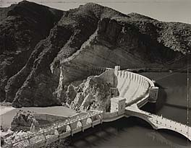

Simultaneous Collaborations
Digital Asset Access & Use Policy
DAMS
Smithsonian American Art Museum
National Postal Museum
10
Notes:
During EDAN’s development we had two other related collaborations underway:
Development of a production-ready DAMS where after hiring a full-time DAMS project manager, we established a DAMS Working Group. This group last year established common minimum metadata standards for images, and in the past year has been working to establish common minimum metadata standards for audio and video.
The Digital Asset Access and Use Policy is in its final stages of approval. It establishes that we are to share our digital assets (images, audio, and video) both internally and externally. This policy also defines when it is appropriate to restrict an asset from sharing to abide by legal restrictions as well as carefully selected policy restrictions. This policy was developed by a working group with cross-unit representation, and rather uniquely many of the allowable restrictions resulted from a pan-Institutional survey we conducted early on in the planning process to see to what extent the Institution was willing to share its digital assets. By having this policy in place, we help to ensure that procedural barriers do not replace technological ones being removed by EDAN.
Dam: Is Roosevelt Dam

Slide 11
Allowable Restriction Categories
Legal
  Intellectual Property Rights (copyright, moral rights, trademark, patent, rights of privacy and publicity, personally identifiable information)
  Contractual Restrictions
  Native American and Native Hawaiian Human Remains and Objects
  Rare, Threatened or endangered species
  Archaeological or sacred sites
  Returned objects
  Uncertain provenance and export records
Policy and Other
  Sensitive Content
  Unpublished Research Data / Resources
  Our own resource limitations
  Commercial use restrictions (discretion of unit)
Notes:
Emboldened with survey of all SI staff

Slide 12
Timeline
2007 EDAN Concept
Feb 2008 EDAN Funding
Sep 2009 EDAN Live
Sep 2008 EDAN Kickoff
2009 DAMS Working Group Forms
2007 Digital Access & Use Working Group Forms
Today EDAN Continues
Notes:
This slide shows how it has all flowed together. Of course, there are many more milestones and in them will be some challenges. Many tied to resources, but at the same time by collaborating on one project we often learn that we need to collaborate on many others along the way.

Slide 13
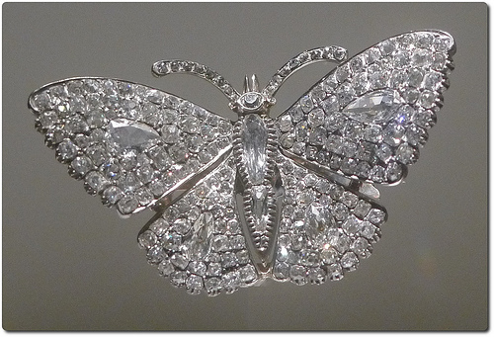

Searching for our Digital Diamonds
Before
After
CC by Swamibu
CC by Swamibu
13
Notes:
When working for a common employer, …
….we collaborate to create new content collaborations that didn’t previously exist until the technology delivered the visibility.
… we collaborate to develop new systems such as EDAN and the DAMS
… and we collaborate to create policy and then to use that policy to create a common environment for future collaborations.
I’m not going to turn the microphone over to my esteemed colleague Meg Bellinger of Yale University
-----------------------
Diamond pile and pin, Swamibu

