Slide 1
RLG Partnership ALA Update Session
Melissa Renspie, Merrilee Proffitt, Jim Michalko, Brian Lavoie, Constance Malpas, Lynn Silipigni Connaway, Timothy J. Dickey, Jennifer Schaffner, Karen Smith-Yoshimura, Jean Godby, Jackie Dooley, Ricky Erway
17 June 2010

Slide 2
RLG Partnership Update Webinar
Selections from wide-ranging work agenda
Projects of broad interest
Necessarily partial!
Website contains comprehensive information
www.oclc.org/research/activities/
Notes:
A selection of approximately 60 projects. Many with moving parts. Speed dating.

Slide 3
Scope of Work
RLG Partnership Activities…
Explore and frame
Allow for experimentation
Urge toward evolution
Provide a path forward
Participation and benefits
Papers and reports
Webinars
Working Groups
Events

Slide 4
Research Libraries, Risk and Systemic Change
Jim Michalko
VP, OCLC Research, San Mateo
Report at:
http://www.oclc.org/research/publications/library/2010/2010-03.pdf

Slide 5
Context
In a rapidly evolving information environment, what are the greatest risks to research libraries?
Individually – as local service providers
Collectively – as a distributed enterprise
Which of these risks is susceptible to mitigation?
Feasibility – controllable risk?
Impact – worth the investment?
Where should local effort be directed?
Where can collective action make a difference?
Notes:
Continuous with “What’s keeping you up at night” RLG podcast interview series – but directed at library management.

Slide 6
Methodology
Structured interviews with library directors at 15 ARL institutions
Identification and characterization of current risks
External – financial markets, legal, natural disasters
Strategic – service portfolio, organizational structure
Operational – management, human resources, workflow
Financial – funding, endowments
Individual rating of risks
Impact – insignificant → catastrophic
Likelihood – improbable → almost certain
Consolidation and calculation of average risk rate
Weighted by frequency of mention during interview
Evaluated against impact, likelihood
Notes:
Name University
1) Karyle Butcher Oregon State University
2) Paul Courant University of Michigan
3) Deborah Jakubs Duke University
4) Charles Lowry University of Maryland
5) Rick Luce Emory University
6) Randy Olsen Brigham Young University
7) Catherine Quinlan University of Southern California
8) Carton Rogers University of Pennsylvania
9) Judith Russell University of Florida
10) Sherrie Schmidt Arizona State University
11) Patricia Steele Indiana University
12) Carla Stoffle University of Arizona
13) Gary Strong University of California, Los Angeles
14) Suzanne Thorin Syracuse University
15) Bill Walker University of Miami

Slide 7
Risk Clusters
Value Proposition
… a reduced sense of library relevance from below, above, and within
… changing … uncertainties about adequate preparation, adaptability, capacity for leadership in face of change
value of library collections and space; prices go up, value goes down – accounting doesn’t acknowledge the change
Human Resources
Durable Goods
… managing and maintaining legacy systems is a challenge; replacement parts are hard to find
… losing some traditional assets to commercial providers (e.g. Google Books) and failing to assume clear ownership stake in others (e.g. local scholarly outputs
Legacy Technology
Intellectual Property
Notes:
We identified five thematic risk clusters that seemed to us to reflect the most important classes of risk.

Slide 8
Library Value - THEN
In the past
Library Value = Collections + Services
and
Collections ≈ Services
then
Services = Support for Quality and Quantity of Institutional outputs
Library Value α Institutional outputs

Slide 9
Library Value - NOW
AND NOW
Collections ≠ Services
Library Value ≠ Institutional outputs
Need to recalibrate the equation
$$ $$
Library Value = Collections + Services
$$ $$

Slide 10
Resources and Focus
More funding to shape new services
$$ $$
Library Value = Collections + Services
$$ $$
Reduce the cost of traditional processes

Slide 11
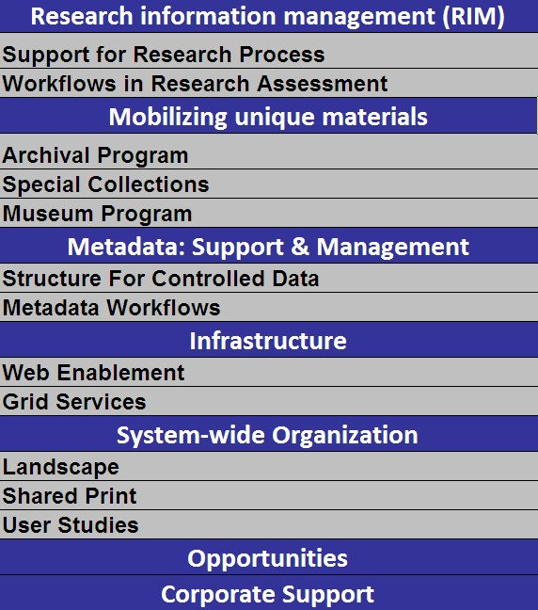
The RLG Partnership and OCLC Research
DEFINE FUTURE RESEARCH LIBRARY SERVICES - REVITALIZE OUR VALUE PROPOSITION
TRANSFORM OUR CURRENT OPERATING PRACTICES AND PROCESSES – IMPLEMENT SYSTEMIC CHANGE

Slide 12
Thank You!
Jim Michalko michalkj@oclc.org

Slide 13
External Research Support
Brian Lavoie
Research Scientist, OCLC Research
ALA Update Webinar
17 June 2010

Slide 14
OCLC and the Research Community
Funding: OCLC/ALISE Library & Information Science Research Grant Program (LISRGP)
http://www.oclc.org/research/grants/
Collaboration: OCLC Research as partner in research collaborations with other agencies
Virtual International Authority File
OhioLink data aggregation project
Support: Provision of in-kind support for external research projects

Slide 15
WorldCat & External Research Projects
Researchers may apply to OCLC for in-kind support for external research
In keeping with OCLC’s public purpose
Program administered by OCLC Research
Applicants must be qualified academics or LAM professionals
Intended use must be research; publishable in open literature
Use of WorldCat data
Subset of WorldCat (processed or unprocessed)
Work with researcher to determine best fit between research goals and available data
Data provided free-of-charge under OCLC research-use license

Slide 16
Example projects …
IATH, CDL, SI-UC Berkeley: using WorldCat data in support of Social Networks and Archival Context Project
University of Sheffield: using WorldCat.org apache logs for searching behavior study
University of Toronto: using WorldCat data to track adoption and diffusion of key technologies through analysis of publication patterns in the literature.
External research support:
Connect our own work to a broader research context
Support community-wide LAM research program
Demonstrate value of library data sources in variety of disciplines

Slide 17
Thank You!
Brian Lavoie lavoie@oclc.org

Slide 18
Cloud Library Findings
Constance Malpas
Program Officer, OCLC Research
ALA Update Webinar
17 June 2010

Slide 19
Premise
Emergence of large scale shared print and digital
repositories creates opportunity for strategic
externalization of traditional repository function
Reduce total costs of preserving scholarly record
Enable reallocation of institutional resources
Support renovation of library service portfolio
Create new business relationships among libraries
A bridge strategy to guarantee access and
preservation of long tail, low use collections
during ongoing p- to e- transition

Slide 20
Research questions
To what degree can academic libraries effectively externalize management of legacy monographic collections to large-scale print and digital repositories under prevailing circumstances?
Under what future conditions is a large-scale transfer of operations likely to occur? What changes in the current system are needed to mobilize a significant shift in library resource?
Who benefits from this change? What value is created?

Slide 21
Key findings
Mass digitized monographic corpus already substantially duplicates academic print collection
30% or more of titles in local collection exist in digital format
Rate of growth in replication exceeds print acquisitions
Extant inventory in large-scale shared print repositories substantially mirrors digitized corpus
~75% of mass-digitized titles already ‘backed up’ in one or more preservation repositories (ReCAP, UC Regional Facilities, CRL, LC)
Distribution of resources sub-optimal for shared print provision

Slide 22
Key findings (cont.)
Opportunity to benefit from externalization is widely distributed; every academic library is affected
Potential market for service is broad; aggregate savings significant
Proportional space, cost recovery varies little across research library cohort
Maximum benefit will be achieved when distribution network for in-copyright content is available
Public domain content inadequate to mobilize collective resources
Print supply chain will be needed for in copyright content

Slide 23
A global change in the library environment
In a year’s time, the “sea level” may be here:
is your library prepared?
Median duplication: 29%
Median duplication: 19%

Slide 24
More information
ALA RUSA/STARS Panel Discussion:
“Remote Storage & Cooperative Collection Building”
C. Malpas, E. Stambaugh, L. Payne
Sunday, June 27th 10:30am-noon
Washington Convention Center, Rm 147B

Slide 25
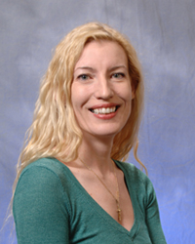
Thank You!
Constance Malpas malpasc@oclc.org

Slide 26
The Digital Information Seeker
Lynn Silipigni Connaway, Ph.D.
Senior Research Scientist, OCLC Research Timothy J. Dickey, Ph.D.
Post Doctoral Researcher, OCLC Research ALA Update Webinar
17 June 2010

Slide 27
The Digital Information Seeker: Report of findings from selected OCLC, RIN, & JISC User Behaviour Projects
JISC-funded research
Analysis of 12 major user behavior studies
Studies conducted in US & UK
Published within last 5 years
Synthesis to:
Better understand user information-seeking behavior
Identify issues for development of user-focused services & systems

Slide 28
Common Findings
Disciplinary differences exist
Similarities “more striking than the differences”
Behaviors vary by discipline
Historians more likely to use Google & publisher platform search tools than life sciences
E-book use varies by discipline
Higher use in business than engineering
Notes:
Finding: Disciplinary Differences
Several studies indicate that some disciplinary differences do exist in researcher behaviours, both professional researchers and students.
Researchers and discovery services, 2006 - Some disciplinary differences exist
E-journals, 2009 - Behaviours also vary by discipline
JISC national e-books, 2009 - Students’ use varies by discipline
Finding: E-journals
The evidence suggests the increasing importance of e-journals to researchers.
Researchers and discovery services, 2006 - Journal articles central
Researchers use of academic libraries, 2007 - Very high value on electronic journals
E-journals, 2009 - Article downloads have nearly doubled; E-journal use strongly correlated with papers published, number of PhD awards, research grants, contracts income
Finding: Google
Even more evidence exists for the increasing centrality of Google & other search engines in researchers’ behaviors
Perceptions of libraries, 2005 - Search engines dominant place to begin; Search engines as lifestyle fit
College students’ perceptions, 2006 - Search engines overwhelming first choice for an information search
Sense-making, 2006 - Heavy reliance on Google and other web information sources
Researchers and discovery services, 2006 - Common tools include general search engines, specialist search engines; Google is often used for relatively simple tasks in conjunction with other sources

Slide 29
Common Findings
Discovery to Delivery
Journal Access
Speed & Convenience
Google
Desktop Access
Notes:
Finding: Discovery to Delivery
The entire Discovery to Delivery process needs to be supported by information systems, including increased access to resources.
Researchers and discovery services, 2006 - Boundary between resources and discovery services is permeable; Gaps in D2D provision included foreign language materials, chapters in multi-author collections, journal backfiles, and lack of specialist search engines
Researchers’ use of academic libraries, 2007 - Users expect not to spend much time locating actual item
Online catalogs, 2009 - User’s experience of delivery is as important, if not more important, than discovery experience
JISC national e-books, 2009 - Users do tend to be confused by a variety of platforms for discovery/delivery
Students’ use of research content, 2009 - Accessibility is seen as a secondary (but still important) criterion
User behaviour in resource discovery, 2009 - Users are finding access hindered by difficult database interfaces; Access is a problem, both for e-books and for moving from e-books to locating print volumes
Finding: Journal Access
Journal backfiles are particularly and routinely problematic in terms of access.
Researchers and discovery services, 2006 - Problems arise when it comes to accessing identified materials or backfiles
Students’ use of research content, 2009 - Libraries should improve students’ access to OS materials, backfiles, and repositories
User behaviour in resource discovery, 2009 - Backfiles are a frustration in terms of access
Finding: convenience
It is clear that regardless of age or experience, academic discipline, or context of the information need, speed and convenience are important to users & are factors when selecting discovery tools and resources.
Finding: Desktop access
Researchers particularly appreciate desktop access to scholarly content, from e-journals to VRS
Researchers and discovery services, 2006 - Value convenience of desktop access
Researchers’ use of academic libraries, 2007 - Immediate access from desktop computer taken for granted
Seeking synchronicity, 2008 - VRS convenient from home computer
Students’ use of research content, 2009 - Home computer is main method of gaining access

Slide 30
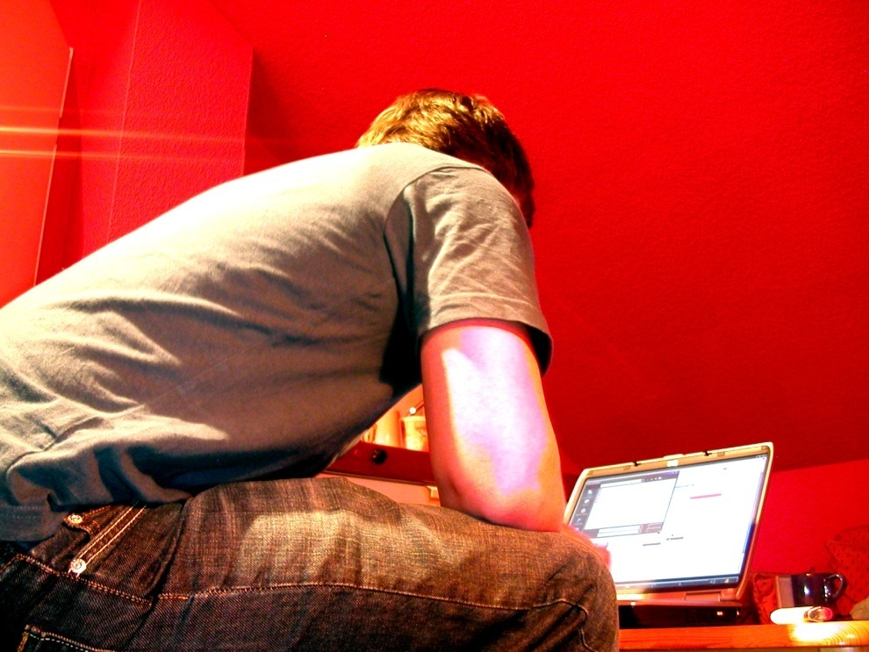
Common Findings
User Behaviours
“Bouncing” between resources
“Squirreling” of downloads
Short sessions
Basic search
Viewing fewer pages
Power browsing
Quick chunks of information
Notes:
Finding: User Behaviours
User behaviours in this electronic environment tend toward quick views of a few pages, and “bouncing” between resources.
Researcher of the future, 2008 - Very little time using content, “squirreling” of downloads by academic users; All users prefer quick chunks of information
E-journals, 2009 - Users are visiting only a few minutes; Behaviors vary but shorter sessions, basic search, and fewer page views
JISC national e-books, 2009 - Users tend to use e-books quickly, viewing only a few pages
User behaviour in resource discovery, 2009 - Users make short visits, with simple searching of Google-like interfaces; power browsing for snippets of information

Slide 31
Common Findings
Enhanced functionality to manage large result sets
Enhanced content to evaluate resources
Convenience over library
Notes:
Finding: Enhanced Functionality
Users are beginning to desire enhanced functionality in library systems, to assist in managing large result sets.
Sense-making, 2006 - Users re-envision library services and spaces
Researchers and discovery services, 2006 - Key problem of irrelevant results and the fear of missing items
Online catalogs, 2009 - List of libraries that own the item is essential; Search results must be obviously relevant and contain helps for navigation/evaluation; Advanced search option and facets help refine searches and manage large results; Participants offered mixed reaction to social features
JISC national e-books, 2009 - Users confused by variety of platforms
User behaviour in resource discovery, 2009 - Improve usability of library and publisher systems
Finding: Enhanced Content
Users also desire enhanced content to assist them in evaluating resources.
Perceptions of libraries, 2005 - Libraries advised to increase collections
Online Catalogs, 2009 - Links to online content/full text helpful; End users rely on and expect enhanced content
Finding: Convenience over Library
Users also appreciate the convenience of electronic access over the physical library, with several studies marking decreased visitation of the library.
College students’ perceptions, 2006 - Use the library less since they began using the Internet
Researchers’ use of academic libraries, 2007 - Sharp fall in the number of researchers who visit their institution’s library
Seeking synchronicity, 2008 - Convenience often dictates choices between physical and virtual library

Slide 32
Common Findings
Users confident in their ability to discover information
BUT
Information literacy not improved with users’ digital literacy
Notes:
Finding: User Confidence
Both professional researchers and younger people do seem generally confident in their own ability to use information discovery tools.
Perceptions of libraries, 2005 - Respondents satisfied with their search; tend to trust results the same as results from libraries
College students’ perceptions, 2006 - Students satisfied with their search; Judgments of quality based upon their own knowledge or common sense
Sense-making, 2006 - Users are adept at doing searches for personal needs
Researchers and discovery services, 2006 - Researchers self-taught but confident in their own skills
Researcher of the future, 2008 - Big gap between performance and self-estimates
Seeking synchronicity, 2008 - Getting an answer was cited most often for success; A mixture of relational and content facilitators contributing to perceptions of success
Finding: Information Literacy
Information literacy has not necessarily improved with users’ digital literacy.
Researcher of the future, 2008 - Not expert searchers; Tend to spend little time, little effectiveness in evaluating search results; prefer natural-language searching and trust Google; do not find library resources intuitive; Teachers not passing literacy on to the pupils
E-journals, 2009 - Shorter sessions, using basic search, and viewing fewer pages
Students’ use of research content, 2009 - Users assess content based on its relevance to their assignment
User behaviour in resource discovery, 2009 - Information literacy skills lacking, have not kept pace with digital literacy; When level of information literacy and domain knowledge increases, increased use of quality resources

Slide 33
Common Findings
Metadata important for discovery
Digital content is better – want MORE
Notes:
Finding: Metadata
One important finding related to this is that high-quality metadata is becoming even more important for discovery of appropriate resources.
Perceptions of libraries, 2005 - Quality of information a determinant of satisfactory information search; Other key criteria determining satisfaction include “worthwhile” information
Researchers’ use of academic libraries, 2007 - Need to provide good metadata; Many resources under-used because inadequately catalogued
Online catalogs, 2009 - List of libraries that own the item essential data element; Links to online content/full text helpful; Differences exist between the data quality priorities of users and librarians
Finding: Digital Content
More digital content of all kinds and formats is almost uniformly seen as better.
Sense-making, 2006 - Desire more digitized sources, including digitization of older literature, sheet music, art images
Researchers’ use of academic libraries, 2007 - Respondents would prefer to have everything available in digital form
JISC national e-books, 2009 - Libraries are a key player in the market for e-books

Slide 34
Common Findings
Library as Place
Library = Books
Human Resources valued
Family
Friends
Colleagues
Peers
Notes:
Finding: Library as Place
People still tend to think of libraries as collections of books.
Perceptions of libraries, 2005 - Libraries viewed as being about books
College students’ perceptions, 2006 - Most common activity in the physical library is do homework/study
Sense-making, 2006 - Users value traditional browsing, praise library as space for information
Researchers’ use of academic libraries, 2007 - Researchers retain a sense of the importance of the library
Seeking synchronicity, 2008 - Those who visit the library continue to experience satisfaction
Finding: Human Resources
Several studies indicated that despite the increasing prominence of digital research and electronic resources, researchers also value human resources such as colleagues, peers, family, friends, and teachers.
Researchers and discovery services, 2006 - Colleagues and peers an important resource
Sense-making, 2006 - Human resources (family, friends, colleagues, teachers) very common
Seeking synchronicity, 2008 - Recommendations by peers are an important part of the marketing of VRS

Slide 35
Contradictory Findings
Aware of differences between authoritative research & internet content
Some students prefer library catalogues to search engines for academic assignments
Notes:
Students are very aware of the difference between formal research and basic internet content,
perhaps because they believe their tutors will penalize use of the latter.
In situations of formal research for these students, this leads them to the library catalogue
first and to use it more (32%, n=137, N=428).

Slide 36
Contradictory Findings
Range of tools
Formal training
Recommendations & social networking
Notes:
Contradictory Findings: Range of Tools
The studies reviewed included findings which seemed to contradict one another, and for which evidence may be mixed. In terms of the range of tools used in information-seeking, there is evidence for both broad (general) and narrow (specific) range of tools.
Perceptions of libraries, 2005 - A wide variety of information resources; Familiarity with different types of resources
College students’ perceptions, 2006 - Using every type of electronic resource; 10% claimed that the library website was the only resource they needed
Sense-making, 2006 - Very few sources were found to be helpful
Researchers and discovery services, 2006 - Researchers are using a range of resource discovery tools: Foreign language materials, multi-author collections, short journal backfiles, specialist search engines; General search engines, specialist search engines, and internal library portals; Journal articles; Monographs; Expertise of individuals is also important
Researchers’ use of academic libraries, 2007 - Relatively little change in demand for ILL; VREs will likely grow in importance to scholarly research
Seeking synchronicity, 2008 - Users indicated mixed preferences between face-to-face and VRS; Open to the possibility of trying VRS
E-journals, 2009 - Much traffic from Google, some link resolvers
JISC national e-books, 2009 - E-books either for leisure or study; Print and e-versions of course texts are complementary, not substitutes; E-textbooks are valuable back-up
Students’ use of research content, 2009 - Keyword searches on a mixture of tools; The library catalogue
User behaviour in resource discovery, 2009 - A wider variety of sources, subscription and the open internet

Slide 37
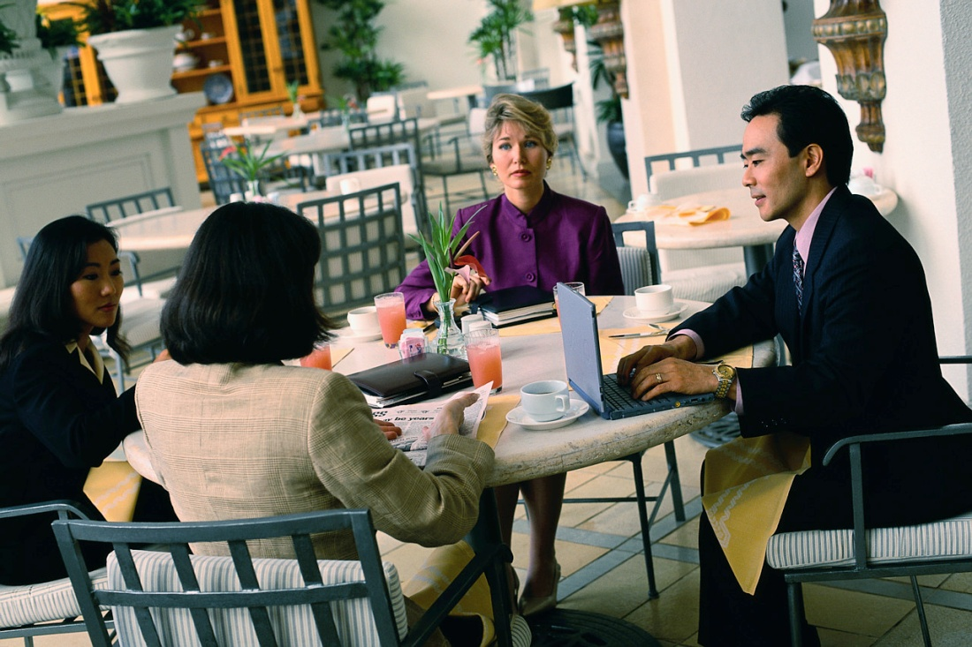
Implications for Library Services
Different constituencies = Different needs and behaviours
Notes:
A synthesis of findings from these major user studies points toward a number of implications for libraries.
Implication: Different Constituencies
The library serves many constituencies, with different needs and behaviours.
Researchers and discovery services, 2006 - Some disciplinary differences exist
E-journals, 2009 - Behaviours vary by discipline
JISC national e-books, 2009 - Students’ use varied by discipline
Students’ use of research content, 2009 - Students need “more guidance and clarity on how to find research content and on how to assess its worth as well as its relevance.”
User behaviour in resource discovery, 2009 - Increase information literacy instruction for users

Slide 38
Implications for Library Services
Seamless access more critical than discovery
Digital resources and content
Greater variety
More = Better
Notes:
Implication: Seamless Access
Library systems must do better at providing seamless access to resources, instead of mere discovery.
Researchers and discovery services, 2006 - Gaps include access to foreign-language materials, chapters in multiple-authored books, backfiles, specialist search engines.
Researchers’ use of academic libraries, 2007 - Joint access should be promoted among institutions
Researcher of the future, 2008 - Recommendations include avoiding being decoupled from the publisher-to-user chain
Seeking synchronicity, 2008 - Users desire answers in VRS
Online catalogs, 2009 - Catalogues would better serve with better delivery, more links, more online content
JISC national e-books, 2009 - Libraries need to help solve barriers to access
Students’ use of research content, 2009 - Libraries should improve access to OS materials, backfiles, and repositories
User behaviour in resource discovery, 2009 - Improve usability of library and publisher systems, to increase visibility and navigability of various forms of digital content
Implication: Variety of Resources
Librarians must increasingly consider a greater variety of digital formats and content.
Perceptions of libraries, 2005 - Libraries can offer different formats and content, advised to increase their collections
Sense-making, 2006 - Users speak of enhancements and changes to electronic resources, blame a lack of sources
Researchers’ use of academic libraries, 2007 - Growth in VREs and digital research must be met by librarians
Researcher of the future, 2008 - Users demand 24/7 access, instant gratification, and ‘the answer’
E-journals, 2009 - E-journals are a strong investment
JISC national e-books, 2009 - Libraries can be important in providing these resources
Students’ use of research content, 2009 - Libraries should improve access to OS materials, backfiles, repositories

Slide 39
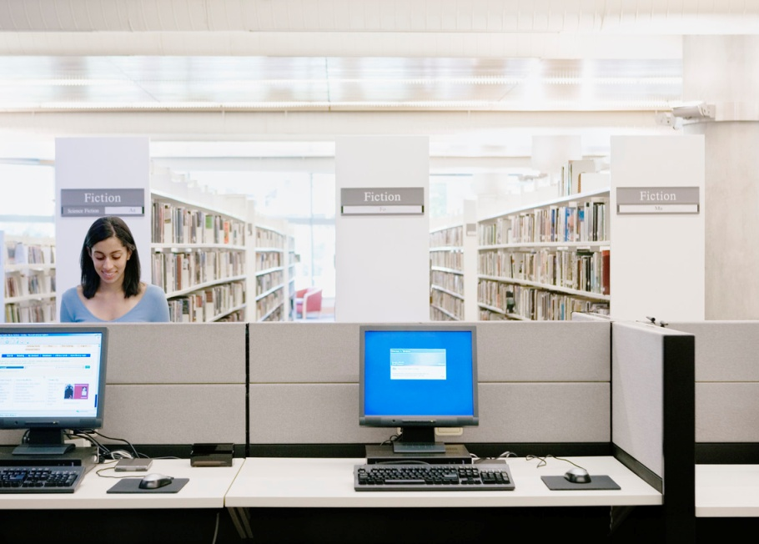
Implications for Library Services
Library Brand
Advertise brand & resources
Demonstrate library value
Creative Marketing
Promote range of
options & convenience
Teach VR as part of
information literacy
Notes:
Implication: Library brand
The library must advertise its brand, and its resources better within the community.
Perceptions of libraries, 2005 - Libraries viewed as being about books, can advertise presence better
College students’ perceptions, 2006 - Students trust library, but are visiting less since they began using Internet
Sense-making, 2006 - Users described institutional information sources as being in the background
Researchers’ use of academic libraries, 2007 - Library of the future needs stronger brand identity
Researcher of the future, 2008 - Recommendations include improving library brand
Seeking Synchronicity, 2008 - Libraries need to market their services and resources more highly
E-journals, 2009 - E-journals (provided by the library) are critical part of research process
Students’ use of research content, 2009 - Students are aware of the difference between formal research and basic Internet content

Slide 40
How Can Librarians Meet User Needs?
Prepare for changing user behaviors
Look & function more like search engines & popular web services
Provide high-quality metadata
Notes:
Library systems must be prepared for changing user behaviours, which include advanced search options, demands for immediate access, and quick perusal of resources.
Library systems need to look and function more like search engines (eg., Google) and popular web services (eg. Amazon.com) as these familiar to users who are comfortable and confident in using them.
High-quality metadata is becoming more important for discovery of appropriate resources.
Librarians must now consider the implications of power browsing behaviours.
Students need more guidance and clarity on how to find content and how to assess its worth as well as its relevance.
The library must advertise its brand and its resources better to academics, researchers and students, demonstrating its value clearly and unambiguously.

Slide 41
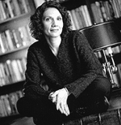
Thank You!
Lynn Silipigni Connaway lynn_connaway@oclc.org
Timothy J. Dickey timothy_dickey@oclc.org
http://www.jisc.ac.uk/media/documents/publications/ reports/2010/digitalinformationseekerreport.pdf

Slide 42
Support for
Research Workflows
From the Researcher’s Point of View
Jennifer Schaffner
Program Officer
Notes:
This project focuses on researchers within their surround of tools and services they use to create and discover knowledge. OCLC Research set out to learn from the IR debacle, and challenge libraries and universities to develop new services that scholars actually need. Our services must provide value to faculty on faculty terms before the library will see more than scant, grudging use.

Slide 43
Support for Research Workflows a joint project with the UK’s Research Information Network
“discover the information-related support services researchers use throughout the life-cycle of their work”
Notes:
OCLC Research and the UK’s Research Information Network combined forces on a collaborative US and UK study of research support, examining good practices in research information management. The OCLC Research report (hot off the presses!) documents the nature and scope of tools and services that researchers currently use, how effective these are in meeting researchers’ needs, and whether there are unmet needs.
This project riffs off of Jim’s comment about the risks to libraries because information services have moved to the network level. This work is also deeply indebted to all the work of my colleague, Lynn, on users and access.

Slide 44
oclc.org/research/publications/library/2010/2010-15.pdf
Notes:
The report is titled “A Slice of Research Life.” Our analysis of case studies – conducted by consultants Susan Kroll and Rick Forsman - set out to identify intersections and gaps among services provided by various on-campus entities, consortia, do-it-yourself Cloud services, and commercial endeavors. The report provides examples of good practice, recommends areas where new practices might emerge, and identifies possible areas and scope for collaboration within and across institutions.

Slide 45
Examples of Departments and Disciplines
African Studies and African Art
Astronomy
Bioinformatics
Computer Science
Digital Arts
Digital Media
Economics
English
Geography
Global Health
History
Health Research
Latin American Studies
Life Sciences
Mathematical Ecology
Mechanical Engineering
Medicine
Music History
Physics
Population Research
Psychiatry
Psychology
Sociology
Veterinary Medicine
Notes:
Kroll and Forsman conducted structured interviews with ‘star’ researchers – and their staff - at universities with reputations for exemplary research support. In the US we chose Cornell, the Ohio State University, the University of Washington and Vanderbilt. Kroll and Forsman secured entrée and introductions through deans of research and provosts, deliberately not through the library.

Slide 46
Examples of Research Support Services
ADS
arXiv.org
Coeus (from MIT)
Community of Science
DevEconTree
NeuroTree
NstED
OSU:pro
QTL (from NCSU)
REDCap (from Vanderbilt)
SAS
SNPedia
SPSS
VIVO
Web of Science
Word processing
Spreadsheets
Open source software
Write their own code
Notes:
For context, these are examples of information-related tools and services cited by name in various interviews with prominent researchers and their staff.
Many services named are tailored to particular disciplines, and are often international in scope.
Some support services have been created by one university, and then are adopted widely – such as Vanderbilt’s REDCap (now in use at 92 universities).
Some generic tools come right out of the box. For example, several people report that they use spreadsheets manage data, or they use cut-and-paste to manage citations.
Other generic tools are open source or free, and a handful of researchers report they write their own code when they have to.

Slide 47
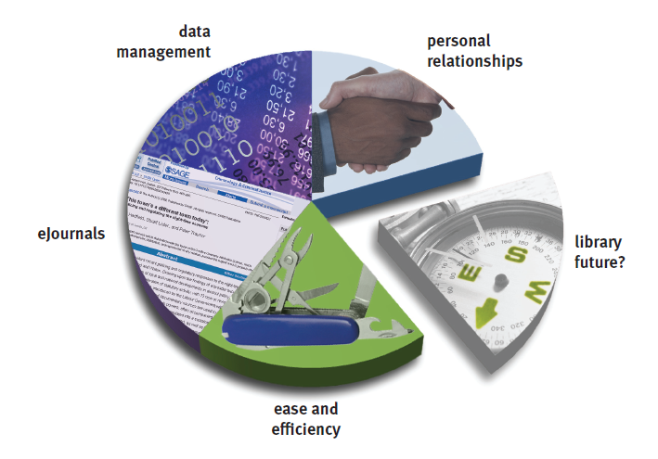
Conclusions:
Researchers value efficient, easy-to-use services.
Electronic journals and Google dominate the landscape in the research process.
No one can manage their documents and data sets.
Researchers use personal relationships to choose collaborators.
Researchers do not use libraries.
Notes:
The conclusion first:
Researchers have adapted quickly to products that expedite their work, and reject tools and services that are not easy-to-use and don’t offer a sizeable payoff. <click>
Google and e-journals epitomize this convenience. WE didn’t ask the question (we were not examining library content, rather research services), but researchers consider ejournals a “service.” <click>
Across disciplines, many of the researchers we spoke with struggle with the burgeoning volume of their own data and documents. They worry that their own work may be unavailable, or lost. This is the sizeable gap and opportunity: interoperable and discoverable data structure standards, metadata management <click>
Before embarking on collaborative work, researchers choose colleagues by introductions and meet with them, face to face. In other words, from the vantage point of the scholars themselves, expertise profiling is not interesting. <click>
Mostly, the “L” word doesn’t come up.
None of this should be news.

Slide 48
What to stop doing? what to forgo?
Services to learn about grants and funding?
Services about where to publish?
Services to manage IP and exploit commercial value of research?
Instruction on how to use information services?
Expertise profiling?
Services to analyze large text and data files?
Citation managers?
Services to manage pre-prints, post-prints and publications?
Notes:
“There is misplaced effort in this space.” Many research support services that libraries and universities offer are now marginal to the interests of their faculty. What might the library and the university consider to stop doing?
Researchers already track funding opportunities, and all the universities have a central office managing grants and contracts. <click>
Researchers are told which journals to publish in, or they just know. <click>
In some fields, there is considerable pressure to place results in the public domain. In the case of legal and technology transfer, though, all universities have offices that deal with this. <click>
Forget about information literacy, classes, bibliographic instruction, all that. Sure, researchers know that technology changes threaten to eclipse their information management and retrieval skills – but this is close to the bottom of their priorities. Google is good enough. <click>
Expertise profiling may serve the university, but researchers are mostly not interested. <click>
Researchers use commercial software to analyze large text and data files, for example, for astronomy data or patient’s medical files <click>
Some researchers are frustrated with citations. Most participants use Word, copy-and-paste, rather than a tool like EndNote or RefWorks. <click>
Services to manage pre-prints, post-prints and publications. <Never. Not one.>

Slide 49
Lingering questions…
Notes:
There are sizeable opportunities for informatics skills and a data valet (data concierge? data guru?) on campus. I’m not sure they’ll be in the library, though.
We are looking forward to the UK report, expected in the fall. Based on our conversations with both the UK and US the consultants, differences in national research structures and funding regimes are substantial, and the fruits of each system are heterogenous. There is a real chance for mutual international exchange of successful research support services, and exciting possibilities for interoperable repositories of discipline-specific international research discoveries and knowledge created.
Cynical conclusions about marginal, misplaced effort - not at odds with our recent Risk and Systemic Change report
Data guru, data valet, data guru – “I have a bucket of bits but can’t make sense of them”
Where the hell are the vendors? Have they missed it altogether? Where are the services we need to get from them?
What about cross-institutional and transnational interoperability of what’s buried in our bespoke IRs?
“if we weren’t using expertise profiling systems for promotion and tenure, we would have wasted millions of dollars.”
organizing management of results of research – transnational subject repositories?
P to E has gone well. Library services are being peeled away from the collection, as the books and the journals have gone digital.

Slide 50
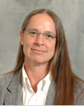
Thank You!
Jennifer Schaffner jennifer_schaffner@oclc.org
Support for Research Workflows project: http://www.oclc.org/research/publications/default.htm
The Research Information Network (RIN) http://www.rin.ac.uk/
Notes:
I’ll hand control to my colleague Karen Smith-Yoshimura, a data guru if there ever was one.

Slide 51
Transitioning from and Beyond MARC
Karen Smith-Yoshimura
Program Officer, OCLC Research
ALA Update Webinar
17 June 2010

Slide 52
Where we are
Where we want to go
How do we get there?

Slide 53
Now: Managing MARC and non-MARC metadata
RLG Partners use same staff to create both
MARC and non-MARC metadata?
Yes | 64 | 66%
No | 33 | 34%
RLG Partners create non-MARC metadata
as part of routine workflows?
Yes | 86 | 80%
No | 22 | 20%
What We’ve Learned from the RLG Partners Metadata Creation Workflows Survey, 2009
Notes:
An RLG Partner working group (Leighann Ayers, U. Michigan; Beth Picknally Camden, U. Pennsylvania; Lisa German, Pennsylvania State University; Peggy Johnson, U. Minnesota; Caroline Miller, UCLA) conducted a survey in 2008 of department heads or directors in the RLG Partnership responsible for creating at least some non-MARC metadata, either solely or in addition to MARC metadata. We received 134 responses from 67 RLG Partner institutions, of which 121 created at least some non-MARC metadata. Only 22 of those (18%) created non-MARC metadata only.

Slide 54
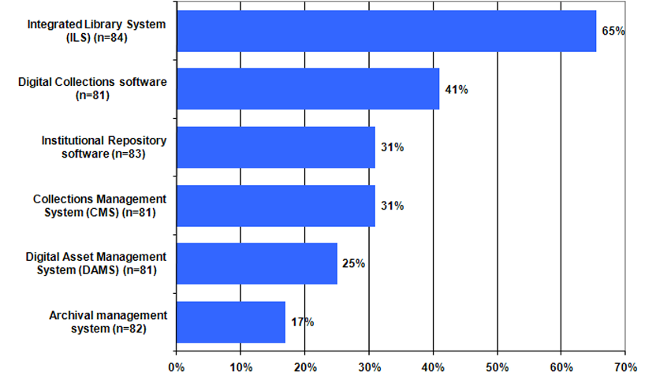
Metadata Description Tools
RLG Programs Descriptive Metadata Practices Survey Results: Data Supplement 2007
Notes:
This is from an earlier survey conducted in 2007 of 18 RLG Partner institutions in the US and UK that had “multiple metadata creation centers” on campus that included libraries, archives, museums and had some interaction among them. Each head of a unit responsible for creating metadata to describe information resources that a researcher, student, or teacher would want to access was requested to respond.

Slide 55
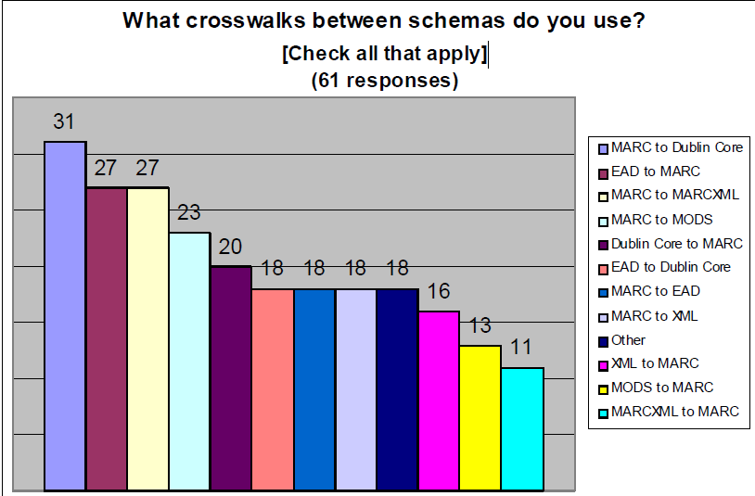
What We’ve Learned from the RLG Partners Metadata Creation Workflows Survey, 2009
Notes:
In the 2008 survey of RLG Partners, 70% reported that they had tools to convert between MARC and non-MARC formats. Only 11 schemas were used by 18% or more of 61 respondents. More people used cross-walk schemas from MARC to something else than schemas to MARC.

Slide 56
Some problems with crosswalking MARC
Extra effort is required to add, validate, and dismantle ISBD and AACR2 rules.
The ISBD and AACR2 layers are not a worldwide standard.
Vocabulary and semantic concepts are different.
Differences in punctuation and formatting require crosswalks to peek at the data. As a result:
The mappings are brittle.
Duplicate detection is difficult.
Carol Jean Godby, “Mapping Bibliographic Metadata”, NETSL Annual Spring Conference, 2010-04-15

Slide 57
OCLC no.
Leader/06 | p | p | p
Leader/07 | c | c | c
001 | ü | ü | ü
005 | ü | ü | ü
008/00-05 | ü | ü | ü
008/06 | i | i | i
008/07-10 | 1800 | 1835 | 1889
008/11-14 | 1865 | 1913 | 1920
008/15-17 | xxu | cau | cau
008/23 MX | r
008/35-37 | eng | eng | ger
008/39 | d | d | d
040 | a b | a b | a b
043 | a | a
100 | a d | a | a d
245 | a b f | a f | a f
300 | a c | 3 a b | a
500 |  |  | a
506 |  |  | a
520 | a | a | a b
530 |  | a
533 | 3 a
535 |  | a
545 |  |  | a
555 |  | a
600 |  |  | a d v
610 |  | a
650 | a x v | a z v | a z v y
651 | a x v | a x v
655 |  | a 2
700 | a d | a d | a d
Mixed material
(3 records)
Catherine Argus (NLA)
comparison of MARC fields
indexed in Amicus, COPAC,
Libraries Australia, WC.org
and FirstSearch
Colour Key
Searching in All databases
Searching in 4 databases
Searching in 3 databases
Searching in 2 databases
Searching in 1 database
Searching in no databases
Limiting in any database
Implications of MARC Tag Usage on Library Metadata Practices Webinar 2010-03
Notes:
For the Implications of MARC Tag Usage on Library Metadata Practices Working Group, Catherine Argus of the National Library of Australia compared the search, limit, and sort options in five different aggregated bibliographic databases, using a sample of 52 MARC records in different formats. This is from the Webinar we conducted last March. She found that all databases offered at least one search option not offered by the others, and at least one MARC field not indexed by the others. The fields that are most in common match closely to the ones that are most frequently occurring in WorldCat: ISBN/ISSN, main/added entries, title/variant title, series, subject.

Slide 58
Some implications
MARC data cannot continue to exist in its own discrete environment. It will need to be leveraged and used in other domains to reach users in their own networked environments.
MARC is a niche data communication format approaching the end of its life cycle.
Future systems need to take advantage of linked data to meet users’ needs. MARC is not the solution.
Future encoding schemas will need to have a robust MARC crosswalk to ingest millions of legacy records.
Implications of MARC Tag Usage on Library Metadata Practices , 2010
Notes:
Here are some of the highlights from the working group’s recently published report, Implications of MARC Tag Usage on Library Metadata Practices. The working group had expected that these statements would be provocative when we presented them in our March 2010 Webinar – we were surprised that we received no pushback at all.

Slide 59
We’re already repurposing the metadata
we have

Slide 60
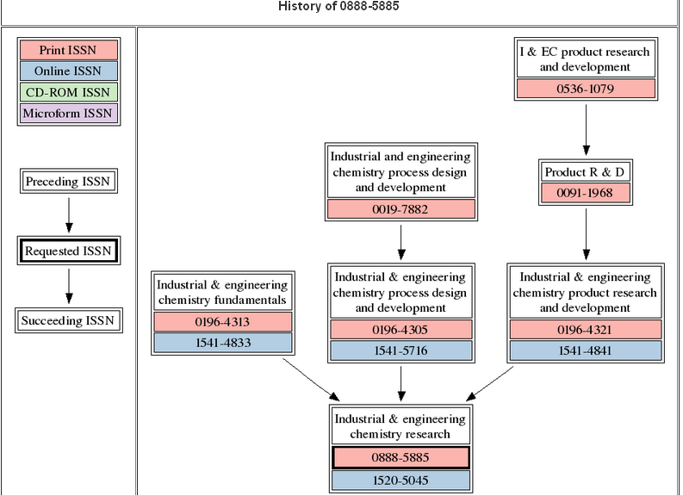
OCLC’s xISSN Web Service
xissn.worldcat.org/

Slide 61
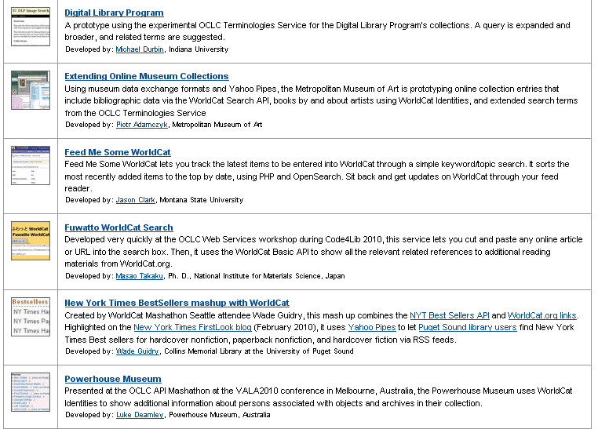
OCLC Web Services’ Application Gallery
oclc.org/applicationgallery/

Slide 62
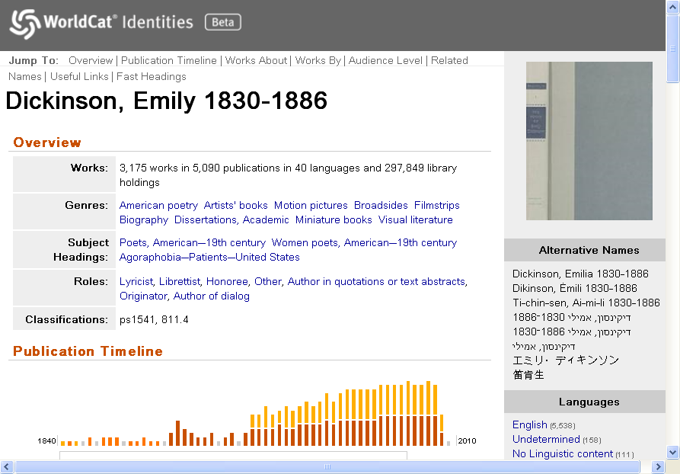
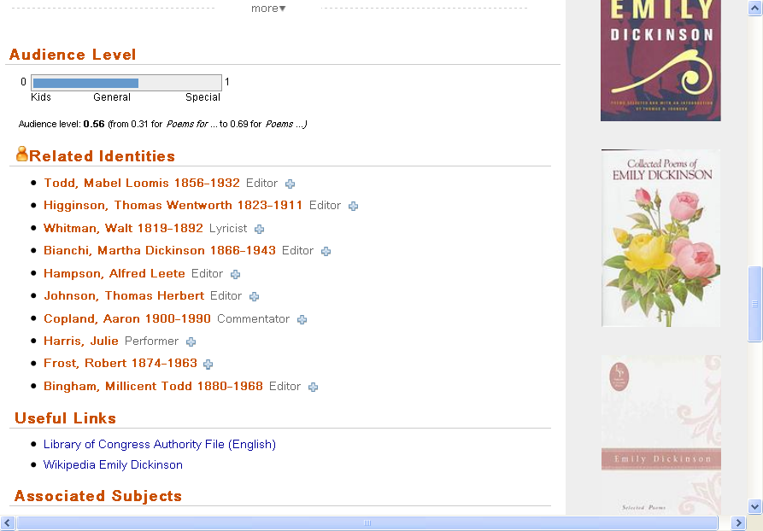
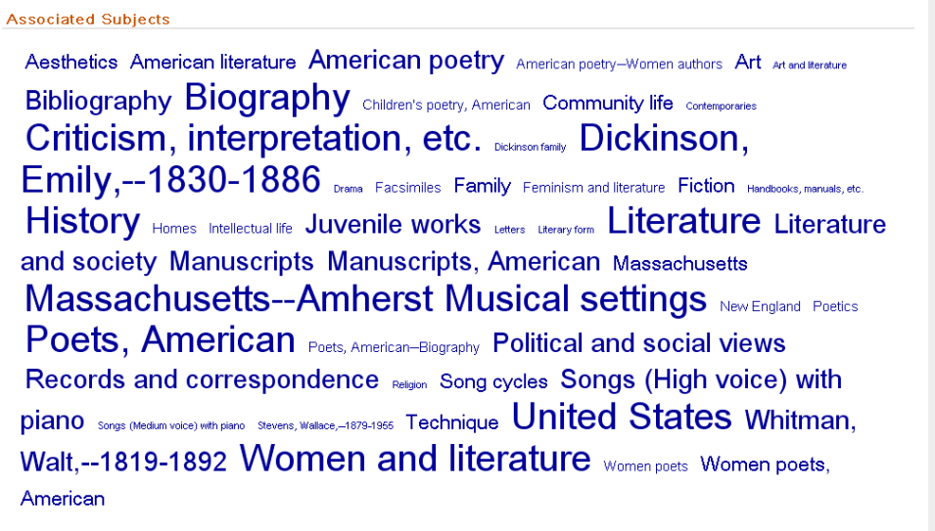
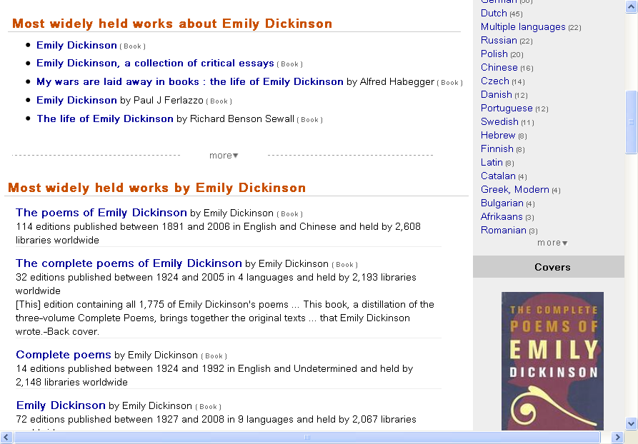
Notes:
WorldCat Identities has compiled information for 30 million people, organizations, fictional characters datamined from WorldCat. The publication timeline is based on the publication dates of all the publications represented in WorldCat. The works are FRBRized from the contents of WorldCat (with a long list of different translations); audience level based on the types of libraries that hold the works, related identities pulled from the bibliographic records, links to authority files, and (click) a Tag cloud of the subjects assigned to all her works.

Slide 63
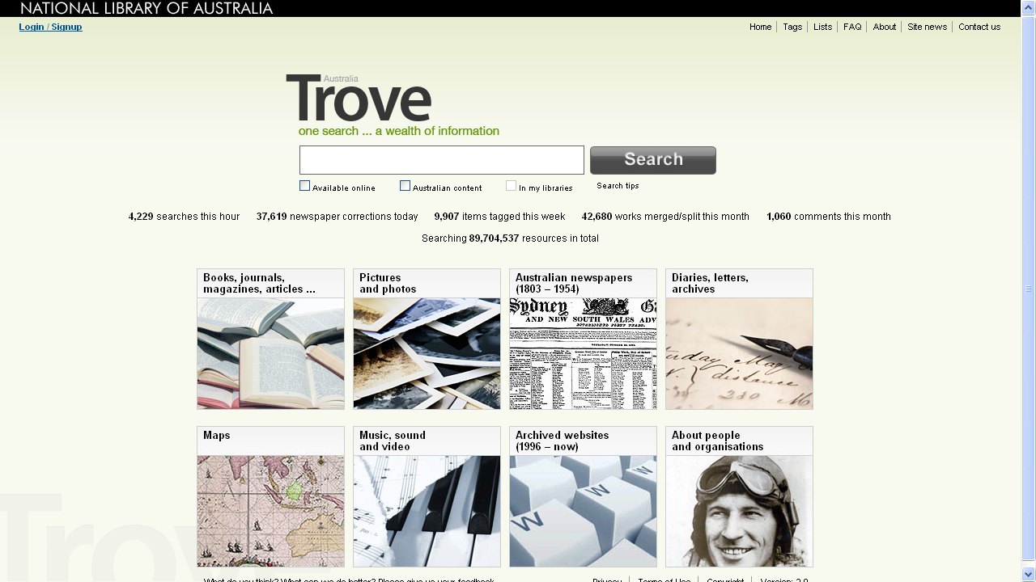

Slide 64
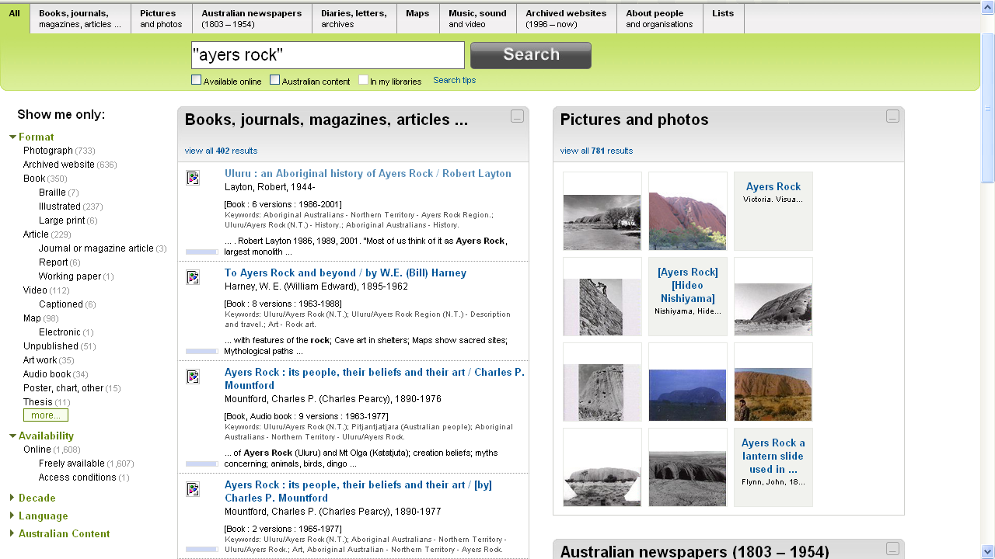
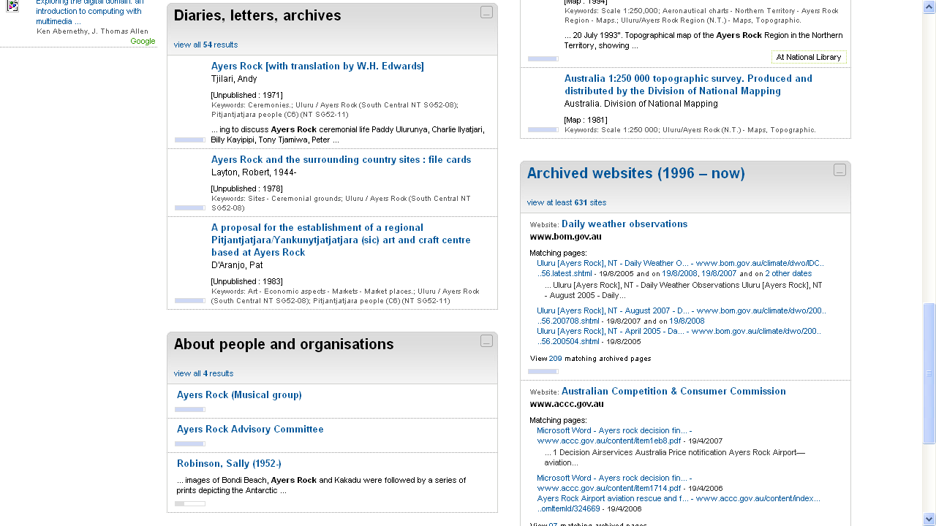
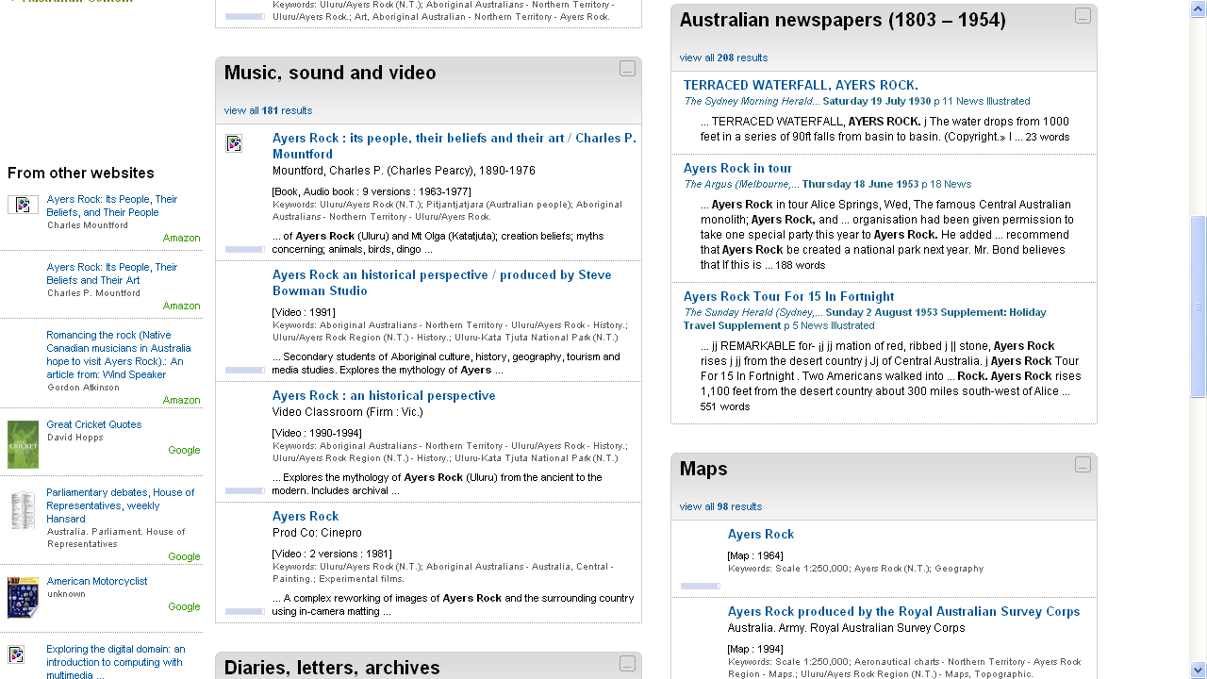
Notes:
A search on Ayers Rock retrieves records from all resources. Note that the books results are “FRBRized” – six editions for the same item have been grouped together. You can also limit your results to those that are “freely available”. Scrolling down (click) you see results for audio and videos; australian newspaper articles, map – with links to other Websites, and (click) archival materials, people and organizations, and archived Websites.

Slide 65
Where we are
Where we want to go
Creating MARC and non-MARC metadata, often redundantly.
Limited reuse outside the library domain.
Metadata created by libraries generally hidden or buried in Web results.
Create metadata once, and reuse in different contexts.
Expanded reuse of metadata from variety of sources for own context.
Contribute own metadata to the Semantic Web for discovery and metadata creation.

Slide 66
How we get there
Move beyond “records” and converse with rest of the networked world.
Aggregate “records” from statements when we need them.
“Statement-based” data can be managed and improved more easily than record-based data
Statement-based data can carry provenance for each statement.
Diane Hillmann, “Application Profiles”, ALA ALCTS: CCDA 2010-01-18
Link data instead of copying it.

Slide 67
Why linked data?
Share data in a non-library-centered exchange format.
MARC not popular with the Web community
Dublin Core not semantically rich
Provide a framework for sharing semantically rich data in a Web-friendly way.
Participate in the Semantic Web. Bridges the gap between our technologies and the rest of the world’s.

Slide 68
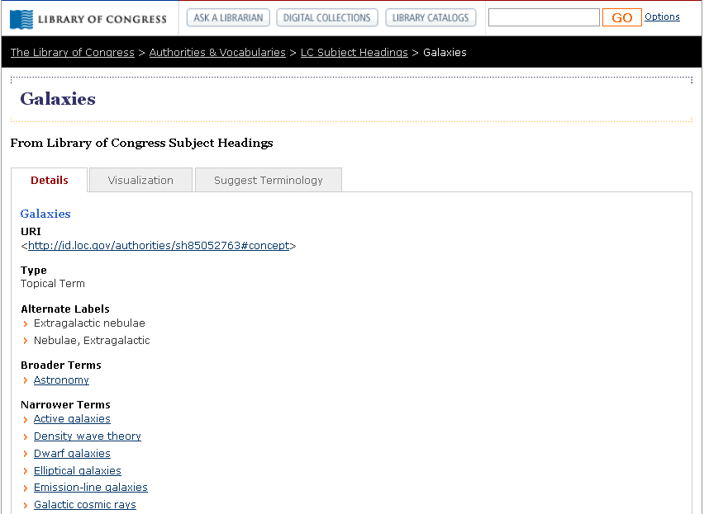
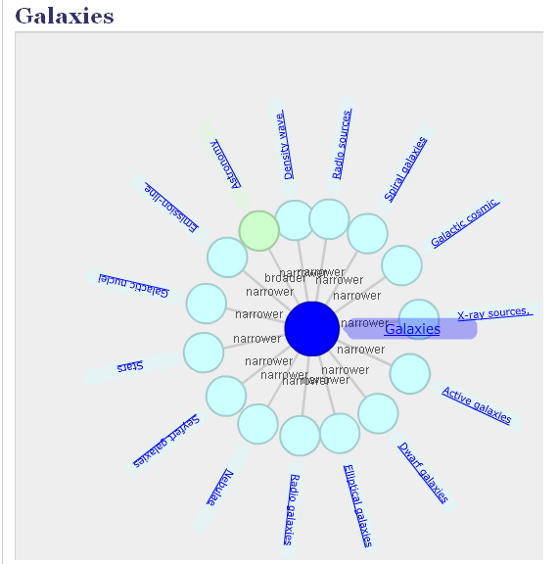
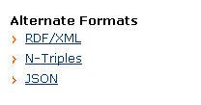
id.loc.gov/authorities
Notes:
The intent of the “authorities and vocabularies” offered by the Library of Congress is to provide human and programmatic access to commonly found standards and vocabularies developed by LC, such as Library of Congress Subject Headings, shown here. Every term is assigned a URI, using the structure shown here with the LC control number, and provides the information in different foramts, including RDSF/XML. The AquaBrowser visualization tool shows the links to narrow and broader terms.

Slide 69
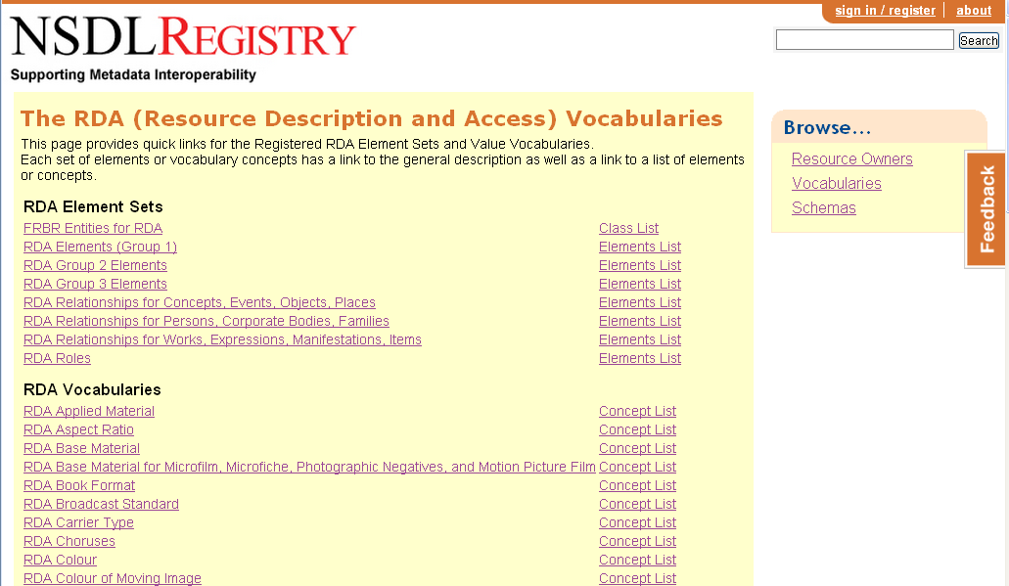
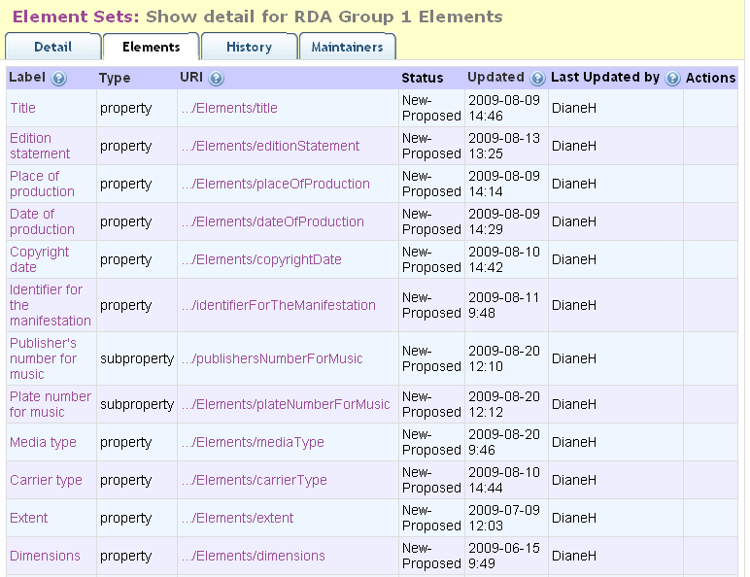
http://metadataregistry.org/rdabrowse.htm
Notes:
The creators of RDA are making the controlled vocabularies freely available on the Web through Metadata Registry so third party providers and Web applications can easily access and make use of the data. <click> This is the list of element sets for RDA Grou 1 elements, with the data elements we’re familiar with like title, edition statement, place and date of production, etc.

Slide 70
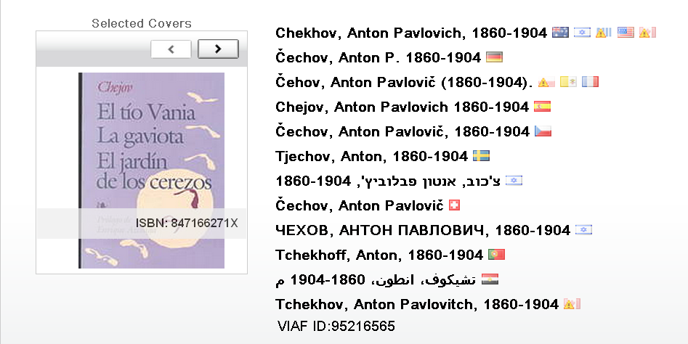
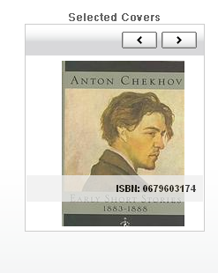
Virtual International Authority File (VIAF)
Application/RDF as xml: http://viaf.org/viaf/95216565/rdf.xml
http://viaf.org/viaf/95216565
Notes:
VIAF is all about creating links between existing files of names – 20 national authority files, currently representing 13 million personnas The result is a VIAF record that shows information derived from the cluster of linked name records and associated bibliographic records. We have made it available as linked data with URIs for everything and content designation for different data formats, including a view of a “cluster” as rdf in xml.

Slide 71
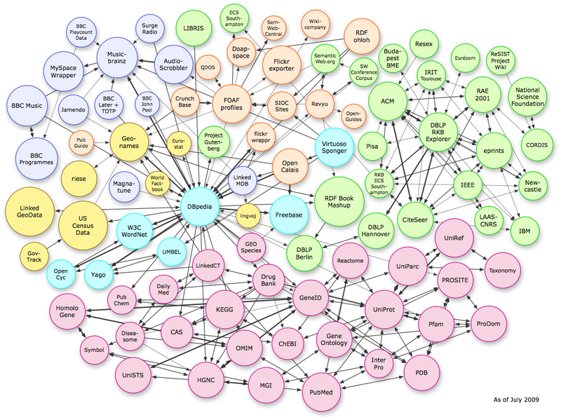
Taking off?
VIAF
National Library of Sweden
R|D|A
LCSH
Notes:
DBpedia is a community effort to extract structured information from Wikipedia and to make this information available on the Web. DBpedia allows you to ask sophisticated queries against Wikipedia, and to link other data sets on the Web to Wikipedia data. This will make it easier for the amazing amount of information in Wikipedia to be used in new and interesting ways, and might inspire new mechanisms for navigating, linking and improving the encyclopaedia itself as well as the linked data, including connections to library data – <click> here showing the link to the database at the National Library of Sweden. This image shows the links as of last July and there are now many more – for example, <click> VIAF, the Library of Congress Subject Headings, and the RDA vocabularies. According to their online site as of last November, the DBpedia knowledge base describes more than 2.9 million things, including persons, places, music, films, names of diseases and species, organizations and more, in 91different languages.

Slide 72
Thank You!
Karen Smith-Yoshimura smithyok@oclc.org

Slide 73
Extracting names and resolving identities in unstructured text
Carol Jean Godby Research Scientist, OCLC Research
ALA Update Webinar 17 June 2010
Notes:
I’m going to give a brief update on a grant-funded project with collaborators from the University of Illinois and the University of Maryland. The purpose of our project is to develop metadata extraction tools for digital preservation and other library applications. It starts from an acknowledgement of the research on automated name extraction that has been developed in the computer science community over the past twenty five years. The outcome of this work is relevant to the library community because the recognition and management of names is so important.

Slide 74
Project Goals
Lower the barrier of access to high-end named entity recognition (NER) tools.
Build bridges to identity resolution research.
Create tools for open use.
Demonstrate use of the tools on library data.
Make recommendations for future collaboration between pure and applied research.
Notes:
Though name-extraction (NER) tools are available as open source, they are not as widely deployed as they should be.
Why not? We tried to answer these questions as we defined our project goals.
1. Workflows are incomplete. They need to be used with a suite of utilities that make it easy to prepare data, tag it, score it, and retrain the NER tool, if required. The result would lower barriers of access.
2. They need to be used in conjunction with identity resolution research, which links the extracted name to the correct entry in an authority file.
3. They need to be more responsive to the needs of the library community. Most name entity recognition tools recognize only a small number of name categories—typically people, organizations, and locations—but library data has many other kinds. When we identify these, we can make recommendations to the computer science community for future enhancements.

Slide 75
Names in an EAD record
Papers of Gennaro M.Tisi, noted clinical and research specialist in the area of pulmonary medicine and a founding member of the School of Medicine, University of California, San Diego. Author of over 100 original articles, chapters, and abstracts, Tisi's research interests included the staging of lung cancer, medical-pulmonary education, pulmonary physiology and mechanics, and clinical research in pulmonary disease. Arranged into six series, the collection contains research notes, correspondence, manuscripts, administrative memos, committee agendas and minutes, and photographs documenting Tisi's professional life from 1964 to his death in 1988.
Gennaro Michael Tisi (September 26, 1935-February 18, 1988), was a pulmonary specialist, both as a clinician and teacher. He earned a B.S. in chemistry, biology, and philosophy from Fordham University in 1956 and a M.D. from Georgetown University Medical School in 1960. He was a founding member of UCSD's medical school, where he worked from 1968…
Notes:
Here’s one potential application that we are studying. EAD records often have long spans of unstructured text—for biographical statements and descriptions of the collection. We would like to extract the names, index them, and link them to authority files. The important names are shown in colored fonts—red for personal, green for location, purple for organization.

Slide 76
Tagging results
Missed
Papers of [PER Gennaro M. Tisi], noted clinical and research specialist in the area of pulmonary medicine and a founding member of the School of [MISC Medicine], [ORG University of California], [LOC San Diego]. Author of over 100 original articles, chapters, and abstracts, [PER Tisi]'s research interests included the staging of lung cancer, medical-pulmonary education, pulmonary physiology and mechanics, and clinical research in pulmonary disease. Arranged into six series, the collection contains research notes, correspondence, manuscripts, administrative memos, committee agendas and minutes, and photographs documenting [PER Tisi]'s professional life from 1964 to his death in 1988.
[PER Gennaro Michael Tisi] (September 26, 1935-February 18, 1988), was a pulmonary specialist, both as a clinician and teacher. He earned a [LOC B.S.] in chemistry, biology, and philosophy from [ORG Fordham University] in 1956 and a M.D. from [ORG Georgetown University Medical School] in 1960. He was a founding member of [ORG UCSD]'s medical school, where he worked from 1968 until his death in 1988 of a cerebral hemorrhage at the age of 52.
Category error
Notes:
Here the output of the state-of-the-art name tagging tool developed by computer science researchers at the University of Illinois, who are research partners in our work. The outcome is pretty good, but it missed School of Medicine and falsely tagged “B.S” as a location name. In a formal evaluation, the hits, misses, and near-misses are tallied into a score like that used in information-retrieval research. On this data—tagging accuracy was around 80-90%--a good score. These results imply that NER tagging on EAD records is promising, and we should be using it to extract indexable terminology from rich fields such as biographical sketches.

Slide 77
Names in a government document
46 | 2009-2010 [ORG Illinois] [MISC Blue Book]
96th [ORG General Assembly]
Office of the [MISC Senate President]
The [MISC Senate President] is the presiding officer of the state [ORG Senate] , elected by and among the members of the [ORG Senate] to serve a two-year term. The [MISC Illinois Constitution], statutes and rules define the functions and responsibilities of the office.
The [MISC President] appoints [ORG Senate] members to standing committees and permanent and interim study commissions, designating one member as [MISC chair]. The [MISC President] also appoints the [MISC Majority Leader] and [MISC Assistant Majority Leaders], who serve as officers of the [ORG Senate].
Passed by the [ORG Senate] are in accordance with [ORG Senate] rules.
Notes:
Government documents also have many names to extract. But these are much more challenging for the NER tools developed in academic research departments. Here is a document marked up by the government documents expert on our project team. These records are full of names of laws, offices, and legislation. But how does it fit into the simple naming scheme implemented in research prototypes? One solution is to use the “Miscellaneous” category, which is reserved for the names of human-designed artifacts. But obviously, government documents require a far richer naming scheme. And NER performance on this data was poor—around 20%--perhaps because Miscellaneous is defined differently from one text to the next and government documents have unique capitalization and punctuation conventions that confuse the tagger.
Nevertheless, regardless of document type, personal names and location names were tagged with a high degree of accuracy. But Miscellaneous and organization names are highly dependent on the subject of the text.
77

Slide 78
Recommendations
For users of named entity tagging tools:
Take advantage of the most successful and mature categories – for personal names and locations.
Work with semi-structured or edited text.
For NER tool developers
Use computational models for “placeholder” categories that can be trained on the unique name types in a collection.
Develop more detailed models for the most mature categories.

Slide 79
For more information
“Who’s who in your digital collection: Developing tools for name disambiguation and identity resolution.” To appear in the Chicago Colloquium for Digital Humanities and Computer Science Journal.

Slide 80
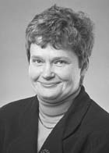
Thank You!
Carol Jean Godby godby@oclc.org

Slide 81
Taking Our Pulse The OCLC Research Survey of Special Collections and Archives
Jackie Dooley Consulting Archivist, OCLC Research
ALA Update Webinar
17 June 2010

Slide 82
Survey population
Libraries surveyed: 275 total
Rate of response: 61% (169)
Five membership organizations
Association of Research Libraries (ARL)
Canadian Association of Research Libraries (CARL)
Independent Research Libraries Association (IRLA)
Oberlin Group (80 liberal arts college libraries)
RLG Partnership

Slide 83
Key for interpreting percentages:
Red = % of respondents
Black = numerical data

Slide 84
What’s wrong with this [big] picture?
Overall size of collections is growing … a lot
Materials remain “hidden” … far too many
Backlogs continue to grow … not acceptable
Staffing is not increasing
75% of library budgets have been cut

Slide 85
Big picture: Action items
Challenge yourself, your institution, your membership organizations, and your professional societies to engage with the issues raised and decide for which ones you’ll become responsible.
Develop and promulgate metrics to enable standardized measurement of collections, use, metadata, and other key elements of special collections management.

Slide 86
Collections
Growth of ARL collections since 1998
Books and archives/manuscripts: 50%
All audiovisual formats: 300%-400%
Cooperative collection development
Very few formal arrangements
Preservation: audiovisual materials at “code blue”

Slide 87
Collections: Action items
Develop best practices for collaborative collection development. Identify barriers. Define key characteristics and desired outcomes of an effective collaboration.
Take collective action to establish shared facilities for cost-effective preservation of audiovisual materials.

Slide 88
User services
Use of all formats has increased
Archives and manuscripts: 88%
Visual materials: 76%
Books: 50%
Number of users
Mean: 4,200
Median: 1,500
Access permitted to materials in backlogs: 90%
Interlibrary loan
Loan of reproductions of originals: 44%
Loan of original rare books: 38%

Slide 89
User services: Action items
Develop best practices to facilitate rather than inhibit access to rare and unique materials.
Develop best practices that will facilitate rather than inhibit interlibrary loan of special collections materials.

Slide 90
Cataloging and metadata
Online catalog records
Books: 85%
Cartographic materials: 42%
Archival formats: 50% or less
Archival finding aids
Online: 44%
Print-only or in local silos: 30%
Backlogs
Decreased: more than 50%
Increased: 25-40%

Slide 91
Cataloging and metadata: Action item
Aggregate and disseminate a slate of replicable, sustainable methodologies for cataloging and processing of special collections. Draw on those already developed by CLIR “hidden collections” grantees and others.

Slide 92
Archival collections management
Simplified processing techniques such as MPLP**: 75%
** Mark Greene and Dennis Meissner. “More product, less process.” The American Archivist, vol. 68 no. 2 (2005), pp. 208-263. Freely available online: http://archivists.metapress.com/home/main.mpx

Slide 93
Archival management: Action item
Convert legacy finding aids, using inexpensive methodology, to enable Internet access.
Do not upgrade or expand the data prior to conversion.
Use PDF or another simple technology to convert print-only finding aids.
Develop generic tools to facilitate conversion from local databases.

Slide 94
Digital special collections
Digitization
One or more projects completed: 78%
Large-scale project completed: 38%
Content licensed to commercial firms: 26%
Born-digital archival materials
Undercollected
Undercounted
Undermanaged
Underpreserved
Inaccessible

Slide 95
Digitization: Action item
Develop models for large-scale digitization of special collections, including methodologies for selection of appropriate collections, security and safe handling, sustainable approaches to metadata creation, and ambitious productivity levels.

Slide 96
Born-digital materials: Action items
Define the characteristics of born-digital materials that warrant management as “special collections.”
Document a reasonable set of basic steps for initiating an institutional program for responsibly selecting, acquiring, accessioning, describing, managing, and securely maintaining born-digital archival materials.
Develop generic use cases and cost models for selection, management, and preservation of archival born-digital materials.

Slide 97
What’s next?
July: Report published
August: Webinar open to all

Slide 98
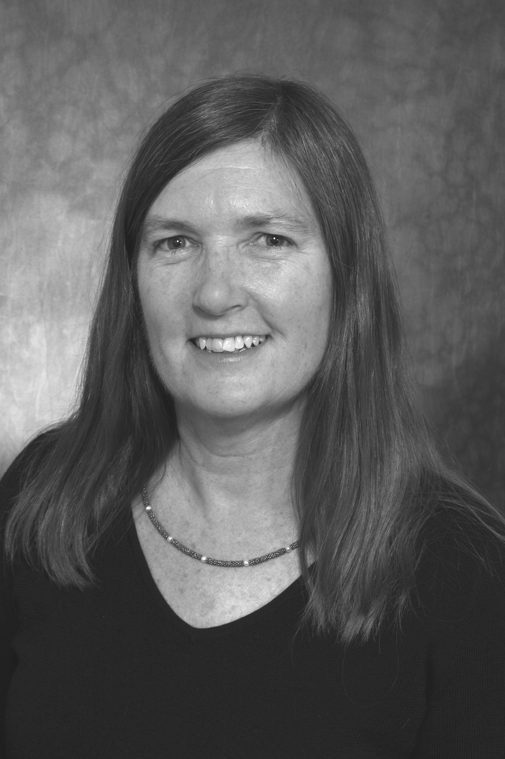
Thank You!
Jackie Dooley
dooleyj@oclc.org

Slide 99
Balance in Rights Management
Ricky Erway Senior Program Officer, OCLC Research
ALA Update Webinar 17 June 2010

Slide 100
Advisory Group
Joanne Archer, University of Maryland
Jeanne Boyle, Rutgers University
Eli Brown, Cornell University
Maggie Dickson, North Carolina State University
Sharon Farb, University of California, Los Angeles
Georgia Harper, University of Texas
Peter Hirtle, Cornell University
Rebekah Irwin, Yale University
Melissa Levine, University of Michigan
Elizabeth Long, University of Chicago
Aprille McKay, University of Michigan
Elizabeth Smart, Brigham Young University
Jenny Watts, Huntington
Jennifer Waxman, New York University
Notes:
We saw the need for action related to digitization of collections of unpublished materials. We formed an advisory group and they helped us craft an event.

Slide 101
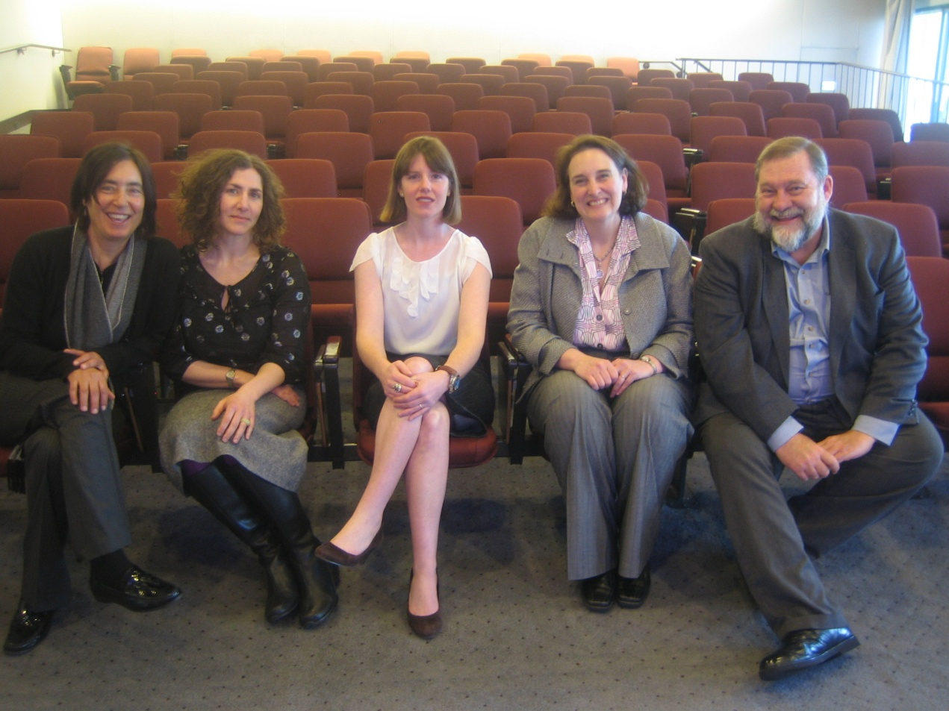
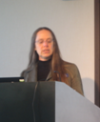
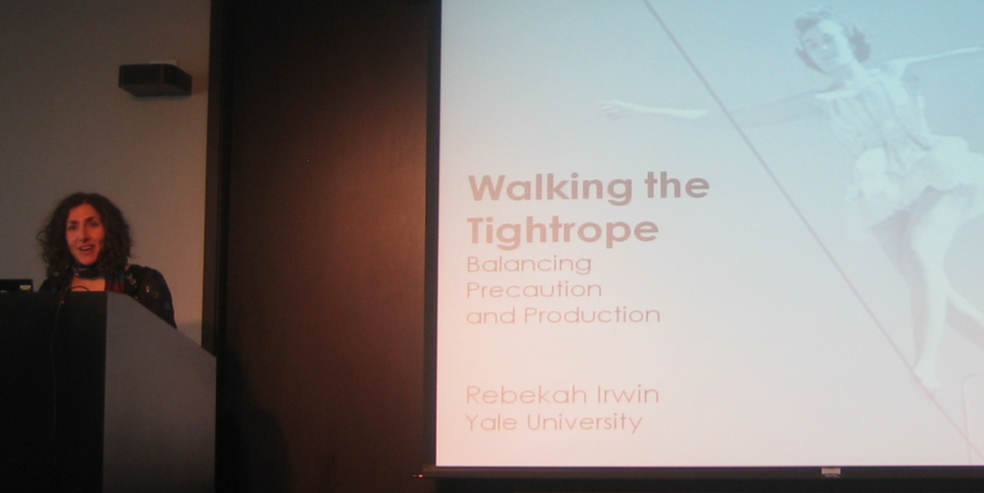
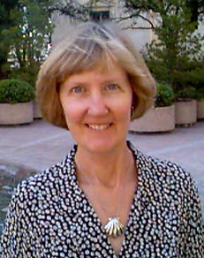
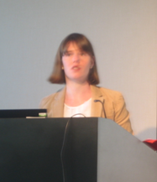
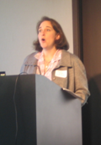
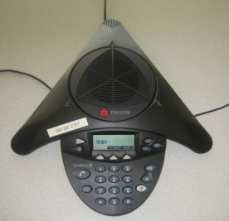
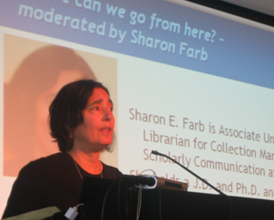
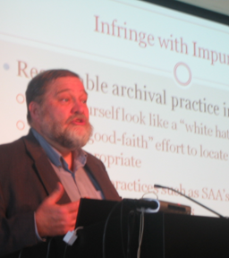
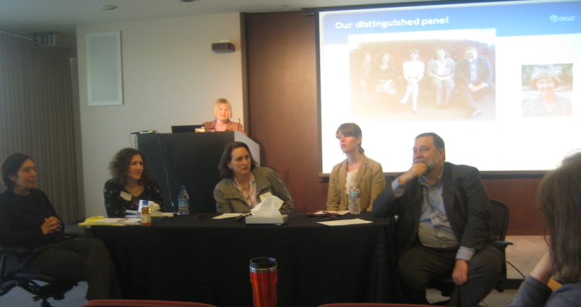
Notes:
On March 11, 2010 we met with local and remote speakers and participants to begin a community debate about managing risks when weighing rights and access.

Slide 102
Archival Code of Ethics
III “Archivists should exercise professional judgment in acquiring, appraising, and processing historical materials….”
VI “Archivists strive to promote open and equitable access to their services and the records in their care without discrimination or preferential treatment...”
IX “Archivists must uphold all federal, state, and local laws.”
Notes:
We were anchored by the archivists’ code, which highlights exercising professional judgment to both promote open access and uphold the law.

Slide 103
Just how much risk are we talking about?
Potential risks and damages are small
Fair use exemption from some damages
Federal actions are prohibitively expensive
No actions have been taken against archives
Notes:
Potential risks and damages are small if the work is unregistered.
There is a Fair use exemption from statutory damages for librarians and archivists
Because federal actions are expensive, it’s more likely that you’d get a take down request and then you can decide how to respond
To date, I am aware of no actions that have been taken in cases where libraries or archives have put digitized collections of unpublished materials online for increased access.

Slide 104
Our distinguished panel
Georgia Harper
on the phone
Sharon Farb, Rebekah Irwin, Maggie Dickson,
Aprille McKay, Peter Hirtle
And our local and remote participants
Notes:
The most significant component of the meeting was the discussion of community practice. We had provided a strawman document that enabled us to focus on the relevant issues and arrive at consensus. The result is the Well-Intentioned Practice document, from which I’ll gloss some highlights.

Slide 105
Well-intentioned practice for putting digitized collections of unpublished materials online
Preamble
The primary responsibilities of cultural materials repositories - stewardship and support for research and learning - require us to provide access to materials entrusted to our care. This document establishes a reasonable community of practice that increases and significantly improves access to collections of unpublished materials by placing them online for the purpose of furthering research and learning. Although it promotes a well-intentioned, practical approach to identifying and resolving rights issues that is in line with professional and ethical standards, note that this document does not concern itself with what individuals who access particular items may do with them. While the document was developed with US law in mind, it is hoped that the spirit of the document will resonate in non-US contexts.
If your institution has legal counsel, involve them in adopting this approach; after the approach has been adopted, only seek their advice on specific questions.
Notes:
Preamble says what the document does and does not attempt to do
It also makes some suggestions about working with counsel (involve them in adopting this approach; then only seek their advice on specific questions).
And remember your counsel’s job is to advise on the risks. Your job is to decide the appropriate course of action.

Slide 106
Select collections wisely
Keep your mission in mind and start with a collection of high research value or high user interest.
Assess the advantages and risks of relying on fair use (in the US) to support public access.
Some types of materials may warrant extra caution when considering rights issues, such as
Contemporary literary papers
Collections with sensitive information, such as social security numbers or medical data
Materials that are likely to have been created with commercial intent (because they are more likely to have economic value)
Very recent materials that were not intended to be made public
If research value is high and risk is high, consider compromises, such as making a sensitive series accessible on-site only, until a suitable time has passed.
Notes:
You’ll want to select collections wisely
Start with a collection of high research value.
Assess the fair use possibilities.
Use extra caution for certain types of collections
Contemporary literary papers
Collections with sensitive information
Materials created with commercial intent
Recent materials not intended to be made public
If research value is high and risk is high, consider compromises, such as on-site access or a time embargo.

Slide 107
Use archival approaches to make decisions
Check donor files and accession records for permissions, rights, or restrictions.
Assess rights and privacy issues at the appropriate level, most often at the collection- or series-level.
Attempt to contact and get permission from the rights-holder, if there’s an identifiable rights-holder at that level.
Include what you know about the rights status in the description of the collection, including if the collection is in the public domain, if the institution holds the rights, or if the rights-holder has given the institution permission to place the digitized collection online.
Document your processes, findings, and decisions and share them with your professional community.
Notes:
Use archival approaches to make decisions
Check donor files.
Assess issues at the appropriate level, most often at the collection- or series-level.
Attempt to get permission from the rights-holder, if there’s an identifiable rights-holder at that level.
Include what you know in the description of the collection.
Document your findings and decisions and share them with your peers.

Slide 108
Provide take-down policy statements and disclaimers to users of online collections
Adopt a liberal take-down policy, such as: “These digitized collections are accessible for purposes of education and research. We’ve indicated what we know about copyright and rights of privacy, publicity, or trademark. Due to the nature of archival collections, we are not always able to identify this information. We are eager to hear from any rights owners, so that we may obtain accurate information. Upon request, we’ll remove material from public view while we address a rights issue .”
Use an appropriate disclaimer at the institutional level, such as “[Institution] makes digital versions of collections accessible in the following situations:
They are in the public domain
The rights are owned by [institution]
[institution] has permission to make them accessible
We make them accessible for education and research purposes as a legal fair use, or
There are no known restrictions on use
To learn what your responsibilities are if you’d like to use the materials, go to [link]”
Notes:
At the institutional level, provide take-down policy statements and disclaimers to users of online collections (sample language)

Slide 109
Prospectively, work with donors
Identify possible intellectual property issues and get relevant contact information.
Ask donors to state any privacy concerns and identify sensitive materials that may be in the collection.
Suggest that donors transfer copyright to the institution or license their works under a Creative Commons CC0 license.
Include statements in your collecting policies and in your deeds of gift or transfer documents that:
ensure that no restrictions are placed on content that is already in the public domain,
grant license to digitize the materials for unrestricted access even when donors retain the rights,
and guard against limitations or restrictions on fair use rights.
Notes:
And then there’s the component to help us avoid these problems in the future: Work with donors to
Identify possible issues and get contact information.
Ask them about privacy concerns
Suggest that donors transfer copyright
ensure that no restrictions are placed on content in the public domain,
grant license for unrestricted access
and guard against limitations on fair use rights.

Slide 110
What Next?
See the document http://www.oclc.org/research/activities/rights/practice.pdf
Support from the community – express yours!
Follow activity http://www.oclc.org/research/activities/rights
Digitize for increased access!
Notes:
We need to establish support from within the community. Very good response (in the US)
Endorsement, testimonial, statement of support, ….

Slide 111
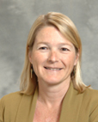
Thank You!
Ricky Erway erwayr@oclc.org

Slide 112
Stay Tuned!
Upcoming Webinars
1 July: TAI CHI Series: Linked Data Part II with Ralph LeVan
15 July: TAI CHI Series: OCLC Web Services with Karen Coombs
TBD August: Overview of Special Collections and Archives Survey Results with Jackie Dooley
23 September: Global Books with Timothy Dickey
Upcoming Events
RLG Partnership Meetings at ALA Annual 25-28 June 2010 Washington, D.C.
Leadership Through Collaboration 20-21 September Smithsonian Institution, Washington D.C.
RLG Partnership European Meeting, Moving the Past into the Future: Special Collections in Digital Age 12-13 October 2010 St Anne’s College, University of Oxford

Slide 113
Upcoming Reports
A Slice of Research Life: Information Support for Research in the United States (June 2010)
Special Collections and Archives Survey Results (July 2010)
Overview of Partner Visits Regarding Special Collections and Archives (July 2010)
Review of Social Metadata Sites Relevant to Libraries, Archives and Museums (July 2010)
Results of the Social Metadata Site Managers Survey (August 2010)
Recommendations on Social Metadata Features Most Relevant to Libraries, Archives and Museums (August 2010)
Scan and Deliver: Digitization on Demand (Fall 2010)
Archival Description Analysis (Fall 2010)
Duct Tape and Twine: Making MissingMaterials.org (Fall 2010)

Slide 114
Thank You!
Send comments to rlg@oclc.org

