Slide 1
Change in Emphasis: The Optimized Print Collection
Carol A. Mandel
Dean, Division of Libraries
2010 RLG Partnership Annual Symposium: When the Books Leave the Building
Chicago, June 2010

Slide 2
Change in Emphasis: The Optimized Print Collection
The NYU perspective on library stacks: “small is beautiful” and “less is more”
Campus size constraints
Demand for library seats (48% increase in main library use in last 5 years)
Nature of current library use
Cost of offsite storage
A paper-less library in Abu Dhabi?

Slide 3
Bobst Renovation Phase II
21st Century Research Commons Space Portfolio
Research Hub: Services, technology, interactions with experts & groups
Graduate Exchange: Informal “watercooler,” decompress, exchange ideas, serendipity, interdisciplinary
Writers Rooms: Subscribed spaces for intense concentration

Slide 4
Bobst Renovation Phase II
21st Century Research Commons Space Portfolio
Grad-only rooms: Quiet, community standards for intense work
Grad-only collaborative rooms: Group “study” rooms, equipped with technology for sharing project work
Intra-stacks and contemplative seating for all users: traditional, with sensitivity to light, acoustics, comfort, electric outlets

Slide 5
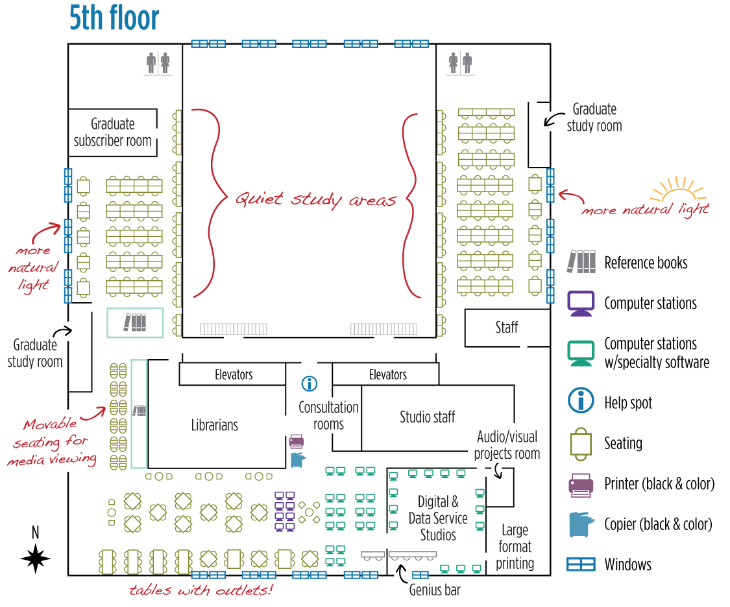

Slide 6
Change in Emphasis: The Optimized Print Collection
Key assumption:
High use books belong in the library stacks, but low use books do not (if they can be made readily available in another way).

Slide 7
Change in Emphasis: The Optimized Print Collection
Emerging assumption:
Low use books do not need to be retained (in one’s own storage facility) if they can be made readily available another way.

Slide 8
Change in Emphasis: The Optimized Print Collection
Low use
Trusted system
Onsite stacks
Offsite repository
Shared repository
Remove from stacks
Remove from local collection

Slide 9
Change in Emphasis: The Optimized Print Collection
Trusted systems for shared print journal repositories are emerging (e.g. WEST)
Scope and vision agreement
Retention agreements
Service agreements
Validation of content
Centralized or distributed?
(See ARL may 2010 presentation by Lizanne Payne)

Slide 10
Change in Emphasis: The Optimized Print Collection
Trusted/feasible systems for shared print monograph repositories are being explored.
Issues include:
Overlap in holdings that are low use
Accessibility vs. “last copy” preservation
Trust and validation via: Agreements? Numbers? Best practices?

Slide 11
Change in Emphasis: The Optimized Print Collection
Key assumption:
Low use can be defined by evidence from circulation and in-house use patterns.

Slide 12
Change in Emphasis: The Optimized Print Collection
Emerging assumption:
Low use can be expected when a digital version is available to substitute for many/most needs.

Slide 13
Change in Emphasis: The Optimized Print Collection
Expanding the candidate print volumes for low use through:
Digitization
Public domain
Hathi assurance of preservation and access
Backfile licensing
Product availability
Enduring access
Appropriate terms

Slide 14
Change in Emphasis: The Optimized Print Collection
Thinking Prospectively in a Collective Environment
Shared print repository
Onsite stacks
Shared acquisitions
Predict low use print
Print packaged with e-book licenses

Slide 15
Change in Emphasis: The Optimized Print Collection
Thinking Prospectively in a New Library: Optimizing Print
Buy print when it is the only or best way to meet known needs
Is “just in time” enough for unknown needs?
Maximize the acquisition and use of e-versions
POD
EBM
Work around consumer e-book readers
Maximize (or optimize) the use of flagship library print collections
Material may be in use
cost and time of delivery

Slide 16
Change in Emphasis: The Optimized Print Collection
We can build new and better models for:
Shared print repositories
Shared acquisitions
Access to digital book content
Interdependent collections
Optimal user space

Slide 17
