Slide 1
“Special Delivery” New Modes of Access to Special Collections
Not
Dennis Massie
Jennifer Schaffner
Program Officers
2010 RLG Annual Meeting
Chicago, June 9, 2010
Commenting:
Jon Shaw - Penn
Paul Constantine -UW

Slide 2
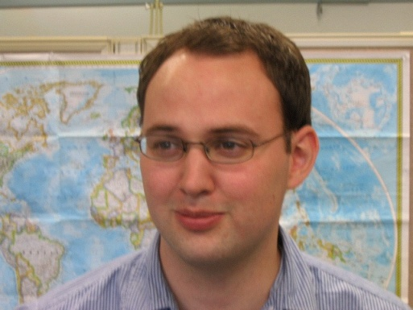
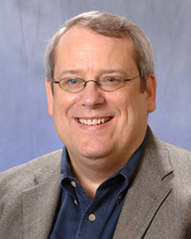
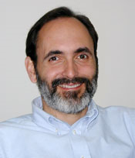
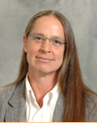
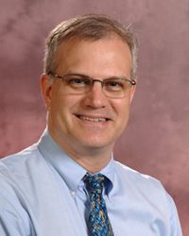
Who We Are
Dennis
Jon
Paul
Jennifer
Eric (the bouncer, er, facilitator)

Slide 3
Agenda
Cameras - internal users (patrons in the reading room)
pause for discussion
Sharing Special Collections – external users (ILL)
pause for discussion
Patron-Initiated Digitization– both
pause for discussion
Cultural divide about sharing what’s special

Slide 4
Discovery = Delivery
Yes
Democratize access
Steward
Case-by-case
It’s being done
No
Err on safe side
Gatekeeper
One-word policy: No
But it shouldn’t be

Slide 5
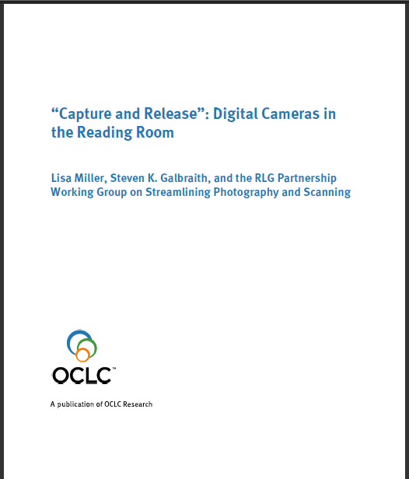
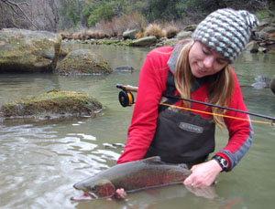
“Capture and Release”
http://www.oclc.org/research/publications/library/2010/2010-05.pdf

Slide 6
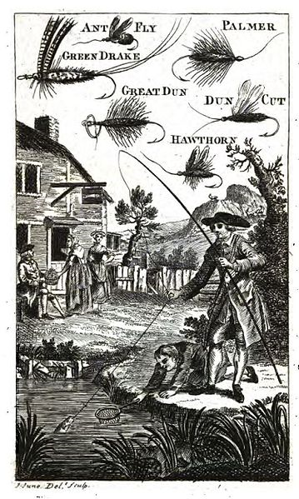
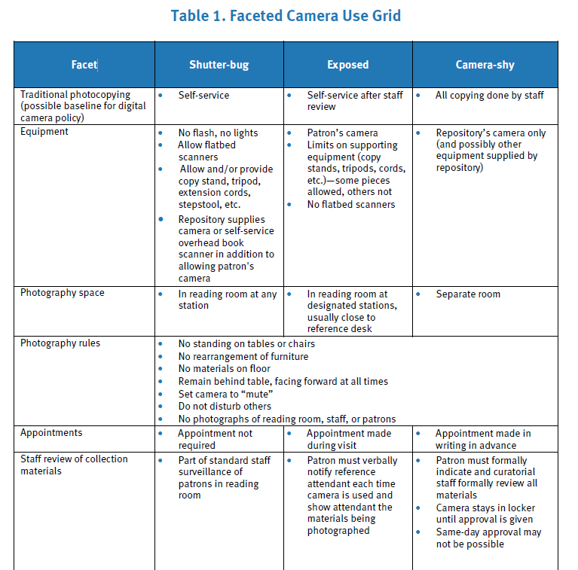

Slide 7
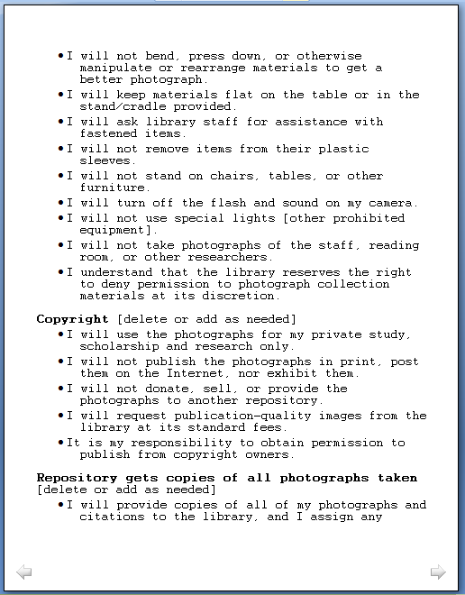
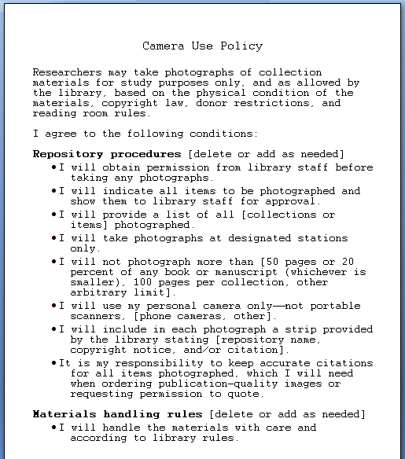

Slide 8
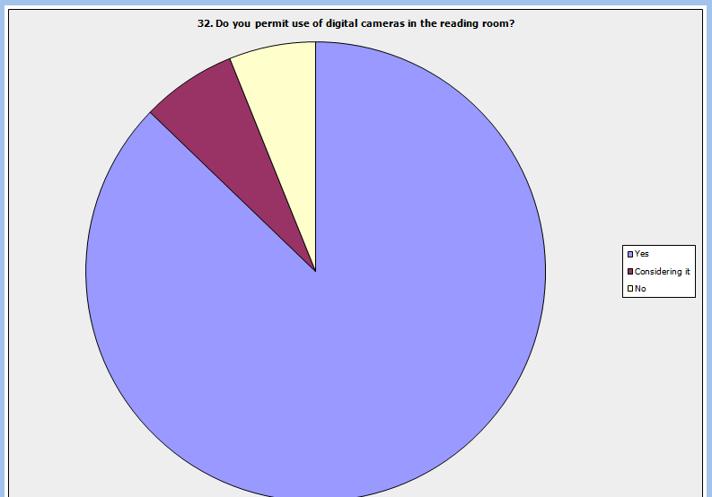
Taking Our Pulse
The OCLC Research Survey of Special Collections and Archives

Slide 9
Sharing Special Collections and SHARES
ILL practitioners, special collections staff
Renewed interest due to increased discoverability of collections
Working group activities
Webinars
Getting on the same page: create a glossary
Streamline work flows
How to establish trust
Making the case that sharing is essential

Slide 10
Sharing Special Collections Advisory Group
Creating
Aimee Lind, Getty
Barbara Coopey, Penn State
Elizabeth Nielsen, Oregon State
Laura Carroll, Emory
Jennifer Block, Princeton
Sandra Stelts, Penn State
Scott Britton, U of Miami
Reviewing
Cristina Favretto, U of Miami
Eleanor Brown, Cornell
Margaret Ellingon, Emory
Paul Constantine, U of Washington
Shannon Supple, UC Berkeley
Sue Hallgren, U of Minnesota

Slide 11
What we talk about when we talk about…
Sharing: making material accessible to users external to your institution, whether by placing it on the Web, sending a digital or physical surrogate, or lending the physical item itself.
Special: any material held in a special collection or archive.
Collections: any material to which your library’s patrons have access via affiliation with your institution, whether via ownership, subscription, or cooperative agreement.

Slide 12
Barking Our Shins: Not Enough O’s in Ouch?
Work flow issues
Who fields requests?
Who decides?
How many sets of hands?
Can one size fit all?
Do requesters understand what they’re asking for?
Trust issues
Personal knowledge necessary?
Facilities checklist?
What’s the tipping point to yes?
How best to document trust for community?
Role for trusted intermediaries?

Slide 13
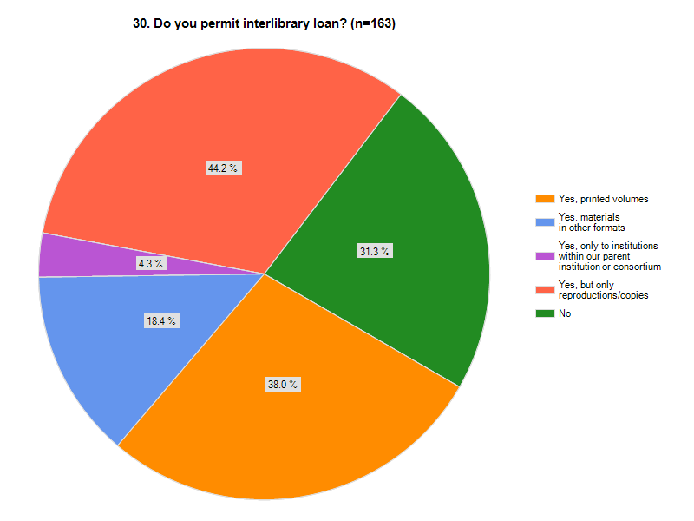
Taking Our Pulse
The OCLC Research Survey of Special Collections and Archives
Notes:
13

Slide 14
New “streamlining work flows” survey
36% (25 of 68) have written policies
Digitizing on demand has become routine
Condition of an item still key to lending decision
“Too risky” (69%) by far the most common reason for not sharing returnable special collections items
“Because we never have” and “Not part of our mission” each got twice as many votes as “Lack staff resources” (10% to 5%) as main reasons not to lend returnable special collections items
Cultural divide is greatest for unpublished materials
Comment: “We are able to borrow things we would not be able to provide to others.”

Slide 15
RBMS/ACRL is at it again…revising guidelines for sharing special collections

Slide 16
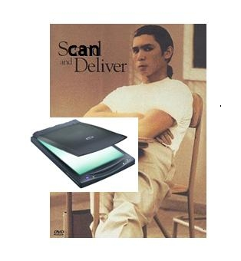
“Scan and Deliver” Getting clobbered by the one-sies and two-sies
Economical and efficient workflows
Digitization is just a facet of both technical and public services – it is not different
Mass “representation”
Standards are great until they get in the way

Slide 17
How many people need to touch this request?
wiki: http://scanondemand.pbworks.com/Workflows

Slide 18
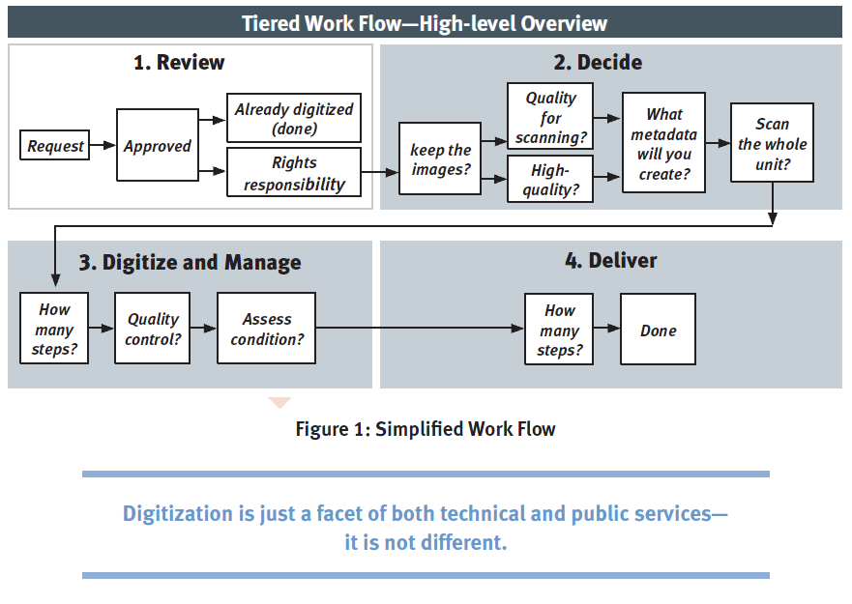

Slide 19
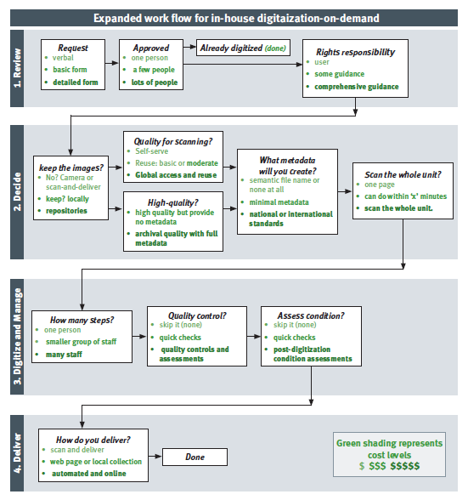
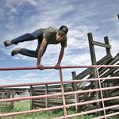
parkour in digitization

Slide 20
Duke on iTunes

Slide 21
Cornell in Flickr

Slide 22
RLG Working Group Streamlining Scanning and Photography
Anne Blecksmith (Getty)
Eleanor Brown (Cornell University)
Paul Constantine
(University of Washington)
Gordon Daines (Brigham Young University)
Tiah Edmunson-Morton
(Oregon State University)
Cristina Favretto (University of Miami)
Steven K. Galbraith
(Folger Shakespeare Library)
Susan Hamson (Columbia University)
Rebekah Irwin
(Beinecke Library, Yale University)
Sue Kunda (Oregon State University)
Jennie Levine Knies
(University of Maryland)
Suzannah Massen
(Frick Art Reference Library)
Dennis Meissner
(Minnesota Historical Society)
Elizabeth McAllister
(University of Maryland)
Lisa Miller
(Hoover Institution, Stanford University)
Timothy Pyatt (Duke University)
Jon Shaw (University of Pennsylvania)
Shannon Supple (UC Berkeley)
Francine Snyder (Guggenheim Museum)
Mattie Taormina (Stanford University)
Cherry Williams
(Lilly Library, Indiana University)

Slide 23
Delivering Unique Materials Related Work:
“Principle 3: Libraries should seek the broadest possible user access to digitized content. This includes patrons of other libraries and unaffiliated researchers.”
- ARL Special Collections Working Group – Principles to Guide Vendor/Publisher Relations in Large-Scale Digitization Projects
“A repository should facilitate access to collections by providing reproduction services.”
- ALA-SAA Joint Statement on Access: Guidelines for Access to Original Research Materials

Slide 24
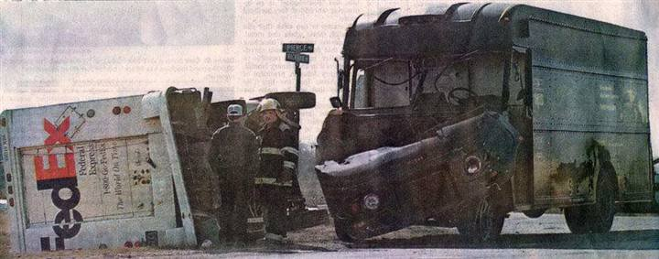
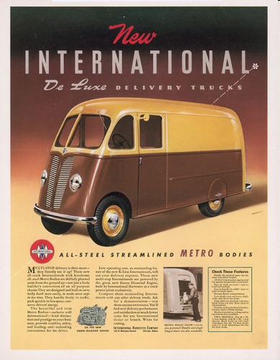
About that cultural divide…
Trust vs fear
Top down, or bottom up?
Tiered degrees of effort
Find your comfort zone, and push at it
Improving process in special collections
Latching onto embedded practices
Upstream consulting
Streamlining metadata
And the paradigm shift

Slide 25
Resources:
Dennis_ Massie@oclc.org
Jennifer_Schaffner@oclc.org
Sharing Special Collections:
http://www.oclc.org/research/activities/sharing/default.htm
Streamlining Photography and Scanning:
http://www.oclc.org/research/activities/photoscan/default.htm
OCLC Research reports:
http://www.oclc.org/research/publications/default.htm

Slide 26
Next up:
4:00
Lightning Rounds
Buckingham

