Slide 1
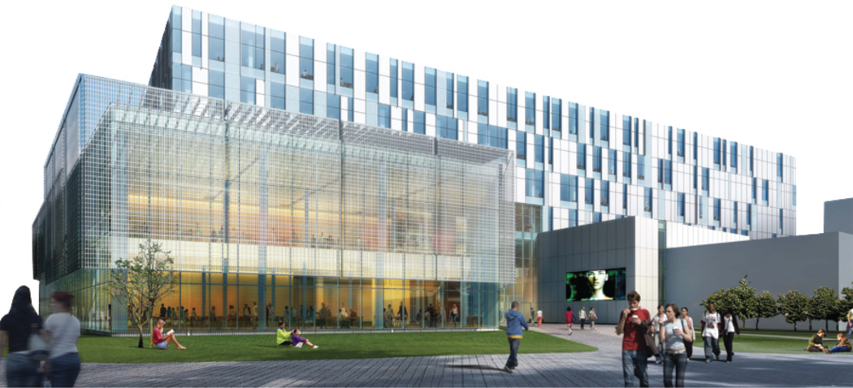
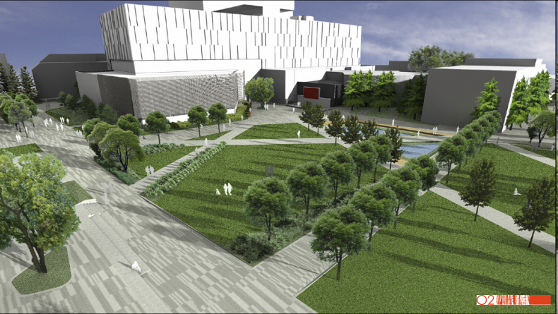
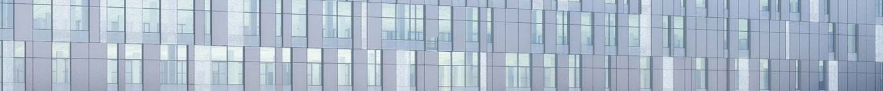
Zen and the Art of
Collection Convergence
Jackie Bell
University of Calgary
June 10, 2010

Slide 2
Taylor Family Digital Library
265,000 ft²
Notes:
The University of Calgary began a large physical project to complement convergence in 2006. We were part way through planning our new library, museum and archive when we received a significant donation from Don and Taylor Family. Hence the Taylor Family Digital Library and the Taylor Quad. Construction will be complete on this $205 million in fall 2010. A phased opening will start in winter 2011.
Gala opening: beginning of fall term 2011.

Slide 3
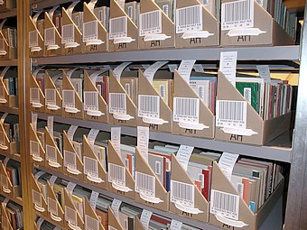
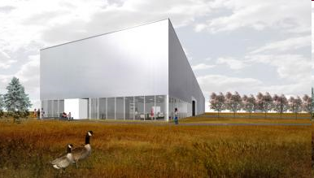
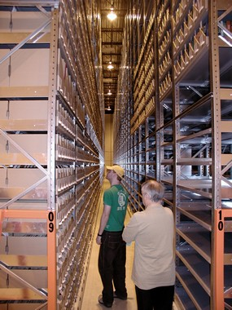
High Density Storage Facility
Books, Journals, Archives & Art
Notes:
Part of our large project also includes our High Density Library, which will open this summer. It has an over 3 million volume equivalency including archives, artifacts, and art.
The HDL offers multiple temperature and humidity zones for paper based products, art and museum objects, a freezer room, and a human-friendly environment for our processing areas. The HDL is one of only a few we know of that houses both art and paper-based materials, but this became a necessity for us with the convergence of multiple collections.

Slide 4
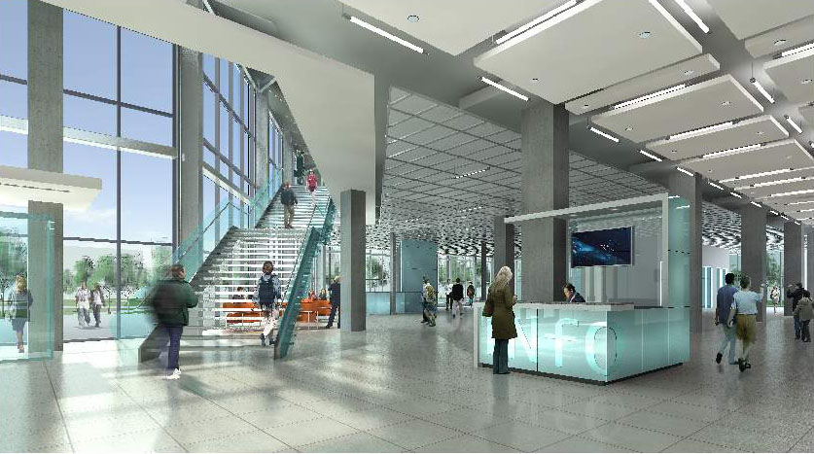
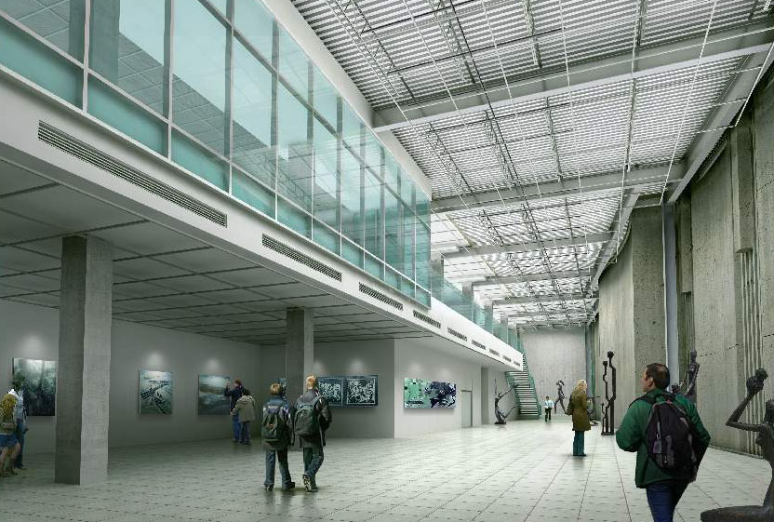
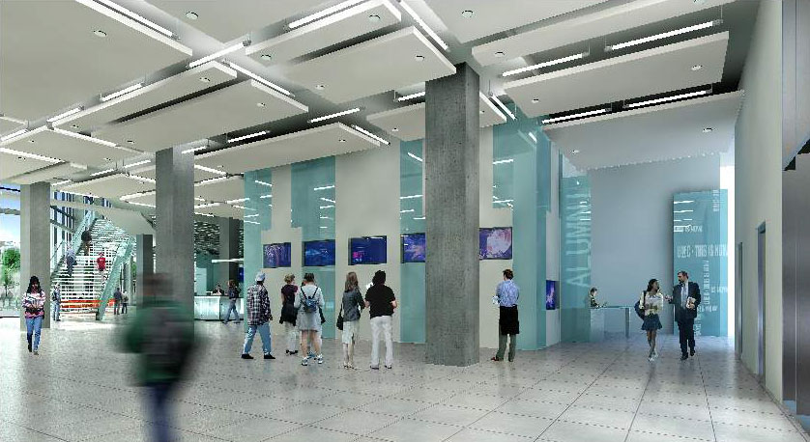
LAM(P)
Central Library University Archives
The Nickle Arts Museum University Press
Notes:
Instead of calling ourselves a LAM, we are actually a LAMP. The library, Archives, Museum and Academic Press all live within Libraries and Cultural Resources. Most have had their survival threatened at various stages of university growth and change. Living under the Libraries and Cultural Resources umbrella gives them a more stable home that others in the university and community may start to understand and appreciate. Organizationally, as we converge, we have developed the Center for Arts and Culture, which will oversee the Archives, and Museum. The Centre for Scholarly Communication will bring together the U. Press, Digitization, and some of our IT programmers dealing with content DM and D space, our institutional repository. Our Press is promoting open access and exploring print on demand.

Slide 5
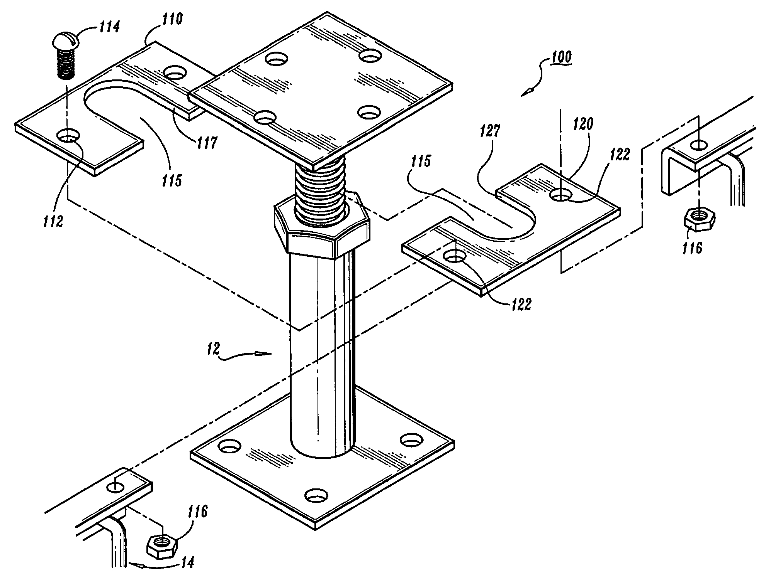
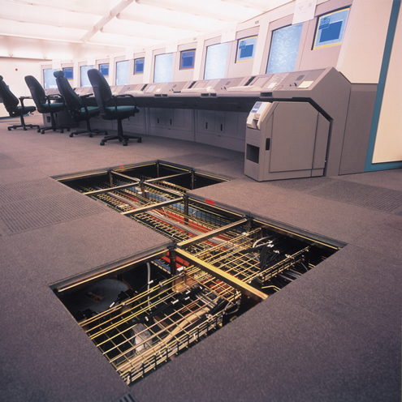
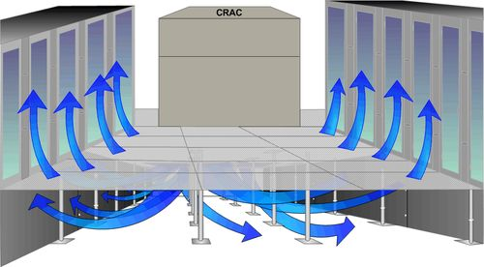
Taylor Technology
Mechanical, Electrical and Data Systems
Notes:
The Taylor Library: The building has high-tech mechanical, electrical and data systems with a raised floor system. Electrical and data (internet) outlets are easily accessible. Heat and air are delivered under floor. The building is designed to be as flexible as possible – moveable walls, furniture, accessible electrical and data lines so that we can reconfigure as needed.
5

Slide 6
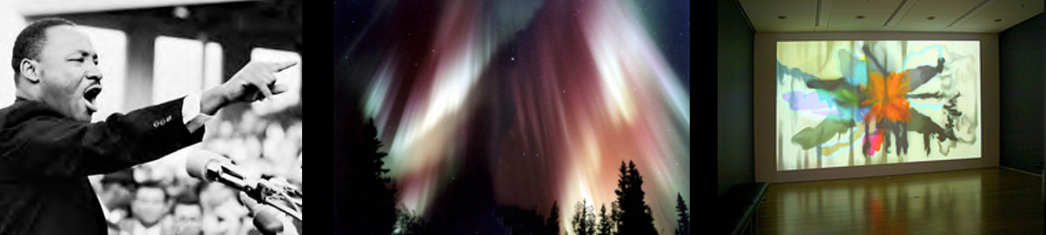
Commit to Being Digital
Notes:
We will still have at least half a million books and journals in the Taylor as well as art and artifacts, but many of our resources are being placed in the realm of the digital.

Slide 7
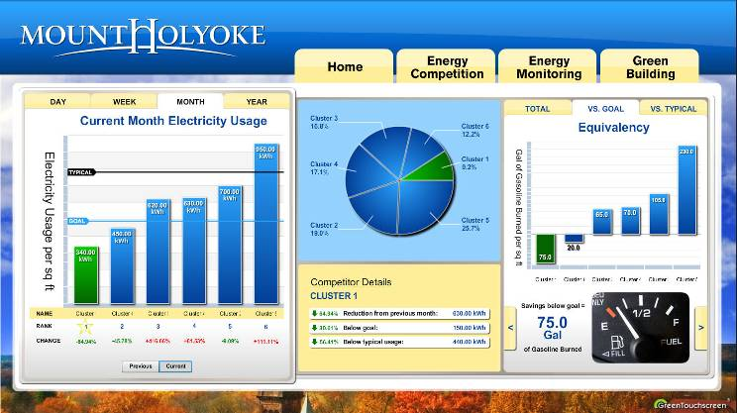
Building and Use Data
Will Become Collections in Themselves
Notes:
We will be streaming real-time data, such as faculty research on northern lights and asteroids. Our Building Management System data will become a teaching tool in itself, and we will stream real-time energy usage to display screens, website, and media walls. Students will be able to compare building energy usage with our new Energy and Environment building.
“Living Library” at Seattle Public Library
Stream real-time LCR data to website and media walls

Slide 8
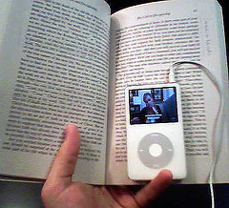
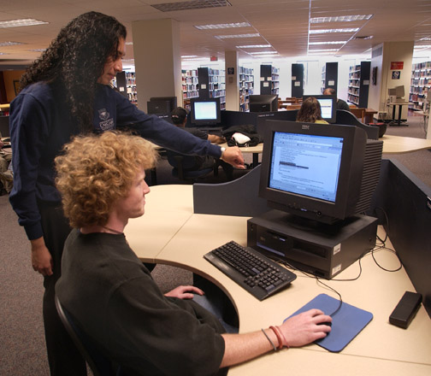
Making Collections Work for Users
Discovery
Technologies and Rights
Deliverability
Interactivity
Stability
Software Compatibility
Notes:
The content has to be in the right form and have the right attributes.
Discovery, Technologies & Rights, Deliverability, Interactivity, Stability, Software Compatibility

Slide 9
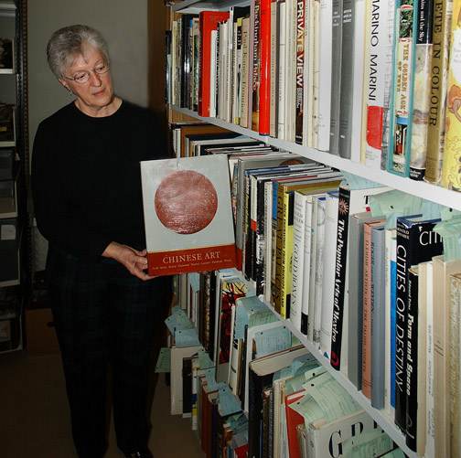
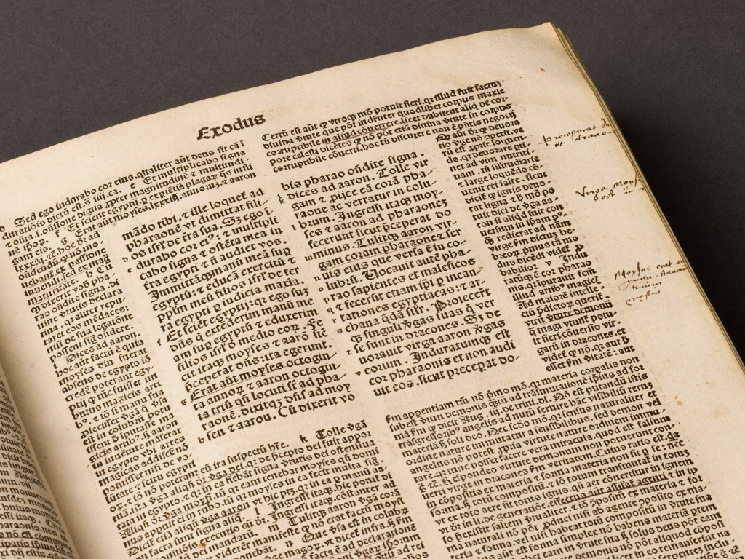
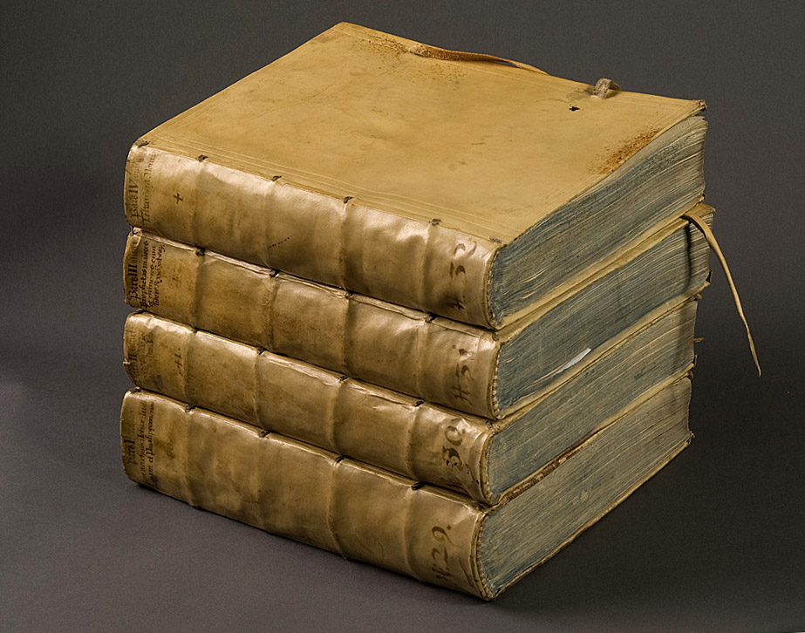
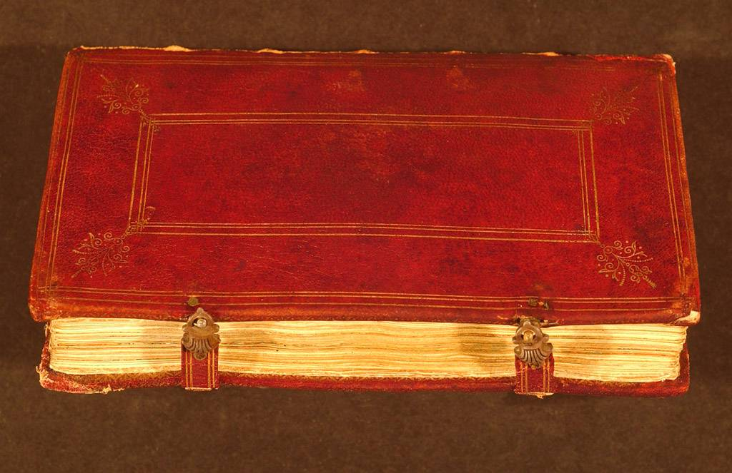
Access to Primary Resources
Art, Archives and Artifacts as Teaching Tools
Notes:
Undergraduates will have more experience with the primary resource. To facilitate this, we have built teaching rooms in the Centre for Arts and Culture and in the Museum.

Slide 10
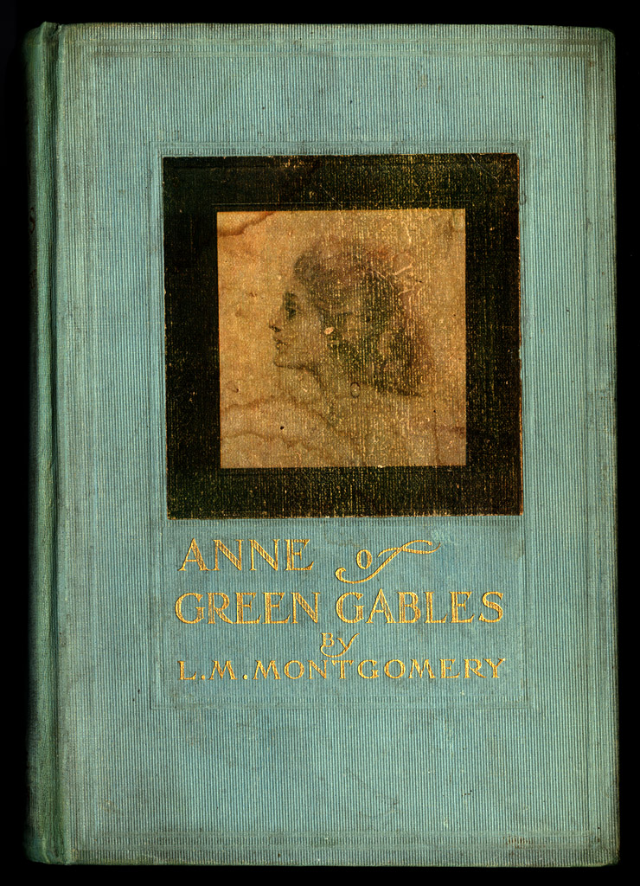
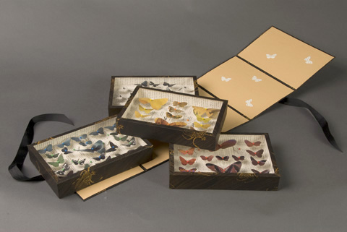
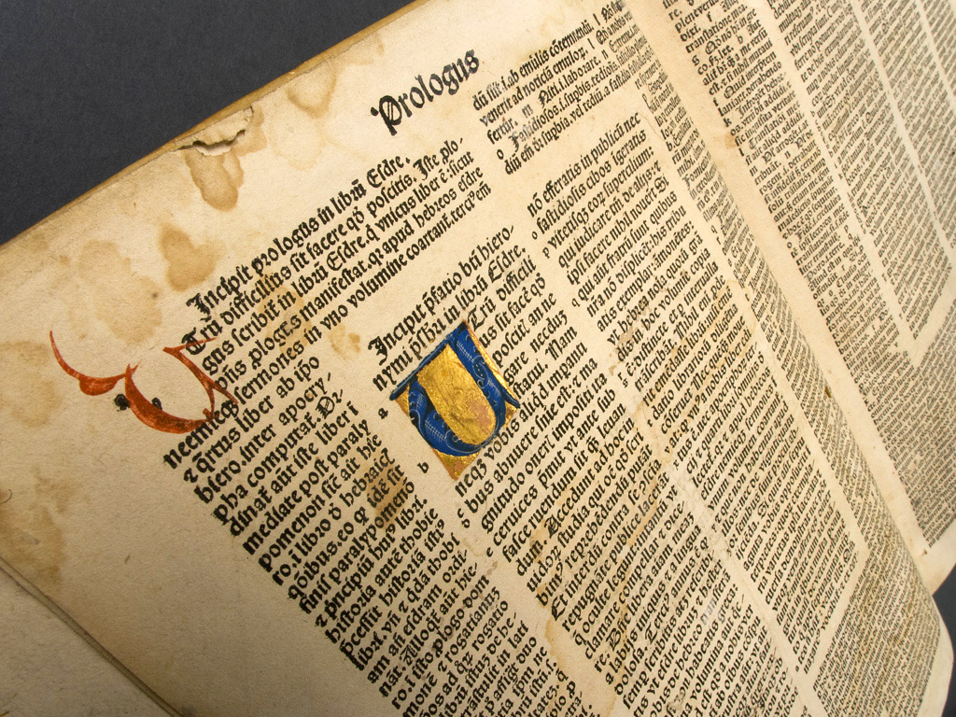
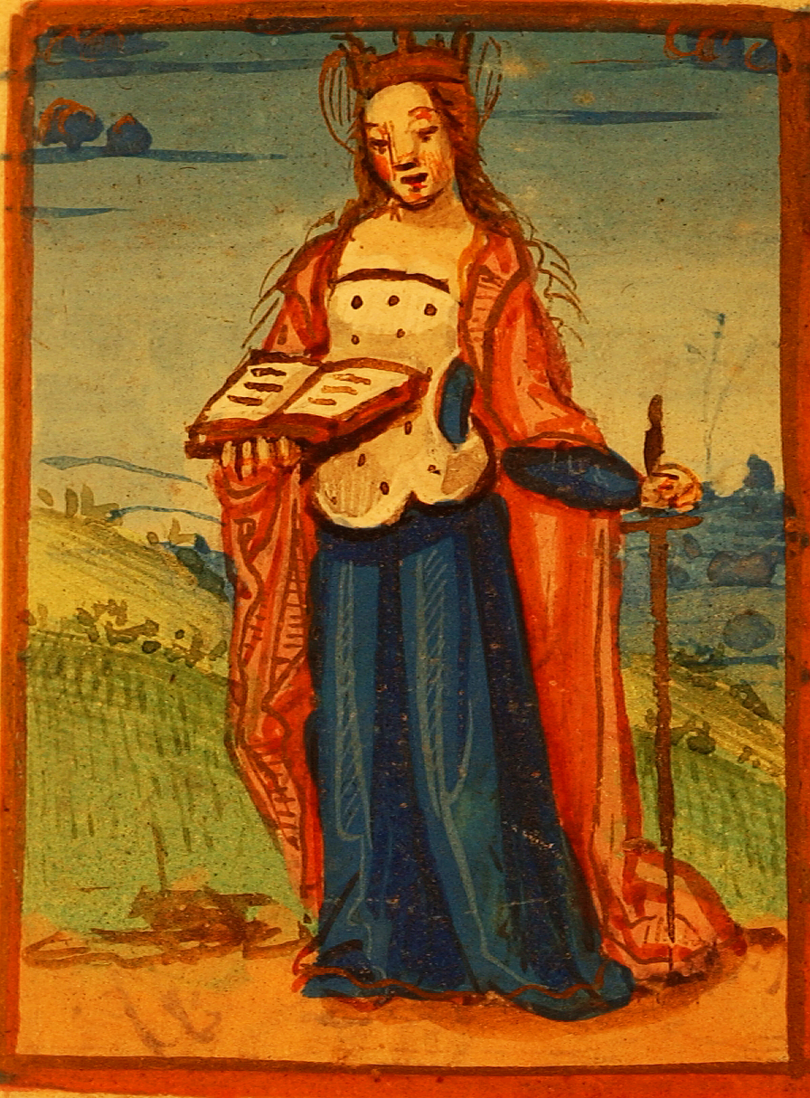
Metadata Services
Notes:
We have established an organizational structure that supports a coordinated approach to metadata creation. Our users want a single search interface incorporating metadata from all LCR collections. This is requiring close collaboration on metadata standards amongst librarians, archivists, and curators.
10

Slide 11
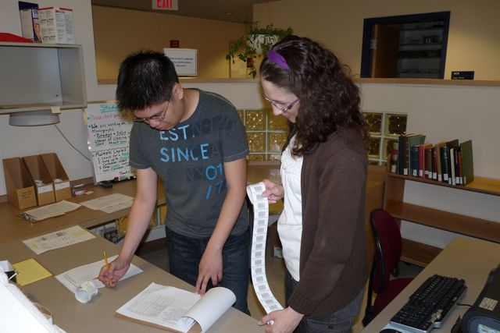
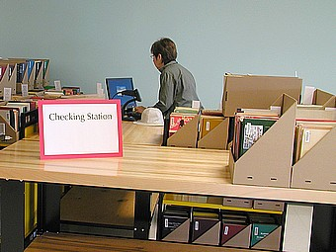
A Moving Opportunity
Begin to standardize metadata
Bar code collections before they move
Move towards common Discovery
Notes:
In preparation for collections to move to the high density library and compact shelving in the Taylor (starting in August), every item is being bar coded for our Inventory System, the LAS (Library Archival System). Additionally, This move has pushed our metadata group to more fully describe collections that weren’t described before. Metadata services has created a structure that coordinates the creation of metadata towards a common emphasis on discovery. The record in many cases is fond-level, but we are in the process of making all collections discoverable. We’re exploring common metadata standards and will be looking at the work OCLC is doing in the next 5 years.

Slide 12
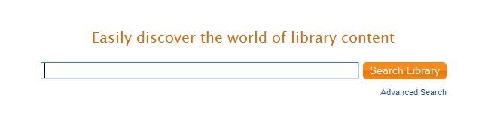
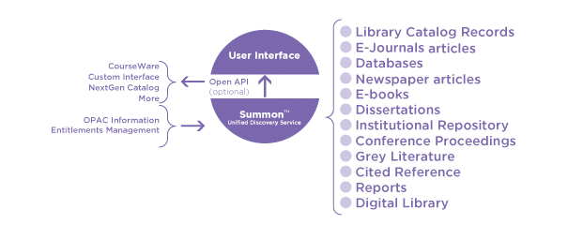
Summon
Notes:
LCR is beta testing Summon, which is a Google-like library search engine. Summon provides a single unified search index, which includes full text, and the results are relevance ranked. Users have a single entrance to the library’s collections and Summon searches all formats (digital and print, audio and video).
6,800+ publishers' content included
94,000+ journals
500+ million items indexed so far
ProQuest, Gale, Ingram Digital, LexisNexis®, IngentaConnect™, ThomsonReuters ISI Web of Science®, ABC-CLIO, Springer, Taylor& Francis, MLA, SAGE etc.

Slide 13

Behind the Scenes
Notes:
Some days, doing all this at once is challenging, to say the least. Some days, there is a lot of confusion and a lot of anxiety. Is the library, which has a huge staff, going to swallow up the museum, which has a small but dedicated staff? What about our professional practices? How are we supposed to converge and still be true to our professional standards? How can you expect me to interfile my collection with one from another profession? How can we move all these collections and keep our services open? How can we move so many in such a short space of time? Have we planned sufficiently for the new technology? Are staff trained sufficiently in their new jobs?

Slide 14
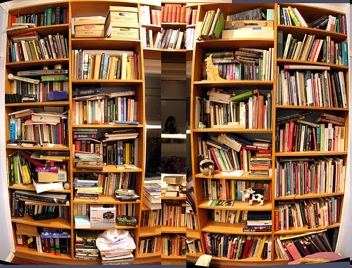
Practicalities
Space
Interfiling
Environments
Proximity
People

Slide 15
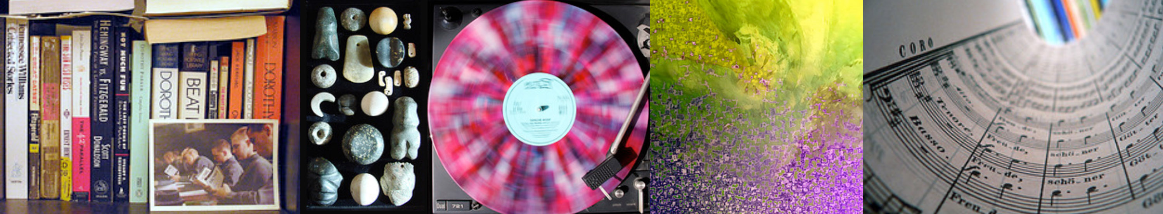
Special Environments
What’s fabulous for the archivist might not be good for the curator but may be great for the librarian.
Notes:
Because we converged our library, archives and museum, we decided to create 4 environments in our high density library and 3 (4) in the Taylor Library: one warm, moist for museum and art objects. One cool and dry for paper-based materials. One regular for human activity. One freezer room in the HDL.

Slide 16
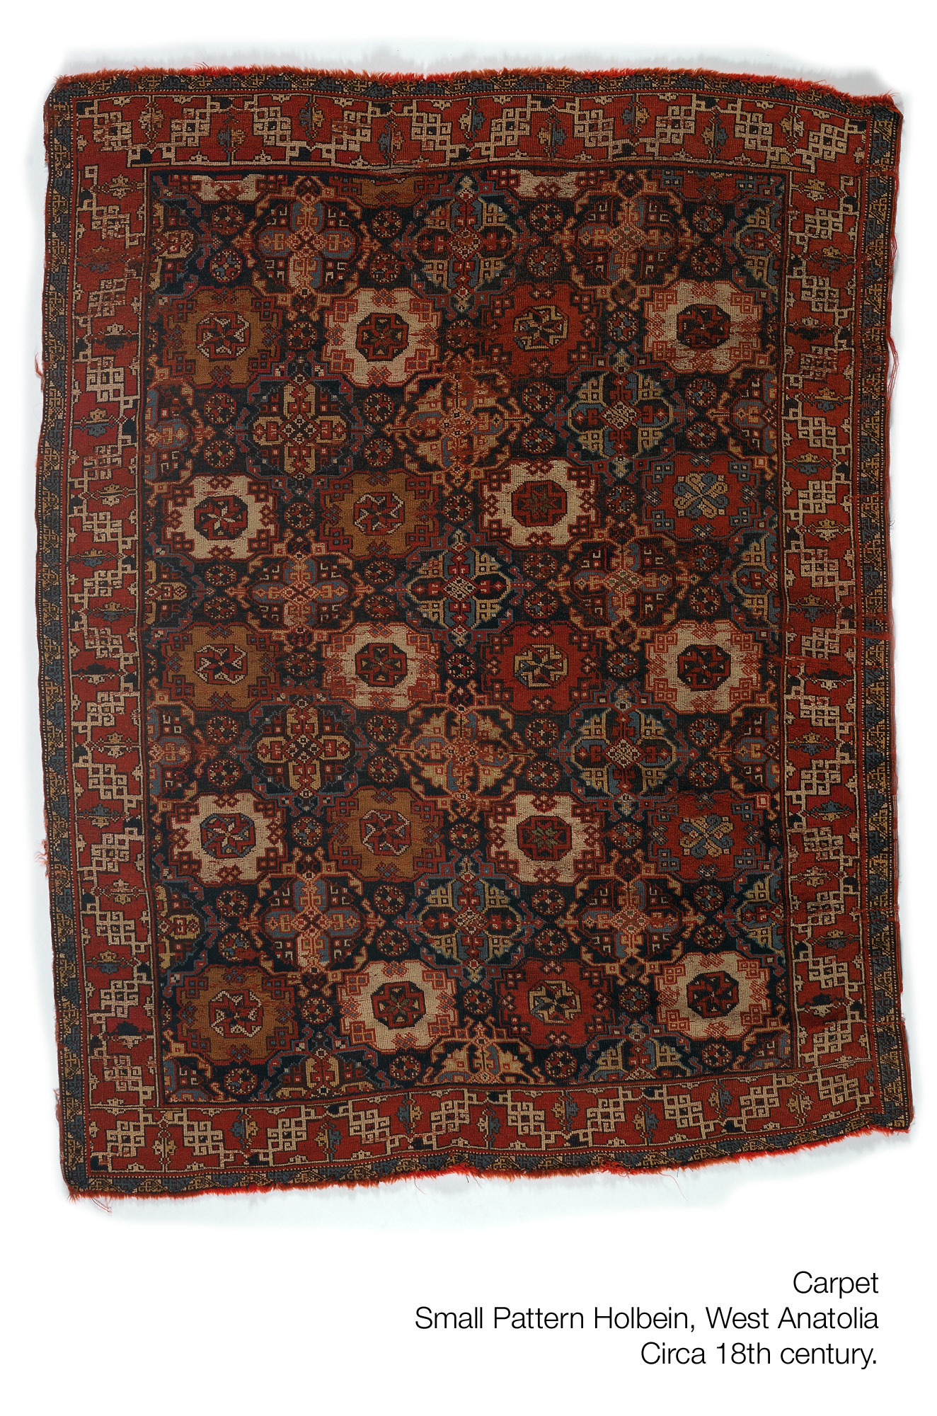
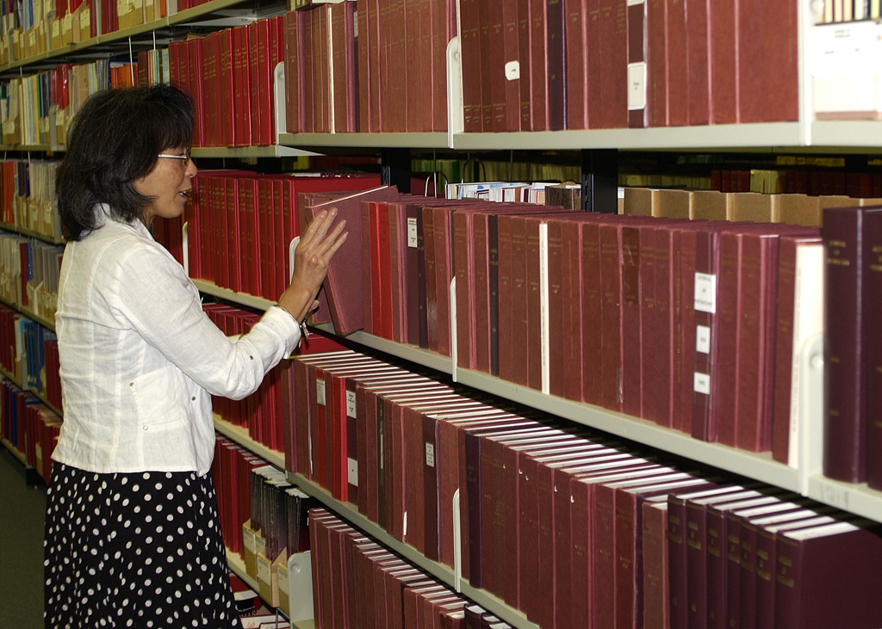
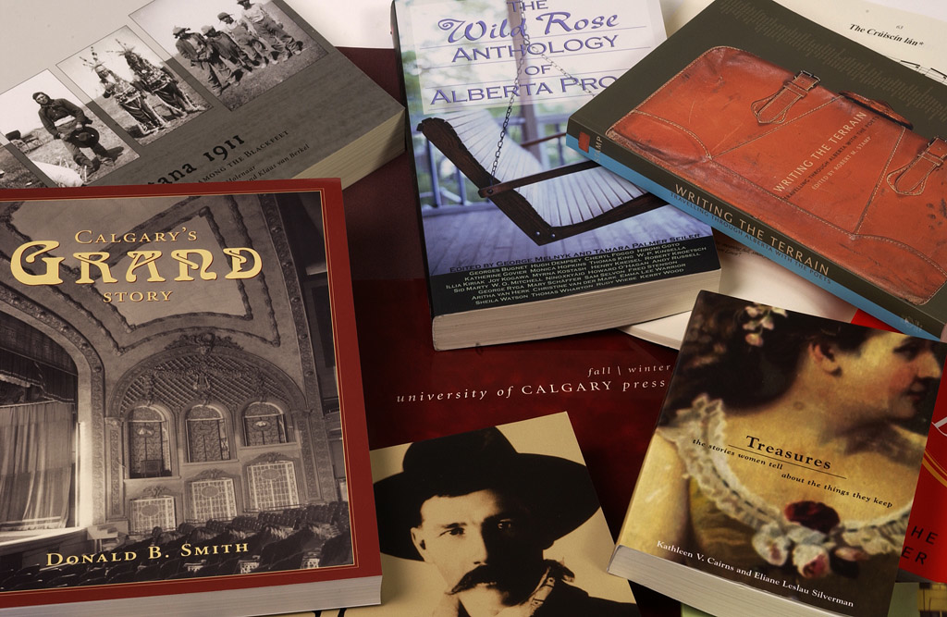
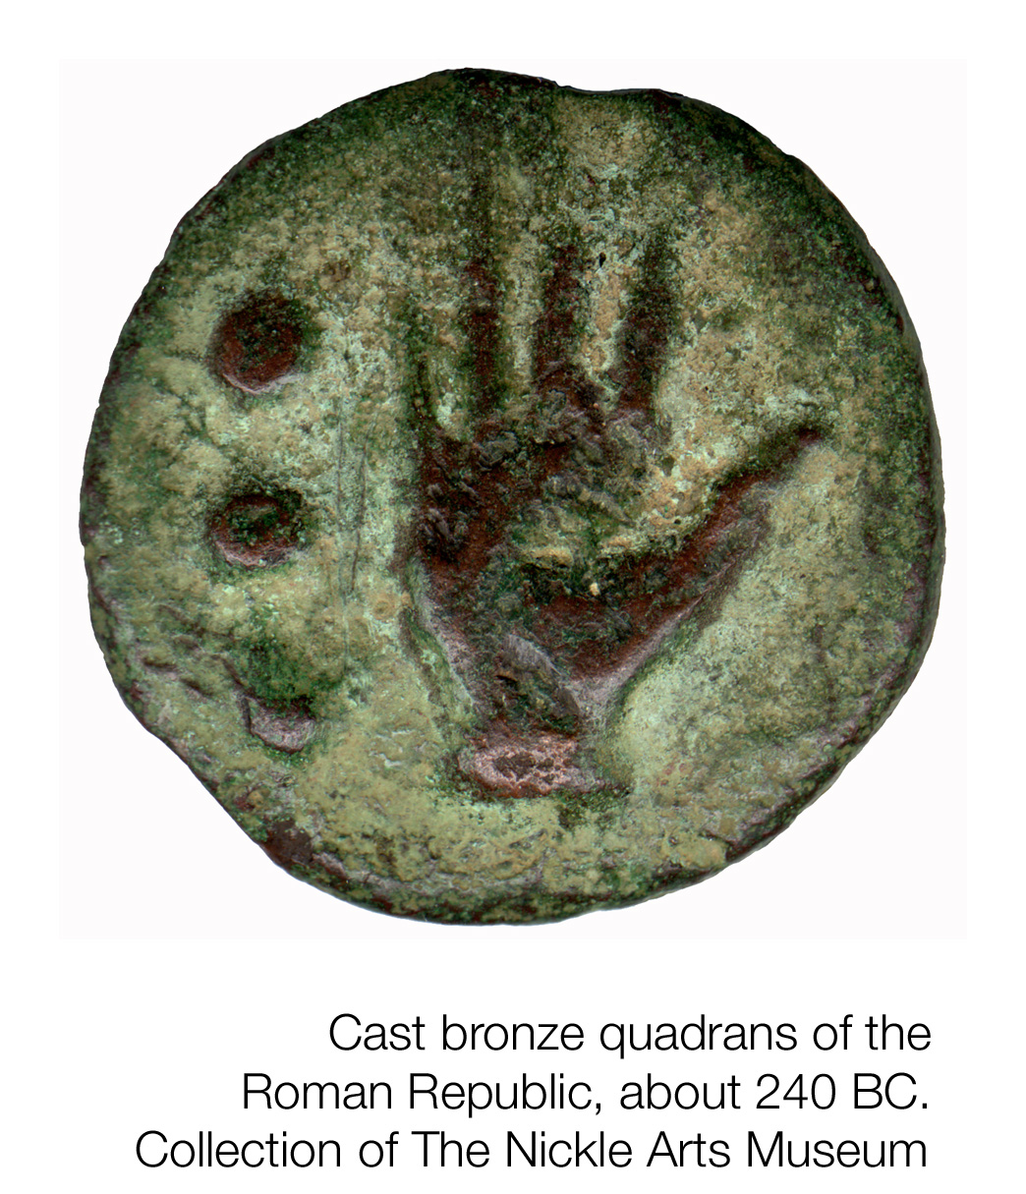
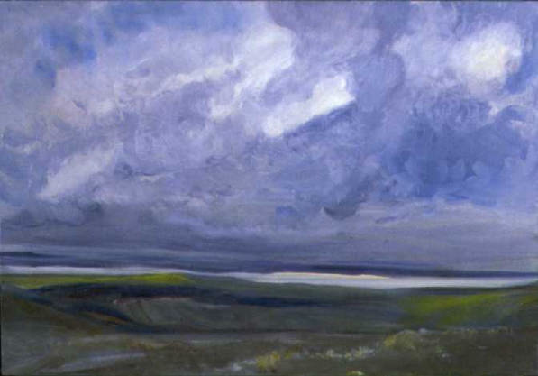
Interfile?
Notes:
Our Vice Provost initially envisioned true convergence with all collections interfiled – collections mixed and stored together. We haven’t done that completely; however, items with like environmental needs are stored in the same HVAC environment. Items with the same physical requirements for storage will be stored together or in proximity – e.g., spears from the museum and Special Collections. Paintings from various collections. Bronzes from various collections.

Slide 17
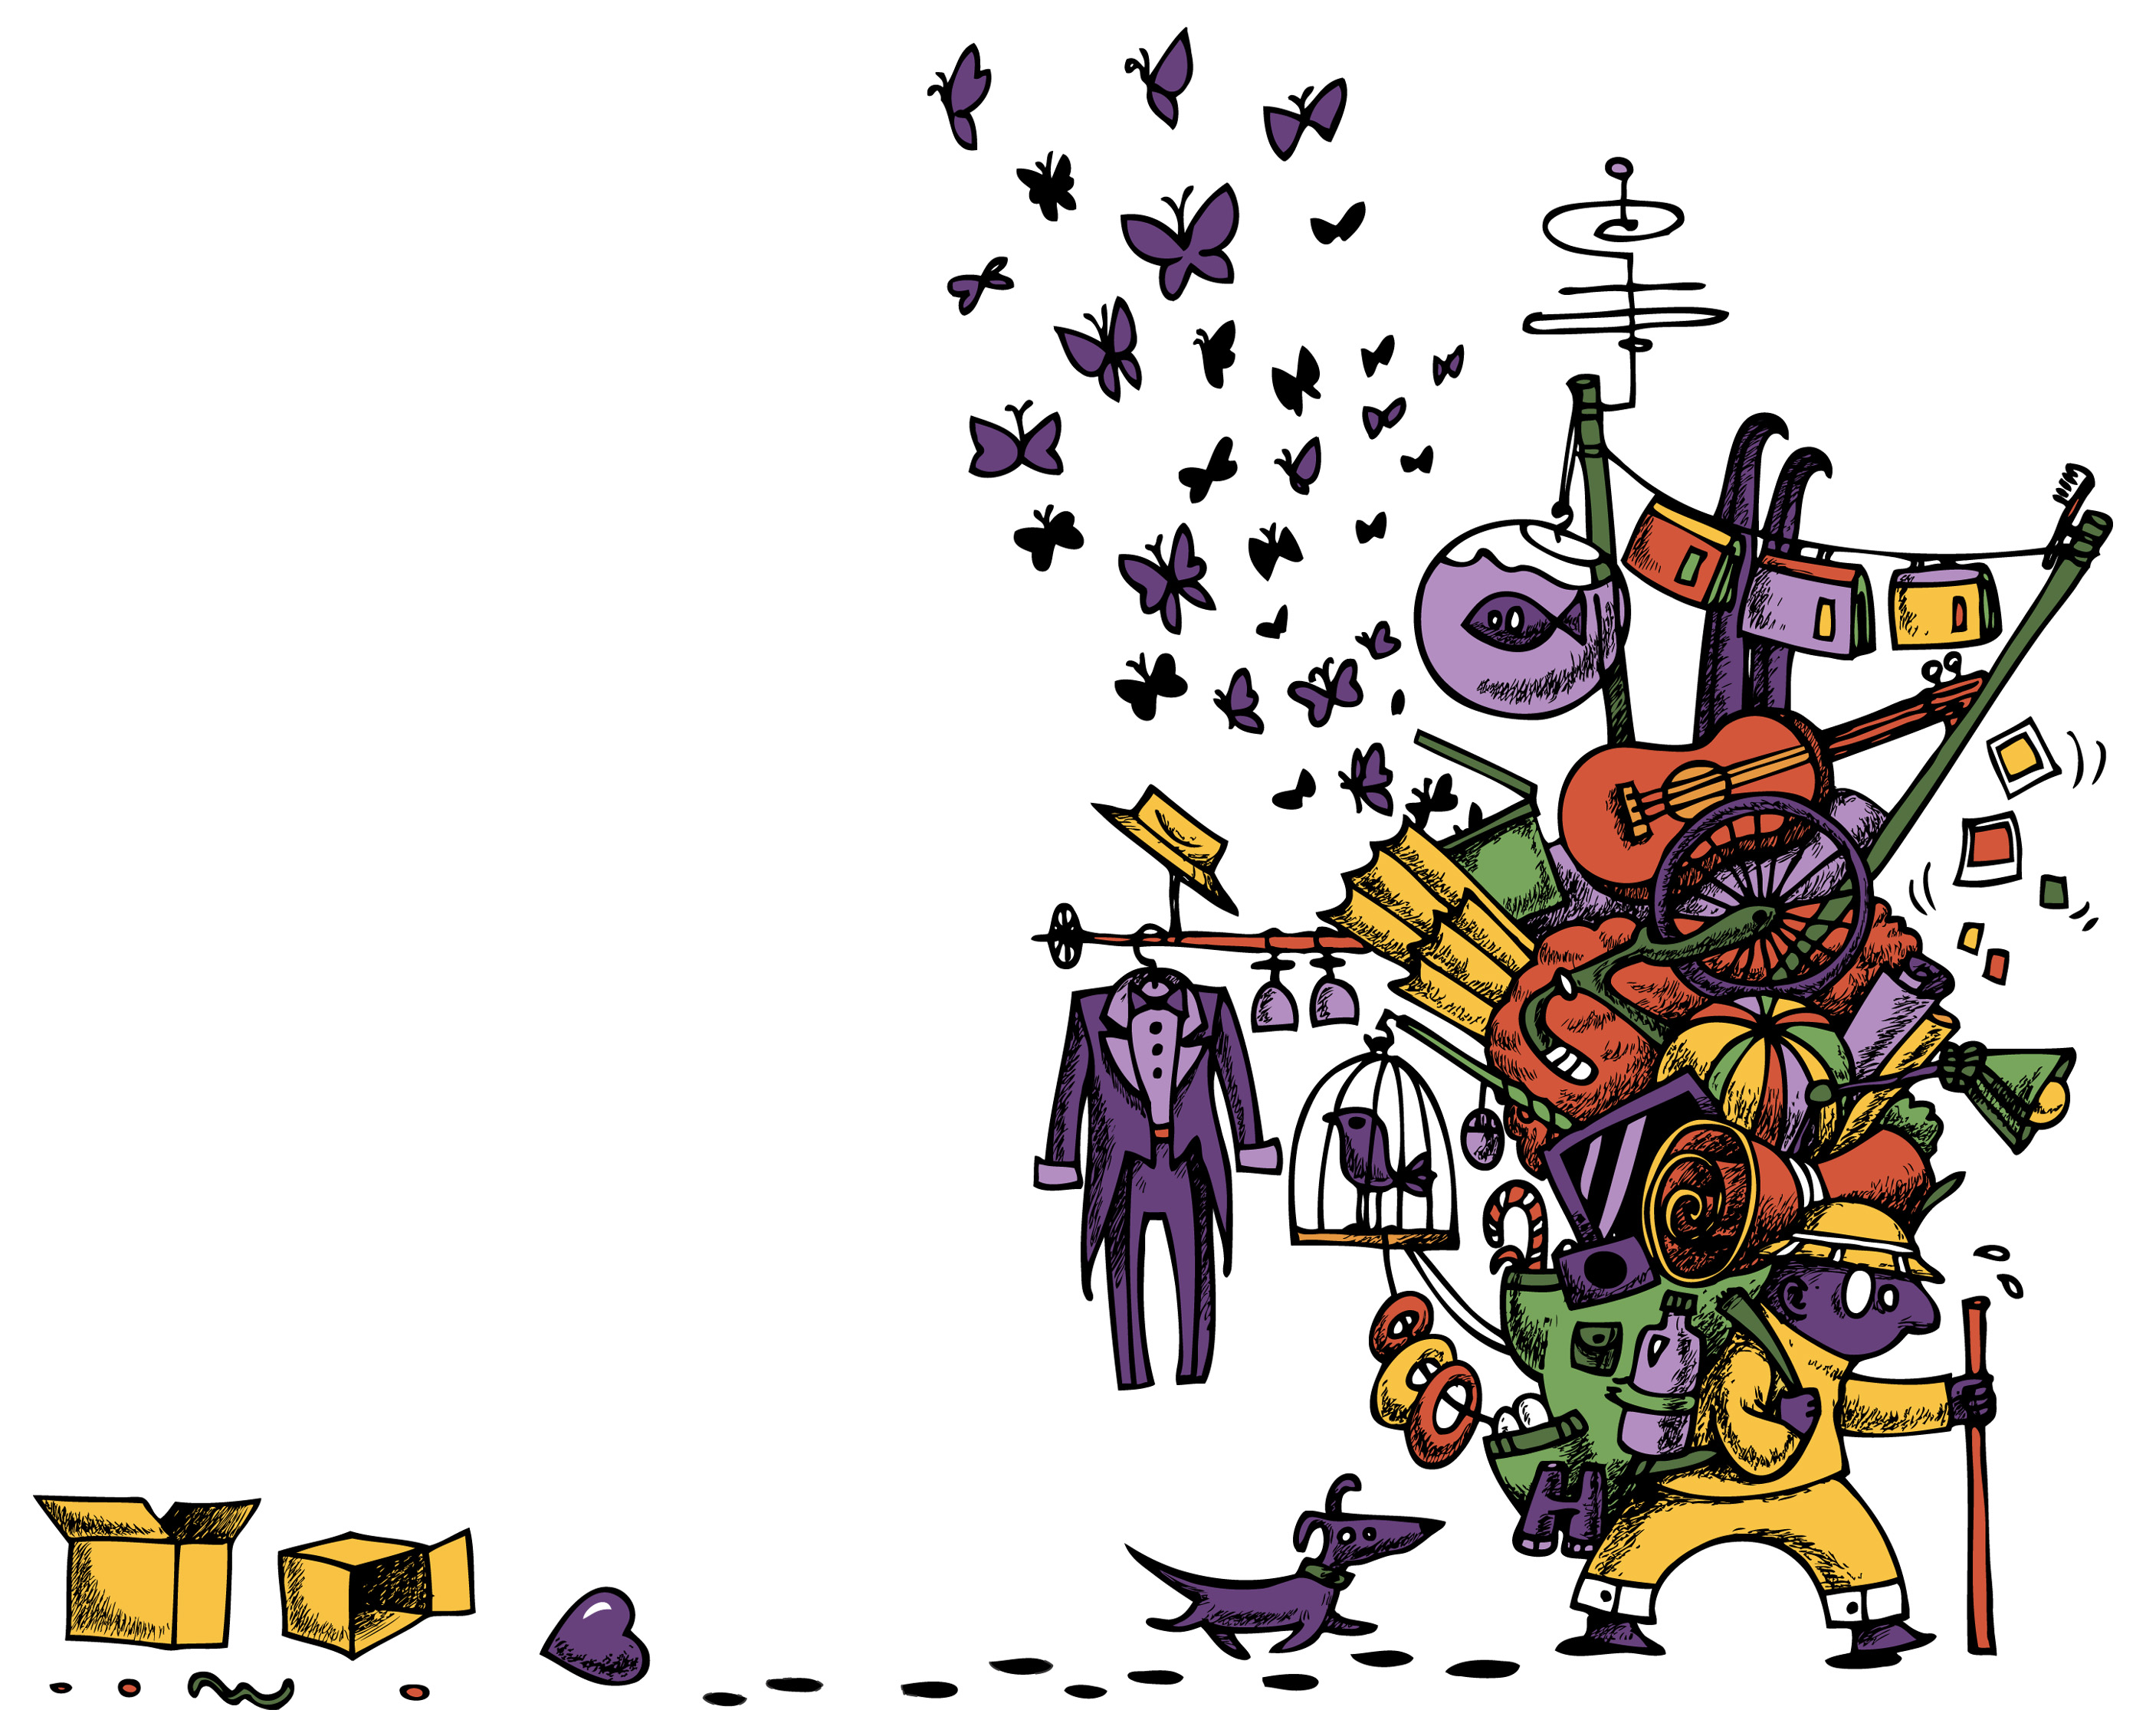
P r o x
I m
I t y
Notes:
What do we actually need with us on a daily basis and what can be stored and retrieved within 24 hours? We have had to identify our high-priority collections and items. High priority stays in the Taylor. Less frequently used items go to the High Density Library. We looked at weeding. We talked about de-accessioning. Our Archivists put on records management workshops for our staff. We implemented a semi-annual file and office clean-up day, because we are moving into a smaller offices. We have had to look the hoarders in the eyes – there’s a certain amount of culture bashing that goes on in all of this. Just because we’ve always done something – does that make it right?

Slide 18
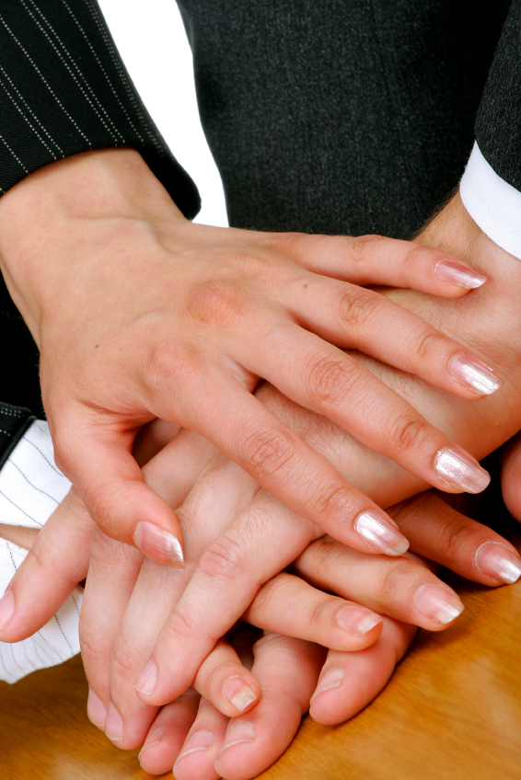
The Human Factor
Professional standards
Trust
Respect
Notes:
I’ve worked on a number of strategic change initiatives – some more successful than others, but I’ve never seen a successful one that didn’t plan for human beings’ predictable unpredictability. Human beings are opinionated. We are often passionate about our professions, about our space, about our collections. We don’t like having change imposed upon us; but given a strong vision, we might listen. Given a strong rationale, we might buy in. Given strong leadership, we might become big advocates -- given time, given the chance to understand, given the opportunity to participate, given personal and professional respect, we might change our minds.
We’re having a whole conference on that in September at the Smithsonian – the focus will be on collaboration.

Slide 19
Convergence is an opportunity for collaboration.
It is a time of wonder and of greater understanding.
It is a time full of potency and potentiality.
It is a time of experiment and play.
It energizes us.
- Geraldine Chimirri-Russell, Numismatics Curator
Notes:
To quote one of our curators, Geraldine Chemurrri-Russell. Convergence is an opportunity for collaboration.
It is a time of wonder and of greater understanding.
It is a time full of potency and potentiality.
It is a time of experiment and play.
It energizes us.

Slide 20
