Slide 1
The Smithsonian:
One-Stop Shopping
Nancy E. Gwinn
Smithsonian Institution Libraries

Slide 2
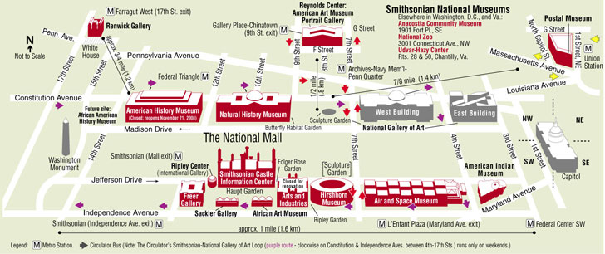
Where is the Smithsonian?

Slide 3
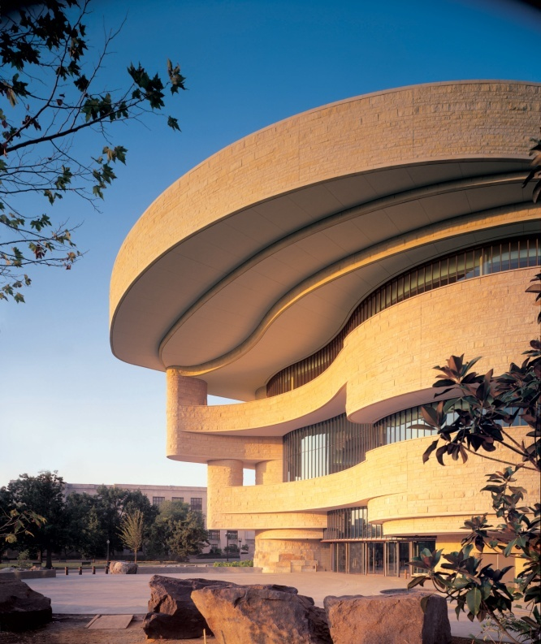
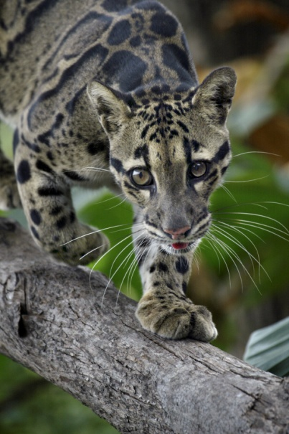
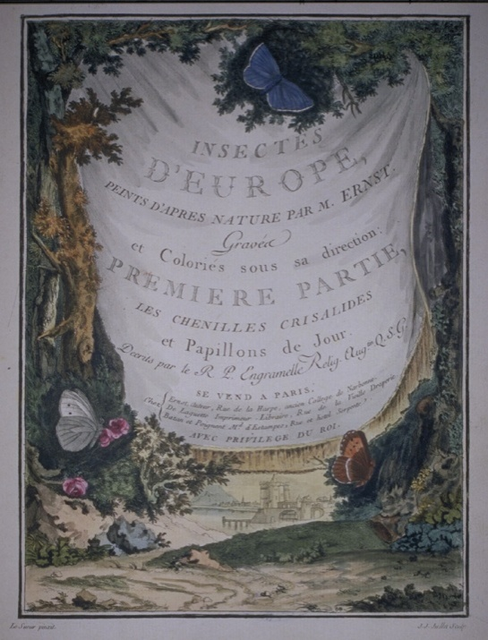
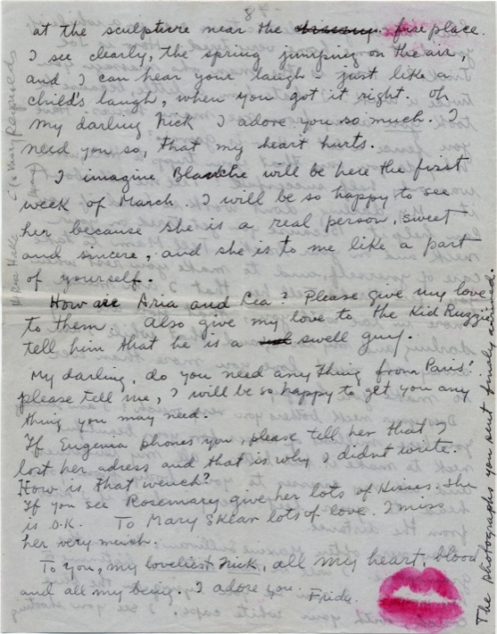
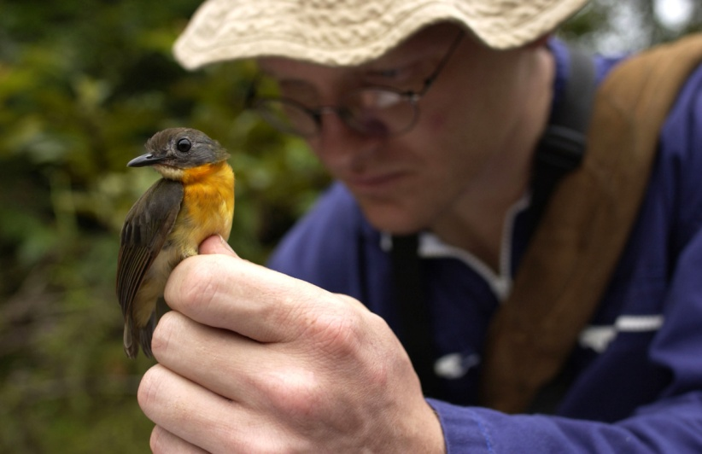
Who we are
19 Museums & Galleries
9 Research Centers
18 Archives
1 Library system (20 branches)
1 Zoo
Notes:
In actuality even though many think of the Smithsonian for its 19 museums and galleries, the Institution also is a major scientific presence in environmental science, natural history, and astronomy with its 9 research centers. The Smithsonian when initially founded was a scientific institution which over time evolved to what it is today—including museums.
In addition to its museums and research centers, the Smithsonian has 18 archives, 1 library with 20 branches and a zoo. As a federated organization, the Smithsonian is more like a university with its independent colleges.
>>>>>>>>>>
Brian Schmidt, a research ornithologist at the Smithsonian’s National Museum of Natural History, makes notes of a female specimen of the newly-discovered olive-backed forest robin. The species was discovered during an on-going biodiversity study in Gabon, Africa.
Credit: Carlton Ward, Photo Taken: September 2003
Frida Kahlo to Nickolas Muray, 27 February 1959. 8 pages.
Nickolas Muray papers, 1911-1978. Archives of American Art, Smithsonian Institution.
From:J. J. Ernst
Papillons d'Europe, peints d'après nature ..., 1779-1792
Date of Image:1779-1792 Caption on Image:Title page and frontispiece More about this image:Tome I Planches - title page Other Subject Terms for this Image:None available ID: 93-690 Image Collection(s):Butterflies and Moths ; Landscapes

Slide 4
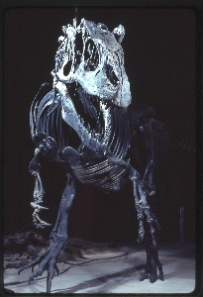
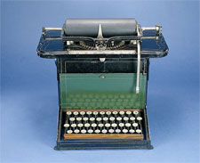
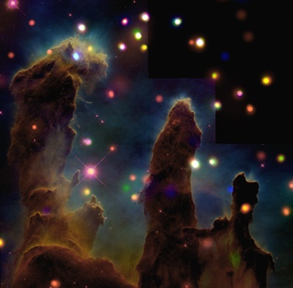
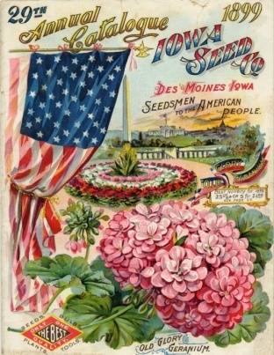
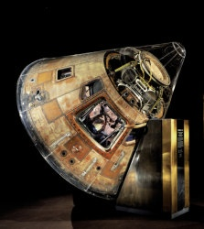
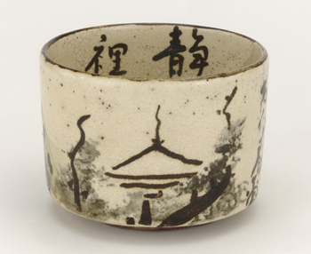
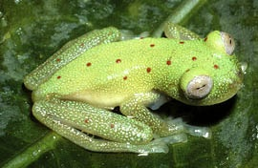
137.2 Million Objects
Smithsonian Collections
13 Million Digital Records
2 Million Digital Images
Notes:
Today the Smithsonian collections holds 137.2 Million collection objects of which only about 10% have digital records and an even smaller subset of these have images associated with them (about 2 million images). We are also increasingly collecting digital files for which there is no physical object – for example research datasets, digital photographs, and sound recordings – all being born digital.
>>>>
124 Million are NMNH

Slide 5

Why collaborate?
To be able to address the BIG issues
To ensure quality, consistency of work
To take advantage of expertise internally
To create easier means of access to collections
To take advantage of technology
To take better advantage of power of Smithsonian to engender understanding of what we do and thus, support

Slide 6
Collaboration Projects
Development of a comprehensive digitization and access program for unencumbered photographic collections.
Creation of an internal single point of access to all Smithsonian collections information for staff.
Notes:
In 2007, 23 members from across the Institution representing LAMS met to discuss collaboration. The group agreed that collaboration helps users access information unhampered by arbitrary boundaries among libraries, archives and museums, and more efficient means for administrators to showcase all of their institutional assets
This group identified two projects, one involving photographic collections across the Institution, the other to create a single point of access to all collections – in effect, one-stop shopping.
Please note that neither of these good ideas came with funding. Instead the Smithsonian would look for opportunities to try to turn these recommendations into reality. We did, but when the opportunities presented themselves, they took a different flavor.

Slide 7
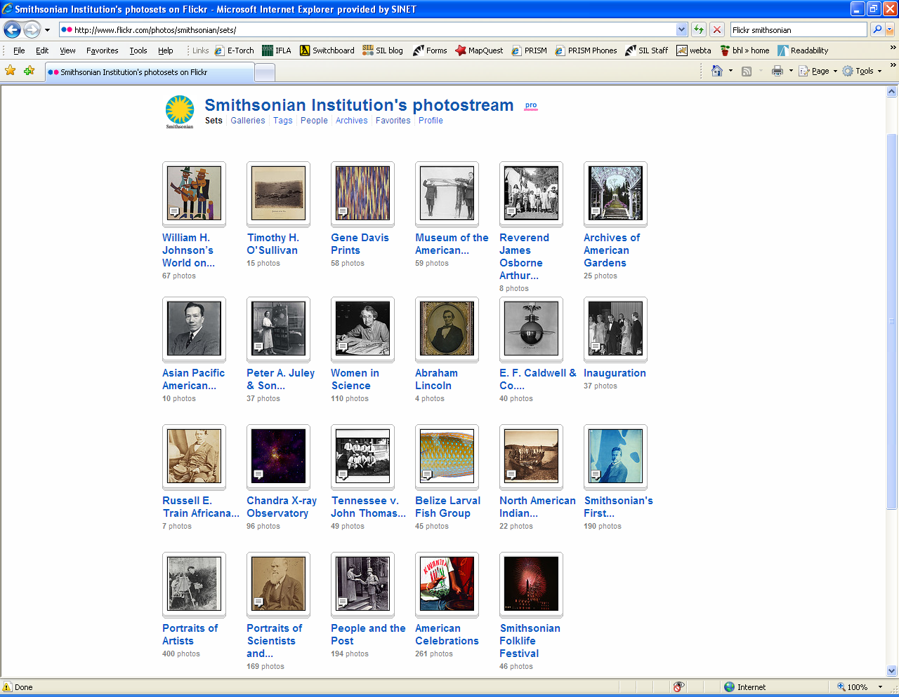
Flickr Commons
1900+ Images
Opened June 7, 2008
Collaborators
  3 Archives
  SI Libraries
  6 Museums
  2 Research Centers
Notes:
In June 2008, the Smithsonian Institution was the 4th institution to launch on Flickr Commons. The nearly 2000 images have no known copyright restrictions and come from 11 different units, including the Libraries and several archives and museums. The images have received nearly 3 million views, tens of thousands of tags, and positive press coverage. And one of the unexpected results was a donation of photos about the famous “Scopes Monkey Trial” to the Smithsonian Institution Archives from a donor who appreciated the Smithsonian’s efforts in open and transparent sharing of its collections.
learning what content is desired by the Web 2.0 world, how to bring crowd-sourcing into professionally curated collections, and how to bring diverse institutional skills together in a collaborative project.
>>>>
Smithsonian Content Participants:
Anacostia Community Museum
National Museum of Natural History
National Museum of the American Indian
National Portrait Gallery
National Postal Museum
Smithsonian American Art Museum
Smithsonian Institution Libraries
Archives of American Art
Archives of American Gardens
Smithsonian Institution Archives
Smithsonian Astrophysical Observatory
Center for Folklife and Cultural Heritage

Slide 8
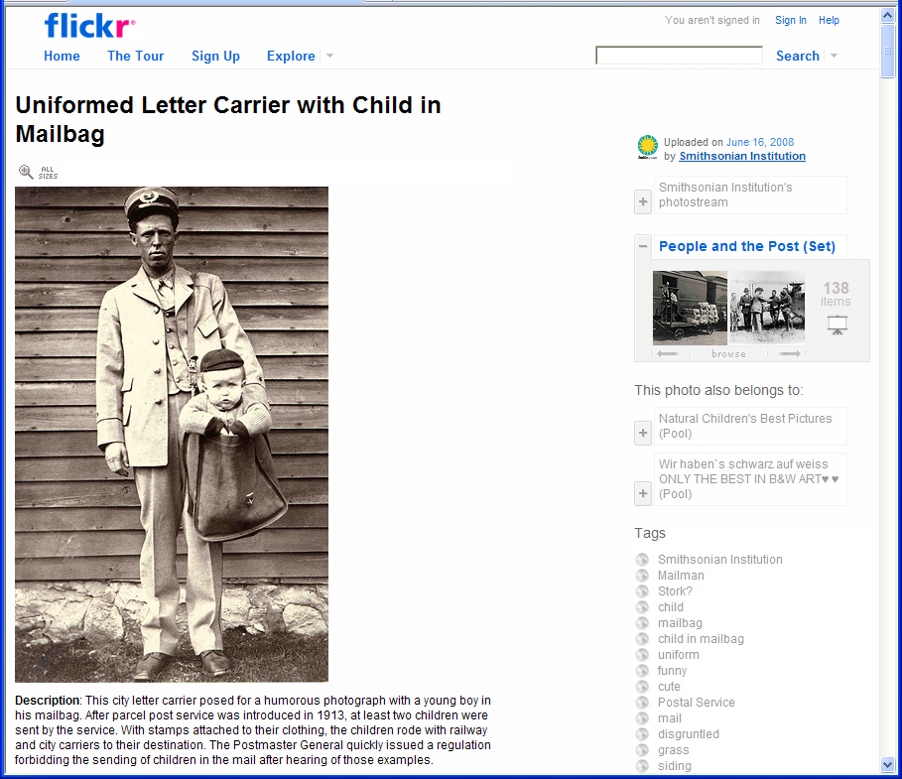
Most Popular
802 people call this photo a favorite
Viewed 63,185 times
Notes:
The most popular image, initially and to this day, remains this photograph of a letter carrier with a child in a mailbag from our National Postal Museum collection.

Slide 9
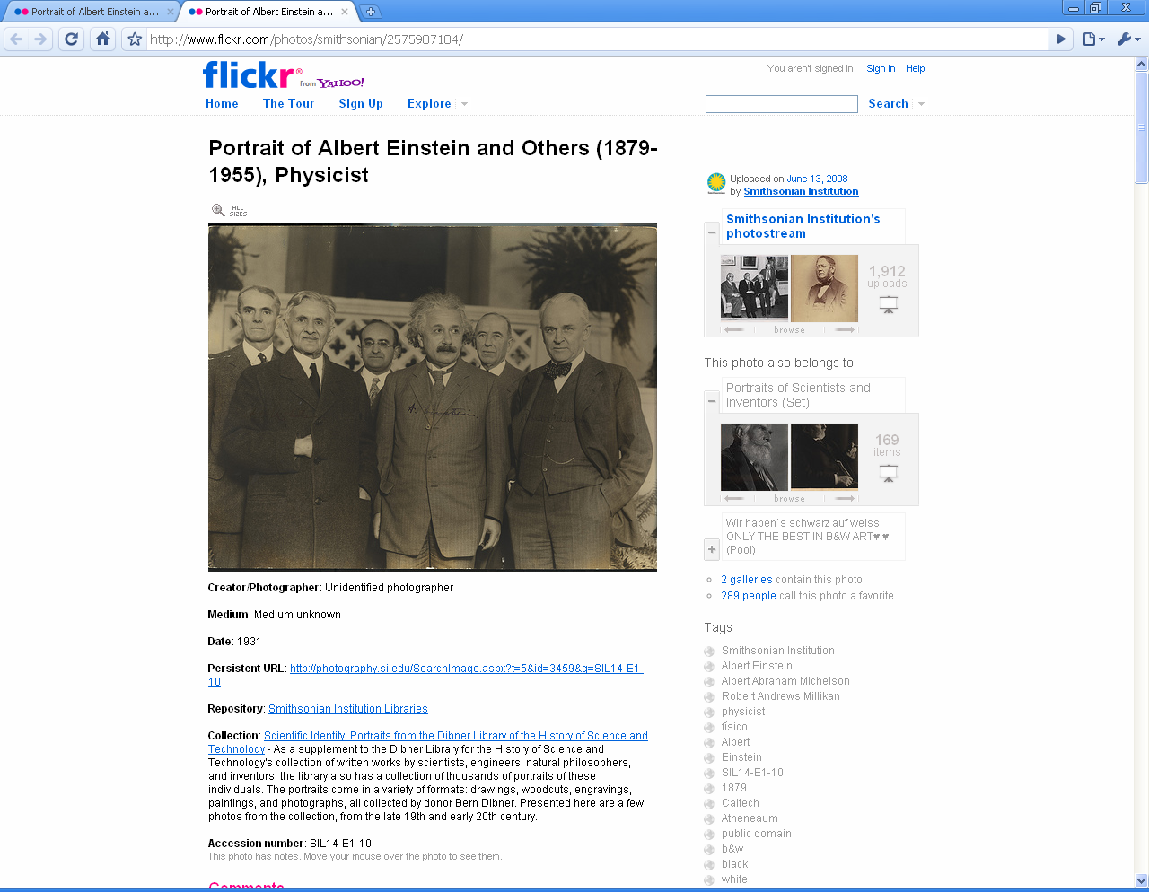
Portraits of Scientists
3rd Most Popular
Image
23,105 Views
“What a tremendous set of photographs. This was the first time
I had seen the faces to go with many of those names. Thank you!”
Notes:
A good example of the increased exposure comes from the Libraries collection of “Portraits of Scientists,” primarily 19th and early 20th century scientists and inventors. When we first offered these, one response from an SI administrator was “Ugh…who wants to see dead white men.” Well, this set had been available on the Smithsonian Libraries’ website for 5 years at the launch of the Flickr project. In the 3 months following, there were nearly as many visits to this collection as had occurred during the previous 5 years. In fact, this image, which includes Albert Einstein, is the third most popular image on the site. Flickr users have identified the other scientists in the image, as well as the date and place—none of which was in our records. SIL receives a constant stream of requests to license these images for a variety of uses.

Slide 10


Searching Across the Silos
Enthusiast
Scientist
Parent
& Child
Colleague
Enterprise Digital Asset Net
(EDAN)
Images, Sound,
Video
Archival
Storage
Metadata
Collection Information Systems
ArtCIS
NPM CIS
NMAI CIS
NMAH CIS
NASM CIS
ACM CIS
NMNH RCIS
SIRIS
DAM

Slide 11
SMITHSONIAN INSTITUTION
COLLECTIONS SEARCH CENTER
http://collections.si.edu

Slide 12
Today’s Collections Search Center
4.6 million records with 445,000 images, video and sound files, electronic journals and other resources

Slide 13
Today’s Collections Search Center
9 Museums (15 collections)
12 Archives (some independent, some in museums)
7 Bibliographic Databases
Smithsonian Libraries Catalog
*Art and Artists Files
*Historical Trade Literature
Image Gallery (266,300 selected images)

Slide 14
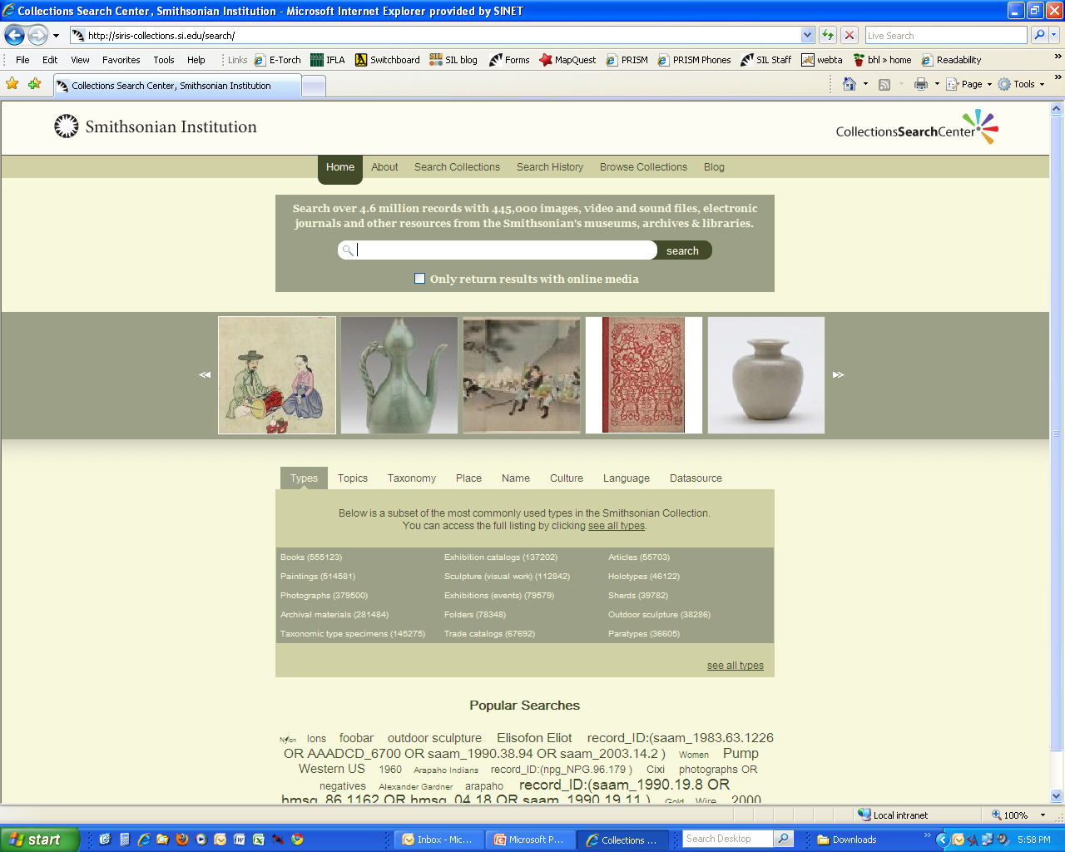

Slide 15
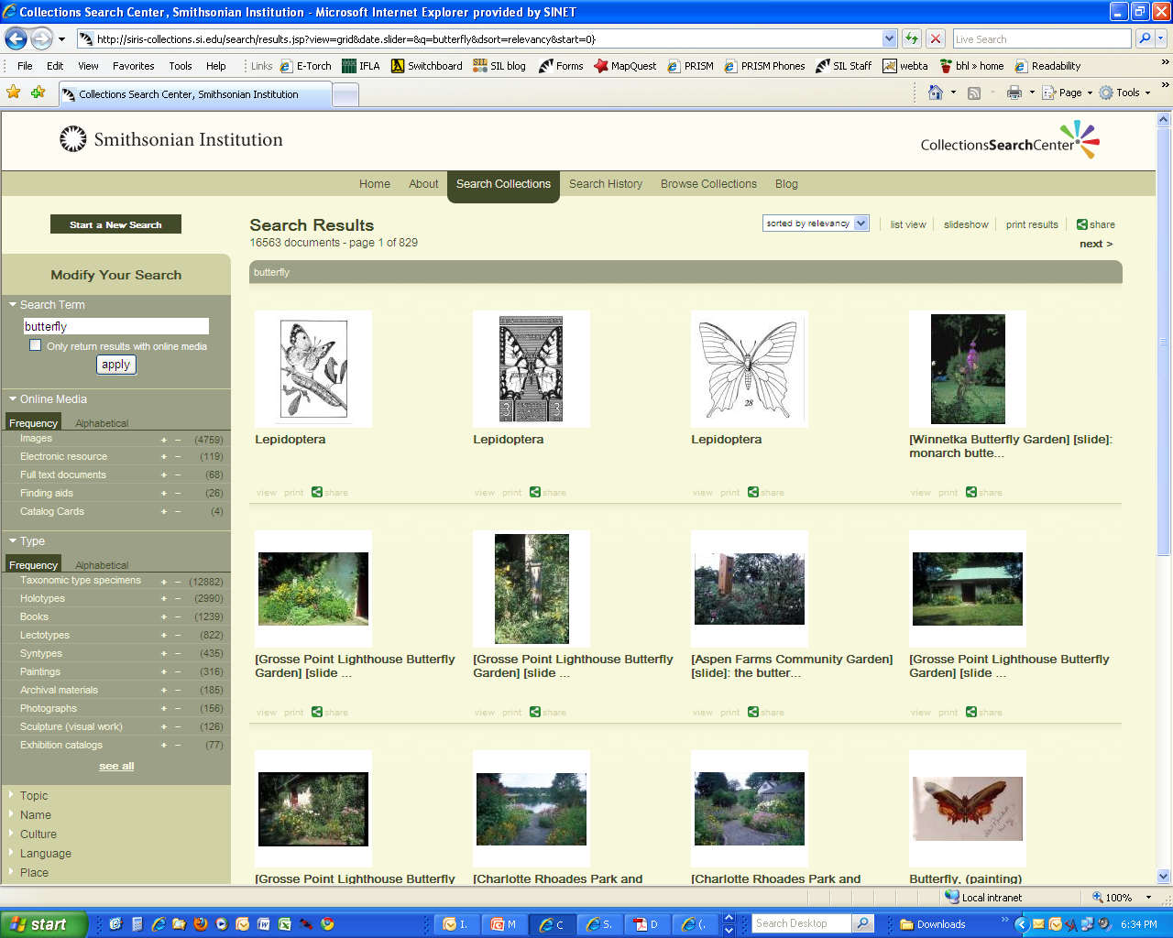
SEARCH TERM: BUTTERFLY
1 OF
829
PAGES
Notes:
This is only the top half of the page; each page contains 20 images in this view.

Slide 16
SEARCH TERM: BUTTERFLY
Notes:
Here I’ve pulled up the list on the left which displays the results by TYPE OF Online Media (at the top—images, electronic resources, full-text documents, catalog cards) and type of item (taxonomic type specimens, books, paintings, photographs, sculpture, etc.) That’s only a partial list.

Slide 17
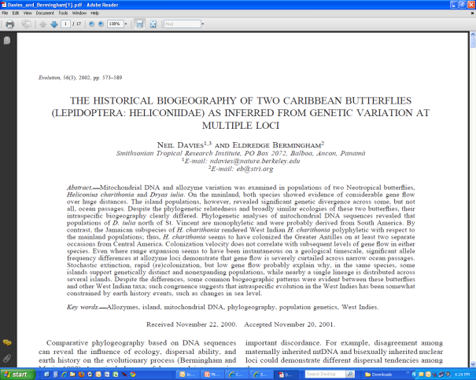
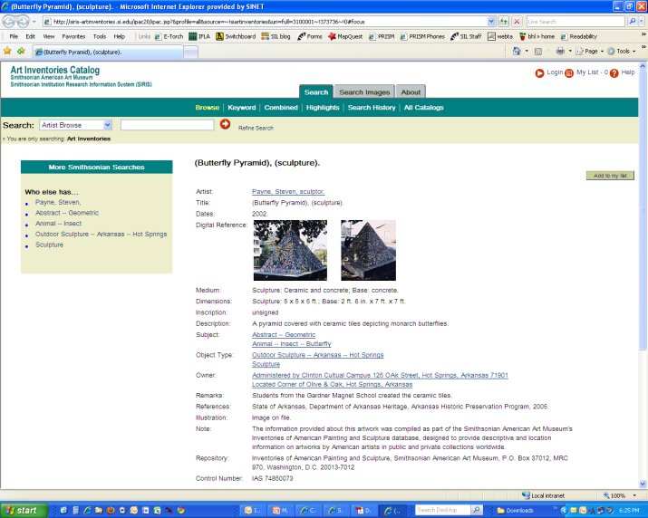
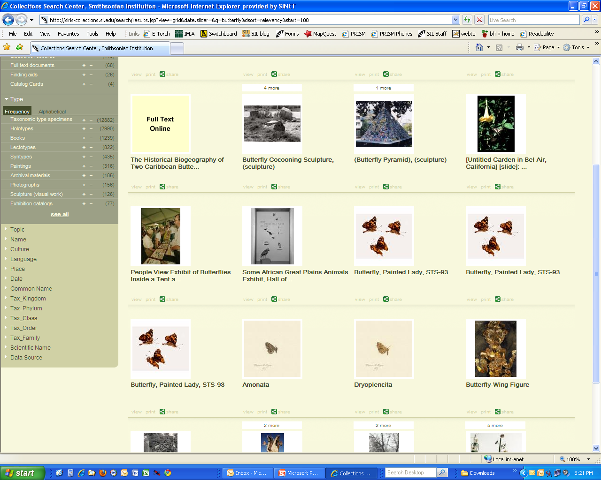
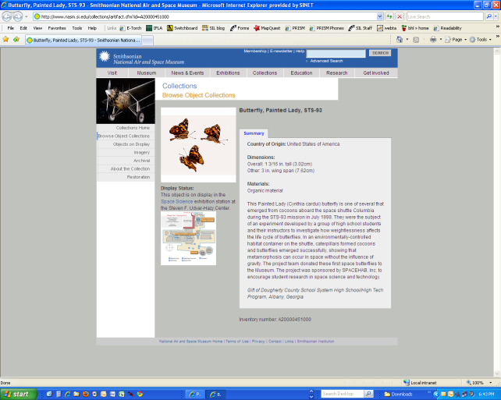
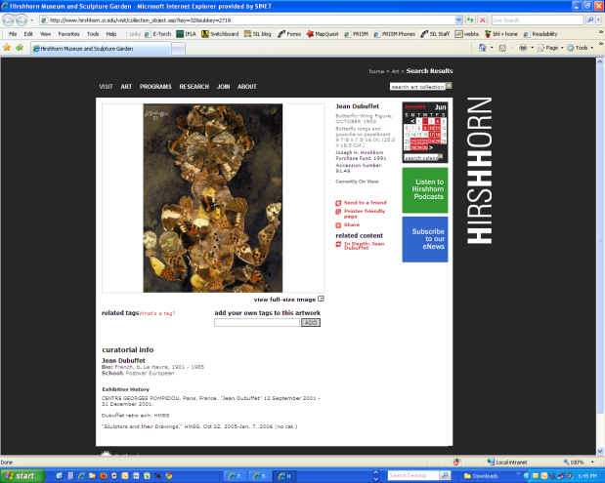
Notes:
If you click on the different images, you’ll begin to see the diversity of collections across the Smithsonian that have something to do with butterflies. Each click takes you out to the specific collection information system that each Smithsonian unit operates and you can either stay in that system or go back to the Search Center.
So, for example, starting at the top and proceeding clockwise, you first find the full text of a scientific article from the Smithsonian Libraries. The second click takes you to a record for a sculpture that is contained in the Smithsonian American Art Museums Art Inventories database; the third is to butterflies in the Air and Space Museum; and the fourth to a butter-fly wing figure found in the Hirshhorn Museum.

Slide 18
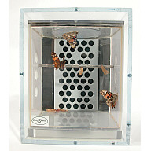
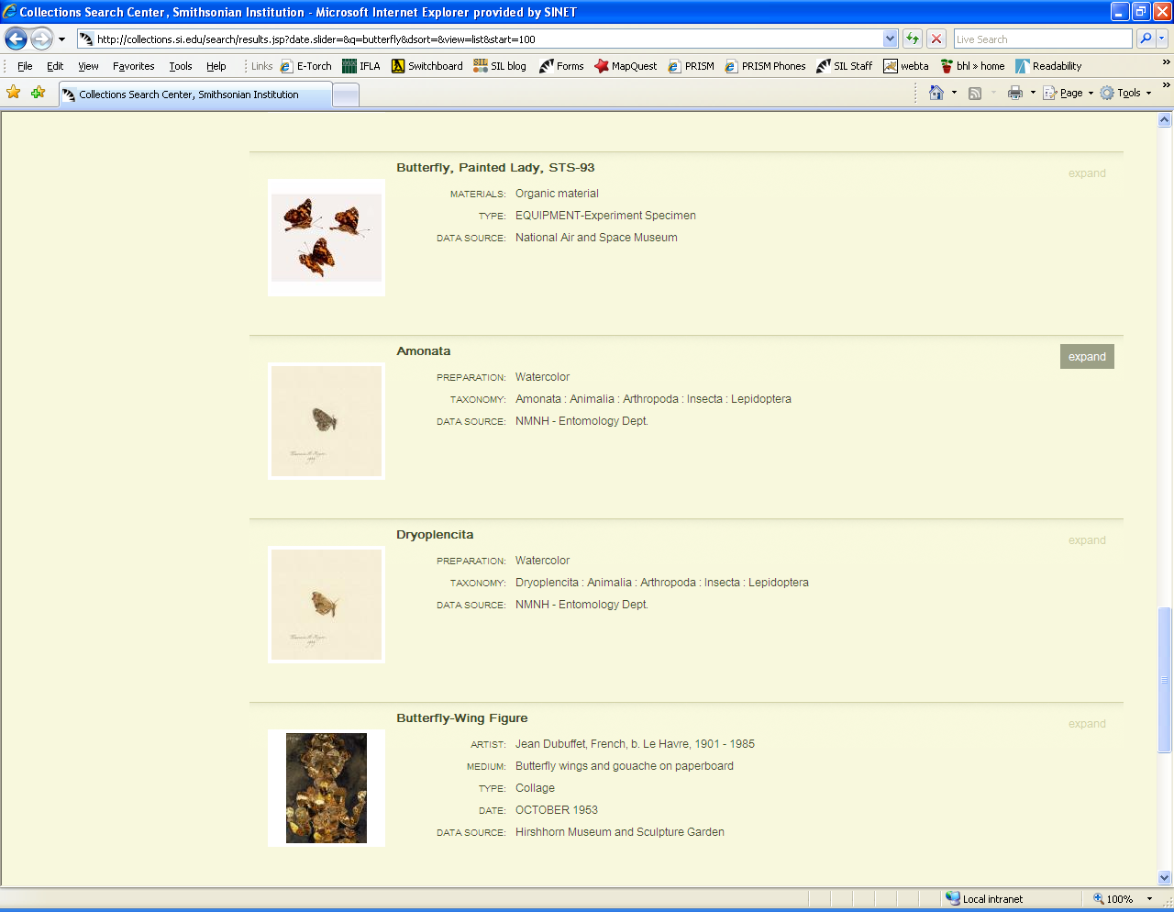
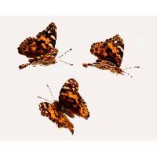
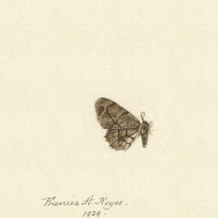
Air & Space Museum Butterfly
Natural History Museum
Notes:
NOT ALL SPECIMENS ARE IN NATURAL HISTORY
Butterfly, Painted Lady, STS-93 ---National Air and Space Museum
TOP: This Painted Lady (Cynthia cardui) butterfly is one of several that emerged from cocoons aboard the space shuttle Columbia during the STS-93 mission in July 1999. A photo of the habitat is to the right. They were the subject of an experiment developed by a group of high school students and their instructors to investigate how weightlessness affects the life cycle of butterflies. The project team donated these first space butterflies to the Museum.
Amonata ---NMNH - Entomology Dept.
Preparation: Watercolor Taxonomy: Amonata : Animalia : Arthropoda : Insecta : Lepidoptera Other Numbers #0: 000753 Specimen Count: 1 Notes: Excellent Record Last Modified: 25 Sep 2008 See more items in: Illustration Archive Entomology Data Source:

Slide 19
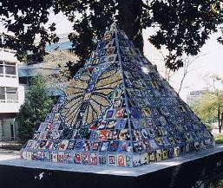
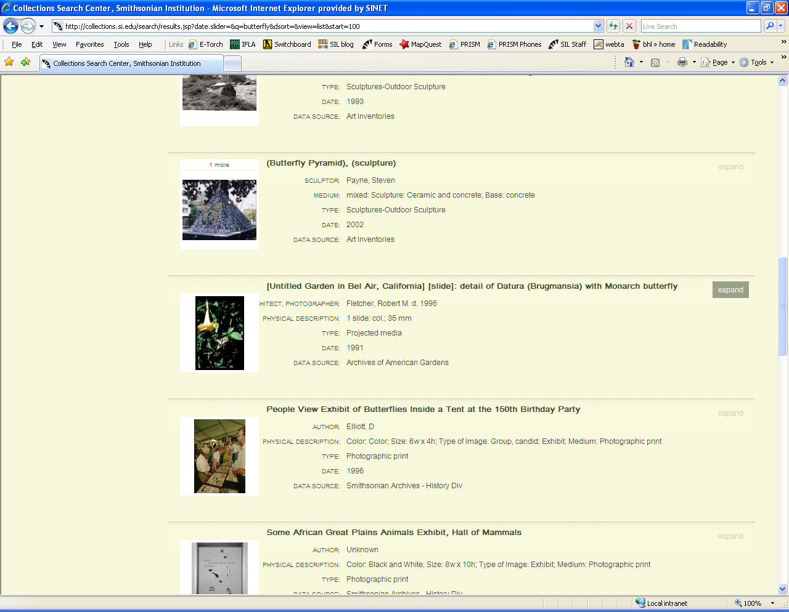
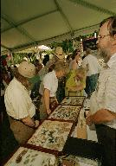
Smithsonian American Art Museum Butterfly
Smithsonian Archives
Notes:
TOP: Smithsonian American Art Museum
A pyramid covered with ceramic tiles depicting monarch butterflies in Hot Springs, AK Payne, Steven, sculptor. Inventories of American Painting and Sculpture
BOTTOM: Smithsonian Institution Archives
In a tent at the Smithsonian’s 150th Birthday Party On the Mall, August 1996, visitors look at cases filled with butterflies.

Slide 20
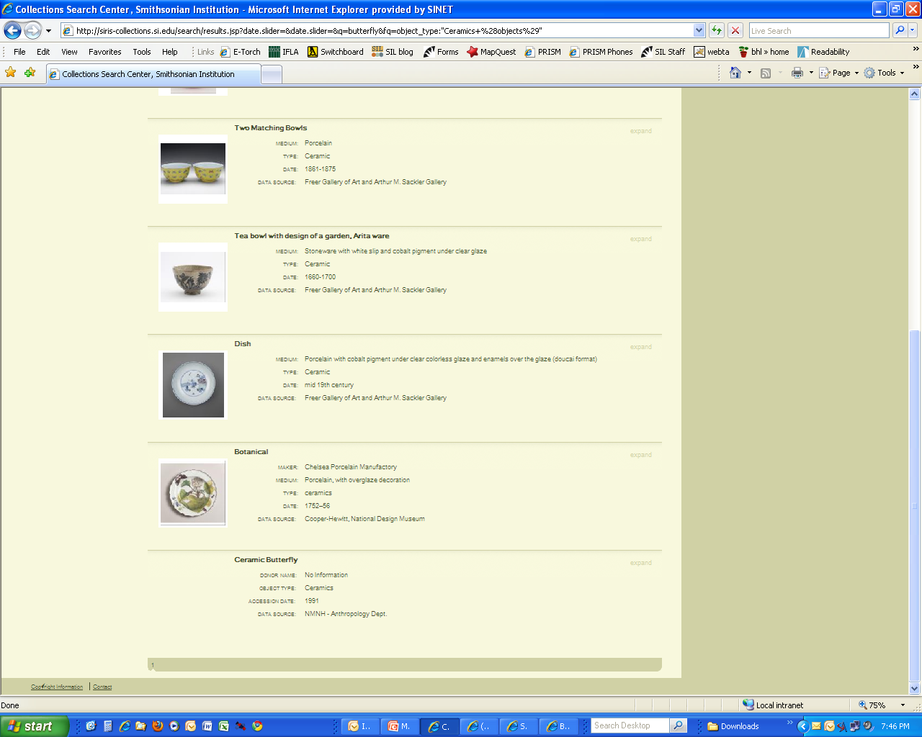
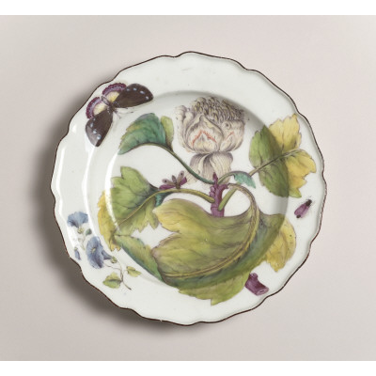
Art & History Museums: Butterfly
Black butterfly [music]
Composer: Ellington, Duke 1899-1974.
1 conductor score and/or parts (Published sheet music), 31 cm 12 manuscripts…..
Notes:
TOP: Duke Ellington music manuscript from the Archives Center, National Museum of American History
BOTTOM: Porcelain plate from the Cooper Hewitt, National Design Museum

Slide 21
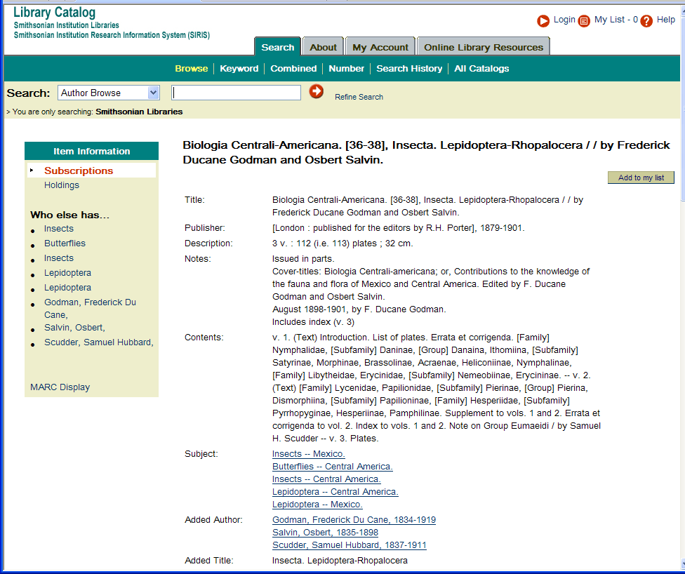
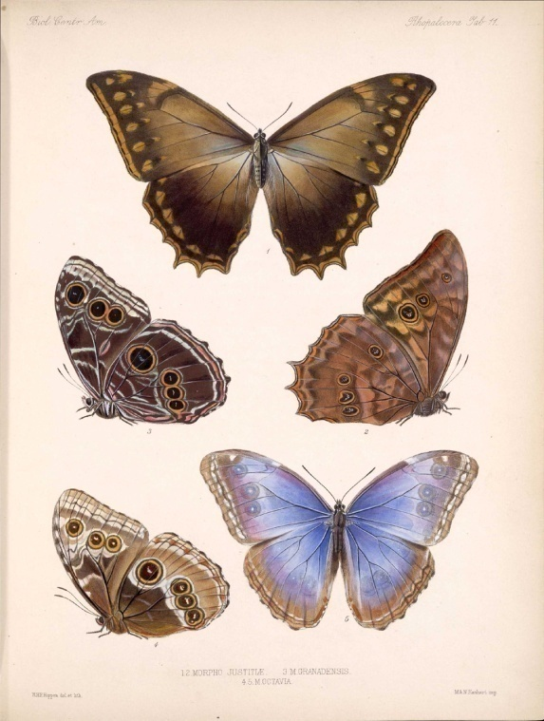
Library: Butterfly
Notes:
Currently the library results in the cross search are a finding aid, even though the library has digital images available through its “Galaxy of Images” website. Plans are to link the images to the Collections Search Center at a later date.

Slide 22
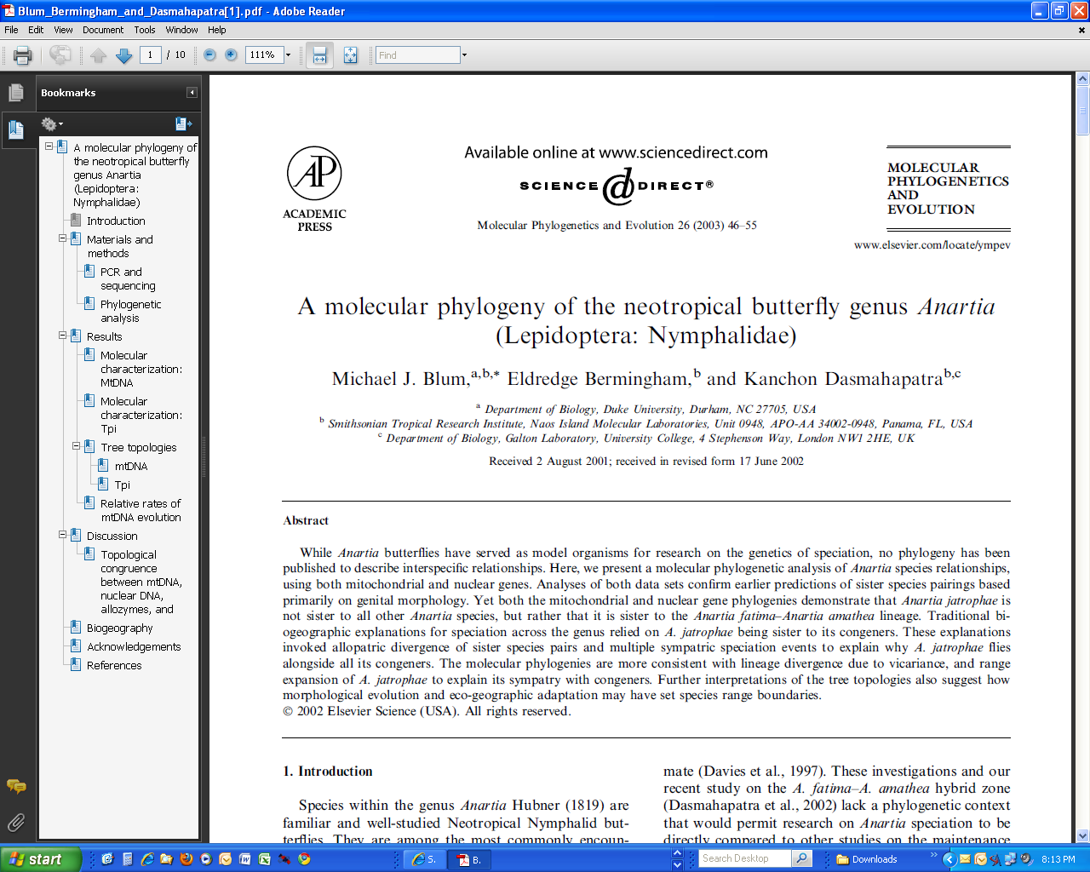
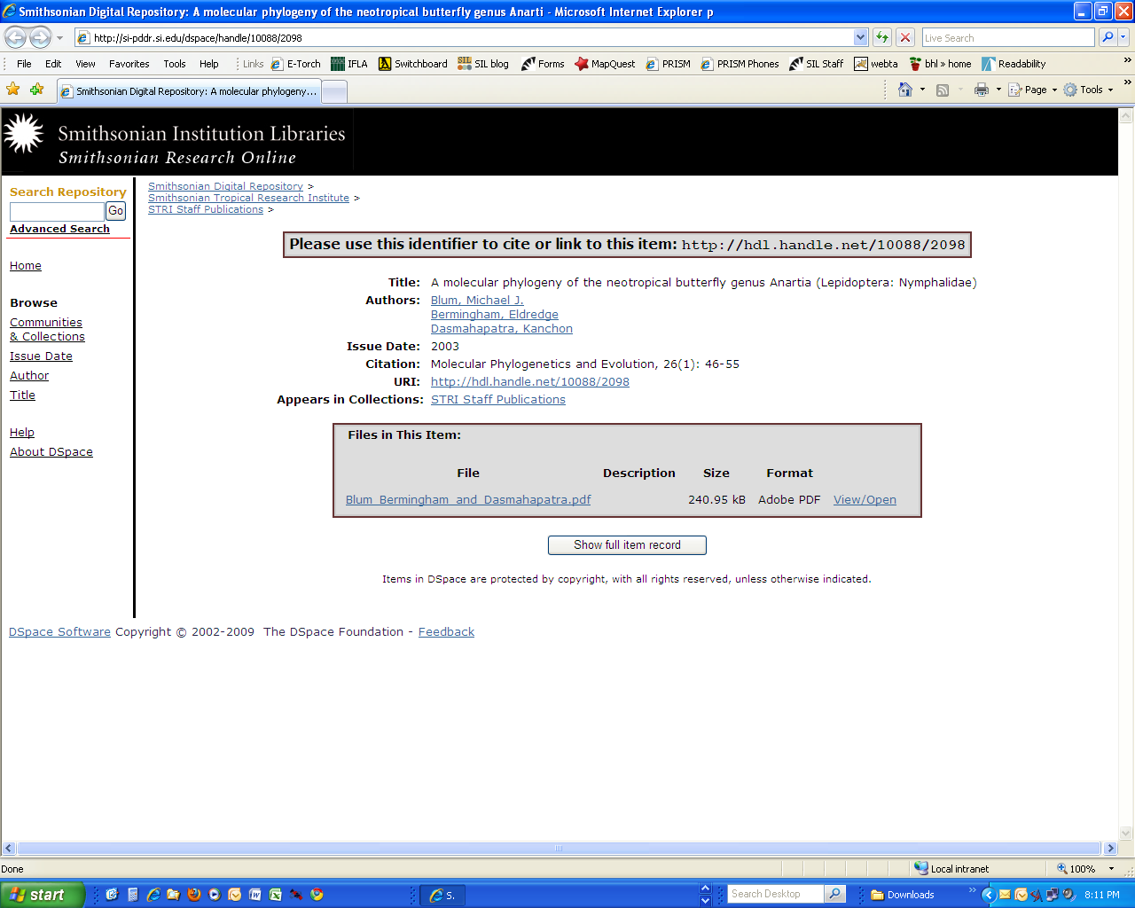
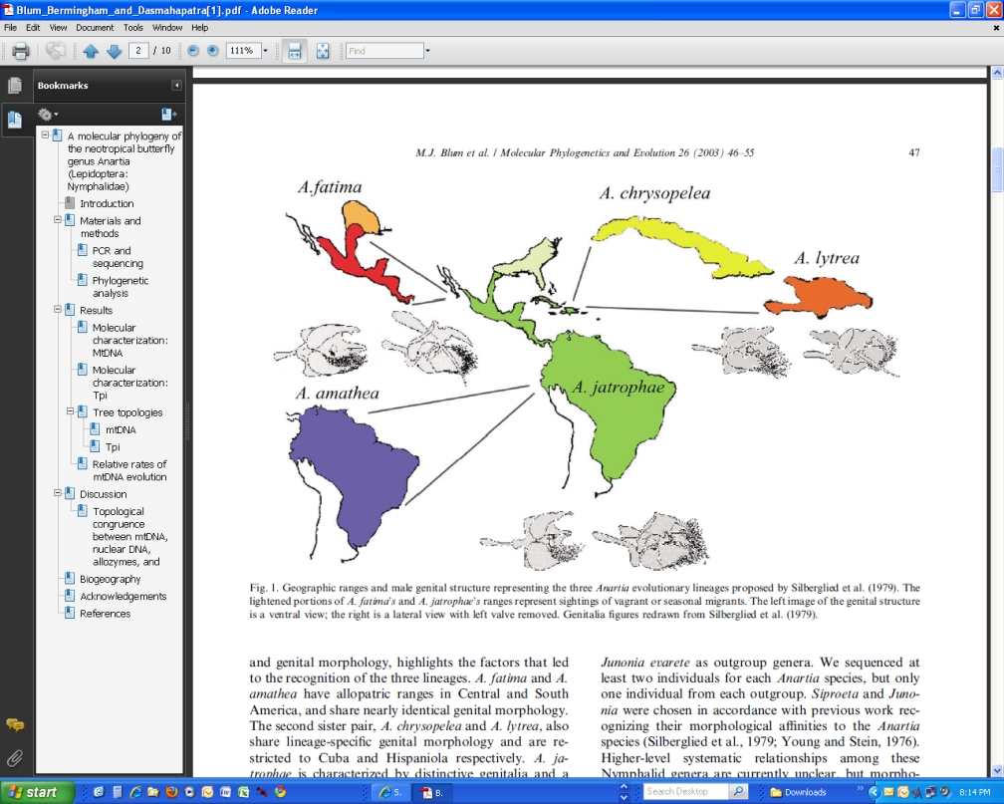
Library: Butterfly
Notes:
And from the Libraries’ Digital Repository is a scientific paper by staff of the Smithsonian Tropical Research Institute

Slide 23
SI Strategic Plan
Unlocking the Mysteries of the Universe
Understanding and Sustaining a Biodiverse Planet
Valuing World Cultures
Understanding the American Experience

Slide 24
Grand Challenge Consortia
Operate under the Under Secretaries for Science and History, Art and Culture
Part-time Directors drawn from staff
Housed together in Castle
Develop cross-Institutional synergies, forums, research programs, areas where SI can make unique contribution

Slide 25
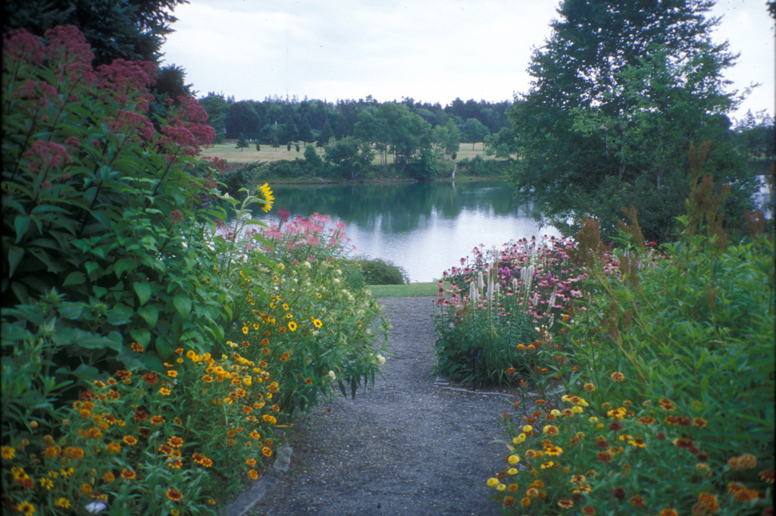
Notes:
Archive of American Gardens
[Charlotte Rhoades Park and Butterfly Garden] Southwest Harbor, Maine

