Slide 1
From the Researcher’s Point of View
Support for
Research Workflows
Jennifer Schaffner
Program Officer
RLG Partnership Annual Meeting
10 June2010

Slide 2
“I have my largest amount of data on grass genomes and I integrated it into a database when I lived in the Philippines.
“Then I left and I couldn't update the data on the fly. So entered into a collaboration with statisticians and computer programmers who entered it in PERL.
“I still feel a weakness in my training because I am dependent on them.”

Slide 3
“I want the essays I have written over the years to be consolidated in one place to be published…
“… but I cannot find them all.”

Slide 4
“I would be interested in tools that can scan lab notebooks and assign metadata for retrieval.”

Slide 5
"I searched for a book on Amazon and couldn't find it so it must not exist."

Slide 6
“I would like to tear apart the current publishing system so everyone owned their own IP.”

Slide 7
“[I would like a service] so I can see what others are doing without sharing my information."

Slide 8
“I used to use the library to obtain all my research information, but now I use Google Scholar.”

Slide 9
“It would be helpful to have a data warehouse.”
“Incentives are low to share data and there is no real means of tracking data in my field. There is no central data repository.”
“Researchers such as myself refuse to submit our original data ,for fear it will be compromised, mis-cited and misquoted.”
“We have consolidated social sciences survey research into an institute, which provides data archiving among physically disparate areas.”

Slide 10
“Journals are like radio stations - you pick them according to your taste.”

Slide 11
“I make working papers - which are under review - publicly available.
“When the paper is accepted, I take down that link and then, after the article is published, I release the new link.
“This process is very tedious and I would love a tool that migrates the paper according to its published status.”

Slide 12
“On my wish list is a program that would scan my email and identify the importance of the message based on my preferences.
“I could then eliminate the messages that were lower priority without reading them.”

Slide 13
Research Information Management
Studying researchers “in the wild”

Slide 14
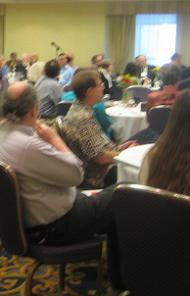
Evolution of the
Research Information Management
Program
Incubation of an idea by OCLC Research staff
Input at from RLG Partners at 2008 RLG Annual Meeting
RIM interest group
Advisory group
Four working groups
Update and recalibration at 2009 Annual Meeting

Slide 15
Research Information Universe
research assessment
support for the research process
Discipline
Sub-discipline
Researcher
Tools & content
Assessment
Institution
research services and data curation
ME
scholarly information practices
support for research workflows

Slide 16
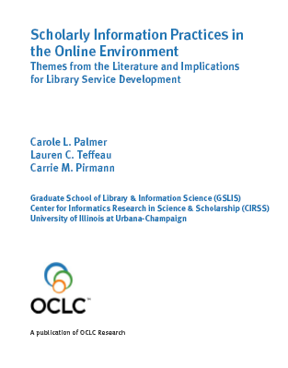
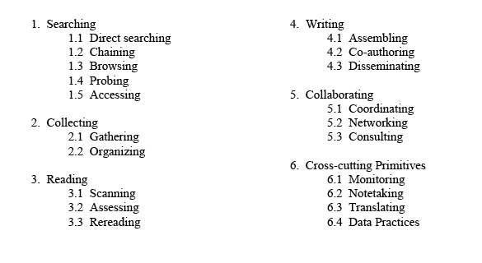
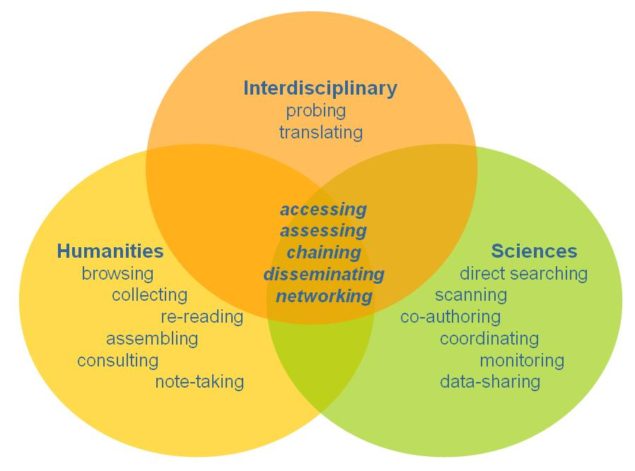
Convergence in Scholarly Practices
Discipline
Sub-discipline
Researcher
Institution
oclc.org/research/publications/library/2009/2009-02.pdf

Slide 17
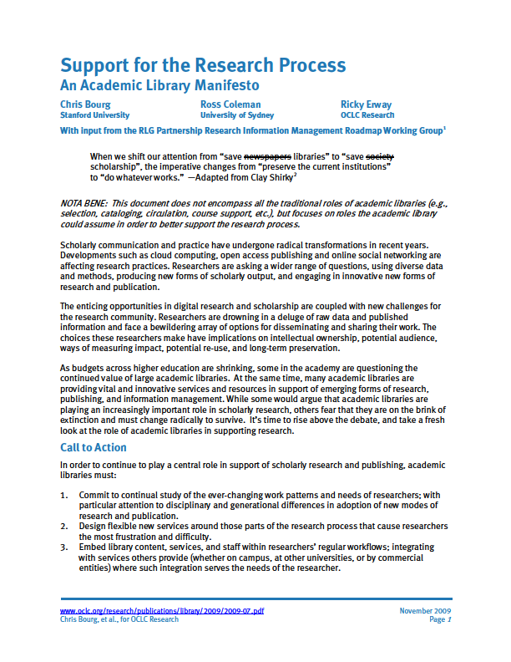
Vision
When we shift our attention
from “save libraries”
to “save scholarship,”
the imperative changes
from “preserve the current
institutions”
to “do whatever works.”
Researcher
Institution

Slide 18
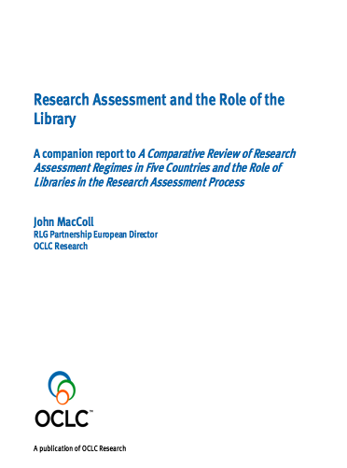
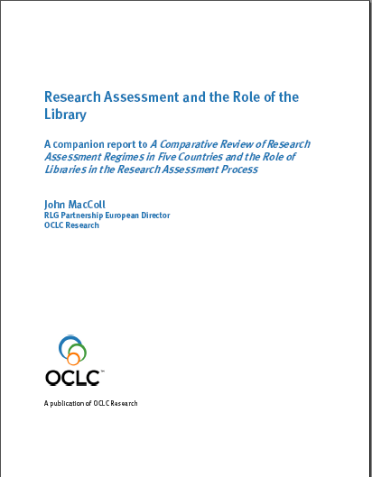
Research Assessment
“Libraries should
claim their territory”
Libraries should:
Claim their territory.
Know disciplinary norms
Manage data at scale
Operate repositories efficiently
Provide bibliometrics
Provide evidence
Assessment
Institution
oclc.org/research/publications/library/2010/2010-01.pdf

Slide 19
Overlapping environments
Research Funders
Domain
Reputational social networks
Mission
Record of publications
Open Access mandate
Output
Output
Output
Output
Output
Academic freedom
Linked repositories
Researcher
Institution
Assessment
Mission
Record of publications
Open Access mandate
ME
National economic performance
National research profile
Share of assessment-based funding
League table ranking
Tenure
Internal assessment

Slide 20
Support for Research Workflows a joint project with the UK’s Research Information Network
“discover the information-related support services researchers use throughout the life-cycle of their work”
Tools & Services
Researcher

Slide 21
oclc.org/research/publications/library/2010/2010-15.pdf
Notes:
Report

Slide 22
Testing the Desirability of Research Services
ensure you can access your data remotely
help you manage your research, tracking who is involved in which grant, which research is funded by which grant…
help you negotiate publication rights
help you comply with NIH and other requirements
do the authority work so you are credited for your work
keep your personal bibliography up-to-date
provide you with a customizable personal web page
include you in the campus expertise database and facilitate inclusion in disciplinary expert databases.
see that you can take your work with you if you leave this institution

Slide 23
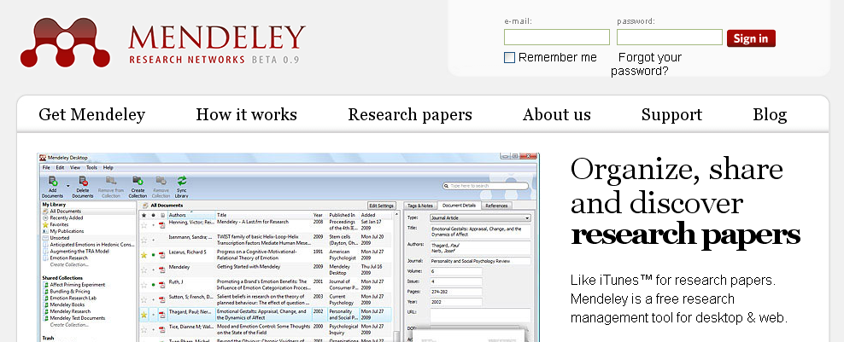
“It’s the Wild West Out There”

Slide 24
Conclusions:
Researchers value efficient, easy-to-use services.
Electronic journals and Google dominate the landscape in the research process.
No one can manage their documents and data sets.
Researchers use personal relationships to choose collaborators.
Researchers do not use libraries.
Tools & content
Researcher

Slide 25
“Relationships between researchers and traditional library and university support for research have shifted radically. Investigators use and prefer solutions that are adequate, not optimal, given major time constraints within which they all work. The majority of researchers interviewed for this study use online tools – and commercial services – related to their discipline rather than tools provided by their university. Structured interviews reveal that researchers today derive tremendous benefit from using network-level search engines such as Google and from convenient access to electronic journals. Despite tremendous advantages offered by digital access and communication, however, the stellar productivity of U.S. researchers continues to be built on a foundation of direct human connection, researcher to researcher.

Slide 26
“Researchers report that they struggle unsuccessfully with storage and management of a burgeoning volume of documents and data sets that they need and that result from their work. While some universities have devised new services to better manage data and other information derived from research, many researchers flounder in a disorganized and rising accummulation of useful findings that may be lost or unavailable when conducting future research.”
-Kroll/Forsman 2010

Slide 27
Methodology:
Tools & Services
Researcher
Qualitative
Exploratory
Comparative, international view
Case studies
Structured interviews
Select 8 exemplary institutions
(4 each in US and UK)
Wide mix of disciplines
Entrée and interviews with deans, provosts, grant and research administrators, etc.

Slide 28
Methodology: Who was interviewed?
Positions:
Art Curator
Associate Professor
Chair, Research Computing Committee
Dean
Graduate Student
Grant Manager
IT Director
Professor
Research Assistant
Research Support Services staff (including both grant and lab management)
Vice President of Research

Slide 29
Methodology: Departments and Disciplines
African Studies and African Art
Astronomy
Bioinformatics
Computer Science
Digital Arts
Digital Media
Economics
English
Geography
Global Health
History
Health Research
Latin American Studies
Life Sciences
Mathematical Ecology
Mechanical Engineering
Medicine
Music History
Physics
Population Research
Psychiatry
Psychology
Sociology
Veterinary Medicine

Slide 30
Collect
Do you think you need to improve your information seeking and information management skills? Do you do so from time to time? If so, how?
Do you use any tools or services to curate and preserve data sets generated through research? What additional support would be desirable?
Do you use any tools or services to analyze large text or data aggregations? What additional support would be desirable?

Slide 31
Read and Write
Do you use any tools or services to manage literature citations? What additional support would be desirable?
How do you identify the most effective manner and vehicle in which to publish? What additional support would be desirable?
Do you disseminate preprints of your papers? Do you disseminate postprints of your papers? How do you do this?
Does anyone provide you with advice and guidance in protecting intellectual property rights or in making your research outcomes openly accessible to others?

Slide 32
Collaborate
Do you collaborate with other researchers? How do you locate potential collaborators? How do you make your expertise known to others?
Do you collaboratively manage documents and data generated in a research project? How do you do this?
Do you take advantage of any services to support researcher reputation management, such as citation analysis or expertise profiling?

Slide 33
Funding
How do you learn about grant or other funding opportunities?
Are you concerned with research topics of potential commercial value to the university? How do you identify them? Describe the process to commercialize.

Slide 34
Example from a recent on-campus interview
Q: Do you use any tools or services to analyze large text or data aggregations? What additional support would be desirable?
A: “I have a programmer to access sequence data that is too complicated to share. So we just send the results.
“The programmers have the answers but don't know the questions to ask. I have the questions but don‘t know the answers. There are only a handful of people that can do both.”

Slide 35
What to stop doing; what not to do?
Services to learn about grants and funding
Services about where to publish
Services to manage IP and exploit commercial value of research
Instruction on how to use information services
Expertise profiling
Services to analyze large text and data files
Citation managers
Services to manage pre-prints, post-prints and publications

Slide 36
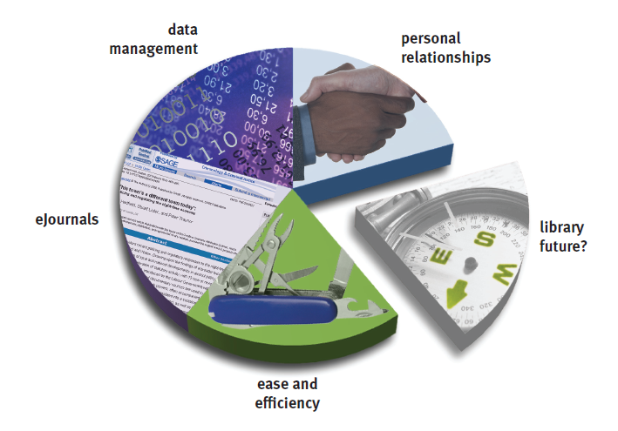
Lingering Questions
Tools & Services
Researcher

Slide 37
“Marginal”
Scientific/Professional Personas
Institution/Individual
Institution/Discipline
Administrative/Scholarly Support
Centralized/Decentralized Universities
Shared/Bespoke Services

Slide 38
Coda: Data Curation
Role of libraries in data curation
Discipline-specific practices and needs
“The Fourth Paradigm”
Archival management of large data sets
Tools & content
Researcher

Slide 39
Resources:
Jennifer_Schaffner@oclc.org
Support for Research Workflows project:
http://www.oclc.org/research/publications/default.htm
OCLC Research reports:
http://www.oclc.org/research/publications/default.htm
The Research Information Network (RIN)
http://www.rin.ac.uk/
Thanks to Susan Kroll, Rick Forsman, Ian Rowlands,
David Brown, Ricky Erway and John MacColl

