Slide 1
Out of the Basement and into the Cloud
Creating a Cloud Service
Bruce Washburn
Software Engineer
OCLC Research, San Mateo CA
Notes:
I work for OCLC Research, in the San Mateo CA office. I came to OCLC from RLG, during its combination with OCLC in 2006. I started at RLG in 1987, coming from the catalog department at Stanford University’s Green Library.
So, during that time, I’ve been a bystander to and sometimes a participant in the evolution of library technologies, and am now engaged as best I can in grappling with the discontinuous and disruptive change we’re all facing.
Much of my time is currently spent on projects that aren’t, strictly speaking, Research efforts. These include the WorldCat Search API, ArchiveGrid, OAIster, and other OCLC services.
But I’ve also been helping with Research projects like the Museum Data Exchange and data mining efforts associated with archival collection descriptions and the Cloud Library.

Slide 2
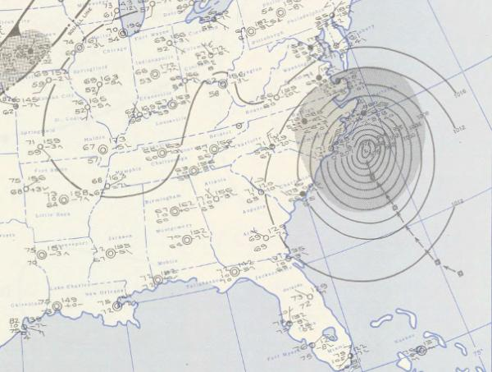
http://en.wikipedia.org/wiki/Hurricane_Ione
Notes:
But today we’re going to take a look at cloud computing, which has been the subject of a lot of discussion recently.
Most cloud computing presentations I’ve seen have used an image of little white puffy clouds to illustrate the topic. I didn’t want to do what everyone else does, but I also thought a weather chart might be a better representation.
Cloud computing is hard to see, directly. It’s a little easier to get at if you look at its effects and metrics. Weather charts do something similar; they take in data, represent current conditions, and from that attempt to forecast future changes.
I’ll try to do something similar for cloud computing today, by assessing some current efforts, then attempting to actually build a service in the cloud so that we can see what that requires, and then look at the hype associated with this topic and survey viewpoints on the technology.

Slide 3
MissingMaterials.org
Notes:
MissingMaterials.org is a website created by OCLC Research, based on an idea developed by Eric Childress and Jen Schaeffner. Ralph Levan and I participated in building the site. It’s a place where those who maintain rare book and special collections can publicize materials that have gone missing. They start by recording those items in a WorldCat.org list. The MissingMaterials.org site regularly scans those lists, and creates blog entries about each title automatically. We used the WordPress blog software with some minor extensions to automate the process. This all runs on a website outside of OCLC’s network, and communicates via an OCLC Research web service back to the WorldCat database.
Some might say that this is not cloud computing, strictly speaking. I’m not focusing on definitions too much in this presentation, as others suggest that anything running outside of a companies firewall is “in the cloud”. This site is something of a hybrid, of applications we run at OCLC, a utility computing service to host the blog, and the blog software.
So, it’s cloudy. One aspect it shares with other cloud computing examples is that it was very fast and easy to set up. We didn’t have to create our own blogging software and don’t maintain the software and hardware for the website.

Slide 4
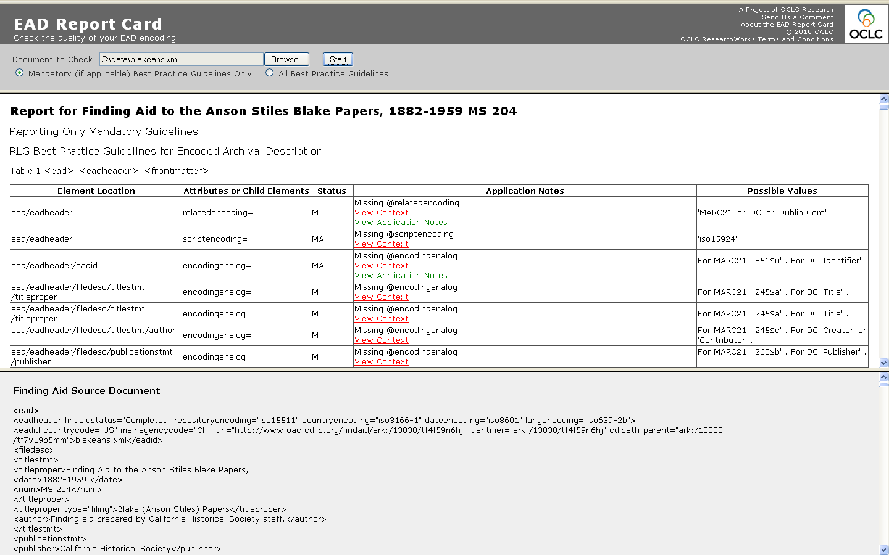
EAD Report Card
Notes:
The EAD Report Card is an application designed to compare EAD XML files with best practice guidelines, and report exceptions and suggest modifications.
It was originally developed by a consultant for RLG and written in a programming language called Perl. After RLG’s combination with OCLC, we wanted to continue to offer it but needed to run it on an OCLC server. Most OCLC applications are written in Java, and so a first step was to “port” it from Perl to Java, which I did.
The next step was to get it running on an externally visible OCLC server. This proved to be more difficult than I expected. The technology for this isn’t hard to assemble, but getting this small, lightly-used, outlier application to have its own server, with security audits and access permissions, took far longer and more staff time than was justified. While weeks passed without my succeeding in finding a server home for it, I was attending the 2009 Google I/O conference and went to a session about the Google App Engine. That’s a cloud computing platform for running applications written in Java (and some other languages). My Java development environment had a plug-in software component that made it very easy to promote an application to the Google App Engine. After that session I went to a quiet area of the Moscone convention center in San Francisco, started up the development application and EAD Report Card code on my notebook, connected to the Google App Engine, and uploaded the program. It was running, in the cloud and externally accessible, literally within the hour with the click of a button. And that’s where it remains available today.

Slide 5
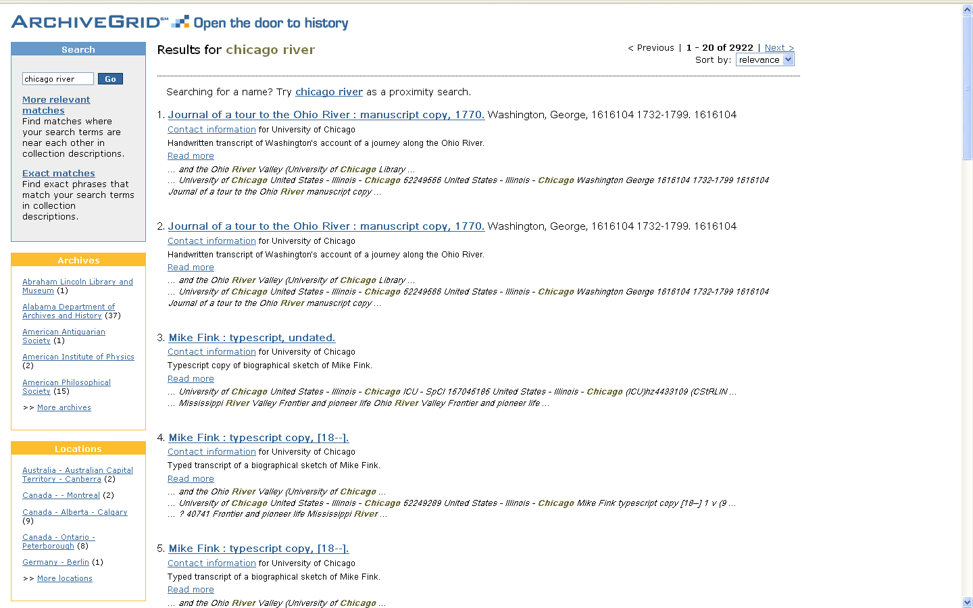
ArchiveGrid
Notes:
ArchiveGrid is an OCLC service that combines descriptions of archival collections, represented internally either as MARC records, HTML finding aids, or EAD XML finding aids. I’ve worked with this data and this service in various forms for at least 15 years now.
RLG launched ArchiveGrid in early 2006, and at that time we had decided that a good way to combine these different kinds of descriptions into a single searchable index would be to use a text searching application called Lucene. It’s an open source text searching program that is still very popular, and turned out to be a good choice for this service.
We also wanted to provide a way to narrow searches via “facets”, like those that are shown in the left-hand sidebar for Archives and Locations. These were a challenge; we invented a way to do this in ArchiveGrid with Lucene, though.
This service does not run in the cloud. It runs entirely on OCLC servers, using software (other than Lucene) that OCLC creates and maintains.
We thought that an interesting idea for this presentation would be to see how much of ArchiveGrid’s functionality we could replicate by using publically available software and cloud computing systems.
So that’s what we’ll try to do, using the Amazon “elastic computing cloud”.

Slide 6
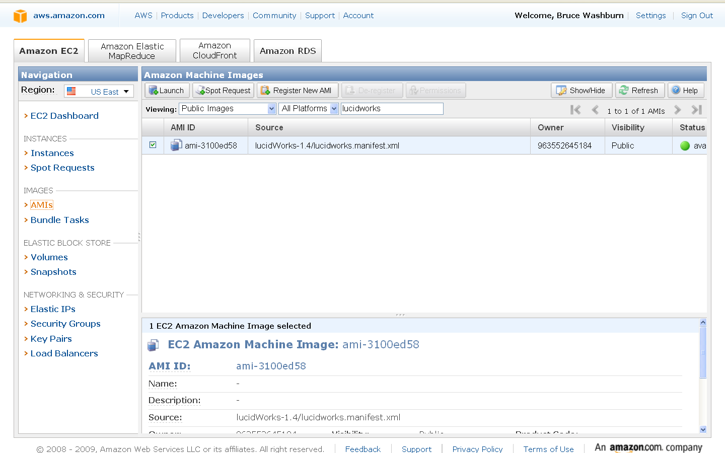
Copy a public Amazon EC2 Image
Notes:
The Amazon Elastic Computing Cloud, or EC2, is accessible via an Amazon web services account through this console interface, in a web browser.
My first step is to look for an “Amazon Machine Image”. Think of that as a virtual version of a physical machine with an operating system like Windows or Linux and some other software, like a web server. In my case, I want to find a machine image that combines the operating system Linux with an Apache Tomcat web server, the Lucene text searching software, and Solr. “Solr” is another open source software project that provides an easy way for websites and applications to interact with a Lucene index. One thing it does particularly well is support facets, like those we make available in ArchiveGrid. If Solr had been around when we created ArchiveGrid, we surely would have used it to create that service.
I searched in Google for “solr ami” and found one created by a company called Lucid Imagination, in a package called LucidWorks. So here I’ve found it in the list of public EC2 machine images.

Slide 7
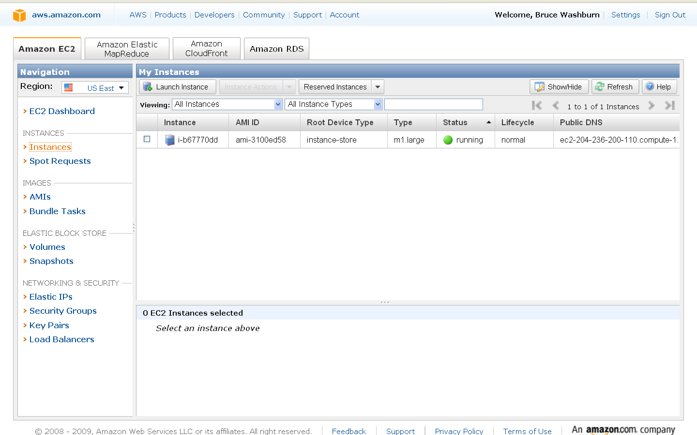
Launch an Amazon EC2 Instance
Notes:
Launching an EC2 instance based on a copy of a public machine image is easy. Just check its checkbox, click the Launch button, accept most of the default configuration prompts and you’re done.
Then you’ll see, in the console’s list of instances, a row showing your running instance.

Slide 8
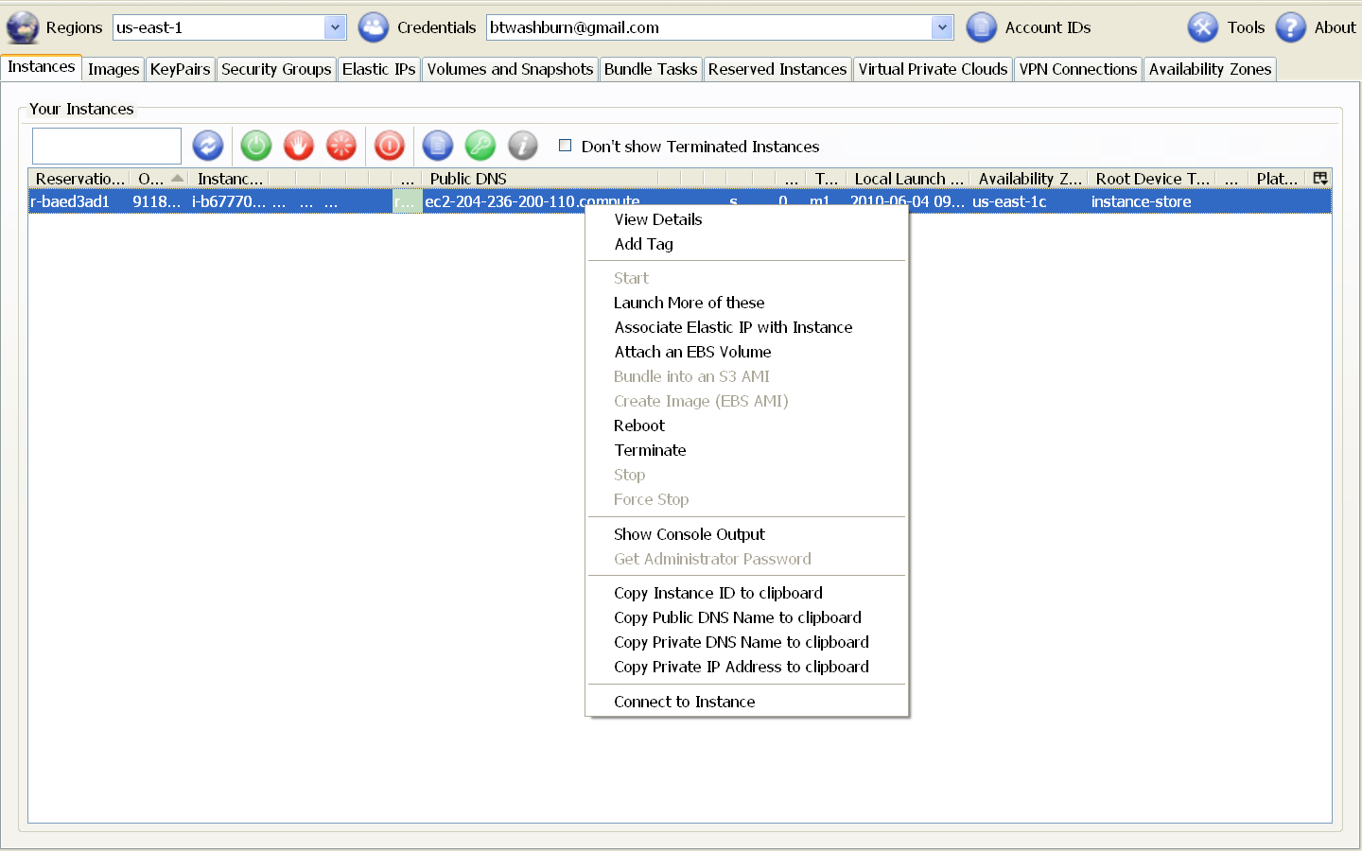
View the Instance with ElasticFox
Notes:
There are other ways to look at your Amazon EC2 instances in a web browser.
Here’s one that I like, a Firefox browser plug-in called Elasticfox. One of its features that I especially like is a quick menu selection to copy the hostname, or Public DNS Name, that Amazon has assigned to this instance. Amazon creates that for me, automatically. It’s long and unwieldy, so quickly copying it to the clipboard for use elsewhere is handy.

Slide 9
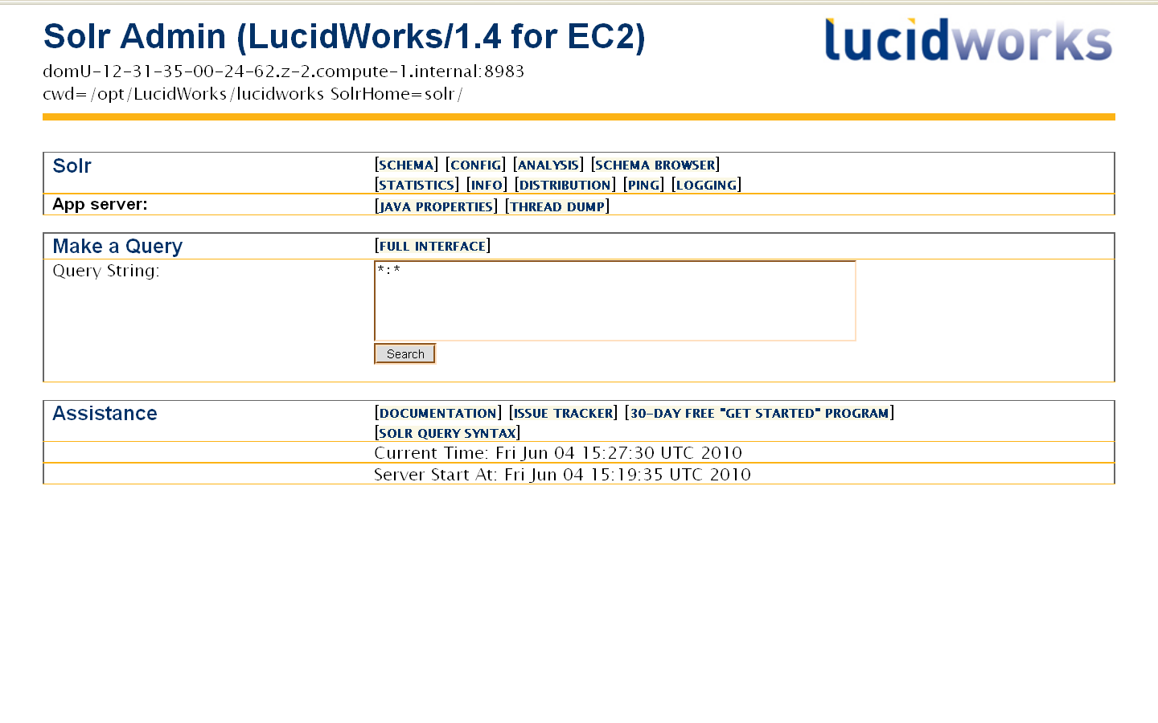
The server’s Admin page
Notes:
Once I’ve copied the public hostname of my instance, I can go to it from any web browser. Here’s the Solr Admin interface for our new server. One of the things I can do here is to search through the example Lucene index that came with this copied machine image.

Slide 10
A default index search result in XML
Notes:
A search returns the example records in their XML form.

Slide 11
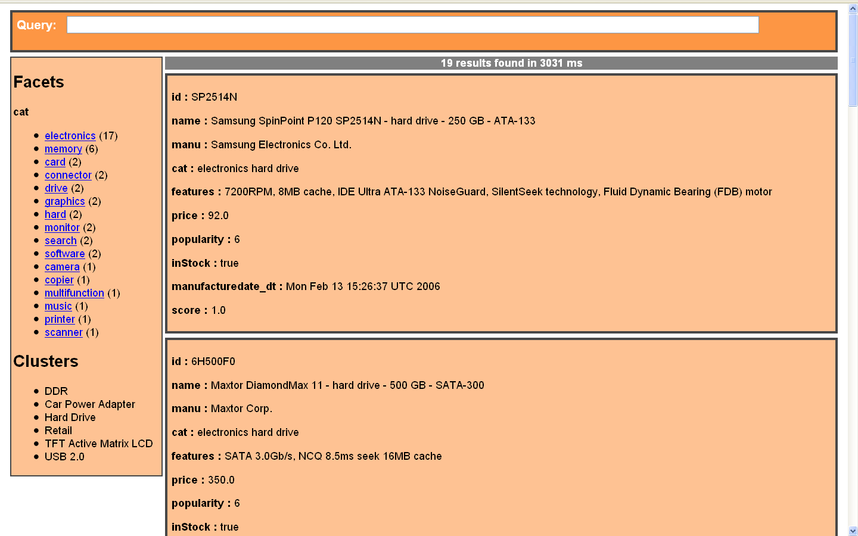
A default index result with Solritas template
Notes:
But a ready-made, more friendly web interface also comes with Solr, and here’s that same search and the same example records in that interface. Note the facet for categories in the left. That was provided quickly and easily by Solr. All it needs is to be told, in a “schema” XML file and a configuration file, what index fields should be treated as facets and they are readily available.

Slide 12
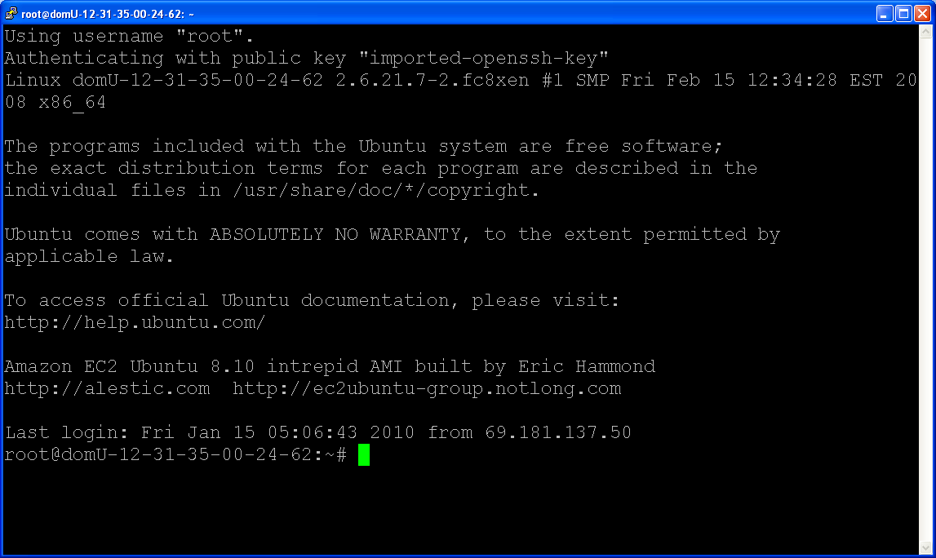
Logging on to the EC2 server
Notes:
To go further with our attempt to replicate ArchiveGrid’s features, we’ll want to change our server’s schema and configuration files so that it understands the fields we want defined for ArchiveGrid, and we’ll also need to provide some new index records.
The ElasticFox plug-in makes it easy to start a command line interface to our new server. Here we’ve logged on to the server.

Slide 13
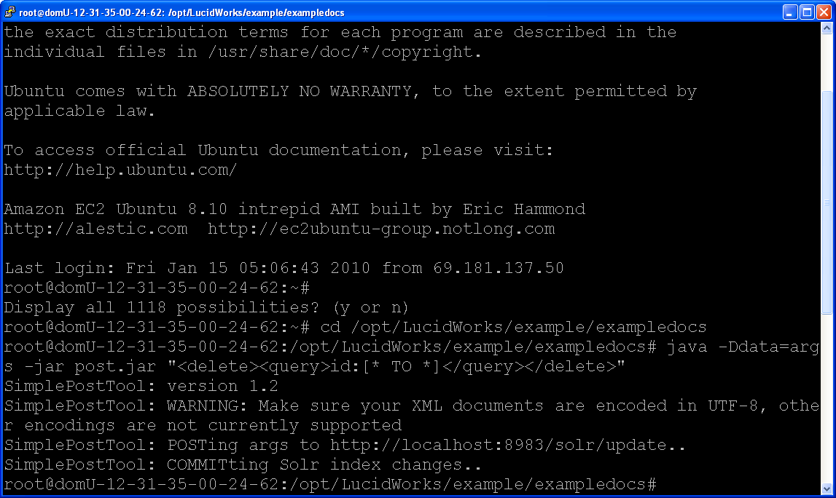
Deleting the default index records
Notes:
And here we’ve issued a command to delete all of the example index records. We’re doing that now so that we can add our ArchiveGrid records later.

Slide 14
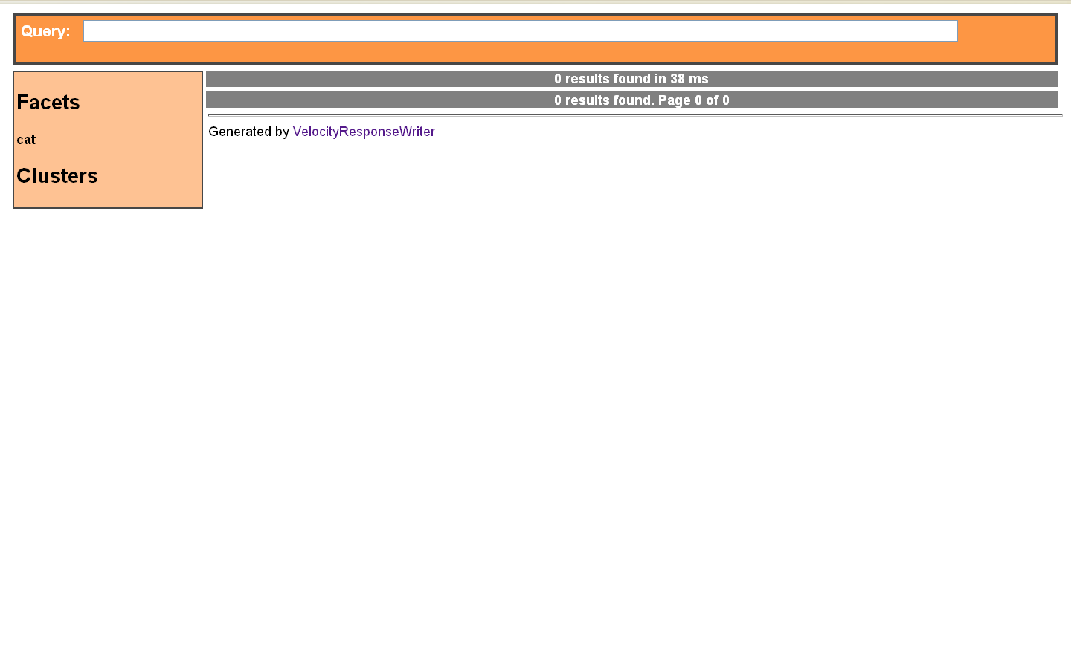
No more records …
Notes:
And, as the Solr default search interface shows, the example records are now all gone.

Slide 15
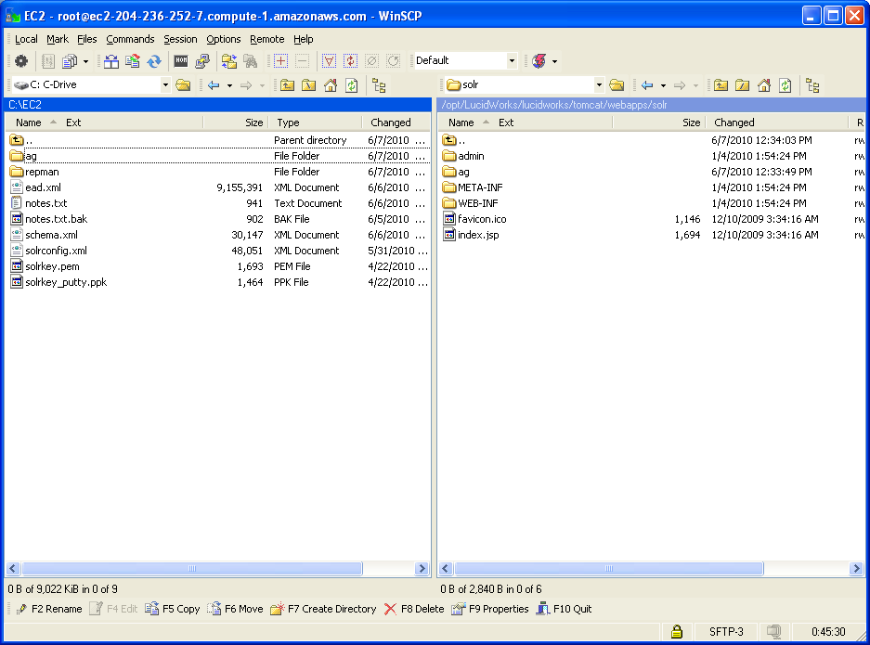
Copy schema, config file, and data
Notes:
Using a file transfer program, I can now move my updated schema and configuration files to the new server, along with a file of ArchiveGrid records.

Slide 16
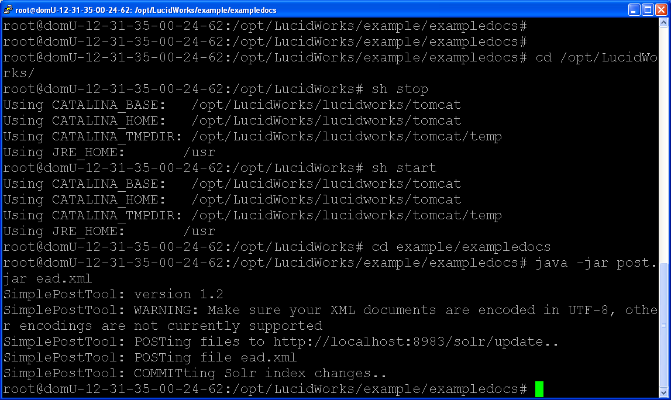
Restart and reindex
Notes:
Back at the command line, I stop and start the server so that the new schema and configuration files take effect, and then load my new data into the index.
In this demonstration, since we didn’t want to have everyone wait while a large file transferred, I kept the sample data from ArchiveGrid to a minimum. The file represents 501 randomly selected finding aids, originally encoded in EAD XML.

Slide 17
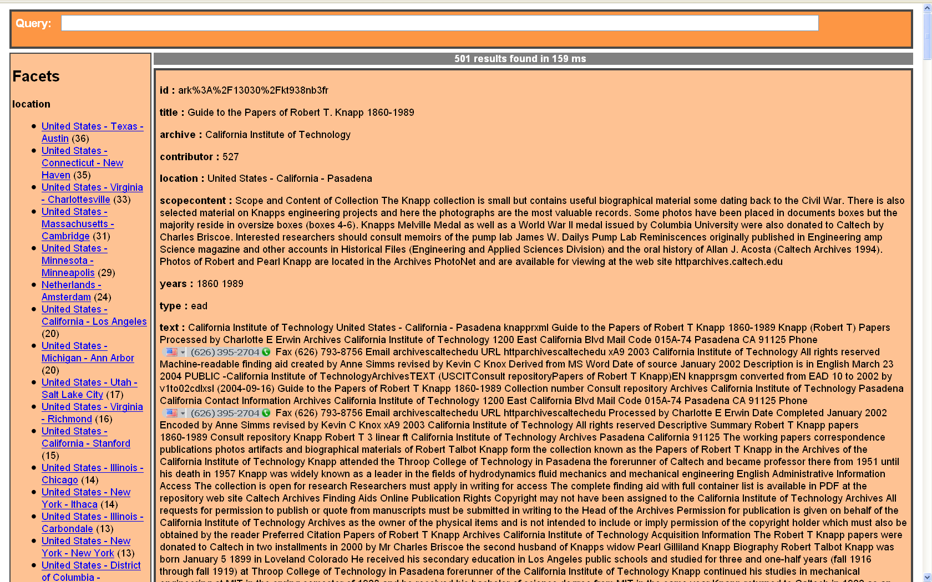
New records. Yay.
Notes:
And, returning to the default Solr interface, we now find our new records and facets, ready to use.

Slide 18
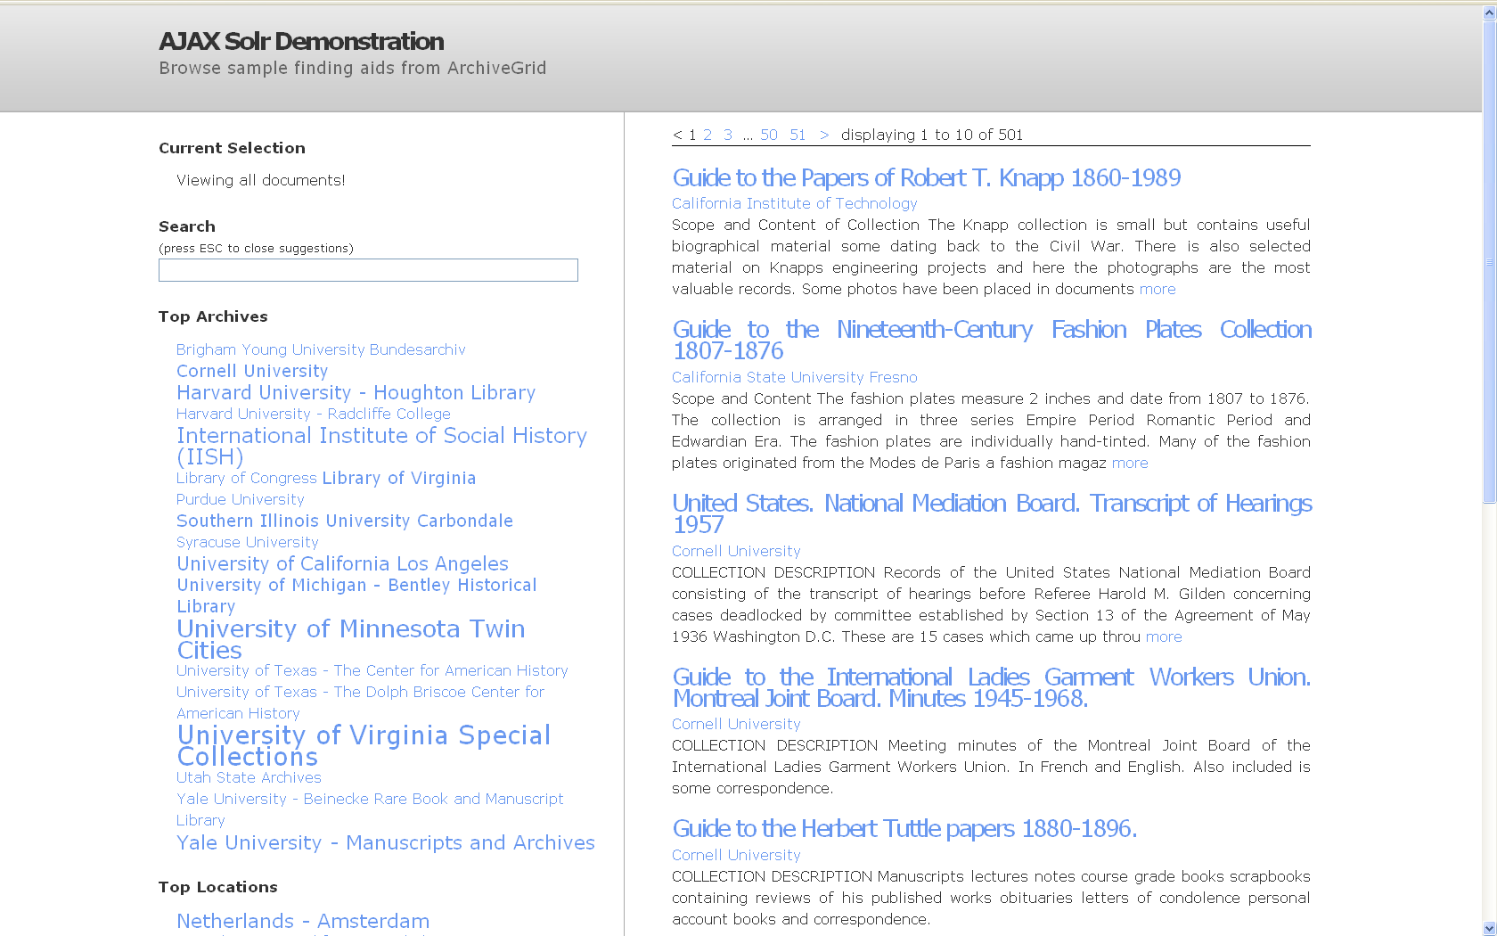
With the evolvingweb Solr/AJAX UI
Notes:
I wasn’t happy with that default interface, so went looking on the web for code I could use to quickly create a new one. A search for “solr ajax” found a base of code, well documented with a tutorial and free to download and use, from evolvingweb. They based their work on a project created by a developer during Google’s 2008 summer of code. I liked its design, so I downloaded the code and made a few minor changes.
Transferring the code back to our new server gives an entirely different look to the application. The evolvingweb code uses a widget design to plug in word-cloud facets

Slide 19
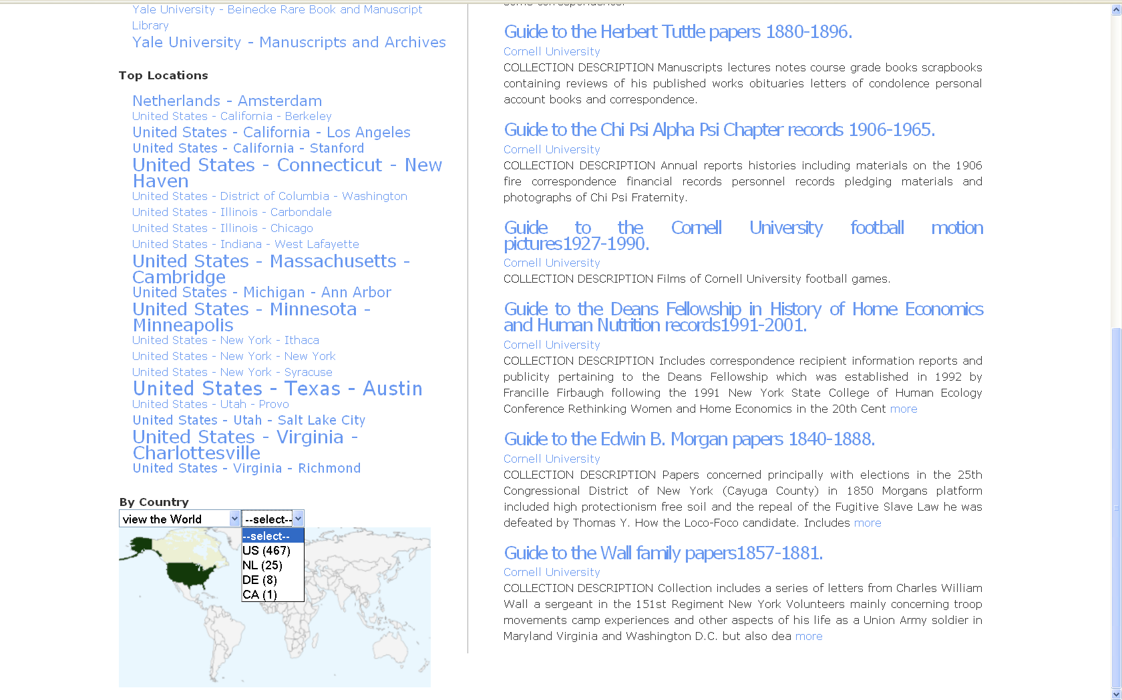
Including facet and map widgets
Notes:
And a map to search by country. The country search is new, here … not available in ArchiveGrid. But ArchiveGrid’s other functions are, such as linking from a matching finding aid title to its web version on the providers site, or to their contact information for access to the archive.
So, in quick order, we have a highly-scalable, externally visible, functionally equivalent version of ArchiveGrid running in the Amazon computing cloud.

Slide 20
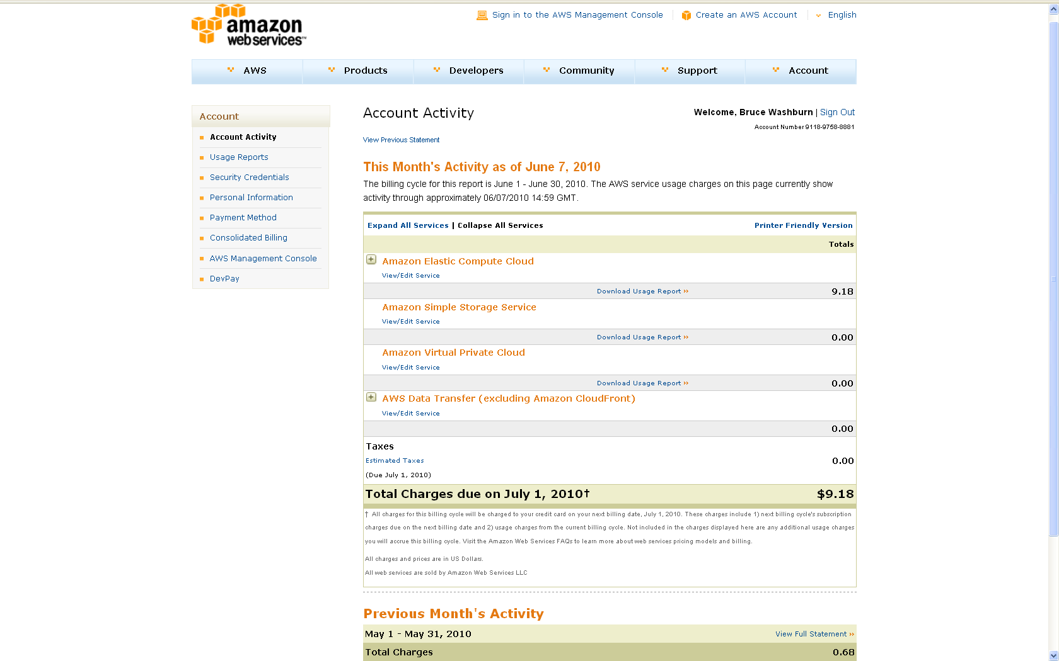
But at what cost?
Notes:
Costs can be quite low, if compared directly to the costs for managing a similar enterprise locally. That can be beguiling, and is sometimes the beginning and end of the conversation about cloud computing.
But it isn’t the whole story. It doesn’t necessarily represent a cost reduction if you’re not able to make corresponding reductions in local IT support, and those are often sunk costs at least in the near term. I think a more interesting evaluation is in considering how much time is saved (in the time equals money sense), and how many opportunity costs are not paid by being able to move ahead more quickly on a project, to reiterate and refactor, and to develop multiple projects if needed.

Slide 21
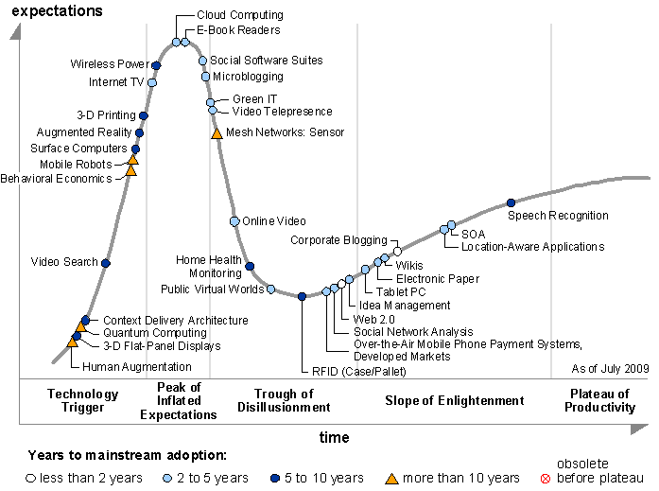
Gartner Research: Hype Cycle of Emerging Technologies, July 2009
Notes:
I’ll switch gears now and take a broader look at cloud computing.
In last year’s Emerging Technologies Hype Cycle report from Gartner Inc., they placed cloud computing on the precipice of the “Trough of Disillusionment”, which in their hype cycle model inevitably follows the peak of inflated expectations. Why might that be?
Cloud computing has been much hyped in recent years, that’s for sure. This demo I just did is a kind of hype as well. Depending on who you listen to, it’s either the silver bullet that solves all IT issues (what a cloud computing purveyor might say) or a risky venture that actually adds more cost and takes away control (what a local IT shop might say). The truth is probably somewhere in the middle, and its likely that, in the near term, there will be some notable successes but more failures of the cloud computing enterprise, consolidation in the market, and disillusionment. That’s natural and expected, I think, and not necessarily a bad thing.

Slide 22
Persistence
Compliance
Security & Privacy
Network Access
Cost
Disaster
Notes:
When people on either side of the fence consider Cloud Computing, they’ll talk about these aspects, and I’ll go over each lightly.

Slide 23
Sea Spray / clairity
http://www.flickr.com/photos/clairity/159249484/
Notes:
Persistence:
Will my cloud computing provider be there, a month from now, a year from now, ten years from now? What’s their commitment to a service level that my systems will require?
This question, like others to come, should also be asked of local IT system providers, to be fair.

Slide 24
Red Rose Cupcakes / clevercupcakes
http://www.flickr.com/photos/clevercupcakes/3189785198/
Notes:
Compliance:
High-end systems can be subject to audits for their compliance with various standards. And, as this area of technology is still evolving, some standards may require details about the underlying systems and support structures that, being handled by the cloud computing site, are not available to the site’s user. In particular, compliance with standards associated with personally-identifying information has been a concern for some. Cloud computing services, to remain viable, are working towards further evolving their operations and the standards to make this less of a concern.

Slide 25
Fox door knocker / andrecarol
http://www.flickr.com/photos/andrec1/4163690109/
Notes:
Security & Privacy:
Concerns about data loss or intrusions into data are real, both locally and in the cloud. The virtual machine environment of the cloud may trouble some people; even with encryption involved, the notion of your private data sidling up next to someone else’s on machines owned by an entirely different company may represent a loss of too much control. Again, cloud computing enterprises, to succeed, are working hard to respond to these concerns. One of their arguments can be that they’ll have the capacity to guard against security problems at a level that no single enterprise could.

Slide 26
Wire twisting – 26 / Windell H. Oskay, www.evilmadscientist.com
http://www.flickr.com/photos/oskay/4662288939/
Licensed under the Creative Commons Attribution 2.0 license
Notes:
Network Access
This is another area where the concerns are reasonable, but have remedies. If your data is in the cloud, and the network between you and the cloud provider is insufficient or unreliable, you’d be reluctant to make that move. And we’re talking about a shared network that has, in the last couple of years, had some real capacity issues. There are shorter and longer term remedies (direct, private network connections, and widescale network upgrades) that come to mind.

Slide 27
Coins / Peter Dutton
http://www.flickr.com/photos/joeshlabotnik/2143212474/
Notes:
Cost
I mentioned how the cloud computing costs, being typically represented as far lower than expected, get a lot of attention.
But as you look at the cost models, if you’re storing a great deal of information, have many transactions to support, or lots of I/O in transferring data to the site, those costs may start to add up to be unsupportable.
And, as mentioned before, there are other ways to either remedy this (redesigning the application to limit transaction and I/O costs, negotiating other arrangements with the provider) and to think about costs (when time = money, what are the savings and avoidance of opportunity costs that balance the equation?).

Slide 28
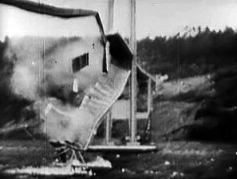
http://en.wikipedia.org/wiki/Tacoma_Narrows_Bridge_%281940%29
Notes:
Disaster
Some anticipate that, before long, there will be a high-profile disaster for a major cloud computing provider, leading everyone to re-evaluate the hype and reconsider its viability. That could happen. A disaster might take the form of a significant and unrecoverable loss of data, or a major intrusion on customer e-commerce information, or widespread identify theft.
Again, cloud computing enterprises are working hard to avoid this. But, as the Tacoma Narrows Bridge disaster reminds us, it isn’t always possible to prevent that kind of collapse, as a technology is still evolving. The bridge builders actually got to the point of completing the bridge and driving cars on it before it, on a very windy day, fell to pieces. One thing we should remember is that what was learned from that disaster (the effects of aero-elastic flutter) was applied to every suspension bridge built after 1940. We build them, use them, and drive on them. It may be part of the life cycle, or hype cycle, for cloud computing too, but won’t necessarily mean the end.

Slide 29
Persistence
Compliance
Security & Privacy
Network Access
Cost
Disaster
Notes:
After considering cloud computing from both sides now, we might guess that an approach we’ll see more of is a hybrid model. Activities that are considered non-mission-critical, or unsupportable at a local scale, may more to the cloud first, while customer data is guarded more closely. Small scale, but still important, applications may move to the cloud more quickly, especially if they lack an e-commerce or other personal data component.
We’ve seen this, from OCLC’s WorldCat Search API service perspective, with some mobile application developers. If the mobile application has a server component (and some do), a cloud computing service like Amazon’s can be a great fit. Some of these applications are created quickly by small staffs with limited local computing facilities. If they really succeed, though, they can demand tremendous computing capacity very quickly. An elastic computing cloud is a great fit for those applications and that growth dynamic. And, for some, if they have an e-commerce component it is handled elsewhere, in the Android Market or iTunes App Store for example.

Slide 30
What business are you in?
Notes:
I think the exercise of building an application in the cloud helps to frame that essential question, “What business are you in?”
For weather forecasters, they necessarily had to also know how to draw weather charts, at one time. No longer; all manner of maps can be produced by data and software now.
For libraries, we used to feel compelled to build our own software and systems. No one else understood our data as well as we did, and there weren’t reliable utilities to turn to. In the recent past, there has been some consolidation, though still local. For example, we’ve seen systems run within the library move to campus-wide facilities, in the academic environment.

Slide 31
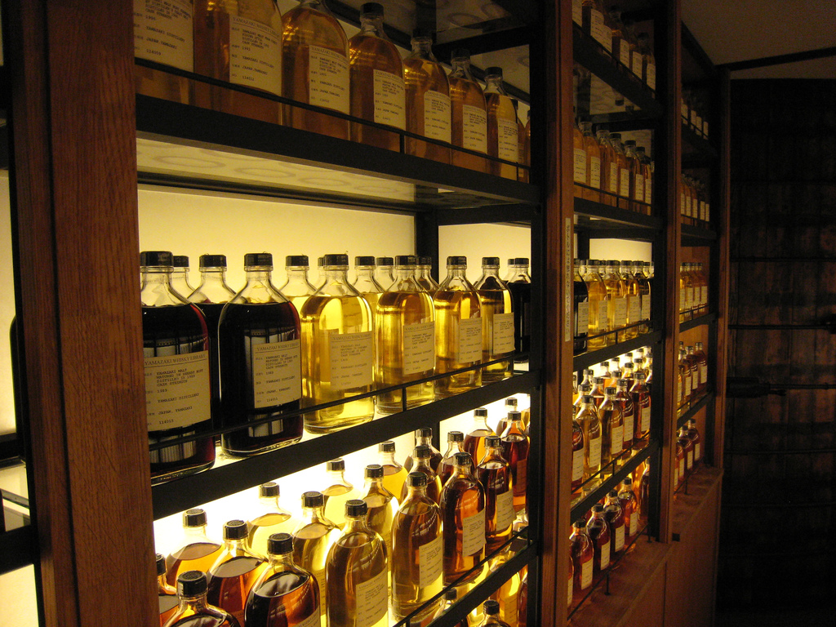
Whisky Library at Yamazaki Distillery / Ethan Prater
http://www.flickr.com/photos/eprater/1598434602/
Notes:
But our business, or our mission, is more abstractly about providing access to information. It isn’t to create a top-notch IT facility, though that was a necessity in the past.
This exercise has distilled, for me, a focus on the data … aggregating it, enriching it, thinking about its uses … and separated that from the means of production and distribution. We don’t have to invent a way to produce facets for a search result, or develop our own proprietary user interface code, or build and maintain a web server.

