Slide 1
Cloud Sourcing
Research Collections
Constance Malpas
Program Officer, OCLC Research
RLG Partnership Meeting, June 2010

Slide 2
Roadmap
System-wide Organization
Cloud Library: Who, Why, What, How
Key Findings
Implications
Next Steps

Slide 3
System-wide organization (2009)
New research theme addresses “big picture” questions about the future of libraries in the network environment; implications for collections, services, institutions embedded in complex networks of collaboration, cooperation and exchange
Parallel in economics: industrial organization
  Nature of the firm
  Behaviors of firms interacting in markets
For libraries:
  Nature of the library in a networked environment
  Behaviors of libraries interacting on the network

Slide 4
Three areas of interest
Characterization of the aggregate library resource
  Collections, services, user behaviors, institutional profiles
  Empirical investigations, data-mining
Re-organization of individual libraries in network context
  Institutions adapting to changes in system-wide organization
  Reconsideration of library service bundle, institutional boundaries
Re-organization of the library system in network context
  Multi-institutional library framework, collective adaptation
  Environmental analyses, case studies

Slide 5
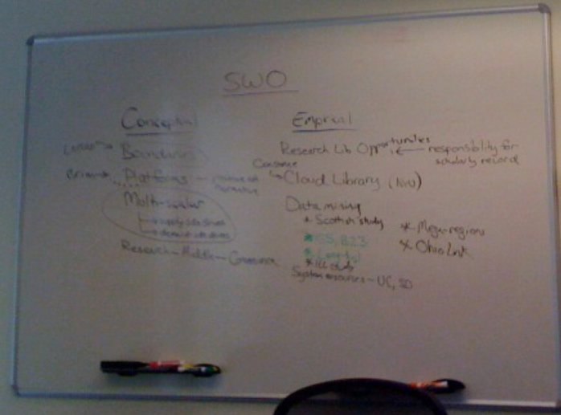

Work in progress
OCLC Research Planning Session - March 2010

Slide 6
Exemplar: Re-organization of library system
Cloud Library project (OCLC, Hathi, NYU, ReCAP)
  Case study in de-composition of library service bundle: ‘cloud sourcing’ research collections
  Data-mining Hathi and WorldCat to determine where cost-effective reductions in print inventory can be achieved for individual libraries (micro economic context)
  Characterizing optimal service profile for shared print/digital service providers; collective market for service (macro economic context)
  Exploring social and economic infrastructure requirements; technical infrastructure a separate (and secondary) challenge
Notes:
A project examining the requirements and probable timeline for a large-scale externalization of the academic library’s traditional repository function.

Slide 7
Organization of Economic Activity
Consumer goal: direct local resources toward high-value collections and services, externalize operations that do not demonstrably enhance institutional reputation
Provider goal: expand base of participation to derive maximum economic value from resource/inventory
Academic library: advance research, teaching mission with dynamic service portfolio, no longer reliant on ‘comprehensive’ local print inventory
print collection continues to deliver value but value not dependent on local management

Slide 8
Premise
Emergence of large scale shared print and digital repositories creates opportunity for strategic externalization of repository function
Reduce total costs of preserving scholarly record
Enable reallocation of institutional resources
Support renovation of library service portfolio
Create new business relationships among libraries
A bridge strategy to guarantee access and preservation of long-tail, low use collections during p- to e- transition
Notes:
The goal is not to remove print collections from local libraries, but to enable a redistribution of library resource sufficient to ensure that collective print preservation objectives can be met and libraries can more fully embrace a role in acquiring and preserving the ‘next generation’ of scholarly outputs.

Slide 9
Research questions
To what degree can academic libraries effectively externalize management of legacy monographic collections to large-scale print and digital repositories under prevailing circumstances?
Under what future conditions is a large-scale transfer of operations likely to occur? What changes in the current system are needed to mobilize a significant shift in library resource?
Who benefits from this change? What value is created?
Notes:
Feasibility – is there evidence that the emerging infrastructure of shared repositories can enable a change in collection management?
Necessary circumstances – assuming current infrastructure isn’t adequate to motivate change, what needs to change?
Economic value, motivation – how will this change affect the broader library system – does everyone benefit equally?

Slide 10
Landscape
Academic off-site storage
01010101010101
01010101010101
10101010101010
01010101010101
10101010101010
01010101010101
25 years
+70M vols.
20 months
+6M vols.
HathiTrust
Will this intersection create new operational efficiencies?
For which libraries?
Under what conditions?
How soon and with what impact?

Slide 11



Who: Role Models
Consumer: NYU
  Research institution with international reputation
  Libraries in the midst of a phase change: shift to digital
  Space pressure acute; collections move ‘up the river’
  Change driven by strategic objectives, not (just) urgent proximate need
Shared Print Provider: ReCAP
Massive inventory from 3 major research repositories (8M items)
Ongoing transfers, collection growth is assured
Physical proximity
Shared Digital Provider: Hathi
  Represents majority share of mass-digitized library content (6M vols)
  Explicit commitment to maximizing scholarly access
  Exploring new business models, beyond content contributors

Slide 12
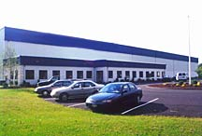
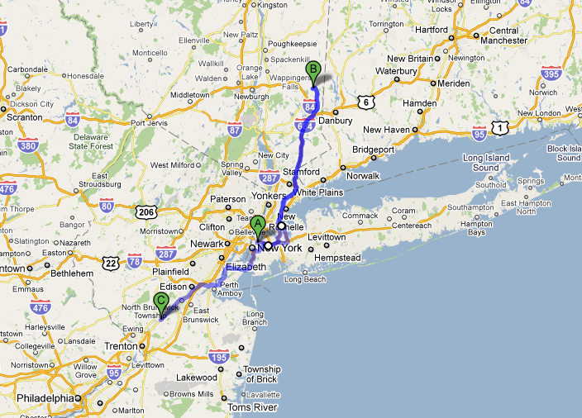

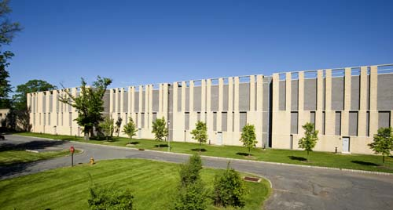
What: Options, Opportunities, Obstacles
A distinction with a difference
Incremental relief or
transformation of library model

Slide 13
Starting point: hypotheses, assumptions
Digitized monographs in the public domain, an easy win
  Shared print provision: insurance, just-in-case access
  Shared digital provision: access and preservation
Limited to holdings in ReCAP facility & Hathi
  State-of-the-art preservation environment
  Vast inventory, ‘dual duplication’ rate (print + digital) will be high
Google Book Search Settlement will enable expansion
  Institutional subscription will provide access to in copyright titles
  Shared print / digital providers offer preservation guarantees and on-demand print options sufficient to satisfy researcher needs

Slide 14
How: Methodology
Examine intersection of monographic holdings in NYU Libraries, Hathi Library and ReCAP storage facility
  Identify local holdings for which surrogate print/digital access might be negotiated; focus on public domain
Characterize minimum service requirements sufficient to enable reduction in local inventory
  Assess feasibility of meeting stated requirements in view of current repository profiles

Slide 15
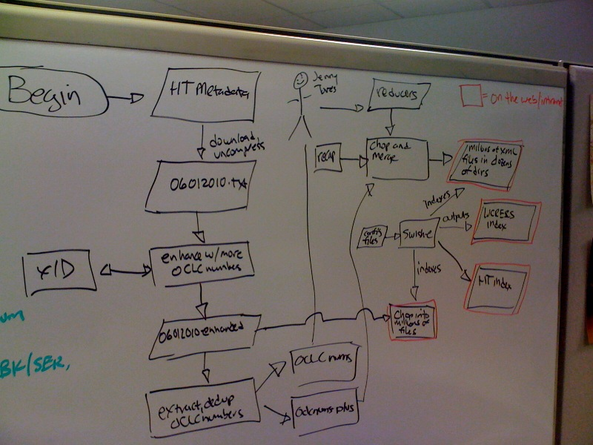
The Goldberg Variations
The Rube Goldberg Variations
Putting the full capacity
of OCLC Research to the test

Slide 16


How: Aggregation, Analysis
Harvest Hathi metadata
Extract, de-duplicate OCLC nos.
xID to identify missing numbers
Concatenate OCLC nos.
Extract WorldCat metadata
Merge Hathi and WorldCat metadata
Enrich with ReCAP metadata
Process, index
Analyze,
re-factor

Slide 17
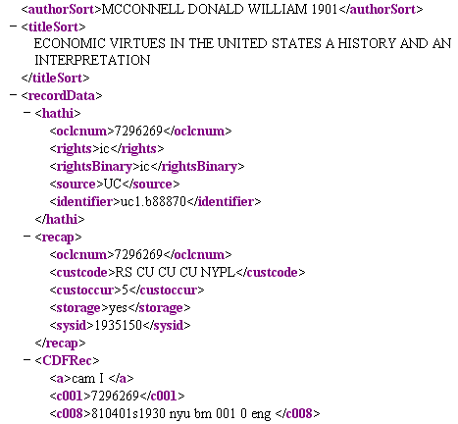
A glimpse of the project test-bed
>29 million XML documents
>3 million unique titles
Supports longitudinal analysis of mass-digitized corpus
Suggests implications for redistribution of print inventory
Hathi segment
ReCAP segment

Slide 18
Key findings
Mass digitized monographic corpus already substantially duplicates academic print collection
  30% or more of titles in local collection have been digitized
Extant inventory in large-scale shared print repositories substantially mirrors digitized corpus
  ~75% of mass-digitized titles already ‘backed up’ in one or more preservation repositories (ReCAP, UC Regional Facilities, CRL, LC)
Opportunity to benefit from externalization is widely distributed; every academic library is affected
  Potential market for service is broad; aggregate savings significant
Maximum benefit will be achieved when distribution network for in-copyright content is available
  Public domain content inadequate to mobilize collective resources

Slide 19
Cloud sourcing: mass digitized titles @ NYU
Potential space recovery is sizeable…
But dependent on access to in-copyright content

Slide 20
Cloud sourcing: the shared print paradox
Less than 30% of total space savings is achievable if ‘dual duplication’ in a regional repository is required…
Shared digital
If further restricted to public domain …
yield is 2%
Shared digital
Shared print: ReCAP
Shared print

Slide 21
The right stuff, in the wrong place?

Slide 22
In short
Regional supplier with vast inventory cannot deliver
adequate ‘value’ as surrogate provider
Why?
Extant storage inventory bears little resemblance to average academic collection
Transfer policies motivated by depositor priorities, not collective interests
This could be remedied by moving more widely held, moderately used content to shared repositories;
or, by expanding the scope of participation to multiple providers

Slide 23
With four potential providers…
+80% of total space savings is achievable if distributed preservation inventory is leveraged
Shared print: ReCAP, UC RLF, CRL, LC
Print distribution option essential for in-copyright material
Shared digital

Slide 24
A global change in the library environment
<- - In a year’s time, the sea level may be here - ->
is your library prepared?

Slide 25
Implications: Shared Print
A small number of repositories may suffice for ‘global’ shared print provision of low-use monographs
Generic service offer is needed to achieve economies of scale, build network; uniform T&C
Fuller disclosure of storage collections is needed to judge capacity of current infrastructure, identify potential hubs
Service hubs will need to shape inventory to market needs; more widely duplicated, moderately used titles
If extant providers aren’t motivated to change service model, a new organization may be needed

Slide 26
Implications: Shared Digital
University and library advocacy needed to ‘unlock’ collective resource in absence of GBS settlement
  Pareto principle doesn’t apply here; 20% access isn’t sufficient
Expand Hathi’s efforts to make current published scholarship ‘part of the fabric’ available alongside mass-digitized retrospective collections
  University presses can maximize presence and impact
Maximize value of resource by expanding base of content and capital contribution
  Consumer institutions will establish the expectation

Slide 27
More work is needed
Close study of public domain corpus – what is its present scholarly value, how can it be enhanced and enlarged?
Systematic examination of post-digitization demand for print monographs – what does existing body of evidence tell us about ‘carrying capacity’ of aggregate resource? OhioLINK, BorrowDirect, ReCAP, Hathi
Characterize total value of Hathi resource in library network – how much value is created, for whom, and who pays?

Slide 28
What you can do, today
If your library has significant off-site inventory and an interest in shared print provision: swap your symbol
  Raise visibility of preservation resource as a community asset
Rigorous, internal library assessment of what an optimal redistribution will accomplish, how much change is needed, on what timeline, toward what end
  Concrete requirements will enable service providers to respond
Facilitate candid dialogue with faculty about long-range preservation requirements and library strategy
  Faculty may be more receptive to change than library staff

Slide 29
Acknowledgments
Project staff:
Michael Stoller, Bob Wolven, Matthew Sheehy (NYU & ReCAP)
John Wilkin, Kat Hagedorn, Jeremy York (HathiTrust)
Roy Tennant, Bruce Washburn, Jenny Toves (OCLC Research)
Sponsors:
Carol Mandel, Jim Neal, Jim Michalko
Funder:
Andrew W. Mellon Foundation

Slide 30
Thanks for your attention
Constance Malpas
malpasc@oclc.org

Slide 31
Next up:
4:00 PM
Lightning Rounds
(Buckingham)

