Slide 1
Leveraging Names with Linked Data
Karen Smith-Yoshimura
Ralph LeVan
2010 RLG Partnership Annual Meeting
Chicago, IL
9 June 2010

Slide 2
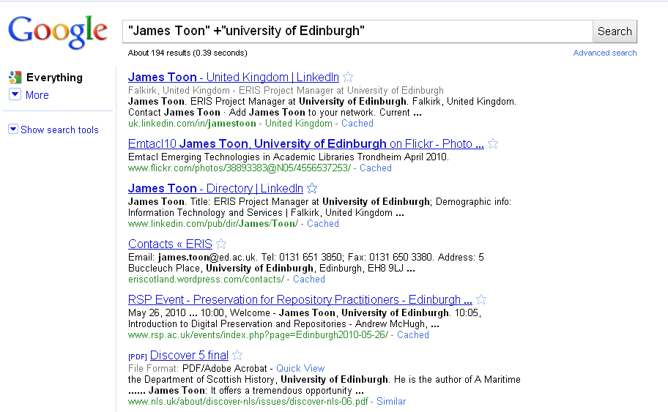
Our community searches for names…
Notes:
Our community has a variety of reasons for searching names. Discovery – who is this person, what has he or she written or presented. Evaluation – Reviews, assessment by peers. What citations are there by or about the person? Is the person authoritative? And often the first step is to (click) Google ‘em! (James Toon is one of our presenters in the session on supporting research dissemination.)

Slide 3
What we like to know about names
At least one form of name
Life events, with dates if known: origin, place(s) of output, knowledge domains, institutional affiliations…
Associated entities (role and what relationship is)
At least some works associated with the name
Short biographical history
Unique identifiers from each source
From Networking Names report
oclc.org/programs/publications/reports/2009-05.pdf

Slide 4
Some efforts to leverage names
WorldCat Identities
A page for each name in WorldCat
Virtual International Authority File
A merge of twenty national-level authority files
UK Names Project
ISNI
ORCID
Support for linked data

Slide 5
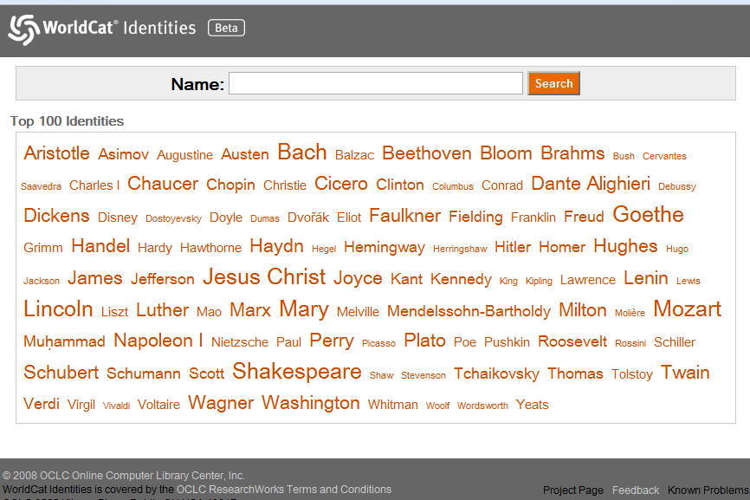
WorldCat Identities

Slide 6
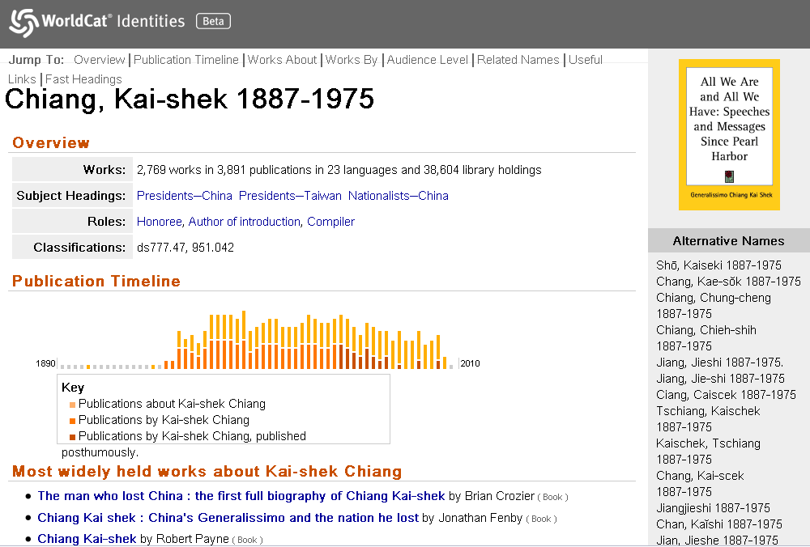
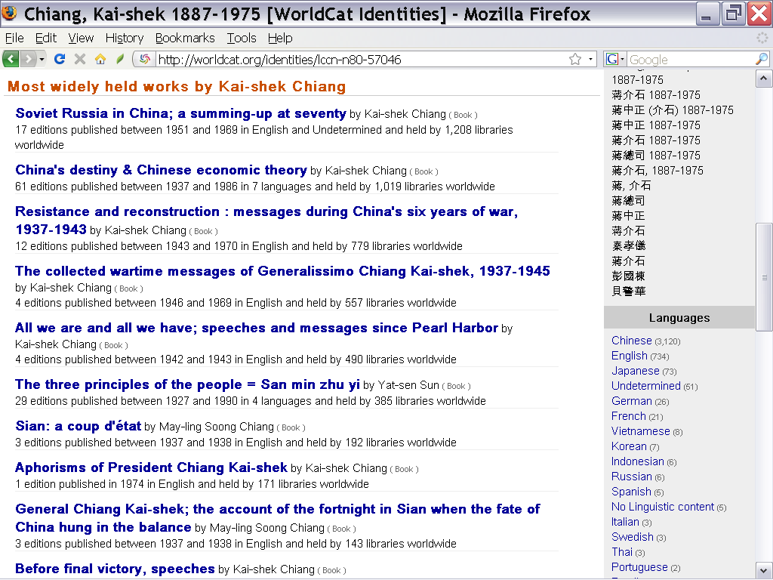
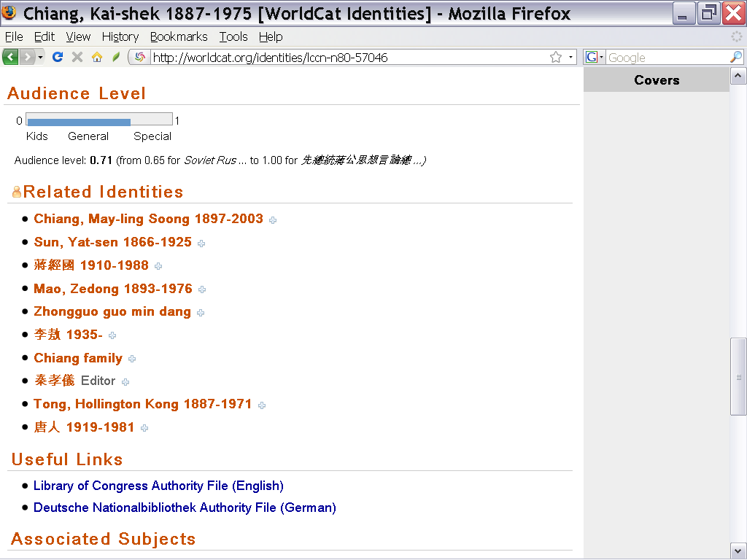
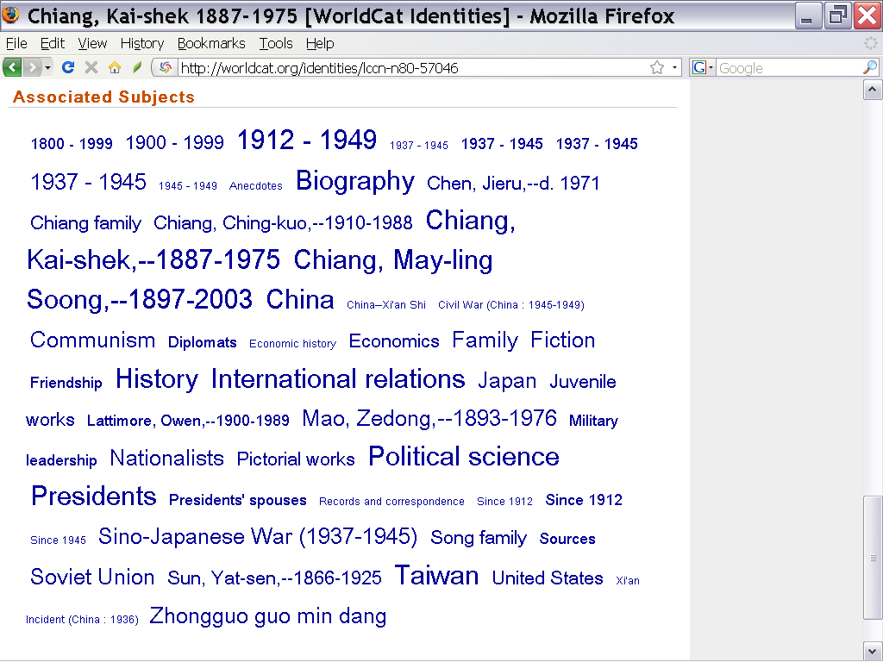
Notes:
6
Smith-Yoshimura & Hickey
Names and Identities

Slide 7
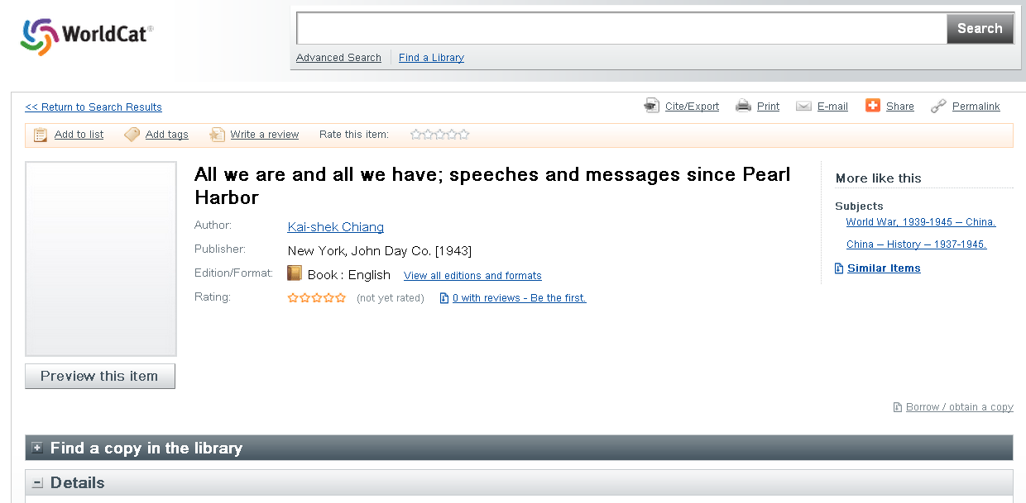

Slide 8
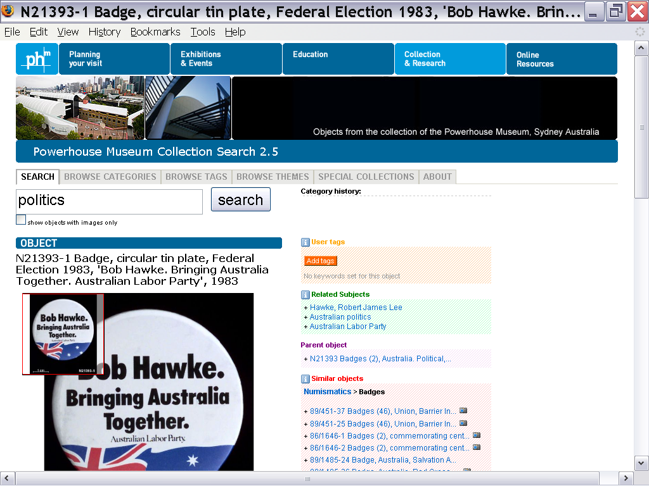
Notes:
Names and Identities
Smith-Yoshimura & Hickey
8

Slide 9
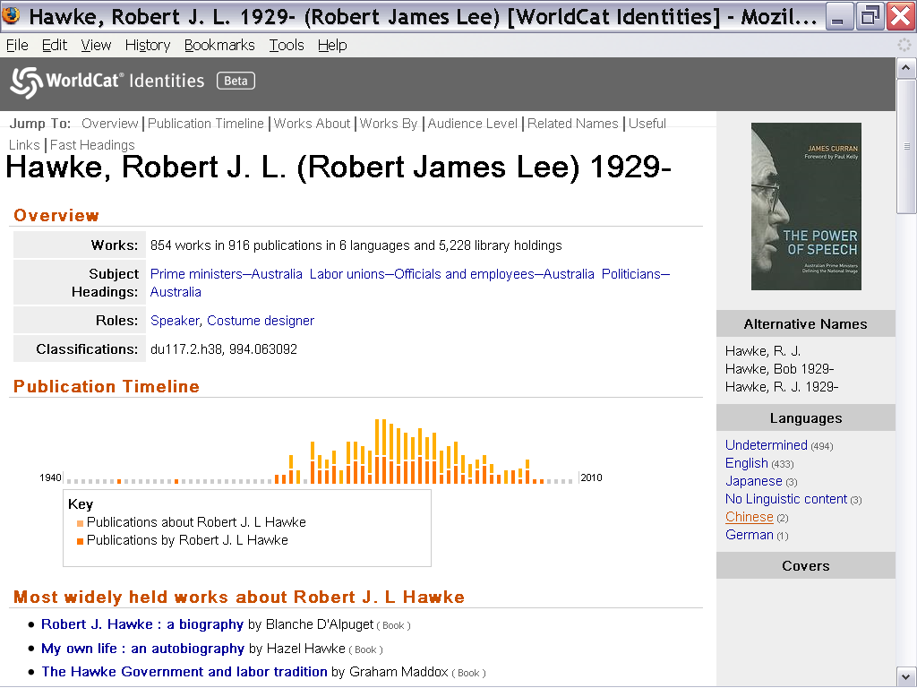
Notes:
Names and Identities
Smith-Yoshimura & Hickey
9

Slide 10
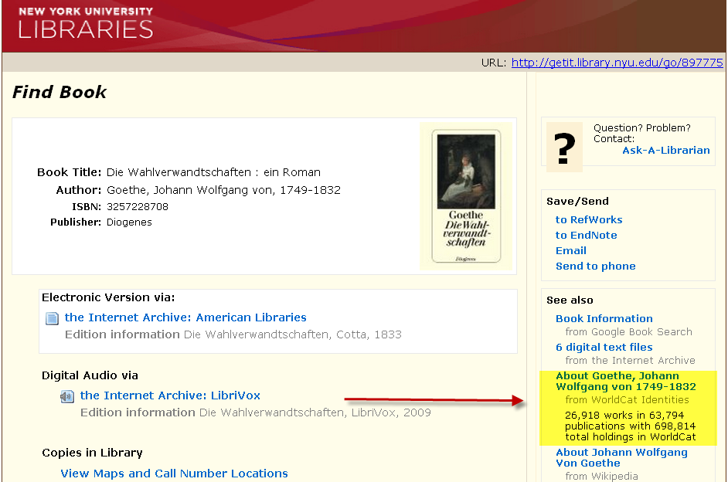
Links to http://worldcat.org/identities/lccn-n79-3362

Slide 11
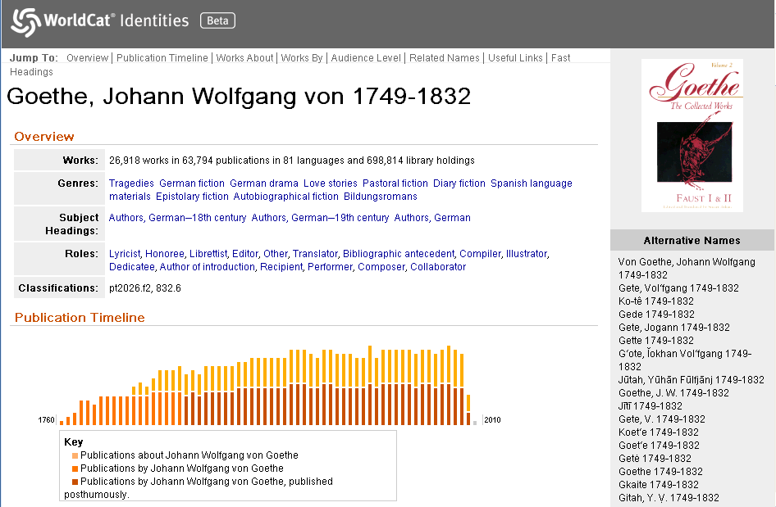

Slide 12
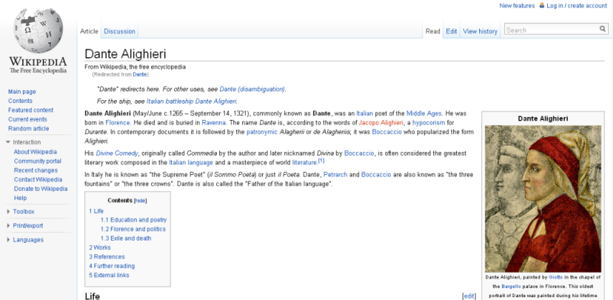
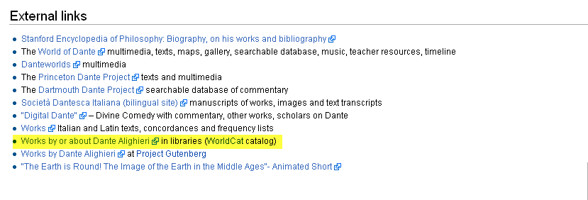
http://worldcat.org/identities/lccn-n78-95495

Slide 13
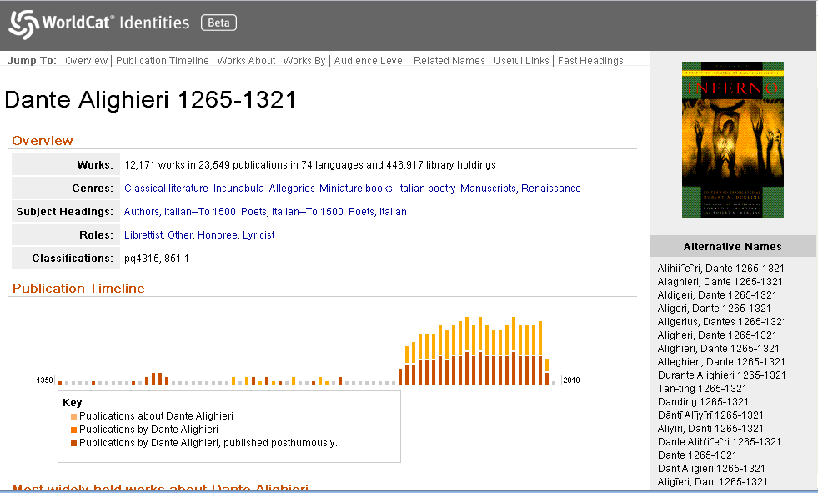

Slide 14
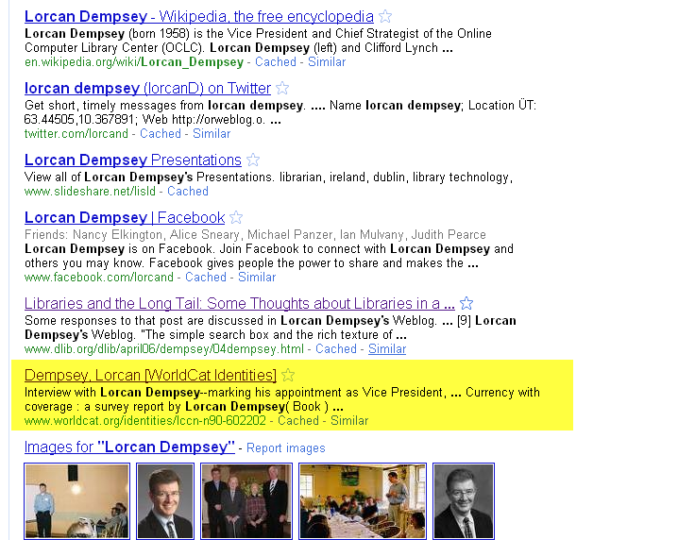
First page of
Google results

Slide 15
Virtual International Authority File
Matches names across 20 authority files
17 million name records
13 million personnas
Jointly run by LC, BnF, DNB and OCLC (hosted by OCLC)
Notes:
VIAF has been going on for more than 5 years. Run by 4 institutions, but most of the rest of the members are very active participants.

Slide 16
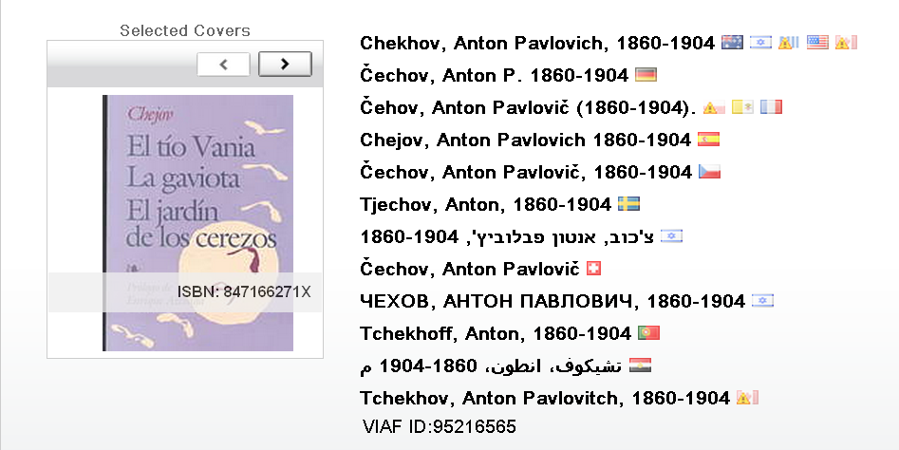
One persona, many representations …
http://viaf.org/viaf/95216565
Notes:
VIAF is all about creating links between existing files of names. The result is a VIAF record that shows information derived from the cluster of linked name records and associated bibliographic records.

Slide 17
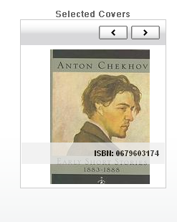
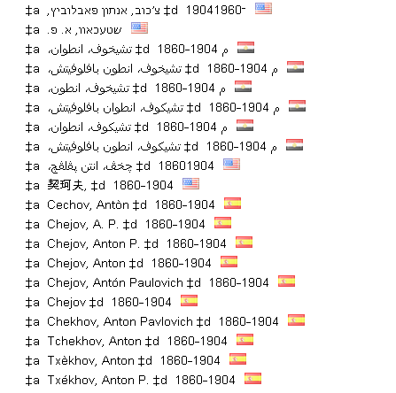
… with lots of alternate forms
Some of the over 200+ alternate forms

Slide 18
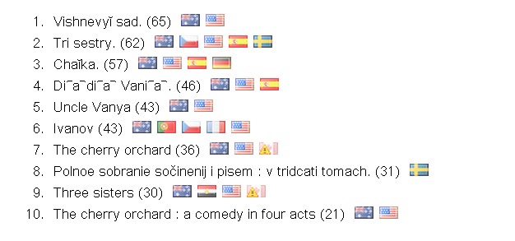
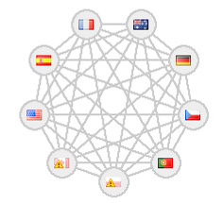
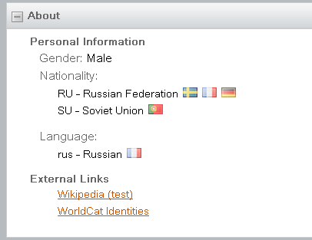
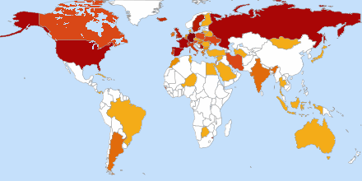
Notes:
The compilation of that information in one place yields quite a bit of information about the names and enables some quite interesting displays.

Slide 19
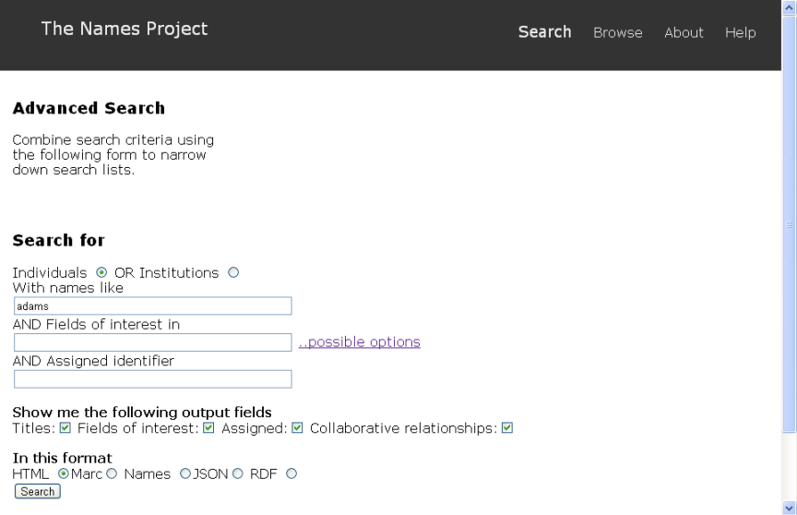
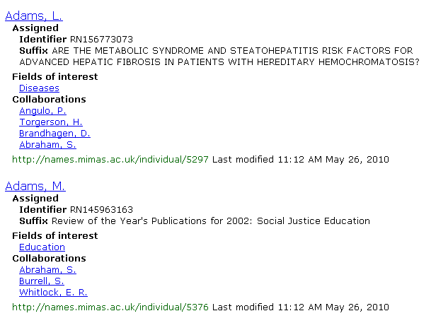
UK Names Project
Notes:
The Names Project is a collaboration with MIMAS (data center at the University of Manchester) and the British Library, funded by JISC (Joint Information Systems Committee). It began in 2007 and has developed a prototype name authority system for UK repositories of research output. Amanda Hill, the project manager, served on the RLG Partners Networking Names Advisory Group and Thom Hickey and Karen Smith-Yoshimura serve on the Names Expert Panel.
As of May 2010 the prototype had 5,697 individuals and 697 institutions. Output is provided in HTML, MARC, JSON, and RDF.

Slide 20
Participation in other names efforts
ISNI (International Standard Name Identifier)
Driven by ‘rights’ holders and publishers
Need standard way to exchange information
OCLC participating in standards effort, matching test files — VIAF may be used as base file.
ORCID (Open Researcher and Contributor ID)
Driven by scientific publishers, primarily authors of STM journal articles
Need to exchange information, most “social”.
OCLC participating in group
Notes:
ORCID is fairly new, and wants to make their systems more usable. OCLC is participating in the group, and will possibly share metadata and work on matching. ORCID is the most social of names efforts, including claiming IDs and interactive verification of associated works.

Slide 21
Linked data
“… a method of exposing, sharing, and connecting data via dereferenceable URIs on the Web.”
- Wikipedia
Bridges the gap between our technologies and the rest of the world’s

Slide 22
Why linked data?
Share data in a non-library-centered exchange format.
MARC not popular with the Web community
Dublin Core not semantically rich
Provide a framework for sharing semantically rich data in a Web-friendly way.
Participate in the Semantic Web.

Slide 23
The Semantic Web dream
“I have a dream for the Web [in which computers] become capable of analyzing all the data on the Web – the content, links, and transactions between people and computers.”
—Tim Berners-Lee

Slide 24
Semantic Web Syntax: RDF
Resource Description Framework: Markup syntax exposing semantic richness of MARC21 and structural richness of AACR2
For everything you want to talk about
Give it a URI (Universal Resource Identifier)
Provide useful information at that URI
Talk about things
Not just descriptions of things
Use structure (e.g. metadata)
Link to other resources
Notes:
Resource Description Framework (RDF)
Links between Web resources
The links themselves are described with URLs

Slide 25
Why Universal Resource Identifiers?
Modern equivalent for control numbers (like LCCNs) that we can associate data to.
Bonuses:
Domain name tells you who created the URI
Since usually includes an HTTP URL, have something to click through to.
Example
<contact:Person rdf:about="http://www.w3.org/People/EM/contact#me"> <contact:fullName>Eric Miller</contact:fullName> </contact:Person>
Notes:
Resource Description Framework (RDF)
Links between Web resources
The links themselves are described with URLs

Slide 26
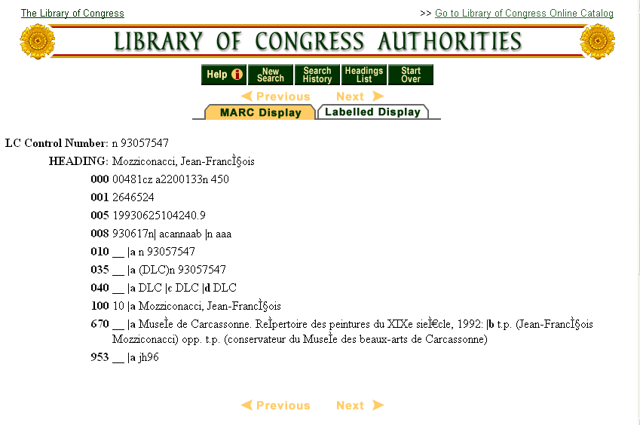

Slide 27
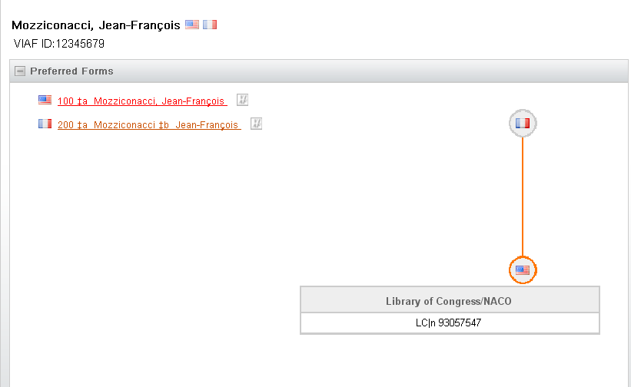
VIAF data translated into RDF
<rdf:RDF>
<viaf:NameAuthorityCluster rdf:about="viaf/12345679> …
<viaf:EstablishedHeading
rdf:about="viaf/12345679/#Mozziconacci,+Jean-François“>
<viaf:NameAuthority
rdf:about="viaf/12345679/#LC%7Cn++93057547“>…
<foaf:Person rdf:about="viaf/12345679/#foaf:Person“>…
<skos:Concept rdf:about="viaf/12345679/#skos:Concept“>…
</rdf:RDF>

Slide 28
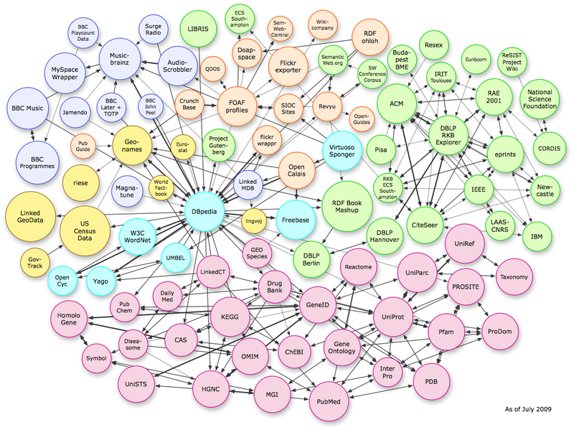
Taking off?
Notes:
DBpedia is a community effort to extract structured information from Wikipedia and to make this information available on the Web. DBpedia allows you to ask sophisticated queries against Wikipedia, and to link other data sets on the Web to Wikipedia data. We hope this will make it easier for the amazing amount of information in Wikipedia to be used in new and interesting ways, and that it might inspire new mechanisms for navigating, linking and improving the encyclopaedia itself.
The DBpedia knowledge base currently describes more than 2.9 million things, including at least 282,000 persons, 339,000 places (including 241,000 populated places), 88,000 music albums, 44,000 films, 15,000 video games, 119,000 organizations (including 20,000 companies and 29,000 educational institutions), 130,000 species and 4400 diseases. The DBpedia knowledge base features labels and abstracts for these things in 91 different languages; 807,000 links to images and 3,840,000 links to external web pages; 4,878,100 external links into other RDF datasets, 415,000 Wikipedia categories, and 75,000 YAGO categories. The knowledge base consists of 479 million pieces of information (RDF triples) out of which 190 million were extracted from the English edition of Wikipedia and 289 million were extracted from other language editions.

Slide 29
Zhang Yimou: What could be
BBC
Wikipedia
VIAF
ISNI/ ORCID
NY Times
National
Library of China
A&I Metadata
Library
Catalogs
Library
Catalogs

Slide 30
Discussion
How might you take advantage of linked data for names in your environment or services?
What uses could others make of the names you contribute to linked data resources?
What else is needed?
Contacts:
Karen Smith-Yoshimura smithyok@oclc.org
Ralph LeVan levan@oclc.org

Slide 31
Next up
4:00
Lightning Rounds
Buckingham

