Slide 1
Library Mobile App Development
Current conditions and strategic choices
Bruce Washburn
Software Engineer
OCLC Research
TAI CHI Webinar Series
Technical Advances for Innovation in Cultural Heritage Institutions

Slide 2
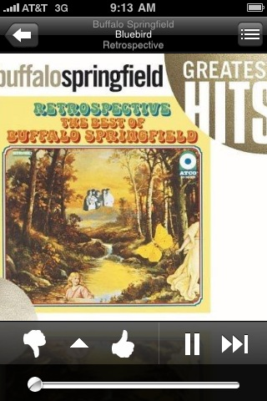
There’s something happening here …
Pandora Radio
Notes:
Today’s discussion will focus on library mobile app development, but before we begin I’ll highlight a different type of application.
Here’s a screenshot of the Pandora Radio iPhone app. Pandora builds upon the Music Genome Project database to provide a way to select songs or artists and find music that’s like your favorites, and that you’d probably like.
I ran across some old Buffalo Springfield music in Pandora recently, and was reminded of their song “For What It’s Worth”, that begins:
“There’s something happening here, what it is ain’t exactly clear …”
In this discussion of the sometimes murky world of library mobile app development, I’ll attempt to offer some clarity and focus. Or, at least, to be clear about one OCLC developer’s perspective on library mobile apps.

Slide 3
Overview
“library”, “mobile”, and “app” – some definitions
The landscape
Native vs. Web apps
The Hype Cycle
Some suggestions
Notes:
I’ll begin by defining my terms, for what might be generally thought of as a library mobile app.
Along the way I’ll have a chance to take a look at some library mobile apps and, through those examples, survey the landscape.
I’ll talk a bit about native vs. web apps for mobile devices.
I’ll also consider the Hype Cycle as it might apply to our work on library mobile apps
And I’ll conclude with some suggestions about where we might most productively place our efforts in the near term.
My interest in library services on mobile devices goes back a ways.
The first mobile interface I designed was for a WorldCat-like discovery system called RedLightGreen, produced by RLG (the Research Libraries Group), about 8 years ago. That didn’t get much promotion or use, but I learned quite a bit about the challenges of developing an effective system within the significant constraints of an early 21st-century mobile device. Web interfaces for mobile devices in those days were written in WML (Wireless Markup Language), which is more like XML than it is HTML, and represented the application as if it were a deck of cards. It reminded me a bit of developing Hypercard applications for the Mac in the early 90’s.
When the iPhone was relatively new, I prototyped an experimental web interface to WorldCat, making use of its APIs for Search and for Identities. That interface was offered by OCLC for a short while, in the Fall of 2008 until the Summer of 2009. And, in building it and seeing how it adapted to other mobile devices that supported the WebKit browser (like iTouch and Android devices), I learned something about the improved functionality and lower barriers to adoption of that modern-day mobile browser.
More recently I’ve done some development on the Android platform, testing an idea for an application that maintains a list of books. This application also uses the WorldCat Search API, but gave me a chance to develop in the native Android environment, and to see how easy it was to tap into some of the features of the Android phone, including its camera (for barcode scanning), voice recognition (for searching), and Geo-location (to find nearby libraries).
But primarily I’ve been working with other developers who are using the WorldCat APIs to enrich their mobile applications with library data, as I’m one of the developers of the WorldCat Search API.
A common thread of my mobile development experience is that in each case I pursued an early-adopter’s enthusiasm for a new technology, then had a chance to evaluate the reality of its capabilities and promise, reaching a more measured perspective over time.

Slide 4
Defining “library”
The library catalog
Library services in general
The institution providing the library
Links from the wider world
Notes:
When I talk about library mobile apps, the word “library” could mean several different things.
It could mean just the library catalog,
or that plus other services provided by the library,
or those plus other services available from the institution of which the library is one part.
Or it could mean ways in which library resources are made visible in applications constructed by those outside the library world.
We’ll look next at examples of all of these.

Slide 5
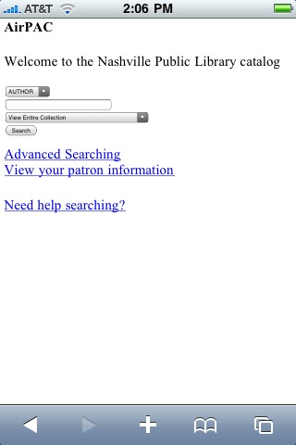
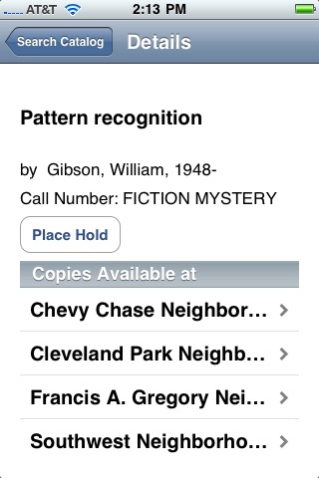
The Library Catalog
A scaled-down version of the full search interface
Search result details are also limited
Some indicate if titles are available
Some provide a way to request an item
Notes:
Some library mobile apps concentrate on the library catalog. Search and discovery of the catalog is perhaps one of the easier applications to implement quickly, in particular if the system that supports the website for the catalog offers an out-of-the-box mobile solution.
The DC Public Library application shown in one of the screenshots here also includes a path to getting information about branch libraries and hours. I thought the catalog search feature they implemented, to help a user place a hold on an item, was an important step forward in making the app behave in the way a mobile user might expect. It emulates in important ways an e-commerce transaction and meets the user about half-way. If wish my favorite public library offered a mobile interface with this feature.

Slide 6
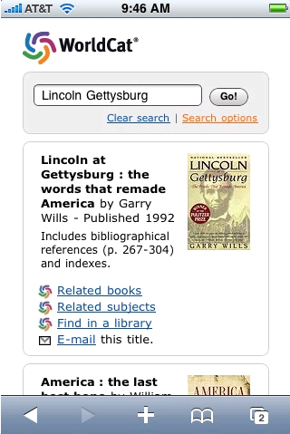
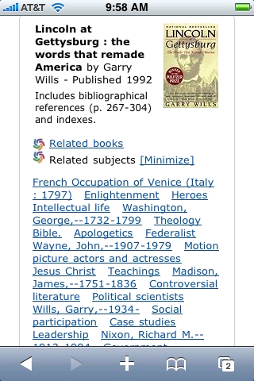
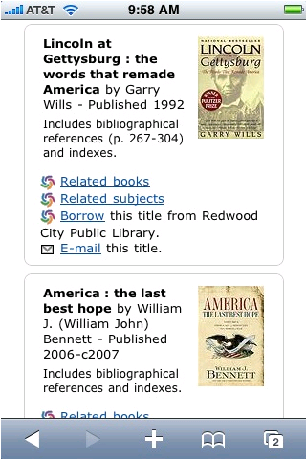
The Library Catalog
Notes:
Here’s another variant on this idea of mobilizing the catalog.
This is a mobile web application I wrote as an experiment a couple of years ago, to search WorldCat from my iPhone. I learned a couple of things along the way:
Developing the web application wasn’t very difficult for me; in fact it went quickly and was a lot of fun. But then, I already knew how to make use of the WorldCat Search API; for someone who didn’t it wouldn’t seem so easy, or fun.
No one especially needed an application that does only what this one did
This gave me a chance to experiment with the iUI interface library and better understand the WebKit browser. But, an important lesson was re-learned. The siren song of the latest thing and a fun development project is enticing, but a good idea that does something to actually improve access to library materials is what we should find harder to resist.

Slide 7
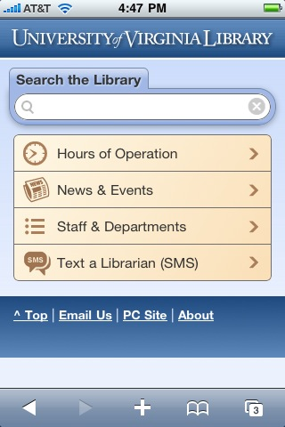
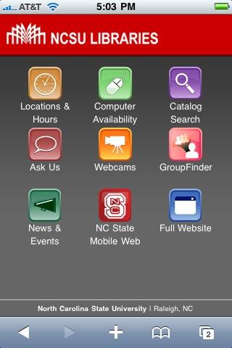
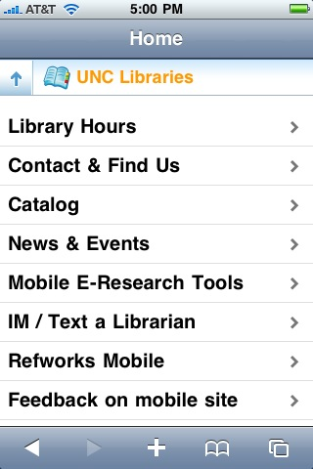
Library Services
For mobile users, the catalog is not the only service of interest
Library hours, reserving a room or computer, checking out materials, paying fines, reading e-resources
Notes:
In some recent surveys of mobile users of library services in academic institutions, the library catalog was not the most used or requested service.
Other services, like looking up library hours, reserving a study room or computer, checking out materials, paying fines, and reading electronic resources were of as much interest as searching the library catalog; in most cases much more important.
Some of the mobile interfaces shown here are doing a particularly good job, I think, of bringing those commonly-used, often-requested features to the forefront. While access to the catalog is still present, quick status checks, information lookups, and mobile contacts are also highly visible.

Slide 8
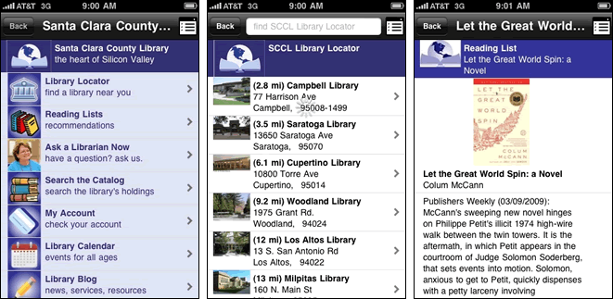
Library Services
Santa Clara County Library
Notes:
This is another example of offering mobile access to a wide array of library services, developed by Boopsie.com for the Santa Clara County Library, along with several other libraries. They’ve also developed the WorldCat Mobile app I’ll show in a bit.
There are some obvious advantages of working with a company with a proven track record in developing mobile applications:
Fast startup … with access to library data, they can often have a working application going with little delay
They’ve encountered most of the problems, and all the common ones, already
They’ve had the time to evaluate and test effective design patterns
The better options among 3rd party developers will offer excellent support and opportunities for localized branding and customization.
As Jakob Nielsen puts it, “Mobile usability is hard”. It’s good to learn from, and lean on, those who’ve been working with this technology for a while, especially if you have ambitions to do a good job of supporting a wide range of users on a wide range of mobile devices.

Slide 9
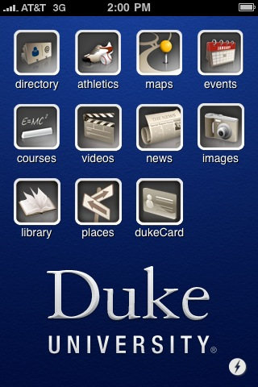
The institution providing the library
Promotion can work well for an institution-focused app, including library services
A one stop shopping advantage
Other app features provide gravitational pull
DukeMobile
Notes:
When the mobile application is intended to serve the entire institution, there are also lots of good promotional opportunities, and a chance for the library to benefit from the one stop shopping advantage that general app provides to users.
The DukeMobile app is based on the application behind iStanford. It’s the work of, initially, a small group of Stanford undergraduates. A 2008 release of their iStanford app was able to make use of data resources that made all sorts of important transactions available, including checking campus events, adding or dropping classes, etc. Interestingly, the library is not one of the featured resources in the iStanford app. This mobile application was further extended and generalized into what its developers (who formed the company Terribly Clever Design along the way) call MobilEdu, with the ambition of extending it to universities nationwide. Towards that end, Terribly Clever joined Blackboard Inc. in 2009.
I think it’s note-worthy that one of the most important advances and keys to success of the original iStanford app was not necessarily technological (though, at Stanford, the choice of an iPhone app in 2008 was probably pretty shrewd). I think it was the social work that needed to happen in order to make campus systems for class registration, etc., open and accessible to this mobile app. In the mobile context that particular kind of transaction would not only work well, but would also be a great fit for how mobile devices like the iPhone are being used by students.

Slide 10
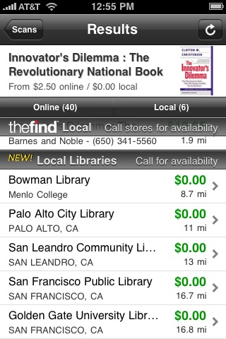
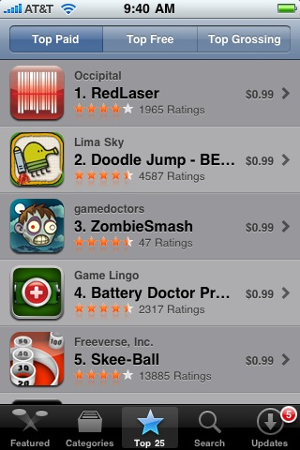
Links from the wider world
Libraries surface in shopping apps
A way for the library to be seen in the flow of popular apps, without the user having to focus first on the institution or library
RedLaser
Notes:
The library can also be found through applications that are created, maintained, and promoted from completely outside the library and its host institution.
Here’s one, an iPhone app named RedLaser. You can scan a book barcode with the iPhone’s camera and find matches for the item in online and local bookstores, and also (through a link to the Worldcat Search API) find nearby libraries that have the title in their collection.
This kind of integration of library availability can help get libraries in the flow … while we continue to promote our own systems and interfaces, our communities are going to be spending most of their time using other applications. RedLaser is (as of early April 2010) the top paid app in the Apple App Store, having been installed by 100’s of thousands of iPhone users.

Slide 11
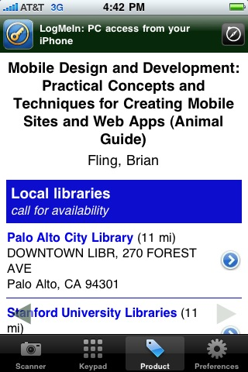
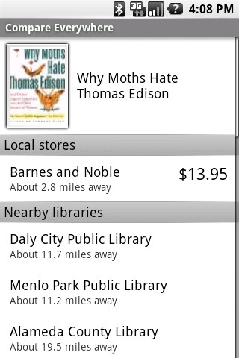
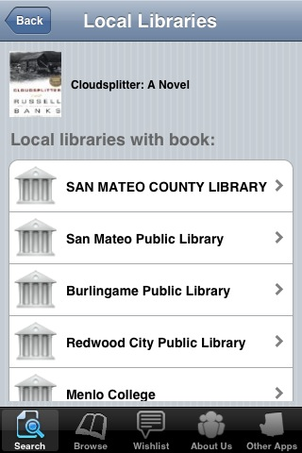
Links from the wider world
Pic2Shop
CompareEverywhere
Book Bazaar
Notes:
Here are three more examples of this kind of integration of library data in applications built, principally, for some other purpose:
Pic2Shop (for the iPhone) and CompareEverywhere (for Android phones) are both popular apps on those devices, both free, and both also use the WorldCat Search API to include links to local libraries, for the book barcodes they’ve scanned.
Book Bazaar is another iPhone app, just recently launched, and used to locate, buy, compare, or sell books, and it also incorporates nearby library locations based on WorldCat Search API results.
These examples, and the previous sets, are all to show what 'Library' might mean, and whose app might be presenting this library.

Slide 12
Defining “mobile”
A medium, a concept, devices, networks
Blurring distinctions between feature phones and smartphones
The past: slow networks, constrained data entry, small screens
The future: fast networks, bigger screens, improved keyboard input, voice recognition
Maybe it means “ubiquitous”, or “always with me”
Notes:
I’ve been using the term “mobile” as if it has only one meaning, and as if we all understand what that is.
But, depending on the context it can mean any number of things.
And when it comes to mobile devices, there isn’t any standard definition. Some people, for example, don’t consider an iTouch to be a smartphone … it lacks a phone.
Those interested in developing mobile web apps may divide the mobile device environment based on the capabilities of the device’s web browser, and that can be a useful way to determine how to gracefully degrade the functions and features of the application on less capable devices.
In the past mobile applications were very highly constrained by limited network bandwidth, awful keyboard input, and tiny displays. Mobile web applications were, in particular, hampered by a wide variety of unpredictably-behaving and barely-functional web browsers.
The iPhone is often referred to as a game changer, and in my view that is not an overstatement when it comes to the experience of applications, web or otherwise, on a mobile device. Especially with a 3G network, it offers a near-desktop experience and raised the web browser bar to a level that makes offering highly interactive web applications a practical reality. Now that Android devices and other competitors are racing to meet or exceed the iPhone’s features, the expectation is that this type of mobile experience will become increasingly affordable and commonplace.
For me, a still useful distinction for a mobile device is whether the information resources it offers can be always with me … and for me that now means having access to high-speed data networks no matter where I am, an operating system capable of using those resources without significant constraints, and a device that is small enough to be taken along without being a burden. But, prior to the iPhone, for me it didn’t mean quite all that.

Slide 13
Smartphones are still outnumbered
2009 Phone Sales
iPhones: 25 million
Other Smartphones: 148 million
All Mobile Phones: 1 billion
http://www.gartner.com/it/page.jsp?id=1306513
Notes:
It’s impressive that the iPhone has obtained so much of the smartphone market share, so quickly. Android too.
Nearly everyone in my office has an iPhone or an Android phone. Some of us have one of each.
But in the larger world that is not yet typical. It’s important to consider the community of users you’re attempting to serve and to determine what kinds of devices they’ll have access to before deciding on your approach.
That said, if the app you envision is going to require advanced browser capabilities, beyond a directory-like design pattern, the number of likely devices that will actually be used to access it changes.

Slide 14
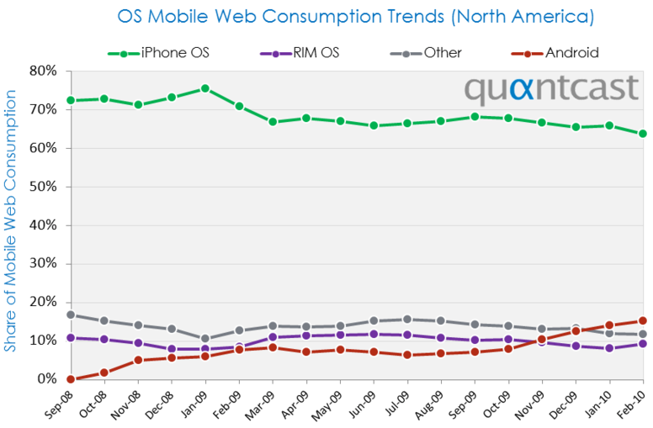
http://blog.quantcast.com/quantcast/2010/03/mobile-os-share.html
Notes:
These March 2010 statistics from Quantcast tell a few interesting stories.
One the one hand, the continuing dominance of the iPhone as a share of devices using the mobile web continues.
But on the other hand, the marketplace is subject to very rapid change, as we see that Android OS devices have gone from a 0% to a 15% market share in 17 months, doubling its share in just the last 4 months.

Slide 15
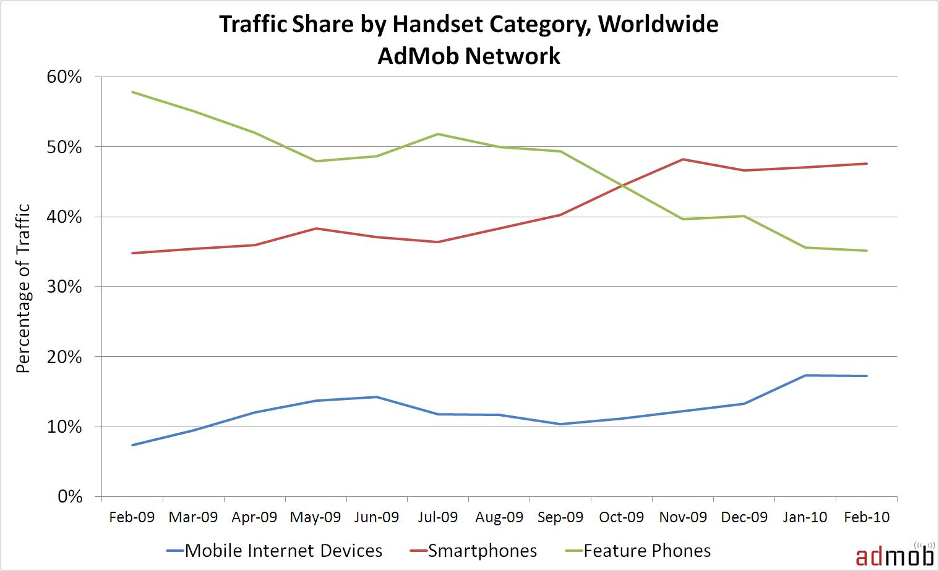
Smartphones and web browsing
http://metrics.admob.com/2010/03/february-2010-mobile-metrics-report/
Notes:
Why is web browsing apparently skewed so heavily towards smartphones?
Limited, feature-poor web browsers and costly data plans for browsing, naturally limit web browsing on some devices and by some users. So, while smartphones make up a relatively small percentage of the overall market, web browsing from smartphones represents a far larger relative share.
AdMob tracks mobile usage in a way that helps us understand how mobile users may be experiencing content.
Their definition of “smartphone” excludes the iTouch … since it isn’t a phone, it falls into the “mobile internet device” category along with other systems like the Sony PSP.
The February 2010 AdMob statistics show the trends … mobile web use from smartphones and mobile internet devices like the iTouch has overtaken feature phone web browsing in the past year, and those trends appear to be continuing. But, feature phones still represent a significant percentage of their overall traffic, around 35%.
AdMob notes: “Although the share of feature phone traffic in AdMob’s network declined from 58% to 35%, the absolute traffic from feature phones still grew 31%. This means that while the overall traffic from feature phones is growing, traffic from smartphones and mobile Internet devices is growing faster.”
This is something to keep in mind, if you’re looking at your website logs for evidence of what mobile devices need to be supported. You’ll probably find that the logs indicate that the majority of website mobile use is coming from iPhones or similarly-adept devices. Given the givens, that’s understandable, though still useful to confirm. But it doesn’t necessarily identify the mobile market opportunity for your application; mobile browsers (like Opera) that are difficult to detect in web logs may not appear. And all of the mobile devices used by your patrons, and aren’t used for browsing the web, but certainly can and will be used for well-designed device-aware applications, won’t be included in your reckoning.

Slide 16
Defining “apps”
Convenient shorthand, or horrendous jargon, depending on your point of view
An application
Might be a “native” program for a specific device
Might be a website that is designed with mobile devices in mind
Might be a widget, or an embedded feature in someone else’s application
Notes:
Along with using the term “mobile” as if we all had the same understanding of its meaning, I’ve also been throwing around the term “app”.
It’s not my favorite word for what I’m getting at, but it is getting fairly wide use … the iTunes “App Store” being just one example … as a shorthand for an application or software program.
In the world of mobile, apps are often referred to as “native” … that is, written to run on a specific device and/or operating system, or a “web” app ... Delivered to the mobile device from a web server, similar to viewing a web page on a desktop browser.
It could also be a widget, as an embedded component intended to run within an application.

Slide 17
Mobile Apps for Library Services
Some libraries have a mobile web interface
A few libraries have developed native apps
Many library websites are not mobile-friendly
Notes:
As we’ve seen, some libraries have a mobile web interface … either specifically designed for mobile, or their web site can function in a limited way on higher-end mobile phones
And we’ve seen that a few libraries have developed native apps for one or more devices. Some agencies (companies, academic institutions, others) have made an effort to create applications that run, as native apps, on a wide variety of devices. Boopsie.com, mentioned previously, has done this, providing an application that can run on just about any mobile device with a data plan.
But most library websites do not yet perform well on mobile devices, even on smartphones. However they are receiving mobile traffic now, and trends suggest that will only increase, so that should be attended to. In the next few slides we’ll take a look at some ways that is now happening.

Slide 18
Mobile Web Apps
Content is served by a website
XHTML optimized for mobile
Widely accessible
Optimizations vary a lot
May not be accepted by some mobile marketplaces, e.g., the iTunes App Store
Some mobile device features unavailable (Geo-location, local data storage, camera, inter-operability with other native apps)
Notes:
Mobile web apps run in a mobile browser from content served by a website
They are often written in XHTML, perhaps optimized for one or more different mobile browsers
Mobile apps are considered to be widely accessible (by any mobile device with a browser)
But mobile web optimizations vary a lot, from device to device and browser to browser, which poses a significant challenge for supporting a wide range of users.
They may not be distributed in device-specific channels, for example, the iTunes App Store
And they may not be able to use all device features (Geo-location, local data storage, camera, inter-operability with other native apps). This situation is starting to change, but in the present day it remains a significant part of determining the native vs. web development approach.

Slide 19
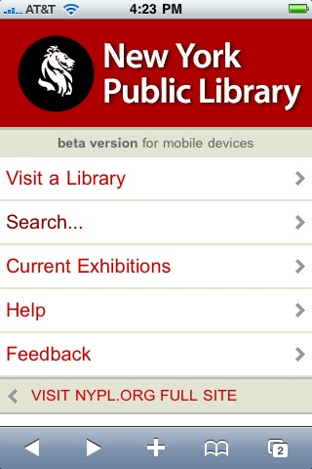
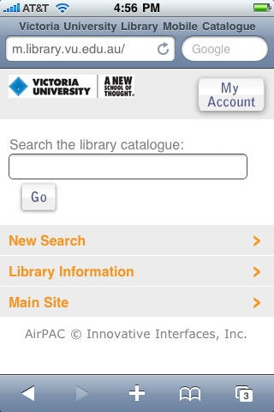
Library mobile web apps
New York Public Library
Univ. of Virginia Library
Victoria University
Notes:
Here are some example web apps. All of the screenshots are, for convenience and consistency, from either an iPhone or Android phone. For many of these applications, a less fully featured version may be available as well for feature phones.
We’ve seen some example library mobile web apps in previous examples. The NCSU library mobile site was shown earlier; it’s based on MIT’s Mobile Web open source project code, as are some others.
NYPL – m.nypl.org
University of Virginia Library -- uvalibmobile.appspot.com
Victoria University -- m.library.vu.edu.au. Innovative Interfaces AirPAC works with most mobile phones; the version pictured here is a smartphone-enabled web app, works more effectively with iPhone, Android, Palm, etc.
Some web apps for libraries support only a shallow layer of library website functions. Links can sometimes take you to the full site, which is not mobile-optimized. If that happens just when a user is about to get the information they were looking for (say, a call number, an indication of availability, a request/hold button), you can expect user frustration and dissatisfaction.

Slide 20
Mobile Native Apps
Written for a mobile operating system, e.g., iPhone, Android, Palm, etc.
Significant effort to support all mobile devices
Mobile developer communities are growing
Device features (camera, microphone, speaker, GPS) are all available
HTML5 technologies may push the pendulum back to web apps, for capable mobile browsers
Notes:
Designed to run in a particular operating system, e.g., iPhone, Android, Palm, etc.
Significant effort to support all mobile devices. By “significant” I mean it is best left to the experts.
Strong developer communities are growing around certain mobile operating systems, in particular iPhone and Android
Device features (camera, microphone, speaker, GPS) and in some cases other applications can be integrated into the app.
If and when HTML5 takes hold, we might see the functional lines further blurred between a web app and one developed within a particular operating system platform, as it promises to offer a richer interactive environment and to open up access to device features that have previously been inaccessible, including local data storage and perhaps geo-location.

Slide 21
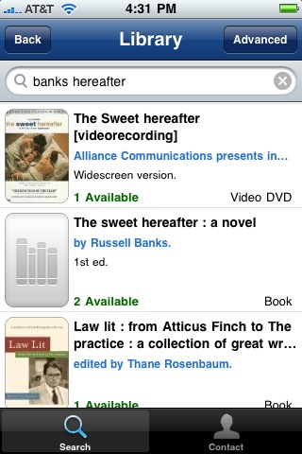
Library mobile native apps
New LIS Books
DC Public Library
DukeMobile
Notes:
New LIS Books – recently added LIS items to the University of Illinois Library Urbana – Champaign
DC Public Library – We saw this one earlier. DCPL Labs shares their iPhone app code under a Creative Commons license
DukeMobile – The DukeMobile app not only offers a library catalog search, but a wide range of information sources for the University, including courses, news, events, a directory, athletics news and schedules, videos, and images from many different library collections.

Slide 22
Strategic Choices
Access to a catalog or something else?
Native or web app?
One device or several?
App code built, bought, or borrowed?
How much to invest?
Notes:
The way forward for a library considering their mobile application development plans is clearer when these kinds of questions are addressed up front.
Based on an assessment of what your communities of users need, are you expecting to make the catalog available on mobile devices, or more than that?
Do the mobile functions, or promotion paths, or support requirements suggest a native, or a mobile web app?
Do you need to support one, or a few, or nearly all devices and browsers?
Can and should you build the app with internal resources, have a 3rd party build it, or base your application on a codebase that is shared and extensible?
How much can you invest in the development, testing, and on-going maintenance of your application?

Slide 23
Native vs. Web
Strong advocates of both
Easy to get absorbed in the arguments
As with most things in life, when determining which path to choose, the choice comes down to “it depends”
Notes:
You’ll find equally strong proponents of both native app and web app development.
That can make it hard to decide on which way to go, and it’s not hard to get bogged down in the considering the relative merits of both.
There may be certain priorities in your plans that can direct you one way or the other.
If you were planning to try and sell your application, then you’d want to be in an app marketplace, like the iTunes App Store, and that’s likely to lead you to choosing a native app as its more likely to be accepted and distributed
Similarly, if your application absolutely depended on device features that aren’t currently available to web apps, like the camera or local data storage, that would make your choice of a native app path easier
If you were confident in most or all of your users being able to effectively use a web app, effectively able to serve that application in forms that worked well on the range of expected mobile browsers in your user community, and in a position to promote, market, and support the web app without the help of a general distribution channel like the App Store, then a web app as your exclusive method of supporting mobile users could be a way to go
You can expect that some web traffic will come your way from mobile devices, and canreasonably assume that it will be mostly from some of the more advanced devices with better web browsers. You’ll want to handle that traffic, one way or the other. One way might be to attempt device detection and point those web visitors to your native app.
And, it’s useful to look around the corner and anticipate changing conditions. The research firm Gartner Inc says:
“In mature markets, the mobile Web, along with associated Web adaptation tools, will be a leading technology for B2C mobile applications through 2012, and should be part of every organization’s B2C technology portfolio.”
So, while the underlying technology for mobile apps could shift over time to what we’d call mobile web apps, they may only do so after further increases in market penetration of capable phones, and are unlikely to lower the development stakes … the need to have deep and sustained expertise available to properly design and develop mobile apps isn’t likely to change, except to increase.

Slide 24
Developing apps for one device
Sometimes it makes good sense:
You require a feature that only that device supports
The device’s market is big enough, for you
You know all of your app users have the device
You’re experimenting
Notes:
If your app required GPS, a camera, and voice recognition, you would probably pay attention to iPhone and Android OS devices, maybe to other similarly advanced phones, and perhaps not as much to some others.
If you thought your app could attract enough use to satisfy you if offered only through the iTunes App Store, and your mission doesn’t motivate you to reach as many users as possible, you might not go anywhere else.
Let’s say you were developing an app for a particular medical facility and you know everyone in the user group has been provided with a specific device; of course you’d only develop for that one.
Your idea may need testing and evolution before you invest the time and effort for wider device support. Starting with just one, and extending it to others if it proves successful, is a pattern we’re seeing. You need to be careful about this approach, though, as the support and development costs quickly grow out of bounds as more devices are added to the mix. In my experience, I’ve seen this approach work with sites that have gotten good traction with, say, an Android app, and have then extended it to iPhones.

Slide 25
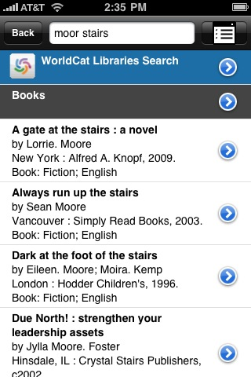
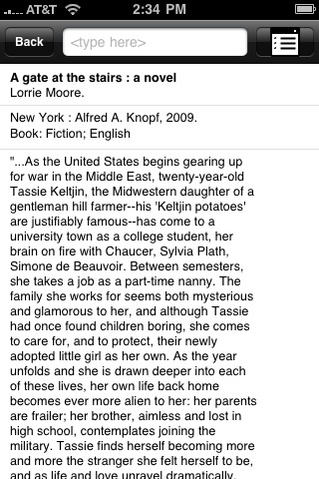
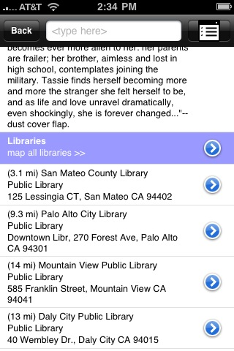
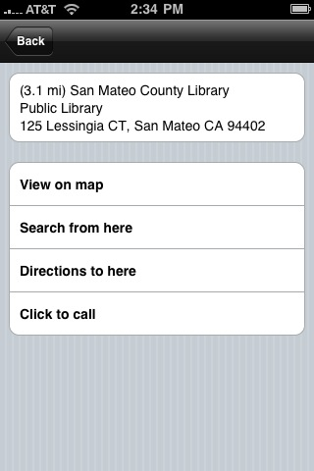
WorldCat Mobile Pilot
library mobile apps
Notes:
I’ve mentioned Boopsie a couple of times. Here we see screenshots of the WorldCat Mobile Pilot app they developed for OCLC. Their app uses a highly-efficient search system to reduce keyboard input and speed up response time, and makes use of data from the WorldCat Search API and the WorldCat Institution Registry API to find nearby libraries and library information.
Their implementation can run on virtually any mobile device with a data pla. The look and feel obviously changes, based on the capabilities of the device. Though we have indications that certain mobile devices are probably used more frequently than others, for OCLC it is especially important to support access from as many devices as possible. And acquiring and maintaining the expertise, within OCLC, to understand how to develop and support the heterogeneous mix of devices would have been a significant, time-consuming, and expensive process. As other organizations have done, it made good sense for us to turn to a partner company with a strong track record in mobile application development and support for this work.
This may come down to a question about your mission. Is it to enable access to library resources, or is it to be a premiere provider of mobile application technology?

Slide 26
The Gartner Hype Cycle
Represents the maturity and adoption of various technologies
Term coined by Gartner, Inc.
Five Phases, from trigger to productivity
Notes:
I’d like to take a brief detour to discuss the Gartner Hype Cycle.
It’s a way to evaluate the maturity and adoption of technologies, developed by Gartner, Inc.

Slide 27
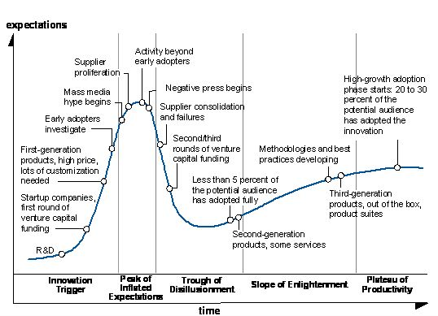
Gartner Research: Hype Cycle
http://blogs.reuters.com/commentaries/2009/08/11/twitter-backlash-foretold/
Notes:
Innovation Trigger — an event that generates significant interest: breakthrough, product launch.
At the Peak of Inflated Expectations — publicity generates over-enthusiasm and unrealistic expectations. Some successful applications, more failures.
In the Trough of Disillusionment — Failure to meet raised expectations leads to dismay.
Along the Slope of Enlightenment — Though no longer the subject of frenzied attention, some businesses continue to work with, learn the benefits and practical applications of, the technology.
On the Plateau of Productivity — Technology benefits can be shown and are accepted. Later generations of the technology are more stable. Productivity and expectations at this stage vary, depending on how widely applicable the technology becomes.

Slide 28
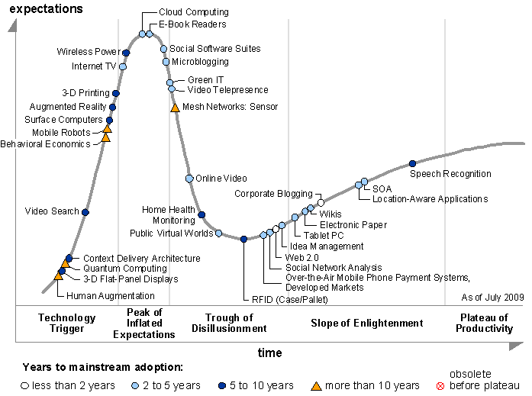
Gartner Research: Hype Cycle of Emerging Technologies, July 2009
http://www.gartner.com/it/page.jsp?id=1124212
Notes:
In a recent Gartner publication, the Hype Cycle of Emerging Technologies was reported.
Note Cloud Computing and E-Book Readers, both poised on the precipice above the Trough of Disillusionment.
Whereas, Speech Recognition is found well out along the Slope of Enlightenment … this made me think of the, in my view, highly effective voice recognition that can be easily activated in Android apps … though indicated as being another 5-10 years from mainstream adoption.
Tablet PCs are also shown just beginning to emerge from the Trough, though expected to be mainstream in 2-5 years. Perhaps prescient, in a report issued a little less than a year before the release of the iPad.

Slide 29
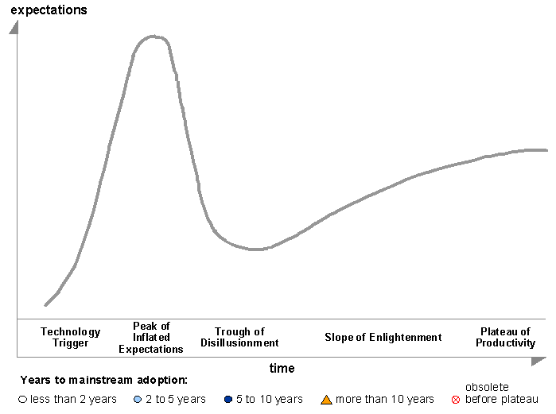
Library Mobile App Hype Cycle – Where are we?
Notes:
So, where would library mobile apps fall on this curve?
In my view, they are somewhere on the downward slope of the Trough of Disillusionment. That’s a period in the cycle when consolidation is occurring, and I think we’re seeing some of that with the advent of commercial and open source solutions for providing native and mobile web apps, from library system vendors, MIT Mobile, Terribly Clever Design, Boopsie, and others. It’s also a time marked by some successes but more failures. Though success metrics for library mobile apps aren’t universally understood and agreed upon, I think it’s fair to say that obvious success stories aren’t yet numerous.
It also follows a period where expectations for adoption and success may have been raised unrealistically high. There is certainly much enthusiasm and interest in the library community about mobilizing library resources. It’s been there, frankly, for years. But, from what we can see so far, there isn’t corresponding evidence of widespread adoption and use of the results of those development efforts. At best, these applications may be partially displacing use that would have otherwise occurred in a desktop application. At worst, they may be either frustrating users by not delivering fully on the expected promised, or being otherwise missed or ignored.

Slide 30
Expectation, then disappointment
“ … it is tempting to wish that this cycle of expectation and disappointment could be avoided. In fact, the cycle is an essential part of the innovation process. It is a collective measure of our goals, and the distance that must be traversed in order to realize them.”
Saffo, Paul. “’Revolution’ the Hype Word of Computer Industry Advances." InfoWorld 4 Feb. 1991: 60. Print.
Notes:
The notion that the path from innovation to adoption of a technology isn’t linear, but looks more like an S-curve, isn’t original to Gartner, of course.
Here’s Paul Saffo in an InfoWorld column from 1991 discussing the concept:
“ … it is tempting to wish that this cycle of expectation and disappointment could be avoided. In fact, the cycle is an essential part of the innovation process. It is a collective measure of our goals, and the distance that must be traversed in order to realize them.”
InfoWorld, February 4 1991, p. 60
‘Revolution’ the Hype Word of Computer Industry Advances

Slide 31
iPhone Apps and the Long Tail
“The average iPhone or iPod Touch owner uses 5 to 10 apps regularly, according to Flurry, a research firm that studies mobile trends. This despite the surfeit of available apps: some 140,000 and counting.”
Hafner, Katie. "When Phones Are Just Too Smart." The New York Times. The New York Times Company, 29 Jan. 2010. Web. 24 Feb. 2010.. http://www.nytimes.com/2010/01/31/fashion/31apps.html.
Notes:
As this comment about the Long Tail of iPhone Apps indicates, some apps are obviously succeeding. But there are far more failures than successes.
The app needs to do what it does well; either do something no other app can do, or do it more effectively than any others.
It helps if it’s based on studying users and uses, designed to fill a shared and present need, and continually adapted to changing requirements, devices, networks, etc.
It helps if it’s free, but maybe not as much as you’d think. $1.99 is the new Free (especially if you figure the app is going to save you money over time)
If helps a lot if it’s promoted.
It helps a lot if it gets talked about by honest brokers, and goes viral.
One good question: Do you use it? If not, why would anyone else?

Slide 32
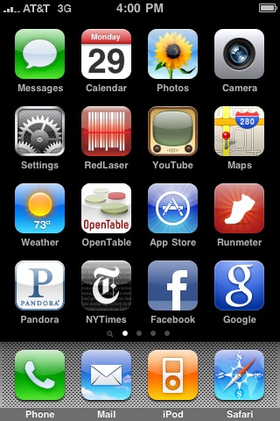
iPhone Apps and the Long Tail
Notes:
Here’s the opening screen of my iPhone. The icons that have made it here are for apps that are used a lot. They drift to the top, over time.
Other apps that were installed on a recommendation or because it seemed like a good idea at the time, but that didn’t get traction, sink to the 2nd or 3rd screen, or eventually get deleted.
There isn’t a strong commitment to keeping an unused free or low-cost app around. Utility wins.
So … where’s the library app on this screen?
Actually, there are two: RedLaser and Safari.

Slide 33
What counts as success?
More use, not just the same use on a different device
Fewer clicks per transaction
New uses
Moving library services into the flow
Notes:
We should consider metrics for success for our library mobile apps.
They’d include taking a closer look at how they are being used, by whom, at what frequency. We could establish some benchmarks for success at the outset of the mobilization project, and test over time to see how we’re doing. From my perspective, there isn’t enough of that kind of scrutiny and judgment being applied to the results of these mobile efforts.
Success criteria might include indications of more use … by more people or by the same people with greater frequency
Counting page views isn’t a conclusive measure of success of a web app, and it’s especially problematic for mobile. Effective mobile applications often try to greatly reduce the number of pages that need to be loaded and viewed, to speed up response time and reduce their user’s data costs. User studies can help us determine whether users are getting to needed information more quickly and effectively … fewer clicks and page loads is an indicator of success in this instance.
Looking at the information architecture of the mobile app, and the key deliverables it intends to provide, can help determine what sorts of transactions should be counted. If the application, for example, intends to make it easy for people to reserve a computer in the library, then count those transactions and the range of users that take advantage of that feature.
If the mobile application offers a new kind of library service, or one that had not yet been offered on the desktop application, track that.
And look for indications of these mobilized library services appearing “in the flow” of your patrons’ mobile work. That may mean watching for signs of your app being noted in social network traffic, blogs, etc. Or, depending on the kind of application and how your services appear, you may see evidence of visibility from some of the 3rd party applications like RedLaser and others.

Slide 34
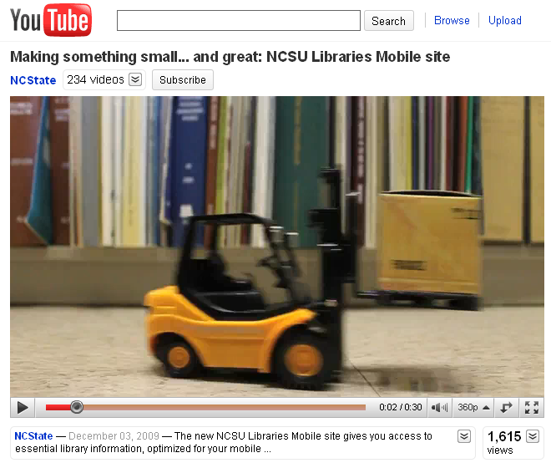
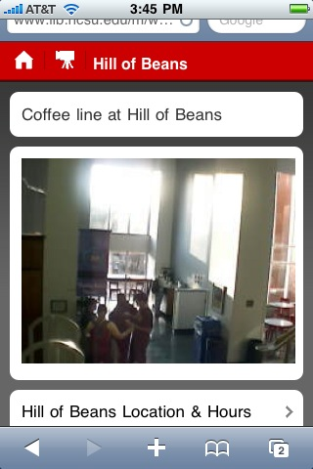
Promotion, Use, and Buzz
http://www.youtube.com/watch?v=BZAbB1kJ-HU
Notes:
Once a library mobile app is available, it needs to be promoted. Just being found via a link on the institution’s website or within one or more mobile market sites isn’t enough. Work has to be done to generate buzz, enthusiasm, and traction.
NCSU created a nice promotional YouTube video to coincide with the launch of their mobile library app:
http://www.youtube.com/watch?v=BZAbB1kJ-HU
Of course, even the video needs to be promoted to have impact.
And around that same time, the developers described the project development and early results in a highly recommended Educause webinar:
“Library in Your Pocket -- Strategies and Techniques for Developing Successful Mobile Services”
David Woodbury (North Carolina State University) and Jason Casden (North Carolina State University)
http://www.educause.edu/Resources/LibraryinYourPocketStrategiesa/195003
Some early results from the NCSU experience: about 75% of use came from iPhones (not a surprise), and about 40% of page views were of the webcam for the coffee bar …
Another interesting early return was that they reported 22,000 page views after just a month or more after its launch and promotion. It wasn’t clear to me, though, how that matched success criteria for this application, as the app serves a community of about 40,000 students, faculty, and staff. And, apparently a plurality of page views were from people checking the coffee bar webcam. That’s a good sign of a new use being activated and making a difference. It shouldn’t be treated as a whimsical novelty; something important has happened in a mobile user’s day, when they can quickly check, from wherever they are, if it’s worth making the trek for coffee or better to wait. That kind of seamless utility builds loyalty, and leads to the users’ helping with the app’s promotion by recommending it to friends.
(This is another way in which page views may not be a helpful way to gauge what’s useful in the app, as the coffee bar webcam page might get periodically reloaded by the mobile app user, to see if the line has gotten any shorter … each reload is a counted page view, thereby potentially inflating its “importance” as an app feature.)

Slide 35
Some suggestions
Mobile devices are reaching your content. Make that work.
Work with, and improve, existing library mobile applications.
Don’t disenfranchise users of mobile devices that tend not to browse the web.
Study user needs, study results of use, and refactor accordingly.
Report your study results to the library community.
Notes:
From my perspective as a developer, and as one of several people helping to develop OCLC’s WorldCat mobile strategy, I’d offer these suggestions.
If you have a website, some people will try to reach it via a mobile device (following links to it from other mobile apps, in twitter feeds, etc.). You’ll want that experience to be not so broken as it may currently be. Better browsers in some devices can ameliorate the impact, and natural forces may lead to most of those connections being made via better browsers. But it’s still work learning something about what mobile devices are reaching your site, what parts of the site are being reached, and how satisfactory the result is. If there’s an available source for a ready-made solution to put in place of a failing site, and the traffic to your site warrants, that is probably a good way to go.
Especially as you consider more fully functional mobile experiences of library services, it makes sense to work with those who can develop and support these uses. You can help extend those services via feedback and co-development, but it’s advisable to begin within a well-designed and tested framework, rather than beginning this development from scratch. This can also help avoid falling into a trap of developing a mobile interface for what’s currently available or easier to implement, while neglecting features and services that your users actually need.
While evaluating your website logs for mobile activity can provide some useful information, it should not be interpreted as a representation of the mobile capabilities of your community of users. Those with devices that tend not to browse the web, but could (with a proper application) use library services, won’t be represented in the logs and should be included in any community-wide solution.
Every community of users and library is different. There’s little enough information currently gathered, analyzed, and shared about how library services should be used on mobile devices, and what information is available can go quickly out of date as conditions change. Spend time evaluating what’s needed before building it. Don’t rely exclusively on the desktop website information architecture as your guide to the design of a mobile app. Test what you’ve built, and challenge your assumptions. Refactor, reimplement, and repeat.
And share what you can about your experiences with the library community. We’re all still learning, and information is hard to come by.

Slide 36
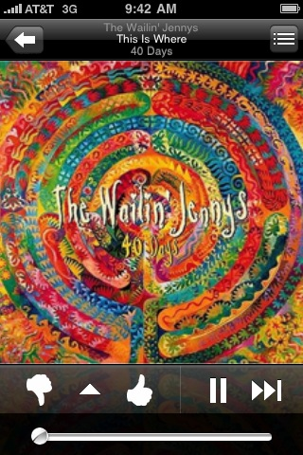
What Makes a Great App?
Pandora Radio
Notes:
I’ll end by returning to Pandora Radio, one of my favorite apps.
It’s one of the few mobile apps that I feel has added real value and enjoyment to my life. It’s a simple but powerful idea, backed by good data, and with a simple but sophisticated design. It’s strongly social, remembering my preferences and choices, and doing a good job of recommending other choices that I would have otherwise missed. I can’t do without it.
What would make a great library app? I’d say it would have to do more than just replicate some of what can be done on the desktop. Though there is utility in having access to library hours, study room reservations, and putting a book on hold via my mobile phone, I’d say those are capabilities that (though still widely lacking) would be generally expected by a mobile device user. They make a mobile library app useful, but not necessarily indispensable.
But what if there was an app that connected me, in a frictionless way, to my library, enabling any of the services that my library can offer when it knows who I am? And what if it ran on a mobile device with a better-than-good-enough eReader, and I could use that to read article full text from open access and licensed resources provided by my library? And what if it both remembered my choices and preferences, but also got better the more I, and others, used it, by offering helpful recommendations for articles that might be of interest and that I would have otherwise missed?
That would be a mobile library app I’d use, return to, and recommend to others.

Slide 37
Resources noted
In Print
Fenn, Jackie, and Mark Raskino. Mastering the Hype Cycle: How to Choose the Right Innovation at the Right Time. Boston, Mass: Harvard Business Press, 2008.
http://www.worldcat.org/oclc/213312226
Fling, Brian. Mobile Design and Development. Sebastopol, CA: O'Reilly Media, 2009.
http://www.worldcat.org/title/mobile-design-and-development/oclc/318413920
Mobile Strategy
http://m-strat.org/
Griffey, Jason. Mobile Technology and Libraries. New York: Neal-Schuman Publishers, 2010.
http://www.worldcat.org/title/mobile-technology-and-libraries/oclc/498135636
Mobile Usability
http://www.useit.com/alertbox/mobile-usability.html

Slide 38
Resources noted
Apps
Book Bazaar
http://itunes.apple.com/us/app/book-bazaar/id309067586
CompareEverywhere
Visit the Android Market on an Android device
DC Public Library
http://itunes.apple.com/app/dcpl/id301077850
DukeMobile
http://itunes.apple.com/app/dukemobile/id306796270
http://m.duke.edu
iStanford
http://itunes.apple.com/us/app/istanford/id292922029
Nashville Public Library
http://waldo.library.nashville.org/airpac/jsp/airpacIndex.jsp

Slide 39
Resources noted
Apps, continued
NCSU Libraries MobiLIB
http://www.lib.ncsu.edu/m
New LIS Books
http://itunes.apple.com/us/app/new-lis-books/id352102769
New York Public Library Mobile
http://m.nypl.org/
Pandora Radio
http://itunes.apple.com/us/app/pandora-radio/id284035177
Pic2shop
http://itunes.apple.com/us/app/pic2shop/id308740640
RedLaser
http://itunes.apple.com/app/redlaser/id312720263
Santa Clara County Library
http://sccl.boopsie.com

Slide 40
Resources noted
Apps, continued
UNC Library Mobile
http://www.lib.unc.edu/m/
University of Virginia Library
http://m.lib.virginia.edu/
Victoria University Library Mobile
http://m.library.vu.edu.au/
WorldCat Mobile
http://www.worldcat.org/wcpa/content/mobile/

Slide 41
Resources noted
Development Resources
Android Developers
http://developer.android.com/index.html
DC Public Library Labs iPhone Application
http://dclibrarylabs.org/projects/iphone/
iPhone Dev Center
http://developer.apple.com/iphone/index.action
iUI iPhone web app library
http://www.joehewitt.com/blog/introducing_iui.php
MIT Mobile Web source code
http://sourceforge.net/projects/mitmobileweb/
W3C Mobile Web Best Practices
http://www.w3.org/TR/mobile-bp/

Slide 42
Contact
Bruce Washburn
Software Engineer, OCLC Research, San Mateo CA
bruce_washburn@oclc.org
TAI CHI Webinar Series
http://www.oclc.org/research/events/taichi.htm

