Slide 1
“I don’t think I have ever picked up a book out of the library to do any research – all I have used is my computer.” (USU1, Female, Age 19)
Bournemouth, 9 April 2013
UKSG 36th Annual Conference and Exhibition
THE NEW DIGITAL STUDENTS, or:
Lynn Silipigni Connaway, Ph. D
Senior Research Scientist
OCLC
@LynnConnaway

Slide 2

“I find Google a lot easier…so many journals come up and when you look at the first ten and they just don’t make any sense. I, kind of, give up.”
(USU7, Female Age 19)
Notes:
Image: Microsoft Clip Art
“Because Google is reliable. And fast.” (Digital Visitors and Residents, UKG1, 0:29:14, Female Age 23)
White, D., & Connaway, L. S. (2011). Visitors and residents: What motivates engagement with the digital information environment. Funded by JISC, OCLC, and Oxford University. http://www.oclc.org/research/activities/vandr/

Slide 3
Then & Now
Then: The user built workflow around the library
Now: The library must build its services around user workflow
Then: Resources scarce, attention abundant
Now: Attention scarce, resources abundant
(Dempsey, 2008)
Notes:
Image: Microsoft Clip Art
The need for local infrastructure or local assembly of materials has declined (Dempsey, Inside Out).
The library is institution scale where many of its users operate at network scale
The inside out library …the library as an actor in research and learning environments of its users
Dempsey, L. (2008). Always on: Libraries in a world of permanent connectivity. First Monday, 14(1). Retrieved from http://www.firstmonday.org/htbin/cgiwrap/bin/ojs/index.php/fm/article/view/2291/207
Dempsey, L. (2013, January 23). The inside out library: Scale, learning, engagement. Presentation at
Hacettepe University, Beytepe, Ankara (Turkey).
Today, more than 1.7 billion people, or almost one out of every four humans on the planet, are online (Wasserman, 2012).
Wasserman, S. (2012, June 18). The Amazon effect. The Nation. Retrieved from http://www.thenation.com/article/168125/amazon-effect
“Yes, I’m sure, because, you know, going to the library was a task. And part of, I’m sure, a lot of people, and as far as me is concerned from laziness, it was much easier to just scrap around. It’s so much easier to just strain to find something on the internet than to, like, drive to the library. “ (Digital Visitors and Residents, USG2, 0:45:28, Male, Age 25)
“I have better things to do than go drive all the way to the library when I can just sit at home and type it into my computer.” (Digital Visitors and Residents, USU1, 0:33:12, Female, Age 19)

Slide 4
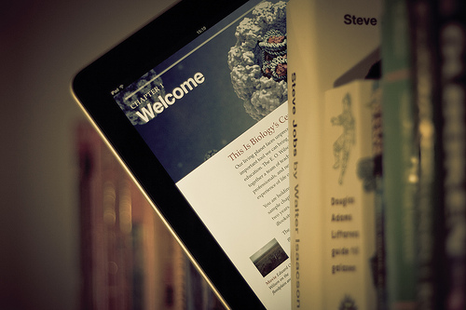
Changes in Information Acquisition
Local to global
Linear to linked
Print to digital
Notes:
Image from http://www.flickr.com/photos/johanl/6966883093/

Slide 5
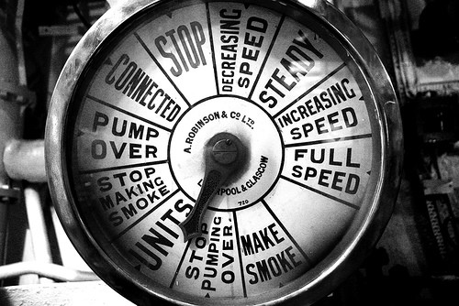
Current Environment
Challenges
  Budget cuts
  High retirement rates
  Hiring freezes
Opportunity
  Best value for most use
  Understand how, why, & under what circumstances individuals use systems & services
Notes:
Image from http://www.flickr.com/photos/matthijs/82616861/
“A diamond is a chunk of coal made good under pressure.” –Henry Kissinger

Slide 6

Convenience
Convenience is king
  Satisficing
  Google and Wikipedia
    84% of users start with a search engine
(De Rosa, 2005
(Centre for Information Behaviour and the Evaluation of Research, 2008)
Notes:
Image: http://www.cjamesgallery.com/shows/past
Centre for Information Behaviour and the Evaluation of Research. (2008). Information behaviour of the researcher of the future: A CIBER briefing paper. London: CIBER (p. 14).
De Rosa, C. (2005). Perceptions of libraries and information resources: A report to the
OCLC membership. Dublin, Ohio: OCLC Online Computer Library Center (p.1-17).
The majority of British Library web site visits were from search engine (p. 14)
84% of users began an information search with search engine (p. 1-17)
1% began information search on library website (p.1-17)
“Last semester I was writing a paper on Brazil and there was a book in the library that I just did not want to leave my house to go to. It is a 50 minute drive, I didn’t want to do that, but I was writing my paper and so I used Google books instead and really they only had a section of the book available but that was the section I used. So, you know, doing that instead of coming here physically and going to get the whole book. And it saved time, it saved gas, I got what I needed and it wasn’t a big deal” (Digital Visitors & Residents , USG4, 0:39:42, Female, Age 23).
“I grew up in a library I was always there reading. I even started working at one when I was in the 5th grade. I loved the whole surrounded by books and just helping out. In truth I do sometimes miss the feel of a hard cover book but it beats wasting gas to go to the library to just get a book when you can find it on line with no trouble” (Digital Visitors & Residents , USU2, Emerging Diary 11, Phase 2, Female, Age 19)
“With Google you are not limited. You have as much as you can pull up” (Digital Visitors & Residents, USU2, Emerging Diary, Female, Age 19)

Slide 7

Information-Seeking Behavior
Power browsing
  Scan small chunks of information
  View first few pages
  No real reading
Squirrelling
  Short basic searches
  Download content for later use
Situational needs determine search
Contextually based rational decisions
Confident in skills
Differ with discipline
“Awareness of open access is low
Lack of understanding of copyright & signed publisher agreements
(Consortium of University Research Libraries, and Research Information Network, 2007)
(Research Information Network, 2006)
(Connaway & Dickey, 2010)
Notes:
Image: http://www.thosefunnypictures.com/picture/7187/squirrel-on-computer.html
Researchers in the sciences are most satisfied, Arts and Humanities researchers indicated serious problems (p. 75)
“Satisficing” (p. 31)
Awareness of open access is low (p. 64).
Lack of Understanding of copyright and publisher agreements (Connaway & Dickey, 2010, Towards a Profile of the Researcher of Today)
Consortium of University Research Libraries, and Research Information Network. (2007). Researchers’ use of academic libraries and their services: A report. London: Research Information Network and Consortium of University Research Libraries (CURL) (p. 31, p.64).
Research Information Network. (2006). Researchers and discovery services: Behaviour, perceptions and needs. London: Research Information Network (p. 75).
Connaway, L. S., & Dickey, T. J. (2010). Towards a profile of the researcher of today: What can we learn from JISC projects? Common themes identified in an analysis of JISC Virtual Research Environment and Digital Repository Projects. http://ie-repository.jisc.ac.uk/418/2/VirtualScholar_themesFromProjects_revised.pdf

Slide 8

The library? What’s that?
Website hard to navigate
Inconvenient
  Limited hours
  Distance to library
  Physical materials
Don’t think electronic resources are library resources
  Associate with books
(Connaway & Dickey, 2010)
Notes:
Image from http://www.flickr.com/photos/auntiep/6721501575/
Connaway, L.S., & Dickey, T.J. (2010). Digital information seekers: Report of findings from selected OCLC, RIN, and JISC user behavior projects. http://www.jisc.ac.uk/media/documents/publications/reports/2010/digitalinformationseekerreport.pdf (p.4).
Connaway, L. S. & Radford, M. L. (2011). Seeking Synchronicity: Revelations and recommendations for virtual reference. Dublin, OH: OCLC Research. Retrieved from http://www.oclc.org/reports/synchronicity/full.pdf
“Yes, yes, like yes. Because I mean the thing that annoys me most is when these things are online, unlike library catalogues that’s supposed to be a really good way for looking for books but usually they are so bad that you are sort of stuck between the two worlds of you can’t go and ask someone for anything. You’re supposed to use the internet but they’re not very well developed” (Digital Visitors and Residents, UKG5, 0:34:36, Female, Age 25).

Slide 9
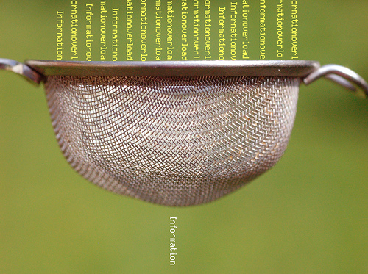
Skills for Finding & Using Information
Students
  Confident with information discovery tools
  Determine credibility by:
    Common sense (83%)
    Cross-checking (71%)
    Reputation of company/organization (69%)
    Credible recommendations (68%)
Researchers
  Self-taught in discovery services
    No formal training (62%)
  Doctoral students learn from dissertation professor
  Confident in skills
(De Rosa, 2006)
Research Information Network, 2006)
Notes:
Image from http://www.flickr.com/photos/verbeeldingskr8/3638834128/
“Well I don’t like pick the first one I see. I try to evaluate two or three and see if there’s some common things between them. Like if two of them say the same thing then that must be right. Rather than like one [??] versus two consistent things.” (Digital Visitors and Residents, USS4 00:10:01, Male, Age 17)
“So, I usually check. I try to test the information, if it’s- my judgment, or also my knowledge in the subject or- or I will read more to see if the information is right or not. I don’t trust it, like from the first second” (Digital Visitors and Residents, USG1, 0:35:15, Female, Age 45).
“It is kind of like a guess and check to see which one works best or which one gives you the most information. It is not necessarily to see which one is more credible because if you want credibility you are not necessarily going to look online for it.” (Digital Visitors and Residents, USU3, 0:18:31, Male, Age 19)
“You know, let’s say it’s not even in an academic context. I have to see the same conclusion reached by lots of different people in different contexts. Like I need to see the same answer again and again and again. And maybe at some point that’s enough time where it starts to gel to me that this probably is a good approximation of the truth. It might not be the truth but this seems to be what a lot of people perceive as the truth. So that would be the simplest way to do it.” (Digital Visitors and Residents, USF3, 0:29:48, Male, Age 40)
“That’s the only problem, just knowing what information to use and why.” (Digital Visitors and Residents, UKS1, 00:24:05, Male, Age 18)
De Rosa, C. (2006). College students' perceptions of libraries and information resources: A report to the OCLC membership. Dublin, Ohio: OCLC Online Computer Library Center. http://www.oclc.org/us/en/reports/perceptionscollege.htm (p.3-3-4).
White, D., & Connaway, L. S. (2011). Visitors and residents: What motivates engagement with the digital information environment. Funded by JISC, OCLC, and Oxford University. http://www.oclc.org/research/activities/vandr/
Most researchers self-taught in discovery services
62% report no formal training (p.64)
Confident in their skills (p.9)
Research Information Network. (2006). Researchers and discovery services: Behaviour, perceptions and needs. London: Research Information Network.
Discuss New Zealand computer science faculty projects, 1996 and 2011.
Cunningham, S. J. & Connaway, L. S. (1996). Information searching preferences and practices of computer science researchers. In J. Grundy (Ed.), Proceedings: Sixth Australian conference on computer-human interaction, November 24-27, 1996, Hamilton, New Zealand (pp. 294-299). Los Alamitos, CA: IEEE Computer Society Press.

Slide 10

Frustrations
Students
  Lack of mobile access
  Library
    Website hard to navigate
    Inconvenient
    Associate with books
Faculty
  Accessing online journal articles & back files
  Need desktop access
  Discovery of non-English content
  Unavailable content
  Irrelevant information in result list
  Lack of specialist search engines
(Connaway & Dickey, 2010)
Notes:
Image from http://www.flickr.com/photos/pixx0ne/6418513533/
“She [professor] was very direct about certain stuff and wanted me to go to the library. Of course like the library’s like a second home for me, so that’s fine. But the research I needed wasn’t showing up. So I was like okay, I’m going to the internet. And I had to find quotes from books, so I just like was able to go on Google, Google book search, and find the quote I needed. And I didn’t write down it was from the internet .... So she doesn’t really know (Laughter) that it’s from the internet.” (Digital Visitors and Residents , USU2, 0:31:50, Female, Age 19)
“I don’t use the library. Most students really don’t anymore, I know a couple of people that live here but they don’t actually use it for books, they use it as a quiet place to study.” (Digital Visitors and Residents ,USU4 0:36:27, Male, Age 19)
“UNCC was really not bringing up anything. I did not have much luck. Maybe I’m not used to it. They probably had a lot but it’s a big library and I’m not patient” (Digital Visitors and Residents, USU2, Emerging Diary, Female Age 19)
“It can be difficult for a UK professional who does not speak foreign languages to get a good academic translation. Would like a very good translation service specifically geared for academics,” (Physical Sciences Researcher, Research Information Network. 2006. Researchers and discovery services: Behaviour, perceptions and needs. London: Research Information Network.)
Connaway, L.S., & Dickey, T.J. (2010). Digital information seekers: Report of findings from selected OCLC, RIN, and JISC user behavior projects. http://www.jisc.ac.uk/media/documents/publications/reports/2010/digitalinformationseekerreport.pdf (p.4).
Research Information Network. (2006). Researchers and discovery services: Behaviour,
perceptions and needs. London: Research Information Network. (p. 67, p. 75)
White, D., & Connaway, L. S. (2011). Visitors and residents: What motivates engagement with the digital information environment. Funded by JISC, OCLC, and Oxford University. http://www.oclc.org/research/activities/vandr/

Slide 11

Tools Used: Students
Undergraduate Students
  Google, Wikipedia
  Also use library website and e-journals
  Human resources
    Other students/classmates
    Family & relatives
    Friends
Graduate students
  Professors, advisors, mentors
  Electronic databases
(De Rosa, 2006)
Connaway & Dickey, 2010)
Notes:
“I had good history with Google. I eventually find what I want. I tried UNCC and the institute and could not find what I wanted. I guess with Google it will search all databases” (Digital Visitors and Residents, USU2, Emerging Diary, Female, Age 19)
“One of my favourite ways of getting information is by asking people. Instead of Googling the whole time I mostly have faith in the fact that people are actually learning, if I can go to a tutor and ask them something.” (Digital Visitors and Residents, UKU3, 0:19:34, Female, Age 19)
“Like usually with homework I usually can do it myself. But like, like sometimes I will just like IM my friend on Facebook and will be like, “Hey do you know how to do this?” That is usually how I will do it or I will text somebody but for the most part if I can’t figure it out then I just kind of star that question because there is usually just one or two questions. Or I will just go to my parents or my Grandma or something.” (Digital Visitors and Residents, USS6, 0:17:08, Female, Age 17)
“I use my friends a lot. I use people that I know know things about like if they’re, maybe not specialised but know what they are. Ask them first and then they’ll give me information. Because for me as I said I’m a people person. I trust what my friends say. I know what to take from them. Maybe they may not be the same as me and may not believe the same stuff. I know what I can take from them at least.” (Digital Visitors and Residents, USS5, 01:01:42, Male, Age 18)
Information studies students: (Bertot, et al., 2012, p. 213)
28% use OPAC daily or weekly
86% use Google daily or weekly
Bertot, J. C., Berube, K., Devereaux, P., Dhakal, K., Powers, S., & Ray, J. (2012). Assessing the usability of WorldCat Local: Findings and considerations. The Library Quarterly, 82(2), 207-221.
Connaway, L.S., & Dickey, T.J. (2010). Digital information seekers: Report of findings from selected OCLC, RIN, and JISC user behavior projects. http://www.jisc.ac.uk/media/documents/publications/reports/2010/digitalinformationseekerreport.pdf (p. 39).
De Rosa, C. (2006). College students' perceptions of libraries and information resources: A report to the OCLC membership. Dublin, Ohio: OCLC Online Computer Library Center.
White, D., & Connaway, L. S. (2011). Visitors and residents: What motivates engagement with the digital information environment. Funded by JISC, OCLC, and Oxford University. http://www.oclc.org/research/activities/vandr/

Slide 12

Tools Used: Researchers
  Online resources
    99.5% use journals as primary resource
    Google, Web of Science, PubMed, Science Direct, JSTOR
  Human resources
    90% mention expertise of individuals as important resource
      Coworkers
      Colleagues
      Other professionals
(Connaway & Dickey, 2010)
(Research Information Network, 2006)
Notes:
Google, Web of Science, PubMed, Science Direct, JSTOR (p.27)
Increasingly important to research process at all levels (p.4)
Articles are central type of resource for researchers (p.34-35)
99.5% say journals are primary resource (p. 34-35)
71% rank journals in their top three resources (p. 34-35)
90% mention expertise of individuals as important resource (pp.7, 34-35)
Connaway, L.S., & Dickey, T.J. (2010). Digital information seekers: Report of findings from selected OCLC, RIN, and JISC user behavior projects. http://www.jisc.ac.uk/media/documents/publications/reports/2010/digitalinformationseekerreport.pdf (p.4).
Research Information Network. (2006). Researchers and discovery services: Behaviour, perceptions and needs. London: Research Information Network (p. 27, p. 34-35).

Slide 13

E-journals
  Visit only a few minutes
  Shorter sessions
  Basic search
  View few pages
  Backfiles difficult to access
  Content often discovered through Google
(Research Information Network, 2009)
(Wong, Stelmaszewska, Bhimani, Barn, & Barn, 2009)
Notes:
Image from Microsoft Clip Art
Backfiles difficult to access (Wong, Stelmaszewska, Bhimani, Barn, & Barn, 2009, p.8)
“I will go into the research databases and usually start with com abstracts or go to some other, you know, similar type of, you know, database and do a search there and then I will end, end up, because I am, this is a hurried thing, limiting myself to the articles that are available online as opposed to the ones that I would have to specifically go to the library and make a copy of. You know, because it’s quick. I know that there are other articles, but I limit myself to the ones I can get online. And, you know, the most recent ones tend to be online, so I luck out in that way.” (Sense-making the Information Confluence, Focus Group Interview 01, Faculty)
“…the first thing I did was, before I came to the library to use the MLA database, I did a Google search and it turns out that there is a professor at Berkeley who keeps a really, really nice and fully updated [unclear – words] page with bibliographic references, all kinds of links, you know, it's just awfully good, and I mean it just gets you really off and running on a lot his information and more novels. And I used it quite a bit, and then I did finally come up with and supplement that with an MLA search, which yielded some articles that were not on that page.” (Sense-making the Information Confluence, Focus Group Interview 01, Faculty)
Dervin, B., Connaway, L. S., & Prabha, C. 2003-2006. Sense-making the information confluence: The whys and hows of college and university user satisficing of information needs. Funded by the Institute of Museum and Library Services (IMLS). http://www.oclc.org/research/activities/imls.html
Research Information Network. (2009). E-journals: Their use, value and impact. London: Research Information Network.
White, D., & Connaway, L. S. (2011). Visitors and residents: What motivates engagement with the digital information environment. Funded by JISC, OCLC, and Oxford University. http://www.oclc.org/research/activities/vandr/
Wong, W., Stelmaszewska, H., Bhimani,N., Barn, S., & Barn, B. (2009). User behaviour in resource discovery: Final report. http://www.jisc.ac.uk/whatwedo/programmes/inf11/userbehaviourbusandecon.aspx

Slide 14
Digital Sources & Educational Stage
Notes:
Major Media Sites and Wikipedia were the highest sources mentioned among the Websites. Major Media Sites only were mentioned by 26% (n=8) of Emerging participants, but 50% (n=5) of Establishing participants, 70% (n=7) of Embedding participants, and 40% (n=4) of Experiencing participants. Wikipedia was highly referred to by 77% (n=24) of Emerging interviewees, 90% (n=9) of Establishing interviewees, 70% (n=7) of Embedding interviewees, before dropping to 50% (n=5) of Experiencing interviewees.
Other notables were University Websites, mentioned by 40% (n=4) of Establishing participants and 50% (n=5) of Embedding participants. The large number of Embedding and Experiencing mentions of University Databases does not necessarily mean they actually use them more than the Emerging group, but could mean they know what they are using, and know enough to call them out by name. Relatively lower numbers of mentions among Emerging should not necessarily be read as a measure of how often undergraduates use university databases—the rate might actually be high, but they don’t know that is what they are doing, and so it doesn’t show up in interviews.
Retail websites were brought up by 40% of Establishing participants and 50% (n =5) of Embedding and Experiencing. The use of retail sites is much lower in Emerging stage, in part because that includes students who have not yet left home. Once they are upper-division students, the percentage jumps to 40%, and then levels off to 50% in both Embedding and Experiencing stages. This is something to think about, because the use of retail websites can set expectations among users in terms of the conventions of websites, what sorts of things they expect to do with chat, etc.
Syllabus- and discipline-based sites were spoken of by 48.4% (n=15) of Emerging interviewees, 40% (n=4) of Establishing and Experiencing interviewees, but only 20% (n=2) of Embedding participants.
Also, the lower percentage of mentions of Wikipedia by Emerging, in comparison to other stages, might be an indication of their worries about the legitimacy of Wikipedia as a source (as expressed by their teachers in high school), and so they mention it less. Perhaps, as students gain more confidence in their ability to tell whether the information on Wikipedia is reliable or not, they are more confident in revealing their uses of it as a resource.
Interviewer: Do you use it [Wikipedia] anyway?
Respondent: No, I just don’t even use it. Because I can find the information I need to on other sites. But looking at the author, I try to use a lot of college websites. Or the university databases. They really like those websites because they’re legitimate. (Digital Visitors and Residents, USS3, 00:32:28, Female Age 17)
“Wikipedia, I shouldn’t use it quite often because anyone can write anything but it is good as long as you don’t rely on it too heavily. “ (Digital Visitors and Residents, UKS3, 10:17:38, Male, Age 17)
White, D. S., & Connaway, L. S. (2011-2012). Visitors and residents: What motivates engagement with the digital information environment. Funded by JISC, OCLC, and Oxford University. Retrieved from http://www.oclc.org/research/activities/vandr/

Slide 15
Contact & Educational Stages
Notes:
Note the importance of Face-to-Face Communication among Faculty, in comparison to other stages, for whom Phone and other remote forms of communication is much more prevalent.
Some of the phone mentions in Emerging may be linked to students communicating with far (or just farther) away family and friends.
IM and Chat is high in Emerging, and goes down with each stage (with a slight rebound among Embedding before plummeting among Experiencing).
Email is only at 51% when Emerging students enter the institutional cultures (applying for and attending university) that require the use of email for official communication.
Once they are in the university, the mentions of email are at 100%.
Private Messaging
“Just because all my friends have it, it’s just an easy way to catch up and then, especially if I need some work to hand in for tomorrow, go and find out on Facebook, ask all my friends.” (Digital Visitors and Residents, UKS1, 0:05:59, Male Age 18) (Emerging)
Phone Call
“…just send an email, because calling, they’re not there, you leave a message, they call you back, they’re not there, new message, come back and forth.” (Digital Visitors and Residents, USF4, 0:42:38, Male Age 54) (Experiencing)
Texting
“I do use texting a lot more than calling on the phone.” (Digital Visitors and Residents, USU1, 0:05:59, Female Age 19) (Emerging)
Video Chat
“I use Skype for communicating with my father and my brother. …I tend to see Skype as a use for people I – they’re not peripheral friends, they’re closer friends and I would like to have longer conversations with them and so I use Skype as a video function to call someone and talk face-to-face.” (Digital Visitors and Residents, UKG2, 0:04:37, Female Age 22 (Embedding)
White, D. S., & Connaway, L. S. (2011-2012). Visitors and residents: What motivates engagement with the digital information environment. Funded by JISC, OCLC, and Oxford University. Retrieved from http://www.oclc.org/research/activities/vandr/

Slide 16

The word “librarian” only mentioned once in original interviews by Emerging Stage participants as a source of information
One participant referred to “a lady in the library who helps you find things”
(USU5, Male, Age 19)
Notes:
Image: Microsoft Clip Art
“– there’s a lady in the library who helps you find things.” (Digital Visitors and Residents USU5, Systems Engineering, Male, Age 19)

Slide 17
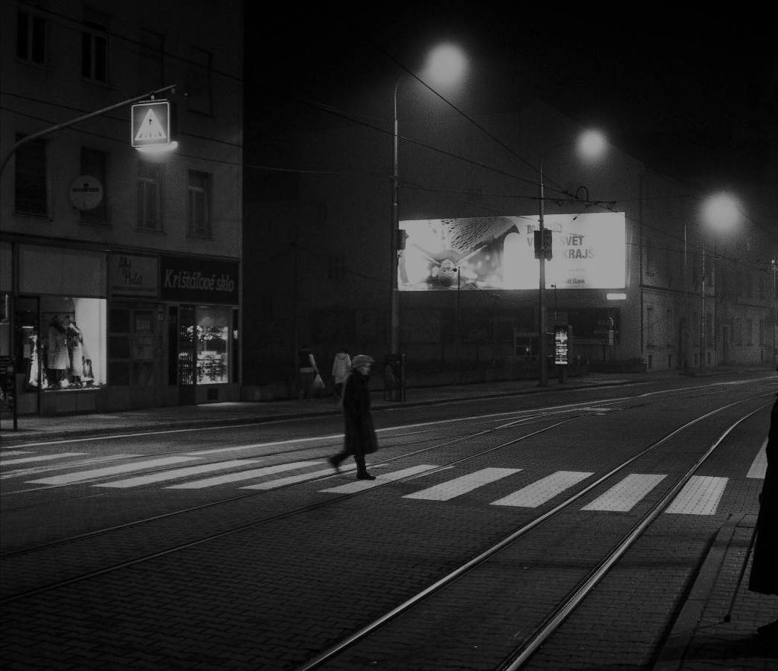
The Learning Black Market
“It’s like a taboo I guess with all teachers, they just all say – you know, when they explain the paper they always say, “Don’t use Wikipedia.”
(USU7, Female, Age 19)
Notes:
Image: http://wp.me/pLtlj-fH
Covert online study habits
Wikipedia
Don’t cite
Widely used
Guilt
Students & teachers disagree
Quality sources
There is a “Learning Black Market”: learners use non-traditional sources but feel they cannot talk about them in an institutional context. Wikipedia usage is an example of this. (White & Connaway, 2011)
“I mean if teachers don’t like using Wikipedia they don’t want you to use Wikipedia. A lot of students will still use Wikipedia and then cite another source. As long as it has the same information and it is not word for word or anything they’ll use Wikipedia because it is the easiest thing to go look up on Wikipedia. It will give you a full in-depth detailed thing about the information. Teachers don’t just like it because it’s not the most reliable source since anyone can post something on there even though the site is monitored, it’s because it’s too easy.” (Digital Visitors and Residents, USU3 0:30:59, Male Age 19)
Students’ Perceptions of Teachers’ opinions of Wikipedia:
“Avoid it.” (Digital Visitors and Residents, UKS8 0:28:28.3, Female Age 16)
“They say it’s because anyone can make up – I mean, anyone can add information on there but I mean when I’ve actually looked into information it seemed the same as any information I find anywhere else. I mean, it’s not like if you look up fourth of July, it’s not like it gives you like some weird explanation of aliens or something.” (Digital Visitors and Residents, USU7 0:33:14, Female Age 19)
Students’ on Wikipedia:
“I use it, kind of like, I won't cite it on my papers but I, kind of, use it as a like, as a start off line. I go there and look up the general information, kind of, read through it so I get a general idea what it is. Then I start going through my research.” (Digital Visitors and Residents, USU7, 0:33:49, Female, Age 19)
“Everyone knows that you try not to use Wikipedia as a source because it is a cardinal sin.” (Digital Visitors and Residents, UKU3, 0:31:03, Female Age 19)
Student: “Ha ha.” I realised that there were some undergraduates that had some papers due yesterday because they were like “Oh, Wikipedia was down! Now where am I going to get my information?”
Interviewer: I know, now it’s not going to happen. But that’s not your problem because you don’t do that.
Student: Exactly. No. I like going to Wikipedia and going “Ha ha ha ha ha.” (Digital Visitors and Residents, USG5 , 0:57:26, Female, Age 30)
White, D. S., & Le Cornu, A. (2011). Visitors and Residents: A new typology for online engagement. First Monday, 16(9). Retrieved from http://firstmonday.org/htbin/cgiwrap/bin/ojs/index.php/fm/article/viewArticle/3171/3049
Connaway, L. S., Lanclos, D., & Hood, E. M. (forthcoming). “I find Google a lot easier than going to the library website.” Imagine Ways to Innovate and Inspire Students to Use the Academic Library. Proceedings of the Association of College & Research Libraries (ACRL) 2013 conference, April 10-13, 2013, Indianapolis, IN.
Connaway, L. S., Lanclos, D., White, D., Le Cornu, A., & Hood, E. M. (2013). User-centered decision making: A new model for developing academic library services and systems. IFLA Journal, 39(1), 30-36.
Connaway, L. S., White, D., Lanclos, D., & Le Cornu, A. (2013). Visitors and Residents: What motivates engagement with the digital information environment? Information Research, 18(1). [Available:http://informationr.net/ir/18-1/infres181.html]

Slide 18
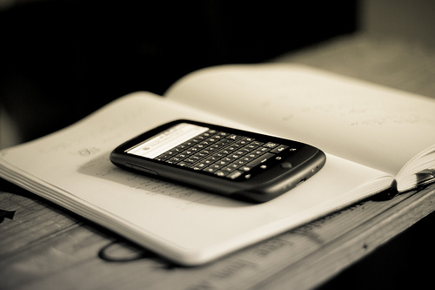
What can we change?
Improved OPACs
Full text, online accessible
Seamless discovery to delivery
  Access more important than discovery
  Mobile access
Notes:
Image from http://www.flickr.com/photos/johanl/5131980180/
Zickuhr, K. , Rainie, L., & Purcell, K. (2013). Library services in the digital age. Pew Internet and American Life Project.
Overall, 63% of respondents say they would be likely to use library a cell phone app that would allow
them to access and use library services from their phone; some 35% say they would be “very likely” to
use such an app, including 45% of smartphone owners and 41% of tablet owners. (Zickuhr, Rainie, & Purcell, 2013, p.62).
In the past 12 months, 25% of Americans (16 and older) visited a library website, 13% used a handheld device to access a library website (Zickuhr, Rainie & Purcell, 2013).
“Not to mention reading online pdf books. Its really cool that now a days you dont have to go to the library to find a book but its right there on your labtop.“ (Digital Visitors & Residents, USU2, Emerging Diary 11, Phase 2, Female, Age 19)
“I know they’ve changed the website. I think they changed that, actually, pretty recently. But now it just seems like you have more access just kind of with your library account just online you have more access. You don’t have to come here. You don’t have to call. It just seems like it’s easier to find something in researching” (Digital Visitors & Residents, USG3, 0:15:54, Female, Age 23).
VRS meets users where they are
Text, e-mail, chat
Facebook
Librarians’ expertise can deliver quality sources to users through VRS that they cannot find with a Google search
Link users to special collections
Facebook (“On Facebook, Librarian Brings 2 Students From the Early 1900s to Life,” January 6, 2012, Nick DeSantis, Chronicle of Higher Education. http://chronicle.com/blogs/wiredcampus/on-facebook-librarian-brings-two-students-from-the-early-1900s-to-life/34845
Joe McDonald, sophomore at University of Nevada, Reno in 1913, and girlfriend and future wife, Leola Lewis
University of Washington includes its special collections in the references in Wikipedia

Slide 19

What can we do?
Advertise resources, brand, & value
Provide search help at time of need
    Chat & IM
    Mobile technology
Design all of our systems with users in mind
  Familiar formats
Model services on popular services
Notes:
Image from Microsoft Clip Art
Zickuhr, K. , Rainie, L., & Purcell, K. (2013). Library services in the digital age. Pew Internet and American Life Project.
Advertise resources, brand, value
One aspect mentioned very often, both in focus groups and in qualitative work from previous research, is that people wish they were more aware of the full range of services offered by their libraries. One focus group member loved her local library and rated it highly in all areas—except communication; “there’s so much good stuff going on but no one tells anybody.” Another said, “they do so many fabulous things, [but] they have horrible marketing” (Zickuhr, Rainie, & Purcell, p. 38)
However, focus group members say that having resources and events listed on their library’s website wasn’t enough—as several participants pointed out, they probably weren’t going to go to the website to look for events (or even to sign up for email newsletters) unless they already knew that the library had those events (Zickuhr, Rainie, & Purcell, p. 38)
Help at time of need
When asked, “What do you value in VRS?”, one participant said “Instantaneous help. Sometimes if you're looking for something and you can't find it, it takes forever. Since you have someone there that can respond to you live, you have the comfort that someone is there” (Cyber Synergy ,VS47, Male, Age 26-34)
Another was able to receive searching help in a database, “I would say it was my freshman year and I was doing an English paper for my expository writing class and I was looking for something in JSTOR and I used the "Ask a Librarian" to do more advanced searches in JSTOR as to what keywords to put in, and it really helped me. One, her quickness and response, and two, the simplicity of her instructions as to the key title words to put in really helped me and made it successful” (Cyber Synergy ,VS17, Female, Age 19-25)
Users in Mind
One size fits no one – design services for those who use them – Boutique libraries (Priestner, A., & Tilley, E. (2012). Personalising library services in higher education: The boutique approach. Farnham, Surrey, England : Ashgate).
Embedded librarians
Familiar formats
It's probably look very similar to Google, like a mass search engine with so many topics (Cyber Synergy ,VS17, Female Age 19-25).
I would say as far as interface goes, I do like the Google interface, but I do want professionals to be answering questions. I do want someone who has either subject expertise or experience in their fields. The interface should be something simple and clean, with options to just narrow things down from a basic search and from there become more specific. Especially for people who are not familiar with using the internet, I think it should be something that's easy for them to use as well (Cyber Synergy ,VS1, Female, Age 19-25).
Something clean, simple, streamlined and user friendly, but also credible sources (Cyber Synergy ,VS 23, Female, Age 26-34).
“Yes, I’m sure, because, you know, going to the library was a task. And part of, I’m sure, a lot of people, and as far as me is concerned from laziness, it was much easier to just scrap around. It’s so much easier to just strain to find something on the internet than to, like, drive to the library. But that was in high school. In college, and especially grad school, I’m not afraid to go to the library anymore because we have a very good [assist 0:45:56] and we have a very good website.” (Digital Visitors and Residents, USG2, 0:45:28, Male, Age 25,)
Trove (National Library of Australia): http://trove.nla.gov.au/
“It would probably have a general search bar like Google …” (Cyber Synergy ,VS21, Male, Age 19-25)
“I like the simplicity of Google, and the origin search box. I do think that my ideal situation would be more qualified people answering.” (Cyber Synergy VS4, Female, Age 26-34)

Slide 20

“By focusing on relationship building instead of service excellence, organizations can uncover new needs and be in position to make a stronger impact.”
(Matthews, 2012)
Notes:
Image from Microsoft Clip Art
Mathews, B. (2012). Think like a startup: A white paper to inspire library entrepreneurialism [White paper]. Retrieved from http://chronicle.com/blognetwork/theubiquitouslibrarian/2012/04/04/think-like-a-startup-a-white-paper/
Users do not know they can ask librarians (Kolowich, Seeking synchronicity: Revelations and recommendations for virtual reference)
Example: Seeking Synchronicity
Librarians identified successful VR encounters as those where they were able to offer instruction and specialized knowledge, the user had a positive attitude
Users identified successful VR encounters as those providing convenience, an accurate answer, and they were comfortable with the service
Connaway, L. S., & Radford, M. L. (2011). Seeking synchronicity: Revelations and recommendations for virtual reference. Dublin, OH: OCLC Research. Retrieved from http://www.oclc.org/reports/synchronicity/full.pdf
Kolowich, S. (2011, 22 August). Study: College students rarely use librarians’ expertise. USA Today. Retrieved from: http://www.usatoday.com/news/education/story/2011-08-22/Study-College-students-rarely-use-librarians-expertise/50094086/1

Slide 21
Selected Bibliography
Bertot, J. C., Berube, K., Devereaux, P., Dhakal, K., Powers, S., & Ray, J. (2012). Assessing the usability of WorldCat Local: Findings and considerations. The Library Quarterly, 82(2), 207-221.
Centre for Information Behaviour and the Evaluation of Research. (2008). Information behaviour of the researcher of the future: A CIBER briefing paper. London: CIBER (p. 14).
  Connaway, L. S. (2013). Exploring shifting changes in user engagement. NextSpace, 20, 16-17. [Available: http://www.oclc.org/nextspace/020/research.htm]
Connaway, L.S., & Dickey, T.J. (2010). Digital information seekers: Report of findings from selected OCLC, RIN, and JISC user behavior projects. http://www.jisc.ac.uk/media/documents/publications/reports/2010/digitalinformationseekerreport.pdf
Connaway, L. S., & Dickey, T. J. (2010). Towards a profile of the researcher of today: What can we learn from JISC projects? Common themes identified in an analysis of JISC Virtual Research Environment and Digital Repository Projects. http://ie-repository.jisc.ac.uk/418/2/VirtualScholar_themesFromProjects_revised.pdf
Connaway, L. S., Dickey, T. J., & Radford, M. L. (2011). “If it is too inconvenient I’m not going after it:” Convenience as a critical factor in information-seeking behaviors. Library & Information Science Research, 33(3), 179-190. (Selected for inclusion in the ALA Reference Research Review: 2011)
Connaway, L. S., Lanclos, D., & Hood, E. M. (forthcoming). “I find Google a lot easier than going to the library website.” Imagine Ways to Innovate and Inspire Students to Use the Academic Library. Proceedings of the Association of College & Research Libraries (ACRL) 2013 conference, April 10-13, 2013, Indianapolis, IN.

Slide 22
Selected Bibliography
Connaway, L. S., Lanclos, D., White, D., Le Cornu, A., & Hood, E. M. (2013). User-centered decision making: A new model for developing academic library services and systems. IFLA Journal, 39(1), 30-36.
Connaway, L. S., & Radford, M. L. (2011). Seeking synchronicity: Revelations and recommendations for virtual reference. Dublin, OH: OCLC Research. Retrieved from http://www.oclc.org/reports/synchronicity/full.pdf
Connaway, L. S., White, D., Lanclos, D., & Le Cornu, A. (2013). Visitors and Residents: What motivates engagement with the digital information environment? Information Research, 18(1). [Available:http://informationr.net/ir/18-1/infres181.html]
Consortium of University Research Libraries, and Research Information Network. (2007). Researchers’ use of academic libraries and their services: A report. London: Research Information Network and Consortium of University Research Libraries (CURL) (p. 31, p.64).
Cunningham, S. J. & Connaway, L. S. (1996). Information searching preferences and practices of computer science researchers. In J. Grundy (Ed.), Proceedings: Sixth Australian conference on computer-human interaction, November 24-27, 1996, Hamilton, New Zealand (pp. 294-299). Los Alamitos, CA: IEEE Computer Society Press.
Dempsey, L. (2013, January 23). The inside out library: Scale, learning, engagement. Presentation at
Hacettepe University, Beytepe, Ankara (Turkey).
Dempsey, L. (2008). Always on: Libraries in a world of permanent connectivity. First Monday, 14(1). Retrieved from http://www.firstmonday.org/htbin/cgiwrap/bin/ojs/index.php/fm/article/view/2291/207

Slide 23
Selected Bibliography
De Rosa, C. (2005). Perceptions of libraries and information resources: A report to the OCLC membership. Dublin, Ohio: OCLC Online Computer Library Center (p.1-17).
De Rosa, C. (2006). College students' perceptions of libraries and information resources: A report to the OCLC membership. Dublin, Ohio: OCLC Online Computer Library Center.
Dervin, B., Connaway, L. S., & Prabha, C. 2003-2006. Sense-making the information confluence: The whys and hows of college and university user satisficing of information needs. Funded by the Institute of Museum and Library Services (IMLS). http://www.oclc.org/research/activities/imls.html
De Santis, N. (2012, January 6). On Facebook, librarian brings 2 students from the early 1900s to life. Chronicle of Higher Education. Retrieved from http://chronicle.com/blogs/wiredcampus/on-facebook-librarian-brings-two-students-from-the-early-1900s-to-life/34845
Kolowich, S. (2011, 22 August). Study: College students rarely use librarians’ expertise. USA Today. Retrieved from: http://www.usatoday.com/news/education/story/2011-08-22/Study-College-students-rarely-use-librarians-expertise/50094086/1
Mathews, B. (2012). Think like a startup: A white paper to inspire library entrepreneurialism [White paper]. Retrieved from http://chronicle.com/blognetwork/theubiquitouslibrarian/2012/04/04/think-like-a-startup-a-white-paper/
Priestner, A., & Tilley, E. (2012). Personalising library services in higher education: The boutique approach. Farnham, Surrey, England : Ashgate.

Slide 24
Selected Bibliography
Radford, M. L., Connaway, L. S., Shah, C. (2011-2013). Cyber Synergy: Seeking Sustainability through Collaboration between Virtual Reference and Social Q&A Sites. Funded by the Institute of Museum and Library Services (IMLS), Rutgers University, and OCLC. http://www.oclc.org/research/activities/synergy/default.htm
Research Information Network. (2006). Researchers and discovery services: Behaviour, perceptions and needs. London: Research Information Network.
Research Information Network. (2009). E-journals: Their use, value and impact. London: Research Information Network.
Wasserman, S. (2012, June 18). The Amazon effect. The Nation. Retrieved from http://www.thenation.com/article/168125/amazon-effect
White, D., & Connaway, L. S. (2011). Visitors and residents: What motivates engagement with the digital information environment. Funded by JISC, OCLC, and Oxford University. http://www.oclc.org/research/activities/vandr/
White, D. S., & Le Cornu, A. (2011). Visitors and Residents: A new typology for online engagement. First Monday, 16(9). Retrieved from http://firstmonday.org/htbin/cgiwrap/bin/ojs/index.php/fm/article/viewArticle/3171/3049
Wong, W., Stelmaszewska, H., Bhimani,N., Barn, S., & Barn, B. (2009). User behaviour in resource discovery: Final report. http://www.jisc.ac.uk/whatwedo/programmes/inf11/userbehaviourbusandecon.aspx
Zickuhr, K. , Rainie, L., & Purcell, K. (2013). Library services in the digital age. Pew Internet and American Life Project.

Slide 25

Special thanks to Alyssa Darden, OCLC Research, for assistance in preparation of this presentation

Slide 26
Questions & Discussion
Lynn Silipigni Connaway, Ph. D
connawal@oclc.org
Notes:
26
26
26

