Slide 1
Visitors and Residents:
What Motivates Engagement with the Digital Information Environment?
University of Sheffield iSchool,
20 February 2013
Lynn Silipigni Connaway, Ph. D.
Senior Research Scientist
OCLC Research
connawal@oclc.org

Slide 2
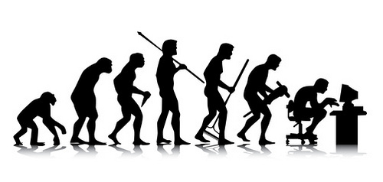
Then & Now
Then: The user built workflow around the library
Now: The library must build its services around user workflow
Then: Resources scarce, attention abundant
Now: Attention scarce, resources abundant
(Dempsey, 2008)
Notes:
Image: http://www.flickr.com/photos/aramisfirefly/3580397954/
Dempsey, L. (2008). Always on: Libraries in a world of permanent connectivity. First Monday, 14(1). Retrieved from http://www.firstmonday.org/htbin/cgiwrap/bin/ojs/index.php/fm/article/view/2291/207
Today, more than 1.7 billion people, or almost one out of every four humans on the planet, are online (Wasserman, 2012).
Wasserman, S. (2012, June 18). The Amazon effect. The Nation. Retrieved from http://www.thenation.com/article/168125/amazon-effect
“Yes, I’m sure, because, you know, going to the library was a task. And part of, I’m sure, a lot of people, and as far as me is concerned from laziness, it was much easier to just scrap around. It’s so much easier to just strain to find something on the internet than to, like, drive to the library. But that was in high school. In college, and especially grad school, I’m not afraid to go to the library anymore because we have a very good [assist 0:45:56] and we have a very good website.” (USG2 0:45:28, Male Age 25)
“I have better things to do than go drive all the way to the library when I can just sit at home and type it into my computer.” (USU1 0:33:12, Female Age 19)

Slide 3

Current Environment
Challenges
  Budget cuts
  High retirement rates
  Hiring freezes
Opportunity
  Best value for most use
  Understand how, why, & under what circumstances individuals use systems & services
Notes:
“A diamond is a chunk of coal made good under pressure.” –Henry Kissinger

Slide 4

Visitors and Residents:
What Motivates Engagement with the Digital Information Environment?
Funded by
  JISC
  OCLC
    Lynn Silipigni Connaway, Ph.D.
  Oxford University
    David White
    Alison Le Cornu, Ph.D.
In partnership with
  University of North Carolina, Charlotte
    Donna Lanclos, Ph.D.
Notes:
Microsoft Clip Art
White, D., & Connaway, L.S. (2011). Visitors and Residents: What Motivates Engagement with the Digital Information Environment. Funded by JISC, OCLC, and Oxford University. http://www.oclc.org/research/activities/vandr/.

Slide 5
Why Visitors and Residents Project?
If we build it, they will NOT come
Shifting changes in engagement with information environment
  Effect of larger cultural changes influenced by Web
  New attitudes towards education
Gap in user behaviour studies – need for longitudinal studies
Understand motivations for using & expectations of technologies & spaces in information environment
Inform project & service design to improve engagement & uptake
http://www.oclc.org/research/activities/vandr/

Slide 6
Research Questions
What are the most significant factors for novice & experienced researchers in choosing their modes of engagement with the information environment?
Do individuals develop personal engagement strategies which evolve over time & for specific needs & goals, or are the educational contexts (or, in the context of this study, “educational stages”) the primary influence on their engagement strategies?
Are modes of engagement shifting over the course of time, influenced by emergent web culture & the availability of “new” ways to engage, or are the underlying trends & motivations relatively static within particular educational stages?

Slide 7

Theoretical Framework
Prensky
  Digital Natives & Digital Immigrants
Wilson
  Models in information behaviour research
Cool & Spink
  Information seeking in context
Notes:
Cool, C., & Spink, A. (September 01, 2002). Issues of Context in Information Retrieval (IR): An Introduction to the Special Issue. Information Processing & Management, 38, 5, 605-11.
Prensky, M. (2001). Digital natives, digital immigrants. On the Horizon, 9(5). Retrieved from http://www.marcprensky.com/writing
Prensky, M. (2006). Listen to the natives. Educational Leadership, 63(4), 8-13.
Wilson, T. D. (1997). Information behaviour: an interdisciplinary perspective. Information Processing and Management, 33(4), 551-572.
Wilson, T. D. (1999). Models in information behaviour research. Journal of Documentation, 55(3), 249-270.
Theoretical Framework
Wilson (1999) defines information behaviour as “. . . those activities a person may engage in when identifying his or her own needs for information, searching for such information in any way, and using or transferring that information.” Within his model of information behaviour, Wilson describes a series of factors which affect and moderate information behaviour (1997). These include characteristics of the individual, the environment, or the resources.
Cool and Spink (2002) describe four levels of context related to information retrieval: 1. information environment level (institutional, organizational, work task), 2. information -seeking level (tasks, goals, intentions), 3. IR-interaction level (multiple searching behaviors), and 4. the query level (are queries interpreted correctly?)

Slide 8
Visitors & Residents
Video: http://is.gd/vanrvideo
First Monday Paper: http://is.gd/vandrpaper
(White & Connaway, 2011)
Notes:
Discuss Prensky and how this is an attempt to move away from Native/Immigrant metaphor:
“‘The digital natives/digital immigrants distinction is dead or at least dying’. So proclaims Doug Holton in his blogpost. He continues: ‘Unfortunately, the idea is still uncritically accepted even in some journal articles, and perhaps used as an excuse or crutch too often for poor or ineffective teaching practices’. Holton is not alone in his criticism. McKenzie (2007) writes strongly against Prensky’s (2001a, b) typology identifying a number of ‘thinly supported claims’, while Kennedy, et al. (2010) demonstrate through an empirical research project that Prensky’s age–related hypothesis is very much less clear–cut than the Natives and Immigrants dichotomy implies. Our intention is to propose an alternative, which we have termed ‘Visitors and Residents’.”
Holton, D. (2010, March 19). The digital natives/digital immigrants distinction is dead or at least dying. [Web log comment]. EdTechDev . Retrieved from http://edtechdev.wordpress.com/2010/03/19/the-digital-natives-digital-immigrants-distinction-is-dead-or-at-least-dying/
Kennedy, G., Judd, T. & Dalgarno, B. (2010). “Beyond natives and immigrants: Exploring types of net generation students,” Journal of Computer Assisted Learning, 26(5), 332–343.
McKenzie, J. (2007). Digital nativism, digital delusions, and digital deprivation. From Now On: The Educational Technology Journal, 17 (2). Retrieved from http://www.fno.org/nov07/nativism.html
Prensky, M. (2001a). Digital natives, digital immigrants. On the Horizon, 9(5). Retrieved from http://www.marcprensky.com/writing/Prensky%20-%20Digital%20Natives,%20Digital%20Immigrants%20-%20Part1.pdf
Prensky, M. (2001b). “Do they really think differently?” On the Horizon, 9(5). Retrieved from http://www.marcprensky.com/writing/Prensky%20-%20Digital%20Natives,%20Digital%20Immigrants%20-%20Part2.pdf
White, D. S., & Le Cornu, A. (2011). Visitors and Residents: A new typology for online engagement. First Monday, 16(9). Retrieved from http://firstmonday.org/htbin/cgiwrap/bin/ojs/index.php/fm/article/viewArticle/3171/3049

Slide 9
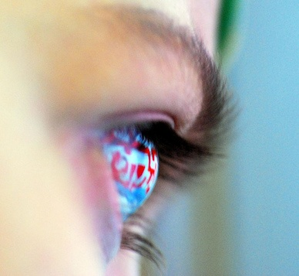
Residents
Significant online presence & usage
Collaborative activity online
Contribute online
Mobile device dependence
>10 hours online/week
Notes:
Residents: significant online presence and usage; high level of collaborative activity online; contributions to the online environment in the form of uploading materials, photos, videos; high dependence on a mobile device (smart phone, laptop, etc.); more than 10 hours a week spent online.

Slide 10

Visitors
Functional use of technology
Formal need
Passive online presence
Favor FtF interactions
<6 hours online/week
Notes:
Visitors: functional use of technology, often linked to formal need (such as use of software for specific coursework, or organising meetings through email contact); less visible/more passive online presence, more likely to favour face- to- face interactions (even as they use the internet to organize/schedule those interactions); fewer than 6 hours spent online a week.

Slide 11
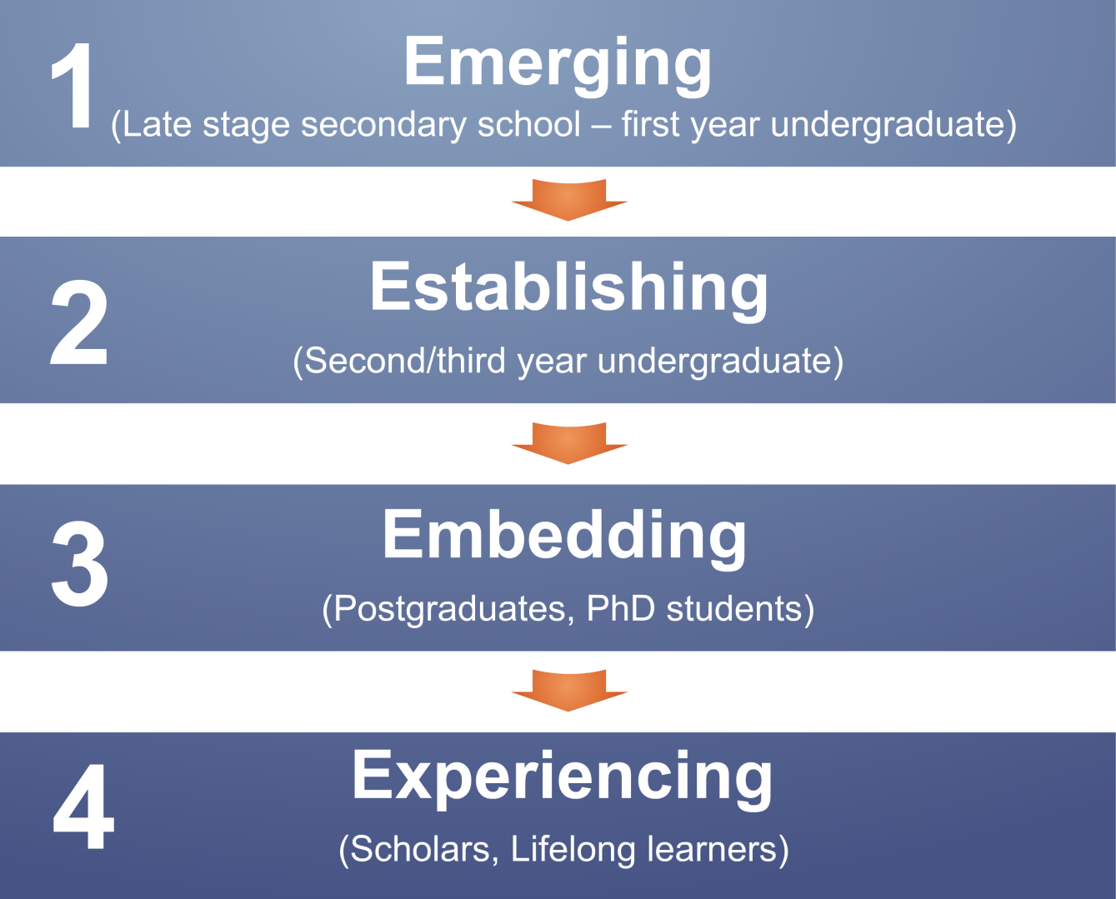
Visitors & Residents
(White & Connaway, 2011-2012)
Notes:
White, D. S., & Connaway, L. S. (2011-2012). Visitors & residents: What motivates engagement with the digital information environment. Funded by JISC, OCLC, and Oxford University. Retrieved from http://www.oclc.org/research/activities/vandr/
Phase I and 2: Participant Demographics (All Stages)
There were 31 Emerging participants, and 10 each for Establishing, Embedding, and Experienced.
15 Secondary students, 46 University students and faculty
Ethnicities (All)
5 African-American, 38 Caucasian, 2 Two or more, 1 Asian, 2 Hispanic, 13 Unidentified
Genders (All)
34 females, 27 males
Economic class:
Attempts were made to recruit secondary students from schools with a wide range of socio-economic backgrounds. This is basically a convenience sample of students—those who were willing to be interviewed by us, in institutions that allowed us entry.
We also asked questions about parents’ educational backgrounds, and current/past vocations, to enrich our picture of interviewee backgrounds. We then analyzed the highest degree attained (the parents’ highest degree attained for students) to create an economic proxy.
Phase 1: Interviewed Emerging educational stage individuals
Majority of students aged 18 & 19 with a few outliers
31 participants (16 US, 15 UK)
Phase 2: Interviewed individuals in
Establishing (second/third year undergraduate),
10 participants (5US, 5 UK)
Embedding (postgraduates, PhD students), &
10 participants (5 US, 5 UK)
Experienced (Scholars) stages
10 participants (5 US, 5 UK)
Some Phase 1 and Phase 2 participants agreed to submit monthly diaries (8 in the US and 6 in the UK)
Phase 3: Continue interviews
Continue collecting diaries
Test interview & diary results with in-depth survey
50 participants from each educational stage from US & UK
Phase 4: Interview second group of 12 students in Emerging stage
Help determine if methods of engagement change over time

Slide 12
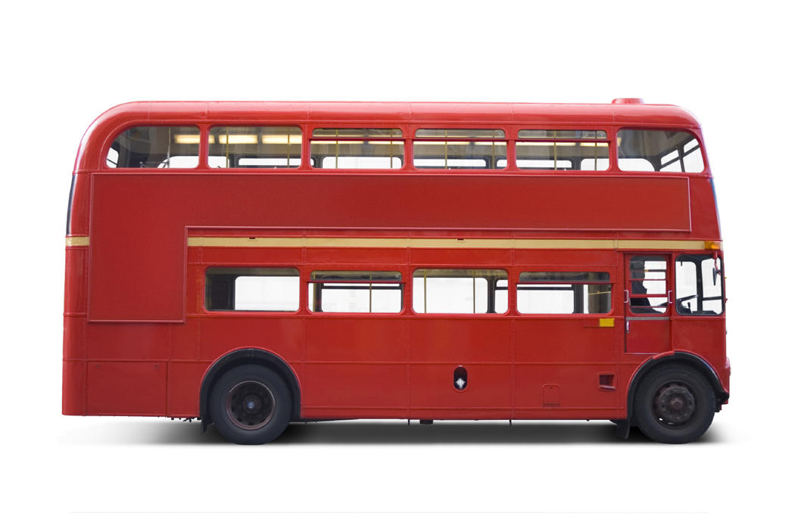

Phase 1
Individual Interviews
  Emerging (secondary school/1st year undergraduates
    31 (16 US, 15 UK)
  Establishing (2nd-3rd year undergraduates)
    10 (5 US, 5 UK)
  Embedding (postgraduates, PhD students)
    10 (5 US, 5 UK)
  Experiencing (scholars)
    10 (5 US, 5 UK)
Completed data analysis
  Quantitative data:
    Demographics, number of occurrences of technologies, sources, & behaviours
  Qualitative data:
    Themes & direct quotes
(White & Connaway, 2011-2012)
Notes:
Image: Microsoft Clip Art
The initial 6-month pilot stage focused on the Emerging educational stage to refine the research methodology and to establish the value of the work to the stakeholders. In the US the project worked in close partnership with the University of North Carolina, Charlotte (UNCC) to recruit participants, from different socio-economic groups from both private and public secondary schools as well as first-year university students. In the UK participants were drawn from Oxford Brooks University, Warwick University and secondary schools in Oxford Leicester.
Convenience Sample
Thirty individuals in the Emerging Educational Stage (late stage secondary/high school and 1st year university) were recruited -15 in the US and 15 in the UK.
Of the 30 participants recruited 8 in the US and 6 in the UK (14 Total) were asked to document their information seeking activities for a 3-month period. Eight have continued to submit monthly diaries throughout the year. They were closely facilitated through this process and communicated with the research team in the medium of their choice over this period.
The quantitative data include demographics; number of occurrences for different types of technologies, sources, and behaviours.
The qualitative data provide themes that identify behaviours and sources for different contexts and situations and include direct quotes and behaviours.
White, D. S., & Connaway, L. S. (2011-2012). Visitors and residents: What motivates engagement with the digital information environment. Funded by JISC, OCLC, and Oxford University. Retrieved from http://www.oclc.org/research/activities/vandr/

Slide 13

Phase I & 2: Participant Demographics
61 participants
15 secondary students
46 university students & faculty
34 females
27 males
38 Caucasian
5 African-American
2 Two or more
1 Asian
2 Hispanic
13 Unidentified
(White & Connaway, 2011-2012)
Notes:
Image: http://www.flickr.com/photos/doug88888/4570566630/in/set-72157606920303752/
Phase I and 2: Participant Demographics (All Stages)
15 Secondary students, 46 University students and faculty
Ethnicities (All)
5 African-American, 38 Caucasian, 2 Two or more, 1 Asian, 2 Hispanic, 13 Unidentified
Genders (All)
34 females, 27 males
White, D. S., & Connaway, L. S. (2011-2012). Visitors and residents: What motivates engagement with the digital information environment. Funded by JISC, OCLC, and Oxford University. Retrieved from http://www.oclc.org/research/activities/vandr/
http://www.flickr.com/photos/doug88888/4570566630/

Slide 14
Academic Disciplines by Educational Stages
Connaway for OCLC Research. 2013.
Notes:
These are the Academic Disciplines for the 46 participants not labeled as still being in Secondary school (Undergraduates, Graduates, and Faculty), pulled from all 4 educational stages.
Because there were so many majors and disciplines, they have been filtered down to the six basic groups. You can find them here http://en.wikipedia.org/wiki/List_of_academic_disciplines. Professions & Applied Sciences are: Agriculture, Architecture and Design, Business, Divinity, Education, Engineering, Environmental Studies and Forestry, Family and Consumer Science, Health Science, Human Physical Performance and Recreation, Journalism, Media Studies and Communication, Law, Library and Museum Studies, Military Sciences, Public Administration, Social Work, Transportation.
Emerging
8 Professions and Applied Sciences (3 UK, 5 US)
2 Undeclared (0 UK, 2 US)
2 Humanities (2 UK, 0 US)
2 Natural Sciences (2 UK, 0 US)
1 double major (0 UK, 1 US)
1 Social Sciences (0 UK, 1 US)
Establishing
4 Professions and Applied Sciences (3 UK, 1 US)
4 double major (1 UK, 3 US)
1 Humanities (1 UK, 0 US)
1 Formal Sciences (0 UK, 1 US)
Embedding
2 Professions and Applied Sciences (2 UK, 0 US)
3 Humanities (3 UK, 0 US)
2 Natural Sciences (0 UK, 2 US)
3 Unidentified (0 UK, 3 US)
Experiencing
2 Humanities (2 UK, 0 US)
3 Professions and Applied Sciences (2 UK, 1 US)
1 Social Sciences (1 UK, 0 US)
1 Natural Sciences (0 UK, 1 US)
3 Unidentified (0 UK, 3 US)
White, D. S., & Connaway, L. S. (2011-2012). Visitors and residents: What motivates engagement with the digital information environment. Funded by JISC, OCLC, and Oxford University. Retrieved from http://www.oclc.org/research/activities/vandr/

Slide 15

Triangulation of Data
Several methods:
  Semi-structured interviews (qualitative)
  Diaries (qualitative)
  Online survey (quantitative)
Enables triangulation of data
(Connaway et al., 2012)
Notes:
Image: Microsoft Clip Art
“Several methods of data collection are being utilized in this study: semi-structured interviews, diaries, and an online survey. The multi-method design enables triangulation, which provides a cross examination of the data analysis and results. The quantitative and qualitative methods, including ethnographic methods that devote individual attention to the subjects, yield a very rich data set enabling multiple methods of analysis.”
Connaway, L. S., Lanclos, D., White, D. S., Le Cornu, A., & Hood, E. M. (2012). User-centered decision making: A new model for developing academic library services and systems. IFLA 2012 Conference Proceedings, August 11-17, Helsinki, Finland.
White, D., & Connaway, L.S. (2011). Visitors and Residents: What Motivates Engagement with the Digital Information Environment. Funded by JISC, OCLC, and Oxford University. http://www.oclc.org/research/activities/vandr/.

Slide 16

Diaries
Ethnographic data collection technique
Get people to describe what has happened
Center on defined events or moments
(Connaway & Powell, 2010)
Notes:
The diaries are an ethnographic data collection technique and a form of event sampling, which can focus participant attention on those areas which most interest researchers. Connaway and Powell (2010) point out that instruments (like diaries) that are intended to get people to describe what has just happened to them may be affected by distortions of memory and retrospection. They recommend that the question under review “center on discrete, defined events or moments so that such recording effort becomes reasonable and recall efforts are relatively straightforward” (Connaway and Powell 2010, 222).
Ethnography
(From Basic Research Methods 5th Edition, p. 175-176)
Ethnography involves establishing rapport, selecting research participants, transcribing observations and conversations, and keeping diaries, although Geertz believes that none of these techniques or procedures adequately defines the venture. He believes ethnography is defined by the kind of intellectual effort it is, “an elaborate venture in ‘thick description.’ ”
Reality, as perceived by the observer, is described in such detail that the reader can experience the total event as if he or she had actually been involved in it.
The goal of ethnography is to establish rapport with target communities, via a flexible toolkit of methods including participant observation, structured and unstructured interviews, reliance on selected research participants as “key informants,” and keeping diaries. The analytical intellectual work of ethnography involves being able to engage in a particular way of seeing (Wolcott 2008) that is informed by the ethnographer’s immersion in the reality of other people’s existence. Such qualitative data must be approached and interpreted in a way that recognizes and retains this richness (Connaway and Powell 2010).
Geertz, Clifford. 1973. The interpretation of cultures: selected essays. New York: Basic Books, 6.
Connaway, L. S., & Powell, R. R. (2010). Basic research methods for librarians. Santa Barbara, CA: Libraries Unlimited.

Slide 17

Interviews
Allows for
  Probing
  Clarifying
  Creating new questions
  Including focused questions
  Exploring new lines of inquiry
Enables data collection for extended period of time
(Connaway & Powell, 2010)
Notes:
Image: http://www.flickr.com/photos/myxi/4327438430/in/gallery-piterart-72157626469014676
Interviews
(From Basic Research Methods 5th Edition, p. 218-220)
Interviewing’s primary strength is its ability to range over a time period, thereby capturing more than the single instant of an isolated action . This flexible technique allows the investigator to probe, to clarify, and to create new questions based on what has already been heard. Well conducted, in-depth interviews develop narratives along the lines of most immediacy for the participant while also providing the researcher with the opportunity to include focused questions that fill in gaps, clear up ambiguities, explore new lines of inquiry, and make connections among statements. The thoughtful sequencing of different mechanisms for eliciting information includes the use of direct questions when following up on topics that a participant has identified as critical, silence that allows people the time needed to reflect on a topic, and structured questions to pull an interview back on track.
Connaway, L. S., & Powell, R. R. (2010). Basic research methods for librarians. Santa Barbara, CA: Libraries Unlimited.
Glaser, Barney G., and Anselm L. Strauss. 1967. The discovery of grounded theory; strategies for qualitative research. Chicago: Aldine Pub. Co., 273.
Kvale, Steinar. 1996. IntervVews: an introduction to qualitative research interviewing. Thousand Oaks, Calif: Sage Publications, 133-135.
Whyte, William F. “On Making the Most of Participant Observation,” The American Sociologist 14 (1979): 56-66.

Slide 18
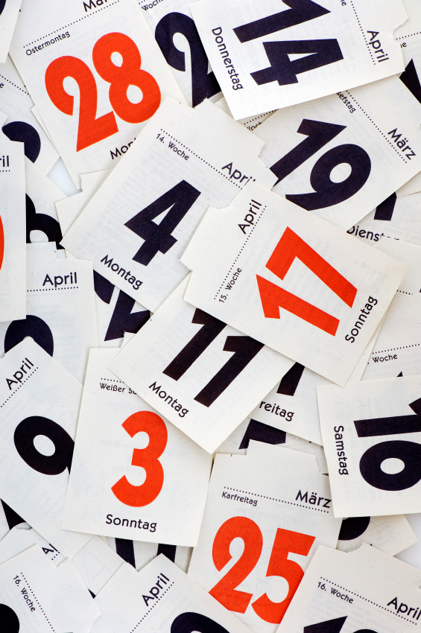
Participant Interview Questions
1. Describe the things you enjoy doing with technology and the web each week.
2. Think of the ways you have used technology and the web for your studies. Describe a typical week.
3. Think about the next stage of your education. Tell me what you think this will be like.
Notes:
Image: Microsoft Clip Art

Slide 19
Participant Interview Questions
4. Think of a time when you had a situation where you needed answers or solutions and you did a quick search and made do with it. You knew there were other sources but you decided not to use them. Please include sources such as friends, family, teachers, coaches, etc.
5. Have there been times when you were told to use a library or virtual learning environment (or learning platform), and used other source(s) instead?
6. If you had a magic wand, what would your ideal way of getting information be? How would you go about using the systems and services? When? Where? How?
(Connaway & Radford, 2005-2007)
(Dervin, Connaway, & Prabha, 2003-2005)
Notes:
These questions come from previous research
1. Dervin, B., Connaway, L. S., & Prabha, C. (2003-2005). Sense-making the information confluence: The hows and the whys of college and university user satisficing of information needs. Funded by the Institute for Museums and Library Services (IMLS). Retrieved from http://www.oclc.org/research/activities/past/orprojects/imls/default.htm
2. Radford, M. L., & Connaway, L. S. (2005-2007). Seeking synchronicity: Evaluating virtual reference services from user, non-user, and librarian perspectives. Funded by the Institute for Museums and Library Services (IMLS). Retrieved from http://www.oclc.org/research/activities/synchronicity/default.htm

Slide 20

Surveys/Questionnaires
Encourages frank answers
Eliminates variation in the question process
Can collect large amount of data in short period of time
Delivery
  In-person
  Telephone
  Mail
  Email
  Online
  Point of contact
(Connaway & Powell, 2010)
Notes:
Basic Research Methods 5th Edition, p. 146-147
“The questionnaire, especially the mail, email, and Web-based questionnaire, tends to encourage frank answers. This is in large part because it is easier for the researcher to guarantee anonymity for the respondent when using a mail questionnaire.”
“Another way of stating the second advantage is that the fixed format of the questionnaire tends to eliminate variation in the questioning process. Once the questions have been written in their final version and included in the questionnaire, their contents and organization will not change.”
“Questionnaires can facilitate the collection of large amounts of data in a relatively short period of time. Questionnaire-based surveys of several thousand people are not unusual, and responses typically are expected within one to two weeks.”
Basic Research Methods 5th Edition, p. 221
“Questionnaires vary by means of delivery (in-person, telephone, mail, email, WWW, and point-of-contact) and format (open-ended questions, attitudinal
scales, multiple choice questions, ratings, and rankings). This is perhaps the most thoroughly studied form of data gathering.”
Connaway, L. S., & Powell, R. R. (2010). Basic research methods for librarians. Santa Barbara, CA: Libraries Unlimited.

Slide 21

Codebook
Place
Sources
Tools
Agency
Situation/context
Quotes
Contact
Technology Ownership
Network used
(White & Connaway, 2011-2012)
Notes:
Microsoft Clip Art
The codebook was created with a grounded analysis of the interviews of the Emerging group, and is to date one of our most significant research findings.
There was significant discussion among researchers about the content of the codebook, via emails and Skype conversations. We started writing the codebook in May, and the final version came about in mid-September.
The content of the codebook reveals the priorities and practices of the Emerging group, but has been used to analyze the remaining groups we interview. (We used the codebook to analyze faculty interviews even if we don’t have a code for LinkedIn)
Discuss the content of the codebook.
White, D. S., & Connaway, L. S. (2011-2012). Visitors and residents: What motivates engagement with the digital information environment. Funded by JISC, OCLC, and Oxford University. Retrieved from http://www.oclc.org/research/activities/vandr/

Slide 22

Codebook
I. Place
A. Internet
1. Search engine
a. Google
b. Yahoo
2. Social Media
a. FaceBook
b. Twitter
c. You Tube
d. Flickr/image sharing
e. Blogging
B. Library
1. Academic
2. Public
3. School (K-12)
C. Home
D. School, classroom, computer lab
E. Other
(White & Connaway, 2011-2012)
Notes:
http://www.flickr.com/photos/themadguru/3546619930/
How we used the codebook:
First: the 3 researchers and research assistant coded the same two transcripts, one US and one UK (both secondary school).
We met and re-met and coded and re-coded until there was agreement.
THEN we went our separate ways to code. BUT we still communicate with each other in our coding processes, because of the remote nature of our collaboration.
Coding is done on paper, for the most part, and then the codes are entered into word, or scanned and sent to research assistants, who enter the coding into NVivo9. When the research assistants are entering the coding, they notice discrepancies, document them, and generate a discussion about what was intended, and what should the final coding be.
This continuous communication provides more consistency in coding across the researchers.
When Inter-coder Reliability was calculated between all five coders it was found to be an average of 0.6380 for Kappa and an Agreement Percentage of 98%.
White, D. S., & Connaway, L. S. (2011-2012). Visitors and residents: What motivates engagement with the digital information environment. Funded by JISC, OCLC, and Oxford University. Retrieved from http://www.oclc.org/research/activities/vandr/

Slide 23
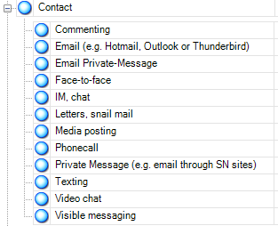
Nvivo 9
Qualitative research software
Upload documents, PDFs, & videos
Create nodes & code transcripts
Merge files
Queries
Reports
Models
(QSR International, 2011)
Notes:
QSR International. (2011). NVivo 9: Getting started. Retrieved from http://download.qsrinternational.com/Document/NVivo9/NVivo9-Getting-Started-Guide.pdf
Screenshot of our codebook in Nvivo 9

Slide 24
You have a last-minute project to complete. Where would you go to get information?
GOOGLE
ASK SOMEONE
-Family
-Colleague
-Friend
-Librarian
-Professor
FACEBOOK SOMEONE
-Family
-Colleague
-Friend
-Librarian
-Professor
TEXT SOMEONE
-Family
-Colleague
-Friend
-Librarian
-Professor
Connaway for OCLC Research. 2013.

Slide 25
Place & Educational Stage
Connaway for OCLC Research. 2013.
Notes:
The percentages of mentions of using Facebook are lowest at 90% with Experiencing, highest with Establishing and Embedding with 100% mentioning Facebook.
Establishing also are the highest users of Google at 100%, with Experiencing at only 80%.
Experiencing, however, are the highest for mentioning Twitter at 70%, with a mere 3% mentioning Twitter in the Emerging stage.
Establishing are the highest YouTube mentions at 50%, with 23% of Emerging being the lowest mentions of YouTube.

Slide 26
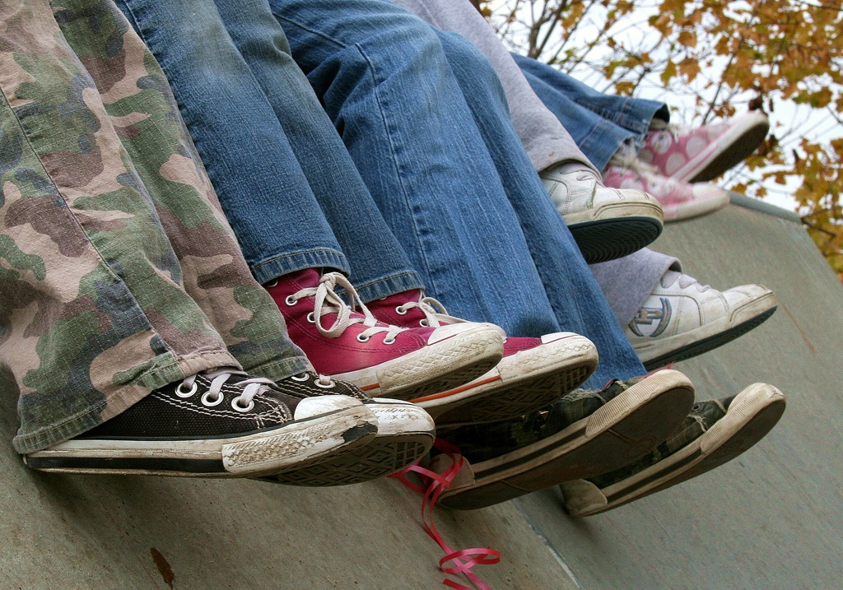
“I always stick with the first thing that comes up on Google because I think that’s the most popular site which means that’s the most correct.”
(USS1, Female, Age 17)

Slide 27
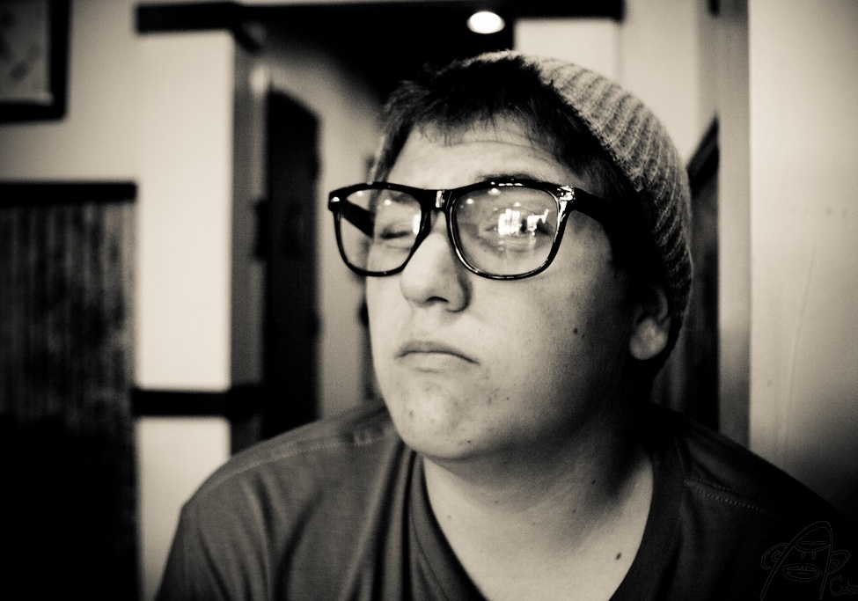
“Google doesn’t judge me”
(UKF3, Male, Age 52)

Slide 28
Human Sources & Educational Stages
Connaway for OCLC Research. 2013.
Notes:
All stages
Mentions of contact with human beings go across the board—the percentages are at the lowest at 90% with Embedding (graduate students). Where the shifts happen is in which particular people are being contacted. Emerging students contact parents at rates of more than 48% (with a high of 58% for mothers—that came out in Sensemaking: The Information Confluence and Seeking Synchronicity). They contact friends even more at 68%. These percentages closely match those of the Establishing upper-division students. There is a striking decline in consultations with family members among graduate students, but there is a decline across the board in human consultation within the Embedding stage, perhaps reflecting an emphasis on individual work, and the need for graduate students in particular to figure things out on their own, before they can be recognized as experts in their field. (cf grad students being afraid that the transcripts for virtual reference would be seen by their professors, in Seeking Synchronicity). The percentages reconfigure themselves altogether in the Experiencing category, with faculty not mentioning parents more than 10% of the time, , but mentioning peers 50%, and Librarians 20%, the highest percentage of mentions in any category.
“One of my favourite ways of getting information is by asking people. Instead of Googling the whole time I mostly have faith in the fact that people are actually learning, if I can go to a tutor and ask them something.” (UKU3 0:19:34, Female Age 19)

Slide 29

The word “librarian” never mentioned in original interviews by Emerging Stage participants as a source of information
One participant referred to “a lady in the library who helps you find things”
(USU5, Male, Age 19)
Notes:
Image: http://www.flickr.com/photos/domesticat/2438570563/
“– there’s a lady in the library who helps you find things.” USU5, Systems Engineering, Male, Age 19

Slide 30

Library=books
34 participants mention the library equating with books
Notes:
Image: Microsoft Clip Art
Findings indicate that the library equates books with this being implied by 22 Emerging participants, 6 Establishing, 6 Embedding, and yet very interestingly, by none of the Experiencing participants.
In a recent Pew Internet & American Life Project report, a national survey of Americans (16 years and older) found that 80% declare borrowing books is a “very important” service libraries provide (Zickuhr, Raine, and Purcell 2013). Additionally, of the 53% who had visited a library or bookmobile in the last year, 73% said they visit to borrow print books (Zickuhr, Raine, and Purcell 2013).
Pew Internet & American Life Project. (2013). Library services in the digital age. Zickuhr, K., Rainie, L., & Purcell, K.
“So I don’t tend to want to spend my weekend wandering round Oxford trying to find books in the library if I’m perfectly honest. You know? That’s just me.” (UKU1 0:19:41, Female Age 57)
“Getting a book out of the library is a slower process but it is a more fulfilling process and if I could add to that I prefer doing my academic work by hand because I feel more of a connection with my work that I put more effort into it.” (UKU3 0:24:44, Female Age 19)
“I don’t use the library. Most students really don’t anymore, I know a couple of people that live here but they don’t actually use it for books, they use it as a quiet place to study.” (USU4 0:36:27, Male Age 19)

Slide 31
Digital Sources & Educational Stage
Connaway for OCLC Research. 2013.
Notes:
Major Media Sites and Wikipedia were the highest sources mentioned among the Websites. Major Media Sites only were mentioned by 26% (n=8) of Emerging participants, but 50% (n=5) of Establishing participants, 70% (n=7) of Embedding participants, and 40% (n=4) of Experiencing participants. Wikipedia was highly referred to by 77% (n=24) of Emerging interviewees, 90% (n=9) of Establishing interviewees, 70% (n=7) of Embedding interviewees, before dropping to 50% (n=5) of Experiencing interviewees.
Other notables were University Websites, mentioned by 40% (n=4) of Establishing participants and 50% (n=5) of Embedding participants. The large number of Embedding and Experiencing mentions of University Databases does not necessarily mean they actually use them more than the Emerging group, but could mean they know what they are using, and know enough to call them out by name. Relatively lower numbers of mentions among Emerging should not necessarily be read as a measure of how often undergraduates use university databases—the rate might actually be high, but they don’t know that is what they are doing, and so it doesn’t show up in interviews.
Retail websites were brought up by 40% of Establishing participants and 50% (n's=5) of Embedding and Experiencing. The use of retail sites is much lower in Emerging stage, in part because that includes students who have not yet left home. Once they are upper-division students, the percentage jumps to 40%, and then levels off to 50% in both Embedding and Experiencing stages. This is something to think about, because the use of retail websites can set expectations among users in terms of the conventions of websites, what sorts of things they expect to do with chat, etc.
Syllabus- and discipline-based sites were spoken of by 48.4% (n=15) of Emerging interviewees, 40% (n's 4) of Establishing and Experiencing interviewees, but only 20% (n=2) of Embedding participants.
Also, the lower percentage of mentions of Wikipedia by Emerging, in comparison to other stages, might be an indication of their worries about the legitimacy of Wikipedia as a source (as expressed by their teachers in high school), and so they mention it less. Perhaps, as students gain more confidence in their ability to tell whether the information on Wikipedia is reliable or not, they are more confident in revealing their uses of it as a resource.

Slide 32
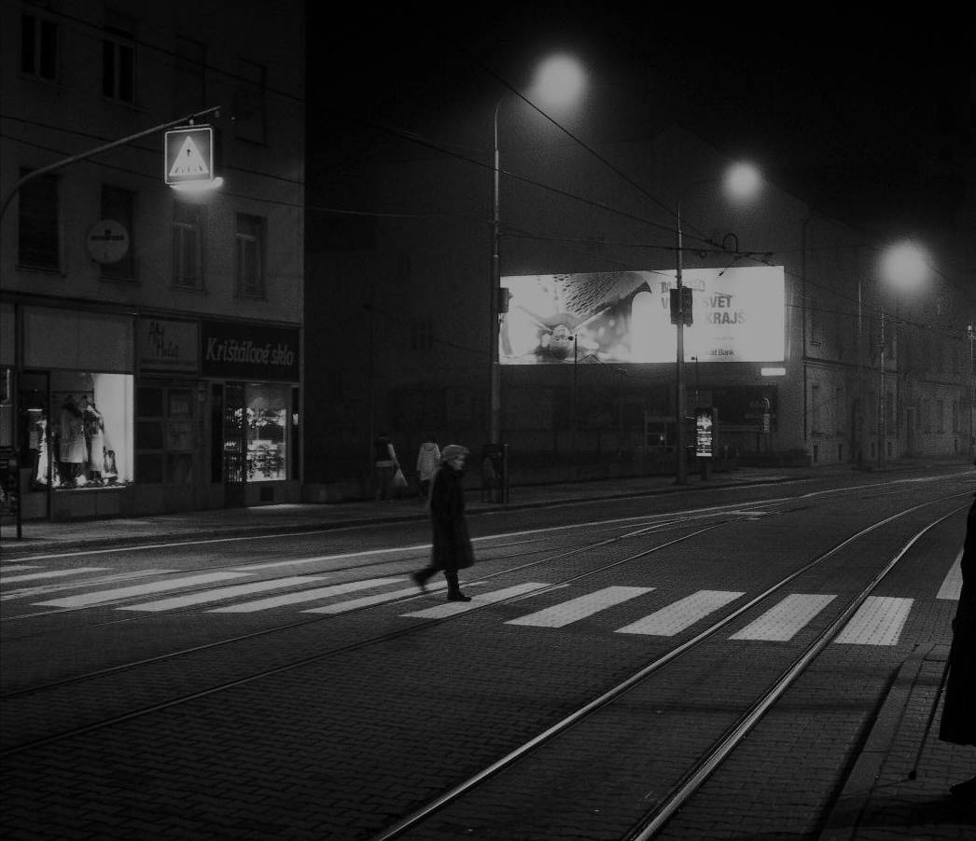
“It’s like a taboo I guess with all teachers, they just all say – you know, when they explain the paper they always say, “Don’t use Wikipedia.” (USU7, Female, Age 19)
“I just type it into Google and see what comes up.” (UKS2)
Learning Black Market
Notes:
Image: http://wp.me/pLtlj-fH
Covert online study habits
Wikipedia
Don’t cite
Widely used
Guilt
Students & teachers disagree
Quality sources
There is a “Learning Black Market”: learners use non-traditional sources but feel they cannot talk about them in an institutional context. Wikipedia usage is an example of this. (White & Connaway, 2011)
White, D. S., & Le Cornu, A. (2011). Visitors and Residents: A new typology for online engagement. First Monday, 16(9). Retrieved from http://firstmonday.org/htbin/cgiwrap/bin/ojs/index.php/fm/article/viewArticle/3171/3049
“I mean if teachers don’t like using Wikipedia they don’t want you to use Wikipedia. A lot of students will still use Wikipedia and then cite another source. As long as it has the same information and it is not word for word or anything they’ll use Wikipedia because it is the easiest thing to go look up on Wikipedia. It will give you a full in-depth detailed thing about the information. Teachers don’t just like it because it’s not the most reliable source since anyone can post something on there even though the site is monitored, it’s because it’s too easy.” (USU3 0:30:59, Male Age 19)
Students’ Perceptions of Teachers’ opinions of Wikipedia:
“Avoid it.” (UKS8 0:28:28.3, Female Age 16)
“They say it’s because anyone can make up – I mean, anyone can add information on there but I mean when I’ve actually looked into information it seemed the same as any information I find anywhere else. I mean, it’s not like if you look up fourth of July, it’s not like it gives you like some weird explanation of aliens or something.” (USU7 0:33:14, Female Age 19)
Students’ on Wikipedia:
“I use it, kind of like, I won't cite it on my papers but I, kind of, use it as a like, as a start off line. I go there and look up the general information, kind of, read through it so I get a general idea what it is. Then I start going through my research.” (USU7 0:33:49, Female Age 19)
“Everyone knows that you try not to use Wikipedia as a source because it is a cardinal sin.” (UKU3 0:31:03, Female Age 19)

Slide 33
Contact & Educational Stages
Connaway for OCLC Research. 2013.

Slide 34
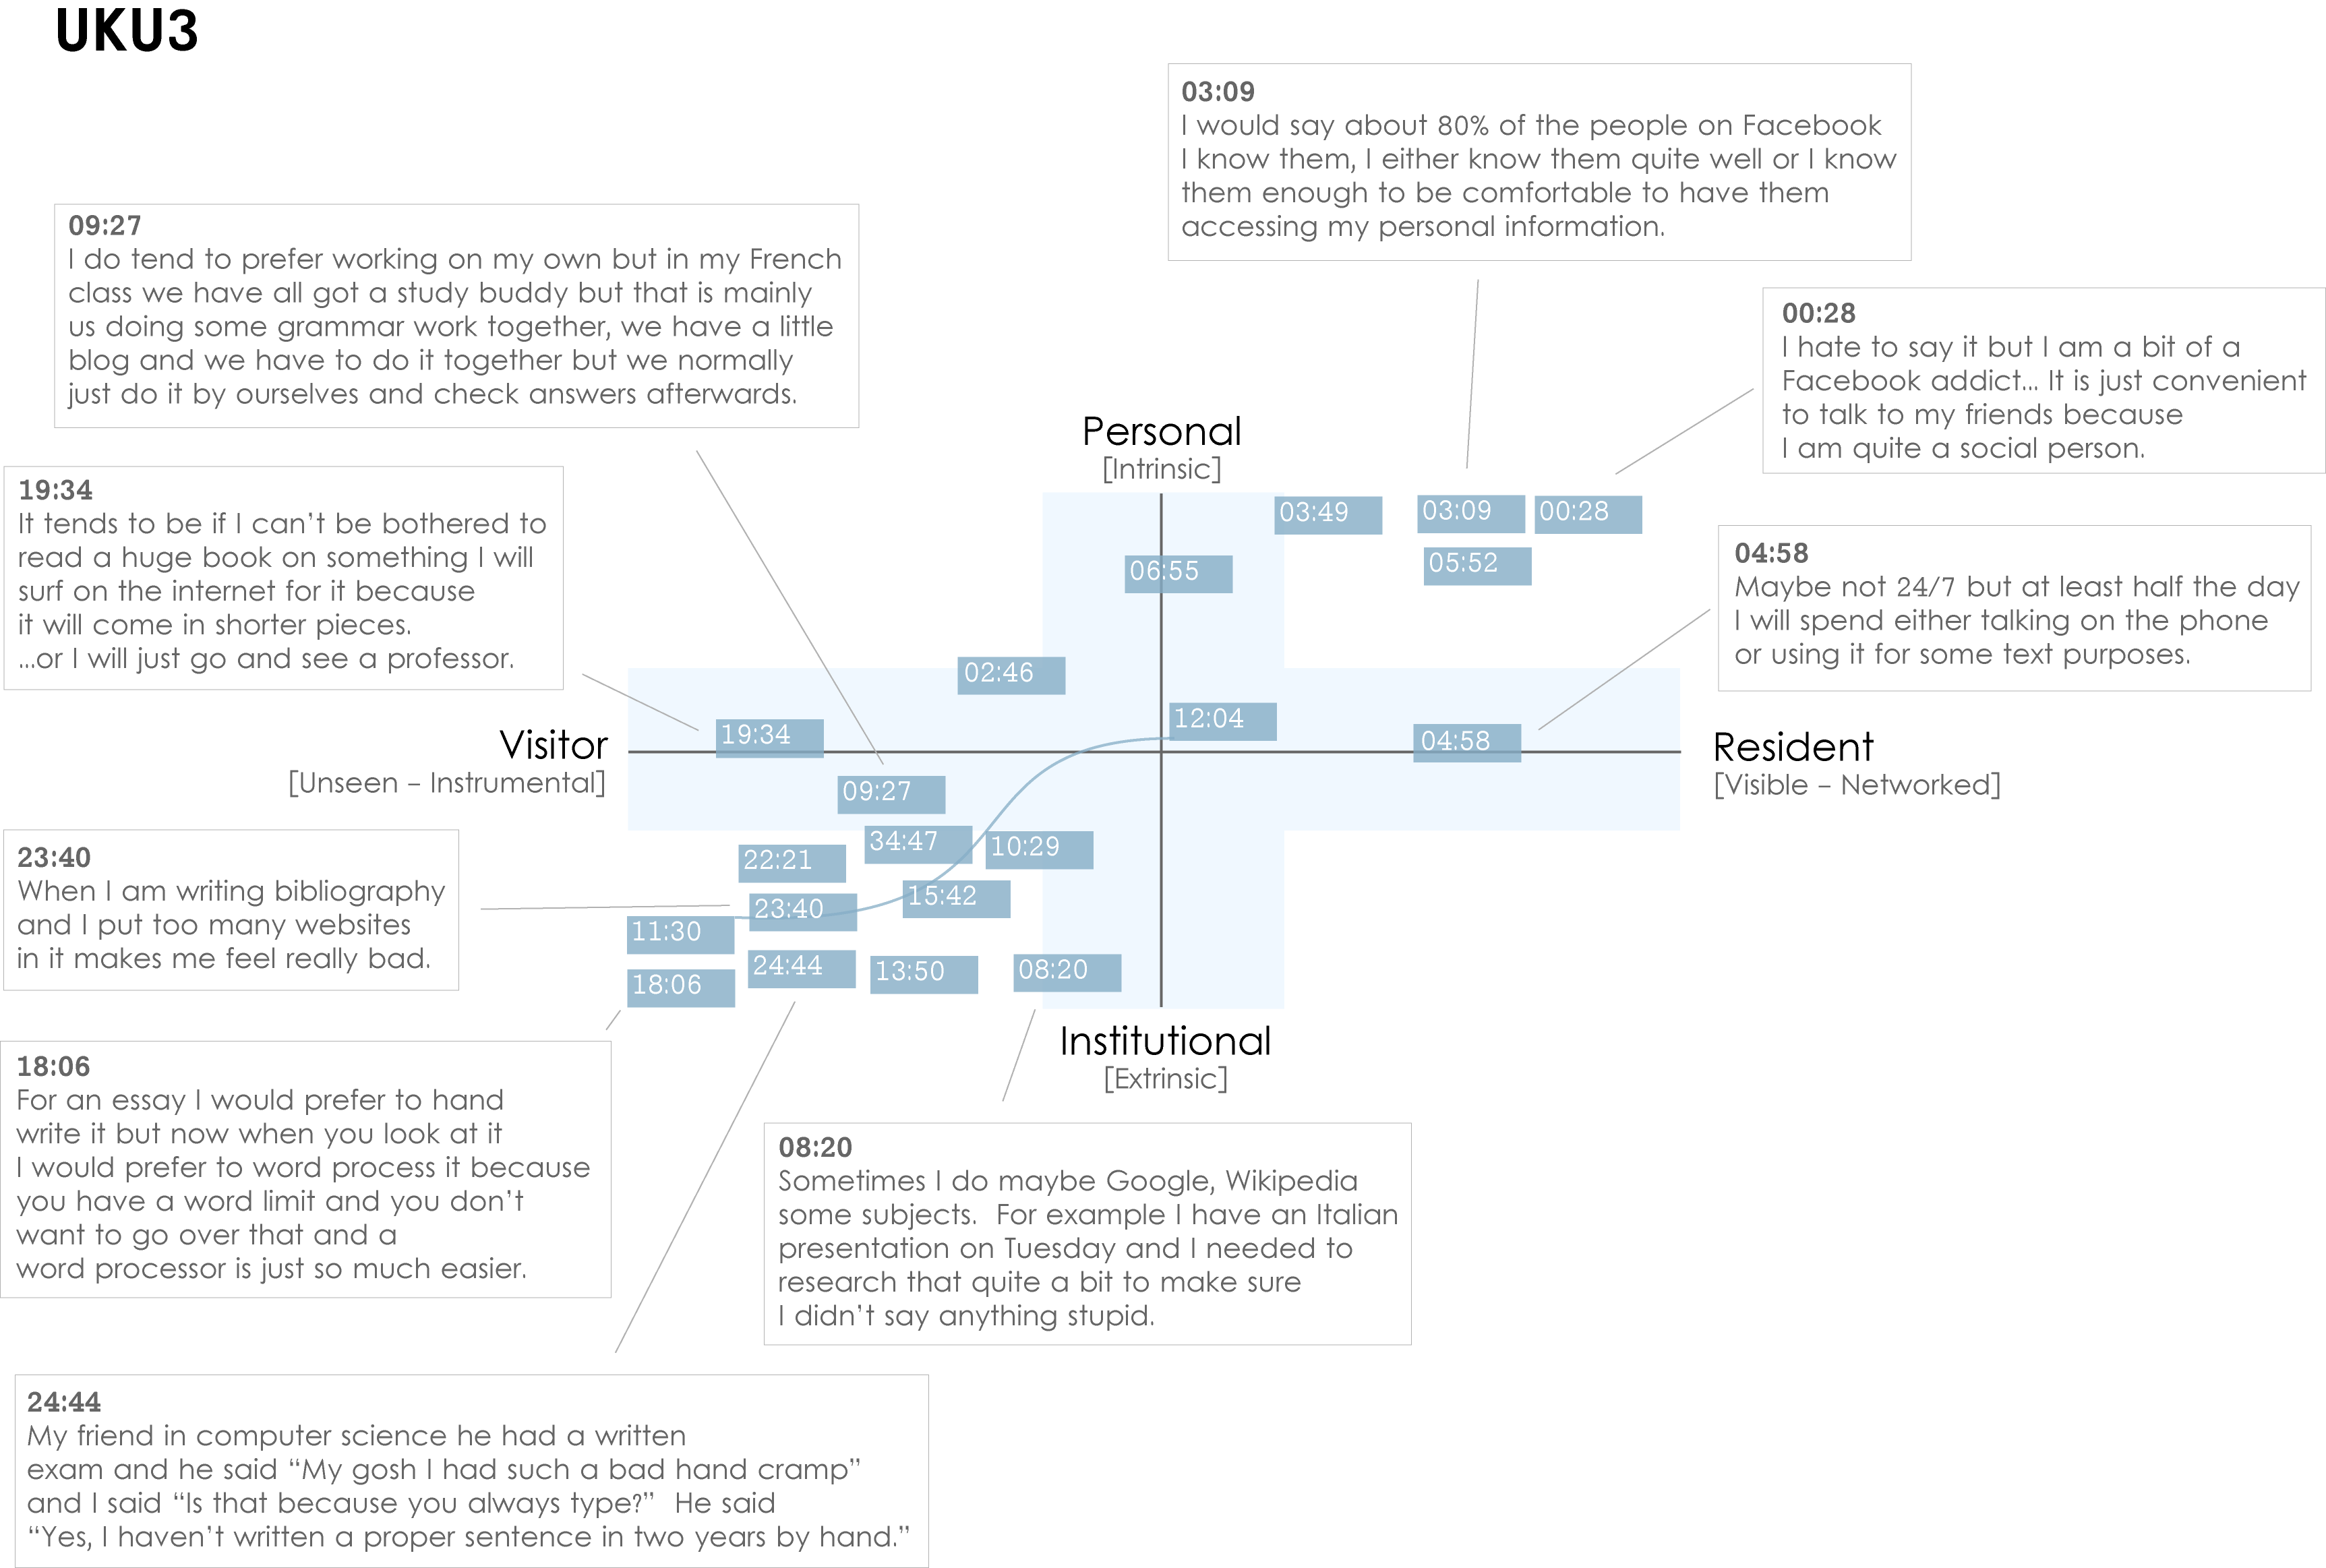
Connaway for OCLC Research. 2013.
Notes:
UKU3 (UK 1st year undergraduate)
This participant has a clear demarcation between Resident modes of engagement in her personal life and Visitor modes of engagement for study.
The map is a mode of engagement landscape onto which individuals can be plotted. The limits of the map have been defined by the four major framing concepts of the project: V&R – Personal and Institutional. The Personal end of the axis encompasses an individual’s private life, and the Institutional is their professional and/or academic life.
The data from the Emerging educational stage seem to suggest that individuals were engaging with systems and materials not provided by their institutions to do institutional work (e.g., consulting Wikipedia to write an essay). Such user-owned literacies, when mapped like this, take a prominent role in the academic work of many of our research subjects. Given the effect that the internet is having on collapsing the relationship between certain modes of activity and specific physical spaces, it is important not to tie notions of the intuitional and the personal to ideas of “school/university/library” and “home” as buildings.
White, D. S., & Connaway, L. S. (2011-2012). Visitors and residents: What motivates engagement with the digital information environment. Funded by JISC, OCLC, and Oxford University. Retrieved from http://www.oclc.org/research/activities/vandr/

Slide 35
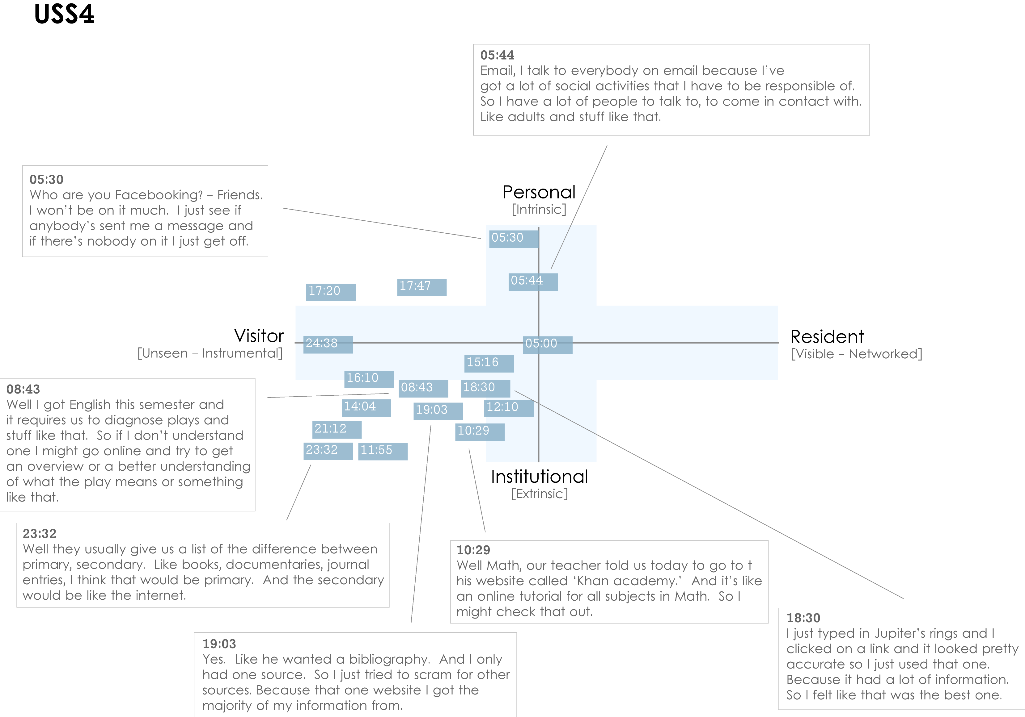
Connaway for OCLC Research. 2013.
Notes:
USS4 (US high-school student)
This is an example of a participant who is predominantly engaging in a Visitor mode. The quotes illustrate that he does use the web regularly for his studies, but is not interested in being “visible” online.
The distinction between internal and external motivation can quickly become complicated. However, attempting to define why individuals engage with particular kinds of information can help identify substantive and relevant issues. For instance, the difference between the personal and the institutional diminishes as individuals become increasingly embedded in academic contexts. This convergence would be representative of the process of “becoming” an expert in a given discipline, and in the shift from predominantly consuming to constructing knowledge.
The numbers on the dark blue blocks represent the time-code point in the interview at which the participant discussed an activity or approach.
White, D. S., & Connaway, L. S. (2011-2012). Visitors and residents: What motivates engagement with the digital information environment. Funded by JISC, OCLC, and Oxford University. Retrieved from http://www.oclc.org/research/activities/vandr/

Slide 36
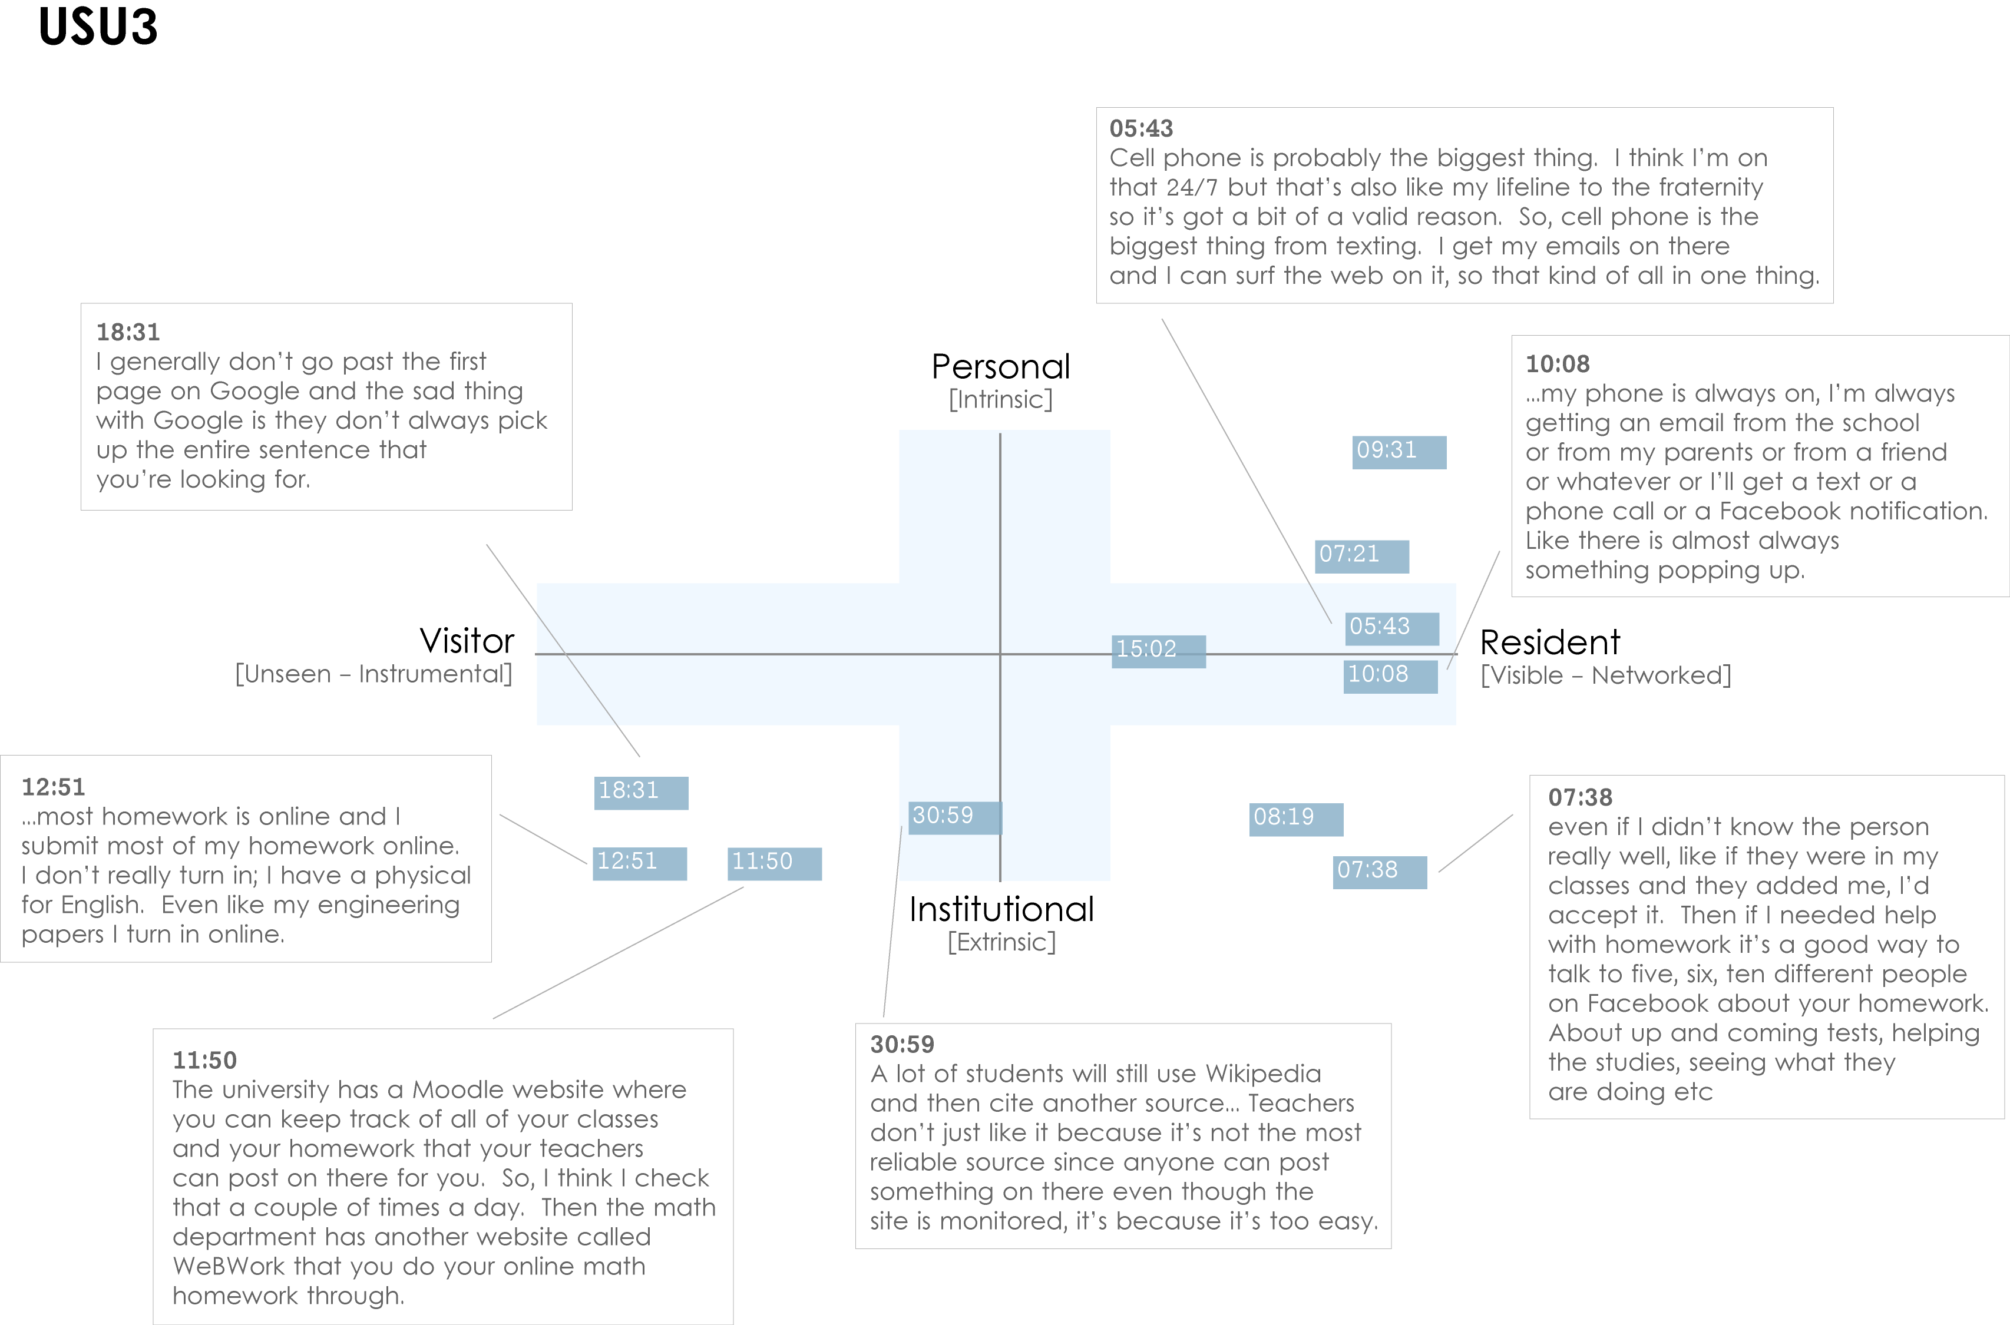
Connaway for OCLC Research. 2013.
Notes:
USU3 (US 1st year undergraduate)
This participant is highly Resident, connected to friends, family and study related matters “24/7” via a smartphone. His willingness to “friend” fellow students with a view to discussing assignments in Facebook is the main form of activity that takes place in the Resident/Institutional quadrant. This tends to be the only activity that takes place in this quadrant amongst participants from the Emerging educational-stage.
It should be possible to plot our code book onto the map, which would provide the ability to automatically plot coded data from individuals or groups. For example, Extrinsic and Intrinsic motives have been coded in NVivo, which map directly to the vertical axis (Personal/Institutional). Other codes can be identified as more Resident in nature: “Visible messaging,” “Media posting,” “Connection: sharing with others;” or as more Visitor in nature: “Searching,” “Email,” “Word processing.”
White, D. S., & Connaway, L. S. (2011-2012). Visitors and residents: What motivates engagement with the digital information environment. Funded by JISC, OCLC, and Oxford University. Retrieved from http://www.oclc.org/research/activities/vandr/

Slide 37

Recommendations
  Begin educating early
  Market
    1/3 of users don’t know services available
  Provide a broad range of tools
  Simple interface
  Discovery & access
  Social networking sites
    Wikipedia
    Facebook
Provide help at time of need
    Chat & IM
    Mobile technology
(Dervin, Connaway & Prabha, 2003-2006)
(De Rosa, 2005)
(Pew Internet & American Life Project, 2013)
Notes:
Dervin, B., Connaway, L.S., & Prabha, C. 2003-2006 Sense-making the information confluence: The whys and hows of college and university user satisficing of information needs. Funded by the Institute of Museum and Library Services (IMLS). http://imlsosuoclcproject.jcomm.ohio-state.edu/ (pp. 11-14, 16-17)
Pew Internet & American Life Project. (2013). Library services in the Digital Age. Retrieved from http://libraries.pewinternet.org/2013/01/22/library-services/
White, D., & Connaway, L.S. (2011). Visitors and Residents: What Motivates Engagement with the Digital Information Environment. Funded by JISC, OCLC, and Oxford University. http://www.oclc.org/research/activities/vandr/.
Library systems need to look and function more like search engines, e.g., Google and Yahoo, and services, e.g., Amazon.com since these are familiar to users who are comfortable and confident in using them (Connaway, Dickey, OCLC Research, & Joint Information Systems Committee, p.5).
36% of respondents reported being extremely familiar with search engines while only 26% reported being very familiar with libraries (De Rosa, p. 1-8)
De Rosa, Cathy. Perceptions of Libraries and Information Resources: A Report to the OCLC Membership. Dublin, OH: OCLC Online Computer Library Center, 2005. (p.1-8).
Connaway, L. S., Dickey, T. J., OCLC Research., & Joint Information Systems Committee. (2010). The digital information seeker: Report of the findings from selected OCLC, RIN, and JISC user behaviour projects. Bristol, England: HEFCE.
Link users to special collections
Wikipedia
University of Washington includes its special collections in the references in Wikipedia
Facebook (“On Facebook, Librarian Brings 2 Students From the Early 1900s to Life,” January 6, 2012, Nick DeSantis, Chronicle of Higher Education. http://chronicle.com/blogs/wiredcampus/on-facebook-librarian-brings-two-students-from-the-early-1900s-to-life/34845)
Joe McDonald, sophomore at University of Nevada, Reno in 1913, and girlfriend and future wife, Leola Lewis
Widget in OPAC for no retrievals using EBSCO Services – tested by St. Louis University, within 1 hour received 20 IM communications
Widget in OPAC at Seattle Public Library
Be available where users need help
Text, e-mail, chat
Librarians’ expertise can deliver quality sources to users through VRS that they cannot find with a Google search

Slide 38
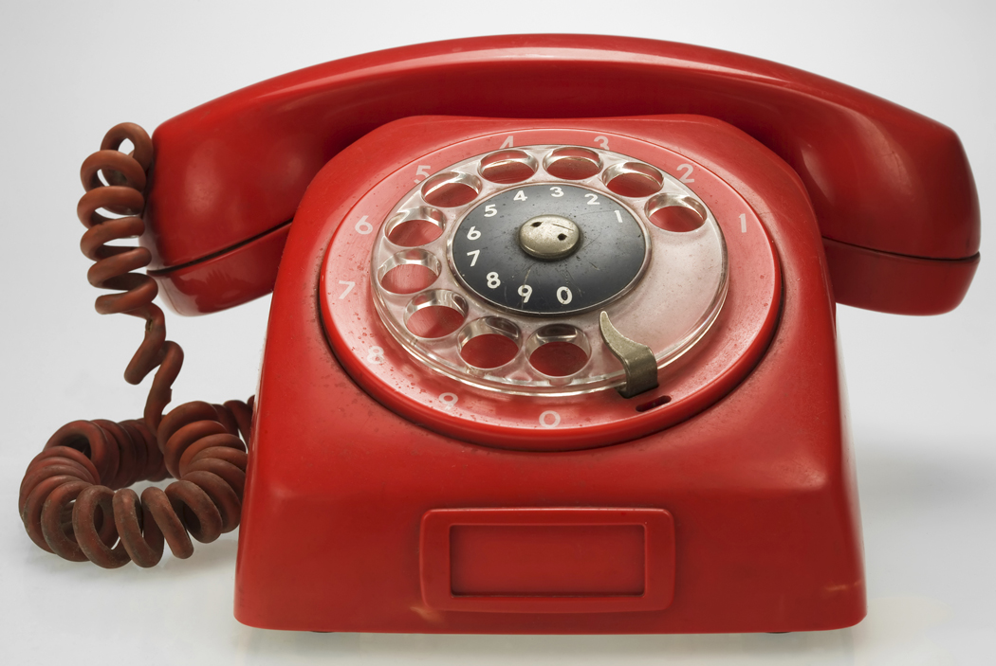

Future Research
Digital Visitors & Residents
  Online survey
  Continue with diaries & interviews
  Initial interviews with 12 new Emerging Stage participants
  Monthly diaries with 6 new Emerging Stage participants

Slide 39
References
Connaway, L. S., Dickey, T. J., OCLC Research., & Joint Information Systems Committee. (2010). The digital information seeker: Report of the findings from selected OCLC, RIN, and JISC user behaviour projects. Bristol, England: HEFCE.
Connaway, L. S., Lanclos, D., White, D. S., Le Cornu, A., & Hood, E. M. (2012). User-centered decision making: A new model for developing academic library services and systems. IFLA 2012 Conference Proceedings, August 11-17, Helsinki, Finland.
Connaway, L. S., & Powell, R. R. (2010). Basic research methods for librarians. Santa Barbara, CA: Libraries Unlimited.
Cool, C., & Spink, A. (2002). Issues of Context in Information Retrieval (IR): An Introduction to the Special Issue. Information Processing & Management, 38, 5, 605-11.
Dempsey, L. (2008). Always on: Libraries in a world of permanent connectivity. First Monday, 14(1). Retrieved from http://www.firstmonday.org/htbin/cgiwrap/bin/ojs/index.php/fm/article/view/2291/207
De Rosa, C. Perceptions of Libraries and Information Resources: A Report to the OCLC Membership. Dublin, OH: OCLC Online Computer Library Center, 2005. (p.1-8).

Slide 40
References
Dervin, B., Connaway, L. S., & Prabha, C. (2003-2005). Sense-making the information confluence: The hows and the whys of college and university user satisficing of information needs. Funded by the Institute for Museums and Library Services (IMLS). Retrieved from http://www.oclc.org/research/activities/past/orprojects/imls/default.htm
Geertz, Clifford. 1973. The interpretation of cultures: selected essays. New York: Basic Books, 6.
Glaser, B.G., & Strauss, A. L. (1967). The discovery of grounded theory; strategies for qualitative research. Chicago: Aldine Pub. Co., 273.
Holton, D. (2010, March 19). The digital natives/digital immigrants distinction is dead or at least dying. [Web log comment]. EdTechDev . Retrieved from http://edtechdev.wordpress.com/2010/03/19/the-digital-natives-digital-immigrants-distinction-is-dead-or-at-least-dying/
Kennedy, G., Judd, T. & Dalgarno, B. (2010). “Beyond natives and immigrants: Exploring types of net generation students,” Journal of Computer Assisted Learning, 26(5), 332–343.
Kvale, S. (1996). IntervVews: an introduction to qualitative research interviewing. Thousand Oaks, Calif: Sage Publications, 133-135.
McKenzie, J. (2007). Digital nativism, digital delusions, and digital deprivation. From Now On: The Educational Technology Journal, 17 (2). Retrieved from http://www.fno.org/nov07/nativism.html
Pew Internet & American Life Project. (2013). Library services in the Digital Age. Retrieved from http://libraries.pewinternet.org/2013/01/22/library-services/

Slide 41
References
Prensky, M. (2001). Digital natives, digital immigrants. On the Horizon, 9(5). Retrieved from http://www.marcprensky.com/writing
Prensky, M. (2006). Listen to the natives. Educational Leadership, 63(4), 8-13.
Radford, M. L., & Connaway, L. S. (2005-2007). Seeking synchronicity: Evaluating virtual reference services from user, non-user, and librarian perspectives. Funded by the Institute for Museums and Library Services (IMLS). Retrieved from http://www.oclc.org/research/activities/synchronicity/default.htm
Wasserman, S. (2012, June 18). The Amazon effect. The Nation. Retrieved from http://www.thenation.com/article/168125/amazon-effect
White, D. S., & Connaway, L. S. (2011-2012). Visitors & residents: What motivates engagement with the digital information environment. Funded by JISC, OCLC, and Oxford University. Retrieved from http://www.oclc.org/research/activities/vandr/
White, D. S., & Le Cornu, A. (2011). Visitors and Residents: A new typology for online engagement. First Monday, 16(9). Retrieved from http://firstmonday.org/htbin/cgiwrap/bin/ojs/index.php/fm/article/viewArticle/3171/3049
Whyte, W. F. (1979). “On Making the Most of Participant Observation,” The American Sociologist 14 , 56-66.
Wilson, T. D. (1997). Information behaviour: an interdisciplinary perspective. Information Processing and Management, 33(4), 551-572.
Wilson, T. D. (1999). Models in information behaviour research. Journal of Documentation, 55(3), 249-270.

Slide 42
Questions &
Discussion
Lynn Silipigni Connaway
connawal@oclc.org
Notes:
42

