Slide 1
Meeting the Needs of Digital Visitors and Residents: Developing Engagement with Institutional Services
EDUCAUSE 2013, Anaheim, CA, October 16, 2013
Lynn Silipigni Connaway, Ph. D.
Senior Research Scientist OCLC
connawal@oclc.org & @LynnConnaway
Donna Lanclos, Ph. D.
Associate Professor for Anthropological Research
University of North Carolina, Charlotte
dlanclos@uncc.edu & @DonnaLanclos
David White
Co-manager, Technology Assisted Lifelong Learning
University of Oxford
david.white@conted.ox.ac.uk & @daveowhite
Erin M. Hood, M.L.I.S.
Research Support Specialist
OCLC
hoode@oclc.org & @ErinMHood1
This work is licensed under a Creative Commons Attribution 3.0 Unported License. http://creativecommons.org/licenses/by/3.0/

Slide 2
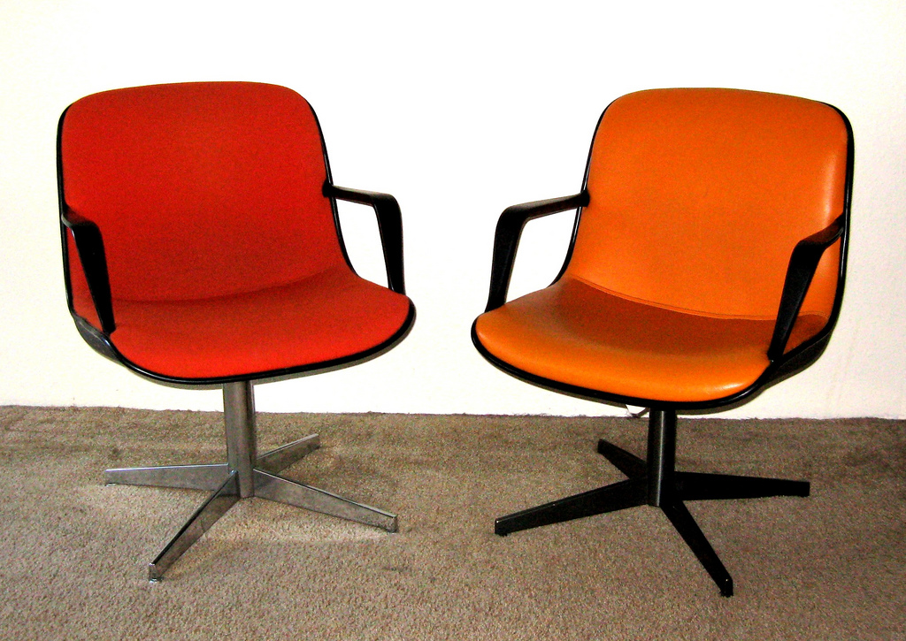
Overview
Notes:
Image: http://www.flickr.com/photos/toddmecklem/2730613340/

Slide 3
Visitors and Residents: What motivates engagement with the digital information environment?
Partners
JISC (UK funding body)
OCLC
Lynn Silipigni Connaway, Ph.D.
Erin M. Hood, M.L.I.S.
Oxford University
David White
Alison Le Cornu, Ph.D.
University of North Carolina, Charlotte
Donna Lanclos, Ph.D.
Notes:
Image: http://www.flickr.com/photos/myxi/712710373/
Erin
The Digital Visitors and Residents (V&R) project is a US/UK collaborative project, funded by JISC, OCLC Online Computer Library Center, Inc., Oxford University, and the University of North Carolina, Charlotte.
“This paper reports the initial findings of a three-year longitudinal study to identify how late-stage secondary school and first-year undergraduate students in the US and UK, referred to here as members of the “Emerging” educational stage, engage with technology and information sources. The assumptions embedded in traditional academic library services and systems and the existing disconnect between the everyday information-seeking behaviors of members of the Emerging stage (last year high school/secondary school or first year college/university) are examined. Initial results highlight the importance of convenience as a crucial factor in information-seeking behavior. There also are indications that as users progress through the educational stages, the digital and information literacies they employ do not necessarily become more sophisticated.” (Connaway, Lanclos, and Hood, 2013)
Connaway, Lynn Silipigni, Donna Lanclos, and Erin M. Hood. 2013. “‘I find Google a lot easier than going to the library website.’ Imagine Ways to Innovate and Inspire Students to Use the Academic Library.” Proceedings of the Association of College & Research Libraries (ACRL) 2013 conference, April 10-13, 2013, Indianapolis, IN. http://www.ala.org/acrl/sites/ala.org.acrl/files/content/conferences/confsandpreconfs/2013/papers/Connaway_Google.pdf.

Slide 4
Video: http://is.gd/vanrvideo
First Monday Paper: http://is.gd/vandrpaper
(White & Connaway, 2011)
Notes:
Erin
Discuss Prensky and how this is an attempt, started by Dave White, to move away from Native/Immigrant metaphor:
“‘The digital natives/digital immigrants distinction is dead or at least dying’. So proclaims Doug Holton in his blogpost. He continues: ‘Unfortunately, the idea is still uncritically accepted even in some journal articles, and perhaps used as an excuse or crutch too often for poor or ineffective teaching practices’. Holton is not alone in his criticism. McKenzie (2007) writes strongly against Prensky’s (2001a, b) typology identifying a number of ‘thinly supported claims’, while Kennedy, et al. (2010) demonstrate through an empirical research project that Prensky’s age–related hypothesis is very much less clear–cut than the Natives and Immigrants dichotomy implies. Our intention is to propose an alternative, which we have termed ‘Visitors and Residents’.”
Prensky, Marc. 2001a. Digital natives, digital immigrants. On the Horizon 9, no. 5, http://www.marcprensky.com/writing/Prensky%20-%20Digital%20Natives,%20Digital%20Immigrants%20-%20Part1.pdf.
Prensky, Marc. 2001b. Do they really think differently? On the Horizon 9, no. 5, http://www.marcprensky.com/writing/Prensky%20-%20Digital%20Natives,%20Digital%20Immigrants%20-%20Part2.pdf.
White, David S., and Alison Le Cornu. 2011. Visitors and Residents: A new typology for online engagement. First Monday 16, no. 9, http://firstmonday.org/htbin/cgiwrap/bin/ojs/index.php/fm/article/viewArticle/3171/3049.

Slide 5
Visitor Mode
Functional use of technology
Formal need
Invisible online presence
Internet is a toolbox
Notes:
Image: Microsoft Office
Erin
Visitors: functional use of technology, often linked to formal need (such as use of software for specific coursework, or organising meetings through email contact); less visible/more passive online presence, more likely to favor face- to- face interactions (even as they use the internet to organize/schedule those interactions)

Slide 6
Resident Mode
Visible and persistent online presence
Collaborative activity online
Contribute online
Internet is a place
Notes:
Image: Microsoft Office
Erin
Residents: significant online presence and usage; high level of collaborative activity online; contributions to the online environment in the form of uploading materials, photos, videos.

Slide 7
Visitors & Residents
(White and Connaway, 2011-2012)
Notes:
Erin
“Using the V&R framework ensures that analysis is firmly focused on motivations to engage rather than on age or technological “skill.” It facilitates the identification of modes of engagement which potentially cut across traditional academic levels and boundaries. The project is tracking US and UK participants’ shifts in their motivations and forms of engagement with technology and information as they transition between four educational stages:
1. Emerging (Late stage secondary school/First year undergraduate);
2. Establishing (Second/third or third/fourth year undergraduate);
3. Embedding (Postgraduates, PhD students);
4. Experienced (Scholars).
In Phase 1 of the V&R research, semi-structured interviews with participants from the four project-defined educational stages were conducted in the US and UK. In Phase 2 of the project, a sub-set of the interviewees were selected to participate in the monthly information diaries.” (Connaway, Lanclos, & Hood 2013)
Connaway, Lynn Silipigni, Donna Lanclos, and Erin M. Hood. 2013. “‘I find Google a lot easier than going to the library website.’ Imagine Ways to Innovate and Inspire Students to Use the Academic Library.” Proceedings of the Association of College & Research Libraries (ACRL) 2013 conference, April 10-13, 2013, Indianapolis, IN. http://www.ala.org/acrl/sites/ala.org.acrl/files/content/conferences/confsandpreconfs/2013/papers/Connaway_Google.pdf.
White, David S., and Lynn Silipigni Connaway. 2011-2012. Visitors & Residents: What Motivates Engagement with the Digital Information Environment. Funded by JISC, OCLC, and Oxford University. http://www.oclc.org/research/activities/vandr/.

Slide 8
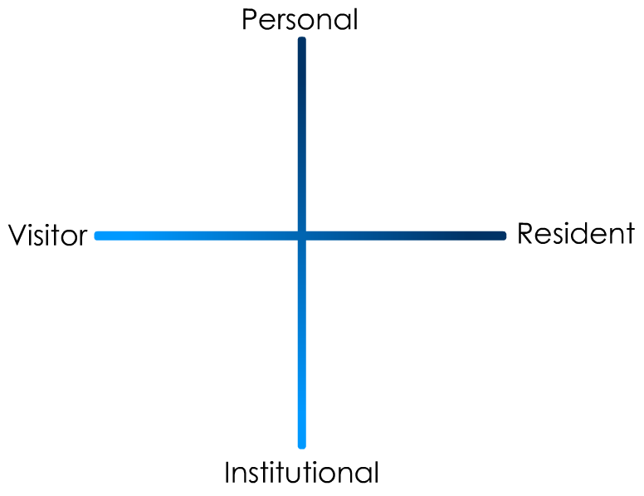
(Connaway and White for OCLC Research, 2012.)
Notes:
Erin
“In simple terms the Visitors see the web as a series of tools. They decide what they want to achieve, chose an appropriate online tool to do the job, then log-off. They leave no social trace of themselves online. The Residents live a proportion of their lives online. They see the web as a place where they can express themselves and spend time with people. Residents will have a profile on a social networking platform and aspects of their persona, or digital identity, maintaining presence even when they are not online. The premise of V&R is presented as a continuum whereby individuals’ modes of engagement will be more Visitor or Resident depending on their personal motivations and the context and situation at the time.” (Connaway, Lanclos, and Hood, 2013)
Connaway, Lynn Silipigni, Donna Lanclos, and Erin M. Hood. 2013. “‘I find Google a lot easier than going to the library website.’ Imagine Ways to Innovate and Inspire Students to Use the Academic Library.” Proceedings of the Association of College & Research Libraries (ACRL) 2013 conference, April 10-13, 2013, Indianapolis, IN. http://www.ala.org/acrl/sites/ala.org.acrl/files/content/conferences/confsandpreconfs/2013/papers/Connaway_Google.pdf.
First Monday Paper: http://is.gd/vandrpaper
Video: http://is.gd/vandrvideo

Slide 9
Project Phases
Phase 1
Interviewed 31 (16 US/15 UK) Emerging educational stage individuals
Last year of secondary/high school & first year undergraduate students
Majority of students aged 18 & 19 with a few outliers
Phase 2
Interviewed
10 (5 US/5 UK) Establishing (second/third year undergraduate students)
10 (5 US/5 UK) Embedding (postgraduates, PhD students)
10 (5 US/5 UK) Experienced (Scholars)
Some Phase 1 participants agreed to submit monthly diaries
Notes:
Image: Microsoft Office
Erin
The findings will be used to create a matrix of implementation options allowing those designing and delivering digital platforms and services to make informed decisions relative to engagement and motivation for individuals at each of the educational stages.
Work as an interdisciplinary team, bringing to bear our relative expertises in Educational Technology, Library Information and Science/Research Methodology (User behaviour), and Anthropology (Ethnography)
Phase 1
Individual Interviews
Emerging (secondary school/1st year undergraduates: 31 (16 US, 15 UK)
Establishing (2nd-3rd year undergraduates): 10 (5 US, 5 UK)
Embedding (postgraduates, PhD students): 10 (5 US, 5 UK)
Experiencing (scholars): 10 (5 US, 5 UK)
Phases 1 & 2: Participant Demographics
61 participants: 15 secondary students/46 university students & faculty
34 females/27 males
38 Caucasian/5 African-American/2 Multi-racial/1 Asian/2 Hispanic/13 Unidentified

Slide 10
Project Phases, cont.
Phase 3
Interviewed second group of 12 students in the Emerging stage
Phase 4
In-depth survey
50 participants from each educational stage in both US & UK
Code, analyze, & compare data
4
Notes:
Image: Microsoft Office
Erin
Phase 3
Interviewed a second group of 6 students in the Emerging stage
This will help to determine if methods of engagement are changing over time
Phase 4
Test interview and diary results with in-depth survey of 50 participants from each educational stage
Code data to refine emerging findings and explore possible trends

Slide 11
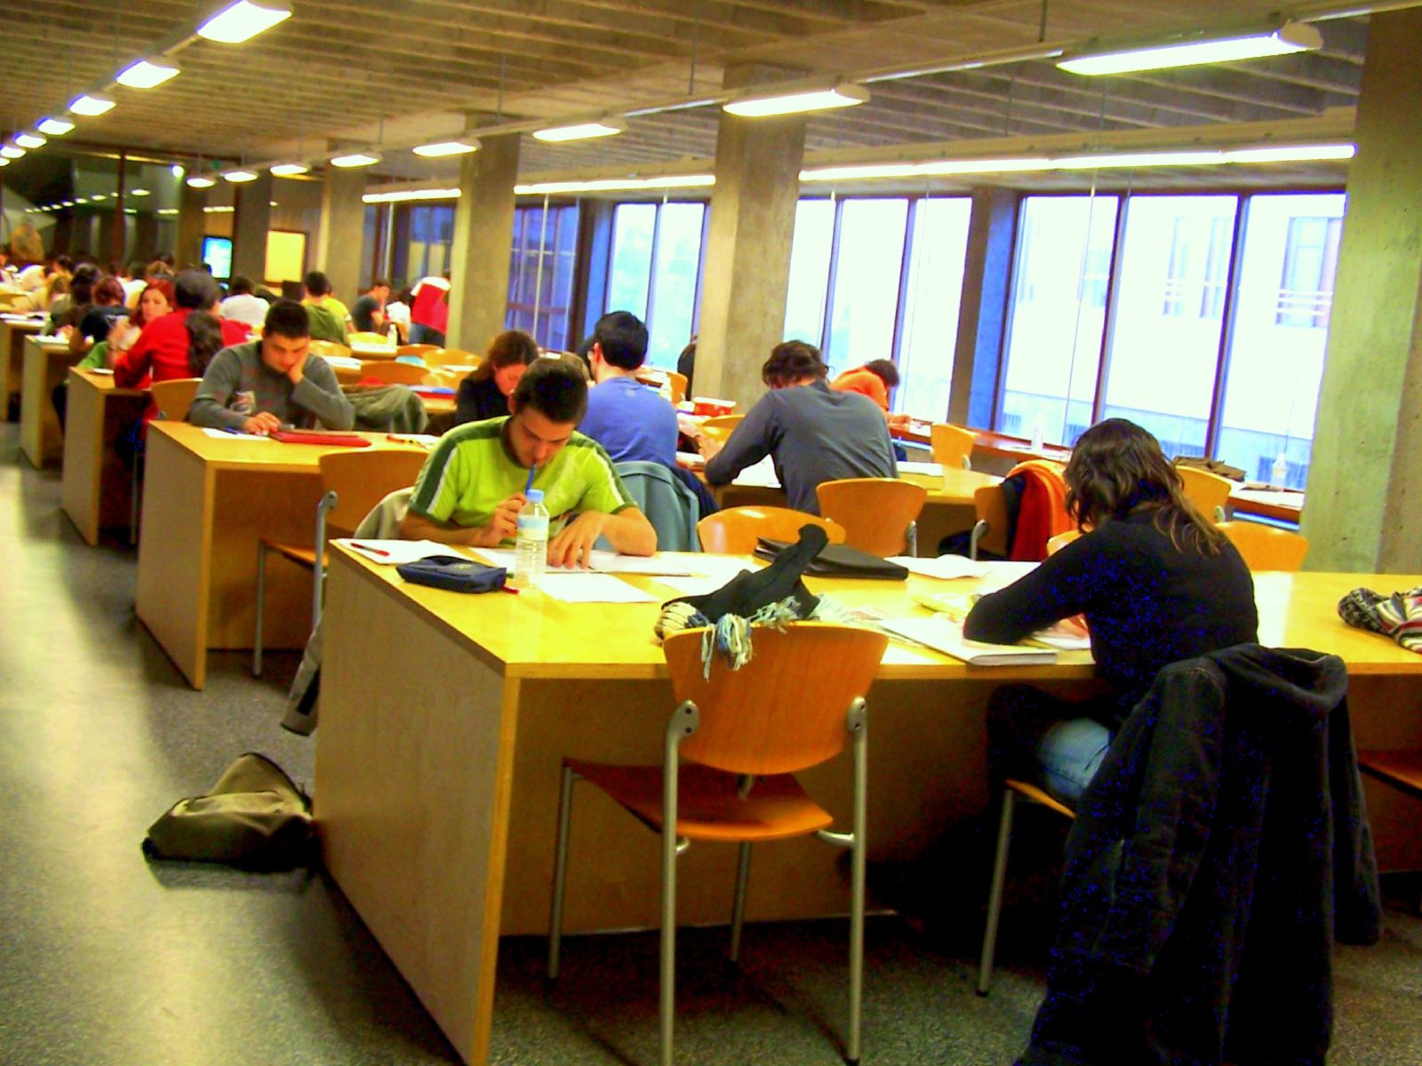
Phase I & 2: Participant Demographics
61 Participants
15 secondary students
46 university students & faculty
38 Caucasian
5 African-American
2 Multi-racial
1 Asian
2 Hispanic
13 Unidentified
(White and Connaway 2011-2012)
Notes:
Image: http://www.flickr.com/photos/elaine_macc/370057046/
Erin
“There are a total of 61 participants in project Phases 1 and 2.” (Connaway, Lanclos, and Hood 2013)
“Altogether, there are 15 secondary students and 46 university students and faculty. The students and faculty are a convenience sample—those who were willing to be interviewed, in institutions that allowed us entry.” (Connaway, Lanclos, and Hood 2013)
Connaway, Lynn Silipigni, Donna Lanclos, and Erin M. Hood. 2013. “‘I find Google a lot easier than going to the library website.’ Imagine Ways to Innovate and Inspire Students to Use the Academic Library.” Proceedings of the Association of College & Research Libraries (ACRL) 2013 conference, April 10-13, 2013, Indianapolis, IN. http://www.ala.org/acrl/sites/ala.org.acrl/files/content/conferences/confsandpreconfs/2013/papers/Connaway_Google.pdf.
Phase I and 2: Participant Demographics (All Stages)
15 Secondary students, 46 University students and faculty
Ethnicities (All)
5 African-American, 38 Caucasian, 2 Multi-racial, 1 Asian, 2 Hispanic, 13 Unidentified
White, David S., and Lynn Silipigni Connaway. 2011-2012. Visitors & Residents: What Motivates Engagement with the Digital Information Environment. Funded by JISC, OCLC, and Oxford University. http://www.oclc.org/research/activities/vandr/.

Slide 12
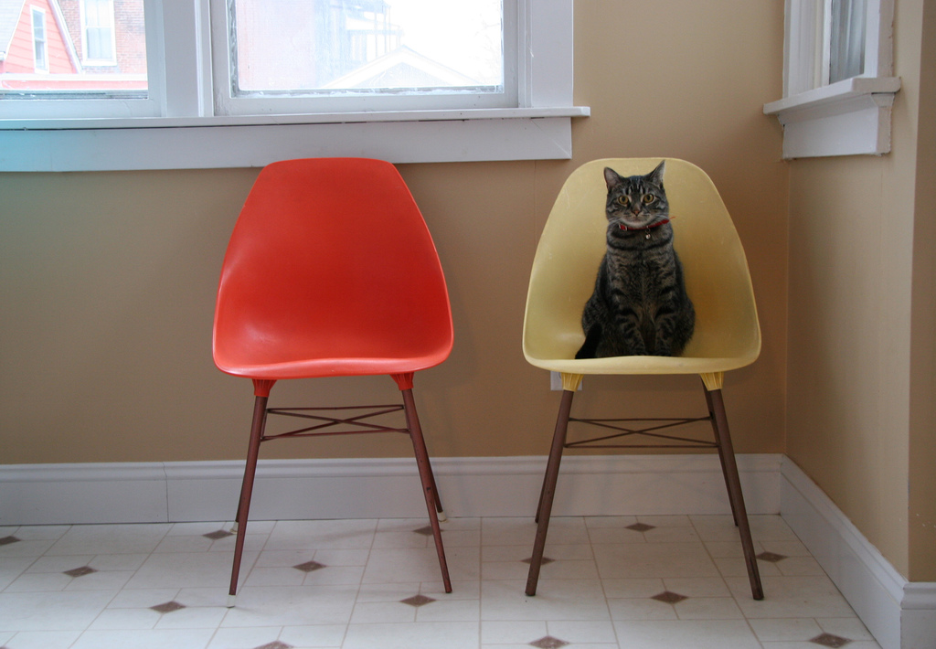
Previous Mappings of Constituent Behavior
Notes:
Image: http://www.flickr.com/photos/prettywarstl/91640932/
Donna

Slide 13
(Connaway and White for OCLC Research, 2012.)
Notes:
Donna
“In simple terms the Visitors see the web as a series of tools. They decide what they want to achieve, chose an appropriate online tool to do the job, then log-off. They leave no social trace of themselves online. The Residents live a proportion of their lives online. They see the web as a place where they can express themselves and spend time with people. Residents will have a profile on a social networking platform and aspects of their persona, or digital identity, maintaining presence even when they are not online. The premise of V&R is presented as a continuum whereby individuals’ modes of engagement will be more Visitor or Resident depending on their personal motivations and the context and situation at the time.” (Connaway, Lanclos, and Hood 2013)
Connaway, Lynn Silipigni, Donna Lanclos, and Erin M. Hood. 2013. “‘I find Google a lot easier than going to the library website.’ Imagine Ways to Innovate and Inspire Students to Use the Academic Library.” Proceedings of the Association of College & Research Libraries (ACRL) 2013 conference, April 10-13, 2013, Indianapolis, IN. http://www.ala.org/acrl/sites/ala.org.acrl/files/content/conferences/confsandpreconfs/2013/papers/Connaway_Google.pdf.
First Monday Paper: http://is.gd/vandrpaper
Video: http://is.gd/vandrvideo

Slide 14
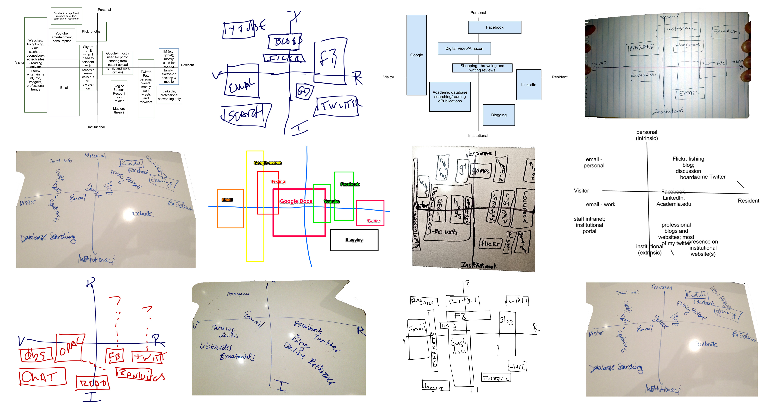
Notes:
Donna
Mappings from EDUCAUSE 2012

Slide 15
Notes:
Donna
Mappings from EDUCAUSE 2012

Slide 16
Notes:
Donna
Mappings from EDUCAUSE 2012

Slide 17
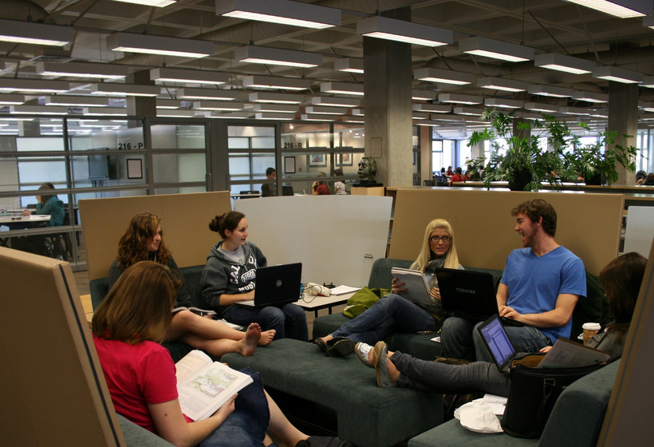
Mapping of Perceptions of Constituent Behavior
Notes:
Image: http://www.flickr.com/photos/kennedylibrary/4312501994/
Donna

Slide 18
(Connaway and White for OCLC Research, 2012.)
Notes:
Donna
“In simple terms the Visitors see the web as a series of tools. They decide what they want to achieve, chose an appropriate online tool to do the job, then log-off. They leave no social trace of themselves online. The Residents live a proportion of their lives online. They see the web as a place where they can express themselves and spend time with people. Residents will have a profile on a social networking platform and aspects of their persona, or digital identity, maintaining presence even when they are not online. The premise of V&R is presented as a continuum whereby individuals’ modes of engagement will be more Visitor or Resident depending on their personal motivations and the context and situation at the time.” (Connaway, Lanclos, and Hood 2013)
Connaway, Lynn Silipigni, Donna Lanclos, and Erin M. Hood. 2013. “‘I find Google a lot easier than going to the library website.’ Imagine Ways to Innovate and Inspire Students to Use the Academic Library.” Proceedings of the Association of College & Research Libraries (ACRL) 2013 conference, April 10-13, 2013, Indianapolis, IN. http://www.ala.org/acrl/sites/ala.org.acrl/files/content/conferences/confsandpreconfs/2013/papers/Connaway_Google.pdf.
First Monday Paper: http://is.gd/vandrpaper
Video: http://is.gd/vandrvideo

Slide 19
How to Share
Google Doc
Donna.lanclos@gmail.com
Lconnaway@gmail.com
Email
connawal@oclc.org
Take a photo and email
Donna.lanclos@gmail.com
connawal@oclc.org
Twitter
#VandR #Them
Whatever else you can think of!
Notes:
Donna

Slide 20
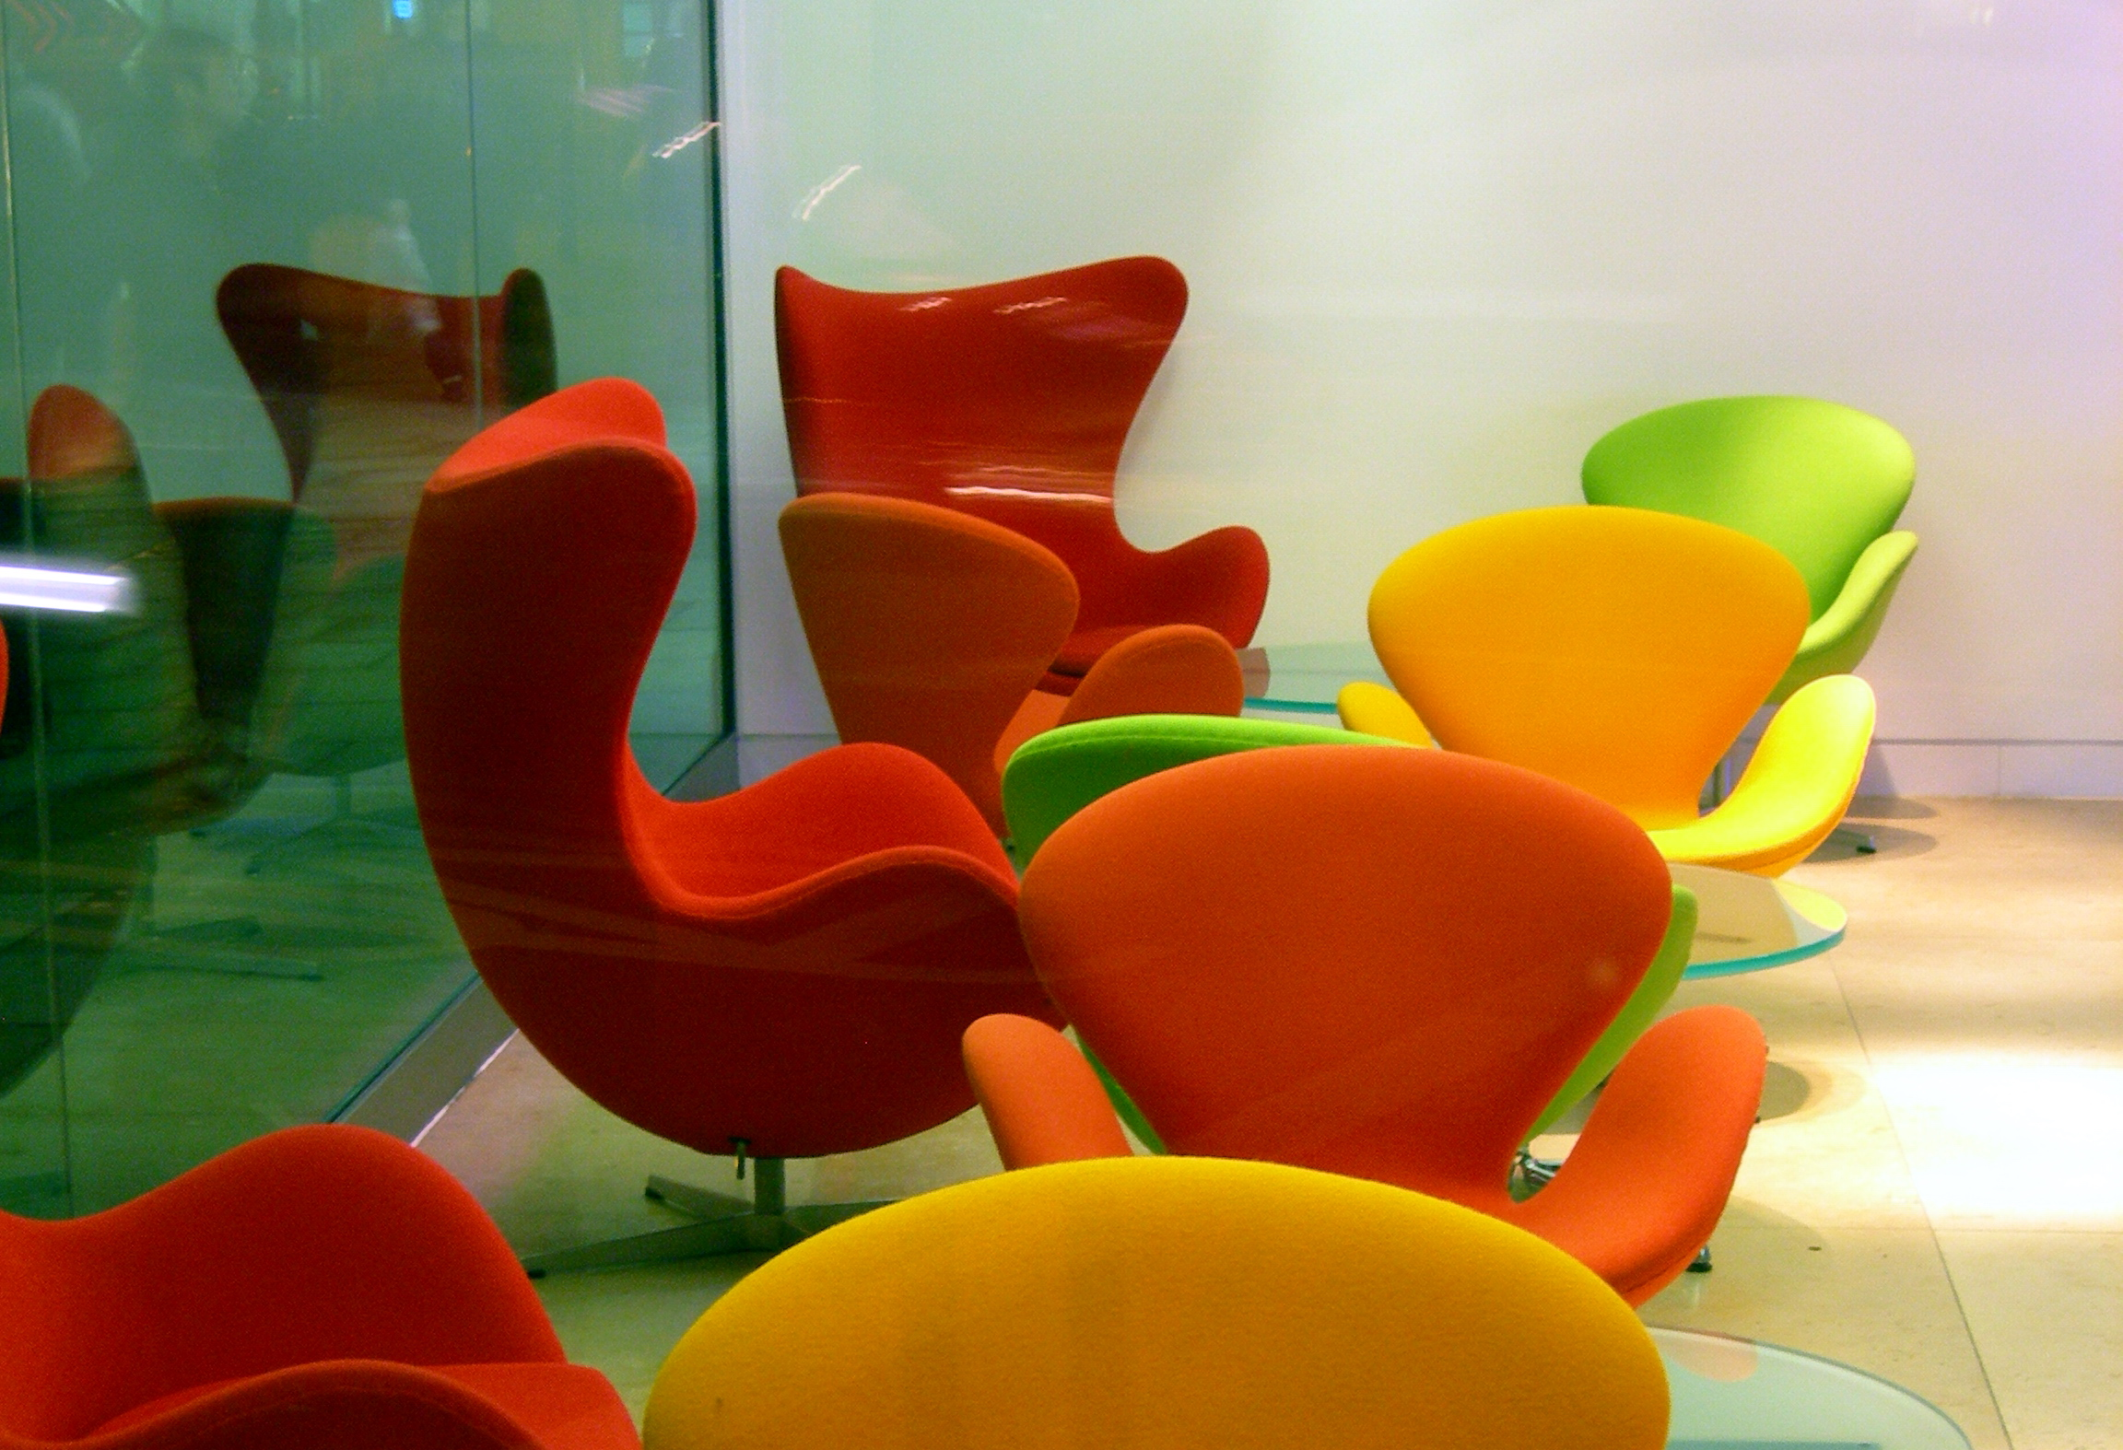
Discussion of Constituent Mapping
Notes:
Image: http://www.flickr.com/photos/criminalintent/89026773/
Lynn, Donna, Erin

Slide 21
Major Findings of Visitors & Residents Project
Notes:
Image: Microsoft Office
Lynn

Slide 22
People Trust People
“I get on Twitter a whole bunch. It’s Twitter or Facebook are what I usually use the most to talk to my friends.”
(USS1, Emerging, Female, Age 17, High School Student)
Notes:
Image: http://www.flickr.com/photos/auro/230377281/
Lynn
Digital resources such as search engines and social media sites are mentioned at much higher percentages than physical places. This is not to say that people are not in physical spaces, just that digital places take up more of their awareness, when they think about places they “go” to find information and people. This reliance on digital spaces co-exists with a persistent need to be in contact with other people, not just online but face to face. Personal networks, and the relationships that comprise them, are tremendously important factors in how people gather information. Personal networks are an important part of people’s information-seeking strategies, across the educational stages, and it is important to keep that in mind when thinking about attracting people to institutional information and technology resources. (InfoKit, People Trust People)
The point is that individuals seek what they need within the relationships that surround them. As they move through the educational stages, their networks are increasingly populated with people who have relevant subject expertise, so that by the time individuals are faculty members, when they say they called a “friend” about an article, it is nearly certain that the friend is also an expert in the field. Relationships continue to be a major component in how individuals get their information and whom they choose for collaboration and one of the reasons for engaging with technology (Connaway and Radford 2011 ). (InfoKit, People Trust People)
Connaway, Lynn Silipigni, and Marie L. Radford. 2011. Seeking synchronicity: Revelations and recommendations for virtual reference. Dublin, OH: OCLC Research. http://www.oclc.org/reports/synchronicity/full.pdf.

Slide 23
“But I could probably not live without the computer and, you know, the internet. Because, work, and the emails.”
(USU2, Emerging, Female, Age 19, Engineering)
Technology
Notes:
Image: http://www.flickr.com/photos/mangpages/3233581857/
Lynn
The high frequency of mentions of texting, telephone calls, and private messaging by the Emerging and Establishing educational stage interviewees correlates with the technology that these participants said they could not live without - the smart phone/cell phone or laptop. These not only are used for communicating and contacting individuals but also for searching the internet, and organizing their time and activities with the calendar. (InfoKit, People Trust People)
Note here the lack of consistency in what is the “most important” device from individual to individual. Some cannot live without their phones, some their laptops. Such results reinforce the importance of device-agnostic services and resources. The results also demonstrate that as portable devices gain functionality that has been traditionally only available on a laptop or desktop, individuals will adopt the technology that is most convenient for their situation. They expect to be able to use their own technology to connect with institutional (and other) resources and exemplify resident modes of behaviour. (InfoKit, People Trust People)

Slide 24
“It’s convenience. It’s the immediacy of it.”
(UKF3, Experiencing, Male, Age 52, Artist & Technical Support)
Convenient Doesn’t Always Mean Simple
Notes:
Image: http://www.flickr.com/photos/dubpics/8685963533/
Lynn
Visitors and Residents (V&R) data agree with other research projects that indicate that some individuals are frustrated with libraries and do not physically visit them because of limited hours, long travel distances, and the time needed to do their research in the library (Connaway 2013; Connaway, Lanclos, and Hood 2013a; Connaway, Lanclos, White, Le Cornu, and Hood 2013; Pullinger 1999; White and Connaway 2011-2012 ). Search engines (in particular, Google) are preferred because they are more convenient and faster—they are always available (De Rosa et al. 2005 ), and also because they are perceived to be reliable, as well as fast. (InfoKit, Convenient Doesn’t Always Mean Simple)
Speed and efficiency are relatively conventional ways of defining “convenience,” and they are certainly factors in the decisions people make about where to go and what to use, when seeking information. (InfoKit, Convenient Doesn’t Always Mean Simple)
Data from the V&R project reveal that individuals in all educational stages cite the relevance of convenience/ease of use to their decision-making, trumping all other reasons for selecting and using a source (White and Connaway 2011-2012 ; Connaway, White, and Lanclos 2011). (InfoKit, Convenient Doesn’t Always Mean Simple)
Familiarity appeared to also be a major component of individuals’ perceptions both of authority and convenience. If an individual had done something/used something before, they were more likely to perceive that thing as being “convenient,” even if it objectively took more steps and/or time than other solutions. While the methods some individuals used to seek and assess information were inelegant, they had been developed at an early age, and had become well worn and comfortable, if not terribly efficient or sophisticated. They continued using these methods in part because they tended to yield effective results. (InfoKit, Convenient Doesn’t Always Mean Simple)
Connaway, Lynn Silipigni. 2013. Why the internet is more attractive than the library. The Serials Librarian 64, no. 1-4: 41-56.

Slide 25
Notes:
Connaway, Lynn Silipigni, Donna Lanclos, and Erin M. Hood. 2013. “I always stick with the first thing that comes up on Google…” Where people go for information, what they use and why. Accepted for publication, EDUCAUSE Review Online.
Connaway, Lynn Silipigni, Donna Lanclos, David White, Alison Le Cornu, and Erin M. Hood. 2013. User-centered decision making: A new model for developing academic library services and systems. IFLA Journal 39, no. 1: 30-36.
Pullinger, David. 1999. Academics and the new information environment: The impact of local factors on use of electronic journals. Journal of Information Science 25, no. 2: 164–172.
White, David S., and Lynn Silipigni Connaway. 2011-2012. Visitors & residents: What motivates engagement with the digital information environment? Funded by JISC, OCLC, and Oxford University. http://www.oclc.org/research/activities/vandr/ and http://www.jisc.ac.uk/whatwedo/projects/visitorsandresidents.aspx.
De Rosa, Cathy, Joanne Cantrell, Diane Cellentani, Janet Hawk, Lillie Jenkins, and Alane Wilson. 2005. Perceptions of libraries and information resources: A report to the OCLC membership. Dublin, OH: OCLC Online Computer Library Center. http://www.oclc.org/content/dam/oclc/reports/pdfs/Percept_all.pdf.
Connaway, Lynn Silipigni, David White, and Donna Lanclos. 2011. Visitors and residents: What motivates engagement with the digital information environment? Proceedings of the 74th ASIS&T Annual Meeting 48: 1-7.
Connaway, Lynn Silipigni, David White, Donna Lanclos, and Alison Le Cornu. 2012. Visitors and residents: What motivates engagement with the digital information environment? Information Research 18, no. 1. http://informationr.net/ir/18-1/paper556.html#.Ug0ZTZI4tMg.

Slide 26
Human Sources
“I use Facebook for organizing my life basically, with friends and stuff. ...I also use that in education to talk to my friends about an equation, the things I don't understand and it works quite well.”
(2UKS2, Emerging, Male, Age 18, Secondary School Student)
Notes:
Image: http://www.flickr.com/photos/sackton/6799330916/
Lynn
It was important to Emerging students that the digital sources they found were authoritative, specifically that they were identified by trustworthy human sources: people who, in their personal experience, had proven that they were knowledgeable, either generally, or specifically about the topic at hand (Connaway, White, Lanclos, and Le Cornu 2012 ). They often were unaware that many of these sources actually came from the library (Connaway, Lanclos, and Hood 2013 ), characterizing them as simply “online” resources. Note: those trustworthy human sources were not always experts in the field, but could simply be family members who had taken a class before, or gone to college ever, or who were just known to be “on top of things.” Getting a source quickly was not enough, the source had to also be perceived as a quality one, or time would have been wasted. (InfoKit, Convenient Doesn’t Always Mean Simple)
Connaway, Lynn Silipigni, David White, Donna Lanclos, and Alison Le Cornu. 2012. Visitors and residents: What motivates engagement with the digital information environment? Information Research 18, no. 1. http://informationr.net/ir/18-1/paper556.html#.Ug0ZTZI4tMg.
Connaway, Lynn Silipigni, Donna Lanclos, and Erin M. Hood. 2013. “I always stick with the first thing that comes up on Google…” Where people go for information, what they use and why. Accepted for publication, EDUCAUSE Review Online.

Slide 27
“It’s like a taboo I guess with all teachers, they just all say – you know, when they explain the paper they always say, ‘Don’t use Wikipedia.’” (USU7, Emerging, Female, Age 19, Political Science)
“I just type it into Google and see what comes up.” (UKS2)
Learning Black Market
Notes:
Image: http://wp.me/pLtlj-fH
Lynn
Our participants indicated that many tutors, faculty, and other members of the academic staff are sceptical about the validity of non-traditional online resources, especially those where authorial provenance is difficult or impossible to establish. It would appear that instead of teaching critical evaluation skills and helping learners to situate non-traditional resources within larger information-seeking frameworks, tutors commonly advise that platforms such as Wikipedia should be totally avoided. We have found this ‘banning’ of Wikipedia to be particularly explicit in the U.S. (InfoKit, The Learning Black Market)
This creates a tension between academia and learning as our participants rarely, if ever, find that a source such as Wikipedia provides them with false or poor quality information. (InfoKit, The Learning Black Market)
The convenience of these types of resources means that their use is almost inevitable, especially by students who are encountering a new topic area or are refreshing their understanding. This kind of use is mirrored in the behaviour of faculty members, who also use Wikipedia and Google to browse, and get themselves up to speed on unfamiliar topics. But this use is hidden by learners from their instructors, because they are well aware that non-traditional resources, of which Wikipedia is the exemplar, are not viewed as legitimate by their educational institution. Not only will learners be wary of citing sources of this type, they also will not discuss their use in formal contexts, such as the lecture theatre or class room. (InfoKit, The Learning Black Market)
The prevalence of the Learning Black Market tends to fade as learners reach the later educational stages (third/fourth year college/university undergraduate and graduate students) because their increasing expertise in their chosen discipline provides them with the subject knowledge and expertise to determine valid information. (InfoKit, The Learning Black Market)
The Learning Black Market also is evident when students collaborate or share sources online using services such as Facebook. The fear of being accused of plagiarism or collusion means that learners often are wary of discussing their learning practices in Social Media. This is especially important to consider if you are planning to engage your users via these kinds of platforms. It also is important to account for the fact that you represent the authority of the institution and are likely to be regarded with suspicion in online social spaces. (InfoKit, The Learning Black Market)
White, David. 2008. Not “natives” & “immigrants” but “visitors” & “residents.” TALL Blog: Online Education with the University of Oxford, April 23, http://tallblog.conted.ox.ac.uk/index.php/2008/07/23/not-natives-immigrants-but-visitors-residents/.

Slide 28
Think Less, Find More
“Like, if two of them say the same thing then that must be right.”
(USS4, Emerging, Male, Age 17, High School Student)
Notes:
Image: http://www.flickr.com/photos/nikonvscanon/1750671901/
Donna
Our participants’ expectations of using technology for information seeking tended to be influenced more by the web than by the services provided by libraries. The phrase, “Think Less – Find More,” is a satirical comment on the concept that Google is “selling” with its approach to search. Web-based search engines have moved from traditional Boolean functionality to natural language queries and Google is now attempting to answer users’ questions before they are asked by analysing data from a plethora of sources to model life-patterns. This is less the case in a learning or research context. However, there is an indication in our data that some learners implicitly view the role of technology as the means by which they receive a “correct” answer. (InfoKit, Think Less Find More)
Students in the Emerging educational stage are operating in the largest information environment. That is to say that Emerging stage students are most likely to simply Google and use the first few links returned as their main source of information. As students transition through the educational stages, their study-related information environment becomes smaller in tandem with specialising in a given discipline. They become familiar with the authoritative, subject-specific online sources and information and increasingly use formal sources, such as journals. Most of our participants in the earlier (Emerging and Establishing) educational stages were preoccupied with the validity of the information they discovered, as were those in the later (Embedding and Experiencing) educational stages if they were tackling a new subject area. Many of our participants regularly used a combination of the following methods to assess the validity of non-traditional online resources. (InfoKit, Think Less Find More)
Comparing the ‘top three’ links returned by Google: If they say roughly the same thing, then the information is often treated as valid.
Checking the provenance of the website via the URL. Trusted provenance includes established institutions such as universities, established charities or “good quality” media organisations such as the BBC. Interestingly in the US students are often advised not to trust “.com” sites as they “will be trying to sell you something.”
3. The ‘look’ of the site: If it has a clean design (looks contemporary) and is not coated in adverts, then the information is usually seen as more valid. (InfoKit, Think Less Find More)

Slide 29
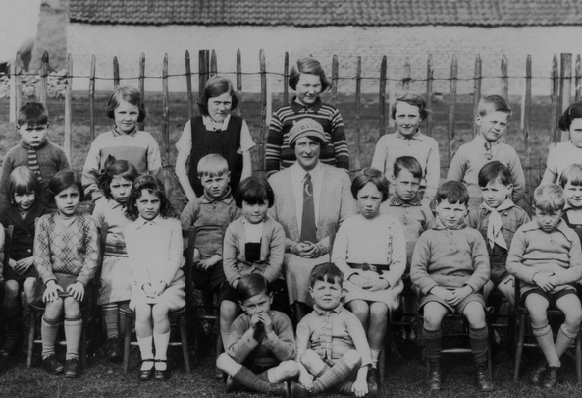
Academia Isn’t (Always) Learning
“And so like my parents will always go, ‘Well look it up in a book, go to the library.’ And I’ll go, ‘Well there’s the internet just there.’” (UKU5, Emerging, Female, Age 19, Chemistry)
Notes:
Image: http://www.flickr.com/photos/22326055@N06/6732616879/
Donna
Those participants in the “Emerging” educational stage tended to consider physical books as the most academically credible source but often used what they considered less authoritative information from the web. This usually was because searching online was the most convenient method of discovering what they needed and usually provided more focused “answers” than alternatives. (InfoKit, Academia Isn’t (Always) Learning)
Participants in the later educational stages (Embedding and Experienced) had more sophisticated critical evaluation techniques and a deeper understanding of their chosen subject so were prepared to vouch for less traditional sources. However, they still were tentative about citing non-traditional resources in formal work even when they knew the information to be high quality. (InfoKit, Academia Isn’t (Always) Learning)
All of the students we interviewed had constructed a precise, if conservative, model of what they thought their institution would accept as legitimate practices in their academic work and were adept at only presenting these during class time and in formal assessments. For tutors, faculty, and other academic staff, the notion of what constitutes legitimate practice was far less clear and appeared to be negotiated on an individual basis. (InfoKit, Academia Isn’t (Always) Learning)

Slide 30
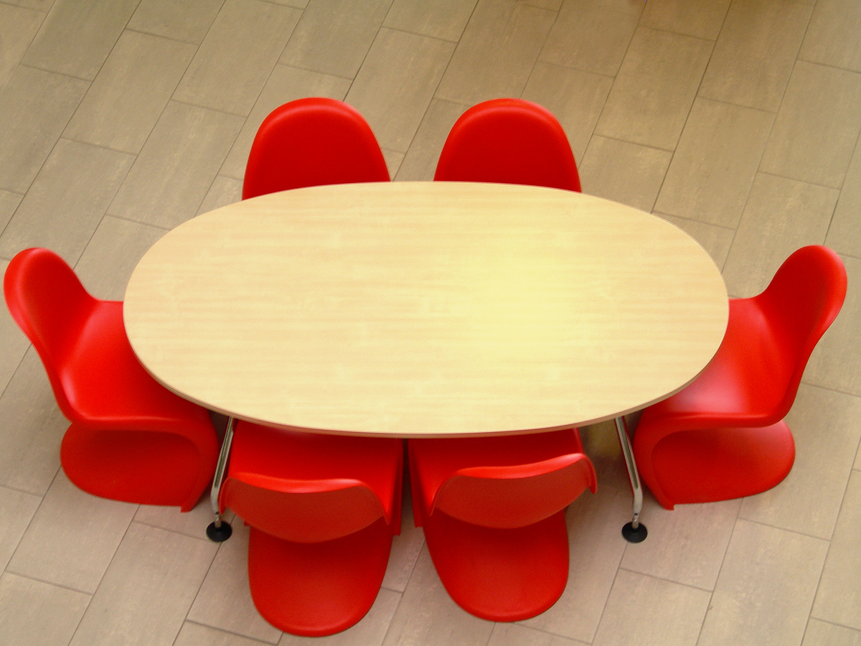
Engaging Constituents
Notes:
Image: http://www.flickr.com/photos/mnadi/32325828/
Lynn
Who has engaged in some type of assessment?
What did you do?
What did you learn?
What, if any, changes came about from what you learned?
What would have helped you during this process?
If you have not engaged in some type of assessment at your institution, why do you think this is the case?
What would help you engage in some type of assessment?

Slide 31
Questions & Discussion
Lynn Silipigni Connaway connawal@oclc.org
@LynnConnaway
Donna Lanclos
dlanclos@uncc.edu
@DonnaLanclos
David White
david.white@conted.ox.ac.uk
@daveowhite
Erin Hood
hoode@oclc.org
@ErinMHood1
Notes:
Image: http://www.flickr.com/photos/joelmarkwitt/2797956179/

Slide 32
Selected Bibliography
Connaway, Lynn Silipigni. 2013. Why the internet is more attractive than the library. The Serials Librarian 64, no. 1-4: 41-56.
Connaway, Lynn Silipigni, Donna Lanclos, and Erin M. Hood. 2013. “I always stick with the first thing that comes up on Google…” Where people go for information, what they use and why. Accepted for publication, EDUCAUSE Review Online.
Connaway, Lynn Silipigni, Donna Lanclos, David White, Alison Le Cornu, and Erin M. Hood. 2013. User-centered decision making: A new model for developing academic library services and systems. IFLA Journal 39, no. 1: 30-36.
Connaway, Lynn Silipigni, and Marie L. Radford. 2011. Seeking synchronicity: Revelations and recommendations for virtual reference. Dublin, OH: OCLC Research. http://www.oclc.org/reports/synchronicity/full.pdf.
Connaway, Lynn Silipigni, David White, and Donna Lanclos. 2011. Visitors and residents: What motivates engagement with the digital information environment? Proceedings of the 74th ASIS&T Annual Meeting 48: 1-7.
Connaway, Lynn Silipigni, David White, Donna Lanclos, and Alison Le Cornu. 2012. Visitors and residents: What motivates engagement with the digital information environment? Information Research 18, no. 1. http://informationr.net/ir/18-1/paper556.html#.Ug0ZTZI4tMg.

Slide 33
Selected Bibliography
Connaway, Lynn Silipigni, Donna Lanclos, and Erin M. Hood. 2013. “‘I find Google a lot easier than going to the library website.’ Imagine Ways to Innovate and Inspire Students to Use the Academic Library.” Proceedings of the Association of College & Research Libraries (ACRL) 2013 conference, April 10-13, 2013, Indianapolis, IN. http://www.ala.org/acrl/sites/ala.org.acrl/files/content/conferences/confsandpreconfs/2013/papers/Connaway_Google.pdf.
De Rosa, Cathy, Joanne Cantrell, Diane Cellentani, Janet Hawk, Lillie Jenkins, and Alane Wilson. 2005. Perceptions of libraries and information resources: A report to the OCLC membership. Dublin, OH: OCLC Online Computer Library Center. http://www.oclc.org/content/dam/oclc/reports/pdfs/Percept_all.pdf.
Prensky, Marc. 2001a. Digital natives, digital immigrants. On the Horizon 9, no. 5, http://www.marcprensky.com/writing/Prensky%20-%20Digital%20Natives,%20Digital%20Immigrants%20-%20Part1.pdf.
Prensky, Marc. 2001b. Do they really think differently? On the Horizon 9, no. 5, http://www.marcprensky.com/writing/Prensky%20-%20Digital%20Natives,%20Digital%20Immigrants%20-%20Part2.pdf.
Pullinger, David. 1999. Academics and the new information environment: The impact of local factors on use of electronic journals. Journal of Information Science 25, no. 2: 164–172.

Slide 34
Selected Bibliography
White, David S., and Lynn Silipigni Connaway. 2011-2012. Visitors & residents: What motivates engagement with the digital information environment? Funded by JISC, OCLC, and Oxford University. http://www.oclc.org/research/activities/vandr/ and http://www.jisc.ac.uk/whatwedo/projects/visitorsandresidents.aspx.
White, David. 2008. Not “natives” & “immigrants” but “visitors” & “residents.” TALL Blog: Online Education with the University of Oxford, April 23, http://tallblog.conted.ox.ac.uk/index.php/2008/07/23/not-natives-immigrants-but-visitors-residents/.
White, David S., and Alison Le Cornu. 2011. Visitors and Residents: A new typology for online engagement. First Monday 16, no. 9, http://firstmonday.org/htbin/cgiwrap/bin/ojs/index.php/fm/article/viewArticle/3171/3049.
©2013 OCLC, David White, & Donna Lanclos. This work is licensed under a Creative Commons Attribution 3.0 Unported License. Suggested attribution: “This work uses content from ‘Meeting the Needs of Digital Visitors and Residents: Developing Engagement with Institutional Services’ © OCLC, David White & Donna Lanclos, used under a Creative Commons Attribution license: http://creativecommons.org/licenses/by/3.0/”

