Slide 1




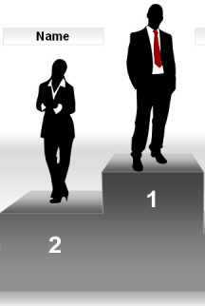
Why the Internet is More Attractive than the Library
2012 NASIG Annual Conference
Nashville
June 7-10, 2012
Lynn Silipigni Connaway, Ph.D.
Senior Research Scientist
OCLC Research

Slide 2

“I find Google a lot easier…so many journals come up and when you look at the first ten and they just don’t make any sense. I, kind of, give up.”
(USU7, Female Age 19)
Notes:
“I find Google a lot easier than going to the library website because I don’t know, it’s just like sometimes so many journals come up and when you look at the first ten and they just don’t make any sense I, kind of, give up. Google, I don’t know. It’s just Google it’s – I find it easier just to look through anything.” (USU7 0:34:11, Female Age 19, Digital Visitors and Residents)
White, D., & Connaway, L. S. (2011). Visitors and residents: What motivates engagement with the digital information environment. Funded by JISC, OCLC, and Oxford University. http://www.oclc.org/research/activities/vandr/

Slide 3
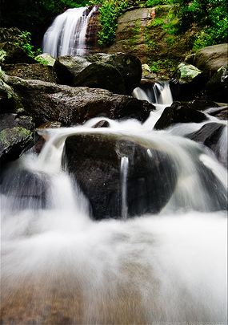
Then and Now
Then: The user built workflow around the library
Now: The library must build its services around user workflow
Then: Resources scarce, attention abundant
Now: Attention scarce, resources abundant
(Dempsey, 2008)
Notes:
Dempsey, L. (2008). "Always on: Libraries in a world of permanent connectivity" First Monday [Online], (14) 1. Retrieved from http://www.firstmonday.org/htbin/cgiwrap/bin/ojs/index.php/fm/article/view/2291/2070
Today, more than 1.7 billion people, or almost one out of every four humans on the planet, are online (Wasserman, 2012).
Wasserman, S. (2012, June 18). The amazon effect. The Nation. Retrieved from http://www.thenation.com/article/168125/amazon-effect

Slide 4

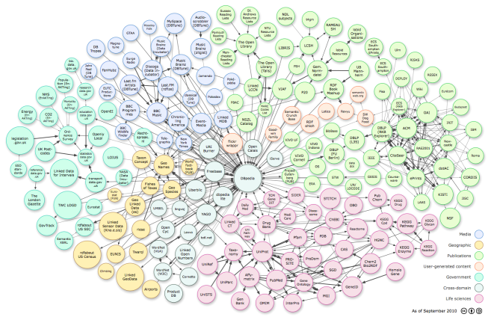
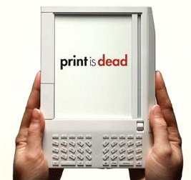
Changes in Information Acquisition
Local to global
Linear to linked
Print to digital

Slide 5

Towards a Profile of the Researcher of Today:
What Can We Learn from JISC Projects?
Digital Information Seekers:
Report of findings from selected OCLC, JISC & RIN User Behavior Projects
Funded by JISC
Analysis of 12 user behavior studies
  Conducted in US and UK
  Published 2005-2010
  Synthesis
    Better understand user information-seeking behavior
    Identify issues for development of user-focused services and systems
Notes:
Calhoun, K., Cantrell, J., & Gallagher, P. (2009). Online catalogs: What users and librarians want: An OCLC report. Dublin, OH: OCLC. Retrieved from http://www.oclc.org/us/en/reports/onlinecatalogs/default.htm
De Rosa, C. (2005). Perceptions of libraries and information resources: A report to the OCLC membership. Dublin, OH: OCLC Online Computer Library Center. http://www.oclc.org/us/en/reports/2005perceptions.htm
De Rosa, C. (2006). College students' perceptions of libraries and information resources: A report to the OCLC membership. Dublin, OH: OCLC Online Computer Library Center. http://www.oclc.org/us/en/reports/perceptionscollege.htm
Dervin, B., Reinhard, C. L. D., Kerr, Z. Y., Song, M., & Shen, F. C. (Eds.)(2006). Sense-making the information confluence: The whys and hows of college and university user satisficing of information needs. Phase II: Sense-making online survey and phone interview study. Report on National Leadership Grant LG-02-03-0062-03 to Institute of Museum and Library Services, Washington, D.C. Columbus, OH: School of Communication, Ohio State University. http://imlsproject.comm.ohio-state.edu/imls_reports/imls_PH_II_report_list.html
Connaway, L. S., Prabha, C., & Dickey, T. J. (2006). Sense-making the information confluence: The whys and hows of college and university user satisficing of information needs. Phase III: Focus group interview study. Report on National Leadership Grant LG-02-03-0062-03, to Institute of Museum and Library Services, Washington, D.C. Columbus, OH: School of Communication, The Ohio State University. Retrieved from http://imlsproject.comm.ohiostate.edu/imls_reports/PHASE_III/PH_III_report_list.html
Prabha, C., Connaway, L.S. & Dickey, T.J. (2006). Sense-making the information confluence: The whys and hows of college and university user satisficing of information needs. Phase IV: Semi-structured interview study. Report on National Leadership Grant LG-02-03-0062-03, to Institute of Museum and Library Services, Washington, D.C. Columbus, OH: School of Communication, The Ohio State University. Retrieved from
http://imlsproject.comm.ohio-state.edu/imls_reports/imls_PH_IV_report_list.html
Research Information Network. (2006). Researchers and discovery services: Behaviour, perceptions and needs. London: Research Information Network. Retrieved from http://www.rin.ac.uk/our-work/using-and-accessinginformation-resources/researchers-and-discovery-services-behaviour-perc
Consortium of University Research Libraries, and Research Information Network. 2007. Researchers' use of academic libraries and their services: A report. London: Research Information Network and Consortium of University Research Libraries (CURL).
Centre for Information Behaviour and the Evaluation of Research. (2008). Information behaviour of the researcher of the future: A CIBER briefing paper. London: CIBER. Retrieved from http://www.jisc.ac.uk/media/documents/programmemes/reppres/gg_final_keynote_11012008.pdf
Radford, M. L., & Connaway, L. S. (2008). Seeking synchronicity: Evaluating virtual reference services from user, non-user, and librarian perspectives: IMLS final performance report. Report on Grant LG-06-05-0109-05, to Institute of Museum and Library Services, Washington, D.C. Dublin, OH: OCLC Online Computer Library Center.
Research Information Network. (2009). E-journals: Their use, value and impact. London: Research Information Network. Retrieved from http://www.rin.ac.uk/our-work/communicating-and-disseminating-research/ejournals-their-use-value-and-impact
JISC and UCL. 2009. JISC national e-books observatory project: Key findings and recommendations: Final report.
Hampton-Reeves, S., Mashiter, C., Westaway, J. , Lumsden, P., Day, H., Hewerston, H. & Hart, A. (2009). Students’ use of research content in teaching and learning: A report of the Joint Information Systems Council (JISC). Retrieved from http://www.jisc.ac.uk/media/documents/aboutus/workinggroups/studentsuseresearchcontent.pdf
Wong, W., Stelmaszewska, H., Bhimani,N., Barn, S., & Barn, B. (2009). User behaviour in resource discovery: Final report. http://www.jisc.ac.uk/whatwedo/programmes/inf11/userbehaviourbusandecon.aspx

Slide 6
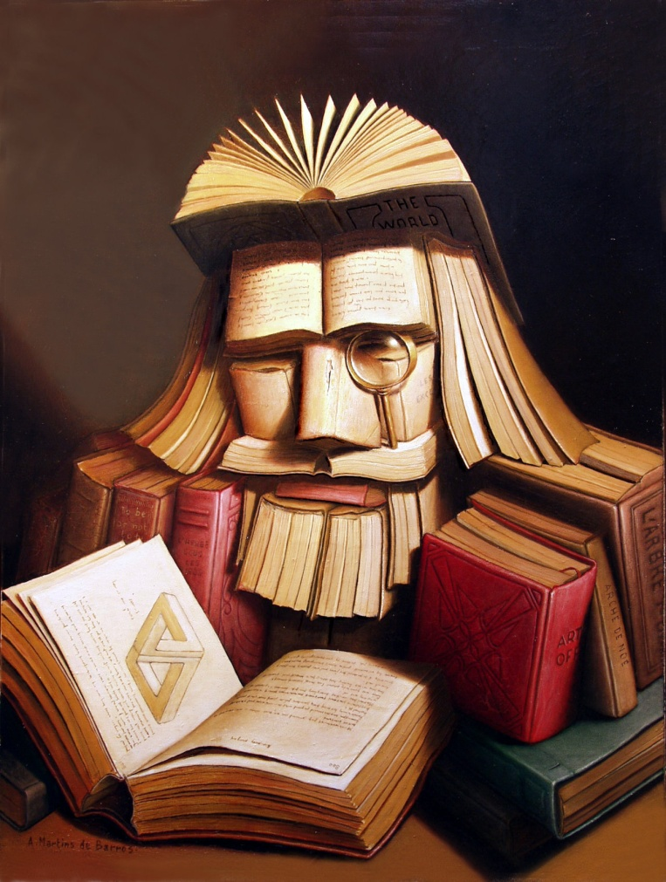

Understanding Motivations & Engagement

Slide 7
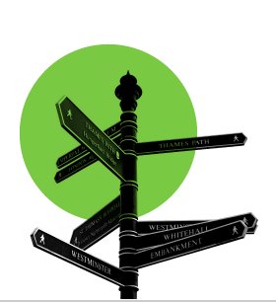
How Individuals Work
Convenience
Value human resources
Contextually based rational decisions
Situational needs determine search
virtual library
physical library
complex search
simple
search
(Connaway & Radford, 2011)
Notes:
User behaviors in this electronic environment tend toward quick views of a few pages, and “bouncing” between resources. This seems to contradict the notion of the hard-core researcher but supports the need for more user behavior research addressing situation and context. DIS, p. 34.
Convenience often dictates choices between physical and virtual library and is based on context and situation.
Connaway, L. S., & Radford, M. L. (2011). Seeking synchronicity: Revelations and recommendations for virtual reference. Dublin, OH: OCLC Research. Retrieved from http://www.oclc.org/reports/synchronicity/full.pdf

Slide 8
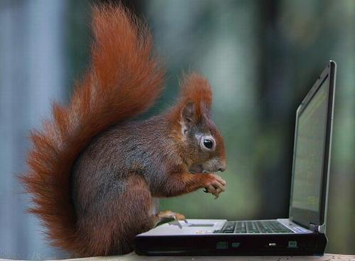
How Individuals Work
Power browsing
  Scan small chunks of information
  View first few pages
  No real reading
Squirreling
  Short basic searches
  Download content for later use
(Center for Information Behaviour and the Evaluation of Research, 2008)
Notes:
“You know, I generally didn’t sit back in my chair and just read the journal, I searched maybe 50 journals at two or three topics I’m looking for and want to read about today, get those topics and read the articles on that” (Focus Group 01, Faculty, Sense-making the Information Confluence)
Dervin, B., Connaway, L.S., & Prabha, C. 2003-2006 Sense-making the information confluence: The whys and hows of college and university user satisficing of information needs. Funded by the Institute of Museum and Library Services (IMLS). http://imlsosuoclcproject.jcomm.ohio-state.edu/
60% of e-journal users view <4 pages
65% of e-journal users do not return to the journal (p.10)
Centre for Information Behaviour and the Evaluation of Research. 2008. Information behaviour of the researcher of the future: A CIBER briefing paper. London: CIBER (p. 31).

Slide 9



All About Students
Behaviors
Information Literacy
Researchers
Students
Students
Tools
Used
Frustrations

Slide 10
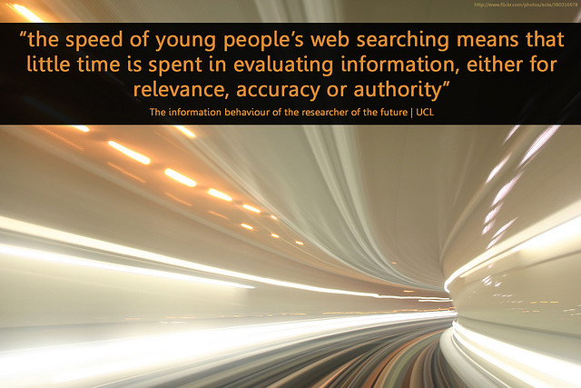
Notes:
University College, London., British Library., & Joint Information Systems Committee. (2008). Information behaviour of the researcher of the future. London: UCL.

Slide 11
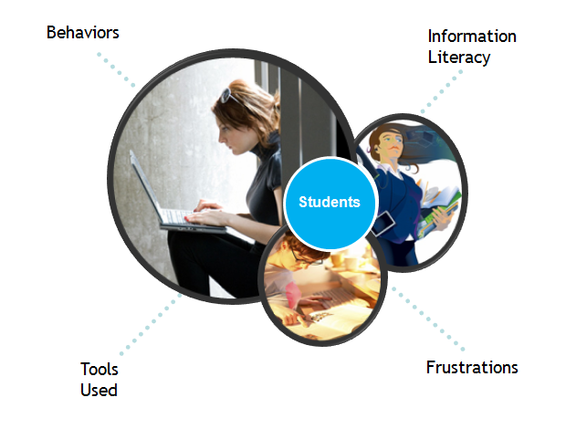
Students: Behaviors
Prefer keyword searches
Confident in skills
“Satisficing”
Speed & convenience key
(Hampton-Reeves, et.al., 2009)
Notes:
Hampton-Reeves, S., Mashiter, C., Westaway, J. , Lumsden, P., Day, H., Hewerston, H. & Hart, A. (2009). Students’ use of research content in teaching and learning: A report of the Joint Information Systems Council (JISC). http://www.jisc.ac.uk/media/documents/aboutus/workinggroups/studentsuseresearchcontent.pdf (p.3).
Connaway, L. S., & Dickey, T. J. (2010). The digital information seeker: Report of findings from selected OCLC, RIN, and JISC user behavior projects. Retrieved from http://www.jisc.ac.uk/media/documents/publications/reports/2010/digitalinformationseekerreport.pdf

Slide 12
Students: Information Literacy Skills
Confident with information discovery tools
Determine credibility by:
  Common sense (83%)
  Cross-checking (71%)
  Reputation of company/organization (69%)
  Credible recommendations (68%)
(De Rosa, 2006)
Notes:
“Usually websites that have like one colour backgrounds, where it’s a lot of just like basic text, there’s not a lot of graphics. They don’t really look nice, they look, kind of, like somebody just threw a website together and put it up online. It’s like I don’t trust those because it’s like, you know, they didn’t put a whole lot of time into this, I wonder how credible they are, so I don’t trust them usually.” (USU4 0:32:59, Male, Age 19, Digital Visitors and Residents)
“It is kind of like a guess and check to see which one works best or which one gives you the most information. It is not necessarily to see which one is more credible because if you want credibility you are not necessarily going to look online for it.” (USU3 0:18:31, Male, Age 19, Digital Visitors and Residents)
“I often just click on the first page, I’m not sure why. Don’t really go further. But yes, it’s hard to know what to trust though.” (UKS1 00:18:19, Male, Age 18, Digital Visitors and Residents)
“You know, let’s say it’s not even in an academic context. I have to see the same conclusion reached by lots of different people in different contexts. Like I need to see the same answer again and again and again. And maybe at some point that’s enough time where it starts to gel to me that this probably is a good approximation of the truth. It might not be the truth but this seems to be what a lot of people perceive as the truth. So that would be the simplest way to do it.” (USF3 0:29:48, age unidentified, Digital Visitors and Residents)
“That’s the only problem, just knowing what information to use and why.” (UKS1 00:24:05, Male, Age 18, Digital Visitors and Residents)
De Rosa, C. (2006). College students' perceptions of libraries and information resources: A report to the OCLC membership. Dublin, Ohio: OCLC Online Computer Library Center. http://www.oclc.org/us/en/reports/perceptionscollege.htm (p.3-3-4).
White, D., & Connaway, L. S. (2011). Visitors and residents: What motivates engagement with the digital information environment. Funded by JISC, OCLC, and Oxford University. http://www.oclc.org/research/activities/vandr/

Slide 13
Students: Frustrations
Need desktop access
Library
  Website hard to navigate
  Inconvenient
  Associate with books
(Connaway & Dickey, 2010)
Notes:
“She [professor] was very direct about certain stuff and wanted me to go to the library. Of course like the library’s like a second home for me, so that’s fine. But the research I needed wasn’t showing up. So I was like okay, I’m going to the internet. And I had to find quotes from books, so I just like was able to go on Google, Google book search, and find the quote I needed. And I didn’t write down it was from the internet .... So she doesn’t really know (Laughter) that it’s from the internet.” (USU2 0:31:50, Female, Age 19, Digital Visitors and Residents)
“I have better things to do than go drive all the way to the library when I can just sit at home and type it into my computer.” (USU1 0:33:12, Female, Age 19, Digital Visitors and Residents)
“Yes, I’m sure, because, you know, going to the library was a task. And part of, I’m sure, a lot of people, and as far as me is concerned from laziness, it was much easier to just scrap around. It’s so much easier to just strain to find something on the internet than to, like, drive to the library. But that was in high school. In college, and especially grad school, I’m not afraid to go to the library anymore because we have a very good [library] and we have a very good website.” (USG2 0:45:28, Male, Age 25, Digital Visitors and Residents)
“I don’t use the library. Most students really don’t anymore, I know a couple of people that live here but they don’t actually use it for books, they use it as a quiet place to study.” (USU4 0:36:27, Male, Age 19, Digital Visitors and Residents)
Connaway, L.S., & Dickey, T.J. (2010). Digital information seekers: Report of findings from selected OCLC, RIN, and JISC user behavior projects. http://www.jisc.ac.uk/media/documents/publications/reports/2010/digitalinformationseekerreport.pdf (p.4).
White, D., & Connaway, L. S. (2011). Visitors and residents: What motivates engagement with the digital information environment. Funded by JISC, OCLC, and Oxford University. http://www.oclc.org/research/activities/vandr/

Slide 14
Students: Tools Used
Undergraduate Students
  Google, Wikipedia
  Also use library website and e-journals
  Human resources
    Other students/classmates
    Family & relatives
    Friends
Graduate students
  Professors, advisors, mentors
  Electronic databases
(De Rosa, 2006)
(Connaway & Dickey, 2010)
Notes:
“One of my favourite ways of getting information is by asking people. Instead of Googling the whole time I mostly have faith in the fact that people are actually learning, if I can go to a tutor and ask them something.” (UKU3 0:19:34, Female, Age 19, Digital Visitors and Residents)
Like usually with homework I usually can do it myself. But like, like sometimes I will just like IM my friend on Facebook and will be like, “Hey do you know how to do this?” That is usually how I will do it or I will text somebody but for the most part if I can’t figure it out then I just kind of star that question because there is usually just one or two questions. Or I will just go to my parents or my Grandma or something. (USS6 0:17:08, Female, Age 17, Digital Visitors and Residents)
I use my friends a lot. I use people that I know know things about like if they’re, maybe not specialised but know what they are. Ask them first and then they’ll give me information. Because for me as I said I’m a people person. I trust what my friends say. I know what to take from them. Maybe they may not be the same as me and may not believe the same stuff. I know what I can take from them at least. (USS5 01:01:42, Male, Age 18, Digital Visitors and Residents)
Connaway, L.S., & Dickey, T.J. (2010). Digital information seekers: Report of findings from selected OCLC, RIN, and JISC user behavior projects. http://www.jisc.ac.uk/media/documents/publications/reports/2010/digitalinformationseekerreport.pdf (p. 39).
De Rosa, C. (2006). College students' perceptions of libraries and information resources: A report to the OCLC membership. Dublin, Ohio: OCLC Online Computer Library Center.
White, D., & Connaway, L. S. (2011). Visitors and residents: What motivates engagement with the digital information environment. Funded by JISC, OCLC, and Oxford University. http://www.oclc.org/research/activities/vandr/

Slide 15

Students: Information Seeking in Action
Notes:
Users often won’t ask the librarian because the librarian looks too busy and they don’t want to bother the librarians or they are intimidated by the librarians.
Connaway, L. S., & Radford, M. L. (2011). Seeking synchronicity: Revelations and recommendations for virtual reference. Dublin, OH: OCLC Research. Retrieved from http://www.oclc.org/reports/synchronicity/full.pdf
Radford, M. L., & Connaway, L. S. (2008). Seeking synchronicity: Evaluating virtual reference services from user, non-user, and librarian perspectives: IMLS final performance report. Report on Grant LG-06-05-0109-05, to Institute of Museum and Library Services, Washington, D.C. Dublin, Ohio: OCLC Online Computer Library Center.

Slide 16

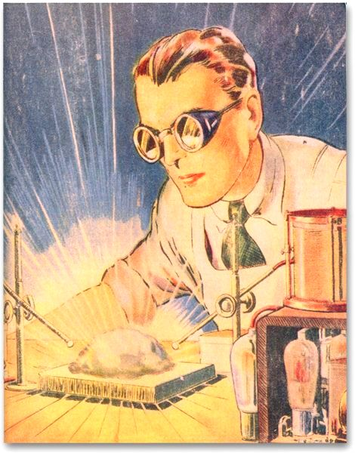

All About Researchers
Information Literacy
Behaviors
Researchers
Tools
Used
Frustrations

Slide 17
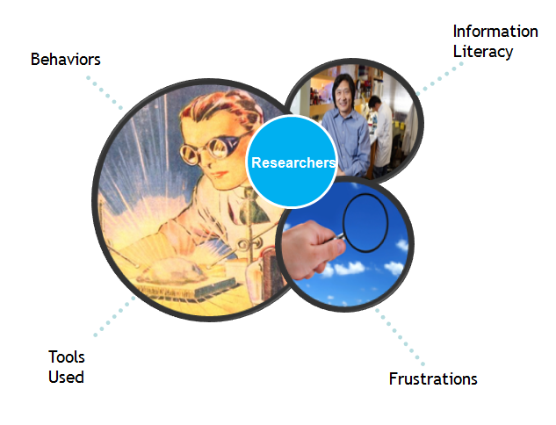
Researchers: Behaviors
Differ with discipline
“Satisficing”
Awareness of open access is low
Lack of understanding of copyright & signed publisher agreements
(Consortium of University Research Libraries, and Research Information Network, 2007)
(Research Information Network, 2006)
(Connaway & Dickey, 2010)
Notes:
Researchers in the sciences are most satisfied, Arts and Humanities researchers indicated serious problems (p. 75)
“Satisficing” (p. 31)
Awareness of open access is low (p. 64).
Lack of Understanding of copyright and publisher agreements (Connaway & Dickey, 2010, Towards a Profile of the Researcher of Today)
Consortium of University Research Libraries, and Research Information Network. (2007). Researchers’ use of academic libraries and their services: A report. London: Research Information Network and Consortium of University Research Libraries (CURL) (p. 31, p.64).
Research Information Network. (2006). Researchers and discovery services: Behaviour, perceptions and needs. London: Research Information Network (p. 75).
Connaway, L. S., & Dickey, T. J. (2010). Towards a profile of the researcher of today: What can we learn from JISC projects? Common themes identified in an analysis of JISC Virtual Research Environment and Digital Repository Projects. http://ie-repository.jisc.ac.uk/418/2/VirtualScholar_themesFromProjects_revised.pdf

Slide 18
Researcher: Information Literacy Skills
Self-taught in discovery services
  No formal training (62%)
Doctoral students learn from dissertation professor
Confident in skills
(Research Information Network, 2006)
Notes:
Most researchers self-taught in discovery services
62% report no formal training (p.64)
Confident in their skills (p.9)
Research Information Network. (2006). Researchers and discovery services: Behaviour, perceptions and needs. London: Research Information Network.
Discuss New Zealand computer science faculty projects, 1996 and 2011.
Cunningham, S. J. & Connaway, L. S. (1996). Information searching preferences and practices of computer science researchers. In J. Grundy (Ed.), Proceedings: Sixth Australian conference on computer-human interaction, November 24-27, 1996, Hamilton, New Zealand (pp. 294-299). Los Alamitos, CA: IEEE Computer Society Press.

Slide 19
Researchers: Frustrations
  Accessing online journal articles & back files
  Need desktop access
  Discovery of non-English content
  Unavailable content
  Irrelevant information in result list
  Lack of specialist search engines
(Connaway & Dickey, 2010)
(Research Information Network, 2006)
Notes:
“It can be difficult for a UK professional who does not speak foreign languages to get a good academic translation. Would like a very good translation service specifically geared for academics,” (Physical Sciences Researcher, Research Information Network. 2006. Researchers and discovery services: Behaviour, perceptions and needs. London: Research Information Network.)
Accessing online journal articles & back files (p. 67)
Need desktop access (p. 4)
Discovery of non-English content (p. 75)
Unavailable content (p. 75)
Irrelevant information in result list (p.75)
Lack of specialist search engines (p. 67)
Connaway, L.S., & Dickey, T.J. (2010). Digital information seekers: Report of findings from selected OCLC, RIN, and JISC user behavior projects. http://www.jisc.ac.uk/media/documents/publications/reports/2010/digitalinformationseekerreport.pdf (p.4).
Research Information Network. (2006). Researchers and discovery services: Behaviour,
perceptions and needs. London: Research Information Network. (p. 67, p. 75)

Slide 20
Researchers: Tools Used
  Online resources
    Google, Web of Science, PubMed, Science Direct, JSTOR
    99.5% use journals as primary resource
  Human resources
    Coworkers
    Colleagues
    Other professionals
(Connaway & Dickey, 2010)
(Research Information Network, 2006)
Notes:
Google, Web of Science, PubMed, Science Direct, JSTOR (p.27)
Increasingly important to research process at all levels (p.4)
Articles are central type of resource for researchers (p.34-35)
99.5% say journals are primary resource (p. 34-35)
71% rank journals in their top three resources (p. 34-35)
90% mention expertise of individuals as important resource (pp.7, 34-35)
Connaway, L.S., & Dickey, T.J. (2010). Digital information seekers: Report of findings from selected OCLC, RIN, and JISC user behavior projects. http://www.jisc.ac.uk/media/documents/publications/reports/2010/digitalinformationseekerreport.pdf (p.4).
Research Information Network. (2006). Researchers and discovery services: Behaviour, perceptions and needs. London: Research Information Network (p. 27, p. 34-35).

Slide 21

Barriers to Library
Poor usability
High complexity
  Library language
Lack of integration of many resources
(Wong, Stelmaszewska, Bhimani, Barn, & Barn, 2009)
Notes:
Poor usability (p. 6)
High complexity (p. 6)
Lack of integration of many resources (p. 6)
Wong, W., Stelmaszewska, H., Bhimani,N., Barn, S., & Barn, B. (2009). User behaviour in resource discovery: Final report. http://www.jisc.ac.uk/whatwedo/programmes/inf11/userbehaviourbusandecon.aspx

Slide 22
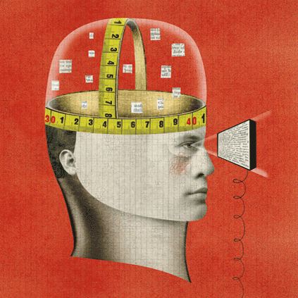
Journals
E-journals
  Visit only a few minutes
  Shorter sessions
  Basic search
  View few pages
  Journal backfiles difficult to access
  Content often discovered through Google
(Research Information Network, 2009)
(Wong, Stelmaszewska, Bhimani, Barn, & Barn, 2009)
Notes:
Research Information Network. (2009). E-journals: Their use, value and impact. London: Research Information Network.
Journal backfiles hard to access (p. 8)
Wong, W., Stelmaszewska, H., Bhimani,N., Barn, S., & Barn, B. (2009). User behaviour in resource discovery: Final report. http://www.jisc.ac.uk/whatwedo/programmes/inf11/userbehaviourbusandecon.aspx
In ERIAL project, JSTOR is the second most frequently mentioned database (Kolowich, 2011).
Kolowich, S. (2011, 22 August). Study: College students rarely use librarians’ expertise. USA Today. Retrived from: http://www.usatoday.com/news/education/story/2011-08-22/Study-College-students-rarely-use-librarians-expertise/50094086/1
JSTOR also frequently mentioned in Sense-making Study
Dervin, B., Connaway, L.S., & Prabha, C. 2003-2006 Sense-making the information confluence: The whys and hows of college and university user satisficing of information needs. Funded by the Institute of Museum and Library Services (IMLS). http://imlsosuoclcproject.jcomm.ohio-state.edu/

Slide 23

Journals
Access more important than discovery
Full text, online versions
Seamless Discovery-to-Delivery
(Research Information Network, 2006)
Notes:
Logins, password, and authentication interferes with access to sources
Research Information Network. (2006). Researchers and discovery. services: Behaviour, perceptions and needs. London: Research Information Network

Slide 24
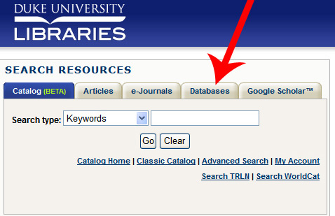
Databases
Electronic databases not perceived as library sources
  Frustration locating & accessing full-text copies
(Dervin, Connaway & Prabha, 2003-2006)
Notes:
Interviewer: Do you use it [Wikipedia] anyway?
Respondent: No, I just don’t even use it. Because I can find the information I need to on other sites. But looking at the author, I try to use a lot of college websites. Or the university databases. They really like those websites because they’re legitimate. (USS3 00:32:28, Female Age 17, Digital Visitors and Residents)
“I will go into the research databases and usually start with com abstracts or go to some other, you know, similar type of, you know, database and do a search there and then I will end, end up, because I am, this is a hurried thing, limiting myself to the articles that are available online as opposed to the ones that I would have to specifically go to the library and make a copy of. You know, because it’s quick. I know that there are other articles, but I limit myself to the ones I can get online. And, you know, the most recent ones tend to be online, so I luck out in that way.” (Focus Group Interview 01, Faculty, Sense-making the Information Confluence)
“…the first thing I did was, before I came to the library to use the MLA database, I did a Google search and it turns out that there is a professor at Berkeley who keeps a really, really nice and fully updated [unclear – words] page with bibliographic references, all kinds of links, you know, it's just awfully good, and I mean it just gets you really off and running on a lot his information and more novels. And I used it quite a bit, and then I did finally come up with and supplement that with an MLA search, which yielded some articles that were not on that page.” (Focus Group Interview 01, Faculty, Sense-making the Information Confluence)
Dervin, B., Connaway, L. S., & Prabha, C. 2003-2006. Sense-making the information confluence: The whys and hows of college and university user satisficing of information needs. Funded by the Institute of Museum and Library Services (IMLS). http://imlsosuoclcproject.jcomm.ohio-state.edu/
White, D., & Connaway, L. S. (2011). Visitors and residents: What motivates engagement with the digital information environment. Funded by JISC, OCLC, and Oxford University. http://www.oclc.org/research/activities/vandr/

Slide 25
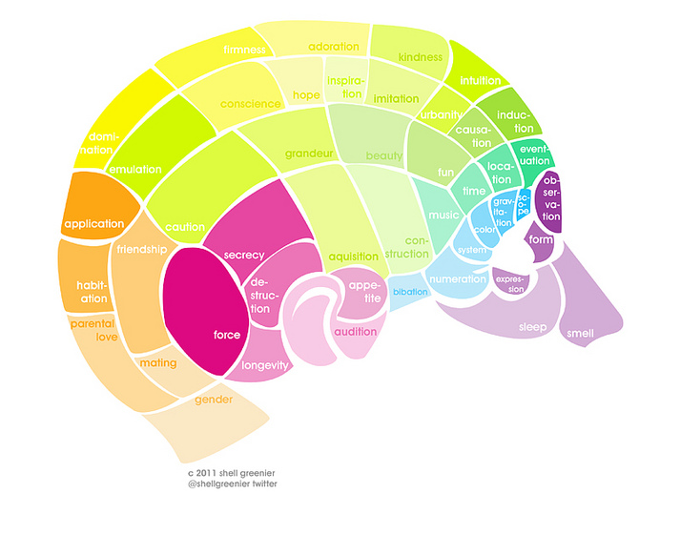



Information Literacy vs. Digital Literacy
Digital literacy
Searching internet,
using technology and social media
Information literacy
Evaluating information for authenticity
Notes:
“Studying for my Earth science class, just Google the question, the first answer that pops up, if it’s right or wrong, that’s what I’m going to study.” (USU8, 0:25:58, Female, Age 19, Digital Visitors and Residents)
“I used a lot of journals, like scientific journals and stuff and then I even didn’t use a computer for some of it. Like I went to the library and found stuff there. And like we learned how to use google a little better, like fish out the .com and stuff, like you can do that. And just get the .orgs and .edu’s because they are more reliable sources.”, (USS6 0:23:00, Female, Age 17,Digital Visitors and Residents).
“I always stick with the first thing that comes up on Google because I think that’s the most popular site which means that’s the most correct. So I tried that and it didn’t work.” (USS1 0:21:57, Female, Age 17, Digital Visitors and Residents)
Ethnographic Research in Illinois Academic Libraries (ERIAL) project
Students search Google more than 2x as much as other databases
Students do not know how to search Google
Don’t know how to limit news articles
Don’t know how to query Google Book Search or Google Scholar
Don’t understand the organization & display of Google results
Ethnographic Research in Illinois Academic Libraries (ERIAL) project:
http://www.usatoday.com/news/education/story/2011-08-22/Study-College-students-rarely-use-librarians-expertise/50094086/1
Kolowich, S. (2011, 22 August). Study: College students rarely use librarians’ expertise. USA Today. Retrieved from: http://www.usatoday.com/news/education/story/2011-08-22/Study-College-students-rarely-use-librarians-expertise/50094086/1
There is a Learning Black Market”: learners use non-traditional sources but feel they cannot talk about them in an institutional context. Wikipedia usage is an example of this. (White & Connaway, 2011)
White, D., & Connaway, L. S. (2011). Visitors and residents: What motivates engagement with the digital information environment. Funded by JISC, OCLC, and Oxford University. http://www.oclc.org/research/activities/vandr/

Slide 26
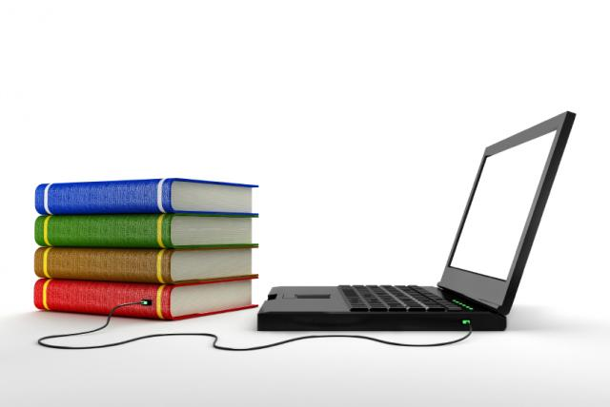
What We Can Improve
OPACs
Traditional library source access
Online sources
(Dervin, Connaway & Prabha, 2003-2006)
Notes:
OPACs are difficult to use; this belief is held by all participants (pp. 11-14)
“Make it as easy as a Google Book Search,” one survey respondent requested when discussing the catalog (Calhoun et al. 2009, p. 14).
One survey respondent suggested, “I wish the results page would list a short blurb (one line) about the book similar to the way Google shows you a tiny bit about what a site link is about” (Calhoun et al. 2009, p. 17).
Calhoun, K., Cantrell, J., & Gallagher, P. (2009). Online catalogs: What users and librarians want: An OCLC report. Dublin, OH: OCLC. Retrieved from http://www.oclc.org/us/en/reports/onlinecatalogs/default.htm
Dervin, B., Connaway, L.S., & Prabha, C. 2003-2006 Sense-making the information confluence: The whys and hows of college and university user satisficing of information needs. Funded by the Institute of Museum and Library Services (IMLS). http://imlsosuoclcproject.jcomm.ohio-state.edu/ (pp. 11-14, 16-17)
Use electronic mediation to reach more traditional library resources, such as Google, Facebook with friends, etc. (pp.11-14)
More online sources, including all print and other physical materials available online (pp.16-17)
Online catalogs: What users and librarians want, 2009. DIS, p. 18.
Information Studies students: (Bertot, et al., 2012, p. 213)
28% use OPAC daily or weekly
86% use Google daily or weekly
Bertot, J. C., Berube, K., Devereaux, P., Dhakal, K., Powers, S., & Ray, J. (2012). Assessing the usability of WorldCat Local: Findings and considerations. The Library Quarterly, 82(2), 207-221.

Slide 27
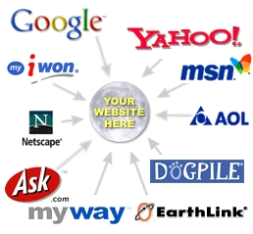
Linking to the Library
84% of users began an information search with search engine
  Majority of British Library web site & WorldCat.org visits from search engine
  1% began information search on library website
Library
(De Rosa, 2005)
(Centre for Information Behaviour and the Evaluation of Research, 2008)
Notes:
The majority of British Library web site visits were from search engine (p. 14)
84% of users began an information search with search engine (p. 1-17)
1% began information search on library website (p.1-17)
Centre for Information Behaviour and the Evaluation of Research. (2008). Information behaviour of the researcher of the future: A CIBER briefing paper. London: CIBER (p. 14).
De Rosa, C. (2005). Perceptions of libraries and information resources: A report to the OCLC membership. Dublin, Ohio: OCLC Online Computer Library Center (p.1-17).
Link users to special collections
Facebook (“On Facebook, Librarian Brings 2 Students From the Early 1900s to Life,” January 6, 2012, Nick DeSantis, Chronicle of Higher Education. http://chronicle.com/blogs/wiredcampus/on-facebook-librarian-brings-two-students-from-the-early-1900s-to-life/34845
Joe McDonald, sophomore at University of Nevada, Reno in 1913, and girlfriend and future wife, Leola Lewis
University of Washington includes it’s special collections in the references in Wikipedia

Slide 28
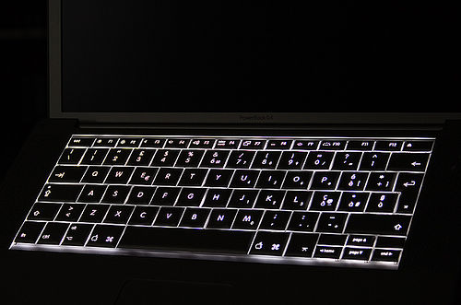
Making the Library More Attractive
Library systems as search engines & web services
Advertise resources, brand & value
Provide search help at time of need
  Chat & IM help during search
Need help?
(Connaway & Dickey, 2010)
(De Rosa, 2005)
Notes:
Library systems need to look and function more like search engines, e.g., Google and Yahoo, and services, e.g., Amazon.com since these are familiar to users who are comfortable and confident in using them (p.5).
36% of respondents reported being extremely familiar with search engines while only 26% reported being very familiar with libraries (p. 1-8)
VRS meets users where they are
Text, e-mail, chat
Facebook (“On Facebook, Librarian Brings 2 Students From the Early 1900s to Life,” January 6, 2012, Nick DeSantis, Chronicle of Higher Education. http://chronicle.com/blogs/wiredcampus/on-facebook-librarian-brings-two-students-from-the-early-1900s-to-life/34845
Joe McDonald, sophomore at University of Nevada, Reno in 1913, and girlfriend and future wife, Leola Lewis
Librarians’ expertise can deliver quality sources to users through VRS that they cannot find with a Google search
Connaway, L. S., & Dickey, T. J. (2010). Digital information seekers: Report of findings from selected OCLC, RIN, and JISC user behavior projects. http://www.jisc.ac.uk/media/documents/publications/reports/2010/digitalinformationseekerreport.pdf (p. 5).
De Rosa, C. (2005). Perceptions of libraries and information resources: A report to the OCLC membership. Dublin, Ohio: OCLC Online Computer Library Center (p.1-8).
“However, I would have used Google if I had had internet connection, because if you spell something incorrectly, there is a notice saying “did you mean to spell ____?” with the correct spelling of the word. So that would have been my first choice of thing to do in this situation, but the dictionary application worked fine since I did not have internet connection.” (USS3 , Emerging, Diary 2 / 5/15/2011, Female, Age 19, Digital Visitors and Residents)
White, D., & Connaway, L. S. (2011). Visitors and residents: What motivates engagement with the digital information environment. Funded by JISC, OCLC, and Oxford University. http://www.oclc.org/research/activities/vandr/

Slide 29

Making the Library More Attractive
Convenience
  Instant gratification at a click
  Deliver answers
User-centered development approach
  Metadata creation
  Interface design
(Centre for Information Behaviour and the Evaluation of Research, 2008)
Notes:
Convenience
Instant gratification at a click (p. 8)
Provide seamless access to digital content
Deliver answers (p. 8)
User-centered development approach
Serve different constituencies
Adapt to changing user behaviors
Create metadata based on user needs
Digital Information Seeker, pg. 45.
A synthesis of findings from these major user studies points toward a number of implications for libraries. The implications below represent broad tendencies. The various user studies themselves do take into account differences in behaviour based on age and gender of the subjects, and context and situation of the information needs. Differences based on academic discipline have been a common finding throughout the user behaviour studies. Even though the studies ask different questions of their subjects, the findings present a rich portrait of user behaviours. In order to generalize findings and to present a valid portrait of user behaviours, it is necessary to conduct longitudinal studies of large populations.
Implications for libraries which are shared by multiple studies include the following:
The library serves many constituencies, with different needs and behaviours.
Library systems must do better at providing seamless access to resources.
Librarians must increasingly consider a greater variety of digital formats and content.
Both academics and non-academics believe more digital resources of all kinds are better.
Library systems and content must be prepared for changing user behaviours.
High-quality, robust metadata is becoming more important for discovery of appropriate resources.
The library must advertise its brand, its value, and its resources better within the community.
Centre for Information Behaviour and the Evaluation of Research. (2008). Information
behaviour of the researcher of the future: A CIBER briefing paper. London: CIBER (p. 8).

Slide 30
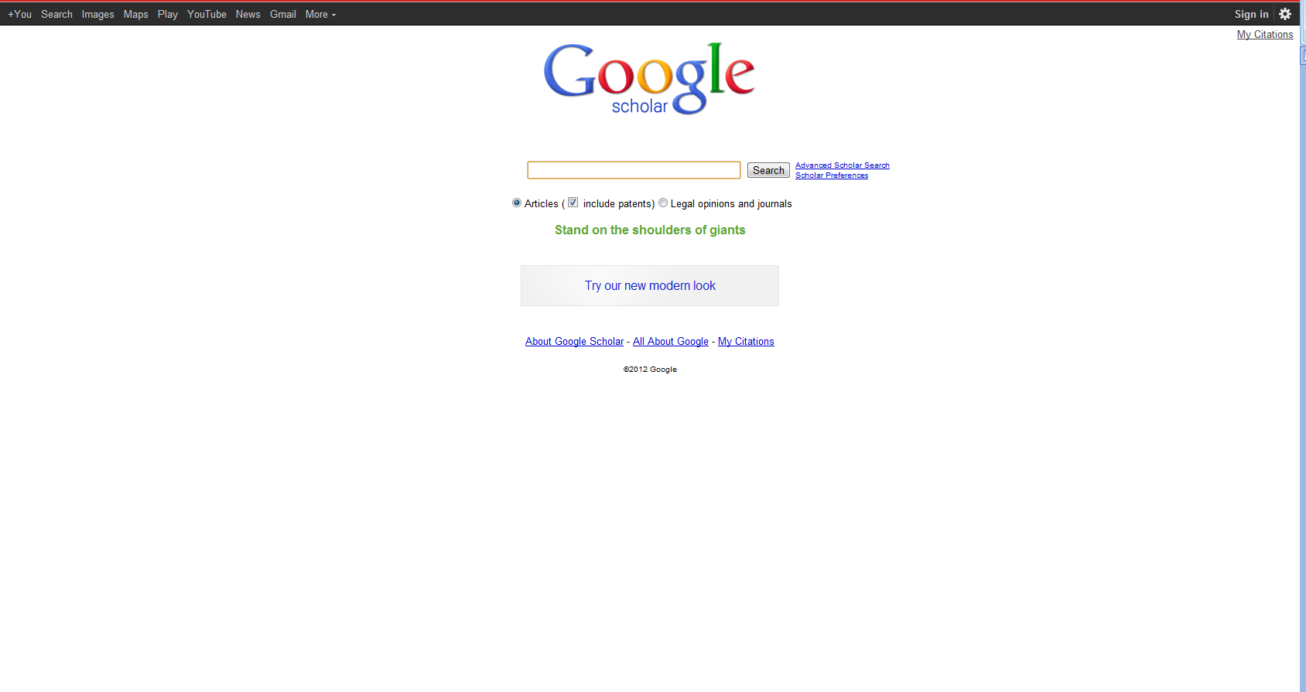
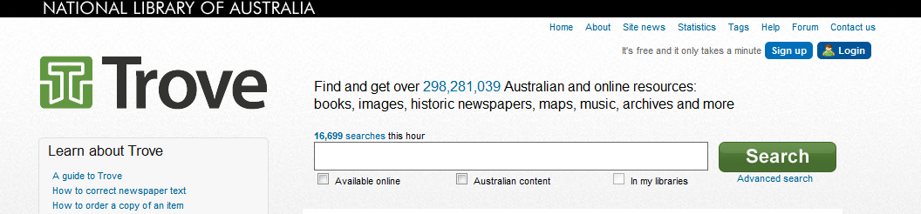
Making the Library More Attractive
Notes:
Trove (National Library of Australia): http://trove.nla.gov.au/

Slide 31
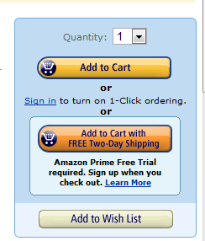
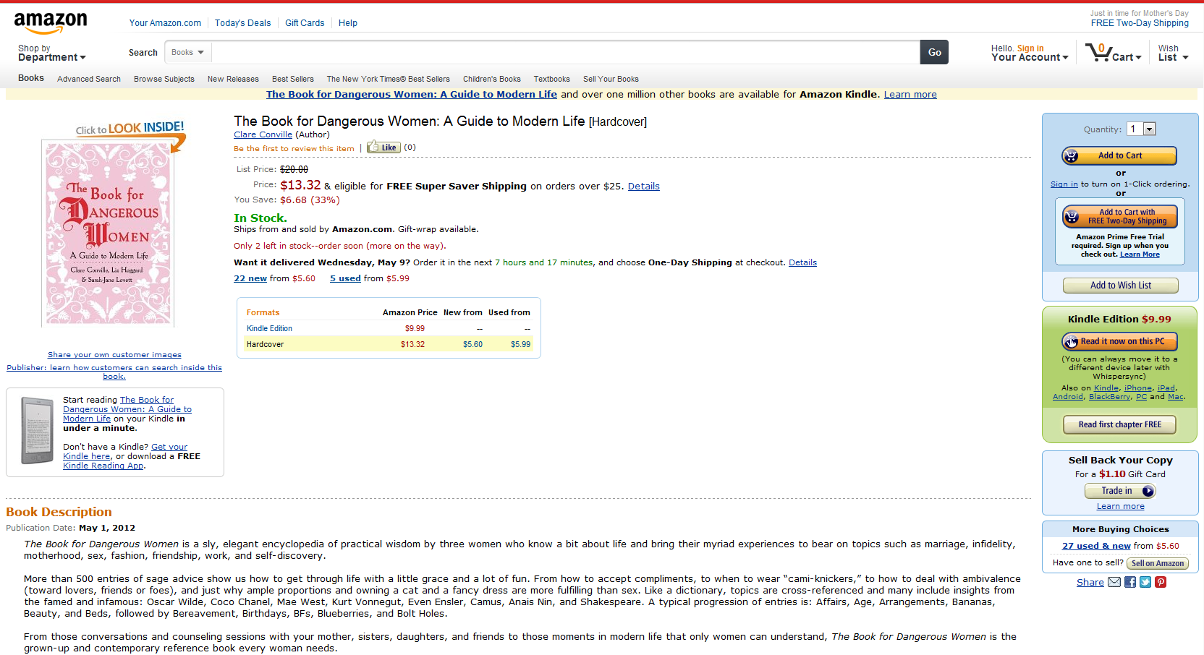
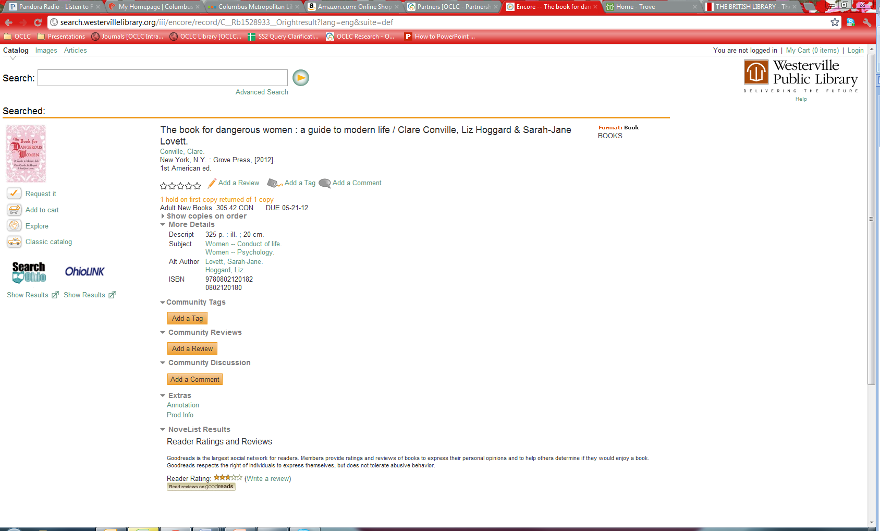
Making the Library More Attractive
Amazon.com
Westerville Public Library
Notes:
Adding tags, reviews, and comments are also options
Interviewer: “Right, so you kind of trust the crowd at a certain level.”
Respondent: “At a certain level, yes. I’m also wary but I also trust the crowd, especially for like tying a tie video. There are 10 million views for this tying a tie video, it probably is pretty good.” (USG2 0:41:09, Male, Age 25, Digital Visitors and Residents)
Westerville Public Library: http://www.westervillelibrary.org/
Amazon: amazon.com

Slide 32

Startup Solutions
Libraries Now:
Library assessment linked to satisfaction & performance
Focus on sustainability
Evaluate how we’re doing right now
Teaching information literacy
Information focused
Culture of tradition
Library’s role as providing access to information & space to study
Libraries as Startup:
Library assessment tries to anticipate unarticulated needs
Focus on revolutionary new services
Evaluate direction we’re headed
Build instructional support to address information literacy
User-focused
Culture of innovation
Expand library’s role
(Matthews, 2012)
Notes:
Mathews, B. (2012). Think like a startup: A white paper to inspire library entrepreneurialism [White paper]. Retrieved from http://chronicle.com/blognetwork/theubiquitouslibrarian/2012/04/04/think-like-a-startup-a-white-paper/

Slide 33



Startup Solutions
“How can libraries support 21st century learners? Follow that thread and you’ll find transformative change.”
Create revolutionary new services instead of improving old ones
Need persistent innovators comfortable with change
Startup is a culture
Look at tools and services users need
The Starbucks Experience
Make library usage personal
Not what’s-now, but what’s-next
(Matthews, 2012)
Notes:
“Joseph Michelli provides insight that propelled Starbucks from turning ordinary into extraordinary experiences. His vision is based on the process of making a personal connection with people through a framework based on connecting, discovering, and responding. This transforms patrons into people and makes library usage personal. By focusing on relationship building instead of service excellence, organizations can uncover new needs and be in position to make a stronger impact.” (pg. 9)
Mathews, B. (2012). Think like a startup: A white paper to inspire library entrepreneurialism [White paper]. Retrieved from http://chronicle.com/blognetwork/theubiquitouslibrarian/2012/04/04/think-like-a-startup-a-white-paper/

Slide 34
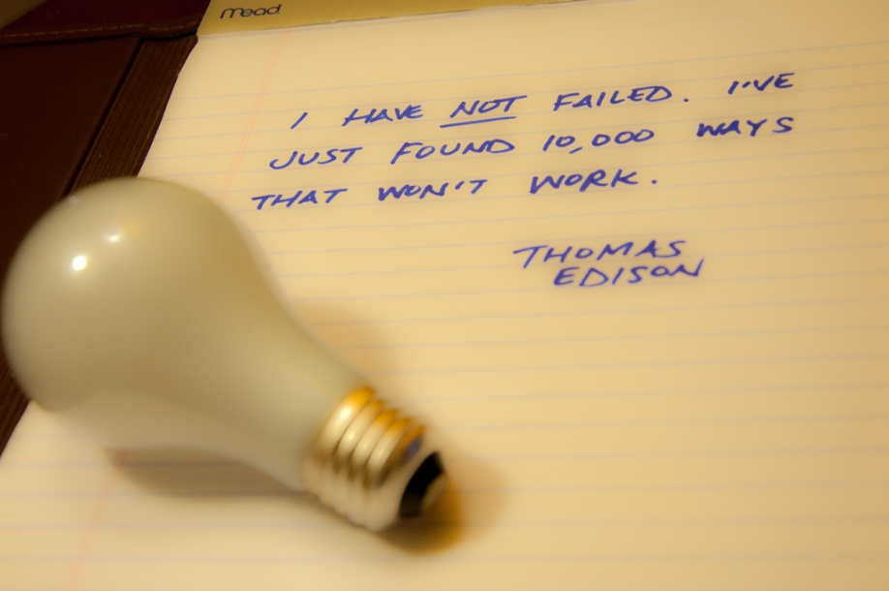
Startup Solutions
“Fail faster, fail smarter”
  Part of process
“Good enough is good enough to start”
  Raw form of concept
  Build upon success
“Feed the feedback loop”
  Users nurture concept
(Matthews, 2012)
Notes:
“Fail faster, fail smarter” (p. 5)
Failure is part of process
“Good enough is good enough to start” (p. 5) – it works for our users
Have a raw form of concept & go with it, then build upon success
“Feed the feedback loop” (p. 5)
Let the users nurture the concept to build it up
Mathews, B. (2012). Think like a startup: A white paper to inspire library entrepreneurialism [White paper]. Retrieved from http://chronicle.com/blognetwork/theubiquitouslibrarian/2012/04/04/think-like-a-startup-a-white-paper/ (p.5)

Slide 35

Startup Solutions
Plant many seeds
  Try lots of decent ideas instead of one good one
  See what works
Seize the white space
  “Don’t limit your innovation to traditional library boundaries”
(Matthews, 2012)
Notes:
Plant many seeds (p.5)
Try lots of decent ideas instead of one good one
See what works
Seize the white space (p.5)
“Don’t limit your innovation to traditional library boundaries”
Mathews, B. (2012). Think like a startup: A white paper to inspire library entrepreneurialism [White paper]. Retrieved from http://chronicle.com/blognetwork/theubiquitouslibrarian/2012/04/04/think-like-a-startup-a-white-paper/ (p.5)

Slide 36

“By focusing on relationship building instead of service excellence, organizations can uncover new needs and be in position to make a stronger impact.”
(Matthews, 2012)
Notes:
Mathews, B. (2012). Think like a startup: A white paper to inspire library entrepreneurialism [White paper]. Retrieved from http://chronicle.com/blognetwork/theubiquitouslibrarian/2012/04/04/think-like-a-startup-a-white-paper/
Users do not know they can ask librarians (Kolowich, Seeking synchronicity: Revelations and recommendations for virtual reference)
Example: Seeking Synchronicity
Librarians identified successful VR encounters as those where they were able to offer instruction and specialized knowledge, the user had a positive attitude
Users identified successful VR encounters as those providing convenience, an accurate answer, and they were comfortable with the service
Connaway, L. S., & Radford, M. L. (2011). Seeking synchronicity: Revelations and recommendations for virtual reference. Dublin, OH: OCLC Research. Retrieved from http://www.oclc.org/reports/synchronicity/full.pdf
Kolowich, S. (2011, 22 August). Study: College students rarely use librarians’ expertise. USA Today. Retrieved from: http://www.usatoday.com/news/education/story/2011-08-22/Study-College-students-rarely-use-librarians-expertise/50094086/1
Microsoft Clip Art

Slide 37
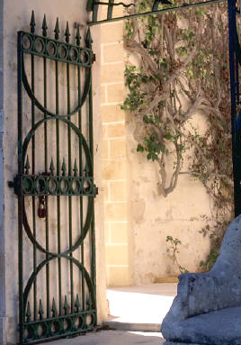
Key Issues for Librarians
Keep talking
Keep moving
Keep the gates open
Keep it simple
Notes:
All of this will affect the role of the librarian who might increasingly have to help students clarify and interpret tasks and briefs, find the appropriate resources and run information skills sessions. Connaway identifies a few key issues for libraries to consider:
1. Keep talking: Librarians need to market and promote their services and be very transparent about what they offer, in addition to ‘books’.
2. Keep moving: Librarians need to provide a range of tools and services in different media. Some people prefer walking into a library and talking face-to-face. Some like to talk to a librarian, others to communicate virtually. While some users want to hold a book, many want electronic access. Librarians need to offer a wide range of services and resources which is difficult in the current economic environment.
3. Keep the gates open: Libraries need to remove the barriers between discovering and accessing information. Older materials need to be made available digitally as researchers perceive a wealth of digital and varied resources as ‘better’.
4. Keep it simple: Researchers are very familiar with other web-based searches like Google, Yahoo or Amazon. Library web services ought to look similar despite providing very detailed ways of searching for information. The majority of users search by keywords and library search tools must have a simple and convenient interface.

Slide 38
References
Bertot, J. C., Berube, K., Devereaux, P., Dhakal, K., Powers, S., & Ray, J. (2012). Assessing the usability of WorldCat Local: Findings and considerations. The Library Quarterly, 82(2), 207-221.
Calhoun, K., Cantrell, J., & Gallagher, P. (2009). Online catalogs: What users and librarians want: An OCLC report. Dublin, OH: OCLC. Retrieved from http://www.oclc.org/us/en/reports/onlinecatalogs/default.htm
Centre for Information Behaviour and the Evaluation of Research. (2008). Information behaviour of the researcher of the future: A CIBER briefing paper. London: CIBER. Retrieved from http://www.jisc.ac.uk/media/documents/programmemes/reppres/gg_final_keynote_11012008.pdf
Centre for Information Behaviour and the Evaluation of Research. (2009). JISC user behaviour observational study. London: CIBER.
Connaway, L. S., & Dickey, T. J. (2010). The digital information seeker: Report of findings from selected OCLC, RIN, and JISC user behavior projects. Retrieved from http://www.jisc.ac.uk/media/documents/publications/reports/2010/digitalinformationseekerreport.pdf
Connaway, L. S., & Dickey, T. J. (2010). Towards a profile of the researcher of today: What can we learn from JISC projects? Common themes identified in an analysis of JISC Virtual Research Environment and Digital Repository Projects. Retrieved from http://ie-repository.jisc.ac.uk/418/2/VirtualScholar_themesFromProjects_revised.pdf
Connaway, L. S., Dickey, T. J., & Radford, M. L. (2011). "If it is too inconvenient I'm not going after it": Convenience as a critical factor in information-seeking behaviors. Library & Information Science Research, 33(3).
Connaway, L. S., Prabha, C., & Dickey, T. J. (2006). Sense-making the information confluence: The whys and hows of college and university user satisficing of information needs. Phase III: Focus group interview study. Report on National Leadership Grant LG-02-03-0062-03, to Institute of Museum and Library Services, Washington, D.C. Columbus, OH: School of Communication, The Ohio State University. Retrieved from http://imlsproject.comm.ohiostate.edu/imls_reports/PHASE_III/PH_III_report_list.html

Slide 39
References
Connaway, L. S., Radford, M. L. 2005-2007. Seeking synchronicity: Evaluating virtual reference services from user, non-user, and librarian perspectives. Funded by the Institute for Museums and Library Services (IMLS). http://www.oclc.org/research/activities/synchronicity/default.htm
Connaway, L. S., & Radford, M. L. (2009, July). “I would sort of appreciate a little understanding:” Engaging Net Gen students in virtual reference. Paper presented at the ACRL 14th Conference, Chicago, IL.
Connaway, L. S., & Radford, M. L. (2011). Seeking synchronicity: Revelations and recommendations for virtual reference. Dublin, OH: OCLC Research. Retrieved from http://www.oclc.org/reports/synchronicity/full.pdf
Connaway, L. S., Radford, M. L. & Dickey, T. J. (2008). On the trail of the elusive nonuser: What research in virtual reference environments reveals. Bulletin of the American Society for Information Science & Technology 34(2), 25-8. http://www.asis.org/Bulletin/Dec-07/DecJan08_Connaway_etc.pdf
Connaway, L. S., Radford, M. L., Dickey, T. J., DeAngelis Williams, J., & Confer, P. (2008). Sense-Making and synchronicity: Information-Seeking behaviors of Millennials and Baby Boomers. Libri(58) 2, 123-135.
Connaway, L. S., Radford, M. L., & Williams, J. D. (2009). Engaging Net Gen students in virtual reference: Reinventing services to meet their information behaviors and communication preferences. In Proceedings of the Fourteenth Annual National Conference of the Association of College and Research Libraries. Seattle, Washington. Chicago: ACRL/ALA. www.oclc.org/research/publications/archive/2009/connaway-acrl-2009.pdf
Consortium of University Research Libraries, and Research Information Network. (2007). Researchers' use of academic libraries and their services: A report. London: Research Information Network and Consortium of University Research Libraries (CURL).
Cunningham, S. J., & Connaway, L. S. (1996). Information searching preferences and practices of computer science researchers. In J. Grundy (Ed.), Proceedings: Sixth Austrailian conference on computer-human interaction, November 24-27, 1996, Hamilton, New Zealand (pp.294-299). Los Alamitos, CA: IEEE Computer Society Press.
Dempsey, L. (2008). "Always on: Libraries in a world of permanent connectivity" First Monday [Online], (14) 1. Retrieved from http://www.firstmonday.org/htbin/cgiwrap/bin/ojs/index.php/fm/article/view/2291/2070

Slide 40
References
De Rosa, C. (2005). Perceptions of libraries and information resources: A report to the OCLC membership. Dublin, OH: OCLC Online Computer Library Center. http://www.oclc.org/us/en/reports/2005perceptions.htm
De Rosa, C. (2006). College students' perceptions of libraries and information resources: A report to the OCLC membership. Dublin, OH: OCLC Online Computer Library Center. http://www.oclc.org/us/en/reports/perceptionscollege.htm
De Santis, N. (2012, January 6). On Facebook, librarian brings 2 students from the early 1900s to life. Chronicle of Higher Education. http://chronicle.com/blogs/wiredcampus/on-facebook-librarian-brings-two-students-from-the-early-1900s-to-life/34845
Dervin, B., Connaway, L.S., & Prabha, C. 2003-2006 Sense-making the information confluence: The whys and hows of college and university user satisficing of information needs. Funded by the Institute of Museum and Library Services (IMLS). http://imlsosuoclcproject.jcomm.ohio-state.edu/
Dervin, B., & Reinhard, C. L. D. (2007). Sense-making the information confluence: The whys and hows of college and university user satisficing of information needs. Final Report. Report on National Leadership Grant LG-02-03-0062-03, to Institute of Museum and Library Services, Washington, D.C. Columbus, OH: School of Communication, The Ohio State University. http://imlsproject.comm.ohiostate.edu/imls_reports/PERFORMANCE_REPORT/PERFORM_ONLINE.pdf
Dervin, B., Reinhard, C. L. D., Adamson, S. K., Lu, T. T., Karnolt, N. M., & Berberick, T. (Eds.) (2006). Sense-making the information confluence: The whys and hows of college and university user satisficing of information needs. Phase I: Project overview, the Three-Field Dialogue project, and state-of-the-art reviews. Report on National Leadership Grant LG-02-03-0062-03, to Institute of Museum and Library Services, Washington, D.C. Columbus, OH: School of Communication, The Ohio State University. http://imlsproject.comm.ohiostate.edu/imls_reports/imls_PH_I_report_list.html

Slide 41
References
Dervin, B., Reinhard, C. L. D., Kerr, Z. Y., Song, M., & Shen, F. C. (Eds.)(2006). Sense-making the information confluence: The whys and hows of college and university user satisficing of information needs. Phase II: Sense-making online survey and phone interview study. Report on National Leadership Grant LG-02-03-0062-03 to Institute of Museum and Library Services, Washington, D.C. Columbus, OH: School of Communication, Ohio State University. http://imlsproject.comm.ohio-state.edu/imls_reports/imls_PH_II_report_list.html
Dervin, B., Reinhard, C. L. D, Kerr, Z. Y., Song, M., & Shen, F.C. (Eds.) (2006). Sense-making the information confluence: The whys and hows of college and university user satisficing of information needs. Phase III: Sense-making focus group interviews. Report on National Leadership Grant LG-02-03-0062-03 to Institute of Museum and Library Services, Washington, D.C. Columbus, OH: School of Communication, Ohio State University.
Dervin, B., Reinhard, C. L. D, Kerr, Z. Y., Song, M., & Shen, F.C. (Eds.) (2006). Sense-making the information confluence: The whys and hows of college and university user satisficing of information needs. Phase IV: Sense-making structured observations. Report on National Leadership Grant LG-02-03-0062-03 to Institute of Museum and Library Services, Washington, D.C. Columbus, OH: School of Communication, Ohio State University.
Hampton-Reeves, S., Mashiter, C., Westaway, J. , Lumsden, P., Day, H., Hewerston, H. & Hart, A. (2009). Students’ use of research content in teaching and learning: A report of the Joint Information Systems Council (JISC). Retrieved from http://www.jisc.ac.uk/media/documents/aboutus/workinggroups/studentsuseresearchcontent.pdf
JISC & UCL. 2009. JISC national e-books observatory project: Key findings and recommendations: Final report.
Kolowich, S. (2011, 22 August). Study: College students rarely use librarians’ expertise. USA Today. Retrieved from http://www.usatoday.com/news/education/story/2011-08-22/Study-College-students-rarely-use-librarians-expertise/50094086/1
Mathews, B. (2012). Think like a startup: A white paper to inspire library entrepreneurialism [White paper]. Retrieved from http://chronicle.com/blognetwork/theubiquitouslibrarian/2012/04/04/think-like-a-startup-a-white-paper/

Slide 42
References
Prabha, C., Connaway, L.S. & Dickey, T.J. (2006). Sense-making the information confluence: The whys and hows of college and university user satisficing of information needs. Phase IV: Semi-structured interview study. Report on National Leadership Grant LG-02-03-0062-03, to Institute of Museum and Library Services, Washington, D.C. Columbus, OH: School of Communication, The Ohio State University. Retrieved from
http://imlsproject.comm.ohio-state.edu/imls_reports/imls_PH_IV_report_list.html
Radford, M. L., & Connaway, L. S. (2008). Seeking synchronicity: Evaluating virtual reference services from user, non-user, and librarian perspectives: IMLS final performance report. Report on Grant LG-06-05-0109-05, to Institute of Museum and Library Services, Washington, D.C. Dublin, OH: OCLC Online Computer Library Center.
Research Information Network. (2009). E-journals: Their use, value and impact. London: Research Information Network. Retrieved from http://www.rin.ac.uk/our-work/communicating-and-disseminating-research/ejournals-their-use-value-and-impact
Research Information Network. (2006). Researchers and discovery services: Behaviour, perceptions and needs. London: Research Information Network. Retrieved from http://www.rin.ac.uk/our-work/using-and-accessinginformation-resources/researchers-and-discovery-services-behaviour-perc
University College, London., British Library, & Joint Information Systems Committee. (2008). Information behaviour of the researcher of the future. London: UCL.
Wasserman, S. (2012, June 18). The amazon effect. The Nation. Retrieved from http://www.thenation.com/article/168125/amazon-effect
White, D., & Connaway, L. S. (2011). Visitors and residents: What motivates engagement with the digital information environment. Funded by JISC, OCLC, and Oxford University. http://www.oclc.org/research/activities/vandr/
Wong, W., Stelmaszewska, H., Bhimani,N., Barn, S., & Barn, B. (2009). User behaviour in resource discovery: Final report. http://www.jisc.ac.uk/whatwedo/programmes/inf11/userbehaviourbusandecon.aspx

Slide 43
Photo Credits
Sl 1(winner’s block): http://www.presentationload.de/fr/Tableaux-diagrammes/Diagrammes-barres-verticales-Escaliers/Tribune-des-vainqueurs.html
Sl. 2 (frustrated teen): http://www.buckshappening.com/the-learning-cooperative-princeton
Sl. 3 (waterfall): http://www.flickr.com/photos/aramisfirefly/3580397954/
Sl. 4
  Print is dead: http://elizabethharmonblog.wordpress.com/category/general-contemplations/
  Linked date: http://rivuli-development.com/linked-data/
  Globe: http://www.oecd.org/site/0,3407,en_21571361_39598752_1_1_1_1_1,00.html
Sl. 5 (conversation): From Changing Information Behaviours: Making Library Content Appeal to Digital Information Seekers presented at 100. Deutscher Bibliothekartag from http://www.oclc.org/research/presentations/default.htm
Sl. 6
  Book scholar: http://ffffound.com/image/d94be1a080d77b71d62f453de9312682f7c6e573
  Modern scholar: http://www.thedigitalshift.com/2012/02/research/what-patrons-teach-us-and-publishers-should-learn/
Sl. 7 (sign): http://www.calista.co.uk/services/marketing-consultancy/
Sl. 8 (squirrel): http://www.thosefunnypictures.com/picture/7187/squirrel-on-computer.html
Sl. 9:
  Student right:: http://www.thedigitalshift.com/2012/02/research/what-patrons-teach-us-and-publishers-should-learn
  Student left http://news.softpedia.com/newsImage/Study-Finds-that-Most-US-Students-Won-t-Buy-Macs-2.jpg/
  Stuedent borrom: http://phillips.blogs.com/goc/2006/11/farewell_milton.html
Sl. 10 (power browsing): http://www.flickr.com/photos/will-lion/2670343917/in/gallery-mheil-72157622993235888/

Slide 44
Photo Credits
Sl. 15:
  Researcher left: http://stargazersfield.com/173
  Researcher bottom right http://www.cloudcomputingworld.org/cloud-computing/who-is-doing-research-into-cloud-computing.html
  Researcher top right: http://www.newswise.com/articles/researcher-identifies-stem-cells-in-tendons-that-regenerate-tissue
Sl. 21 (Red learner): http://chronicle.com/article/Online-Learning-Supplement-/131624/
Sl. 23 (databases): http://library.duke.edu/research/finding/how-to-find.html
Sl. 24 (brain diagram): http://www.flickr.com/photos/shellberry/5683934976/in/faves-37635807@N08/
Sl. 25 (books and laptop): http://www.asgbowl.com/blog/bid/77911/Top-5-Best-Online-Resources-for-Bowling-Center-Management
Sl. 26 (search engines): http://sitesubmiturl.com/best-search-engine-submission-service.php
Sl. 27 (keyboard): http://www.flickr.com/photos/flod/26083507/
Sl. 31 (seedlings): http://blog.officelinks.com/2011/last-chance-for-spring-seedling-sales-at-garfield-park-conservatory/
Sl. 33 (failure): http://www.flickr.com/photos/8047705@N02/5366637592/
Sl. 34 (lightbulb plants): http://sandivand.blogspot.com/2011/10/growing-those-ideas.html

Slide 45
End Notes
Special thanks to Alyssa Darden and Erin Hood, OCLC Research, for assistance in preparation of this presentation

Slide 46
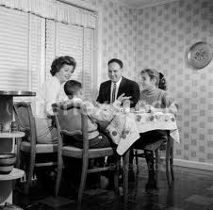
Thank You!
Questions and Discussion

