Slide 1
“I find Google a lot easier than going to the library website.” Imagine Ways to Innovate and Inspire Students to Use the Academic Library
ACRL, Indianapolis, IN, April 10-13, 2013
Lynn Silipigni Connaway, Ph. D.
Senior Research Scientist OCLC
@LynnConnaway
Donna Lanclos, Ph. D.
Associate Professor for Anthropological Research
University of North Carolina, Charlotte
@DonnalLanclos
Erin M. Hood, M.L.I.S.
Research Support Specialist
OCLC Research
hoode@oclc.org

Slide 2
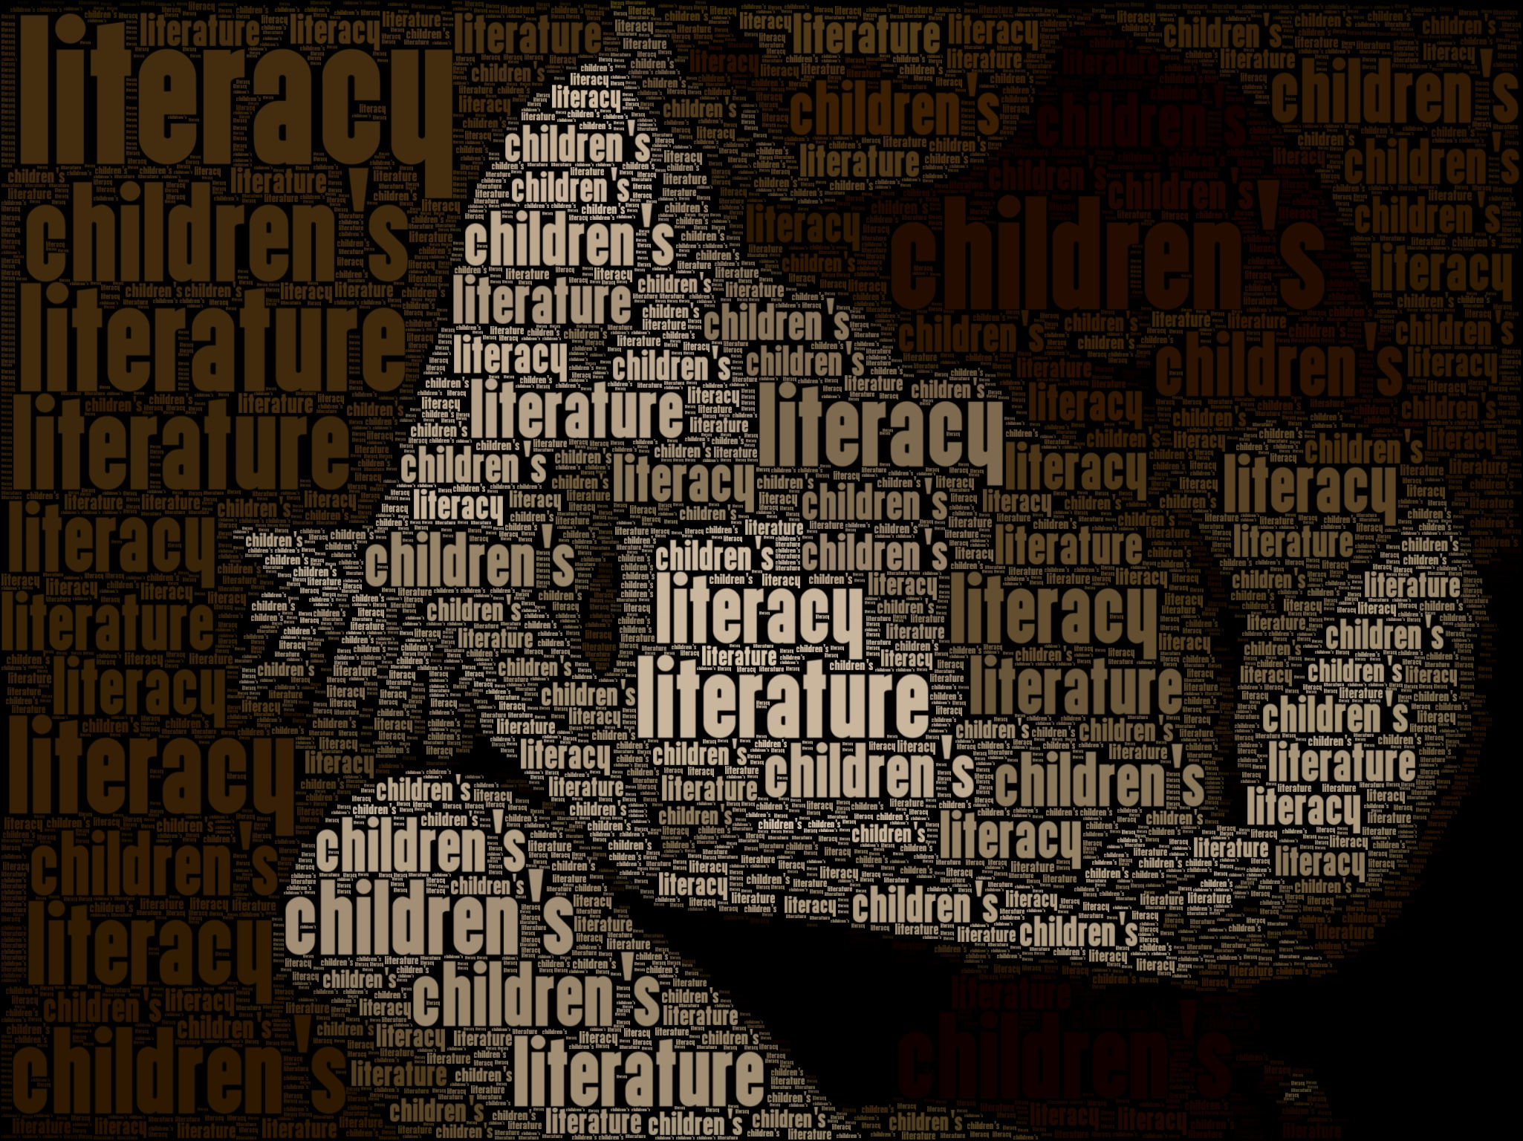
Defining “Literacies”
Digital Visitors & Residents
Notes:
Image from http://www.flickr.com/photos/mrsdkrebs/5913123665/

Slide 3
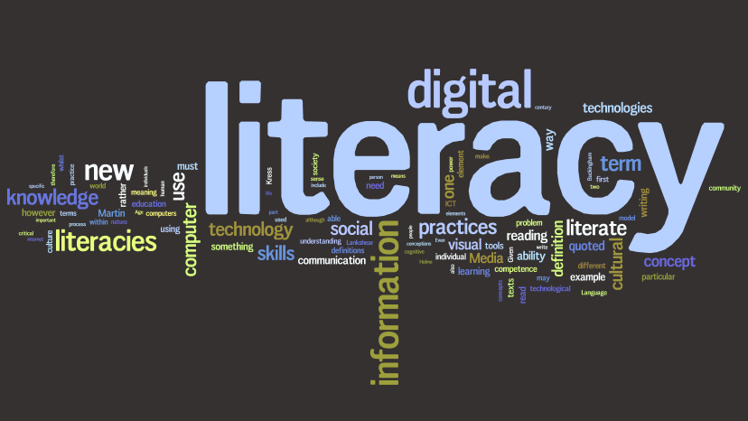
Defining “Literacies”
Digital Literacy
Strategies & skills needed to work with information & communication technologies
Information Literacy
Strategies & skills needed to find and evaluate the information itself
(Connaway, Lanclos, and Hood, Forthcoming)
Notes:
“The ALA Digital Literacy Task Force has defined “Digital Literacy” as “the ability to use information and communication technologies to find, evaluate, create, and communicate information, requiring both cognitive and technical skills.”” (Connaway, Lanclos, & Hood, Forthcoming)
“And I feel like people- especially for subjects like history or whatever where the context is just so important; if you’re obsessed with getting an answer really quickly then you’re missing out a lot on learning around the subject which gives more understanding. So you can build up a lot of knowledge and I’d know how to get a lot of information but I wouldn’t necessarily know what to do with it.” Digital Visitors and Residents (UKU12 0:45:10 Female Age 21)
“In terms of technological tools, there’s the notion of the native learners of digital technology. I tend to be able to catch onto new technologies really quickly. I’m not really worried about missing out on any skills at Oxford because I feel that my generation’s very quick to adapt to any new technology and I don’t ever find it onerous to learn a new technology.” Digital Visitors and Residents (UKG2 0:40:11 Female Age 22)
The Digital Literacy Task Force, “Digital Literacy Definition,” ALA Connect, September 14, 2012, http://connect.ala.org/node/181197.
Connaway, Lynn Silipigni, Donna Lanclos, and Erin M. Hood. Forthcoming. “‘I find Google a lot easier than going to the library website.’ Imagine Ways to Innovate and Inspire Students to Use the Academic Library.” Proceedings of the Association of College & Research Libraries (ACRL) 2013 conference, April 10-13, 2013, Indianapolis, IN.
Image from http://www.flickr.com/photos/dougbelshaw/4099913923/

Slide 4
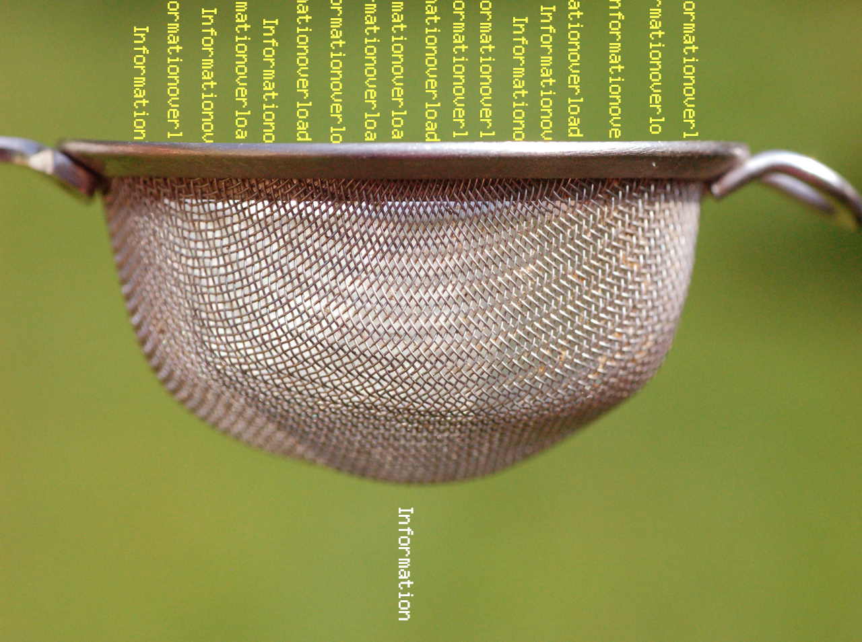
Defining “Literacies”
Information Literacy
Strategies & skills needed to find and evaluate the information itself
(Connaway, Lanclos, and Hood, Forthcoming)
Notes:
Image from http://www.flickr.com/photos/verbeeldingskr8/3638834128/
“The ALA definition of “Information Literacy” is a set of abilities requiring individuals to "recognize when information is needed and have the ability to locate, evaluate, and use effectively the needed information.”” (Connaway, Lanclos, & Hood, Forthcoming)
“Based on these definitions and discussion, “digital literacy” refers to the strategies and skills needed to work with information and communication technologies, while “information literacy” refers to the strategies and skills needed to find and evaluate the information itself. These definitions are employed in this paper to distinguish among the different literacies employed by people as they seek and evaluate information in a variety of settings.” (Connaway, Lanclos, and Hood, Forthcoming)
“Yes. I suppose it all depends what you call learning because to gather all the information in itself whether or not you sort of filter it as what’s useful and what’s not, I wouldn’t say that’s sort of effective learning by itself. But then sort of going on to the other sort of echelons of like applying it an analysing it and evaluating it, I’d say that’s where most of learning is done. And sort of the information gathering is sort of a preface to that part.” Digital Visitors and Residents (UKU10 0:35:53 Male Age 20).
“Well I don’t like pick the first one I see. I try to evaluate two or three and see if there’s some common things between them. Like if two of them say the same thing then that must be right. Rather than like one [??] versus two consistent things.” Digital Visitors and Residents (USS4 00:10:01 Male Age 17)
ACRL Standards Committee, “Information Literacy Competency Standards for Higher Education,” ACRL Association of College & Research Libraries, accessed February 8, 2013, http://www.ala.org/acrl/standards/informationliteracycompetency; American Library Association, Presidential Committee on Information Literacy: Final Report (Chicago: American Library Association, 1989); also cf. Popp 2012’s discussion of “necessary literacies” (p. 86).
Connaway, Lynn Silipigni, Donna Lanclos, and Erin M. Hood. Forthcoming. “‘I find Google a lot easier than going to the library website.’ Imagine Ways to Innovate and Inspire Students to Use the Academic Library.” Proceedings of the Association of College & Research Libraries (ACRL) 2013 conference, April 10-13, 2013, Indianapolis, IN.

Slide 5
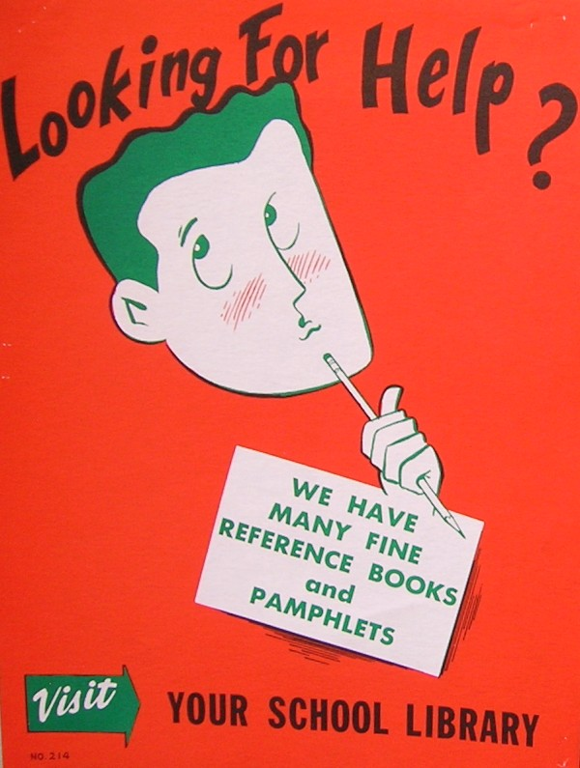
Introduction
Digital Visitors & Residents
Notes:
Image from http://www.flickr.com/photos/vblibrary/4480093266/

Slide 6
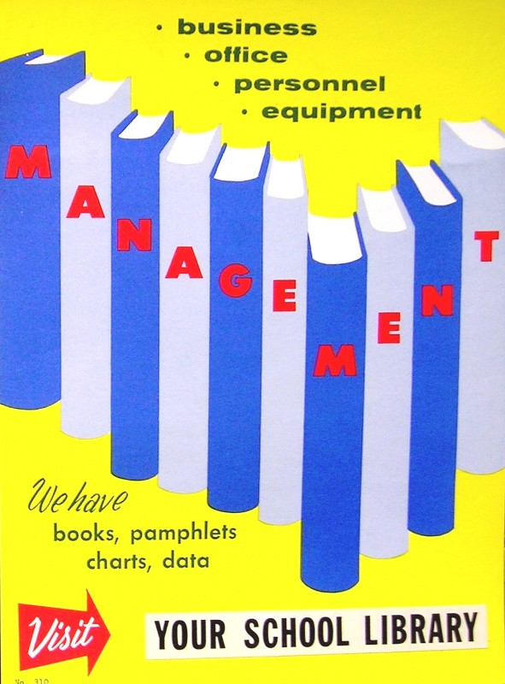
Visitors and Residents: What motivates engagement with the digital information environment?
Partners
JISC (UK funding body)
OCLC
Lynn Silipigni Connaway, Ph.D.
Erin M. Hood, M.L.I.S.
Oxford University
David White
Alison Le Cornu, Ph.D.
University of North Carolina, Charlotte
Donna Lanclos, Ph.D.
Notes:
The Digital Visitors and Residents (V&R) project is a US/UK collaborative project, funded by JISC, OCLC Online Computer Library Center, Inc., Oxford University, and the University of North Carolina, Charlotte.
“This paper reports the initial findings of a three-year longitudinal study to identify how late-stage secondary school and first-year undergraduate students in the US and UK, referred to here as members of the “Emerging” educational stage, engage with technology and information sources. The assumptions embedded in traditional academic library services and systems and the existing disconnect between the everyday information-seeking behaviors of members of the Emerging stage (last year high school/secondary school or first year college/university) are examined. Initial results highlight the importance of convenience as a crucial factor in information-seeking behavior. There also are indications that as users progress through the educational stages, the digital and information literacies they employ do not necessarily become more sophisticated.” (Connaway, Lanclos, and Hood, Forthcoming)
Connaway, Lynn Silipigni, Donna Lanclos, and Erin M. Hood. Forthcoming. “‘I find Google a lot easier than going to the library website.’ Imagine Ways to Innovate and Inspire Students to Use the Academic Library.” Proceedings of the Association of College & Research Libraries (ACRL) 2013 conference, April 10-13, 2013, Indianapolis, IN.
Image from http://www.flickr.com/photos/vblibrary/4480093752/

Slide 7
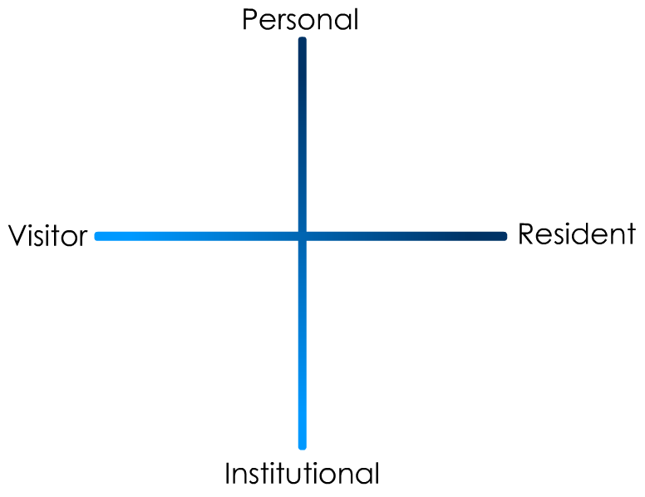
(Connaway and White for OCLC Research, 2012.)
Notes:
“In simple terms the Visitors see the web as a series of tools. They decide what they want to achieve, chose an appropriate online tool to do the job, then log-off. They leave no social trace of themselves online. The Residents live a proportion of their lives online. They see the web as a place where they can express themselves and spend time with people. Residents will have a profile on a social networking platform and aspects of their persona, or digital identity, maintaining presence even when they are not online. The premise of V&R is presented as a continuum whereby individuals’ modes of engagement will be more Visitor or Resident depending on their personal motivations and the context and situation at the time.” (Connaway, Lanclos, and Hood, Forthcoming)
Connaway, Lynn Silipigni, Donna Lanclos, and Erin M. Hood. Forthcoming. “‘I find Google a lot easier than going to the library website.’ Imagine Ways to Innovate and Inspire Students to Use the Academic Library.” Proceedings of the Association of College & Research Libraries (ACRL) 2013 conference, April 10-13, 2013, Indianapolis, IN.
First Monday Paper: http://is.gd/vandrpaper
Video: http://is.gd/vandrvideo

Slide 8
Visitors & Residents
(White and Connaway, 2011-2012)
Notes:
“Using the V&R framework ensures that analysis is firmly focused on motivations to engage rather than on age or technological “skill.” It facilitates the identification of modes of engagement which potentially cut across traditional academic levels and boundaries. The project is tracking US and UK participants’ shifts in their motivations and forms of engagement with technology and information as they transition between four educational stages:
1. Emerging (Late stage secondary school/First year undergraduate);
2. Establishing (Second/third year undergraduate);
3. Embedding (Postgraduates, PhD students);
4. Experienced (Scholars).
In Phase 1 of the V&R research, semi-structured interviews with participants from the four project-defined educational stages were conducted in the US and UK. In Phase 2 of the project, a sub-set of the interviewees were selected to participate in the monthly information diaries.” (Connaway, Lanclos, & Hood, Forthcoming)
Connaway, Lynn Silipigni, Donna Lanclos, and Erin M. Hood. Forthcoming. “‘I find Google a lot easier than going to the library website.’ Imagine Ways to Innovate and Inspire Students to Use the Academic Library.” Proceedings of the Association of College & Research Libraries (ACRL) 2013 conference, April 10-13, 2013, Indianapolis, IN.
White, David S., and Lynn Silipigni Connaway. 2011-2012. Visitors & Residents: What Motivates Engagement with the Digital Information Environment. Funded by JISC, OCLC, and Oxford University. http://www.oclc.org/research/activities/vandr/.

Slide 9
Demographics
Digital Visitors and Residents
Notes:
Image from http://www.flickr.com/photos/europeanyouthforum/4696932355/

Slide 10
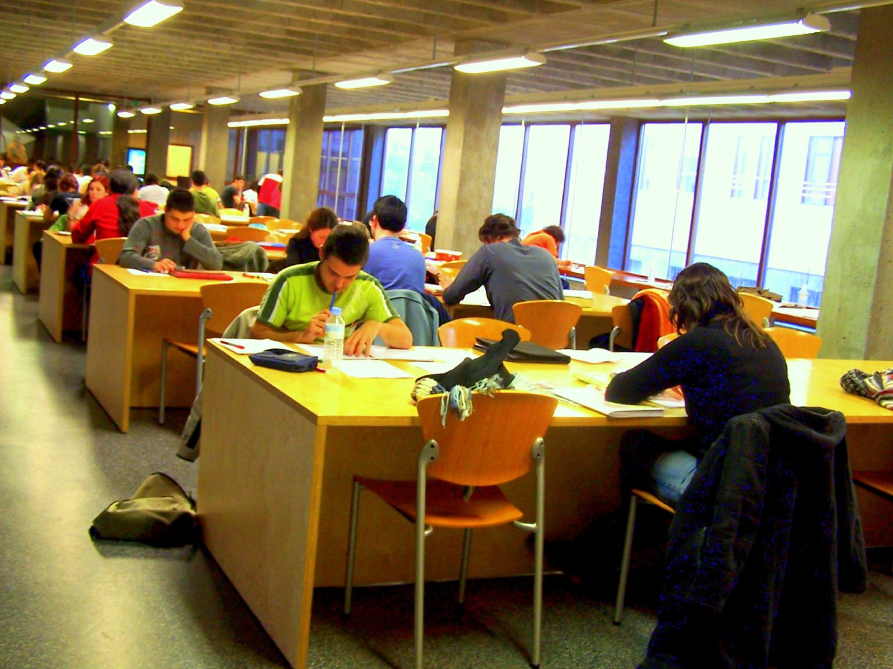
Phase I & 2: Participant Demographics
61 Participants
15 secondary students
46 university students & faculty
38 Caucasian
5 African-American
2 Multi-racial
1 Asian
2 Hispanic
13 Unidentified
(White and Connaway 2011-2012)
Notes:
Image from: http://www.flickr.com/photos/elaine_macc/370057046/
“There are a total of 61 participants in project Phases 1 and 2.” (Connaway, Lanclos, and Hood, Forthcoming)
“Altogether, there are 15 secondary students and 46 university students and faculty. The students and faculty are a convenience sample—those who were willing to be interviewed, in institutions that allowed us entry.” (Connaway, Lanclos, and Hood, Forthcoming)
Connaway, Lynn Silipigni, Donna Lanclos, and Erin M. Hood. Forthcoming. “‘I find Google a lot easier than going to the library website.’ Imagine Ways to Innovate and Inspire Students to Use the Academic Library.” Proceedings of the Association of College & Research Libraries (ACRL) 2013 conference, April 10-13, 2013, Indianapolis, IN.
Phase I and 2: Participant Demographics (All Stages)
15 Secondary students, 46 University students and faculty
Ethnicities (All)
5 African-American, 38 Caucasian, 2 Multi-racial, 1 Asian, 2 Hispanic, 13 Unidentified
White, David S., and Lynn Silipigni Connaway. 2011-2012. Visitors & Residents: What Motivates Engagement with the Digital Information Environment. Funded by JISC, OCLC, and Oxford University. http://www.oclc.org/research/activities/vandr/.

Slide 11
Gender
(Connaway, Lanclos, and Hood, Forthcoming)
Notes:
“In the US, 15 participants are female and 16 are male, and in the UK, 19 are female and 11 are male.” (Connaway, Lanclos, and Hood, Forthcoming)
Connaway, Lynn Silipigni, Donna Lanclos, and Erin M. Hood. Forthcoming. “‘I find Google a lot easier than going to the library website.’ Imagine Ways to Innovate and Inspire Students to Use the Academic Library.” Proceedings of the Association of College & Research Libraries (ACRL) 2013 conference, April 10-13, 2013, Indianapolis, IN.
Genders (All)
34 females, 27 males

Slide 12
Disciplines and Educational Stages
(Connaway, Lanclos, and Hood, Forthcoming)
Notes:
Humanities: Languages 1, History 3, Theology/Religious Studies 3, Art 2, Theatre 1
Social Sciences: Political Science 1, Anthropology 1, Sociology 1, Latin American Studies 2, Economics 1
Natural Sciences: Chemical Biology 1, Chemistry 1, Physics 2, Bio-Informatics 2, Biology 3
Formal Sciences: Computer Science 2
Professions & Applied Sciences: Engineering 6, Teaching 3, Pre-Business 1, Law 1, Education 2, City/Regional Planning 1, Criminal Justice 1, Communications 1, Gerontology 1, Learning and Technology 2, Marketing 1, Urban Design 1
Undeclared 2
“The breakdown of academic disciplines in the sample also is broad. There were many majors and disciplines, and they have been filtered down to six basic categories.” (Connaway, Lanclos, and Hood, Forthcoming)
Connaway, Lynn Silipigni, Donna Lanclos, and Erin M. Hood. Forthcoming. “‘I find Google a lot easier than going to the library website.’ Imagine Ways to Innovate and Inspire Students to Use the Academic Library.” Proceedings of the Association of College & Research Libraries (ACRL) 2013 conference, April 10-13, 2013, Indianapolis, IN.
“List of Academic Disciplines,” Wikipedia: The Free Encyclopedia, last modified February 10, 2013, http://en.wikipedia.org/wiki/List_of_academic_disciplines.
Emerging: 2 Humanities, 1 Social Sciences, 3 Natural Sciences, 0 Formal Sciences, 9 Professions & Applied Sciences, 2 Undeclared
Establishing: 1 Humanities, 2 Social Sciences, 1 Natural Sciences, 2 Formal Sciences, 7 Professions & Applied Sciences, 0 Undeclared
Embedding: 4 Humanities, 2 Social Sciences, 2 Natural Sciences, 0 Formal Sciences, 2 Professions & Applied Sciences, 0 Undeclared
Experiencing: 3 Humanities, 1 Social Sciences, 3 Natural Sciences, 0 Formal Sciences, 3 Professions & Applied Sciences, 0 Undeclared

Slide 13
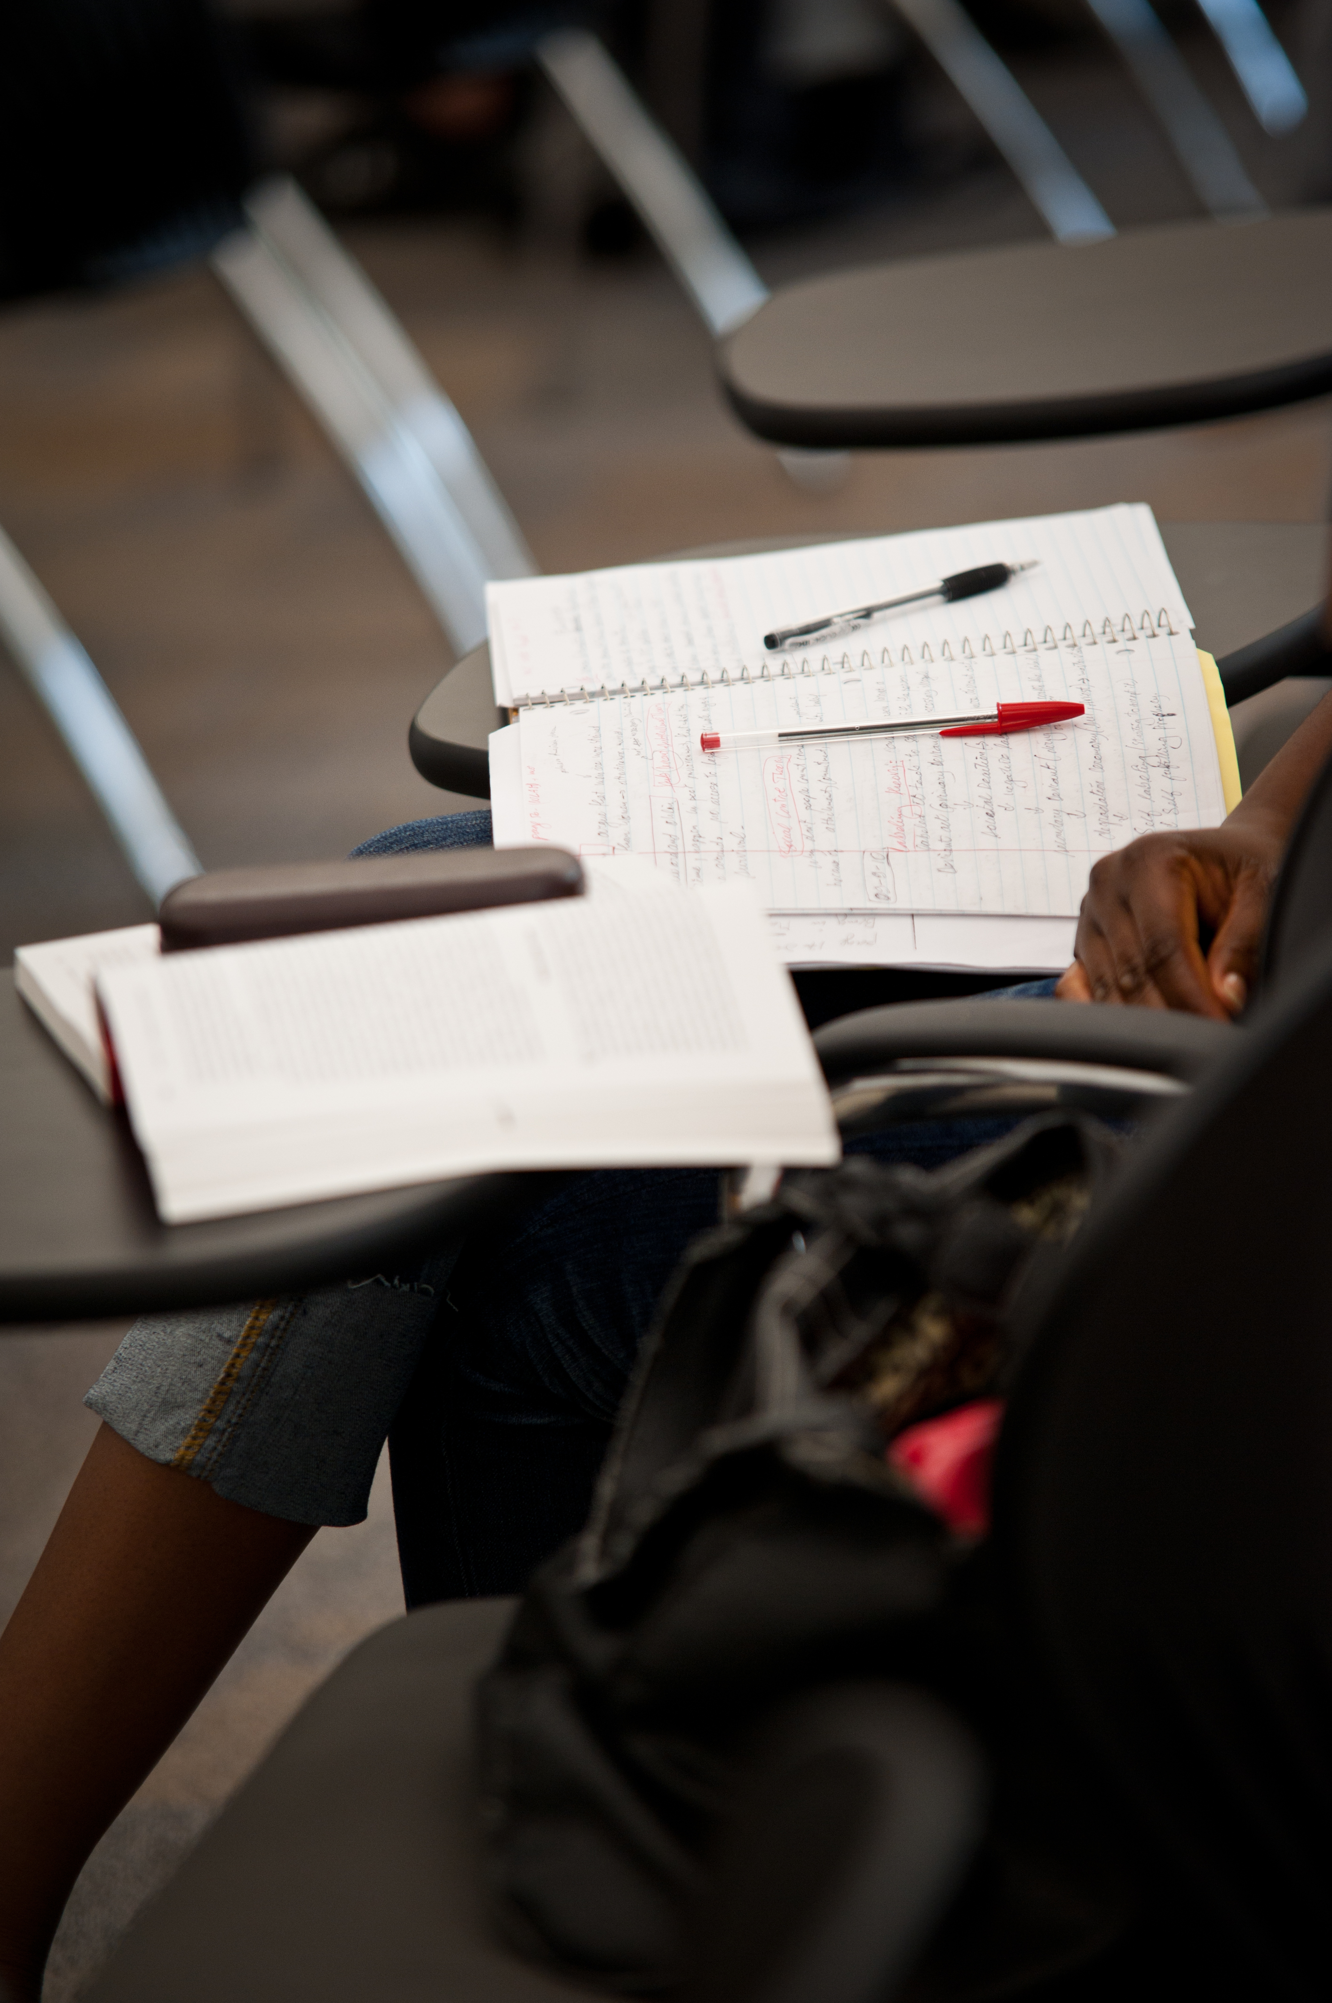
Diarists
Diarists (17)
11 US
6 UK
13 Emerging
2 Establishing
1 Embedding
1 Experiencing
(Connaway, Lanclos, and Hood, Forthcoming)
Notes:
“There were 17 diarists in Phase 2, 11 from the US and 6 from the UK. Among the diarists, we had 13 Emerging, 2 Establishing, one Embedding, and one Experiencing participant. Each diarist submitted, in the form of their choice, descriptions of the kinds of activities they did online, both in academic and non-academic settings. Diaries were primarily submitted via email (because they were “formal communication” with researchers), but a few video logs were also delivered.” (Connaway, Lanclos, and Hood, Forthcoming)
Connaway, Lynn Silipigni, Donna Lanclos, and Erin M. Hood. Forthcoming. “‘I find Google a lot easier than going to the library website.’ Imagine Ways to Innovate and Inspire Students to Use the Academic Library.” Proceedings of the Association of College & Research Libraries (ACRL) 2013 conference, April 10-13, 2013, Indianapolis, IN.
Lynn Silipigni Connaway, Donna Lanclos, David White, Alison Le Cornu, and Erin M. Hood, “User-centered Decision Making: A New Model for Developing Academic Library Services and Systems,” IFLA World Library and Information Congress 2012 Helsinki Proceedings: Libraries Now! Inspiring, Surprising, Empowering (2012), http://conference.ifla.org/sites/default/files/files/papers/wlic2012/76-connaway-en.pdf.
Image from http://www.flickr.com/photos/jeremywilburn/5430508291/

Slide 14
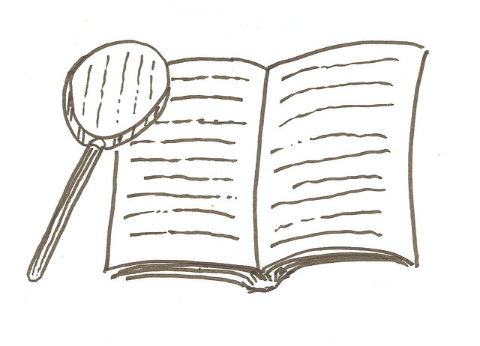
The Findings
Digital Visitors & Residents
Notes:
Image from http://www.flickr.com/photos/tallchris/14288135/
Begin Donna

Slide 15
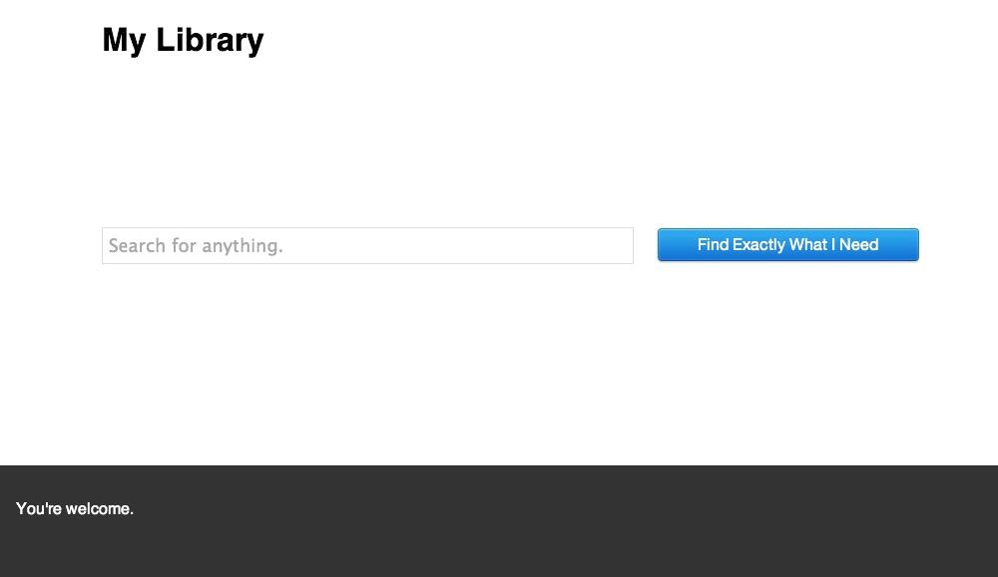
Convenience
Convenience dictates choices
Is it readily accessible online?
Does it contain the needed information & is it easy to use?
How much time will it take to access & use the source?
Is it a familiar & easily navigable interface?
Google
Wikipedia
pic.twitter.com/AyZLa8sdNg
Notes:
“They do often advise that we go to the library and look for books but I would normally go to the internet and go to the library as my last sort of option really. (Laughter) It just takes me – I don’t really know how to use the library, I’ve got to be honest, but I know how to use the internet. Yes, I would normally use the internet or sort of word of mouth if someone else knows how to do it – that kind of thing – first.” Digital Visitors and Residents, (UKU5 0:14:19, Female Age 19)
“I find Google a lot easier than going to the library website because I don’t know, it’s just like sometimes so many journals come up and when you look at the first ten and they just don’t make any sense I, kind of, give up. Google, I don’t know. It’s just Google it’s – I find it easier just to look through anything.” Digital Visitors and residents, (USU7 0:34:11, Female Age 19)
“I could easily have found the information she found for me, but the fact that I could just ask her question and have them look up the reference and read through articles instead of me having to look through like a million Googled articles…it was definitely a nice convenience and would definitely make it more likely for me to go to them and actually ask a librarian a question or figure it out on my own.” –Seeking Synchronicity, User (Focus Group, Rutgers University, July 11, 2006)
Although campus Information Commons, with cafes and 24/7 access to the facilities and resources, are still popular with students and faculty, convenient access to resources, whether human, print, or electronic is the most critical factor. After all, “If it is too inconvenient I’m not going after it.”
Connaway, L. S., Dickey, T. J., & Radford, M. L. (2011). "If it is too inconvenient I'm not going after it": Convenience as a critical factor in information-seeking behaviors. Library & Information Science Research, 33 (3) 188.
Image from https://twitter.com/mreidsma/status/312640441860370433/photo/1

Slide 16
Digital Sources and Educational Stages
(Connaway, Lanclos, and Hood, Forthcoming)
Notes:
“Analysis of the V&R interview data reveal that digital sources were spoken of at high rates by participants in all four educational stages, at a rate of 96.8% (n=30) for Emerging interviewees and 100% (n's=10) for the other three stages. Databases were mentioned the most. While they were only mentioned by 19.4% (n=6) of Emerging participants and 30% (n=3) of Establishing participants, they were mentioned by 80% (n's=8) of both Embedding and Experiencing participants.” (Connaway, Lanclos, and Hood, Forthcoming)
Connaway, Lynn Silipigni, Donna Lanclos, and Erin M. Hood. Forthcoming. “‘I find Google a lot easier than going to the library website.’ Imagine Ways to Innovate and Inspire Students to Use the Academic Library.” Proceedings of the Association of College & Research Libraries (ACRL) 2013 conference, April 10-13, 2013, Indianapolis, IN.

Slide 17
Digital Sources and Educational Stages
(Connaway, Lanclos, and Hood, Forthcoming)
Notes:
Digital Sources and Educational Stages (Books and Databases)
E-books: Emerging 29%, Establishing 40%, Embedding 50%, Experiencing 40%
Online Textbooks: Emerging 10%, Establishing 0%, Embedding 10%, Experiencing 0%
Databases: Emerging 19%, Establishing 30%, Embedding 80%, Experiencing 80%
“Interest in e-books varied among the participants of the four educational stages. They only were mentioned by 29% (n=9) of those in the early years of their academic careers (Emerging participants), 40% (n=4) of Establishing participants, increasing to 50% (n=5) of Embedding participants, then decreasing again to 40% (n=4) of Experiencing participants. However, it was the online textbooks that were spoken of the least, mentioned by only 3 (9.7%) of Emerging interviewees, none of the Establishing interviewees, only 1 (10%) of the Embedding participants, and none of the Experiencing interviewees.” (Connaway, Lanclos, and Hood, Forthcoming)
“University databases were mentioned most often by the Embedding (80%) and Experiencing (80%) participants. The large number of Embedding and Experiencing mentions of university databases could be attributed to the fact that those in the advanced educational stages actually realize they are accessing databases provided by the university and not because they actually use university databases more than those in the early stages of their academic careers. The lower number of mentions among the Emerging and Establishing stage participants is not necessarily a measure of how often undergraduates use university databases—the rate might actually be high, but they may not know that they are accessing university databases; therefore, not mentioning them in the interviews.” (Connaway, Lanclos, and Hood, Forthcoming)
Connaway, Lynn Silipigni, Donna Lanclos, and Erin M. Hood. Forthcoming. “‘I find Google a lot easier than going to the library website.’ Imagine Ways to Innovate and Inspire Students to Use the Academic Library.” Proceedings of the Association of College & Research Libraries (ACRL) 2013 conference, April 10-13, 2013, Indianapolis, IN.

Slide 18
Digital Sources and Educational Stages
(Connaway, Lanclos, and Hood, Forthcoming)
Notes:
Digital Sources and Educational Stages (Wikipedia and Media Sites)
Major Media Sites: Emerging 26%, Establishing 50%, Embedding 70%, Experiencing 40%
Retail: Emerging 32%, Establishing 40%, Embedding 50%, Experiencing 50%
“Major Media Sites and Wikipedia were the highest sources mentioned among the websites. Major media sites, such as the BBC or Discovery Channel only were mentioned by 26% (n=8) of Emerging participants, but 50% (n=5) of Establishing participants, 70% (n=7) of Embedding participants, and 40% (n=4) of Experiencing participants. Wikipedia was highly referred to by 77.4% (n=24) of Emerging interviewees, 90% (n=9) of Establishing interviewees, 70% (n=7) of Embedding interviewees, before dropping to 50% (n=5) of Experiencing interviewees.” (Connaway, Lanclos, and Hood, Forthcoming)
“The use of retail sites is much lower by those in the Emerging stage. It may be because those in this stage include students who still are in high school/secondary school and who generally live with parents or guardians. In our sample, the upper-level college/university students indicate they use retail sites 40% of the time, which is an 8% increase of reported use of the Emerging Stage participants. The reporting of the use of retail sites is consistent at 50% for both the Embedding and Experiencing stages.” (Connaway, Lanclos, and Hood, Forthcoming)
Connaway, Lynn Silipigni, Donna Lanclos, and Erin M. Hood. Forthcoming. “‘I find Google a lot easier than going to the library website.’ Imagine Ways to Innovate and Inspire Students to Use the Academic Library.” Proceedings of the Association of College & Research Libraries (ACRL) 2013 conference, April 10-13, 2013, Indianapolis, IN.

Slide 19
Digital Sources and Educational Stages
(Connaway, Lanclos, and Hood, Forthcoming)
Notes:
Digital Sources and Educational Stages (Retail and University Sites)
Wikipedia: Emerging 77%, Establishing 90%, Embedding 70%, Experiencing 50%
Syllabus-and Discipline-based Sites: Emerging 48%, Establishing 40%, Embedding 20%, Experiencing 40%
University Websites: Emerging 32%, Establishing 40%, Embedding 50%, Experiencing 30%
“Other notables were university websites, mentioned by 40% (n=4) of Establishing participants and 50% (n=5) of Embedding participants. Retail websites were discussed by 40% of the Establishing participants and 50% (n=5) of the Embedding and Experiencing participants. Syllabus- and discipline-based sites were spoken of by 48% (n=15) of Emerging interviewees, 40% (n=4) of Establishing and Experiencing interviewees, but only by 20% (n=2) of Embedding participants.” (Connaway, Lanclos, and Hood, Forthcoming)
“When Wikipedia was mentioned many of the Emerging stage participants believe that teachers, professors, and tutors do not accept Wikipedia as a legitimate source. However, the students admit to using Wikipedia and citing the references included in the Wikipedia articles but not formally acknowledging the use of Wikipedia; therefore, creating a covert, underground Learning Black Market. Perhaps, as students gain more confidence in their ability to tell whether the information on Wikipedia is reliable or not, they are more confident in revealing their uses of it as a resource.” (Connaway, Lanclos, and Hood, Forthcoming)
Connaway, Lynn Silipigni, Donna Lanclos, and Erin M. Hood. Forthcoming. “‘I find Google a lot easier than going to the library website.’ Imagine Ways to Innovate and Inspire Students to Use the Academic Library.” Proceedings of the Association of College & Research Libraries (ACRL) 2013 conference, April 10-13, 2013, Indianapolis, IN.

Slide 20
Notes:
Helena Francke and Olof Sundin, “Negotiating the Role of Sources: Educators’ Conceptions of Credibility in Participatory Media,” Library & Information Science Research 34, no. 3 (2012): 169-175.
Alison J. Head and Michael B. Eisenberg, “How Today’s College Students Use Wikipedia for Course-related Research,” First Monday 15, no. 3 (2010), http://firstmonday.org/htbin/cgiwrap/bin/ojs/index.php/fm/article/view/2830/2476.
Sook Lim and Christine Simon, “Credibility Judgement and Verification Behavior of College Students Concerning Wikipedia,” First Monday 16, no. 4 (2011), http://firstmonday.org/htbin/cgiwrap/bin/ojs/index.php/fm/article/view/3263/2860.
Olof Sundin and Helena Francke, “In Search of Credibility: Pupils’ Information Practices in Learning Environments,” Information Research 14, no. 4 (2009), http://informationr.net/ir/14-4/paper418.html.
Allen McKiel, “2011 Global Student E-book Survey,” (n.p.: ebrary, 2012), http://site.ebrary.com/lib/surveys/docDetail.action?docID=80076107.
Lynn Silipigni Connaway, Timothy J. Dickey, and Marie L. Radford, “‘If it is too inconvenient I’m not going after it:’ Convenience as a Critical Factor in Information-seeking Behaviors,” Library & Information Science Research 33, no. 3 (2011): 179-190.
David White, The Learning Black Market (blog), September 30, 2011, http://tallblog.conted.ox.ac.uk/index.php/2011/09/30/the-learning-black-market/.
Connaway, Lynn Silipigni, Donna Lanclos, and Erin M. Hood. Forthcoming. “‘I find Google a lot easier than going to the library website.’ Imagine Ways to Innovate and Inspire Students to Use the Academic Library.” Proceedings of the Association of College & Research Libraries (ACRL) 2013 conference, April 10-13, 2013, Indianapolis, IN.

Slide 21
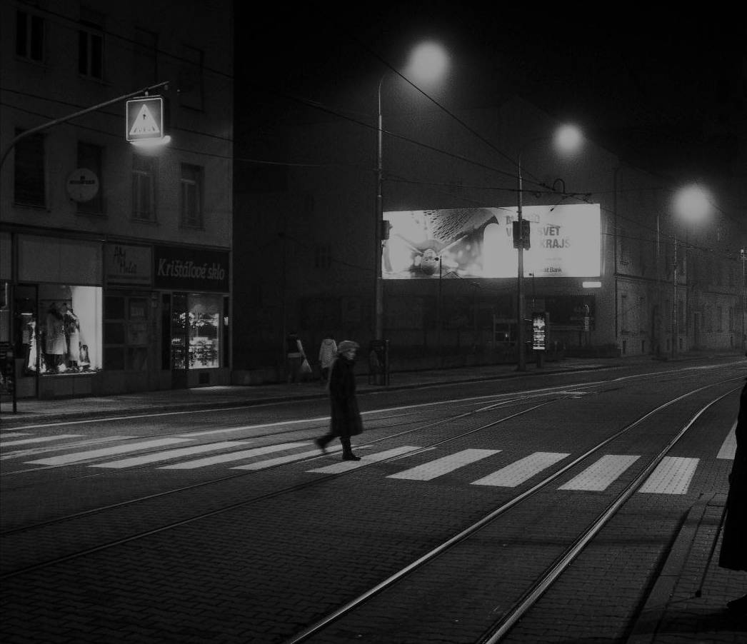
“It’s like a taboo I guess with all teachers, they just all say – you know, when they explain the paper they always say, “Don’t use Wikipedia.” (USU7, Female, Age 19)
“I just type it into Google and see what comes up.” (UKS2)
Learning Black Market
Notes:
Image: http://wp.me/pLtlj-fH
Covert online study habits
Wikipedia
Don’t cite
Widely used
Guilt
Students & teachers disagree
Quality sources
There is a “Learning Black Market”: learners use non-traditional sources but feel they cannot talk about them in an institutional context. Wikipedia usage is an example of this. (White & Connaway, 2011)
White, D. S., & Le Cornu, A. (2011). Visitors and Residents: A new typology for online engagement. First Monday, 16(9). Retrieved from http://firstmonday.org/htbin/cgiwrap/bin/ojs/index.php/fm/article/viewArticle/3171/3049
“I mean if teachers don’t like using Wikipedia they don’t want you to use Wikipedia. A lot of students will still use Wikipedia and then cite another source. As long as it has the same information and it is not word for word or anything they’ll use Wikipedia because it is the easiest thing to go look up on Wikipedia. It will give you a full in-depth detailed thing about the information. Teachers don’t just like it because it’s not the most reliable source since anyone can post something on there even though the site is monitored, it’s because it’s too easy.” (USU3 0:30:59, Male Age 19)
Students’ Perceptions of Teachers’ opinions of Wikipedia:
“Avoid it.” (UKS8 0:28:28.3, Female Age 16)
“They say it’s because anyone can make up – I mean, anyone can add information on there but I mean when I’ve actually looked into information it seemed the same as any information I find anywhere else. I mean, it’s not like if you look up fourth of July, it’s not like it gives you like some weird explanation of aliens or something.” (USU7 0:33:14, Female Age 19)
Students’ on Wikipedia:
“I use it, kind of like, I won't cite it on my papers but I, kind of, use it as a like, as a start off line. I go there and look up the general information, kind of, read through it so I get a general idea what it is. Then I start going through my research.” (USU7 0:33:49, Female Age 19)
“Everyone knows that you try not to use Wikipedia as a source because it is a cardinal sin.” (UKU3 0:31:03, Female Age 19)

Slide 22
Human Sources and Educational Stages
(Connaway, Lanclos, and Hood, Forthcoming)
Notes:
Mother: Emerging 58%, Establishing 50%, Embedding 40%, Experiencing 10%
Father: Emerging 48%, Establishing 50%, Embedding 40%, Experiencing 10%
Extended Family: Emerging 52%, Establishing 50%, Embedding 20%, Experiencing 20%
“There is a high level of mentions of contact with human beings across the participants in all of the educational stages. The differences between the different educational stages occur with the identification of the types of people who are contacted. Emerging students contact parents at rates of more than 48% (with a high of 58% for mothers). See Figure 5. Connaway, Prabha, and Dickey also found that undergraduate and graduate students contacted parents, with undergraduates contacting fathers more than mothers because fathers would find the information for them and mothers often wanted to teach them how to find the information.” (Connaway, Lanclos, and Hood, Forthcoming)
Connaway, Lynn Silipigni, Donna Lanclos, and Erin M. Hood. Forthcoming. “‘I find Google a lot easier than going to the library website.’ Imagine Ways to Innovate and Inspire Students to Use the Academic Library.” Proceedings of the Association of College & Research Libraries (ACRL) 2013 conference, April 10-13, 2013, Indianapolis, IN.
Lynn Silipigni Connaway, Chandra Prabha, and Timothy J. Dickey. Sense-making the Information Confluence: The Whys and Hows of College and University User Satisficing of Information Needs. Phase III: Focus Group Interview Study. Columbus, OH: School of Communication, The Ohio State University, 2006.
Connaway, Lynn Silipigni, and Marie L. Radford. Seeking Synchronicity: Revelations and Recommendations for Virtual Reference. Dublin, OH: OCLC Research, 2011. http://www.oclc.org/reports/synchronicity/full.pdf.

Slide 23
Human Sources and Educational Stages
(Connaway, Lanclos, and Hood, Forthcoming)
Notes:
Friends/Colleagues: Emerging 68%, Establishing 70%, Embedding 40%, Experiencing 30%
Librarians: Emerging 13%, Establishing 0%, Embedding 10%, Experiencing 20%
“They Emerging stage participants contacted friends 68% of the time, which is even more than their mention of asking one of their parents for information. These percentages closely match those of the Establishing upper-division undergraduate students. There is a striking decline in consultations with family members among graduate students, but there is a decline across the board in human consultation within the Embedding stage, perhaps reflecting an emphasis on individual work, and the need for graduate students in particular to figure things out on their own, before they can be recognized as experts in their field. See Figure 5. Connaway and Radford reported that graduate students were concerned about using virtual reference services because of their fear that the virtual reference transcripts would be seen by their professors and they would be perceived as not knowing some critical information within their discipline.” (Connaway, Lanclos, and Hood, Forthcoming)
“Faculty mention consulting parents (mother and father mentions combined) 20% of the time, but friends/colleagues 30%, and librarians 20%. The faculty mentions of librarians comprise the highest percentage of any of the educational stages.” (Connaway, Lanclos, and Hood, Forthcoming)
Connaway, Lynn Silipigni, Donna Lanclos, and Erin M. Hood. Forthcoming. “‘I find Google a lot easier than going to the library website.’ Imagine Ways to Innovate and Inspire Students to Use the Academic Library.” Proceedings of the Association of College & Research Libraries (ACRL) 2013 conference, April 10-13, 2013, Indianapolis, IN.

Slide 24
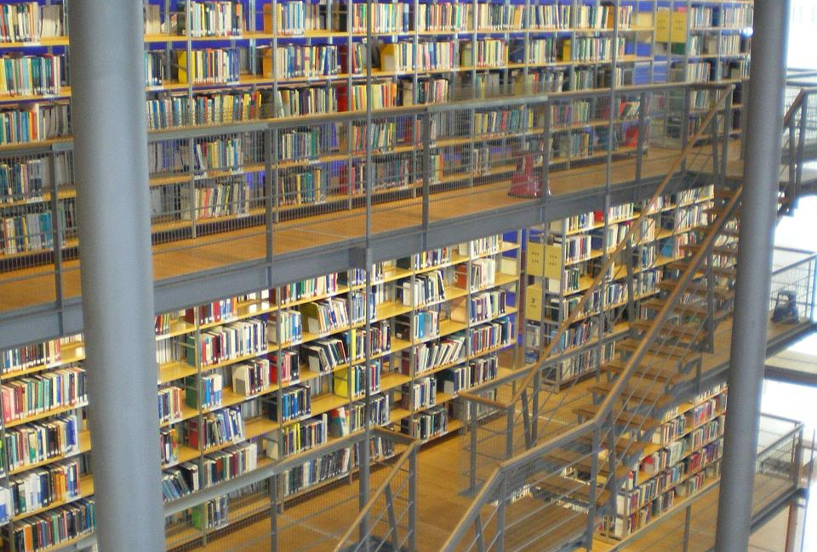
The word “librarian” was mentioned once in original interviews by Emerging Stage participants as a source of information
One participant referred to “a lady in the library who helps you find things”
(USU5, Male, Age 19)
Notes:
Image: http://www.flickr.com/photos/jenwaller/2844687403/
“– there’s a lady in the library who helps you find things.” Digital Visitors and Residents (USU5 0:37:17 Male Age 19)

Slide 25
Contact and Educational Stages
(Connaway, Lanclos, and Hood, Forthcoming)
Notes:
Contact and Educational Stages
Face-to-Face: Emerging 55%, Establishing 60%, Embedding 40%, Experiencing 70%
Phone Call: Emerging 84%, Establishing 90%, Embedding 70%, Experiencing 70%
IM, Chat: Emerging 52%, Establishing 30%, Embedding 40%, Experiencing 10%
Email: Emerging 52%, Establishing 100%, Embedding 100%, Experiencing 100%
“The importance of FtF communication among faculty is high, in comparison to other stages, for whom phone and other remote forms of communication are much more prevalent. Some of the phone mentions by the Emerging stage participants may be linked to students communicating with family and friends who are located in distant geographical locations. IM and chat are mentioned more than 50% of the time with the Emerging stage participants, and decreases with each stage, with a slight rebound among Embedding before plummeting among the Experiencing stage. Email is mentioned 52% by Emerging students who are about to enter or are entering institutions of higher education (applying for and attending university) and are required to use email for official communication. Once the individuals are acclimated to the university culture (Establishing, Embedding, and Experiencing educational stages), the mentions of email are at 100%.” (Connaway, Lanclos, and Hood, Forthcoming)
Connaway, Lynn Silipigni, Donna Lanclos, and Erin M. Hood. Forthcoming. “‘I find Google a lot easier than going to the library website.’ Imagine Ways to Innovate and Inspire Students to Use the Academic Library.” Proceedings of the Association of College & Research Libraries (ACRL) 2013 conference, April 10-13, 2013, Indianapolis, IN.
Hand Off to Lynn

Slide 26
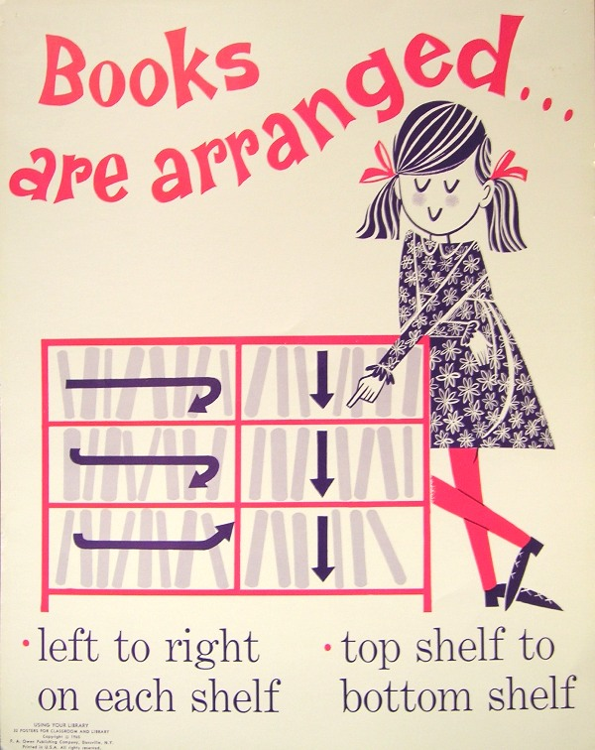
Library=Books
Library=Books
22 Emerging
6 Establishing
6 Embedding
0 Experiencing
(Connaway, Lanclos, and Hood, Forthcoming)
Notes:
“In a recent Pew Internet & American Lie Project report, a national survey of Americans (16 years and older) found that 80% declare borrowing books is a “very important” service libraries provide. Additionally, of the 53% who had visited a library or bookmobile in the last year, 73% said they visit to borrow print books. The perception of equating libraries with books has appeared consistently in the literature.” (Connaway, Lanclos, & Hood, Forthcoming)
“Prabha, Connaway, and Dickey stated, “Students tend to view the library as a place to borrow books, and to obtain books and articles on ILL.” Connaway and Radford consistently found that when individuals mentioned libraries, they usually mentioned books or getting books there. In De Rosa’s Perceptions of Libraries and Information Resources report for OCLC, a 41-year-old Canadian respondent may have articulated this idea of a library best when stating, “Books, books, books, rows and rows of books, stacks of books, tables filled with books, people holding books, people checking out books. Libraries are all about books.”” (Connaway, Lanclos, and Hood, Forthcoming)
“The findings from the V&R study support this perception of libraries and books. Twenty-two of the Emerging participants, 6 Establishing participants, and 6 Embedding participants also articulated this image of libraries. Interestingly, none of the Experiencing participants discussed libraries in terms of books. It may be attributed to the increased range of experiences that faculty have with the library, and in particular their first-hand experience with requesting and using electronic resources provided by the library. Particularly faculty in the science fields associated the library with their access to electronic resources, which are their most prevalent sources of information as opposed to books and monographs.” (Connaway, Lanclos, and Hood, Forthcoming)
“If people rely on digital sources and associate the library with books, they probably are less likely to think about the library in relation to digital sources. Shifting the perception to that of the Experiencing participants in the V&R study, i.e., libraries provide more than books, will help the libraries’ image as a place that can provide digital and human sources.” (Connaway, Lanclos, and Hood, Forthcoming)

Slide 27
“Yes, yes, like yes. Because I mean the thing that annoys me most is when these things are online, unlike library catalogues that’s supposed to be a really good way for looking for books but usually they are so bad that you are sort of stuck between the two worlds of you can’t go and ask someone for anything. You’re supposed to use the internet but they’re not very well developed.” Digital Visitors and Residents (UKG5 0:34:36 Female Age 25).
“Frequently when I’m working from home, it does feel a bit onerous to come all the way, which is about two miles away on bike, to use the library when I’m immediately probably going to go home afterwards. I find working from home very comfortable. I’d like – it feels also very private, it’s easy for me to concentrate without other people within the library space. So all of those reasons influenced my decision to take the easier route rather than physically having to move to get information.” Digital Visitors and Residents (UKG2 0:49:42 Female Age 22)
Notes:
“Not to mention reading online pdf books. Its really cool that now a days you don’t have to go to the library to find a book but its right there on your laptop. I grew up in a library I was always there reading. I even started working at one when I was in the 5th grade. I loved the whole surrounded by books and just helping out. In truth I do sometimes miss the feel of a hard cover book but it beats wasting gas to go to the library to just get a book when you can find it on line with no trouble.” Digital Visitors and Residents (USU2 Diary 11 Female Age 19)
“So I don’t tend to want to spend my weekend wandering round Oxford trying to find books in the library if I’m perfectly honest. You know? That’s just me.” (Laughter) Digital Visitors and Residents (UKU1 0:19:41 Female Age 57)
Connaway, Lynn Silipigni, Donna Lanclos, and Erin M. Hood. Forthcoming. “‘I find Google a lot easier than going to the library website.’ Imagine Ways to Innovate and Inspire Students to Use the Academic Library.” Proceedings of the Association of College & Research Libraries (ACRL) 2013 conference, April 10-13, 2013, Indianapolis, IN.
Kathryn Zickuhr, Lee Rainie, and Kristen Purcell, Library Services in the Digital Age (Washington, DC: Pew Research Center’s Internet & American Life Project, 2013), http://libraries.pewinternet.org/files/legacy-pdf/PIP_Library%20services_Report.pdf.
Chandra Prabha, Lynn Silipigni Connaway, and Timothy J. Dickey. Sense-making the Information Confluence: The Whys and Hows of College and University User Satisficing of Information Needs. Phase IV: Semi-Structured Interview Study. Columbus, OH: School of Communication, The Ohio State University, 2006, 19.
Connaway, Lynn Silipigni, and Marie L. Radford. Seeking Synchronicity: Revelations and Recommendations for Virtual Reference. Dublin, OH: OCLC Research, 2011. http://www.oclc.org/reports/synchronicity/full.pdf.
Cathy De Rosa. Perceptions of Libraries and Information Resources: A Report to the OCLC Membership. Dublin, OH: OCLC Online Computer Library Center, 2005, 3-31. http://www.oclc.org/us/en/reports/2005perceptions.htm.
Image from http://www.flickr.com/photos/vblibrary/4479445497/

Slide 28
Place and Educational Stages
(White and Connaway 2011-2012)
Notes:
Google: Emerging 84%, 26, Establishing 100%, 10, Embedding 90%, 9, Experiencing 80%, 8
White, David S., and Lynn Silipigni Connaway. Visitors & Residents: What Motivates Engagement with the Digital Information Environment. 2011-2102. Funded by JISC, OCLC, and Oxford University. http://www.oclc.org/research/activities/vandr/.
“Google, I don’t know. It’s just Google it’s – I find it easier just to look through anything.” Digital Visitors and Residents (USU7 0:34:11 Female Age 19)
“With Google you are not limited. You have as much as you can pull up.” Digital Visitors and Residents (USU2 Diarist Follow-Up Interview 5 Female Age 19)
“I had good history with Google. I eventually find what I want.” Digital Visitors and Residents (USU2 Diarist Follow-Up Interview 5 Female Age 19)

Slide 29
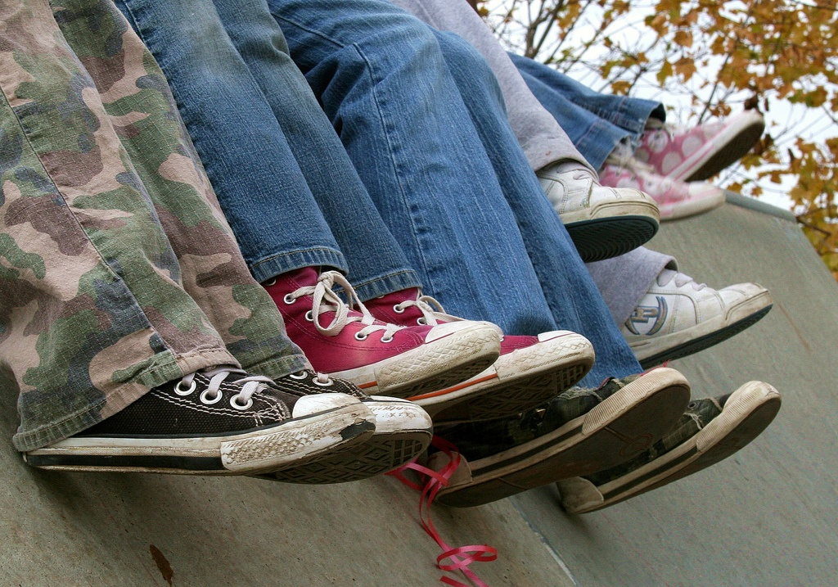
“I always stick with the first thing that comes up on Google because I think that’s the most popular site which means that’s the most correct.”
(USS1, Female, Age 17)
Notes:
“I always stick with the first thing that comes up on Google because I think that’s the most popular site which means that’s the most correct.” Digital Visitors and Residents (USS1 0:21:57 Female Age 17)
“I had to write a paper on Sunday where the education library was open 12pm until 4pm. I should have gone there because it would have had all of my sources. I didn’t; I Google searched and found an older version of the book and used it online, so that would be one time where I could have gone to the library for the most recent source; instead, I Google searched an older version and called that good.” Digital Visitors and Residents (UKG2 0:48:56 Female Age 22)
“She was very direct about certain stuff and wanted me to go to the library. Of course like the library’s like a second home for me, so that’s fine. But the research I needed wasn’t showing up. So I was like okay, I’m going to the internet. And I had to find quotes from books, so I just like was able to go on Google, Google book search, and find the quote I needed.” Digital Visitors and Residents (USU2 0:31:50 Female Age 19)

Slide 30
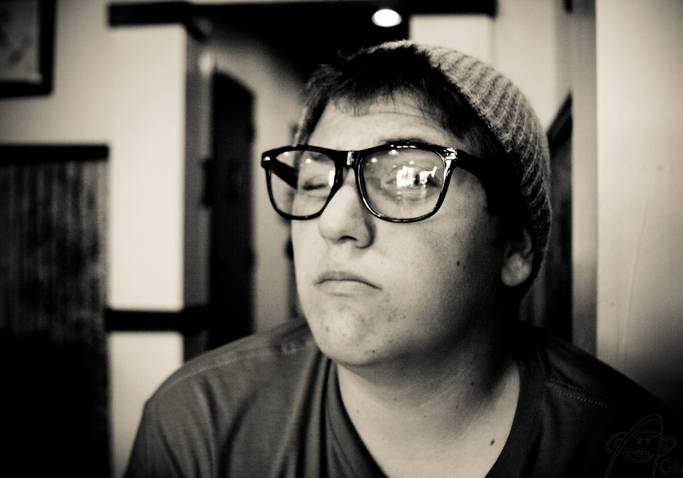
“...Google doesn’t judge you.”
(UKF3, Male, Age 52)
Notes:
“And also the fact that Google doesn’t judge you.” Digital Visitors and Residents (UKF3 0:16:35 Male Age 52)
“I don’t know, it’s habit. I know what it looks like and how to use it.” Digital Visitors and Residents (UKU9 0:19:06 Male Age 27) (speaking about Google)
“I find Google a lot easier than going to the library website because I don’t know, it’s just like sometimes so many journals come up and when you look at the first ten and they just don’t make any sense I, kind of, give up.” Digital Visitors and Residents (USU7 0:34:11 Female Age 19)

Slide 31
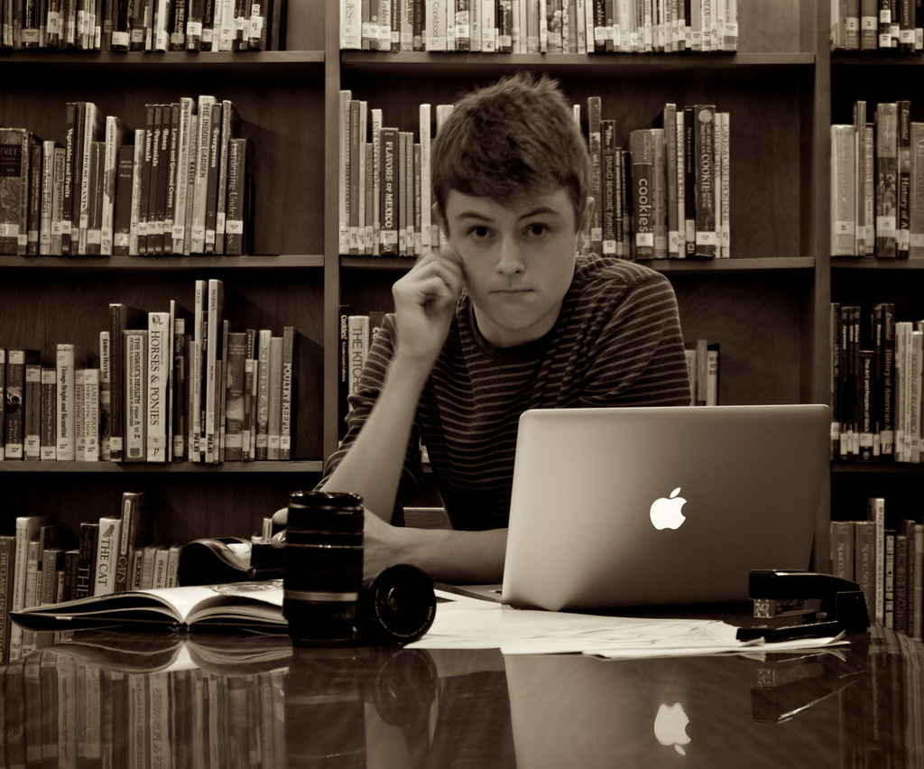
Recommendations & Future Research
Digital Visitors & Residents
Notes:
Image from http://www.flickr.com/photos/burtoo/6221572132/

Slide 32
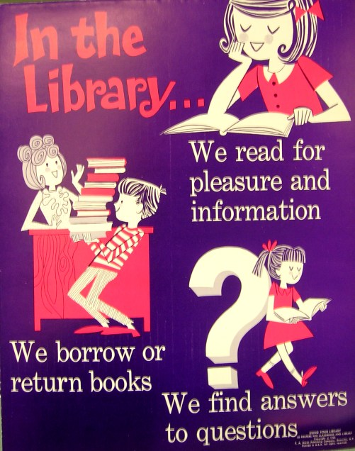
Recommendations
Recommendations for libraries
Market & promote library services
Create simple & convenient interface designs
Provide a broad range of tools
Remove the barriers between discovering & accessing information
(Connaway, Lanclos, and Hood, Forthcoming)
Notes:
“There are several implications in the V&R research results for enhancing library services, and creating systems to better meet the academic communities’ information needs and expectations. Recommendations for libraries based on the literature and the V&R findings are: 1. Market and promote library services. 2. Create simple and convenient interface designs. 3. Provide a broad range of tools. 4. Remove the barriers between discovering and accessing information” (Connaway, Lanclos, and Hood, Forthcoming)
“Librarians need to market and promote their services and be very transparent about what they offer, in addition to books. This will help people to associate the authority of the library with the types of sources (full-text digital) that they value and expect in their everyday lives.” (Connaway, Lanclos, and Hood, Forthcoming)
“Researchers are very familiar with other web-based searches like Google, Yahoo, or Amazon. Library web services ought to look similar despite providing very detailed ways of searching for information. The majority of users search by keywords and library search tools must have a simple and convenient interface.” (Connaway, Lanclos, and Hood, Forthcoming)
“Librarians need to provide a broad range of tools and services in different media. Some people prefer walking into a library and talking FtF with a librarian or expert, others prefer to communicate virtually. While some users want to hold a book, many want electronic access. In the current economic environment it is difficult to provide everything to everyone. However, collaboration can be a powerful way to broaden the library’s services.” The librarian needs to be embedded within the academic community (Connaway, Lanclos, and Hood, Forthcoming)
“Librarians need to remove the barriers between discovering and accessing information. Access is the key to meeting users’ expectations since they want full-text information in both digital and paper formats, depending upon the context and situation of their needs.” (Connaway, Lanclos, and Hood, Forthcoming)
Connaway, Lynn Silipigni, Donna Lanclos, and Erin M. Hood. Forthcoming. “‘I find Google a lot easier than going to the library website.’ Imagine Ways to Innovate and Inspire Students to Use the Academic Library.” Proceedings of the Association of College & Research Libraries (ACRL) 2013 conference, April 10-13, 2013, Indianapolis, IN.
Image from http://www.flickr.com/photos/vblibrary/4479445699/

Slide 33
Future Research
Digital Visitors & Residents
Online survey
Continue with diaries & interviews
Initial interviews with 12 new Emerging Stage participants
Monthly diaries with 6 new Emerging Stage participants

Slide 34
Future Research
Librarian Toolkit for Engagement
Design Sessions
Librarians
ALA 2013
EDUCAUSE 2013
Educational Technology Staff
EDUCAUSE 2013
Notes:
Image from http://www.flickr.com/photos/chrisnoessel/6254923283/

Slide 35
Selected Bibliography
ACRL Standards Committee. “Information Literacy Competency Standards for Higher Education.” ACRL Association of College & Research Libraries. Accessed February 8, 2013. http://www.ala.org/acrl/standards/informationliteracycompetency.
American Library Association. Presidential Committee on Information Literacy: Final Report. Chicago: American Library Association, 1989.
Connaway, Lynn Silipigni, Timothy J. Dickey, and Marie L. Radford. “‘If it is too inconvenient I’m not going after it:’ Convenience as a Critical Factor in Information-seeking Behaviors.” Library & Information Science Research 33, no. 3 (2011): 179-190.
Connaway, Lynn Silipigni, Donna Lanclos, and Erin M. Hood. “‘I find Google a lot easier than going to the library website.’ Imagine Ways to Innovate and Inspire Students to Use the Academic Library.” Proceedings of the Association of College & Research Libraries (ACRL) 2013 conference, April 10-13, 2013, Indianapolis, IN (Forthcoming).
Connaway, Lynn Silipigni, Donna Lanclos, David White, Alison Le Cornu, and Erin M. Hood. “User-centered Decision Making: A New Model for Developing Academic Library Services and Systems.” IFLA World Library and Information Congress 2012 Helsinki Proceedings: Libraries Now! Inspiring, Surprising, Empowering (2012). http://conference.ifla.org/sites/default/files/files/papers/wlic2012/76-connaway-en.pdf.

Slide 36
Selected Bibliography
Connaway, Lynn Silipigni, Chandra Prabha, and Timothy J. Dickey. Sense-making the Information Confluence: The Whys and Hows of College and University User Satisficing of Information Needs. Phase III: Focus Group Interview Study. Report on National Leadership Grant LG-02-03-0062-03, to Institute of Museum and Library Services. Columbus, OH: School of Communication, The Ohio State University, 2006.
Connaway, Lynn Silipigni, and Marie L. Radford. Seeking Synchronicity: Revelations and Recommendations for Virtual Reference. Dublin, OH: OCLC Research, 2011. http://www.oclc.org/reports/synchronicity/full.pdf.
Connaway, Lynn Silipigni, David White, and Lorcan Dempsey. Digital Visitors and Residents: What Motivates Engagement with the Digital Information Environment? An Update on Current Findings. Video presentation, October 13, 2011. http://www.youtube.com/watch?v=ZCBoLWynsl8.
De Rosa, Cathy. Perceptions of Libraries and Information Resources: A Report to the OCLC Membership. Dublin, OH: OCLC Online Computer Library Center, 2005. http://www.oclc.org/us/en/reports/2005perceptions.htm.
Digital Literacy Task Force. “Digital Literacy Definition.” ALA Connect. September 14, 2012. http://connect.ala.org/node/181197.
Francke, Helena, and Olof Sundin. “Negotiating the Role of Sources: Educators’ Conceptions of Credibility in Participatory Media.” Library & Information Science Research 34, no. 3 (2012): 169-175.

Slide 37
Selected Bibliography
Head, Alison J., and Michael B. Eisenberg. “How Today’s College Students Use Wikipedia for Course-related Research.” First Monday 15, no. 3 (2010). http://firstmonday.org/htbin/cgiwrap/bin/ojs/index.php/fm/article/view/2830/2476.
Lim, Sook, and Christine Simon. “Credibility Judgement and Verification Behavior of College Students Concerning Wikipedia.” First Monday 16, no. 4 (2011). http://firstmonday.org/htbin/cgiwrap/bin/ojs/index.php/fm/article/view/3263/2860.
McKiel, Allen. “2011 Global Student E-book Survey.” n.p.: ebrary, 2012. http://site.ebrary.com/lib/surveys/docDetail.action?docID=80076107.
Prabha, Chandra, Lynn Silipigni Connaway, and Timothy J. Dickey. Sense-making the Information Confluence: The Whys and Hows of College and University User Satisficing of Information Needs. Phase IV: Semi-Structured Interview Study. Funded by the Institute of Museum and Library Services. Columbus, OH: School of Communication, The Ohio State University, 2006.
Sundin, Olof, and Helena Francke. “In Search of Credibility: Pupils’ Information Practices in Learning Environments.” Information Research 14, no. 4 (2009). http://informationr.net/ir/14-4/paper418.html.
White, David. The Learning Black Market (blogpost). September 30, 2011. http://tallblog.conted.ox.ac.uk/index.php/2011/09/30/the-learning-black-market/.

Slide 38
Selected Bibliography
White, David S., and Lynn Silipigni Connaway. Visitors & Residents: What Motivates Engagement with the Digital Information Environment. 2011-2012. Funded by JISC, OCLC, and Oxford University. http://www.oclc.org/research/activities/vandr/.
White, David S., and Alison Le Cornu, A. “Visitors and Residents: A New Typology for Online Engagement.” First Monday 16, no. 9 (2011). http://firstmonday.org/htbin/cgiwrap/bin/ojs/index.php/fm/article/viewArticle/3171/3049.
White, David S., and Alison Le Cornu, A. “Visitors and Residents: A New Typology for Online Engagement.” First Monday 16, no. 9 (2011). http://firstmonday.org/htbin/cgiwrap/bin/ojs/index.php/fm/article/viewArticle/3171/3049.
Wolcott, Harry F. The Art of Fieldwork. Walnut Creek, CA: AltaMira Press, 1995.
Wolcott, Harry F. Ethnography: A Way of Seeing. Walnut Creek, CA: AltaMira Press, 1999.
Wu, Somaly Kim, and Donna Lanclos. "Re-imagining the Users' Experience: An Ethnographic Approach to Web Usability and Space Design.” Reference Services Review 39, no. 3 (2011): 369-389.
Zickuhr, Kathryn, Lee Rainie, and Kristen Purcell. Library Services in the Digital Age. Washington, DC: Pew Research Center’s Internet & American Life Project, 2013. http://libraries.pewinternet.org/files/legacy-pdf/PIP_Library%20services_Report.pdf.

Slide 39
Questions & Discussion
Lynn Silipigni Connaway connawal@oclc.org
@LynnConnaway
Donna Lanclos
dlanclos@uncc.edu
@DonnaLanclos
Erin Hood
hoode@oclc.org
Notes:
39
39
39
Image from http://www.flickr.com/photos/joelmarkwitt/2797956179/

