Slide 1
Gramado, Brazil • September 19, 2012
The XVII Seminário Nacional de Bibliotecas Universitárias
Using Virtual Reference Services to Embed the Library in the Academic Workflow
Lynn Silipigni Connaway, Ph.D.
Senior Research Scientist
OCLC Research

Slide 2

“The convenience is still better online than in person, you don’t have to make trips to the library.”
(UTI-24, Male 15-18 years old)
library
Notes:
Image: http://www.flickr.com/photos/courtneyrian/5750960959/

Slide 3
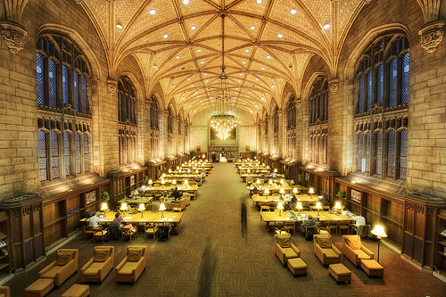
Then & Now
Then: The user built workflow around the library
Now: The library must build its services around user workflow
Then: Resources scarce, attention abundant
Now: Attention scarce, resources abundant
(Dempsey, 2008)
Notes:
Image: http://www.flickr.com/photos/aramisfirefly/3580397954/
Dempsey, L. (2008). Always on: Libraries in a world of permanent connectivity. First Monday, 14(1). Retrieved from http://www.firstmonday.org/htbin/cgiwrap/bin/ojs/index.php/fm/article/view/2291/207
Today, more than 1.7 billion people, or almost one out of every four humans on the planet, are online (Wasserman, 2012).
Wasserman, S. (2012, June 18). The Amazon effect. The Nation. Retrieved from http://www.thenation.com/article/168125/amazon-effect

Slide 4
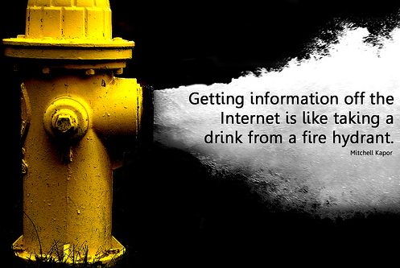
Notes:
Image: http://www.flickr.com/photos/will-lion/2595497078/
“…the unfortunate thing of that is that sometimes there is just an overload of information as opposed to a paragraph consistently found, is that there is just, you know, volumes upon volumes of information based upon one particular individual. And so, time to sift through which of those information who I feel I want to convey to students can be a very difficult process.” Sense-Making the Information Confluence, User (Faculty Focus Group Interview, Institution B, 2005)“
Librarians are ideal “discovery experts” to help users navigate information on Internet
VRS can build up knowledge bases, adding trust and authority to their services and sources
VRS librarians can connect users with quality information not linked to a publication
Help bring open access information into research
Facilitate data reuse
OCLC QuestionPoint Knowledge Base
Replace “the vertical file”
Store, preserve, & facilitate access to reference question & answer pairs
>6 million reference transactions
Enable reference cooperatives, librarians, & users to share knowledge
Ready Reference is NOT dead!
Ready Reference questions increased from 2004-2006 (n=243, 27%) to 2010 (n=179, 31%) (Connaway & Radford 2012)
Save time of librarians & users
Decreasing budgets – share and cooperate
Connaway, L.S., & Radford, M.L.(2012). Extending Our Virtual Reach: A Longitudinal Study of Query Type & Accuracy in Live Chat & IM Reference IM Reference [PowerPoint slides]. Retrieved from http://www.oclc.org/research/activities/synchronicity/ppt/alise2012.pptx (Sl. 15).
Standards could better facilitate reference cooperatives and allow users and librarians to easily search different knowledge bases
Saves time of librarian and the user – back to Ranganathan (1957)– save time of the reader
Books are for use.
Every reader his [or her] book.
Every book its reader.
The library is a growing organism.
Ranganathan, S.R. (1957). The Five Laws of Library Science. Madras: Madras Library Association; London: G. Blunt and Sons

Slide 5

Virtual Reference Services
Global reach
Anytime/anywhere access
Cooperative services may reduce costs
Notes:
Image: http://www.trimite.com/about/press-releases-images/

Slide 6


The Study
Seeking Synchronicity
Seeking Synchronicity
Notes:
Image: Microsoft Clip Art
$1,090,072 project, 2005-2008, funded by:
Institute of Museum & Library Services (IMLS) $684,996 grant
Rutgers, The State University of New Jersey & OCLC, Inc.
$405,076 in kind contributions
Co-PI: Marie Radford

Slide 7
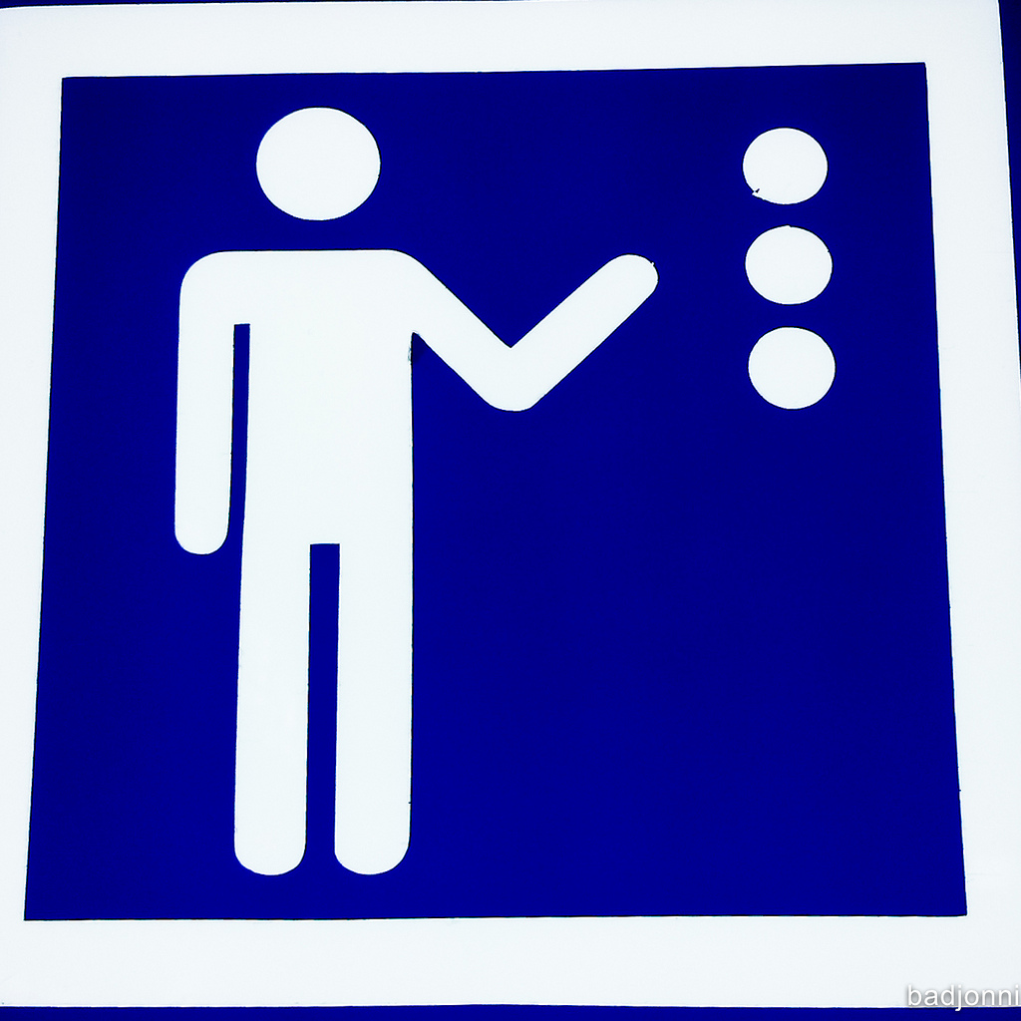
Seeking Synchronicity:
Evaluating Virtual Reference Services from User, Non-User & Librarian Perspectives
Librarians
Studied habits & needs of virtual reference service (VRS) librarians, users, & non-users to identify characteristics for informing library system & service development
Generalizable through large sample sizes, multiple methods of data collection, & triangulation of results
Users
Non-users
(Connaway & Radford, 2011)
Notes:
Image: http://www.flickr.com/photos/badjonni/7131927517/
Connaway, L. S., Radford, M. L., & OCLC Research. (2011). Seeking synchronicity: Revelations and recommendations for virtual reference. Dublin, Ohio: OCLC Research. http://www.oclc.org/research/activities/synchronicity/default.htm

Slide 8


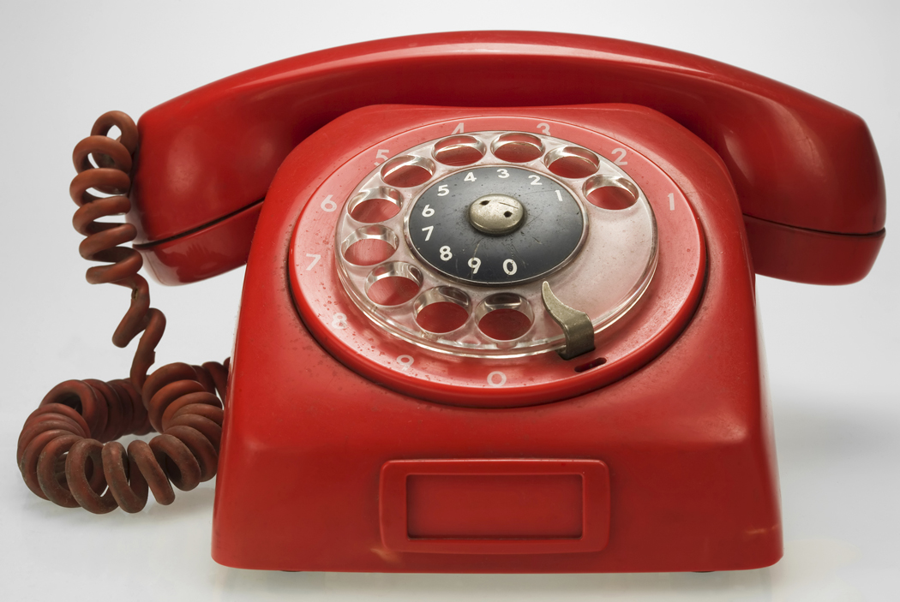
Seeking Synchronicity Phases
Phase I:
Focus Group Interviews
Phase II:
Transcript Analysis
850 QuestionPoint live chat transcripts
Phase III:
Telephone Interviews
100 VRS Librarians
76 VRS Users
107 VRS Non-users
Phase IV:
Online Surveys
173 VRS Librarians
137 VRS Users
134 VRS Non-users
Notes:
Images: Microsoft Clip Art
Live Chat Transcripts 2004-2006 (QP1)
8/2004 to 10/2006
Total QuestionPoint & 24/7 = 651,687
850 randomly selected (550 QP & 300 24/7)
Live Chat & Qwidget Transcripts 2010 (QP2 & QW)
6/2010 to 12/2010
Total QP2 & QW = 296,797 (QP2 221,158 & QW 75,639)
560 randomly selected (350 QP2 & 210 QW)

Slide 9
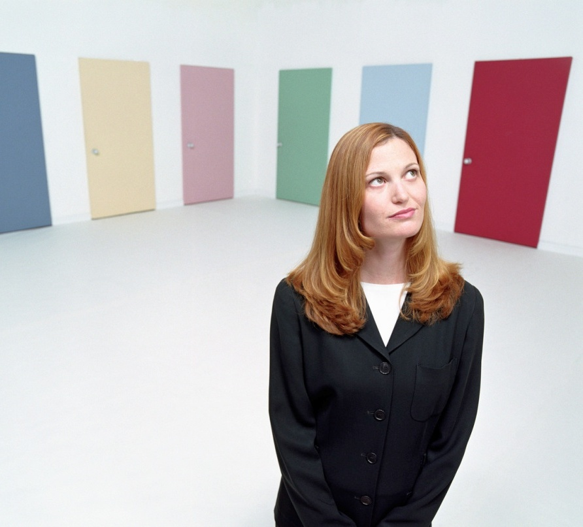
Critical Incident Technique (CIT) for Telephone Interviews & Survey
Flanagan (1954)
Qualitative technique
Focuses on most memorable event/experience
Allows categories or themes to emerge rather than be imposed
(Flanagan, 1954)
Notes:
Image: Microsoft Clip Art
Chapter 4: “Way Sweet” or “Just Wrong:” Critical Factors for Virtual Reference Success
Flanagan, J. C. (1954). The critical incident technique. Washington: American Psychological Association.

Slide 10

Critical Incident Technique (CIT) for Telephone Interviews & Survey
VR Users’ & Librarians’ Questions
Remember 1 specific successful VRS interaction
Remember 1 specific unsuccessful VRS interaction
Describe each interaction
Identify factors that made interactions successful or unsuccessful
Notes:
Chapter 4: “Way Sweet” or “Just Wrong:” Critical Factors for Virtual Reference Success
In order to find out what users most highly value (or dislike) about VR, we asked VRS librarians and users these CI questions:
• Think about one experience in which you felt a chat reference encounter achieved (or did not achieve) a positive result.
• Describe the circumstances and nature of the reference query.
• Describe why you felt this encounter was (was not) a success.
We also added an additional question for the VRS users:
• Did the chat format help your experience to be successful/unsuccessful? If yes, how?
For non-users of VRS, the questions were very similar, but they solicited comment on the other reference format(s) the non-users experienced, including face-to-face (FtF), phone, e‑mail and SMS text messaging.

Slide 11
Types of Questions
Seeking Synchronicity
Types of questions
Notes:
Image: Microsoft Clip Art

Slide 12


What politician supports gay rights and or is an activist for them
QP2-282
how many books can i check out at one time?
QP2-276
Is “The Mindful Child: How to Help Your Kid Manage Stress and Become Happier, Kinder, and More Compassionate” Available?
How do I get a job and what are the requirements?
QP2-274
I need some help with finding articles
QP2-273
how do you spell I miss you in spanish
Cannot log in, telling me authentication failed. Was able to log in yesterday.
QP2-269
I need a good website all about the history of DESIGN of telephones with a timeline and good pictures with it.
QP2-269

Slide 13

Types of VR Questions
Subject Search
Ready Reference
Procedural
No Question
Holdings
Research
Inappropriate
Directional
Reader’s Advisory
(Arnold & Kaske, 2002,2005)
Notes:
Image: http://www.flickr.com/photos/marcobellucci/3534516458/
Our study draws on categories for questions defined by Katz (1997) and enhanced by Arnold & Kaske (2002, 2005).
Arnold, J., & Kaske, N. (2002). Chat with a Librarian. Computers in Libraries Annual Conference and Exhibition Usa-, 1-6.
Arnold, J., & Kaske, N. (2005). Evaluating the quality of a chat service. portal: Libraries and the Academy, 5(2), 177-193.

Slide 14
Subject Search or Specific Search
“Almost always takes the form of giving the user a document, for example, a list of citations, a book, or a report” (Arnold & Kaske, 2005).
  How was the labeling theory important in deinstitutionalization?
  (QW–023)
  can you help me find poems by Maya Angelou and criticism on them? (QP1–230)
  Where can i find information about ADHD?
  (QP2–005)
Notes:
A search on a topic. Arnold and Kaske called this “Specific Search,” we are calling it “Subject Search”.
Note that all quotes are verbatim and have not been corrected if there are errors.

Slide 15
Ready Reference
“These are the typical ready-reference or data queries that require only a single, usually uncomplicated, straightforward answer...Who? What? When? Why? Where?” (Arnold & Kaske, 2005).
  who won the world cup game between south africa and france?
  (QW–024)
  How do i cite a political talk show in MLA format?
  (QP2–013)
  Who was Bentonville, NC named after?
  (QP1–147)

Slide 16
Procedural
“Questions pertaining to the policies or procedures within the library system” (Arnold & Kaske, 2005).
  Can I get summer long term renewals online? How? (QP1–004)
  what is the max for checkout on blu ray dvids? (QW–033)
  need access logon info to lexis from scool library website (QP2– 027)

Slide 17
Holdings
“Questions about specific holdings of a library in print or digital form” (Arnold & Kaske, 2005).
  I was wondering if you have textbooks to rent for an hour or 2?
  (QP2–172)
  Do you have any books on Paris Hilton? (doing a project on her)
  (QP 1–195)
  hi there; i was wondering if you guys have Moby Dick in stock?
  (QW–014)

Slide 18
Research
“Research questions… involve trial-and-error searching or browsing… [and] are usually identified as coming from an adult specialist who is seeking detailed information to assist in specific work” (Arnold & Kaske, 2005).
  Looking for information on national traffic survey and incident reports.
  (QP2–169)
  Hi, I am trying to find out information on how the Learn Direct initiative was started, the criteria that was set and if local government had to be involved in the first stage. (QP 1–155)
  Hi I’m looking for studies similar to one I’ve already found. How do I go about this?
  (QW–013)

Slide 19
Inappropriate
“Questions which are not appropriate for a reference service including personal questions” (Radford, 2005).
  How do I have sex?
  (QP1–159)
  Are
  You
  Typing
  War
  and Peace
  (QW–020)
  WAT DOES it mean when a guy said he like me more as a friend doesnt it mean like a gf? (QP2–153)
Notes:
QP2-153, Seeking Synchronicity, 2005-2008
U: WAT DOES it mean when a guy said he like me more as a friend doesnt it mean like a gf?
L: what do you think it means?
U: well like a relationship but wuts u think?
L:It is a nice way of saying he wants to be friends and nothing more.
U: are you for reallllll?
L: Yes I am.
U: oh wtffff grrrrrr now am fkin MAD CRYING*
U:cause he said he likes me and how am cute etc and he even kisses me etc so i dont think thats bein a friend lol
L: Sorry.
L: If you have to ask, you already know, right?
U: cause i thought when a guy says more then a friend i thought it meant as a bf / gf
L: You wrote "more as a friend" not "more than a friend".
L: Very different meaning.
U: he said more as a friend
L: Be honest with yourself.
U: he told his friend about me yoo how hot i am etc and he likes me alot and loves to hang out with me
U: i am being honest he said he wants us to be more then friends like a relationship

Slide 20
Directional
“The general information or directional question is of the information booth variety…” (Arnold & Kaske, 2005).
  what is the URL for the summer reading program for teens?
  (QP2–032)
  I heard that you have adapted book kits for ESL speakers. Where can I find these online?
  (QW–008)
  Where is the 67th street library? Is it on the west or east side?
  (QP1–387)
Notes:
Includes virtual directions like 2nd example asking for URL

Slide 21
Reader’s Advisory
Reader’s Advisory questions are “focused on helping readers find materials they want to read, listen to, or view for pleasure“
(Ross, Nilsen, & Radford, 2009).
  Hello I am looking for recommendations for the author jonathan kellerman. (QP1–218)
  Hi, my 7 year old son is looking for a copy of the Hobbit suitable for children, but we can’t seem to find anything in the library catalogue. Can you please offer any advice? Thanks.
  (QW– 120) (from Australia)
  I was wondering if u would happen to know any good fantasy books…
  (QP2 – 050)

Slide 22
n=293
n=243
n=162
n=104
n=77
Notes:
Total N for 2004-2006 is 915 questions (not transcripts)
Subject Search (n=293, 32%)
Ready Reference (n=243, 27%)
Procedural (n=162, 18%)
No Question (n=104, 11%)
Holdings (n=77, 8%)
Research (n=23, 3%)
Inappropriate (n=10, 1%)
Directional (n=2, <1%)
Reader’s Advisory (n=1, <1%)

Slide 23
Query Type: 2010
Notes:
575 is actual number of questions from 560 transcripts (includes both QP and QW)
Subject Search (n=97, 17%)
Ready Reference (n=179, 31%)
Procedural (n=181, 31%)
No Question (n=25, 4%)
Holdings (n=49, 9%)
Research (n=19, 3%)
Inappropriate (n=4, <1%)
Directional (n=15, 3%)
Reader’s Advisory (n=6, 1%)

Slide 24
32%
31%
31%
27%
18%
17%
11%
8%
9%
4%
Notes:
2004-2006
QP1:
n = 915 questions vs. 575 questions
Subject Search (n=293, 32%) vs. (n=97, 17%)
Ready Reference (n=243, 27%) vs. (n=179, 31%)
Procedural (n=162, 18%) vs. (n=181, 31%)
No Question (n=104, 11%) vs. (n=25, 4%)
Holdings (n=77, 8%) vs. (n=49, 9%)
Research (n=23, 3%) vs. (n=19, 3%)
Inappropriate (n=10, 1%) vs. (n=4, 1%)
Directional (n=2, <1%) vs. (n=15, 3%)
Reader’s Advisory (n=1, <1%) vs. (n=6, 1%)
2010
QP2:
N=366
Directional (n=7, 2%)
Ready Reference (n=127, 35%)
Subject Search (n=74, 20%)
Research (n=16, 3%)
Procedural (n=99, 27%)
Holdings (n=25, 7%)
No Question (n=11, 3%)
Inappropriate (n=4, 1%)
Reader’s Advisory (n=3, 1%)
QW2:
N=209
Directional (n=8, 4%)
Ready Reference (n=52, 25%)
Subject Search (n=23, 11%)
Research (n=3, 1%)
Procedural (n=82, 39%)
Holdings (n=24, 11%)
No Question (n=14, 7%)
Inappropriate (n=0, 0%)
Reader’s Advisory (n=3, 1%)

Slide 25
Query Type 2010: Live Chat (QP2) vs. Qwidget (QW)
n=179
n=181
n=127
n=99
n=97
n=82
n=74
n=52
n=49
n=23
n=25
n=24
n=25
n=11
n=14
Notes:
Total n= 575 questions
QP2:
N=366 questions
Directional (n=7, 1%)
Ready Reference (n=127, 22%)
Subject Search (n=74, 13%)
Research (n=16, 3%)
Procedural (n=99, 17%)
Holdings (n=25, 4%)
No Question (n=11, 2%)
Inappropriate (n=4, 1%)
Reader’s Advisory (n=3, 1%)
QW2
N=209
Directional (n=8, %)
Ready Reference (n=52, 9%)
Subject Search (n=23, 4%)
Research (n=3, 1%)
Procedural (n=82, 14%)
Holdings (n=24, 4%)
No Question (n=14, 2%)
Inappropriate (n=0, 0%)
Reader’s Advisory (n=3, 1%)
Total
N=575
Directional (n=15, 3%)
Ready Reference (n=179, 31%)
Subject Search (n=97, 17%)
Research (n=19, 3%)
Procedural (n=181, 31%)
Holdings (n=49, 9%)
No Question (n=25, 4%)
Inappropriate (n=4, 1%)
Reader’s Advisory (n=6, 1%)

Slide 26
Ready Reference Questions (2004-2006 vs. 2010)
Received by Type of Chat Service
40%
39%
36%
28%
21%
20%
12%
<1%
2%
<1%
Notes:
Note: this chart shows the chat service that received the questions as initially submitted by the user (e.g., user submitted to this type of service).
Referred to/Answered would be a different number.
2004-2006 (n=162 ready reference queries)
Public (n=59, 36%)
Consortium (n=45, 28%)
Academic & Law (n=34, 21%)
National (n=20, 12%)
Other (n=4, 2%) breakdown State (n=3), K-12 (n=1)
2010 Total (n=168)
Public (n=33, 20%)
Consortium (n=68, 40%)
Academic & Law (n=65, 39%)
National (n=1, <1%)
Other (n=1, <1%)

Slide 27
Ready Reference Questions (QP2 vs. QW)
Received by Type of Chat Service
Notes:
Total (n=168)
Public (n=33, 20%)
Consortium (n=68, 40%)
Academic & Law (n=65, 39%)
National (n=1, <1%)
Other (n=1, <1%)
QP2 (n=118)
Public (n=22, 19%)
Consortium (n=63, 53%)
Academic & Law (n=32, 27%)
National (n=1, <1%)
Other (n=0, 0%)
QW Total (n=50)
Public (n=11, 22%)
Consortium (n=5, 10%)
Academic & Law (n=33, 66%)
National (n=0, 0%)
Other (n=1, 2%)

Slide 28
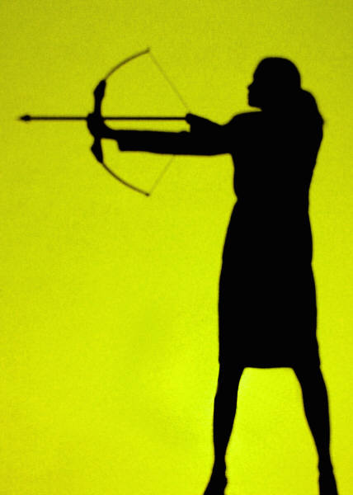
Accuracy in Ready Reference
Seeking Synchronicity
Types of questions
Notes:
Image: Microsoft Clip Art

Slide 29

Accuracy in VR Ready Reference
How accurate are VR librarians/staff in answering ready reference questions?
Do we see the 55% rule in effect?
(Hernon & McClure, 1987)
Notes:
Image: Microsoft Clip Art
Hernon, P., & McClure, C. R. (1987). Unobtrusive testing and library reference services. Norwood, New Jersey: Ablex Publishing.

Slide 30
Ready Reference Accuracy: 2004-2006 vs. 2010
90%
78%
20%
6%
4%
2%
Notes:
*Other is a new category covering a variety of circumstances, including librarian unable to find answer and users finding information themselves. Does not include responses that were terminated without an answer due to technical problems or inquiries that were referred elsewhere.
Example:
U: “What is the number to financial aid”
L: “Okay. Let me see if I can find the number for you. Please hold on.”
U: “thanks sorry found it” (QP 24/7-100)
--------
U: who is selena? (Then signs off.) (QP2- 199)
--------
This chart compares the Accuracy for 2004-2006 to 2010.
2004 – 2006 (n=180 ready reference questions only)
Correct: n=141, 78%
Incorrect: n=36, 20%
Other: n=3, 2%
2010 (n=168 ready reference questions for both QP2 and QW)
Correct: n=151, 90%
Incorrect: n=7, 4%
Other: n=10, 6%
Also: note that referred questions are not counted in either 04-06 or 10 dataset.

Slide 31
A Simple Way to Increase Accuracy
For 2004 –2006, accuracy would rise from 78% to 90% if VR librarians only…
  -Answered specific question asked!
Seeking Synchronicity urged VRS librarians
  -Before pushing a general info page make sure it has specific & exact answer to user’s question!
2010 sample included far fewer with this error: accuracy 90% (perhaps b/c of recommendation?)
Notes:
Other suggestions to improve accuracy:
Check for broken links before sending URLs
Make sure all questions & all parts of questions are answered

Slide 32
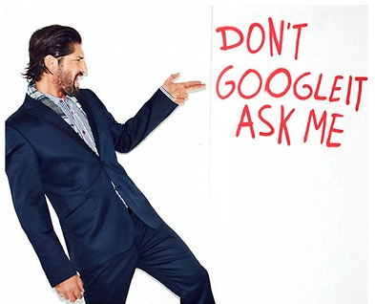
VRS Librarians
Critically evaluate sources
Create metrics for evaluating new scholarly forms of authoring, publishing, & researching
Assist new content creators
Develop customized widgets
Provide services in different formats
  Be available to the users
    Face-to-face
    Online
      Email
      Text Messaging
      IM
    Mobile
    Telephone
    Social Media Services
Notes:
Image: http://librarianista.tumblr.com/page/87
“I used a lot of journals, like scientific journals and stuff and then I even didn’t use a computer for some of it. Like I went to the library and found stuff there. And like we learned how to use google a little better, like fish out the .com and stuff, like you can do that. And just get the .orgs and .edu’s because they are more reliable sources.” Digital Visitors and Residents, 2010 (USS6 0:23:00, Female Age 17).
One tool used on a large scale by Tuck School of Business, Dartmouth, is Chatter. This is an application that is very similar to Facebook, but offers users more privacy and the facility to create numerous subgroups.
However, social media can also be used to help organise the reams of data. “You can consolidate feeds into the right channel, which students can access when they want. This reduces the overload,” says Prof Johnson.
“The more information we get the better, but the way it is organised is critical.” (Clark, 2012)
Clark, C. (2012, March 12). Social media: Information networks are vital to success. Financial Times. Retrieved from http://www.ft.com/cms/s/2/0e97b7a0-6389-11e1-9686-00144feabdc0.html

Slide 33
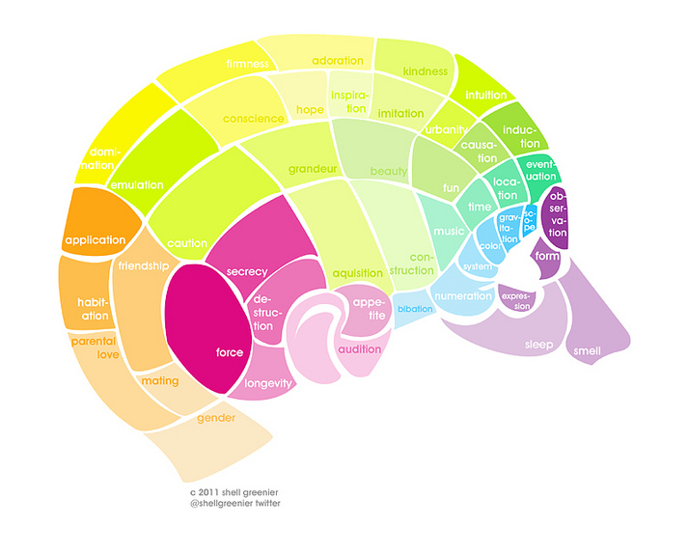
What We Learned
Seeking Synchronicity
Types of questions
VRS Lessons
Notes:
Image: Microsoft Clip Art

Slide 34

Why Not Virtual Reference?
What we learned from non-users:
  Preference for FtF service
  Do not know service exists
  Unknown or unfamiliar format
Notes:
Image: Microsoft Clip Art
Chapter 1: Pull, Not Push—Attracting Potential Users
What’s Hot and What’s Not
While the people we interviewed and surveyed for our studies reported many reasons for not using VR, several stand out as worthy of focus if we are to try to encourage more use of these services:
• Preference for FtF Service. Many users have great relationships with reference librarians that have developed in traditional settings. This makes the value proposition of VR one that “can sometimes compete with, rather than augment, FtF reference.”
• They don’t know it exists. Many users are simply unfamiliar with available VRS and the technology and information available through these services.
• VR is an unknown or unfamiliar format. Users may lack comfort with the chat format, which may be attributed to demographic factors, such as age and socio-economic and educational levels, and experience with technology and chat services.
Other notable reasons:
• Equating chat reference with a generic online chat room in which they might encounter unknown strangers.
• Being negatively evaluated by a librarian; possible embarrassment.
• Having reference transcripts revealed (e.g., to professors).

Slide 35

Convenience is King
Convenience dictates choices
  Is it readily accessible online?
  Does it contain the needed information & is it easy to use?
  How much time will it take to access and use the source?
  Is it a familiar interface and easily navigable interface?
    Google and Wikipedia
CONVENIENCE
(Connaway, Dickey, & Radford, 2011)
Notes:
Image: Microsoft Clip Art
“They do often advise that we go to the library and look for books but I would normally go to the internet and go to the library as my last sort of option really. (Laughter) It just takes me – I don’t really know how to use the library, I’ve got to be honest, but I know how to use the internet. Yes, I would normally use the internet or sort of word of mouth if someone else knows how to do it – that kind of thing – first.” Digital Visitors and Residents, (UKU5 0:14:19, Female Age 19)
“I could easily have found the information she [librarian] found for me, but the fact that I could just ask her question and have them look up the reference and read through articles instead of me having to look through like a million Googled articles…it was definitely a nice convenience and would definitely make it more likely for me to go to them and actually ask a librarian a question or figure it out on my own.” –Seeking Synchronicity, User, Female, 27 years old (Focus Group, Rutgers University, July 11, 2006)
Although campus Information Commons, with cafes and 24/7 access to the facilities and resources, are still popular with students and faculty, convenient access to resources, whether human, print, or electronic is the most critical factor. After all, “If it is too inconvenient I’m not going after it.”
Connaway, L. S., Dickey, T. J., & Radford, M. L. (2011). "If it is too inconvenient I'm not going after it": Convenience as a critical factor in information-seeking behaviors. Library & Information Science Research, 33 (3) 188.

Slide 36

Barriers to Convenience
Difficulty of library systems
Print articles
Limited hours, distance to library
Notes:
Image: http://www.istockphoto.com/stock-illustration-991918-store-sign-open-closed-will-return.php
Chapter 6: The Convenience Factor—Easy Is as Easy Does
What’s Not Effective
• Difficulty of library systems. Researchers (students and faculty) find libraries frustrating and try to avoid them.
• Print articles. People think it is less convenient to physically access print articles.
• Limited hours, distance to the library. Some individuals believe the library presents barriers to their access to information.

Slide 37
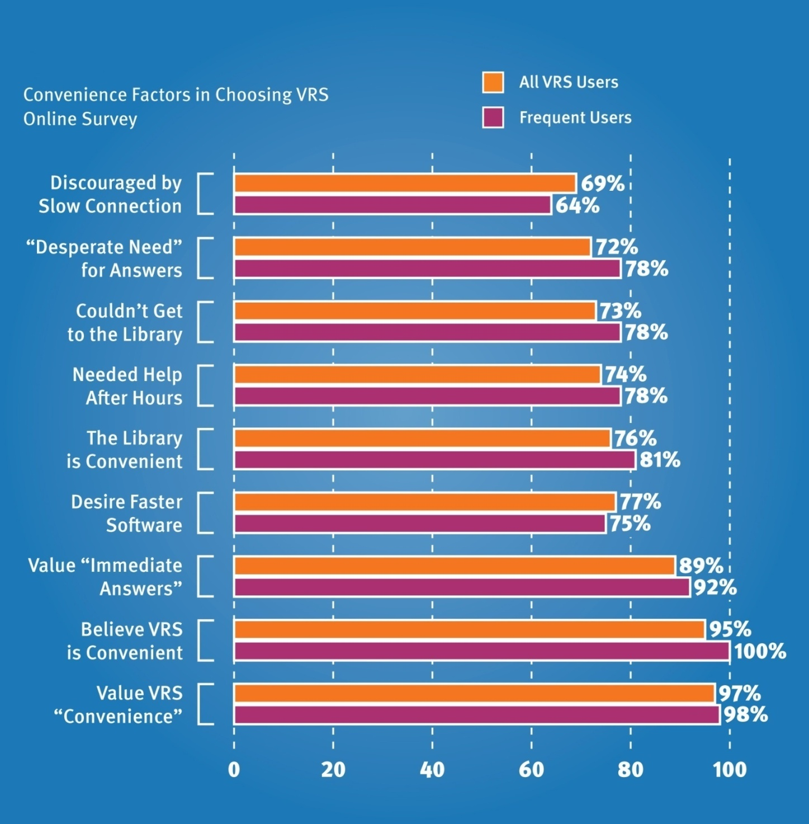
VR Users
Notes:
Chapter 6: The Convenience Factor—Easy Is as Easy Does

Slide 38
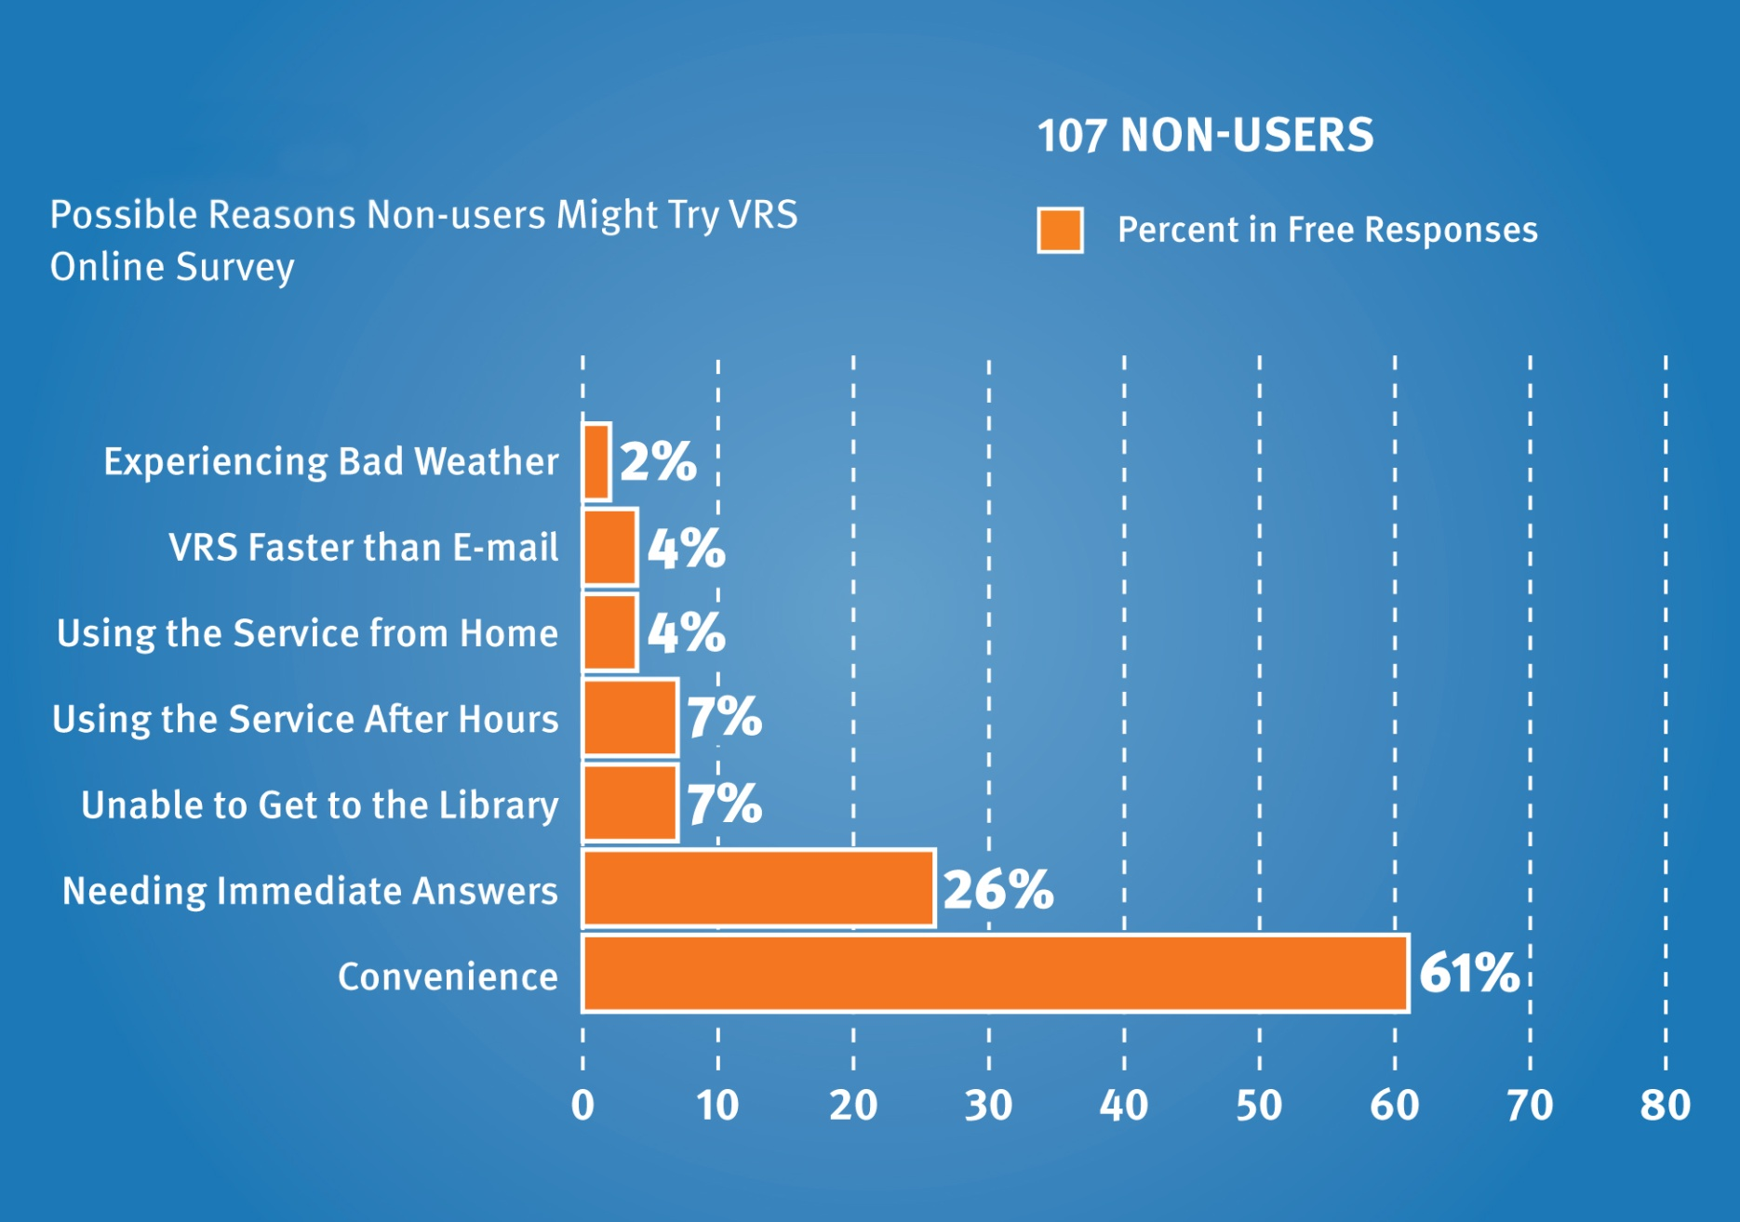
VR Non-users
Notes:
Chapter 6: The Convenience Factor—Easy Is as Easy Does

Slide 39
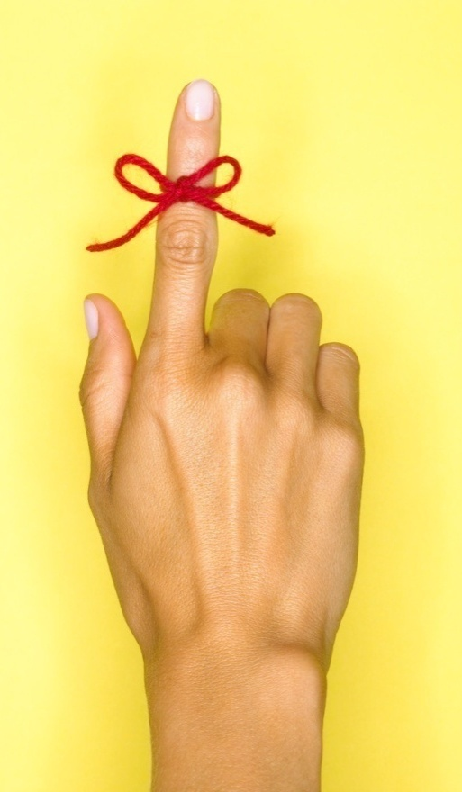
Recommendations to Boost Convenience
Deliver resources 24/7
Integrate library tools in popular sites
Provide links & reminders
Make interfaces more like web browsers
Accommodate different & personalized discovery & access preferences
Offer multiple service modes
Provide opportunities for collaboration
Offer help at time of need
  Chat/IM on library
    Web site
    Online catalog
Notes:
Image: Microsoft Clip Art
Chapter 6: The Convenience Factor—Easy Is as Easy Does
Recommendations
Libraries can and must become more convenient in the eyes of today’s users by improving services and systems. In order to achieve this goal librarians should:
• Deliver resources 24/7—efficiently and quickly—at the point of need at the network level.
• Integrate library tools into the sites that people use most—this integration alone may be the best method for increasing convenience and, therefore, use.
• Provide links and reminders about appropriate services, intelligently cross-connecting VRS with other library offerings.
• Make catalog and database interfaces more like Web browsers.
• Accommodate different and personalized discovery and access preferences, including mobile capability.
• Offer multiple modes of service—virtual, face-to-face and telephone.
• Provide opportunities for collaboration online and in physical library spaces.
Offer help at time of need

Slide 40
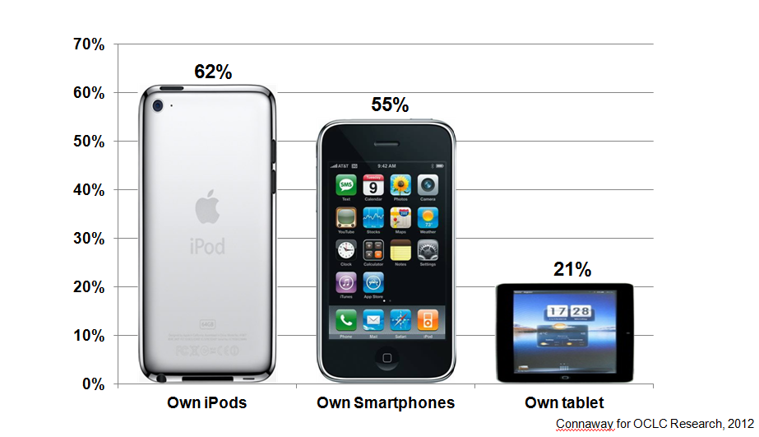
What Mobile Technology Undergraduate Students Own
(Dahlstrom, de Boor, Grunwald, & Vockley, 2011)
Notes:
Data from: Dahlstrom, E., de Boor, T., Grunwald, P., & Vockley, M. (2011). The ECAR national study of undergraduate students and information technology. Boulder, CO: EDUCAUSE Center for Applied Research. Retrieved from http://www.educause.edu/ecar. (p. 8).
“I would use more of the iPhone than my computer because obviously this is always with me whereas my Mac Book is not with me at school or anything. Whereas my phone I bring to school and I use it, I probably use the phone more to communicate but if it is say a really long message where I just want an answer straight away, if someone is online I will then speak to them through online.” Digital Visitors and Residents, (UKS5 0:03:19, Female Age 17)
“Yes, now that I’ve got an iPhone I don’t think I could go back. It just has everything on it. It’s very much a convenience, it has my calendar, it has everything on it. If I have it with me then I can always organise things, I know what I’m doing, when I’m going. But, having said that, I can cope without it if I need to.” Digital Visitors and Residents, (UKS2, 0:09:30, Female Age 18)
My laptop and my phone, I would not be able to live without. I think more so my phone, just because with my phone I feel connected, so if I’m ever in difficulty or if I ever need to ask a question I’m always able to do that. And it’s kind of, yes, for security as well, I find I always feel secure when I have my phone with me. Digital Visitors and Residents, (UKS4 00:07:27, Female Age 17)
Mobile devices are changing the way information is delivered and accessed (Connaway & White, 2011).
Connaway, L.S., White, D., & Lanclos, D. (2011). Visitors and residents: What motivates engagement with the digital environment? Proceedings of the 74th ASIS&T Annual Meeting, Volume 48. Silver Spring, MD: Richard B. Hill.

Slide 41
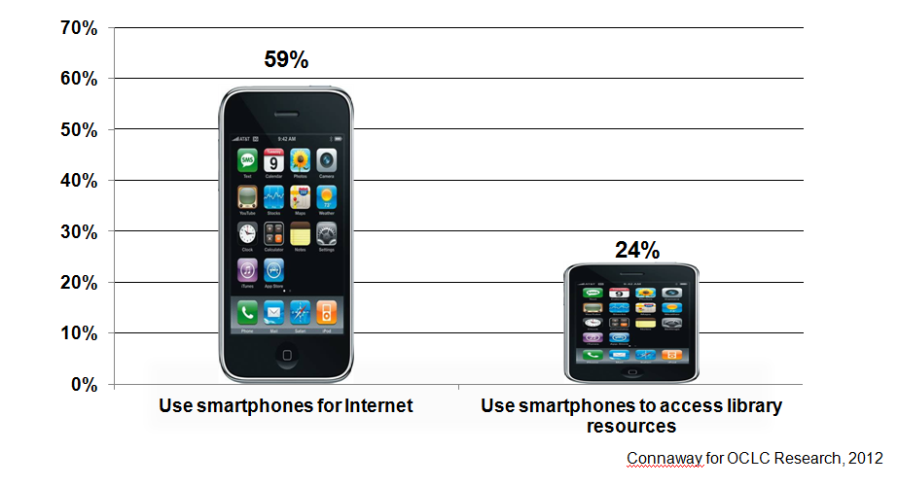
How Undergraduate Students Use Their Smartphones
24%
Connaway for OCLC Research, 2012
(Dahlstrom, de Boor, Grunwald, & Vockley, 2011)
Notes:
Data from: Dahlstrom, E., de Boor, T., Grunwald, P., & Vockley, M. (2011). The ECAR national study of undergraduate students and information technology. Boulder, CO: EDUCAUSE Center for Applied Research. Retrieved from http://www.educause.edu/ecar. (p. 15).
“The new Smartphones are very useful. I can’t really think of anything more accessible than having a device where you can get everything on a little tablet. There has been talk of gadgets like epaper where you can fold it out and it acts like a tablet and you can go through it. That would be quite good, it would save a lot of, this is slightly off topic, it would save a lot of trees, and you just download it. You buy a paper online then download it. But as far as information gathering now I wouldn’t change anything right now.” Digital Visitors and Residents, (UKS3 0:31:54, Male Age 17)
Roving librarians (Zabel, 2011, pp. 175-176)
Use mobile devices
Move from behind the reference desk
Extend services to groups and/or students studying abroad
Videoconferencing via Skype, etc.
Offer reference apps as mobile interfaces develop
Zabel, D. (2011). Reference reborn: Breathing new life into public services librarianship. Santa Barbara, Calif: Libraries Unlimited. pp. 175-176.
Embedded librarians:
Librarians, too, are making themselves available to students and faculty through a number of channels including social media, such as Facebook, chat, IM, and text reference, as well as making themselves physically available within the academic departments, student unions, and cafeterias (ACRL Research Planning and Review Committee).
. This is referred to as embedded librarianship (Kesselman & Watstein, 2009). To be embedded is described by Kessleman and Watstein (2009): “with the dramatic increase in electronic resources and technological capabilities, bringing the library and the librarian to the user, wherever they are – office, laboratory, home, or even on their mobile deice is at the forefront of what it means to be embedded.”
A perfect example of this was the October 2011 announcement that the William H. Welch Medical Library at Johns Hopkins University in Baltimore, MD would close its physical doors to patrons on January 1, 2012 (Kelley, 2011). The library continues to provide resources, which are completely online. One of the main reasons for the closing of the library was the decreasing use and circulation of physical materials (41 checkouts a day and 106 visits a day, OCLC Distinguished Seminar Series, 2012) and the exponential increase in the use of electronic materials. The librarians have been embedded within the academic departments for the past 6 years and are available to students and faculty via email or phone.
Kesselman, M. A., & Watstein, S. B. (2009). Creating Opportunities: Embedded Librarians. Journal of Library Administration, 49, 4, 383-400.
Kelley, M. (2011, October 27). Major medical library closing its doors to patrons and moving to digital model. The Digital Shift. Retrieved from http://www.thedigitalshift.com/2011/10/research/major-medical-library-closing-its-doors-to-patrons-and-moving-to-digital-model/

Slide 42

What We Can Do
Types of questions
VRS Superpowers
Notes:
Image: Microsoft Clip Art

Slide 43

Lack of Knowledge that VR Exists:
VR Non-users Online Survey
“I’ve never used this type of service and never knew it was available—that’s probably why I never tried it.”
millennial
Notes:
Chapter 1: Pull, Not Push—Attracting Potential Users
When asked what would get them to try VRS, older adults wanted some hand holding as these comments indicate:
“I would need much guidance.” – Seeking Synchronicity, 2005-2008, Older Adult (Non-users Online Survey)
“Someone walking me through it.” – Seeking Synchronicity, 2005-2008, Older Adult (Non-users Online Survey)
“Perhaps someone could teach me on a face‑to‑face basis.” – Seeking Synchronicity, 2005-2008, Older Adult (Non-users Online Survey)
I've never used this type of service and never knew it was available -- that's probably why I never tried it. Also, in my everyday life I don't run accross the need to research something in depth (the internet usually has enough information) so I don't really have a need to chat with someone for reference help. – Seeking Synchronicity, 2005-2008, Millenial (Non-users Online Survey)

Slide 44
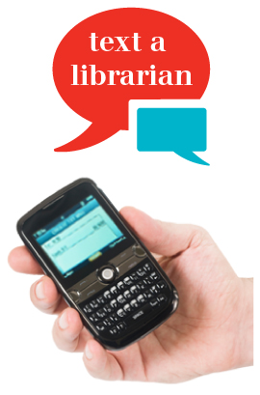
Market VRS
Market & publicize services
  Don’t know what is available
    Text
    Email
    Chat
    Phone
    Face-to-face
    Facebook
    Skype
(Radford & Connaway, 2010)
Notes:
Image: http://www.carnegielibrary.org/research/ask/
Radford, M. L., & Connaway, L. S. (2010). “I stay away from the unknown, I guess.” Measuring impact and understanding critical factors for Millennial Generation and adult non-users of virtual reference services. In Online proceedings of the Fifth Annual iConference, University of Illinois at Urbana-Champaign, February 3-6, 2010. [Available: http://nora.lis.uiuc.edu/images/iConferences/2010papers2_Page-Zhang.pdf]
“[Market] it more. Because I didn’t hear about it until I started working at this job a few months ago.” –User (Focus Group, Rutgers University, June 5, 2006) , Seeking Synchronicity
VRS meets users where they are
Text, e-mail, chat
Facebook (DeSantis)
Joe McDonald, sophomore at University of Nevada, Las Vegas in 1913, and girlfriend and future wife, Leola Lewis
Librarians’ expertise can deliver quality sources to users through VRS that they cannot find with a Google search
Library systems need to look and function more like search engines, e.g., Google and Yahoo, and services, e.g., Amazon.com since these are familiar to users who are comfortable and confident in using them (p.5).
36% of respondents reported being extremely familiar with search engines while only 26% reported being very familiar with libraries (p. 1-8)
VRS meets users where they are
Text, e-mail, chat
Facebook (DeSantis)
Joe McDonald, sophomore at University of Nevada, Reno in 1913, and girlfriend and future wife, Leola Lewis
Librarians’ expertise can deliver quality sources to users through VRS that they cannot find with a Google search
Connaway, L.S., & Dickey, T.J. (2010). Digital information seekers: Report of findings from selected OCLC, RIN, and JISC user behavior projects. http://www.jisc.ac.uk/media/documents/publications/reports/2010/digitalinformationseekerreport.pdf (p. 5).
De Rosa, C. (2005). Perceptions of libraries and information resources: A report to the OCLC membership. Dublin, Ohio: OCLC Online Computer Library Center (p.1-8). Retrieved from http://www.oclc.org/reports/2010perceptions/2010perceptions_all_singlepage.pdf
DeSantis, N. (2012, January 6). On Facebook, librarian brings 2 students from the early 1900s to life. Chronicle of Higher Education. Retrieved from http://chronicle.com/blogs/wiredcampus/on-facebook-librarian-brings-two-students-from-the-early-1900s-to-life/34845
“However, I would have used Google if I had had internet connection, because if you spell something incorrectly, there is a notice saying “did you mean to spell ____?” with the correct spelling of the word. So that would have been my first choice of thing to do in this situation, but the dictionary application worked fine since I did not have internet connection.” Digital Visitors and Residents, (USS3 Emg Diary 2 / 5/15/2011, Female Age 19)
“I find Google a lot easier than going to the library website because I don’t know, it’s just like sometimes so many journals come up and when you look at the first ten and they just don’t make any sense I, kind of, give up. Google, I don’t know. It’s just Google it’s – I find it easier just to look through anything.” Digital Visitors and Residents, (USU7 0:34:11, Female Age 19)
“Being at University allows you membership of a large and well respected library on campus. There are librarians and other staff who can help you if you need advice, whereas searching online you can’t ask anyone for help.” (Undergraduate, Age 18, Australia) De Rosa, C. (2005). Perceptions of libraries and information resources: A report to the OCLC membership. Dublin, Ohio: OCLC Online Computer Library Center.

Slide 45
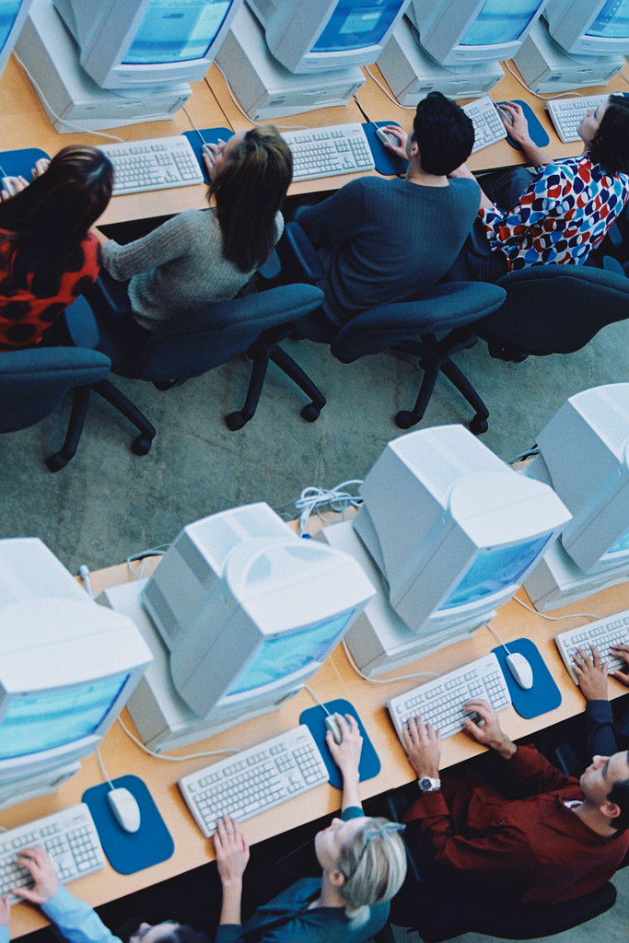
Top Recommendation
Attract Potential Users
Introduce & demonstrate online alternatives during in-person reference sessions, library use instruction classes & library programs
Notes:
Image: Microsoft Clip Art
Chapter 1: Pull, Not Push—Attracting Potential Users
Recommendations
In providing VRS, libraries are clearly attempting to offer an easy, convenient, Web-based alternative service to live reference. When asked in telephone interviews what might convince them to try VR, 61% of our participants listed some factor related to convenience. Being unaware of VRS is the biggest factor for not using it. The factors listed above clearly outweigh the convenience factor of chat reference and limit the widespread use of VRS.
Our strongest recommendation to boost use of VRS is to introduce and demonstrate online alternatives during in-person reference sessions, library use instruction classes and library programs. Taking the initiative to educate users in the physical library about
VR options addresses all three of the main issues we identified:
• First, by acknowledging and leveraging the positive relationship that users have with librarians FtF, the promotion of VRS can become an extension of that bond, rather than competing with it. The trust that users place in live librarians—and that we hope would be validated in every reference session, either in person or virtually—can then help users overcome their initial reluctance.
• Since most users were not even aware of VRS, there is probably no better moment to promote them than in the live, library environment. In the live environment, a current, active library user makes a much more impressionable and persuadable user. Any marketing done, even reasonably priced marketing, such as “viral marketing” (referrals), can help promote VRS. Not knowing about the service makes it impossible to use!
• Introduction of the service by a trusted librarian may go a long way toward allaying the fears of users, especially younger ones. If librarians acknowledge the validity of these concerns, they can place the use of VR within a broader context, initiating a discussion about media literacy in general.

Slide 46

Two Views of What’s Effective in VR Experiences
Users:
Convenience
Comfort with service
Accuracy
Positive attitude
Good communication skills
Relationships with librarians
Librarians:
Ability to leverage complex & specialized knowledge
Positive attitudes, responses, & feedback
VR tools & hybrid communication modes
Relationships with users
Notes:
Image: Microsoft Clip Art
Chapter 2: Double Vision—How Users’ And Librarians’ Views on Virtual Reference Differ
Chapter 4: “Way Sweet” or “Just Wrong:” Critical Factors for Virtual Reference Success
It also is vitally important to remember to “show your smile” in VR. As far as relationships go, many factors contribute to a positive VR interaction. These include interpersonal issues such as attitude, relationship quality and rituals of polite behavior; skill-related factors, such as the ability to teach, convey information and demonstrate knowledge; and convenience/ease of use.
VR Users Value Relationships with VR Librarians Who:
Offer opinions/advice
Explain search strategy
Are less formal (e.g., use chat speak)
Encourage users during reference encounter
Use personal greetings
Let users know when search will take time
Warn users before signing off/disconnecting
VR Librarians Value Relationships with Users Who:
Have a positive attitude
Are agreeable to receiving help
Demonstrate ordinary politeness & common courtesy (e.g., use please & thank you)

Slide 47
Two Views of What’s Not Effective in VR Experiences
Users:
Abrupt, dismissive answers
Grumpy, ill-informed or uninterested librarians
Poor wrap-up
Limiting time of session
Being sent to Google
Failing or refusing to provide info
Librarians:
Convoluted & confusing questions
Rude, impatient &/or disappearing users
Unrealistic expectations
Unreceptive to suggestions
Notes:
Image: Microsoft Clip Art
Chapter 2: Double Vision—How Users’ And Librarians’ Views on Virtual Reference Differ
It may be a truism that people on opposite sides of any service experience will be exasperated by perceived bad behavior on the other’s part; nobody likes dealing with cranky people. It is interesting to note, though, that librarians put so much emphasis on users’ positive attitudes and behaviors as success factors, along with the technology and quality of their materials and training.
Users, on the other hand, emphasize a need for comfort, ease of use, accuracy and speed. While this dichotomy isn’t surprising, it is important to recognize these differences so that service behaviors do not turn off inadvertently and turn away users. In any customer- supplier relationship, hoping that the customer will change his/her attitudes is a losing proposition. If improvements are to be made, they must be undertaken by the provider.
What’s Not Effective
Using “closed” questions in online interactions with users: Librarians used closed questions (67%, 569) twice as often as open questions (33%, 285) as a clarifying technique, which suggests that librarians may be worried about time pressure and may be rushing to closed questions too quickly. Meanwhile open questions used to refine heir understanding of the questioner’s information needs in the presearch stage of the VR interaction is seen in our sample to actually save time. Librarians who do not clarify before searching may go on a wild goose chase for the wrong information. School or work assignments (“imposed queries”) (Gross 1995, 1997), which may not be open to the same question negotiation techniques as personal information needs (“self-generated queries”) (Gross 1999), were 26% (151 of 592 interactions) of the analyzed chat reference interactions. Of the 26% (151), 24% (36) were school or academic assignments. A slightly higher number of interactions (29%, 171 of 592 interactions) were self-generated queries. Query type—imposed or self-generated—could not be determined 46% (270 of 592 interactions) of the time, which indicates that librarians did not clarify by asking about query type in almost half of the interactions we analyzed.
Not clarifying reference questions: A review of one reference transaction illustrates why asking a user for more information is not only good practice but also important for service excellence. In this case, the user asked: “if a 15 year old can start diving classes now.” After saying, “One moment please. I will see what I can find,” the librarian begins to search and then, after several minutes, replies: “After looking at a few websites it seems that beginning scuba diving classes start at age 12 to 16. It depends on how good a swimmer the person is. As a scuba diver myself I think the age range sounds right.” The user then responds: “I don’t want scuba diving classes I want driving classes.” Although the user typed the word “diving” instead of “driving,” to trigger the misunderstanding, the librarian wasted valuable time searching when a quick clarification via a closed question (e.g., “Do you mean scuba diving or sky diving?”) would have immediately revealed the typo. Later the user grows impatient with waiting for a reply and logs off abruptly.

Slide 48

Recommendations from CIT Findings
Ask open questions
Portray positive attitude
Provide specific & accurate answers
Clarify questions
Take your time
Pay attention to “close”
Always be pleasant & polite
Notes:
Image: Microsoft Clip Art
Chapter 4: “Way Sweet” or “Just Wrong:” Critical Factors for Virtual Reference Success
This leads us to the following recommendations when it comes to establishing positive VR interactions:
First, provide specific and accurate answers. The fastest way to turn off a user to your VR service is to give poorly researched, sloppy or vague information.
Take your time. Users are open to waiting for quality information, especially if the librarian asks them politely to be patient and sets accurate expectations about how long the process will take. When possible, connect users to a specialist and/or give a referral to a subject specialist as appropriate.
Pay attention to the “close.” Users report a negative reaction to an abrupt ending to the VR interview and to feeling that the librarian was limiting their time. Be personal in your closing rather than just pushing an impersonal script. Adding a “Bye, take care” or other similar, informal closing is recommended.
Always, always, always be pleasant and polite. In almost every society, admitting ignorance and asking for help is considered a passive and “needy” activity. In FtF encounters, much of the negative social stigma associated with asking questions can be mitigated by normal, friendly, inviting behavior on the part of the librarian. In VR situations, though, many of the positive emotional and social cues are missing. A response that a VR librarian intends to be simply concise can be interpreted as brusque or rude. Taking the time to add encouraging remarks, asking for patience, using a pleasant greeting and personal closing, and explaining what’s going on are all ways to “sound” friendly when you can’t do so in person. Use your basic service excellence skills.
These recommendations are appropriate, of course, for any VR interaction. They are especially important, though, for creating positive reference interactions. For example, ask the user if this is the first time using VR. If it is, there’s a very good chance that you’re about to determine their attitude about the service for a long time to come. The absolute definition of a “win” is simple—do they come back to use the service again? Do they recommend VRS to their friends? If they have had positive encounters they will come back and they will tell others to try VRS.
Chapter 5 Questions About Questions—The Importance of Query Clarification

Slide 49
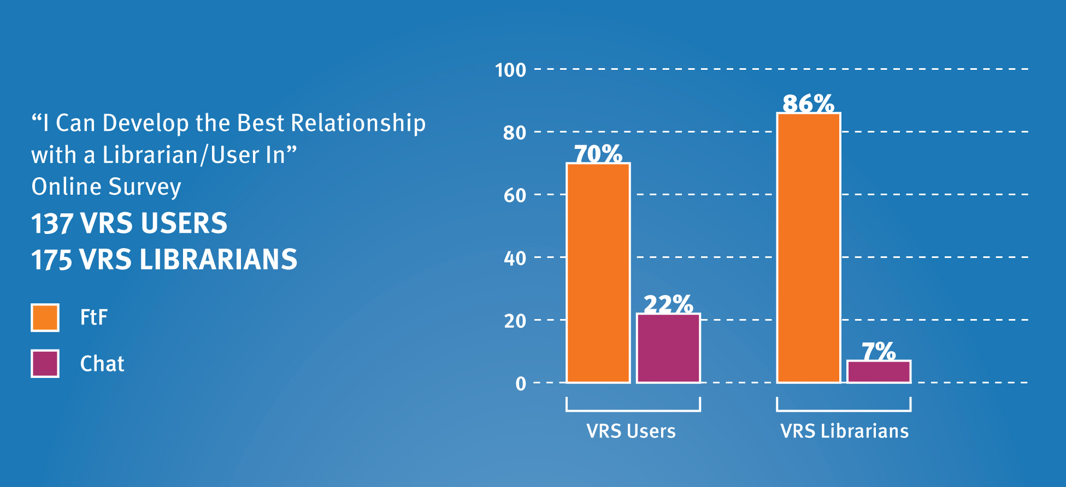
Mode for Developing Best Relationship:
VR Users & Librarians
Notes:
Chapter 2: Double Vision—How Users’ And Librarians’ Views on Virtual Reference Differ

Slide 50
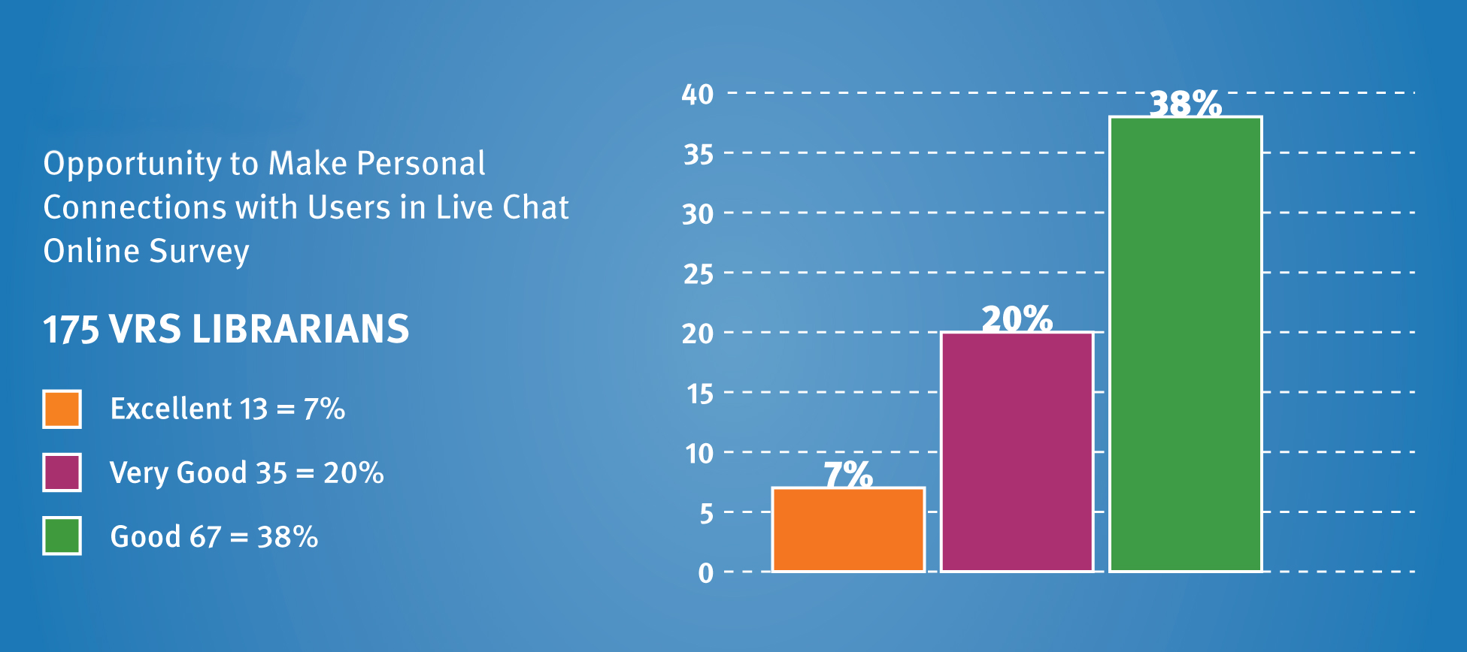
Making Personal Connections:
VR Librarians
Notes:
Chapter 2: Double Vision—How Users’ And Librarians’ Views on Virtual Reference Differ

Slide 51

What’s Effective:
Importance of Query Clarification
Found to boost accuracy
Use variety of clarifying questions
Expect clarifying questions from users
Use follow-up questions to verify needs are met
Notes:
Image: Microsoft Clip Art
Chapter 5: Questions About Questions—The Importance of Query Clarification
What’s Effective
Query clarification is needed: Our analysis revealed that only 4% (24) of interactions did not need some type of additional dialogue to further define the question. And librarians are asking questions for clarification; 74% (438) of librarians asked clarifying questions in VR encounters. This rate is higher than those reported in FtF reference studies, which find that query clarification is done in between 45–60% of interactions (Gers and Seward 1985; Dewdney and Ross 1994; Ross and Nilsen 2000).
Query clarification improves the quality of VR answers: Our research reports that 73% (72 of 98 questions) of correctly answered, ready-reference questions were clarified as opposed to 21% (21 of 98 questions) that were correctly answered without clarification. So asking questions definitely boosts accuracy.
A variety of clarifying questions: Almost half (45%, 196 of 436 respondents) of the VR librarians we studied sought additional subject information, while about a third (31%, 135) asked for more background on the question, such as deadline and project requirements. One-fifth (87) verified their understanding of the question by restating it, and 19% (83) asked which sources and search strategies had already been tried by the user. More than 10% (48) asked about both the type of resources desired—book, article, online information—and the depth of information needed— summary or detailed history. Only 4% (17) of librarians asked whether the user wanted to be referred to a subject expert or another library or librarian.
Clarifying questions from users. Our transcript analysis provided a unique opportunity for us to study the behavior of both librarians and users in the back and forth of the VR encounter. Our research is among the first to study query clarification by users as well as librarians. We found that users engaged in clarification 22% (130) of the time by offering additional information about the question. Users offered information both in response to librarians’ questions and spontaneously, without librarian prompting. More than half (52%, 69) offered additional subject information while 24% (32) provided background information, such as class- or grade-level data. One-fifth of users (20%, 26) elaborated on the amount of information needed and 14% (18) revealed the sources and search strategies they already had used.
Verifying that needs are met: More than half (52%, 219) of the librarians who clarified the user’s question closed the interview with “Does this completely answer your question?” or some variant of that question. This has proven to be a tried and true strategy for increasing user satisfaction in FtF reference research (Ross, Nilsen, and Radford 2009).

Slide 52
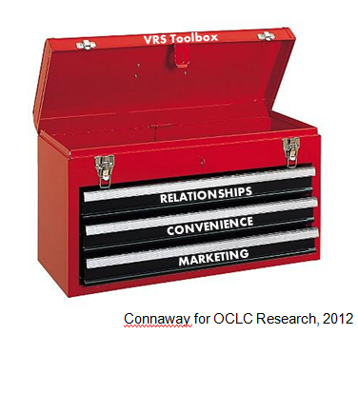
Conclusions
It’s all about the relationships
Death of ready reference exaggerated
To boost accuracy
  Clarify question
  Answer specific question
Convenience is the hook
Marketing matters
VRS Toolbox
RELATIONSHIPS
CONVENIENCE
MARKETING
Notes:
Image: http://www.pronto.com/shop/chest-of-drawers-organizers
Not only is immediate access to electronic sources a critical component of meeting the information needs of students and faculty, but access to human sources is also important. When students and faculty were interviewed in 2005, 2008, and 2010 to identify how they get their information for both academic and personal situations, parents, friends, family, colleagues, and professors are often the first sources queried. Why? Convenience! These sources immediately can be reached by texting, voice calling, IMing, or emailing, with an often instantaneous response. Librarians, too, are making themselves available to students and faculty through a number of channels including social media, such as Facebook, chat, IM, and text reference, as well as making themselves physically available within the academic departments, student unions, and cafeterias. (ACRL Research Planning and Review Committee, 2012).
ACRL Research Planning and Review Committee. (2012). ACRL Top Ten Trends. Accepted for publication in C&RL News.
Connaway, L.S., Prabha, C. & Dickey, T.J. (2006). Sense-making the Information Confluence: The Whys and Hows of College and University User Satisficing of Information Needs. Phase III: Focus Group Interview Study (Report on National Leadership Grant LG-02-03-0062003, to Institute of Museum and Library Services, Washington, D.C. Columbus, OH: School of Communication, The Ohio State University). Retrieved from http://web.archive.org/web/20100906114819/http://imlsproject.comm.ohio-state.edu/imls_reports/imls_PH_III_report_list.html
Connaway, L. S., Radford, M. L., & OCLC Research. (2011). Seeking synchronicity: Revelations and recommendations for virtual reference. Dublin, Ohio: OCLC Research.
Radford, M.L. & Connaway, L.S. (2008). Seeking Synchronicity: Evaluating Virtual Reference Service from User, Non-user, and Librarian Perspectives. IMLS Final Performance Report. Retrieved from: http://www.oclc.org/research/activities/synchronicity/reports/20080626-final.pdf
Connaway, L.S., White, D., & Lanclos, D. (2011). Visitors and residents: What motivates engagement with the digital environment? Proceedings of the 74th ASIS&T Annual Meeting, Volume 48. Silver Spring, MD: Richard B. Hill.
OCLC Distinguished Seminar Series (Producer). (2012, January 16). From books and buildings to information and services. Seminar recording retrieved from http://player.multicastmedia.com/player.php?p=j1v57etx
Library systems need to look and function more like search engines, e.g., Google and Yahoo, and services, e.g., Amazon.com since these are familiar to users who are comfortable and confident in using them (p.5).
36% of respondents reported being extremely familiar with search engines while only 26% reported being very familiar with libraries (p. 1-8)
VRS meets users where they are
Text, e-mail, chat
Facebook (DeSantis)
Joe McDonald, sophomore at University of Nevada, Reno in 1913, and girlfriend and future wife, Leola Lewis
Librarians’ expertise can deliver quality sources to users through VRS that they cannot find with a Google search
Connaway, L.S., & Dickey, T.J. (2010). The digital information seeker: Report of findings from selected OCLC, RIN, and JISC user behavior projects. Retrieved from http://www.jisc.ac.uk/media/documents/publications/reports/2010/digitalinformationseekerreport.pdf
De Rosa, C. (2005). Perceptions of libraries and information resources: A report to the OCLC membership. Dublin, Ohio: OCLC Online Computer Library Center (p.1-8).
DeSantis, N. (January 6, 2012). On Facebook, librarian brings 2 students from the early 1900s to life. Chronicle of Higher Education. Retrieved from http://chronicle.com/blogs/wiredcampus/on-facebook-librarian-brings-two-students-from-the-early-1900s-to-life/34845

Slide 53
Current Research
Cyber Synergy: Seeking Sustainability through Collaboration between Virtual Reference and Social Q&A Sites
New grant - amount of $250,000 for ’11-’13
Funded by IMLS, OCLC, & Rutgers University
Co-PIs Marie Radford (RU), Lynn Silipigni Connaway (OCLC), & Chirag Shah (RU)
http://www.oclc.org/research/activities/synergy.html

Slide 54
References
ACRL Research Planning and Review Committee. (In press). ACRL top ten trends. C&RL News.
Arnold, J., & Kaske, N. (2002). Real time interactive reference service: Chat with a librarian. 17th Annual Computers in Libraries Annual 2002, March 13-15.
Arnold, J., & Kaske, N. (2005). Evaluating the quality of a chat service. portal: Libraries and the Academy, 5(2), 177-193.
Clark, C. (2012, March 12). Social media: Information networks are vital to success. Financial Times. Retrieved from http://www.ft.com/cms/s/2/0e97b7a0-6389-11e1-9686-00144feabdc0.html
Connaway, L. S., & Dickey, T. J. (2010). The digital information seeker: Report of findings from selected OCLC, RIN, and JISC user behavior projects. Retrieved from http://www.jisc.ac.uk/media/documents/publications/reports/2010/digitalinformationseekerreport.pdf
Connaway, L. S., Dickey, T. J., & Radford, M. L. (2011). “If it is too inconvenient I’m not going after it:” Convenience as a critical factor in information-seeking behaviors. Library & Information Science Research, 33(3),179-190.
Connaway, L. S., Prabha, C., & Dickey, T. J. (2006). Sense-making the information confluence: The whys and hows of college and university user satisficing of information needs. Phase III: Focus group interview study. Report on National Leadership Grant LG-02-03-0062-03, to Institute of Museum and Library Services, Washington, D.C. Columbus, Ohio: School of Communication, The Ohio State University. Retrieved from http://web.archive.org/web/20100213164444/http://imlsosuoclcproject.jcomm.ohio-state.edu/imls_reports_list.html

Slide 55
References
Connaway, L. S., & Radford, M. L. (2011). Seeking synchronicity: Revelations and recommendations for virtual reference. Dublin, OH: OCLC Research. Retrieved from http://www.oclc.org/reports/synchronicity/default.htm
Connaway, L. S., & Radford, M. L. (2012). Extending our virtual reach: A longitudinal study of query type & accuracy in live chat & IM reference [PowerPoint slides]. Retrieved from http://www.oclc.org/research/activities/synchronicity/ppt/alise2012.pptx
Connaway, L. S., White, D., & Lanclos, D. (2011). Visitors and residents: What motivates engagement with the digital environment? Proceedings of the 74th ASIS&T Annual Meeting, Volume 48. Silver Spring, MD: Richard B. Hill.
Dahlstrom, E., de Boor, T., Grunwald, P., & Vockley, M. (2011). The ECAR national study of undergraduate students and information technology. Boulder, CO: EDUCAUSE Center for Applied Research. Retrieved from http://www.educause.edu/ecar
Dempsey, L. (2008). Always on: Libraries in a world of permanent connectivity. First Monday, 14(1). Retrieved from http://www.firstmonday.org/htbin/cgiwrap/bin/ojs/index.php/fm/article/view/2291/207
De Rosa, C. (2005). Perceptions of libraries and information resources: A report to the OCLC membership. Dublin, Ohio: OCLC Online Computer Library Center. Retrieved from http://www.oclc.org/reports/2010perceptions/2010perceptions_all_singlepage.pdf
Dervin, B., Connaway, L. S., & Prabha, C. (2003-2005). Sense-making the information confluence: The whys and hows of college and university user satisficing of information needs. Funded by the Institute of Museum and Library Services (IMLS). Retrieved from http://imlsosuoclcproject.jcomm.ohio-state.edu

Slide 56
References
DeSantis, N. (2012, January 6). On Facebook, librarian brings 2 students from the early 1900s to life. The Chronicle of Higher Education. Retrieved from http://chronicle.com/blogs/wiredcampus/on-facebook-librarian-brings-two-students-from-the-early-1900s-to-life/34845
Flanagan, J. C. (1954). The critical incident technique. Washington: American Psychological Association.
Hernon, P., & McClure, C. R. (1987). Unobtrusive testing and library reference services. Norwood, New Jersey: Ablex Publishing.
Kelley, M. (2011, October 27). Major medical library closing its doors to patrons and moving to digital model. The Digital Shift. Retrieved from http://www.thedigitalshift.com/2011/10/research/major-medical-library-closing-its-doors-to-patrons-and-moving-to-digital-model/
Kesselman, M. A., & Watstein, S. B. (2009). Creating opportunities: Embedded librarians. Journal of Library Administration, 49(4), 383-400.
OCLC Distinguished Seminar Series (Producer). (2012, January 16). From books and buildings to information and services. Seminar recording retrieved from http://player.multicastmedia.com/player.php?p=j1v57etx
Radford, M. L. (2006). Encountering virtual users: A qualitative investigation of interpersonal communication in chat reference. Journal of the American Society for Information Science and Technology, 57(8),1046–1059.

Slide 57
References
Radford, M. L., & Connaway, L. S. (2005–2008). Seeking synchronicity: Evaluating virtual reference services from user, non-user, and librarian perspectives. Funded by the Institute of Museum and Library Services (IMLS). http://www.oclc.org/research/activities/synchronicity/default.htm
Radford, M. L., & Connaway, L. S. (2010). “I stay away from the unknown, I guess.” Measuring impact and understanding critical factors for Millennial Generation and adult non-users of virtual reference services. Online proceedings of the Fifth Annual iConference, University of Illinois at Urbana-Champaign, February 3-6, 2010. http://nora.lis.uiuc.edu/images/iConferences/2010papers2_Page-Zhang.pdf
Radford, M. L., Connaway, L. S., & Shah, C. (2011-2013). Cyber synergy: Seeking sustainability through collaboration between virtual reference and social Q&A sites. Funded by the Institute of Museum and Library Services (IMLS). http://www.oclc.org/research/activities/synergy/default.htm
Ranganathan, S. R. (1957). The five laws of library science. Madras: Madras Library Association; London: G. Blunt and Sons.
Wasserman, S. (2012, June 18). The Amazon effect. The Nation. Retrieved from http://www.thenation.com/article/168125/amazon-effect
Zabel, D. (2011). Reference reborn: Breathing new life into public services librarianship. Santa Barbara, CA: Libraries Unlimited.

Slide 58
The researchers would like to thank Alyssa Darden for her assistance in preparing this presentation.

Slide 59
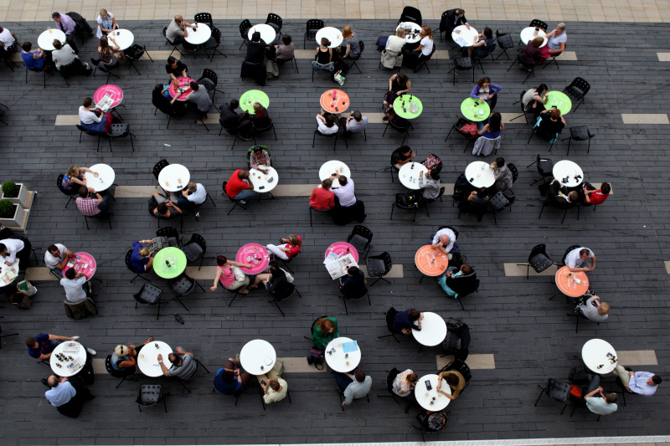
Questions & Discussion
Lynn Silipigni Connaway
connawal@oclc.org
Lynn Connaway
connawal@oclc.org
Notes:
59
59
59
Image: http://www.flickr.com/photos/massimo_riserbo/6292167005/

