Slide 1
OhioLINK Collection Analysis Project
Report on the OCLC/OhioLINK Circulation Study
Webinar
Nov. 18, 2010
Julie Gammon, University of Akron
Ed O’Neill, OCLC Research

Slide 2

The Overview

Slide 3
Research Project
  Joint study by OhioLINK, OhioLINK members, OhioLINK Collection Building Task Force (CBTF) and OCLC Research
  The goal is to strengthen the collective collection and expand cooperative acquisitions
  This project is distinct from OCLC’s collection analysis service
  Much of the analysis is new or previously untested
Notes:
3

Slide 4




Distinctive Aspects
Size and scope of collections
Use of local holdings and circulation information
Number and variety of institutions
FRBR (Functional Requirements for Bibliographic Records)
New metrics (Audience Level, Comprehensiveness, …)
Notes:
4

Slide 5
The Libraries
Library Type | Number
ARL | 5
Universities | 18
Colleges | 36
2 Year Colleges | 49
Depositories | 6
Other Types | 25

Slide 6
The Data
Item No.:
OCLC No.:
Title:
LCCN:
Location Code:
Status Code:
Circulation:
Renewals:
Accession date:
Date of Last Use:
ISBN:
Source:
i25878591
45207959
The infinite / A.W. Moore
00051722
bc
-
5
1
8/3/2001
8/23/2004
0415252857 (pbk.)
Akron
Notes:
Circulation records are at the physical items level
Items numbers are unique only within the source file.
No distinction between local use and use by other OhioLINK users
Circulation data is accumulative (Total circulation since acquired or OhioLINK start)
The standard numbers (OCLC No., LCCN, ISBN) are not always present.

Slide 7
WorldCat Linking
The OCLC Number is used to link the circulation records to the corresponding bibliographic record in WorldCat
Obsolete OCLC numbers were replaced,
Unique LCCNs or ISBNs were used to identify an OCLC number,
Records lacking any standard number were excluded from the study,
Records from the 2007 & 2008 circulation files were paired to determine annual circulation,
Approximately 93% of the records were validated; many of the unvalidated records were for non-book materials.
Notes:
7

Slide 8
The Circulation Data (1 Year)
Annual circulation | 2,822,035
No. of Items (Volumes) | 29,002,327
No. of Items Circulated | 2,106,142
No. of manifestations (Titles) | 6,779,969
No. of Manifestations Circulated | 1,041,405

Slide 9
Multi Level Structure
Top level units: Individual campus, depositories, and external organizations (Museums, Centers, Hospitals)
University of Akron
University of Akron
University of Akron
Second level units: Separate administrative units [university libraries, law, medicine, etc.) or distinct library units.
University Libraries
University Libraries
Third level units: Distinct library units.
Bierce Library
Location codes : The codes used within OhioLINK to identify the location of the individual items. Over 4,200 different location codes are used.
bccco, bccct, bccir, bccm, bcgd, bcgdo, bcmu, …

Slide 10
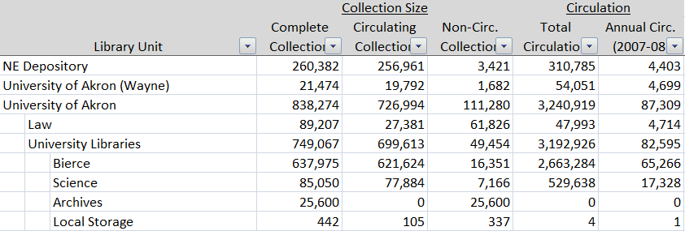
Three Level Holdings Structure (Akron)

Slide 11

Analysis

Slide 12

Individual Institution Focus
Detailed holdings
General Statistics
Languages
Age
Subjects
Single campus Language, Age, and Subjects tables have been added to improve readability

Slide 13
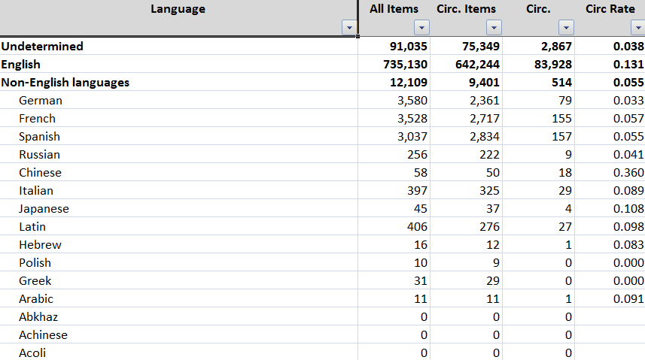
Language Table (Akron)
12 Major Non-English Languages

Slide 14
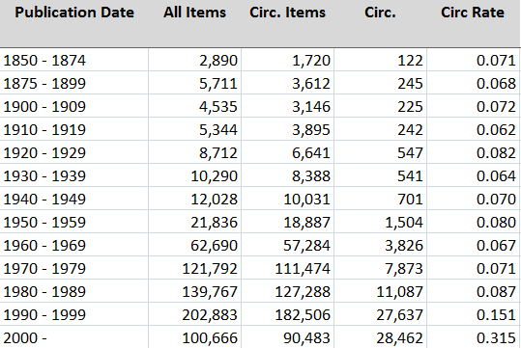
Age Tables (Akron)

Slide 15
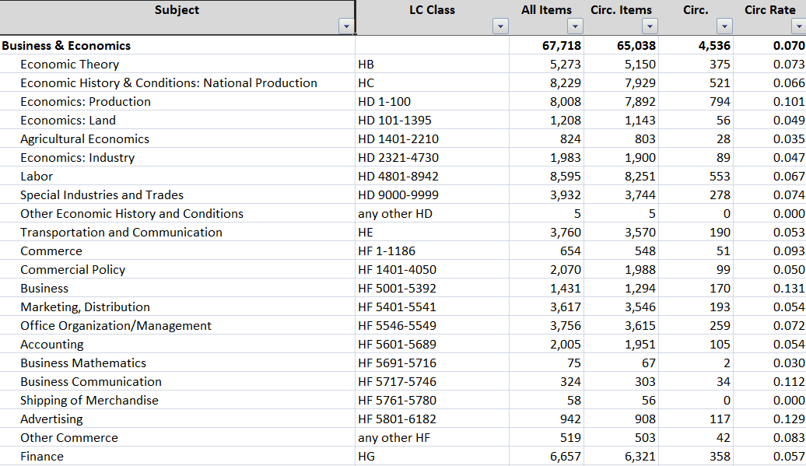
Subjects Tables (Akron)

Slide 16
‘Collective’ Collection Focus
Tables
  Subject
  Language
Analysis
  Subject
  Language
  Duplication
  Obsolescence
  Library Type
  FRBR
  etc.

Slide 17
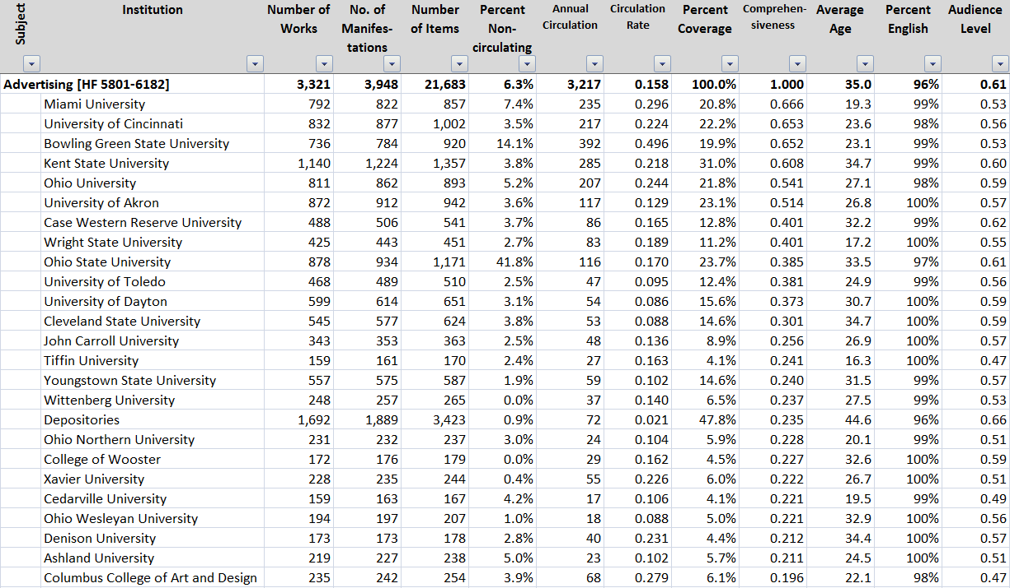
Subject Table (Advertising)
Circulation Rate: The average number of times a circulating item in the collection was used during the year observed.
Percent Coverage: The percent of all OhioLINK manifestations held in specified collection.
Comprehensiveness: The proportion of all OhioLINK circulations that could have been met by the manifestations in the collection.
Audience Level: The type of audience for which the collection is most suitable.

Slide 18
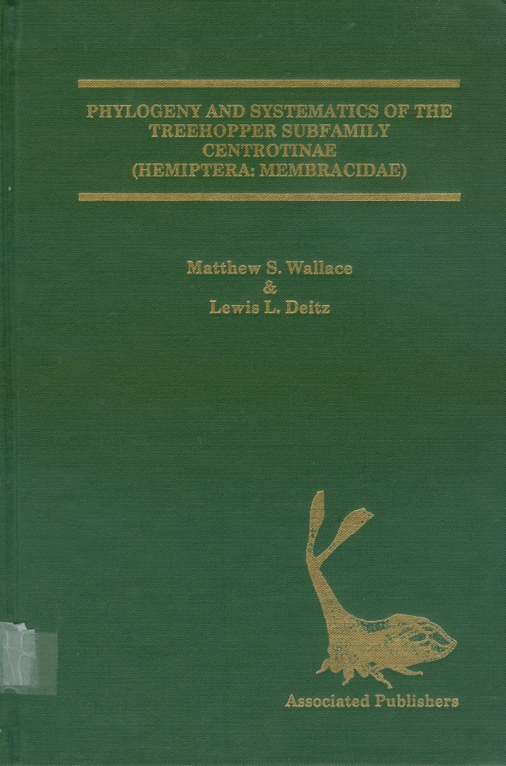





Audience Level
Phylogeny and systematics of the treehopper subfamily
Audience level: 0.96
Octopusses and squid
Audience level: 0.06
Fundamentals of entomology
Audience level: 0.51
∇
∇
∇
0 (Juvenile)
(Scholarly) 1

Slide 19
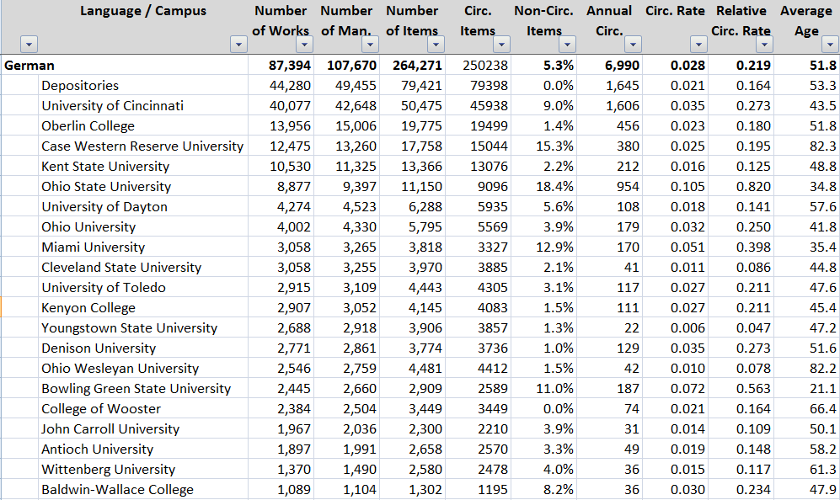
Language Tables
(German / Language & Literatue)
Eight broad subjects are used:
Arts & Recreation
Business & Economics
History & Geography
Language & Literature
Science & Technology
Social Science
Medicine
Law
Relative Circ. Rate: The circulation rate relative to the rate for English language books.

Slide 20
Holdings by Library Type

Slide 21
Annual Circulation Rates by Library Type

Slide 22
Usage Distribution
Annual Circulation
455,000
6.5%
Number of Manifestations

Slide 23
Subject Distribution of Items

Slide 24
Annual Circulation Rates

Slide 25
Duplication Rates

Slide 26
Duplication Rate
4.5
Average No. of Copies
Publication Date

Slide 27
Non-English Collections

Slide 28
Relative Usage by Language
Notes:
Relative usage is the ratio of circulation rates of books in the specified language to English language books. For example, German language materials are used (circulate) only about a forth as much as English language books.

Slide 29
Non-English Percent of Collection

Slide 30
Relative Use of Non-English Books by Publication Date

Slide 31
Relative Non-English Language Use by Library Type
Notes:
The usage is relative to English language materials; That is on the average, a non-English book in an ARL library is used less than half as much as an English language book.

Slide 32
Non-English Distribution by Subject

Slide 33
Relative Usage of Non-English Books by Subject

Slide 34
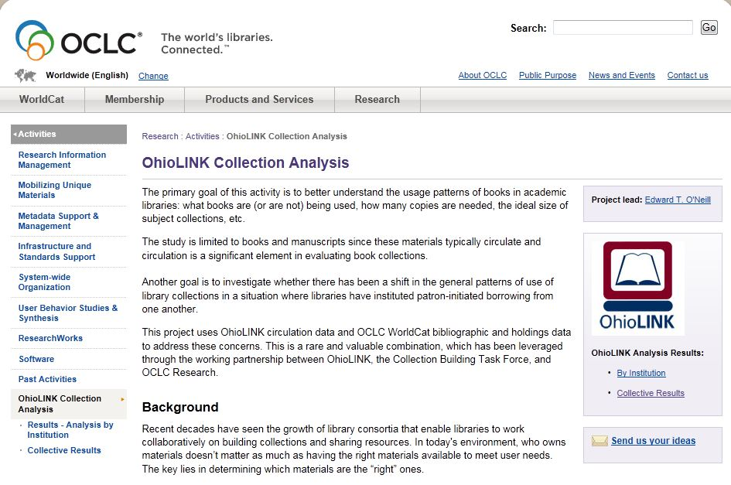
Project Website http://www.oclc.org/research/activities/ohiolink/collections.htm
*
†

Slide 35
Conclusions
  Limited use of non-English materials,
  Unique resources widely distributed,
  Circulation rates vary greatly by subject, institution, …
  Collectively duplication level are high.
  Next Steps
    Analysis is ongoing,
    What information is helpful; what isn’t?
    What did we get wrong?
    What did we miss?
    Sharing of the data.

