Slide 1



Print Management at “Mega-scale”: A Regional Perspective on Print Book Collections in North America
OCLC Research Webinar
Featuring
Brian Lavoie,
Research Scientist
and
Constance Malpas,
Program Officer
14 March 2013
#ormega #InsightSeries
          OCLC Research
          Exploration, innovation and community
          for libraries and archives.

Slide 2
Print Management at ‘Mega’-scale
OCLC Research Webinar - 14 March 2013
Brian Lavoie
Constance Malpas
OCLC Research
#ormega
#Insight Series

Slide 3
Roadmap
The future of print management
Mega-regions and cooperative print management
Focus on academic libraries
Mega-regions and library consortia
Conclusions & takeaways
Discussion

Slide 4
Print Management:
Future Strategies
Sourcing and Scaling

Slide 5
Background: The future of print collection management
Opportunity cost:
  Declining use of print collections (OCLC/Ohio Link study); ever-expanding array of digital alternatives
  Resources supporting print needed for new service priorities
Reduce cost of print collections while leveraging more value from legacy print investment. Contours of a solution?
  Print resource as a shared asset managed cooperatively
  Regions are attractive scale for this cooperation
OCLC Research: “Cloud-Sourcing Research Collections”
  ARL libraries: growing overlap with Hathi Trust, most of which widely held
  Significant opportunity for collaboration in print management

Slide 6
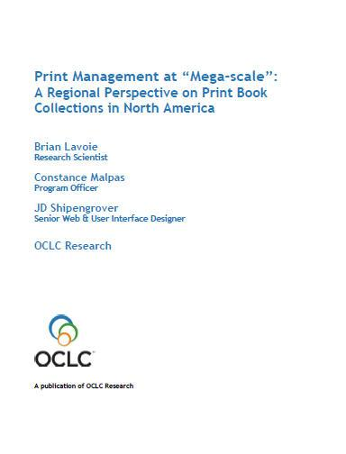
Print Management at “Mega-Scale”
OCLC Research report: characteristics and implications of a North American network of regional shared print book collections
Many current discussions around cooperative shared print organized at regional scale
Regional framework operationalized using mega-region concept
Not prescriptive: one model among many
www.oclc.org/research/publications/library/2012/2012-05.pdf

Slide 7
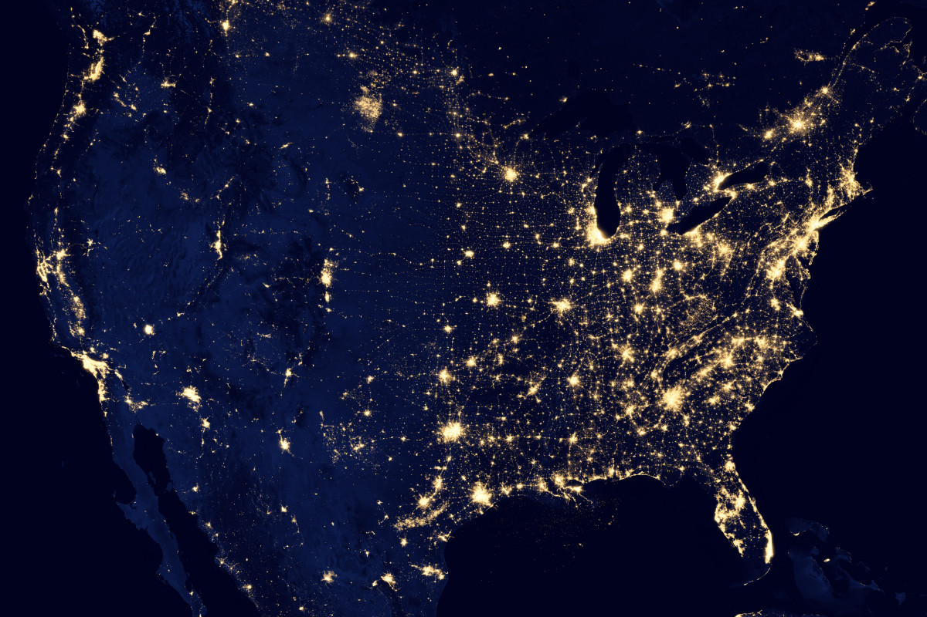
Mega-regions
Geographic area defined by high level of economic
integration, underpinned by robust supporting
infrastructure (transportation, logistics, etc.)
“Lights from space” definition (Richard Florida et al.)
In some respects, a
“natural” unit of analysis?

Slide 8
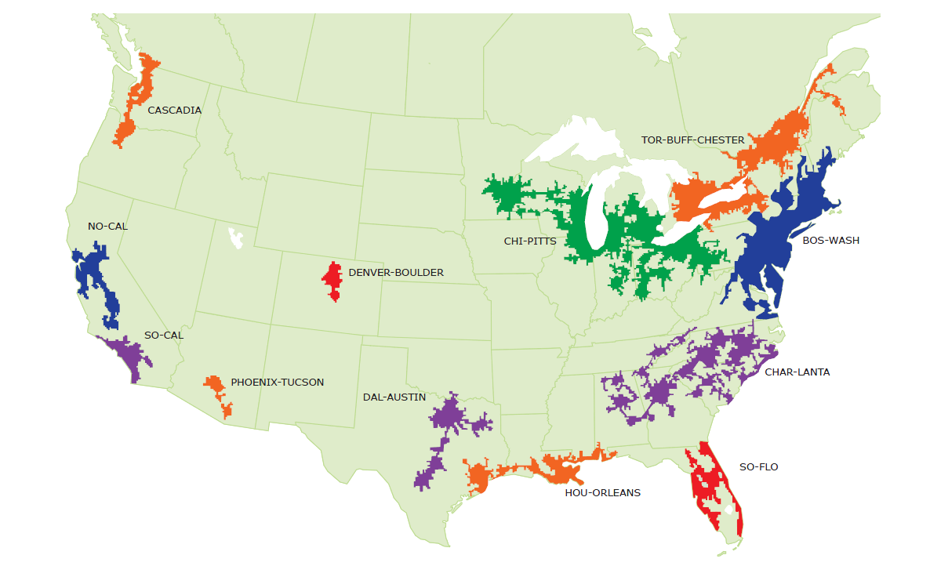
North American Mega-regions
OCLC Research, 2013

Slide 9
Mega-regions & Library Consortia
Orbis-Cascade
OCUL
MINITEX
Boston Library Cons.
CIC
NERL
SCELC
GWLA
TEXSHARE
ASERL
LOUIS
OCLC Research, 2013

Slide 10
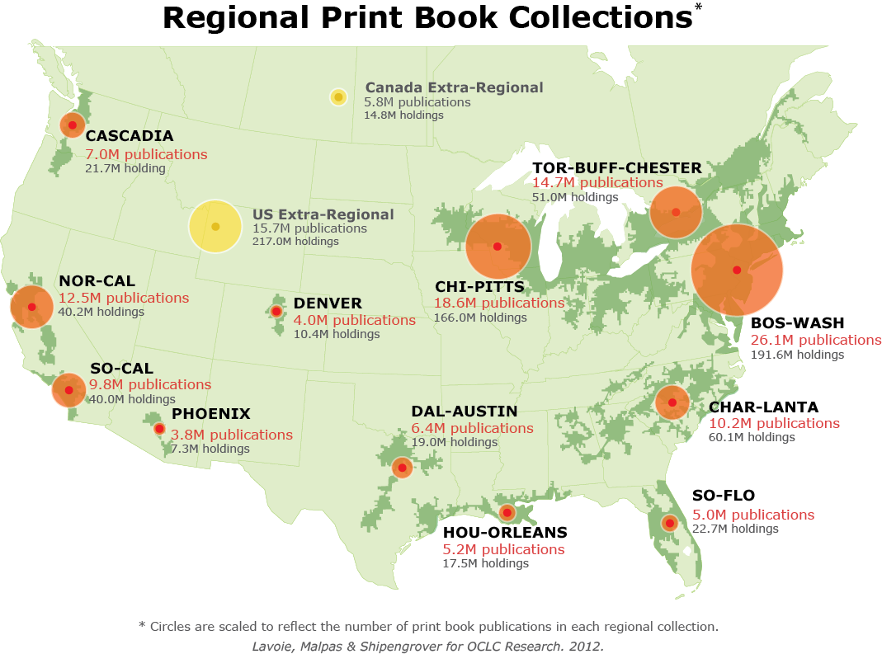
North American print book resource:
45.7 million distinct publications
889.5 million total library holdings
OCLC Research, 2013

Slide 11
Regional coverage of the North American print book resource
BOS-WASH | 57 %
CHI-PITTS | 41 %
TOR-BUFF-CHESTER | 32 %
NOR-CAL | 27 %
CHAR-LANTA | 22 %
SO-CAL | 21 %
CASCADIA | 15 %
DAL-AUSTIN | 14 %
HOU-ORLEANS | 11 %
SO-FLO | 11 %
DENVER | 9 %
PHOENIX | 8 %
OCLC Research, 2013

Slide 12
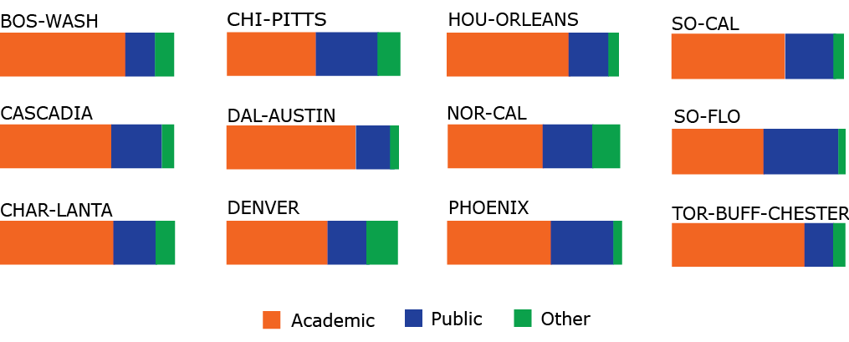
Share of regional print book holdings, by institution type
OCLC Research, 2013

Slide 13
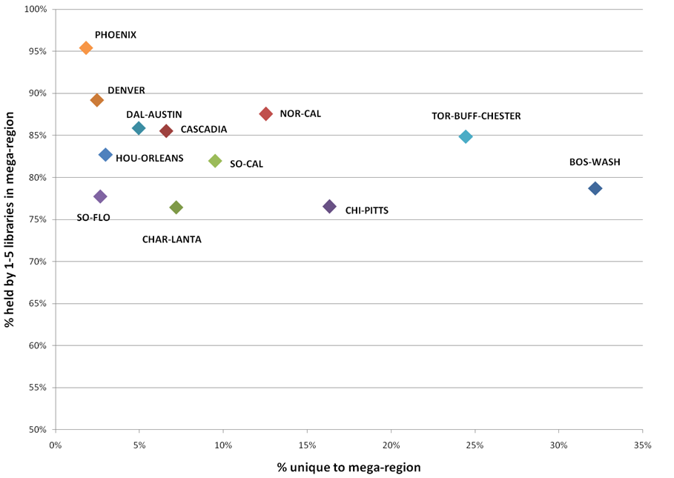
Rareness is common
OCLC Research, 2013

Slide 14
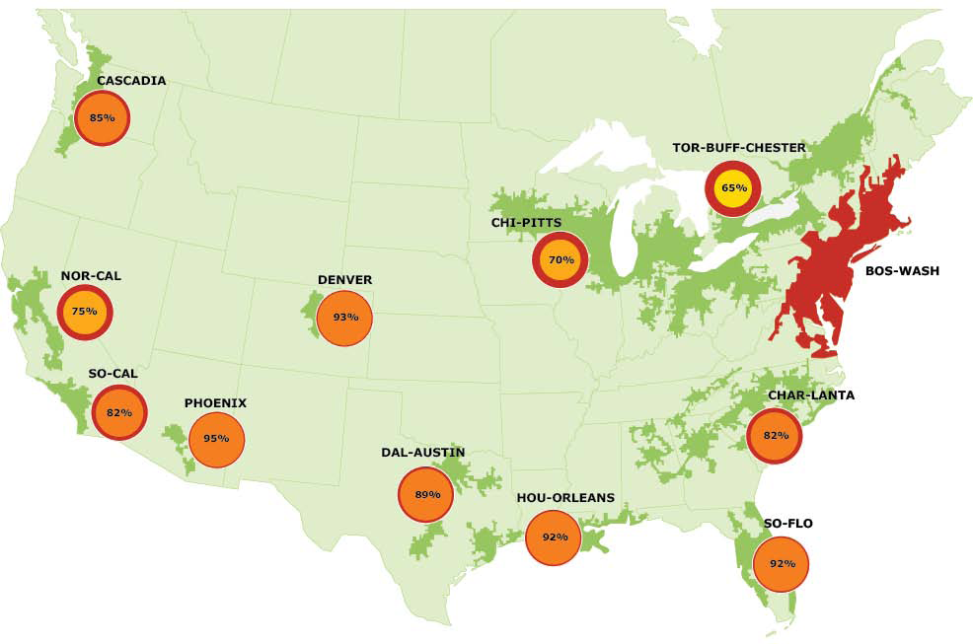
Overlap with BOS-WASH, by region
OCLC Research, 2013

Slide 15
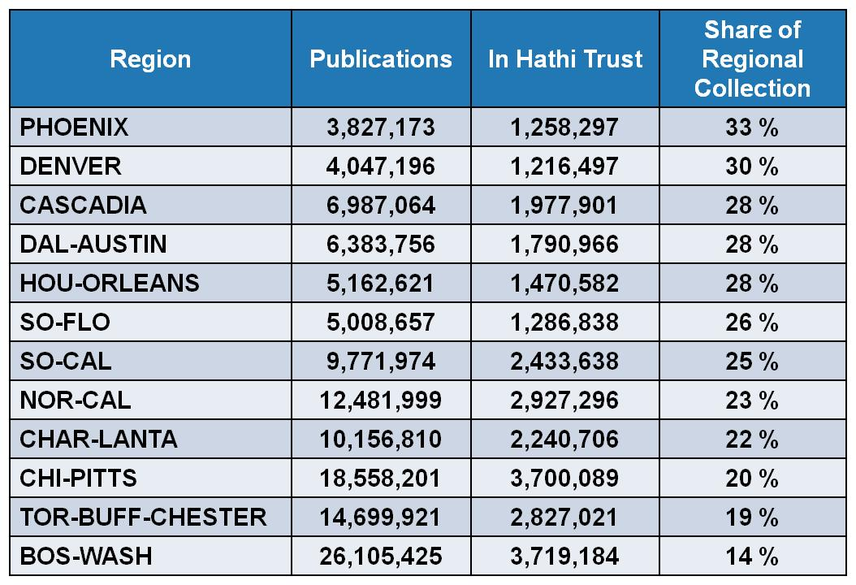
HathiTrust coverage of regional print book collections
OCLC Research, 2013

Slide 16
Academic Libraries
Stewardship of the Scholarly Record

Slide 17
Asymmetries in Distribution of Resource and Institutional Capacity to Preserve
More than half of print book holdings in each mega-region are held by academic libraries
ARL libraries, presumptive stewards of monographic print record, hold just 28% of regional inventory on average
  Stewardship mandate is strong; institutional resources are limited
Non-ARL academic libraries hold 35% of regional inventory on average
  Limited preservation capacity or mandate
Uncertainties about whether inventory in ARL is sufficient to meet aggregate demand
Questions about business models for sustainable stewardship

Slide 18






Changes in Higher Education System Will Alter Organization of Library System
Globalization of higher education, distance learning and rise of MOOCs – traditional library infrastructure is out of step with emerging trends
Institution-scale stewardship of print collections increasingly unsustainable for many academic institutions
Shared print management may be a solution – but organized at what scale?

Slide 19
Distribution by Academic Library Type Varies by Region
As of January 2011
OCLC Research, 2013

Slide 20

Preservation Value of Shared Digital Infrastructure Varies by Region
As of February 2012
OCLC Research, 2013

Slide 21

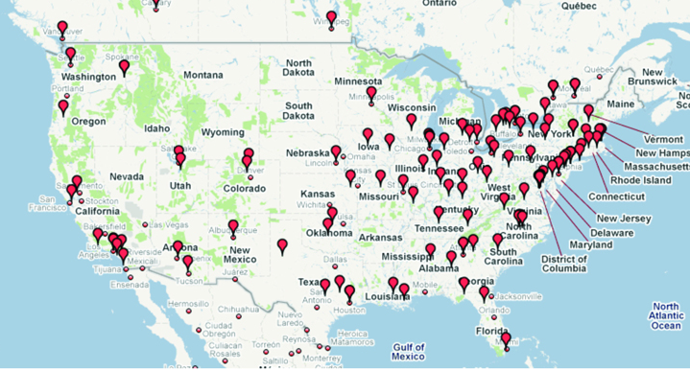
Asset
13 Jan 2011
SoCal 1 @ 38%
NorCal 1 @ 34%
Charlanta 1 @ 25%
BosWash 2 @ 20%
. . .
Thanks for Shopping ARL
v
ARL total holdings: 357,419,468
ARL total print book holdings: 232,610,958 (65%)
ARL print book titles: 33,355,216
~73% of North American print book collection
As of January 2013
http://www.arl.org/arl/membership/members.shtml
OCLC Research, 2013

Slide 22
Mega-regions and Library Consortia
Maps and Gaps

Slide 23
Mega-regions & Library Consortia
Orbis-Cascade
OCUL
MINITEX
Boston Library Cons.
CIC
NERL
SCELC
GWLA
TEXSHARE
ASERL
LOUIS
OCLC Research, 2013

Slide 24
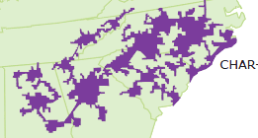



Right-scaling stewardship: assessing group-scale options
Char-lanta
Shared print agreement for print books in ASERL libraries could secure 67% of titles in Charlanta
Might enable hundreds of academic libraries in region to manage local collections differently
Could support cost-effective redistribution of stewardship and new business model for ASERL
Partnership with WRLC could expand benefit to BosWash
10M print book titles
1800 libraries

Slide 25



Right-scaling stewardship: assessing group-scale options
NorCal
Shared print agreement for print books in SCELC libraries could secure 28% of NorCal and 47% of SoCal print book titles
Not clear that a consortium on non-ARL academic libraries should assume primary stewardship role – limits options for member libraries
Opportunity to consider where SCELC can offer distinctive value in larger shared print eco-system
12M print book titles
775 libraries
SoCal
10M print book titles
774 libraries

Slide 26
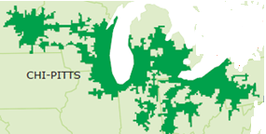

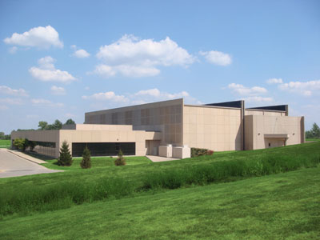

Right-scaling stewardship: assessing group-scale options
ChiPitts
Shared print agreement for print books in CIC libraries could secure 58% of ChiPitts print book titles
As CIC libraries expand Shared Print Repository plans to include print monographs, new questions about which library should retain what (and where)
For research institutions, redistributing stewardship for monographic collections in the humanities will entail hard choices
19M print book titles
in 4000 libraries

Slide 27

OSU/CIC Project: A Mega-Regions Application
In partnership with:
Explore contours of regional print book management strategy:
  At three levels: institution (OSU); consortial “collective collection” (CIC); and regional print book resource (CHI-PITTS)
Some questions:
  What part of OSU print book collection is a distinctive asset in comparison to CIC or CHI-PITTS? What are characteristics of these distinctive resources (subject, age, system-wide work-level holdings)?
  What part of OSU collection is widely held across CIC membership or institutions within CHI-PITTS region? Can a “core” set of titles be identified at consortial or regional level that represent duplicative investment?
  What does ILL demand profile for OSU suggest about consortial and regional demand for its print book collection? How much of this demand is centered around OSU’s distinctive print book titles?

Slide 28
Conclusions and Takeaways
Striking asymmetries in regional distribution of print books in North America
Majority of holdings are managed by academic libraries – for whom institutional stewardship mandate is uncertain
Research libraries have a significant role to play in securing long-term preservation of national resource – but they can’t do it all
Cooperative infrastructure embodied in large-scale, multi-type regional consortia can be leveraged to maximize coverage
Sustainable stewardship models will combine institution-, group-, and network-scale solutions

Slide 29
lavoie@oclc.org malpasc@oclc.org www.oclc.org/research/activities/megascale.html www.oclc.org/research/activities/sharedcollections.html
Comments or Questions?

Slide 30
OCLC Research Webinar
Print Management at “Mega-scale”: A Regional Perspective on Print Book Collections in North America
#ormega #InsightSeries
Cultural Webinar
1 August 2012
Brian Lavoie
lavoie@oclc.org
Constance Malpas
malpasc@oclc.org
OCLC Research
http://www.oclc.org/research.html
Our Webinars
http://www.oclc.org/research/events/webinars.html
          OCLC Research
          Exploration, innovation and community
          for libraries and archives.

