Slide 1
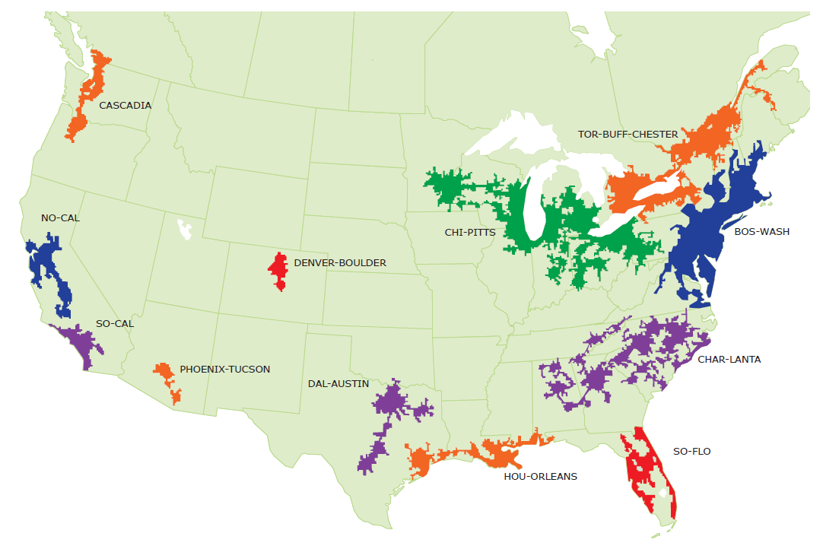
A mega-regional perspective on print books in Southern California libraries
SoCal
Constance Malpas
OCLC Research
malpasc@oclc.org
Shared Print Collections Southern California Mega-Region Meeting
14 December 2012 - UCLA - Bob Kieft, convener

Slide 2
What we mean by ‘mega-region’
Geographic area defined by high level of economic integration underpinned by robust supporting infrastructure (transportation, logistics, etc.)
Anchored by one or more urban agglomerations
High concentration of educational and cultural organizations, a center of gravity for the ‘creative class’

Slide 3
Mega-regions and print management
An empirically derived framework (Richard Florida, et al.) based on regional economic activity; mega-regions are a ‘natural unit’ for analysis
Helps situate print management within broader networks of economic exchange; builds on existing organizational infrastructure and institutional interests
Shared print management efforts being undertaken at variable (and overlapping) scale; we have no objective benchmarks for establishing appropriate scale of action
For monographic literature especially, we believe a model based on economic ‘flows’ is an appropriate choice
Notes:
Mega-region framework not prescriptive – simply one model among others for how to organize a regional approach to print management.

Slide 4
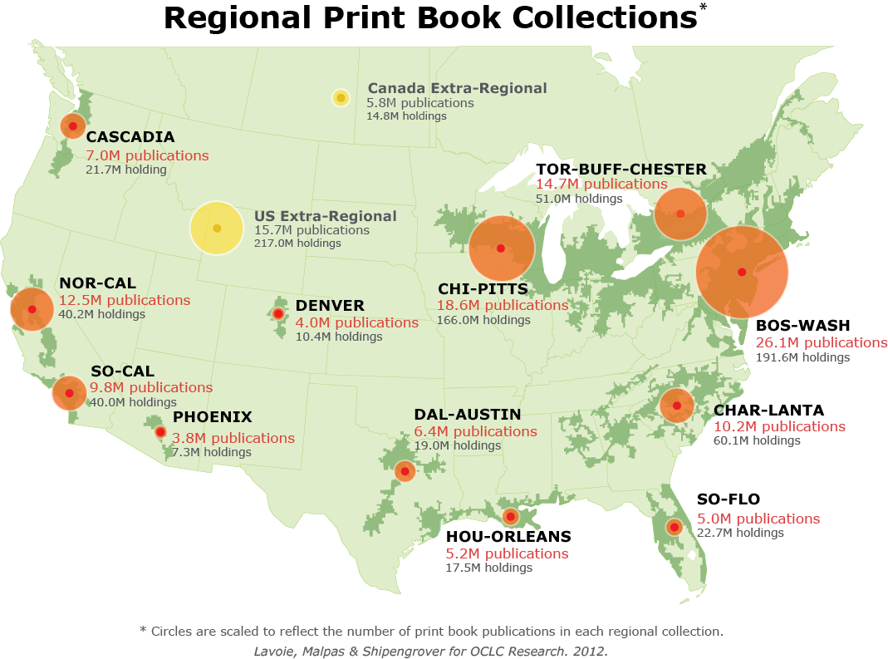
OCLC Research, 2012
Notes:
Here to talk about SoCal print book resource, but useful to put it in context of other NA mega regions.

Slide 5
Print books in Southern California libraries
SoCal
Regional print book collection
9,771,974 discrete titles (manifestations)
7,880,297 discrete works
1.24 manifestations per work on average
39,969,816 holdings in SoCal libraries
4.09 holdings per title on average
Median age: 30 (i.e. published 1982)
21% of titles (4% of holdings) in North American print book collection
including more than 900K titles unique to SoCal
OCLC Research, 2012
Notes:
A vast collection of titles – the scope of the regional resources is very broad.
>80% of titles in the regional collection represent distinctive works (as opposed to variant editions of a title).
What does this mean? There is breadth of intellectual scope in the collection.
On the supply side, we find that 4 SoCal libraries on average hold one or more copies of these titles. So there is some duplication, put perhaps less than might be anticipated.
The collection is relatively young, with a median age per title of 30 years.
SoCal collection represents about a fifth of the print book titles we’ve identified in the North American print book collection, and just 4% of all holdings. Broad coverage; thin supply. But note that we can’t draw any conclusions about the sufficiency of the average 4 holdings without some regional demand side data.
Recall that our data is incomplete for public libraries, especially for branch libraries – so the total duplication is likely greater than what is reflected here. On the other hand, from a preservation perspective, public library holdings are not generally viewed collections of record – so the redundancy in public library holdings may not be a good measure of the preservation status of the regional collection as a whole.

Slide 6
‘Density’ of print book holdings in SoCal
SoCal
Majority of titles held by <5 libraries in region
OCLC Research, 2012
Notes:
So this necessarily raises the question of ‘how much is enough’ and the degree to which SoCal institutions must rely on extra-regional partners to supplement intra-regional preservation infrastructure.

Slide 7
In sum: supply-side view of regional resource
Evidence
SoCal print book collection is the sixth largest regional collection in North America
SoCal library holdings provide coverage for about 20% of print book titles in North America
OPINION
SoCal institutions will continue to rely on access to, and preservation of extra-regional book collections
Need to coordinate regional management plan with other North American partners
Notes:
A rich regional resource that is relatively diffuse; it represents only a small part of NA print book resource and hence SoCal remains dependent on preservation and access decisions made in other MR.

Slide 8
Intra-regional stewardship: institutional infrastructure
SoCal
774 holding library symbols in WorldCat
Type | Percent of SoCal population
School libraries | 48%
Non-ARL academic libraries | 19%
Special libraries | 16%
Public libraries | 10%
Other | 5%
ARL libraries | 2%
*
(
)
*
*
Institutions with stewardship mandate and preservation capacity
OCLC Research, 2012
Notes:
20% of the SoCal library population holds 65% of the regional print book resource; but this population does not have commensurately sized preservation capacity – non-ARL institutions have limited preservation resources or mandate.
NB because state library is based in Sacramento (NorCal), it isn’t counted here.

Slide 9
Demand-side dynamics: inter-lending traffic
SoCal
CY2010 Returnable Borrowing & Lending Activity (WCRS)
Percent of Returnable Requests Filled by Mega-region
 | Lending Location
Requesting Location | Outside North American mega-regions | Unknown location (no zip data) | Bos-Wash | Cascadia | Char-lanta | Chi-Pitts | Dal-Austin | Denver-Boulder | Hou-Orleans | NorCal | Phoenix-Tucson | SoCal | So-Flo | Tor-Buff-chester
NorCal | 18% | 0% | 9% | 3% | 2% | 8% | 2% | 2% | 1% | 31% | 1% | 21% | 1% | 2%
SoCal | 16% | 1% | 7% | 3% | 2% | 7% | 2% | 2% | 1% | 17% | 2% | 41% | 1% | 1%
41% of SoCal demand is fulfilled within the mega-region
OCLC Research, 2012
Notes:
This suggests that the SoCal regional resource is valued within the region and therefore should be a priority for collective stewardship.

Slide 10
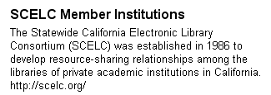
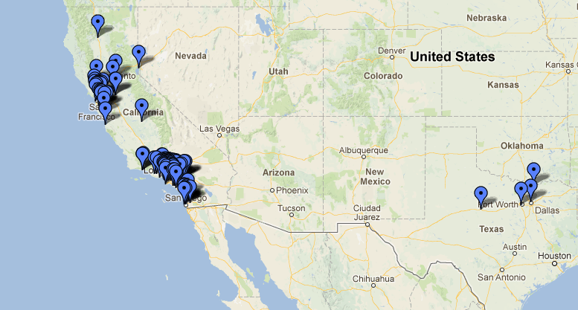
Regional stewardship: cooperative infrastructure
Leveraging resource-sharing capacity on a regional scale
https://maps.google.com/maps/ms?gl=us&ie=UTF8&oe=UTF8&msa=0&msid=116372932749076038893.00044700bc73cbe3a8198

Slide 11
In sum: demand-side view of regional resource
Evidence
SoCal print book resource is a vital part of regional information economy
SoCal resource delivers value beyond the immediate region
OPINION
By more effectively surfacing distinctive regional resources in discovery systems, SoCal can increase support for regional stewardship; preservation of ‘redundant’ resources should be informed by aggregate demand

Slide 12
Distribution of SoCal Print Books by Holding Library Type
SoCal
Majority of titles held by academic libraries
N = 40M holdings
OCLC Research, 2012
Notes:
About 2/3rds of the regional print book collection (holdings) is held by academic libraries. So as academic sector changes, we can anticipate potentially major impact on SoCal print book collection.

Slide 13
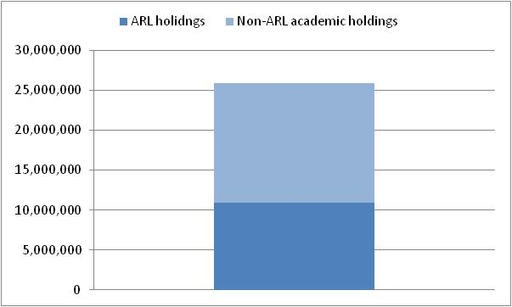
Distribution of SoCal Print Books in Academic Libraries
SoCal
… mostly non-ARL libraries
37%
of SoCal holdings
27%
of SoCal holdings
N = 26M holdings in SoCal academic libraries; 40M holdings in all SoCal libraries
OCLC Research, 2012
Notes:
About 2/3rds of the regional print book collection (holdings) is held by academic libraries. So as academic sector changes, we can anticipate potentially major impact on SoCal print book collection. A significant part of the regional inventory is held by institutions that are likely to shed low-use print materials.

Slide 14
In sum: institutional stewardship
Evidence
2/3rds of SoCal print book collection is held by academic libraries
Most of these held by non-ARL institutions with limited preservation capacity or mandate
OPINION
As mid-tier HEI seek to adapt to competitive e-learning environment, local investment in print management is likely to decline; external cooperative or commercial strategies will be increasingly attractive to academic administrators

Slide 15
Intra-regional stewardship: in the room today*
SoCal
1,796,497
+
7,329,672
+
969,884
+
715,426
=
10.8M print book holdings
27% of SoCal regional resource
*excludes UoP and HNU, which fall outside SoCal zone

Slide 16
Extra-regional preservation capacity for SoCal print books
Percent of titles (manifestations) duplicated in other North American mega-regions
46%
62%
63%
75%
82%
33%
58%
32%
45%
SoCal
9.8M titles
40%
39%
OCLC Research, 2012
Notes:
BosWash, ChiPitts, TorBuffChester NorCal and Charlanta each duplicate >50% of titles in SoCal regional collection.
All but NoCal are too distant to be regarded as proxy suppliers for print – though from a preservation perspective, their distance may be plus. One can imagine that a mega-regional preservation agreement might be struck between SoCal and ChiPitts for example, with the Midwest libraries providing ‘emergency backup book power’ to institutions in Southern California in the event of a catastrophic disaster on the West Coast.

Slide 17
Digital preservation (HathiTrust) status of SoCal print books
SoCal
Range for other mega-regions:
19%-33%
25%
N = 9.8M titles (manifestations)
OCLC Research, 2012
Notes:
Pretty good – but what’s the strategy for the other 75%
Need to figure out how many HathiTrust members are in SoCal
UCLA + SRLF
UC Riverside
UCSD
Santa Barbara
Irvine

Slide 18
In sum: regional stewardship
Evidence
A preservation compact among a small number of institutions would secure a significant part of the regional resource
If comprehensive coverage is desired, extra-regional agreements may be needed
OPINION
Given growing stewardship expectations for ARL institutions, investment in print preservation should be reassessed in view of growing digital preservation infrastructure; regional efforts should acknowledge inter-regional dependencies
Notes:
UC SRLF alone holds 22% of the discrete PB publications in SoCal. The collection is a sunk cost for UC and could deliver preservation benefit to the whole region if it were designated as a shared archive.

Slide 19
In conclusion
SoCal print book collection is a vital regional resource
It delivers value within the SoCal region
It complements and enriches other regional collections
Pressures on academic libraries will continue to destabilize current preservation ecosystem
Strategic planning on a (mega-) regional scale is a reasonable place to start; it builds on existing infrastructure and networks of supply and demand

