Slide 1
Print Management at ‘Mega’-scale
ASERL webinar, 5 February 2013
ASERL/WRLC Collections in a Mega-regional framework
Brian Lavoie
Constance Malpas
OCLC Research

Slide 2
Roadmap
The future of print management
Mega-regions and cooperative print management
Spotlight on Char-lanta, ASERL & WRLC
Implications & takeaways
Discussion

Slide 3
Print Management: Future Strategies
ASERL/WRLC Collections in a Mega-regional framework

Slide 4
Background: The future of print collection management
Opportunity cost:
Declining use of print collections (OCLC/Ohio Link study); ever-expanding array of digital alternatives
Resources supporting print needed for new service priorities
Reduce cost of print collections while leveraging more value from legacy print investment. Contours of a solution?
Print resource as a shared asset managed cooperatively
Regions are attractive scale for this cooperation
OCLC Research: “Cloud-Sourcing Research Collections”
ARL libraries: growing overlap with Hathi Trust, most of which widely held
Significant opportunity for collaboration in print management

Slide 5
Cloud-sourcing
Report
Mega-regions
Report
HUB MODEL
Example:
CIC Print Archive
FLOW MODEL
Example:
BorrowDirect
Use
WHY CONSOLIDATE?
STOCK MODEL
Example:
JSTOR backfiles
SPREAD MODEL
Example:
Hathi Print
Back-up
Physical
Virtual
HOW TO CONSOLIDATE?
OCLC Research, 2013

Slide 6
Print Management at “Mega-scale”
ASERL/WRLC Collections in a Mega-regional framework

Slide 7
Mega-regions
Geographic area defined by high level of economic
integration, underpinned by robust supporting
infrastructure (transportation, logistics, etc.)
“Lights from space” definition (Richard Florida et al.)
In some respects, a
“natural” unit of analysis?

Slide 8
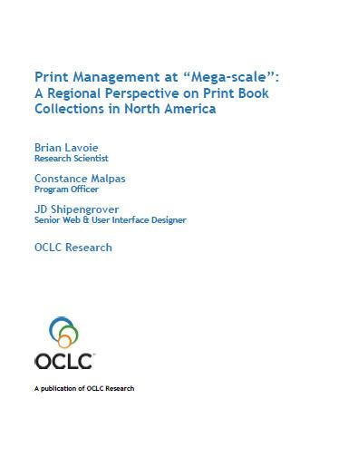
Print Management at “Mega-Scale”
OCLC Research report: characteristics and implications of a North American network of regional shared print book collections
Many current discussions around cooperative shared print organized at regional scale
Regional framework operationalized using mega-region concept
Not prescriptive: one model among many
www.oclc.org/research/publications/library/2012/2012-05.pdf

Slide 9
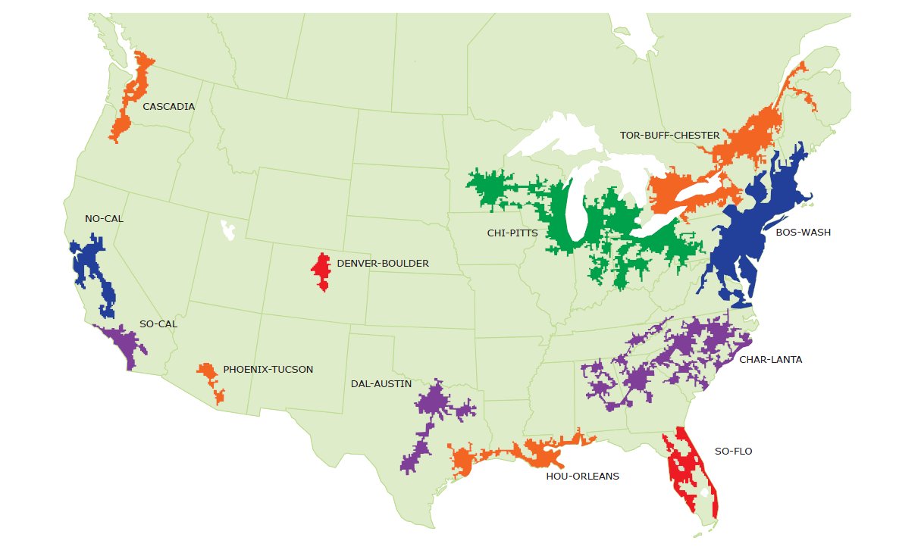
North American Mega-regions
OCLC Research, 2013

Slide 10
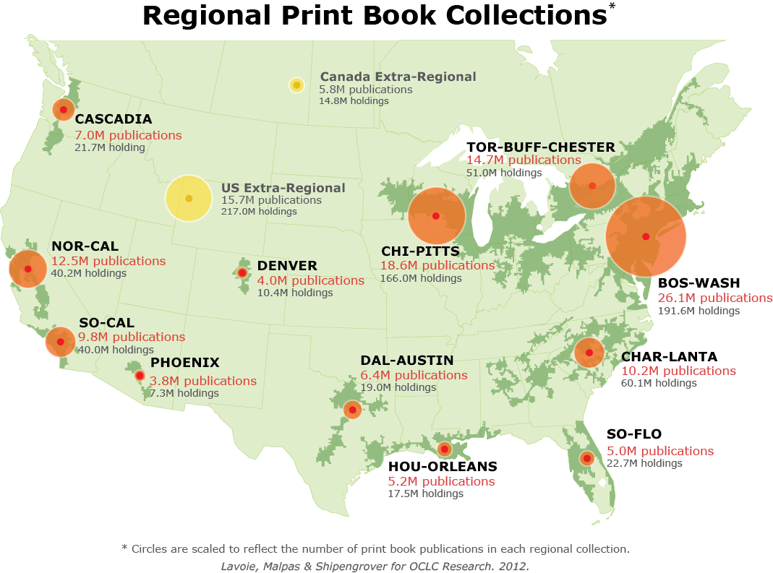
North American print book resource:
45.7 million distinct publications
889.5 million total library holdings
OCLC Research, 2013

Slide 11
Regional coverage of the North American print book resource
BOS-WASH | 57 %
CHI-PITTS | 41 %
TOR-BUFF-CHESTER | 32 %
NOR-CAL | 27 %
CHAR-LANTA | 22 %
SO-CAL | 21 %
CASCADIA | 15 %
DAL-AUSTIN | 14 %
HOU-ORLEANS | 11 %
SO-FLO | 11 %
DENVER | 9 %
PHOENIX | 8 %
OCLC Research, 2013

Slide 12
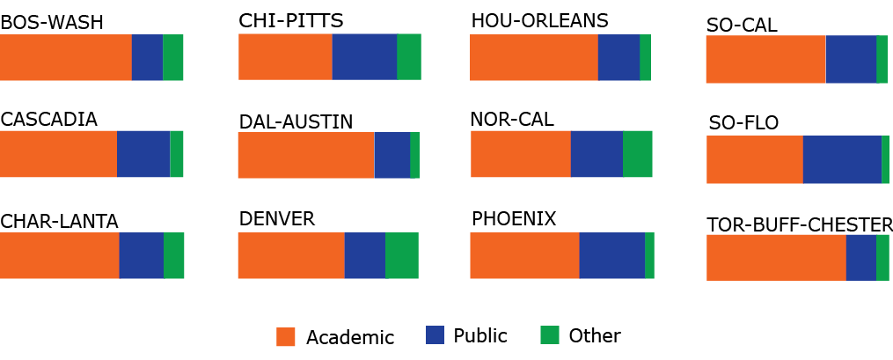
Share of regional print book holdings, by institution type
OCLC Research, 2013

Slide 13
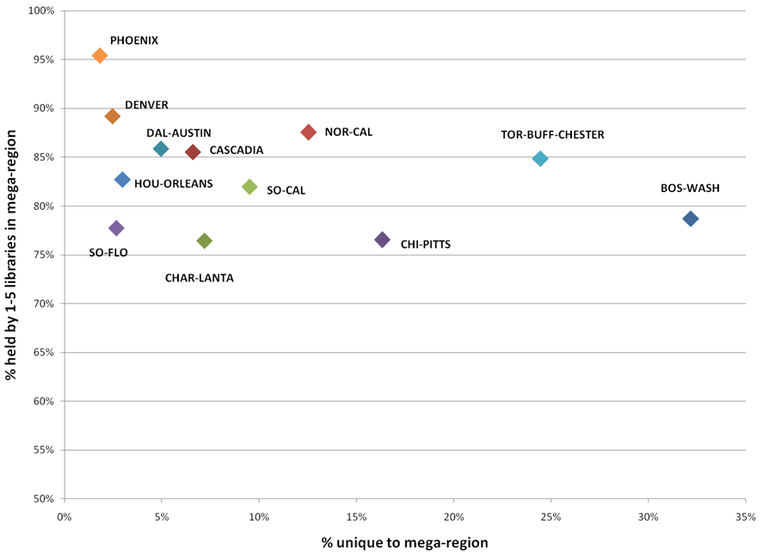
Rareness is common
OCLC Research, 2013

Slide 14
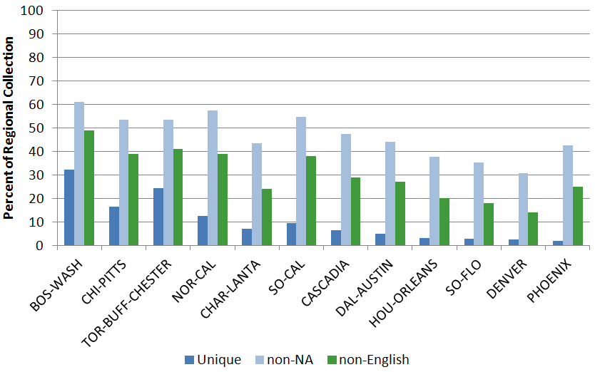
Size is a driver for uniqueness and global diversity
OCLC Research, 2013

Slide 15
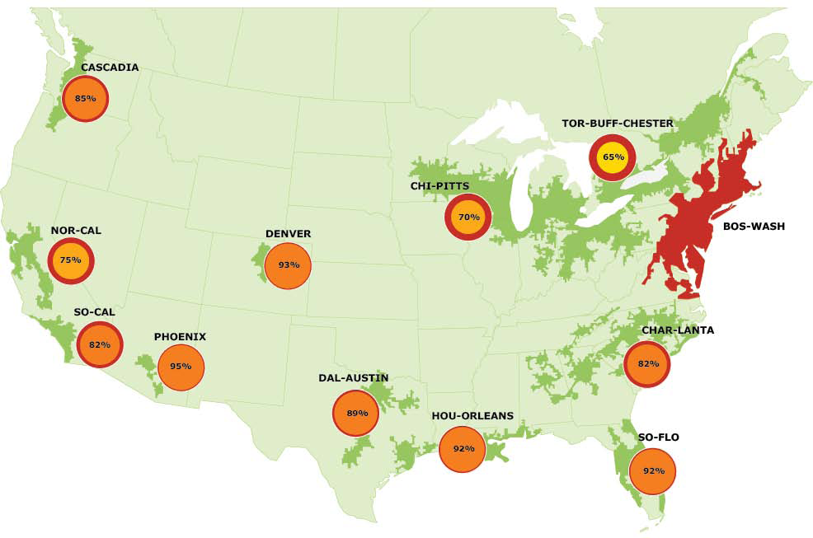
Overlap with BOS-WASH, by region
OCLC Research, 2013

Slide 16
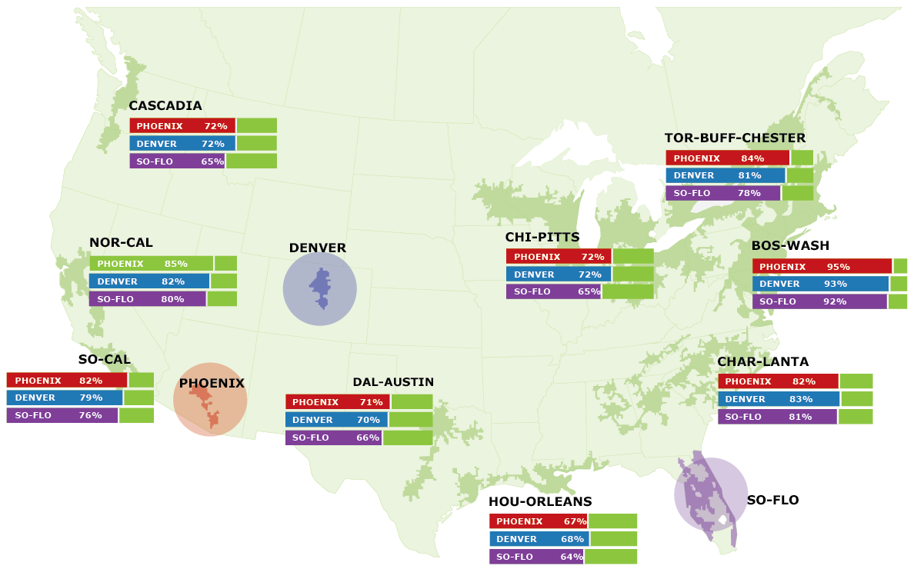
PHOENIX, DENVER, SO-FLO: overlap with other regions
OCLC Research, 2013

Slide 17
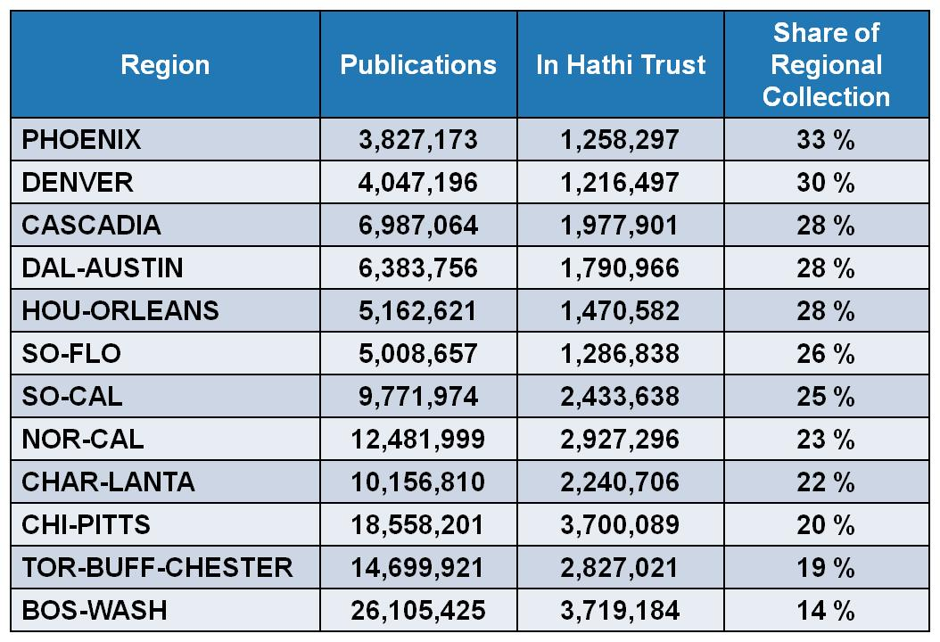
HathiTrust coverage of regional print book collections
OCLC Research, 2013

Slide 18
Spotlight on Char-lanta
ASERL/WRLC Collections in a Mega-regional framework

Slide 19
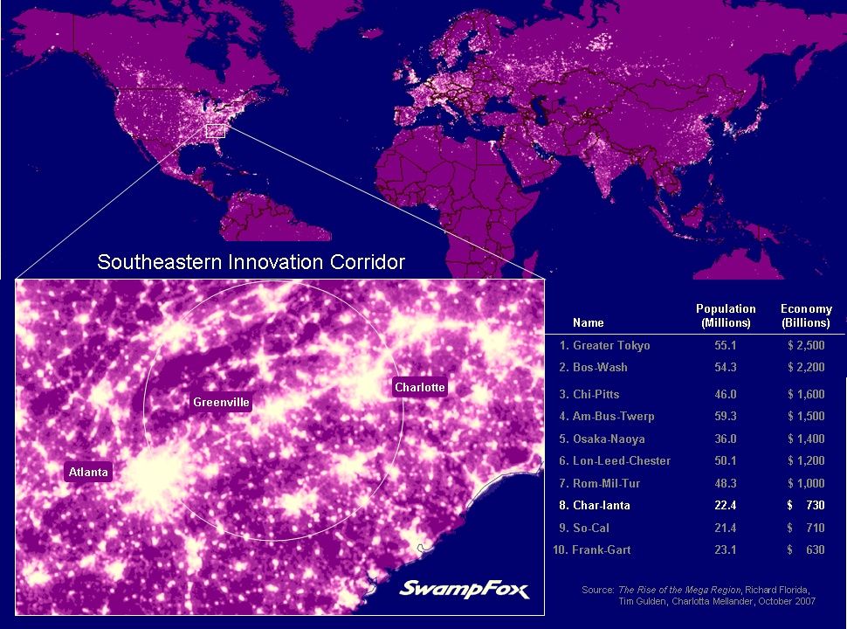
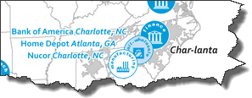
Notes:
http://www.flickr.com/photos/15021633@N07/2287562918/sizes/z/

Slide 20
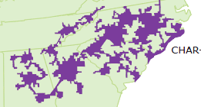
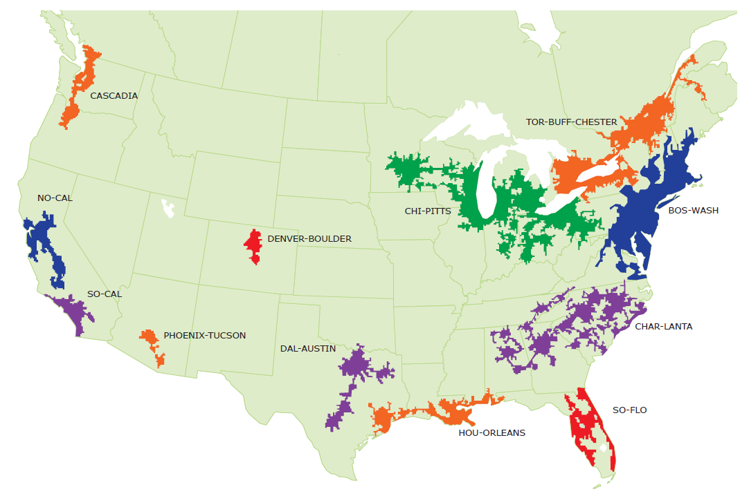
A mega-regional perspective on print books in Char-lanta, ASERL & WRLC
Char-lanta
5th largest collection by scope (titles)
3rd largest collection by size (holdings)
Robust cooperative infrastructure
OCLC Research, 2013

Slide 21
Print Books in Char-lanta Libraries
Char-lanta
Regional print book collection
10,156,810 discrete titles (manifestations)
8,098,748 discrete works
1.25 manifestations per work on average
60,102,186 holdings in Char-lanta libraries
5.92 holdings per title on average
Median age: 25 (i.e. published 1986)
= 22% of titles (7% of holdings) in North American print book collection
including more than 700K titles unique to Char-lanta
OCLC Research, 2013

Slide 22
‘Density’ of print book holdings in Char-lanta
Char-lanta
Majority of titles held by <5 libraries in region
73%
OCLC Research, 2013

Slide 23
In sum: supply-side view of regional resource
Evidence
Char-lanta print book collection is the third largest regional collection in North America
Char-lanta library holdings provide coverage for about 20% of print book titles in North America
OPINION
Char-lanta institutions will continue to rely on access to, and preservation of book collections in other regions
Need to coordinate regional management plan with other North American partners
Long-term preservation of the regional print book resource will require partnerships within and outside of Char-lanta

Slide 24
Intra-regional stewardship: institutional infrastructure
Char-lanta
1,811 libraries (holding symbols) in WorldCat
Type | Percent of Char-lanta library population
School libraries | 60%
Non-ARL academic libraries | 17%
Public libraries | 9%
Special libraries | 6%
Other | 6%
ARL libraries | 2%
*
(
)
*
*
Institutions with stewardship mandate and preservation capacity
OCLC Research, 2013

Slide 25
Distribution of Char-lanta Print Books by Holding Library Type
Char-lanta
Majority of holdings are managed in academic libraries
N = 60M holdings
OCLC Research, 2013

Slide 26
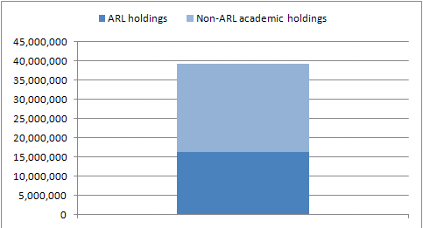
Distribution of Char-lanta Print Books Academic Libraries
Char-lanta
… mostly non-ARL libraries
38%
of Char-lanta holdings
27%
of Char-lanta holdings
N = 39M holdings in Char-lanta academic libraries; 60M holdings in all Char-lanta libraries
OCLC Research, 2013

Slide 27
In sum: institutional stewardship
Evidence
2/3rds of Char-lanta print book collection is held by academic libraries
Most are non-ARL institutions with limited preservation capacity or mandate
OPINION
As mid-tier HEI seek to adapt to competitive e-learning environment, local investment in print management is likely to decline; external cooperative or commercial strategies will be increasingly attractive to academic administrators
Unrealistic to imagine that a handful of ARL institutions can assume stewardship responsibility for regional print book resource

Slide 28
Intra-regional stewardship: cooperative infrastructure
Char-lanta
43% of ASERL members are located within Char-lanta mega-region
represents <1% of libraries in Char-lanta
accounts for 31% of print book inventory (holdings) in the region
i.e., a monographic preservation program limited to 18 ASERL libraries would secure almost a third of regional print book holdings
UNC Chapel Hill alone holds 25% of titles in the Char-lanta regional collection – but is it solely responsible for stewardship of this resource?
Cooperative infrastructure enables broader (re)distribution of stewardship
OCLC Research, 2013

Slide 29
Mega-region preservation capacity for Char-lanta print books
Percent of Char-lanta print books duplicated in other North American mega-regions
46%
62%
Bos-Wash
82%
65%
79%
33%
Char-lanta
10M titles
56%
45%
31%
So-Flo holds
40%
41%
Hou-Orleans holds
of Char-lanta collection
OCLC Research, 2013

Slide 30
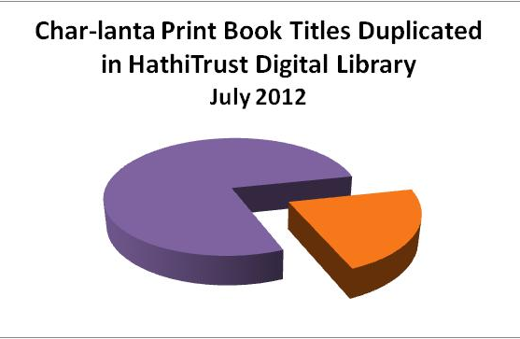
Digital preservation status of Char-lanta print books
Char-lanta
Range for other regions:
19% ←→ 33%
22%
2.24M titles
N = 10M titles (manifestations)
OCLC Research, 2013

Slide 31
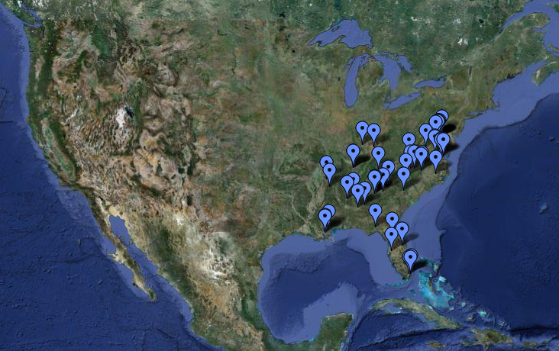
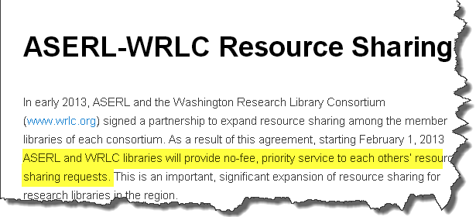
Scaling up: cooperative infrastructure
~50 libraries spanning four mega-regions
9.36M print book titles; 44M library holdings
What is the carrying capacity of this network?

Slide 32
Scale matters: assessing print preservation risks
“rareness is common”
~75% of print books in ASERL/WRLC collective collection are held by fewer than 5 libraries in the group
0
N = 9.36M titles (manifestations)
OCLC Research, 2013

Slide 33
Scale matters: assessing print preservation risks
~75% of print books in ASERL/WRLC collective collection are held by fewer than 5 libraries in group
~15% of print books in ASERL/WRLC collective collection are held by fewer than 5 libraries in WorldCat
0 %
N = 9.36M titles (manifestations)
OCLC Research, 2013

Slide 34
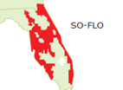
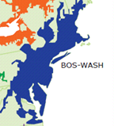
Mega-regional stewardship: cooperative infrastructure
Char-lanta
9,358,508 print book titles in ASERL/WRLC collective collection
Represents 68% of print book titles in Char-lanta
75% of print book titles in Hou-Orleans
75% of print book titles in So-Flo
31% of print book titles in Bos-Wash
20% of print book titles in North America
OCLC Research, 2013

Slide 35
In sum: regional stewardship
Evidence
A preservation compact among a small number of institutions would secure a significant part of the regional resource
If comprehensive coverage is desired, extra-regional agreements may be needed
OPINION
Given growing stewardship expectations for ARL institutions, investment in print preservation should be reassessed in view of growing digital preservation infrastructure; regional efforts should acknowledge inter-regional dependencies
Joint ASERL / WRLC agreements could transform print preservation strategy for libraries throughout the Southeast

Slide 36
In conclusion
Char-lanta print book collection is an important regional resource; it complements and enriches other regional collections in North America
Pressures on academic libraries will continue to destabilize current preservation eco-system
Strategic planning on a mega-regional scale builds on existing infrastructure and networks of supply and demand
ASERL / WRLC cooperative infrastructure has potential to transform print management in Char-lanta and other regions

Slide 37
lavoie@oclc.org malpasc@oclc.org www.oclc.org/research/activities/megascale.html www.oclc.org/research/activities/sharedcollections.html
Comments or Questions?

Slide 38
Questions to consider
How can the cooperative infrastructure of ASERL and WRLC be leveraged to support an efficient redistribution of print stewardship responsibilities?
What synergies exist between ASERL / WRLC print archiving efforts and other regional efforts (WEST, CIC, etc.)?
Where does ASERL / WRLC infrastructure fit within regional higher education and economic development plans? What strategic alliances are possible?

