Slide 1
Taking Our Pulse The OCLC Research Survey of Special Collections and Archives
Jackie Dooley [took 45 minutes, 75 in audience]
OCLC Research
Program Officer
ALCTS Midwinter Forum
10 January 2011

Slide 2
Overview
Survey population
Project objectives
Data & action items

Slide 3
What’s wrong with this [big] picture?
Overall collections size is growing
Use is increasing
Too many materials remain “hidden”
Backlogs continue to grow
Staffing is stable
75% of library budgets have been cut

Slide 4
Project objectives
Obtain current data to determine changes across the ARL libraries since 1998
Expand ARL’s survey population
Enable institutions to place themselves in the context of norms
Provide data to support decision-making
Recommend actions based on survey results

Slide 5
Survey population
Libraries surveyed: 275
Rate of response: 61% (169)
Five membership organizations
Association of Research Libraries
Canadian Association of Research Libraries
Independent Research Libraries Association
Oberlin Group
RLG Partnership

Slide 6
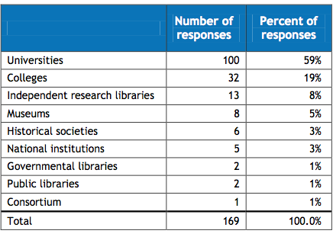
Respondents by type of institution

Slide 7
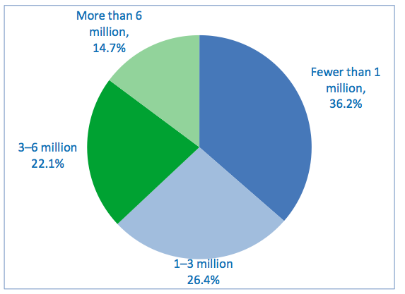
Printed volumes in overall library

Slide 8
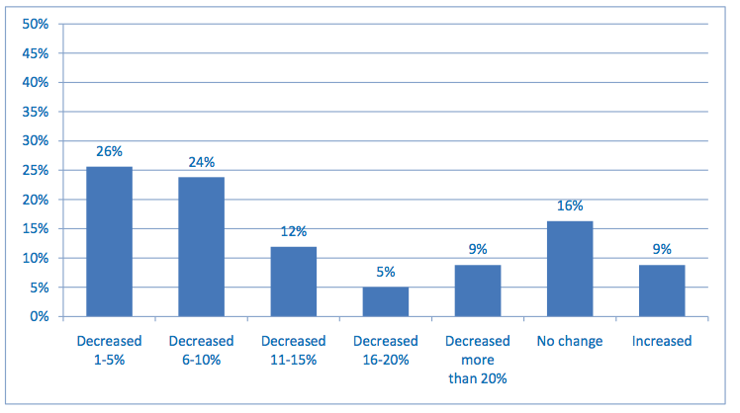
Change in overall library funding

Slide 9
“Your three most challenging issues” **
Space: 64%
Born-digital materials: 37%
Digitization: 35%
** Funding and staffing were disallowed. Respondents could name up to three challenges.

Slide 10
Assessment: Action item
Develop and promulgate metrics that enable standardized measurement of key elements of special collections use and management.

Slide 11
Key to percentages:
Red = % of respondents
Black = numerical data

Slide 12
Collections: Growth
Mean ARL collections growth since 1998
Books: 50%
Archives/manuscripts: 50%
Audio: 240%
Visual and moving image: 300%
Microforms: decreased 80%
Special collections in remote storage: 67%

Slide 13
Collections: Acquisitions
Purchase vs. gift
57% of books are purchased
50/50 institutional and special funds
18% of other formats are purchased
Source of funding
Institutional: 38%
Special: 62%

Slide 14
Collections: Acquisitions Funding
ARL
Mean: $488,000
Median:$200,000
CARL
Mean: $293,000
Median: $103,000
IRLA
Mean: $821,000
Median: $167,000
Oberlin
Mean: $53,000
Median:$18,000
RLG
Mean: $724,000
Median: $268,000

Slide 15
Collections: Acquisitions
Hundreds of new collecting directions
#1: gift
#2: new institutional direction
#3: faculty suggestion
Cooperative collection development
Mostly informal/regional
Very few formal arrangements (5%)

Slide 16
Collections
Materials deaccessioned
Reported by 33 respondents (20%)
Most frequent reasons
Transferred to more appropriate institution (13)
Returned to donor (5)
Transferred to general stacks (4)
Preservation
Audiovisual materials are at “code blue”

Slide 17
Collections: Action items
Identify barriers that limit collaborative collection development. Define key characteristics and desired outcomes of effective collaboration.
Take collective action to share resources for cost-effective preservation of at-risk audiovisual materials.

Slide 18
User services: Onsite visits
Percent of each type of user
Faculty/staff: 9%
Graduate students: 5%
Undergraduates: 12%
Visiting scholars/researchers: 24%
Local community: 7%
“Other”: 43%

Slide 19
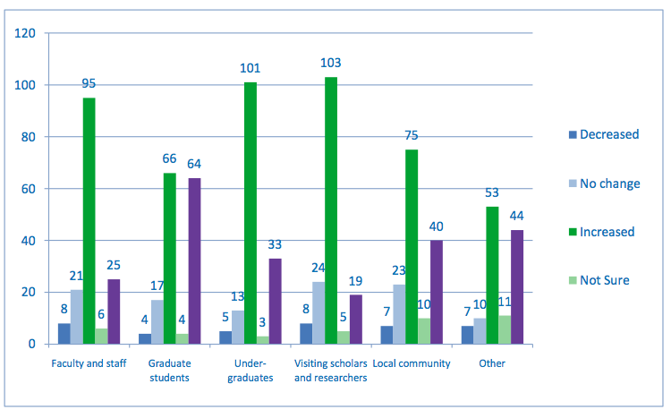
Changes in level of use by type of user
Note: Numbers of respondents.

Slide 20
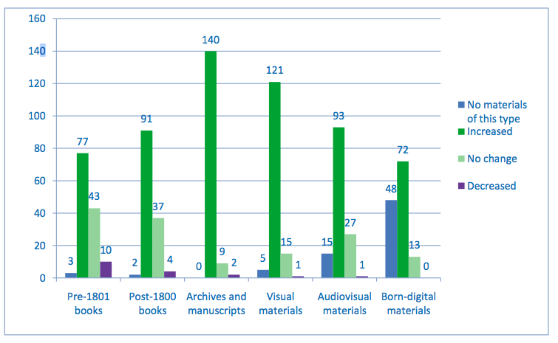
Changes in use by format
Note: Numbers of respondents.

Slide 21
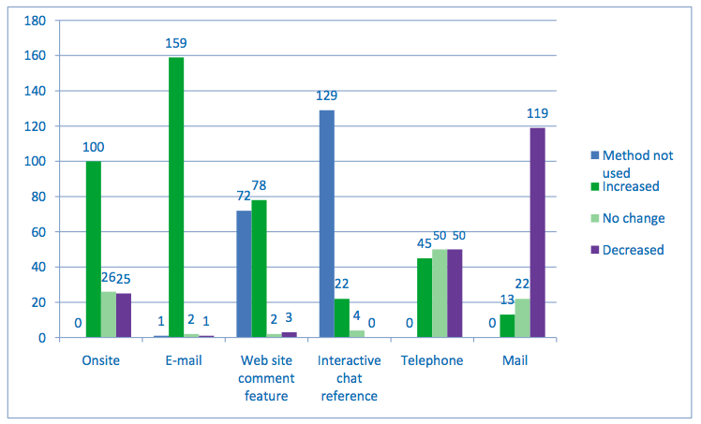
Changes in users’ methods of contact
Note: Numbers of respondents.

Slide 22
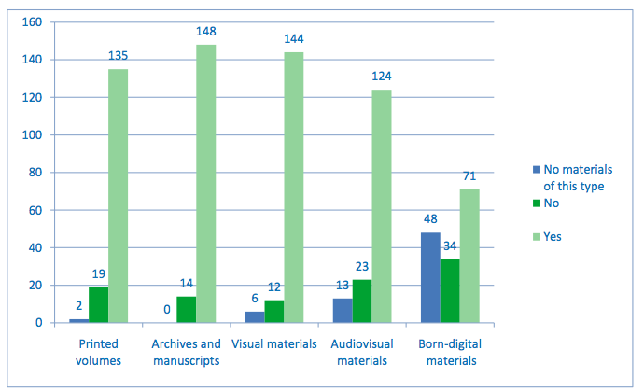
Access to uncataloged/unprocessed materials
Note: Numbers of respondents.

Slide 23
Use of digital cameras
Users may employ personal digital cameras in the special collections reading room: 87%
C.f. Lisa Miller, et al. “Capture and Release”: Digital Cameras in the Reading Room. OCLC Research, 2010. http://www.oclc.org/research/publications/library/2010/2010-05.pdf

Slide 24
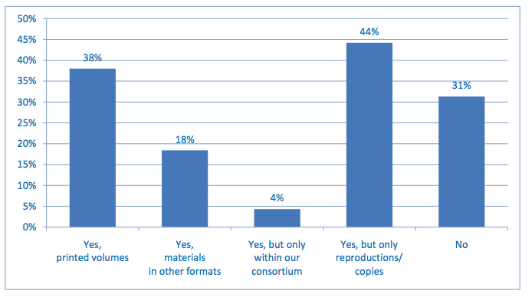
Interlibrary loan

Slide 25
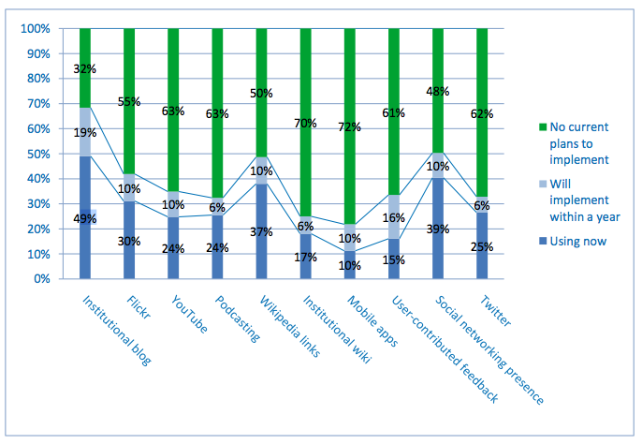
Web-based communication methods

Slide 26
User services: Action items
Develop and liberally implement exemplary policies to facilitate rather than inhibit access to and interlibrary loan of rare and unique materials.

Slide 27
Cataloging and metadata
Online catalog records
Books: 85%
Maps: 42%
Archival formats: 50% or less
ARLs show minimal improvement in “exposing hidden collections”
Backlogs
Decreased: 59% (books), 44% (other)
Increased: 25% (books), 41% (other)

Slide 28
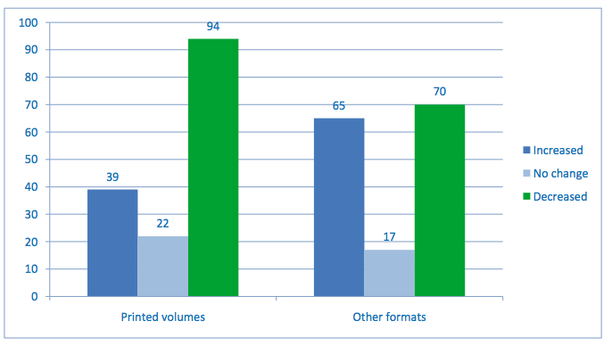
Change in size of backlogs
Note: Numbers of respondents.

Slide 29
Cataloging and metadata: Action items
Compile, disseminate, and adopt a slate of replicable, sustainable methodologies for cataloging and processing to facilitate exposure of materials that remain hidden and stop the growth of backlogs.
Develop shared capacities to create metadata for published materials such as maps and printed graphics for which cataloging resources appear to be scarce.

Slide 30
Archival management
Archival finding aids
Online: 44%
Print-only or in local silos: 30%
Simplified processing techniques
Always: 18%
Sometimes: 57%

Slide 31
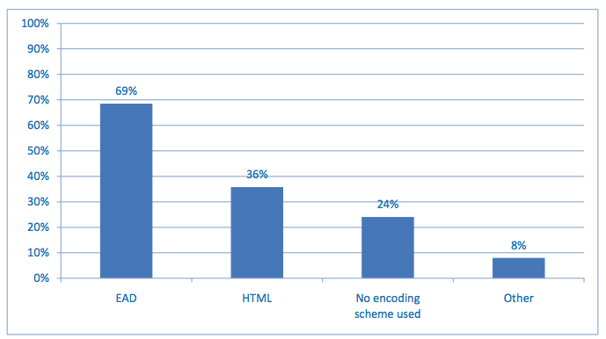
Encoding of archival finding aids
Note: Percentages of respondents.

Slide 32
Archival management
Finding aids tools are not standardized
Most commonly used: word processing, databases
Archivists Toolkit: 34%
Archon: 11%
Institutional archives
Reports to library: 87%
Responsible for records management: 70%

Slide 33
Archival management: Action item
Convert legacy finding aids using affordable methodologies to enable Internet access.
Resist the urge to upgrade or expand the data.
Develop tools to facilitate conversion from local databases.

Slide 34
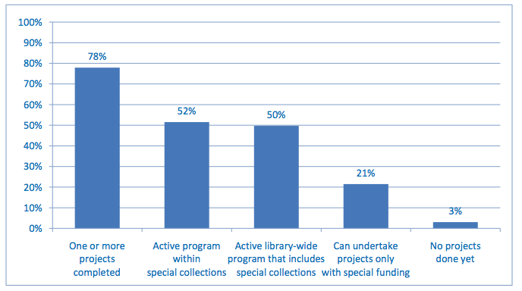
Digitization

Slide 35
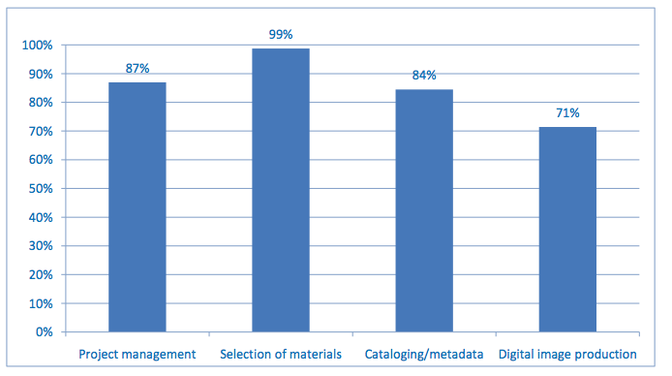
Special collections involvement in digitization projects

Slide 36
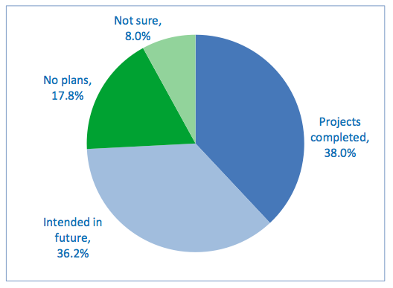
Large-scale digitization of special collections
Definition: Systematic reproduction of entire collections using streamlined production methods that account for special needs.

Slide 37
Licensed content
Content licensed to commercial firms for digitization: 26%
C.f. Principles to Guide Vendor/Publisher Relations in Large- Scale Digitization Projects of Special Collections Materials. ARL policy, approved July 2010.
http://www.arl.org/bm~doc/principles_large_scale_digitization.pdf

Slide 38
Digitization: Action items
Develop models for large-scale digitization of special collections, including methodologies for selection of appropriate collections, security, safe handling, sustainable metadata creation, and ambitious productivity levels.
Determine the scope of the existing corpus of digitized rare books, differentiating those available as open access from those that are licensed. Identify the most important gaps and implement collaborative projects to complete the corpus.

Slide 39
Born-digital archival materials
In a nutshell …
Undercollected
Undercounted
Undermanaged
Unpreserved
Inaccessible

Slide 40
Born-digital archival materials
Holdings reported by: 35%
Percent held by top two libraries: 51%
Percent held by top 13 libraries: 93%
Digital materials currently held by: 79%
Assignment of responsibility for born-digital management made by: 55%
Education/training needed by: 83%

Slide 41
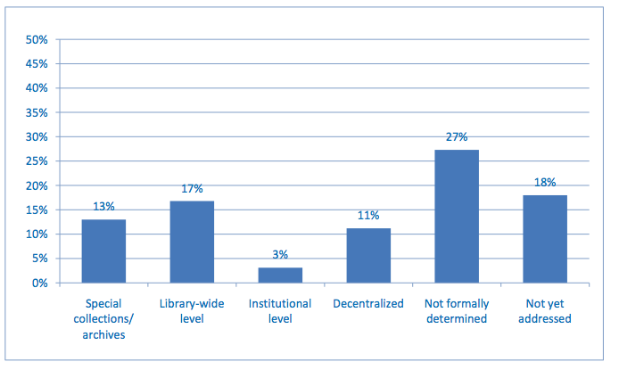
Responsibility for born-digital archival materials

Slide 42
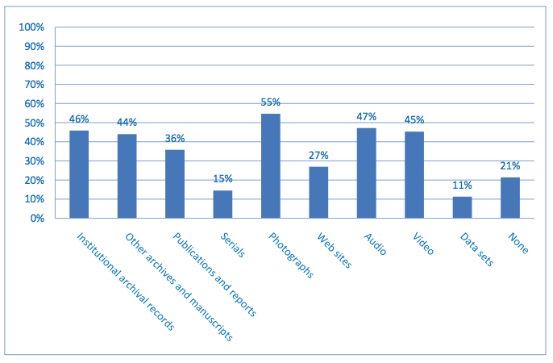
Born-digital materials already held

Slide 43
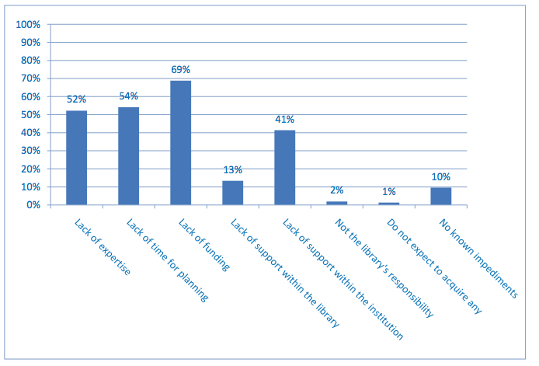
Impediments to born-digital management
Note: Respondents could check all that apply.

Slide 44
Born-digital materials: Action items
Define the characteristics of born-digital materials that warrant management as “special collections.”
Define a reasonable set of basic steps for initiating an institutional program for responsibly managing born-digital archival materials.
Develop use cases and cost models for selection, management, and preservation of born-digital archival materials.

Slide 45
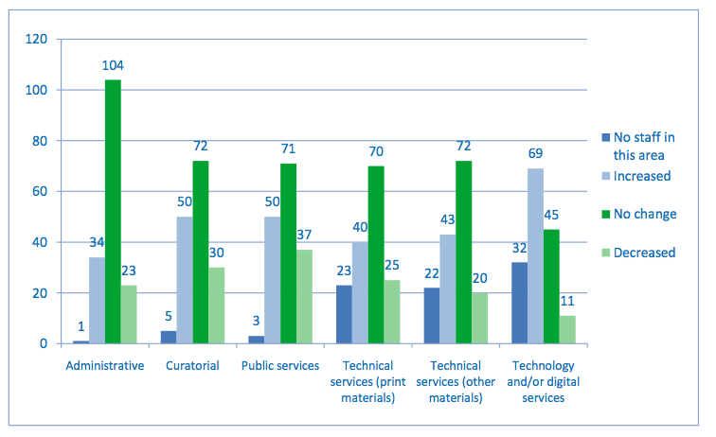
Changes in staffing levels
Note: Numbers of respondents.

Slide 46
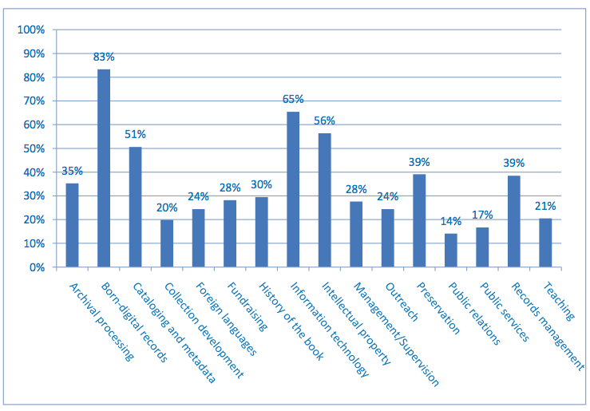
Education and training needs

Slide 47
Staffing
Retirements likely within five years: 9%
Multiple special collections units/depts: 25%

Slide 48
Staffing: Action items
Confirm high-priority areas in which education and training opportunities are not adequate for particular segments of the professional community. Exert pressure on appropriate organizations to fill the gaps.

Slide 49
Taking our Pulse
The OCLC Research Survey of
Special Collections and Archives
http://www.oclc.org/research/publications/library/2010/2010-11.pdf

