Slide 1
FAST Report
Faceted Subject Access Interest Group
Eric Childress
Ed O’Neill
ALA Annual 2013
29 June 2013
Notes:
(Faceted Application of Subject Terminology)

Slide 2
FAST (Faceted Application of Subject Terminology)
Joint OCLC Research and Library of Congress project
Provides a faceted version of the Library of Congress Subject Headings
Available in various interfaces and downloadable versions
http://fast.oclc.org/searchfast/

Slide 3
FAST stats
Total headings: 1.7 million
Facets:
Personal names: 704,143
Corporate names: 357,625
Events: 11,915
Uniform titles: 61,633
Chronological: 676
Topical: 392,593
Geographic: 148,722
Form/Genre: 1,905
Deprecated/deleted: 46,719
FAST headings have been successfully added to an off-line copy of OCLC's WorldCat database.
WorldCat contained 1,678,279 distinct FAST headings (excluding chronological) each controlled with a single authority record.
WorldCat contained 26,425,717 distinct LCSH headings (including names valid as subjects) with approximately 7.5% controlled by a single authority record.

Slide 4
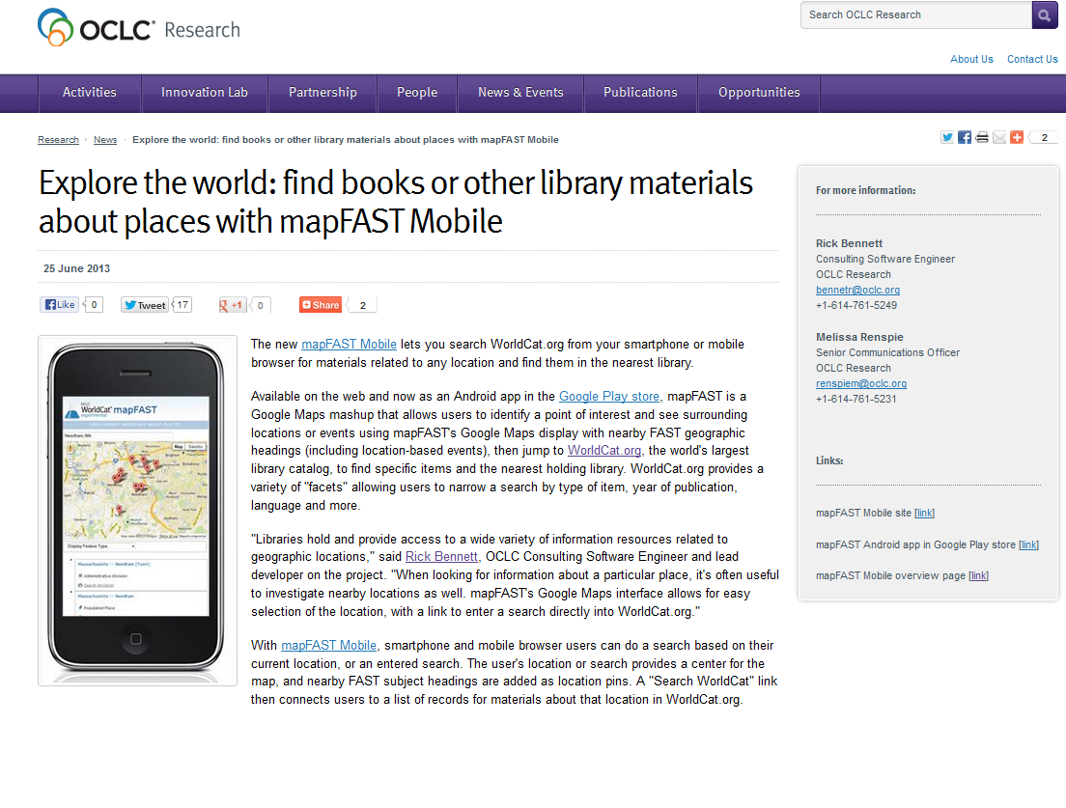
mapFAST Mobile
http://www.oclc.org/research/news/2013/06-25.html
http://experimental.worldcat.org/mapfast/mobile/

Slide 5
“Centers” work
Experimental
Leverages FAST and VIAF in OCLC Research’s upgraded version of WorldCat
Reveals:
What a given library has relative-to-others’ strengths
Which libraries are strong for a given topic/person/country
http://hangingtogether.org/?cat=13

Slide 6
Forthcoming…
Interviews with 16 parties
9 adopters
7 non-adopters
Presented in two parts
Summary of findings
16 interviews

Slide 7
FAST report - interview subjects
Adopters
Bodleian Libraries (University of Oxford)
Databib.org
National Library of New Zealand (Te Puna Mātauranga o Aotearoa)
OCLC
RMIT Publishing
Sterling and Francine Clark Art Institute Library
Universiteitsbibliotheek Amsterdam (Amsterdam University Library)
University of Illinois at Chicago
University of North Dakota
Non-adopters
Biodiversity Heritage Library (BHL)
Minnesota State University, Mankato
University of Western Ontario - PhD Research
People of the Founding Era
l’Université du Québec à Montréal (UQAM) (University of Quebec in Montreal)
University of Texas School of Public Health at Houston
World Maritime University

Slide 8
RMIT quote
http://www.informit.com.au/downloads/bulletin_issue3_2011.pdf

Slide 9
Facets used
From: Mixter, Jeffrey, and Eric Childress. 2013. FAST (Faceted Application of Subject Terminology) users summary and case studies. Dublin, Ohio: OCLC Research.

Slide 10
Why adopted…
From: Mixter, Jeffrey, and Eric Childress. 2013. FAST (Faceted Application of Subject Terminology) users summary and case studies. Dublin, Ohio: OCLC Research.

Slide 11
Adopters vs. Non-adopters
From: Mixter, Jeffrey, and Eric Childress. 2013. FAST (Faceted Application of Subject Terminology) users summary and case studies. Dublin, Ohio: OCLC Research.

Slide 12
In-press
Will be released in July 2013

Slide 13
Thank you
fast@oclc.org

Slide 14
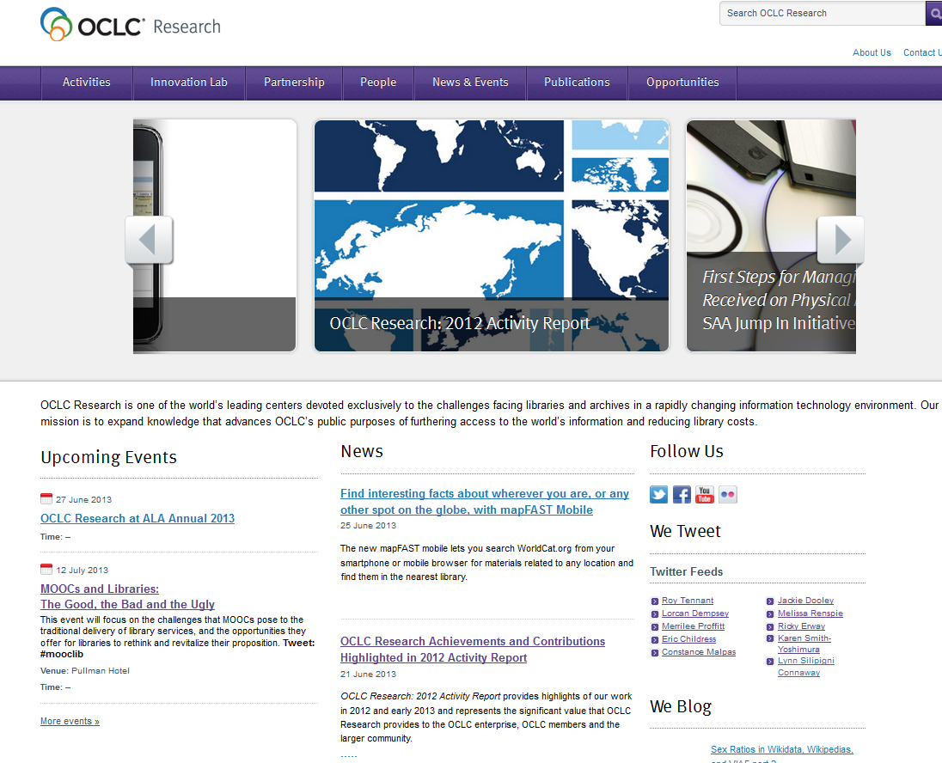
For more about OCLC Research…
http://www.oclc.org/research.html

