Slide 1
Dissemination Information Packages for Information Reuse
University of Amsterdam, Faculty of Media Studies
January 18, 2013
Elizabeth Yakel, Ph.D.
Ixchel M. Faniel, Ph.D.
Professor University of Michigan
yakel@umich.edu
Postdoctoral Researcher OCLC Research
fanieli@oclc.org

Slide 2
Today’s Talk
Project Overview
Research questions
Methodology
3 studies
Managing fixity and change in disciplinary repositories
Understanding data reuse among novices
Trust in digital repositories
Next steps

Slide 3
Project Overview

Slide 4
Project led by Drs. Ixchel Faniel (PI) & Elizabeth Yakel (co-PI);
National Leadership Grant from the Institute for Museum and Library Services, LG-06-10-0140-10, “Dissemination Information Packages for Information Reuse”
Studying the intersection between data reuse and digital preservation in three academic disciplines to identify how contextual information about the data that supports reuse can best be created and preserved.
The intended audiences of this project are researchers who use secondary data and the digital curators, digital repository managers, data center staff, and others who collect, manage, and store digital information.
For more information, please visit http://www.dipir.org

Slide 5
Research Team
DIPIR Project
Nancy McGovern
ICPSR/MIT
Ixchel Faniel
OCLC Research
(PI)
Eric Kansa Open Context
William Fink UM Museum of Zoology
Elizabeth Yakel University of Michigan (Co-PI)

Slide 7
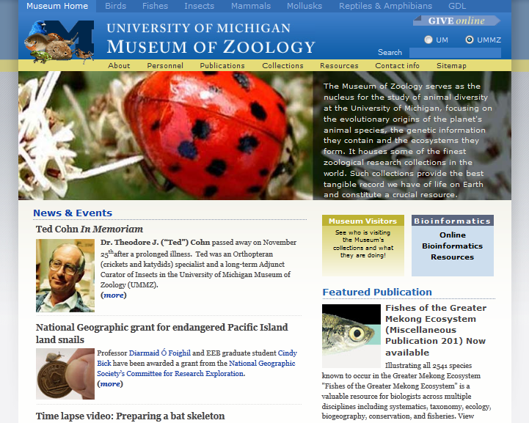

Slide 8
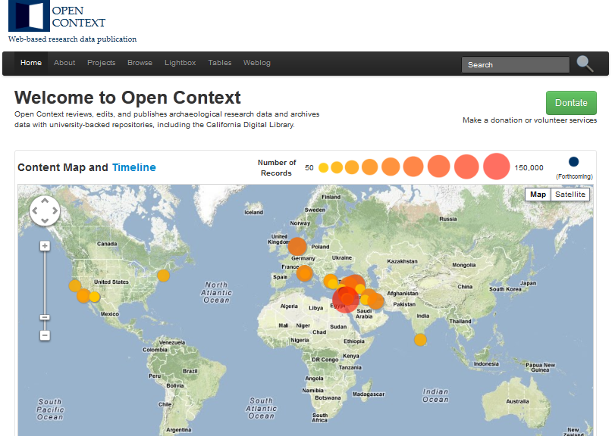

Slide 9
Terminology
Dissemination information packages
From the Open Archival Information System (OAIS) Standard
For on the end-user
Preservation
Bits
Meaning
Data reuse
“The use of data collected for one purpose to study a new problem” (Zimmerman, 2008)

Slide 10
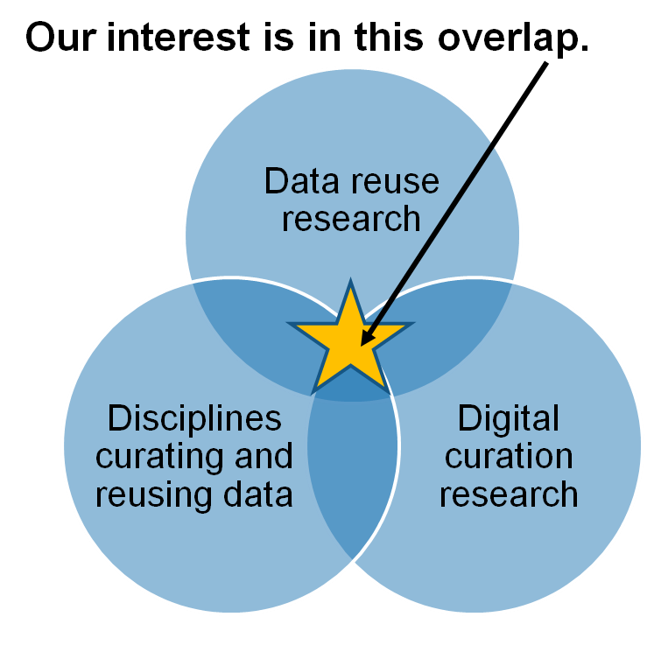
Research Motivations & Questions
What are the significant properties of quantitative social science, archaeological, and zoological data that facilitate reuse?
2. How can these significant properties be expressed as representation information to ensure the preservation of meaning and enable data reuse?
Faniel & Yakel 2011

Slide 11
Research Methodology
 | ICSPR | Open Context | UMMZ
Phase 1: Project Start up
Interviews Staff | 10 Winter 2011 | 4 Winter 2011 | 10 Spring 2011
Phase 2: Collecting and analyzing user data
Interviews data consumers | 44 Winter 2012 | 22 Winter 2012 | 27 Fall 2012
Survey data consumers | 2000 Summer 2012
Web analytics data consumers |  | Server logs Ongoing
Observations data consumers |  |  | 10 Spring 2013
Phase 3: Mapping significant properties as representation information

Slide 12
Phase 1: Project Start Up
Understand each site in more depth
Interview site staff about data submission, archival, and dissemination process
Review documentation, metadata standards, data available for reuse, supportive tools and services
Create profiles of designated communities
Inform future data collection across the three sites

Slide 13
Phase 2: Data Collection & Analysis
Understand significant properties of data production employed during reuse
Interview users from designated communities about reuse practices, how they assess data reusability
Use multi-methods to triangulate findings given site capabilities
Surveys of ICPSR users
Online behavior of Open Context users
Observations of UMMZ users

Slide 14
Phase 3: Mapping Significant Properties
Examine unique and common significant properties
2. Work with team and subjects to rank order them
3. Examine how they might be captured in a preservation repository
4. Determine how to express them as representation information

Slide 15
Study 1: Staff Interviews

Slide 16
Staff Interviews: Managing Fixity and Change
Research question:
How do repository staff manage changes to data over time?
Methods
27 semi-structured interviews

Slide 17
Findings: Categories of Change
Adding value
Correcting errors
Creating consistency
Changing representations of data to reflect new knowledge
Responding to designated communities
Evolving practices around collecting

Slide 18
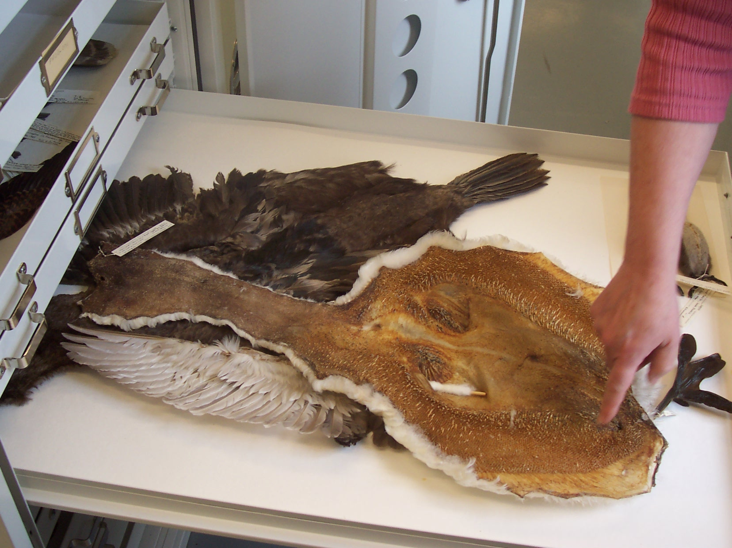
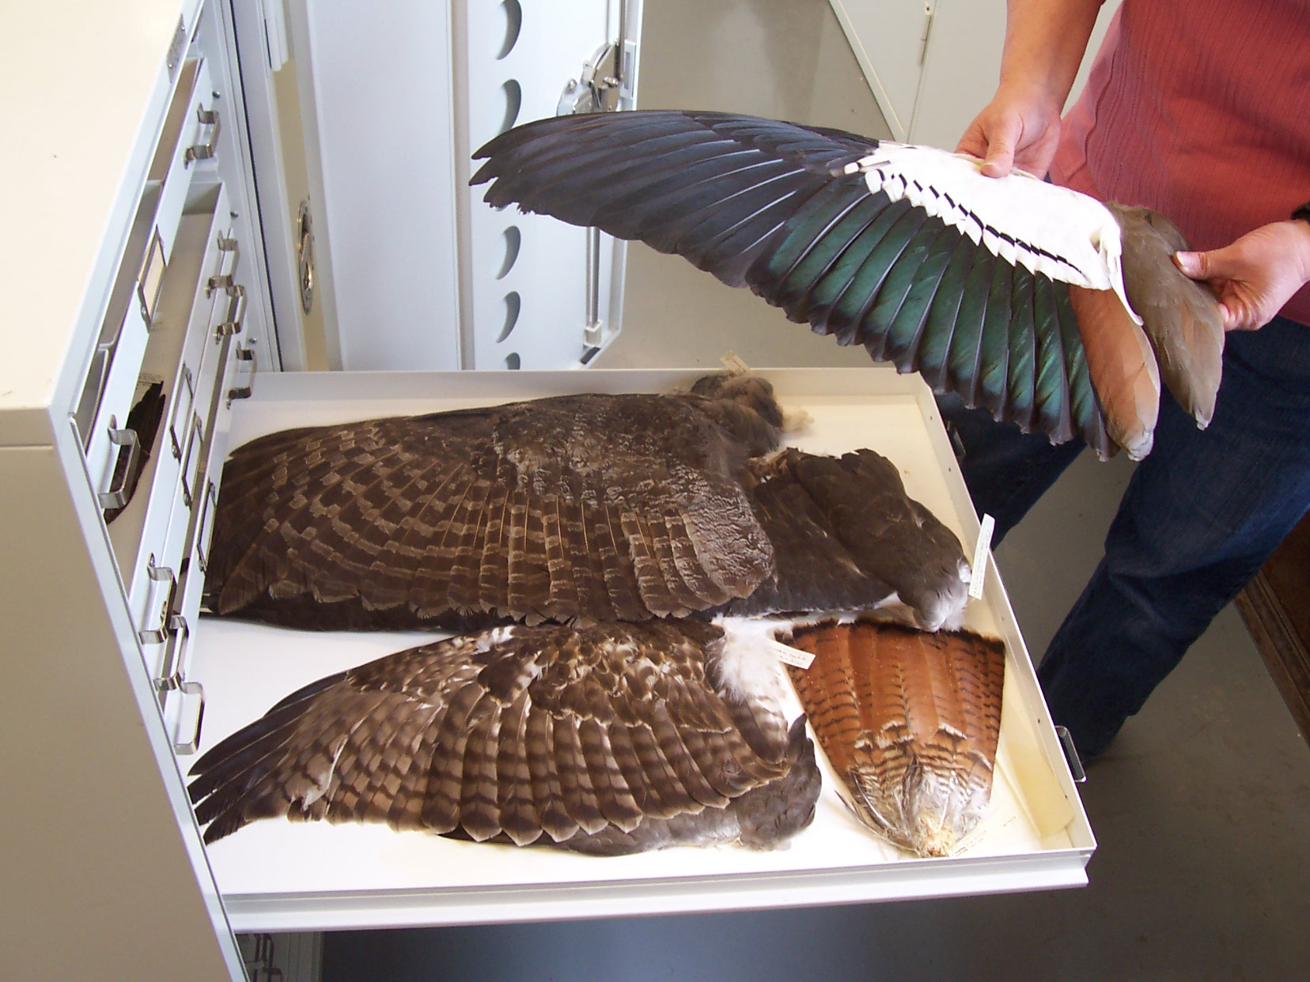
Adding Value
Processing data for reuse
Peer review
“If it [the dataset] sufficiently surpasses these various questions then we’re going to going to add a little like stamp or star or something to mark that that dataset has gone through this additional level of scrutiny” (CC02, Open Context).

Slide 19
Correcting Errors
During submission
“We note problems in the data and, you know, we let the PI's... [we] tell them we found X, Y, Z. We can't change it. Not unless they direct us” (CB07, ICPSR).
During dissemination
“We get quite a bit of feedback from people saying, you know, ‘Shouldn't this be a different species?’ And we'll say, ‘Oh yes, it was a mistake in the database’ or ‘that name was wrong in the database’” (CA02, UMMZ).

Slide 20
Creating Consistency
For interoperability between collections
ICPSR and Open Context
Across institutions
“We have […] a subset of the Darwin Core and we participate with […] other collections in the data portal. So our content is available to anybody by going to this portal, along with the content of these other museums” (CA05, UMMZ).
Chosen to encourage submission
“[…] to do a full CIDOC implementation, that would also require a lot more metadata that I think would be difficult to actually get from our contributors” (CC01, Open Context).

Slide 21
Changing Representations of Data to Reflect New Knowledge
Records change to reflect new understandings
“Science is not an error. In fact, it changes in time. For example, the specific name can be changed later and the relationship with other groups of animals can change over time. So it's not really error” (CA07, UMMZ).
Captured in a bibliographic database but does not change the representation of the data (ICPSR)

Slide 22
Responding to Designated Communities
Preparing specimens in new ways
“Most of the loans that we do now is actually little clips of skin from lung specimens that people are using for their DNA, or the frozen tissues of the same” (CA02, UMMZ).
Collecting new types of data
“No one has really tackled [providing video data]. And it’s ripe, right now; we’re going to start moving in that direction” (CB03, ICPSR).
Creating a venue for data publication
“They want to have something where you can put your data in and it’s citable” (CC02, Open Context).

Slide 23
Evolving Practices Around Collecting
Internally motivated by curator practices (UMMZ)
Emphasis may change over time.
Based on researcher interests
“We're trying to go for the low hanging fruit, right now, the projects that are, everyone's on board and everyone's happy to share. And there's not going to be any issues with people who don't want to share the content” (CC02, Open Context).
Comprehensive approach to collection development
“Currently, we have an interest in mixed methods studies and then we have sort of this prospective technique to go out and try and cull a good list of mixed methods studies and then go after them, both from the leads database and from other ways” (CB15, ICPSR).

Slide 24
Discussion
Documenting change
What is documented?
For what audience?
Instigating change
Staff members
Designated communities
Individual users
Organizational influences
Staff size
Extent of collections
Standardization

Slide 25
Study 2: Novice Quantitative Social Scientists as Data Reuses

Slide 26
The Study
Research Question
How do novice social science researchers make sense of social science data?
Data Collection
22 Interviews
Data Analysis
Code set developed and expanded from interview protocol
http://www.english.sxu.edu

Slide 27
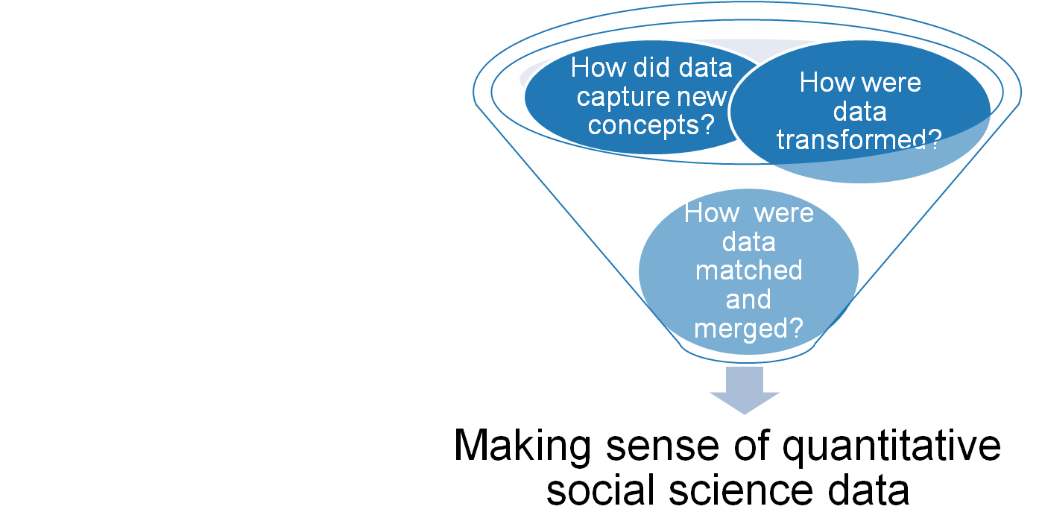
Findings
“…it's numerical value on things that don't have numerical value. So it's not like a sort of thing is worth a certain amount, that numerical value is something that everybody can understand” (CBU14).
Faniel, Kriesberg & Yakel 2012

Slide 28
Making sense of transformations from qualitative to quantitative data
Direct maps (e.g. White=0, Black=1, Asian=2, etc.) not enough
“…I want to find out when they ask the question to the parent or to the student, how was that question asked and was there follow-up questions in terms of did they ask what is your race as opposed to allowing the parent or the student to tell them what their race was” (CBU10).
Interested in how direct maps developed
“So they use New York Times continuously for like the 30 years. New York Times, it has changed. So I want to know like what years New York Times was used to gather data. I'm sure they used more than one newspaper. Also, I want to know which ones those were, for example” (CBU03).

Slide 29
Making sense of concepts not well-established in the literature
Do beliefs match data producer actions
“And that’s not to exclude it just by the nature of it being a right wing organization, but I would want to evaluate their methods to see if that’s the methods that I would’ve chosen…” (CBU09).
How will reusing data impact research
“some parties,… had only like one or two experts rating them, in the Dutch case, which makes it not super reliable, so that’s what’s kind of like [it made me think,…] ‘Oh I should really pay attention that that’s not going to hurt me…” (CBU17).

Slide 30
Making sense of matching and merging capabilities across multiple datasets
Combining longitudinal data
“If they're not asking the same question over years,… [it’s] particularly difficult because if they’ve changed the question wording, are then people answering differently and so there were several discussions that I had with my dissertation advisor…” (CBU18).
Merging data from different sources
“…authors will create a variable, they’ll average across a four or five year period, and I’m trying to match that with a variable that was coded for a single year period. So making an argument…that these two things should be put together …, is something I always have to be wary of …So when dealing with that,…I’ll see if it’s been done by others” (CBU04).

Slide 31
Discussion
Novices engaged in careful articulation of the data producer’s research process.

Slide 32
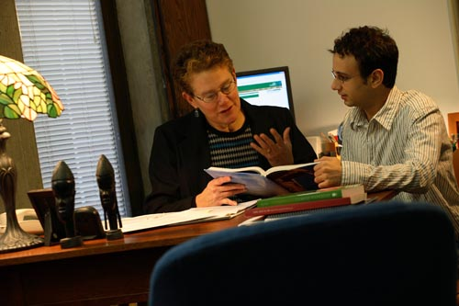
Discussion
Novices relied on human scaffolding
in the form of faculty
advisors and instructors.
http://www.lemoyne.edu

Slide 33
Discussion
Human scaffolding also came from the community as represented in the literature.
http://www.texasenterprise.utexas.edu

Slide 34
Study 3: Trust in Digital Repositories

Slide 35
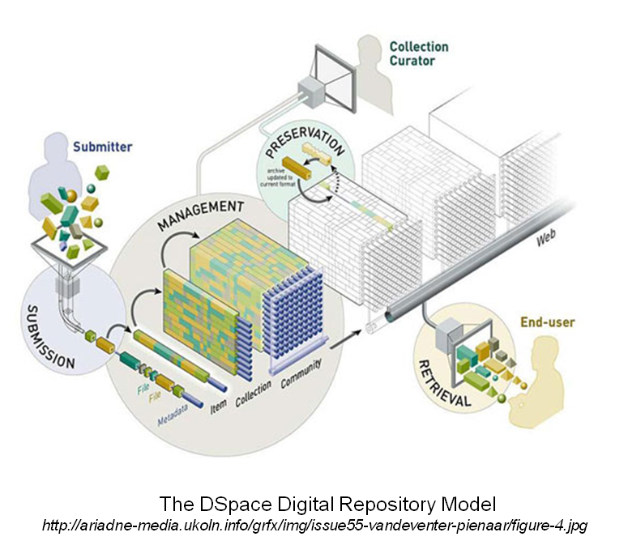
Trust in Digital Repositories
Research questions
How do data consumers associate repository actions with trustworthiness?
How do data consumers conceive of trust in repositories?

Slide 36
Theoretical Framework
Construction of Trust
Trustworthy actions by repositories
Trust by external stakeholders
Reciprocal nature of Trust
Prieto (2009) views “the digital repository as a trusted system” noting “user communities and their perceptions of trust” are key (p. 595).

Slide 37
Trustworthy Actions by Repositories
ISO 16363:2012: Space data and information transfer systems -- Audit and certification of trustworthy digital repositories (hereafter ISO TRAC)
Establishes functions for repositories to enact in order to be considered trustworthy (i.e. selection, data processing/cleaning, preservation).
Designated community – understanding
Transparency – underlying principal

Slide 38
Trust by External Stakeholders
Stakeholder trust in the organization (Pirson & Malhotra, 2011; Mayer, Davis, & Schoorman, 1995; Sitkin & Roth, 1993; Lewicki & Bunker, 1996)
Structural assurance (Gefen, Karahanna, & Straub, 2003; McKnight, Cummings, & Chervany, 1998)
Social factors (Venkatesh, Morris, Davis, & Davis, 2003; Thompson, Higgins, & Howell, 1991; Triandis, 1977)

Slide 39
Stakeholder Trust
Benevolence
The organization demonstrates goodwill toward the customer
Integrity
The organization is honest and treats stakeholders with respect
Identification
Understanding and internalization of stakeholder interests by the organization
ISO TRAC understanding the designated community (pp. 25-26)
Transparency
Sharing trust-relevant information with stakeholders
ISO TRAC sharing audit results (p. 19)

Slide 40
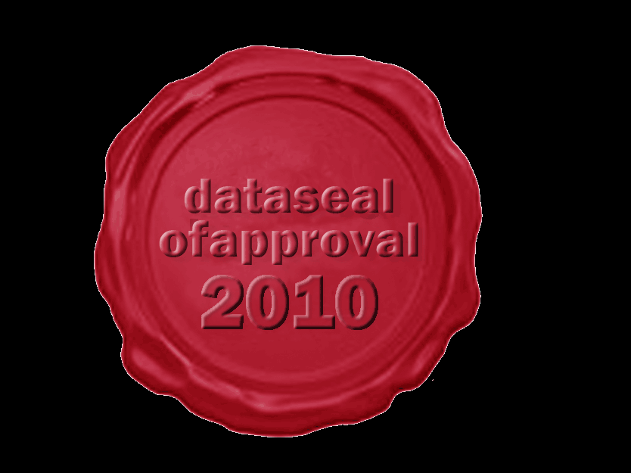
Structural Assurance
“Refers to one's sense of security from guarantees, safety nets, or other impersonal structures inherent in a specific context” (Gefen, Karahanna, & Straub, p. 64)
Third-party endorsement
Guarantees
Reputation

Slide 41
Social Factors
Positive reinforcement from
Peers
Mentors or senior colleague
Institutions
http://austinmccann.com/2012/06/06/mentoring-your-adult-volunteers

Slide 42
The Study
Data Collection
66 Interviews
22 Archaeologists
22 Novice quantitative social scientists
22 Expert quantitative social scientists
Data Analysis
Code set developed and expanded from interview protocol
http://www.english.sxu.edu

Slide 43
Findings: Repository Actions Matter
Recognizing Trustworthy Actions by Repositories
Metadata creation
‘They're very keen on producing the comprehensive metadata. And it's not that I trust each research … but I trust that the metadata is there for me to go back and check…on my own. I don't give [the archaeological repository] a sort of blanket trust that all the data in there is correct…they provide enough metadata for me to check that on my own…I sort of trust going there because I know that I can find the information I need to validate it’ (CCU02).
Selection
‘I mean I wouldn't use a scale from a very overtly conservative or overtly liberal organization that was involved in other kinds of political activities outside of collecting data because that would make you question what the goal is in collecting that data. So that would I think affect sort of the trustworthiness of repositories at least in my field’ (CBU14).

Slide 44
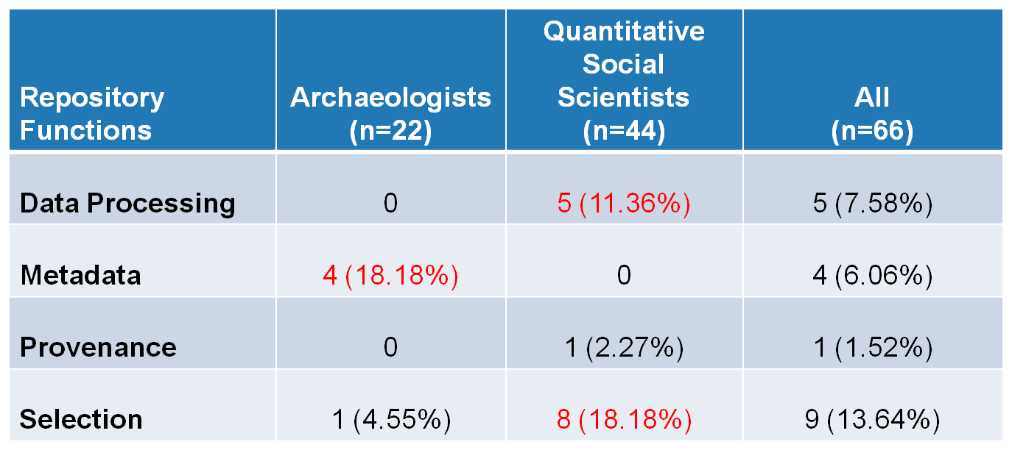
Frequency interviewees linked repository functions and trust
Yakel, Faniel, Kriesberg, & Yoon, IDCC 8, 2013

Slide 45
Engendering Trust
Identification
‘Data migration is critical…I believe, that a good repository has to be field-centric. That is to say, if you're going to put archaeological data into a repository, that repository has to understand archaeology. Because when the data must be migrated, they need to be able to look at it and to understand whether or not the migration is correct. It's one thing to say we got all the bits moved, it's another thing to say it still makes sense for archaeological data’ (CCU21).

Slide 46
Engendering Trust
Social factors: Disciplinary practice
‘I guess that's, well, trust …my own experience with using the data and then the organization’s long history, and then within the profession, it's very well spoken of. So, largely, informal mechanisms are why I trust [repository name]’ (CBU32).
Structural assurance and preservation
‘They're the only repository that I know around for individual investigator data. They've existed for a long time, they have incredible reputation for being able to maintain data, keep it well preserved, the issue of preservation is key, and that they go through extensive interrogation of the data to make sure that it is of high enough quality to be allowed to be part of their repository’ (CBU28).

Slide 47
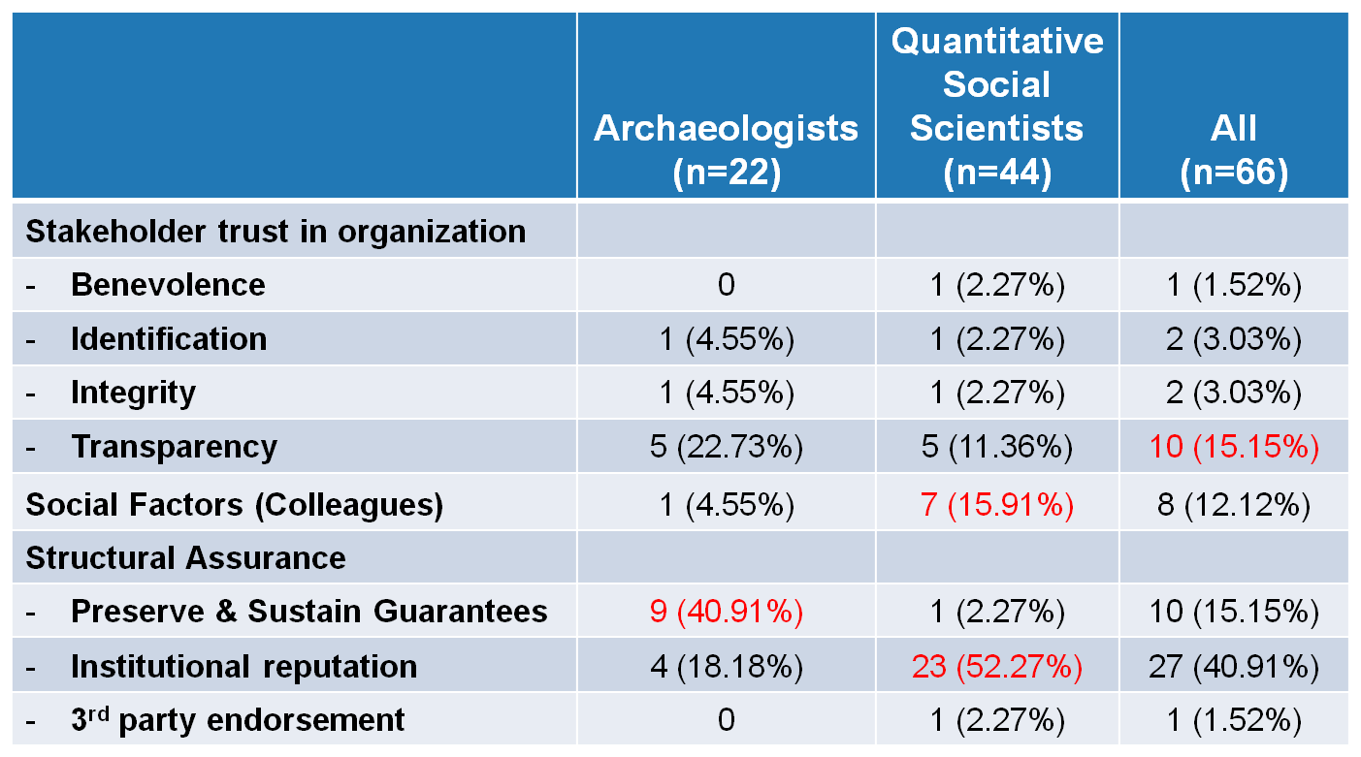
Frequency interviewees mentioned trust factors
Yakel, Faniel, Kriesberg, & Yoon, IDCC 8, 2013

Slide 48
Discussion
Repository functions are indicators of trust
Transparency is a trust factor
Discipline and level of expertise affect perceptions of trust
Preservation and sustainability should be considered structural assurance guarantees
Institutional reputation important

Slide 49
Themes across the Studies

Slide 50
Themes
Preservation
Responding to designated communities
Transparency
Social factors

Slide 51
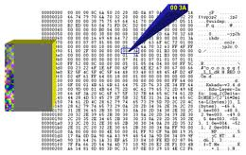
Preservation
Preservation of bits versus meaning
Create fixity in the data while changing it to enhance meaning
Preservation as a guarantee linked to trust
http://www.dlib.org/dlib/july08/buonora/07buonora.html

Slide 52
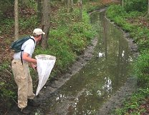
Responding to Designated Communities
Allowing for new methodological approaches to data (ICPSR and UMMZ)
Reciprocity of trust; understanding how data reusers respond to repository actions
http://www.dcr.virginia.gov/natural_heritage/localityliaison.shtml

Slide 53
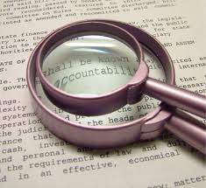
Transparency
Documenting data preparation and subsequent changes (ICPSR, UMMZ, Open Context)
Need to understand the data producer’s original research design (ICPSR novices)
http://www.utzedek.org/whoweare/mission-a-3-pillars/values-and-transparency.html

Slide 54
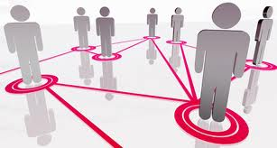
Social Factors
Scaffolding for novices
Trust
http://newvaluestreams.com/wordpress/?p=1701

Slide 55
Next Steps
Interviews
Social scientists
Archaeologists
Zoologists
Survey
ICPSR Data Reusers
Observations
UMMZ Data Reusers
Web analytics
OpenContext.org transaction log analysis
Map significant properties of data as representation information

Slide 56
Survey of ICPSR Data Reusers
Data Collection
1,632 first authors of published journal articles 2008-2012 surveyed
The Survey
Part 1: inquire about data reuse experience
Part 2: inquire about experience using ICSPR repository and intention to continue use

Slide 57
ICPSR Survey of Data Reusers – Part I Data Reuse Experience
Data Producer Reputation
Data Quality
Completeness
Relevancy
Interpretability
Accessibility
Ease of Operation
Traceability
Credibility
Data Reuse Satisfaction
Faniel & Yakel for the DIPIR Project, 2010-2013
Documentation Quality
Other variables of interest: data scarcity, reuse experience, data scarcity, reuse dependence, data integrator, ICPSR contributor, data restrictions, journal impact factor.

Slide 58
ICPSR Survey of Data Reusers – Part I Data Reuse Experience
Data Producer Reputation
Data Quality
Completeness
Relevancy
Interpretability
Accessibility
Ease of Operation
Traceability
Credibility
Data Reuse Satisfaction
Faniel & Yakel for the DIPIR Project, 2010-2013
Documentation Quality
Other variables of interest: data scarcity, reuse experience, data scarcity, reuse dependence, data integrator, ICPSR contributor, data restrictions, journal impact factor.

Slide 59
ICPSR Survey of Data Reusers – Part II Data Repository Experience & Intention
Stakeholder Trust
in ICPSR
Integrity
Benevolence
Transparency
Identification
Structural Assurances
Trust in ICPSR
Intention to Continue Using ICPSR
Social Influence
Faniel & Yakel for the DIPIR Project, 2010-2013
Other variables of interest: data scarcity, reuse experience, data scarcity, reuse dependence, data integrator, ICPSR contributor, data restrictions, journal impact factor.

Slide 60
Acknowledgements
Institute of Museum and Library Services
Partners: Nancy McGovern, Ph.D. (MIT), Eric Kansa, Ph.D. (Open Context), William Fink, Ph.D. (University of Michigan Museum of Zoology)
Students: Morgan Daniels, Rebecca Frank, Julianna Barrera-Gomez, Adam Kriesberg, Jessica Schaengold, Gavin Strassel, Michele DeLia, Kathleen Fear, Mallory Hood, Molly Haig, Annelise Doll, Monique Lowe

Slide 61
Questions & comments

Slide 62
For More Information
Ixchel Faniel: fanieli@oclc.org
Elizabeth Yakel: yakel@umich.edu
Dissemination Information Packages for Information Reuse (DIPIR)
http://dipir.org

